Slide 1
Machine Learning and Artificial Intelligence
Lab 04 – Principal Component Analysis
30/03/2021

Slide 2
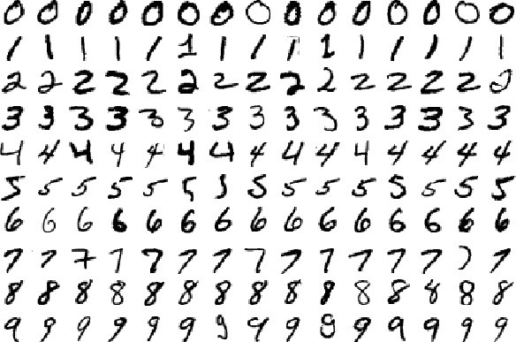
The problem
We want to recognise and classify images of handwritten figures
https://en.wikipedia.org/wiki/MNIST_database
For this lesson, we only consider images of “0” and “1”→ the training set size is reduced to about 12000 images
«0»
«1»

Slide 3
Feature Extraction
Problem: each image is a 28x28 matrix.
Feature extraction: How can I describe the points of the training set in a compact way?

Slide 4
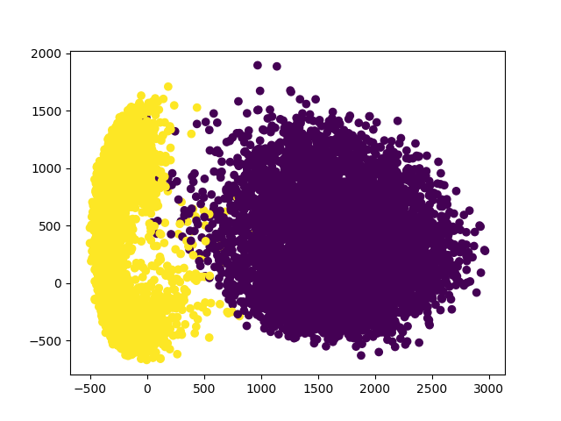
Idea
Reduce the dimensionality of the space, while retaining as much information as possible.

Slide 5
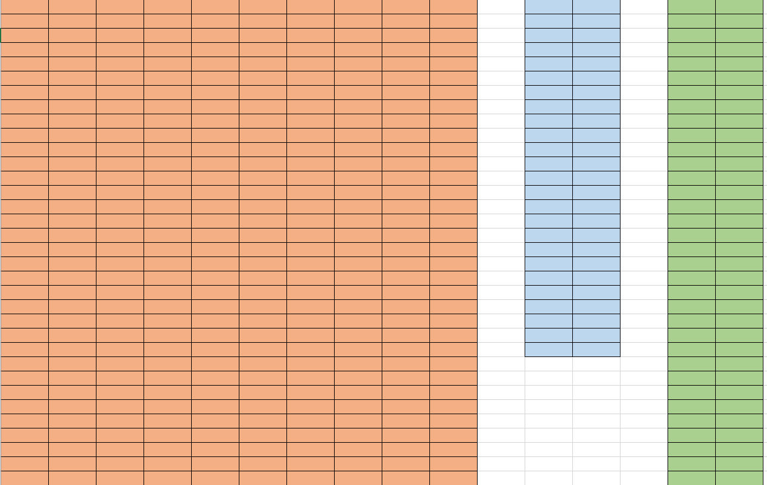
Idea
Dimensionality reduction:
.
=
X
A
X’
(12000x784)
(784x2)
(12000x2)

Slide 6
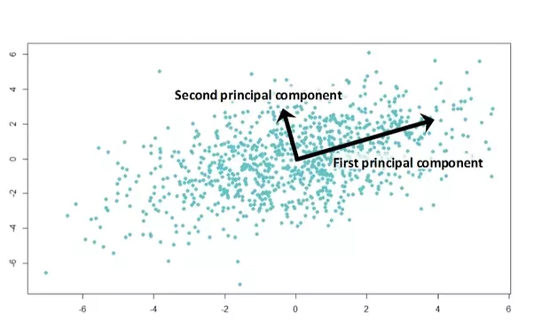
Principal Component Analysis
Project the data into a space such that:
The first direction is the direction of maximum variance.
The second direction is the one of maximum variance, orthogonal to the first one.
And so on....
Information → Variance

Slide 7
Principal Component Analysis
The eigenvectors of the covariance matrix encode the principal directions.
The largest eigenvalues occur in the directions of maximum dispersion of the data.

Slide 8

Principal Component Analysis
How to apply it:
Subtract from each $x^{k}, k=1…M$ , the mean $m=\frac{1}{M} Σ_{k=1}^{M}x^{k},$ obtaining in this way the centered data $\left\{{x_{c}}^{k}\right\}$
Calculate the covariance matrix $C$ from the centered data.
Calculate the eigenvalues and eigenvectors of the covariance matrix.
>> D,V = np.linalg.eigh(C)
>> # D vector of eigenvalues, V matrix with eigenvectors in its columns
https://docs.scipy.org/doc/numpy/reference/generated/numpy.linalg.eigh.html

Slide 9
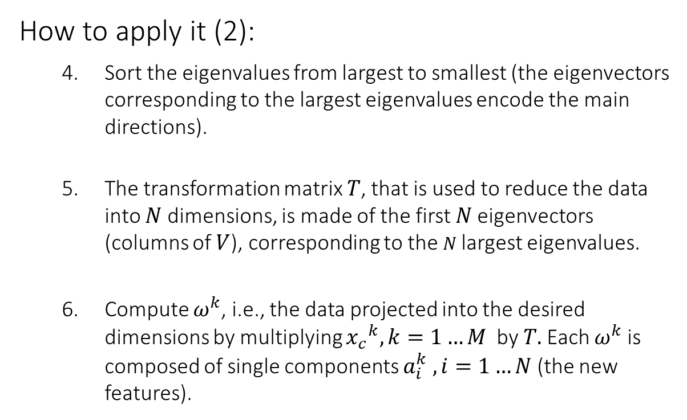
Principal Component Analysis
How to apply it (2):
Sort the eigenvalues from largest to smallest (the eigenvectors corresponding to the largest eigenvalues encode the main directions).
The transformation matrix $T$, that is used to reduce the data into $N$ dimensions, is made of the first $N$eigenvectors (columns of $V$), corresponding to the 𝑁 largest eigenvalues.
Compute $ω^{k}$, i.e., the data projected into the desired dimensions by multiplying ${x_{c}}^{k}, k=1…M$ by $T.$Each $ω^{k}$ is composed of single components $a_{i}^{k} , i=1…N$ (the new features).

Slide 10
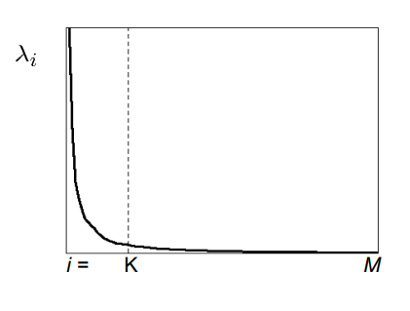
How many eigenvectors to use?
Each eigenvector “carries” a certain variance, which can be seen as the amount of information with respect to the data.
“Good” data, i.e., tractable, have low dimensions and high variance.

Slide 11

Exercises

Slide 12
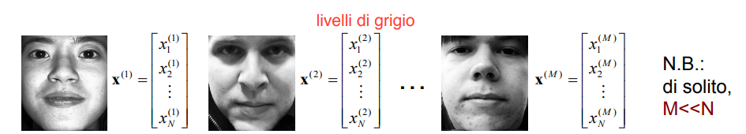

Practical problem
Appearance-based recognition of faces.
Consider each point $x^{k}, k=1…M$ as the image of a face.
Gray levels
Usually,
M << N

Slide 13
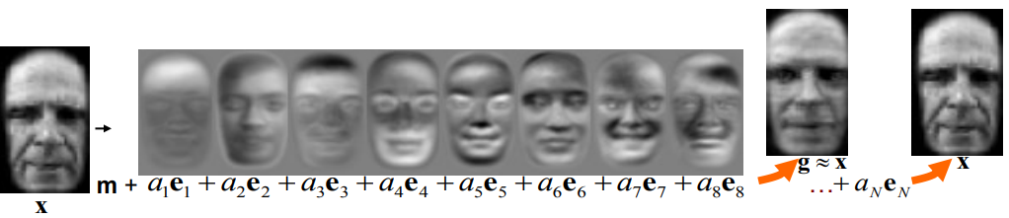

EigenFaces
The image of a face 𝑥 can be projected in the same way in a new space obtaining $ω^{k}=[a_{1}^{k},a_{2}^{k},…a_{N}^{k}]$.
The reconstruction $g$ is given from the sum of the multiplications of the components $a_{i}^{k}$ of the image $x$, with the corresponding eigenfaces $e_{i}, i=1…N$ , used for the projection.

Slide 14
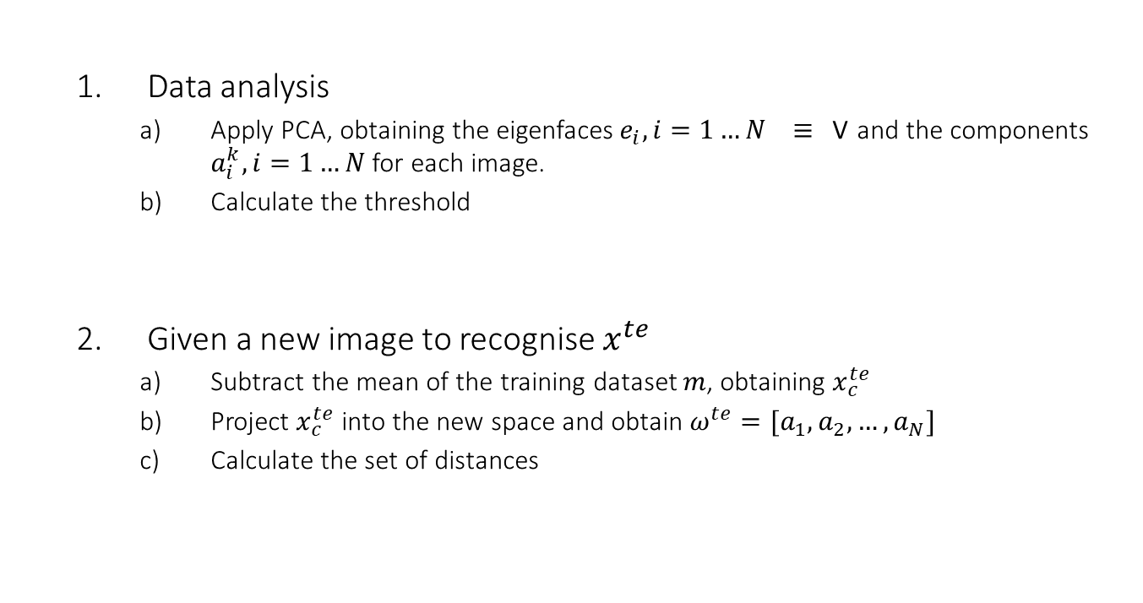

Recognition with eigenfaces
Data analysis
Apply PCA, obtaining the eigenfaces$e_{i}, i=1…N ≡$V and the components $a_{i}^{k}, i=1…N$for each image.
Calculate the threshold
Given a new image to recognise $x^{te}$
Subtract the mean of the training dataset $m$, obtaining $x_{c}^{te}$
Project $x_{c}^{te}$ into the new space and obtain $ω^{te}=[a_{1},a_{2},…, a_{N}]$
Calculate the set of distances
TRAINING
$$Θ=\max\left\{{\left\|ω^{j}−ω^{k}\right\|}_{2}\right\} for j,k=1,…M$$
TESTING
$${{(ε}^{k})}^{}={\left\|ω^{te}−ω^{k}\right\|}_{2} for k=1,..,M$$

Slide 15
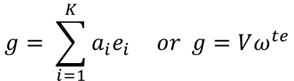
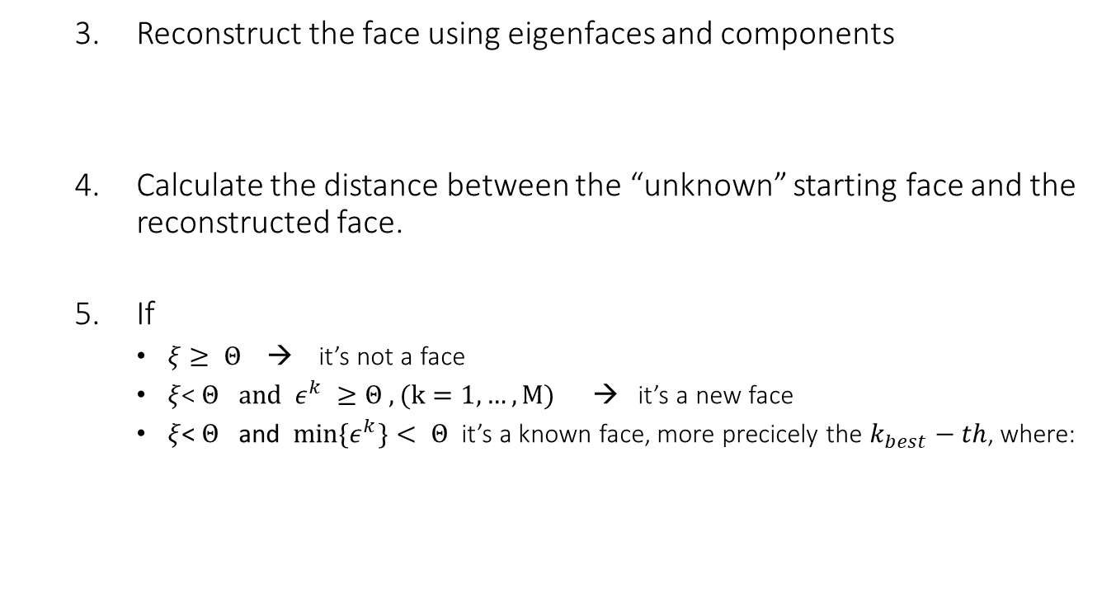


Recognition with eigenfaces
Reconstruct the face using eigenfaces and components
Calculate the distance between the “unknown” starting face and the reconstructed face.
If
$ξ≥ Θ$ → it’s not a face
$ξ$< $Θ$ $and{ ε}^{k} ≥Θ , (k=1,…,M)$ → it’s a new face
$ξ$< $Θ$ and ${min⁡\{ε}^{k}\}< Θ$ it’s a known face, more precicely the $k_{best}−th$, where:
$$g= \sum_{i=1}^{K}{a_{i}e_{i}} or g=Vω^{te}$$
TESTING
$$ξ={\left\|g −x_{c}^{te}\right\|}_{2}$$
$$k_{best}=argmin_{k} \{ε^{k}\}$$

Slide 16
Exercises

