Slide 1
Machine Learning and Artificial Intelligence
Lab 02 – Bayes decision theory
and discriminant functions
15/03/2021

Slide 2
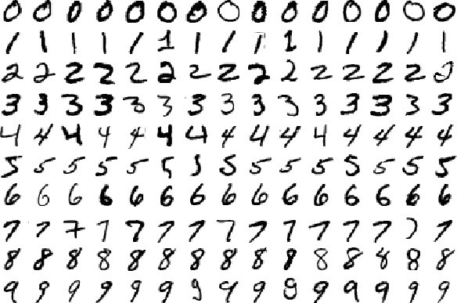
Recap
In supervised machine learning, we address problems by learning from experience.
Each object in the training set is:
Represented by a set of features
Labeled
«0»
«1»

Slide 3

Bayes’ decision rule
Given an input $x$, do I assign it to class $ω_{1}$ or $ω_{2}$ ?
x
Assign to $ω_{1}$ if $P\left(ω_{1} \right| x )$ > $P\left(ω_{2} \right| x )$, $ω_{2}$ otherwise

Slide 4


Bayes’ decision rule
Bayes’ formula
Steps:
Inference → calculate $P\left(ω_{j} \right| x )$
Decision → using the decision rule
Likelihood
Prior
$P\left(ω_{j} \right| x )= \frac{P\left(x \right|{ ω}_{j}) P(ω_{j})}{P(x)}$ = $P\left(x \right|{ ω}_{j}) P(ω_{j})$
Posterior
Evidence

Slide 5

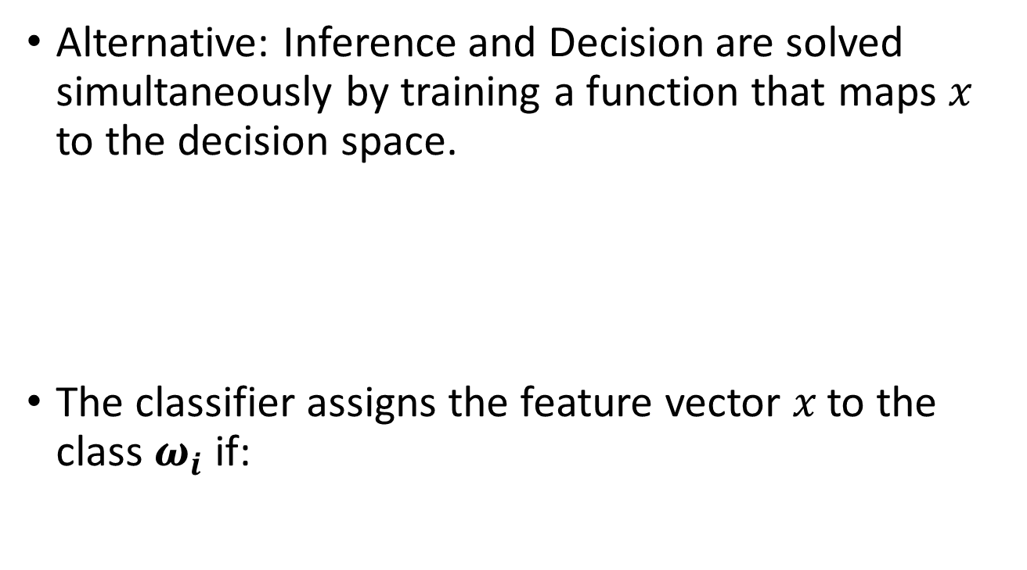

Discriminant Functions
Alternative: Inference and Decision are solved simultaneously by training a function that maps 𝑥 to the decision space.
The classifier assigns the feature vector 𝑥 to the class $ω_{i}$ if:
Discriminant functions $g_{i}\left(x\right), i=1,…,c$
$$g_{i}\left(x\right)>g_{j}\left(x\right) \text{∀} j≠i$$

Slide 6


Discriminant Functions
Goal: get a form of $g_{i}\left(x\right)$ that is easy to understand and calculate.
How can we model probability?
$$g_{i}\left(x\right)=P\left(x \right|{ ω}_{i}) P(ω_{i})$$
$$g_{i}\left(x\right)=ln P\left(x \right|{ ω}_{i})+ln P(ω_{i})$$

Slide 7
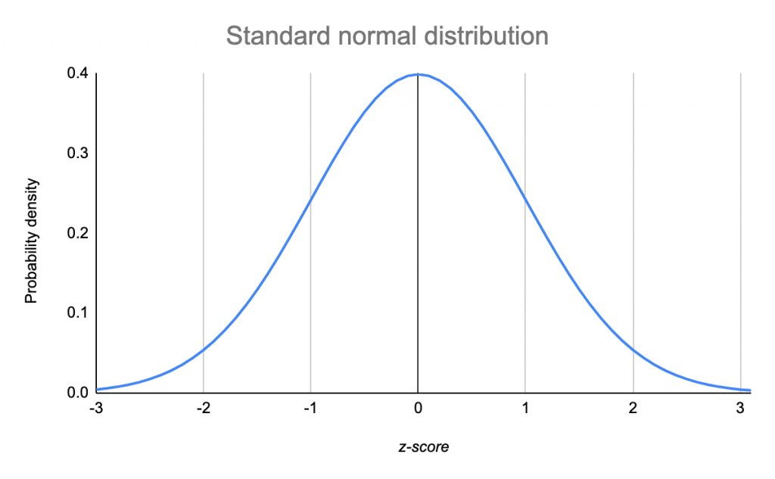
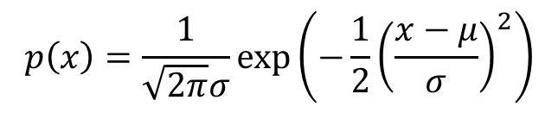
The Normal Distribution
Univariate Gaussian
Parameters:
Mean 𝜇
Standard deviation 𝜎
$$p\left(x\right)=\frac{1}{\sqrt{2π}σ}\text{exp}\left(−\frac{1}{2}{\left(\frac{x−μ}{σ}\right)}^{2}\right)$$
>> from scipy.stats import norm
>> norm.pdf(x, mu, sigma)
https://docs.scipy.org/doc/scipy/reference/generated/scipy.stats.norm.html

Slide 8
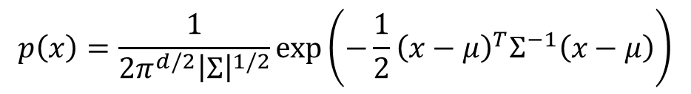
The Normal Distribution
Multivariate Gaussian
Parameters:
𝑑 number of features
Vector of averages μ
Covariance matrix Σ
$$p\left(x\right)=\frac{1}{{2π}^{d/2}{\left|Σ\right|}^{1/2}}\text{exp}\left(−\frac{1}{2}{\left(x−μ\right)}^{T}Σ^{−1}\left(x−μ\right)\right)$$
>> from scipy.stats import multivariate_normal
>> multivariate_normal.pdf(x, mu, sigma)
https://docs.scipy.org/doc/scipy/reference/generated/scipy.stats.multivariate_normal.html

Slide 9
Discriminant Functions - Normal Distribution
Translation of the discriminant function in the case of normal probability density:
Depending on 𝚺, the formula can be simplified.
$$g_{i}\left(x\right)=ln P\left(x \right|{ ω}_{i})+ln P(ω_{i})$$
$$g_{i}\left(x\right)=−\frac{1}{2}{\left(x −μ_{i}\right)}^{t} Σ_{i}^{−1}\left(x−μ_{i}\right)−\frac{d}{2}ln 2π −\frac{1}{2}ln \left|Σ_{i}\right|+ln P(ω_{i})$$

Slide 10


Variations according to 𝚺
$Σ_{i}=σ^{2}I$ → statistically independent features
$$g_{i\left(x\right)}=w_{i}^{t}x+w_{i0} , w_{i}=\frac{1}{σ^{2}} μ_{i} , w_{i0}=−\frac{1}{2σ^{2}}μ_{i}^{t}μ_{i}+ln P\left(ω_{i}\right)$$
The discriminant function defines a hyperplane that passes through $x_{0}$ and orthogonal to $w$:
$$w^{t}\left(x−x_{0}\right)=0$$
$$w=μ_{i} −μ_{j}$$
$$x_{0}=\frac{1}{2}\left(μ_{i}+μ_{j}\right)−\frac{σ^{2}}{||μ_{i}−μ_{j}|{\left.​\right|}^{2}}\ln{\frac{P\left(ω_{i}\right)}{P\left(ω_{j}\right)}(μ_{i}−μ_{j})}$$

Slide 11
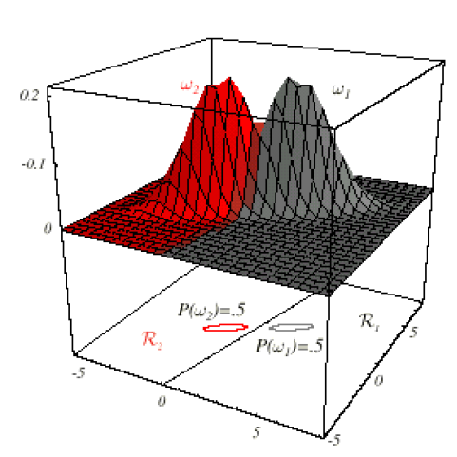


Variations according to 𝚺
$Σ_{i}=σ^{2}Σ$ with $Σ$ equal for all classes
$$g_{i\left(x\right)}=w_{i}^{t}x+w_{i0} , w_{i}=Σ^{−1}μ_{i} , w_{i0}=−\frac{1}{2}μ_{i}^{t}{Σ^{−1}μ}_{i}+ln P\left(ω_{i}\right)$$
The discriminant function defines a hyperplane that passes through $x_{0}$ and orthogonal to $w$:
$$w^{t}\left(x−x_{0}\right)=0$$
$$w={Σ^{−1}(μ}_{i} −μ_{j})$$
$$x_{0}=\frac{1}{2}\left(μ_{i}+μ_{j}\right)−\frac{\ln\left(\frac{P\left(ω_{i}\right)}{P\left(ω_{j}\right)}\right)}{{\left(μ_{i}−μ_{j}\right)}^{t}Σ^{−1}(μ_{i}−μ_{j})}(μ_{i}−μ_{j})$$

Slide 12
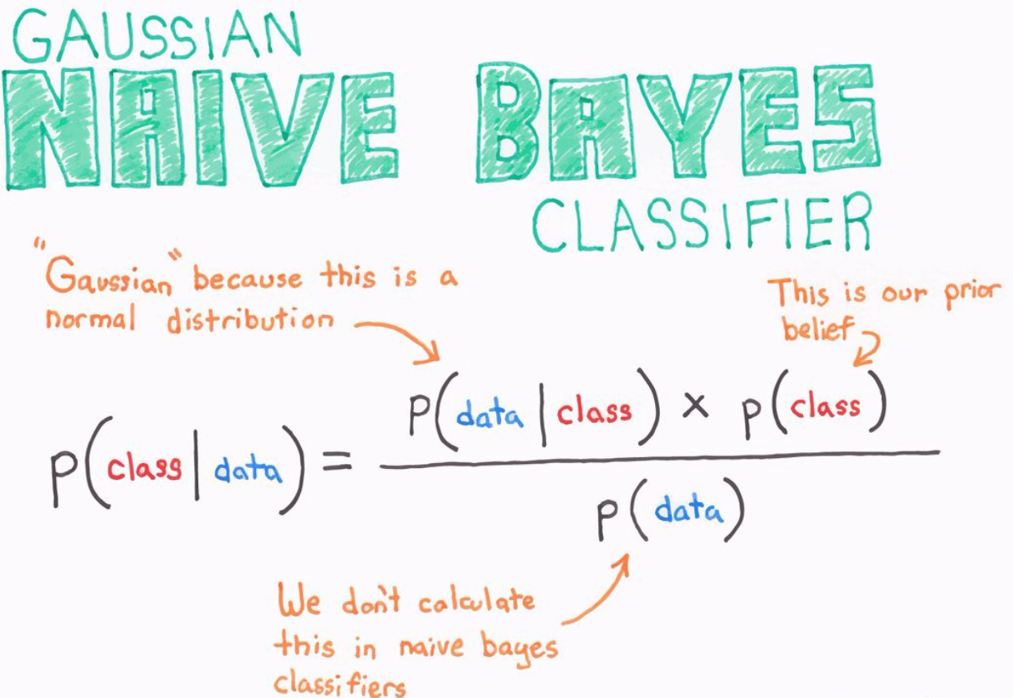

Slide 13

Exercises

