Slide 1

Group project for the course
Design and Implementation of Mobile Applications
Goal: implementing the Microsoft House app
Filippo Pedrazzini, Emanuele Torelli
<name.surname>@mail.polimi.it
Final Presentation
July 27, 2017
Notes:
Hi everyone, we are Filippo and Emanuele. We are going to show our project. We decided to take one of the available project and the overall aim of the project was to develop an app capable to manage the new Microsoft House building in Milan.

Slide 2
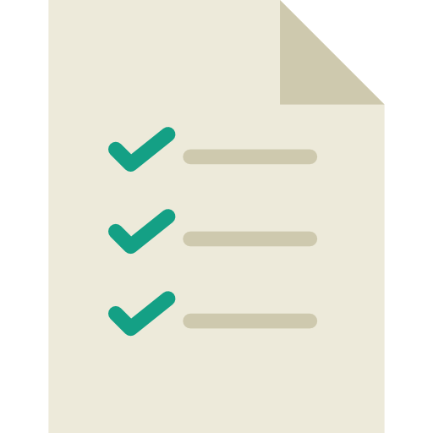



Outline
Requirements
Design Phase
Implementation
Demo
Notes:
The presentation is divided in 4 different phases in which we are going to explain our work from different points of view.

Slide 3

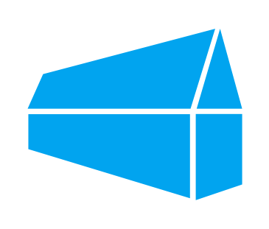


Requirements
Booking Meeting Rooms
Parking Reservations
Shared Calendar
Notes:
Starting from the requirements…. We analyzed the description document and we identified 3 different main functionalities that the app should have: See the available rooms in the building in order to book them, allow the user to park and finally having the possibility to see the different events hosted in the building. Moreover Microsoft asked us to develop the app using Xamarin and Azure, that implicitly influenced all our future choices.

Slide 4




Requirements
Notes:
In order to create real requirements and starting to develop the app we had to define in a precise way the different functionalities. We did some assumption and we clarified how the app could work in an effective way.
Starting from the Booking of the rooms, we decided that every kind of user registered trough the app should be able to reserve an available room in the building.

Slide 5
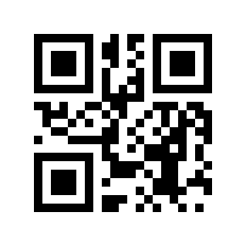
Requirements
Notes:
The second functionality was more difficult to define, indeed we had to find a way to allow the user to park through the app and our solution was to use a QR Code placed close to the park in order to update the parking availability and allow the different employees to see how many places are free.

Slide 6
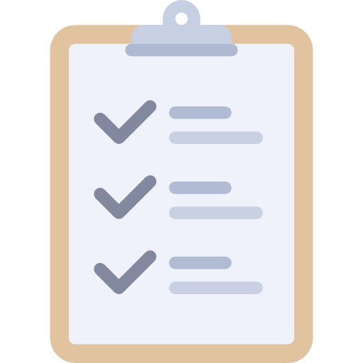

Requirements
Notes:
The last requirement was about the public events. We decided to see the Calendar as a way to check and being notified in the case of a new Public event hosted in the building in one of the biggest room.

Slide 7
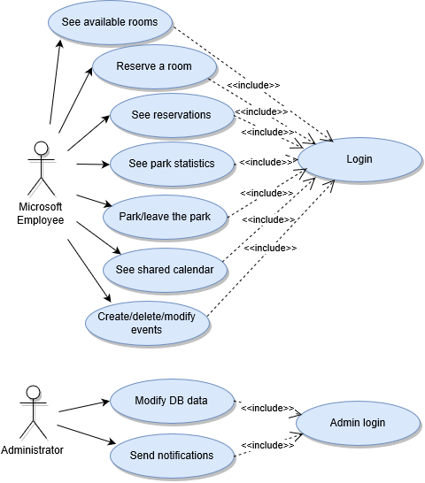
Use case
Notes:
To show in an engineering way the requirements we decided to build a use case diagram that can be seen as a method to recap all the requirement showed previously.

Slide 8
Outline
Requirements Analysis
Design Phase
Implementation
Demo
Notes:
Moving on to the Design Phase…

Slide 9
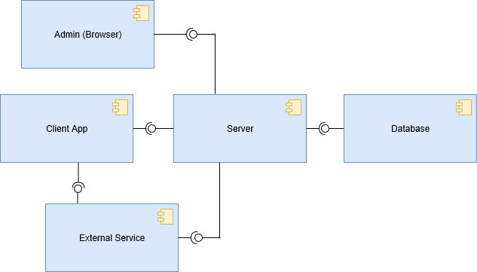
High Level Component
Notes:
In this phase we focused our attention on the design of the overall architecture and the different interactions between the components. As we can see from the figure we have 5 different components.

Slide 10
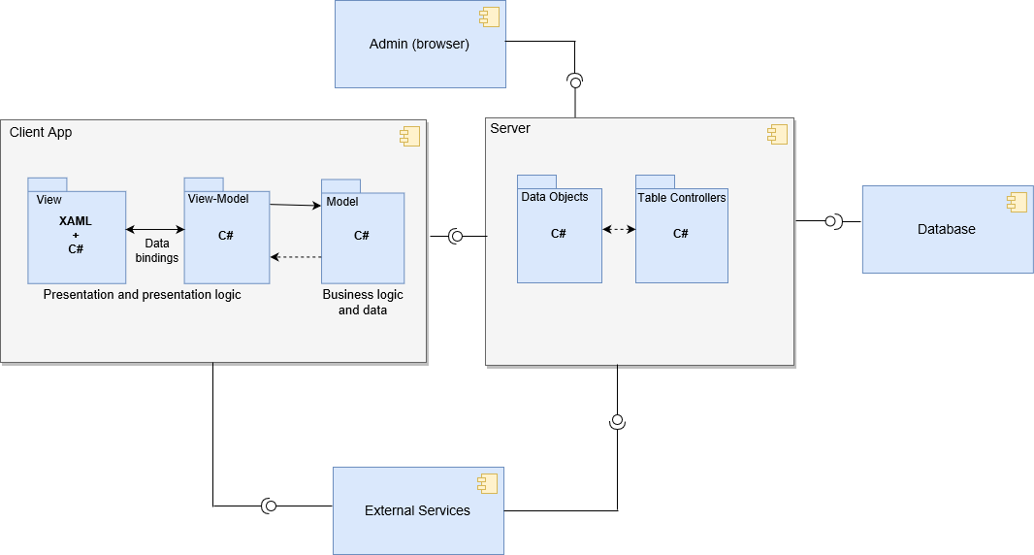
Low Level Component
Notes:
Zooming on the two main components we showed the low level packages that belong to Client and Server. Here, what it’s importante to notice is the client structure. Indeed, Xamarin uses the MVVM pattern that is modified version of the MVC pattern.

Slide 11
MVVM
Model
View
Controller
Notes:
From the MVC we know that the interaction between the different classes is based on the Observable observer pattern in which each element listens to the other element creating a perfect cohesion.

Slide 12
MVVM
Model
View
Model
View
Notes:
While moving on the MVVM we have a new component called ViewModel, that creates a bind with the View and communicate with the Model.

Slide 13
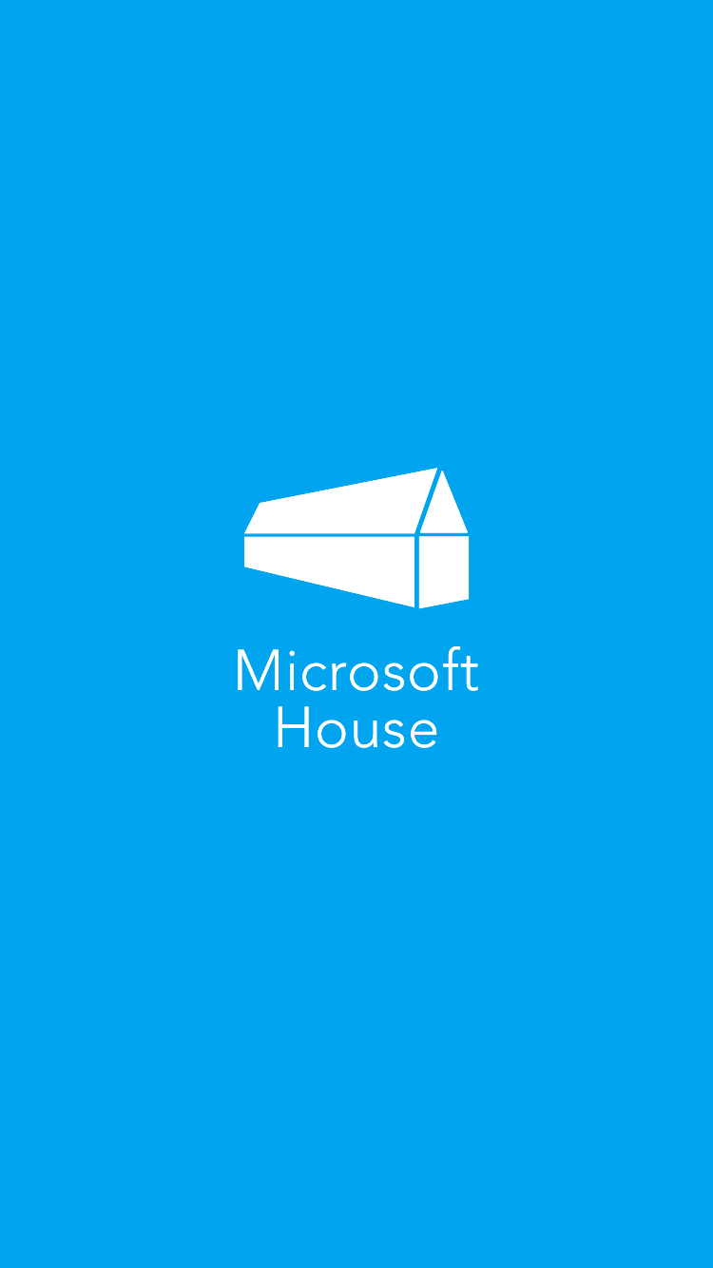
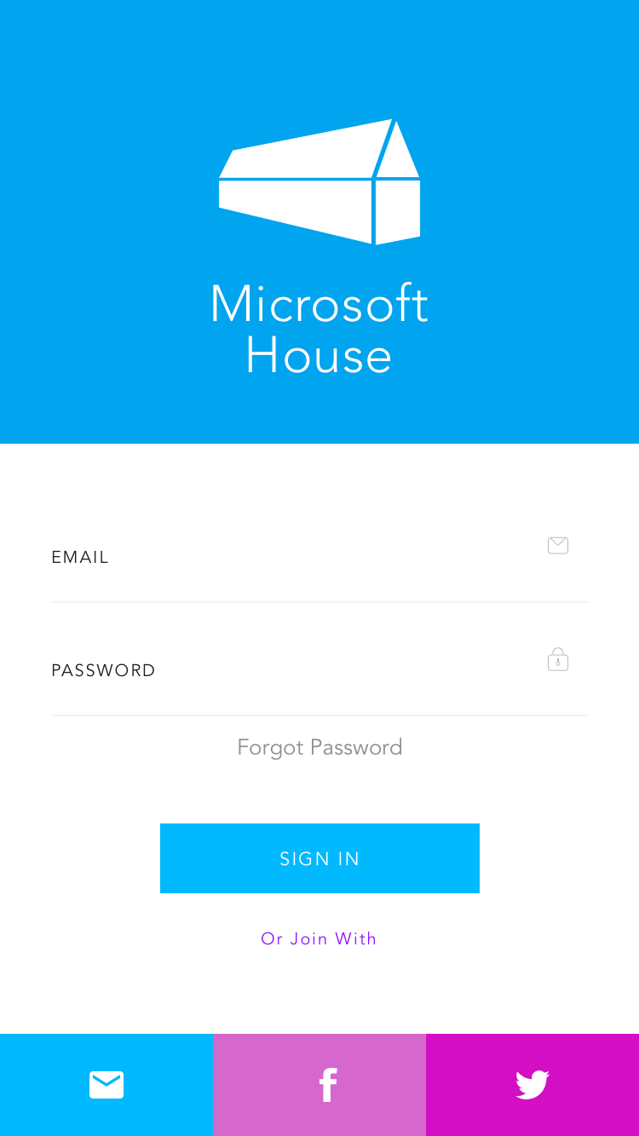
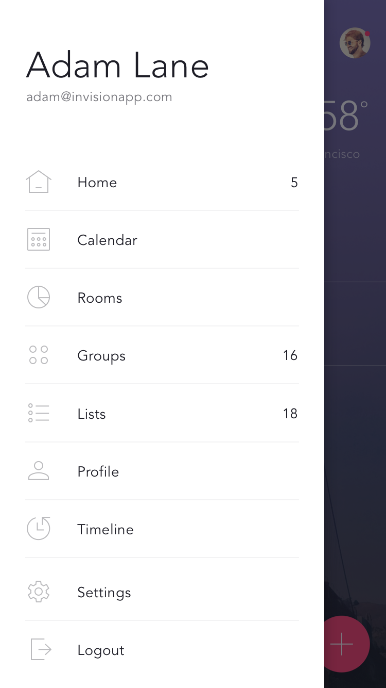
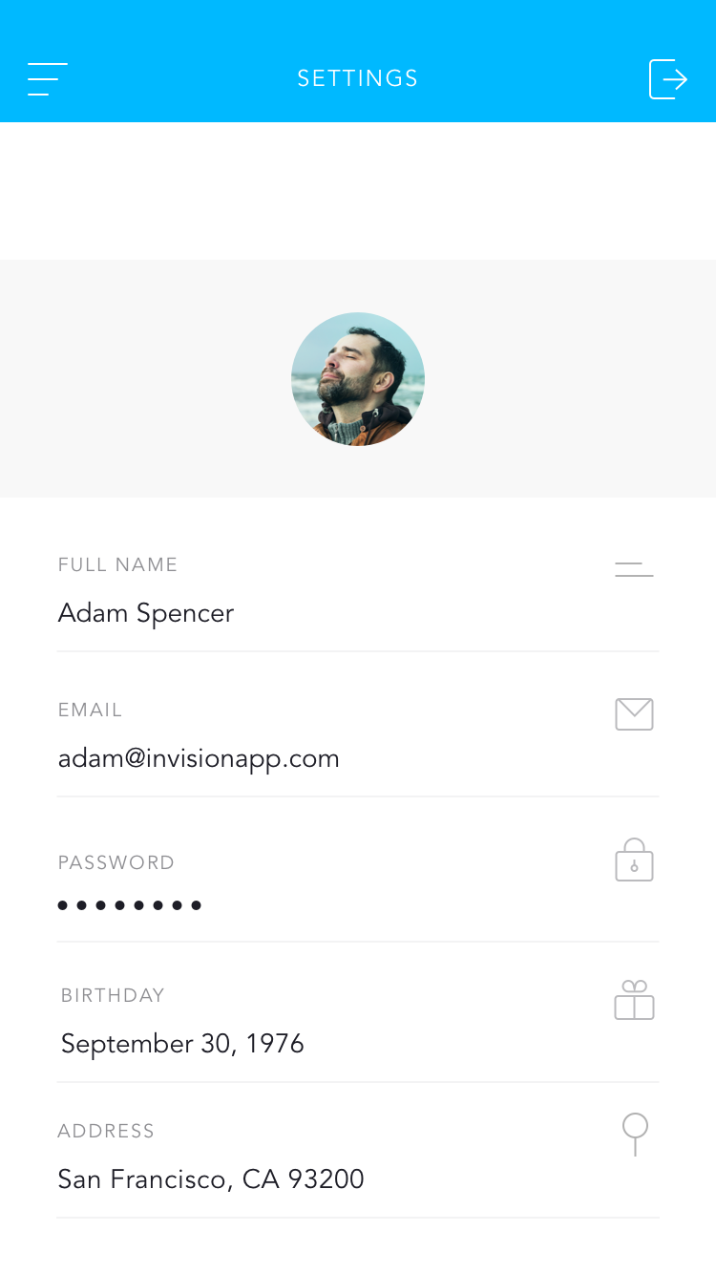
User Interface
Notes:
Before starting to code we did a Mockup of the application in order to have an idea on the final results.

Slide 14
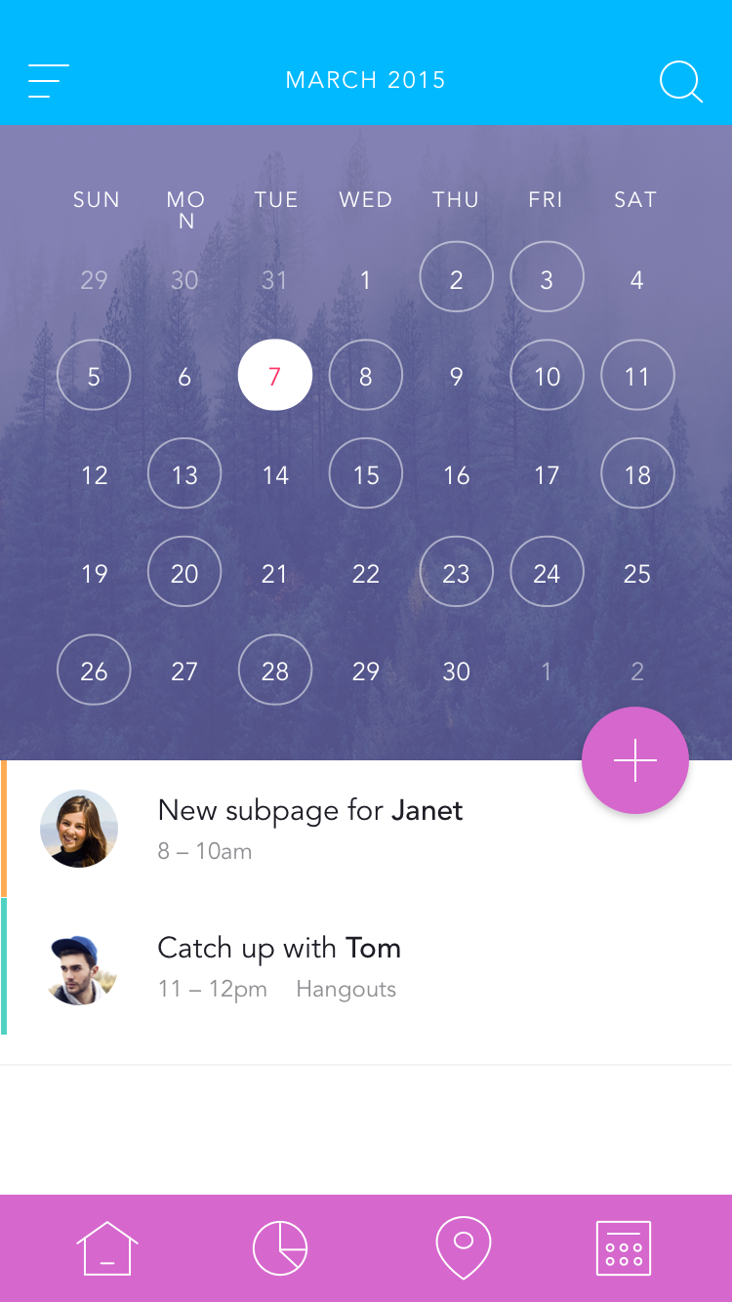
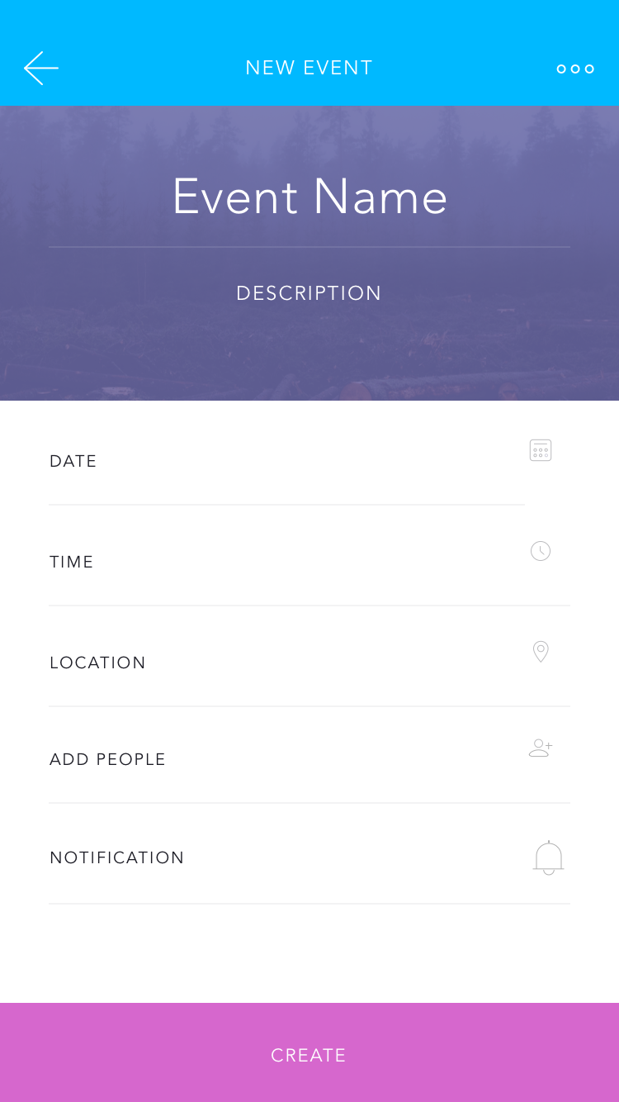
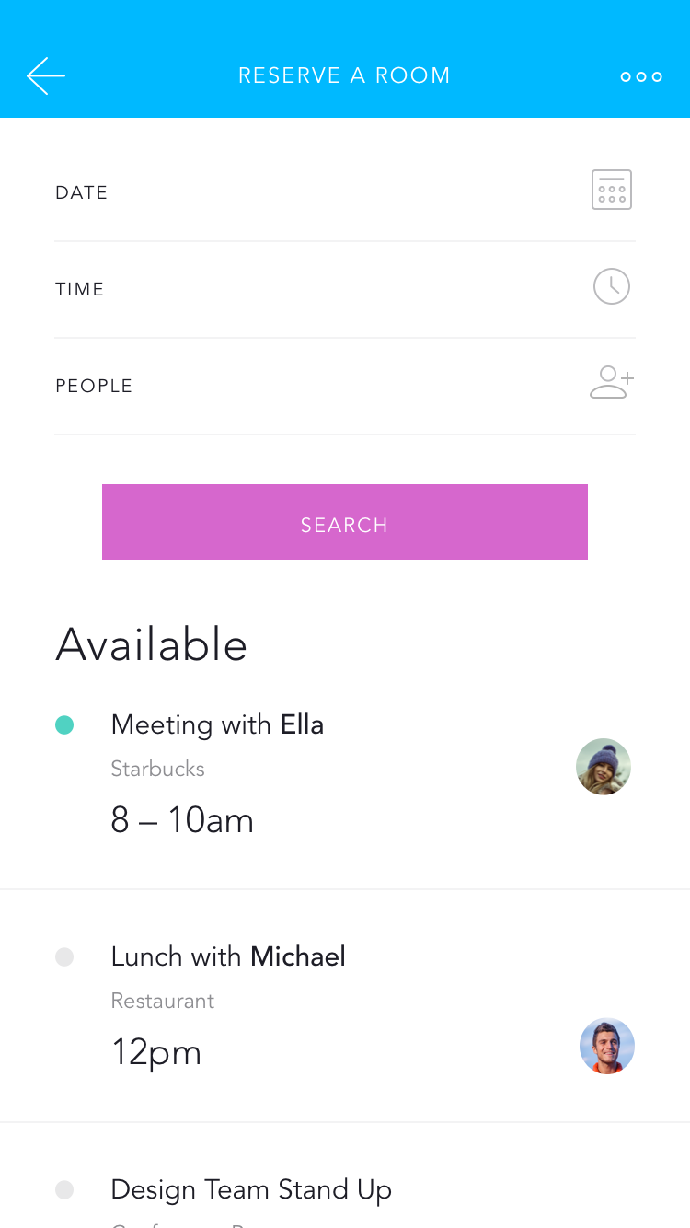
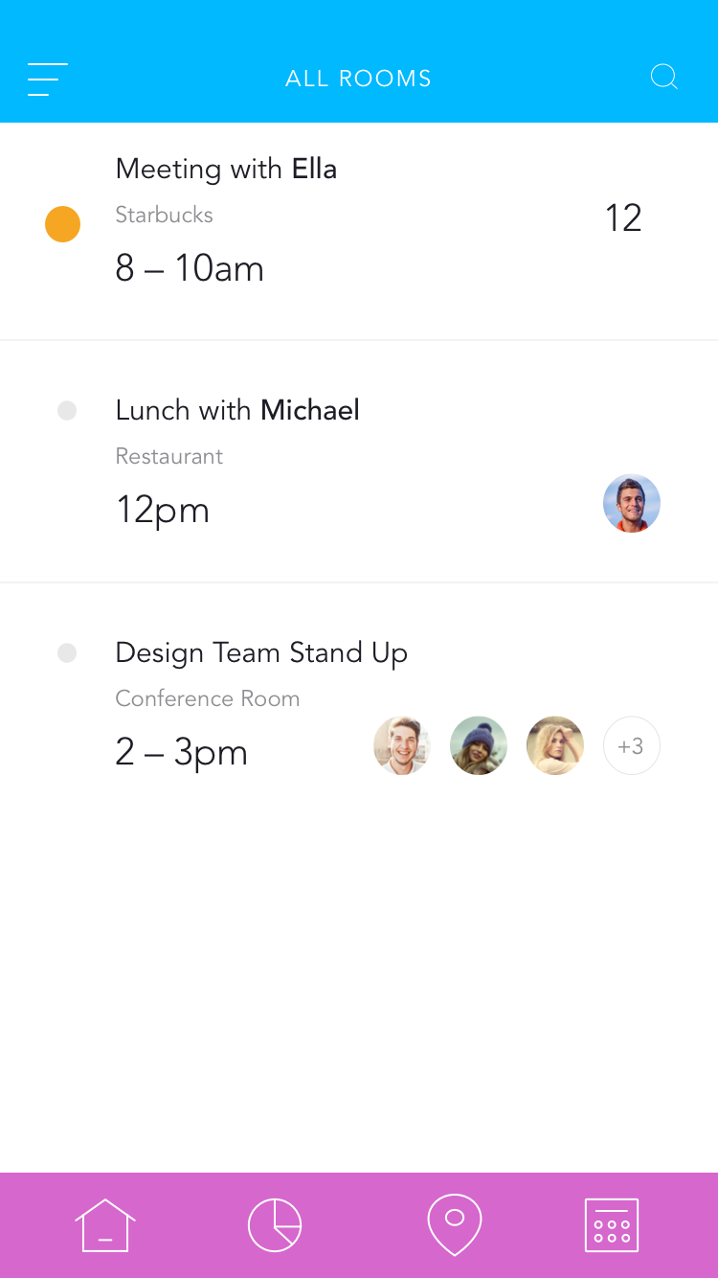
User Interface

Slide 15
Outline
Requirements Analysis
Design Phase
Implementation
Demo
Notes:
The next step was the real implementation.

Slide 16




Implementation Tools
Notes:
These are all the tools we used: Xamarin, Visual Studio, C# and Azure. The main advantage of using Xamarin is that the resulting application will be native for each target platform.

Slide 17
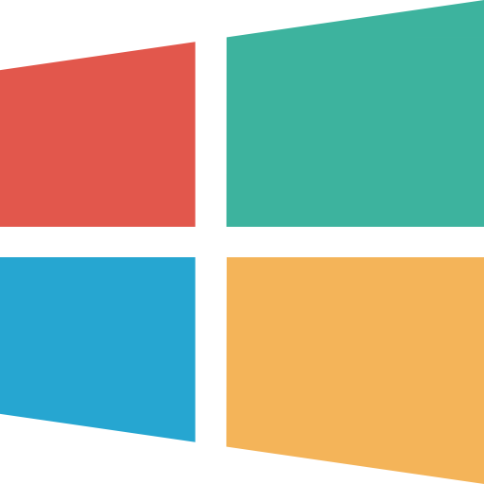


External Services
Notes:
In order to improve our product we decided to use different external services integrated with Xamarin forms or Azure. For example the notifications, the maps and the microsoft login. During the Demo we will explain better the detail of each service.

Slide 18
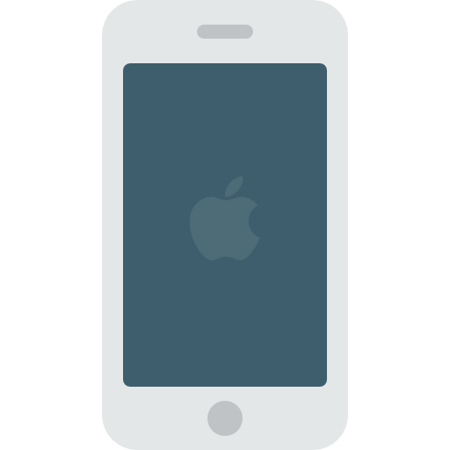
Graphical Issues
Notes:
Of course during the implementation we had many problems and probably the main one that we encountered was in the beginning. Usually a single application has just one main function and all the GUI is done based on this functionality, while here we had to put 3 main functionalities in the same app keeping high the usability.

Slide 19
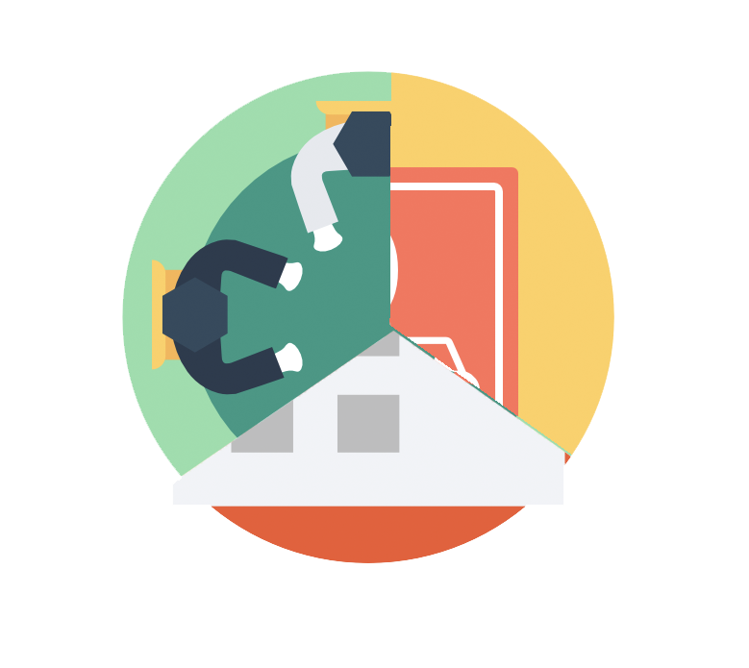
Graphical Issues

Slide 20


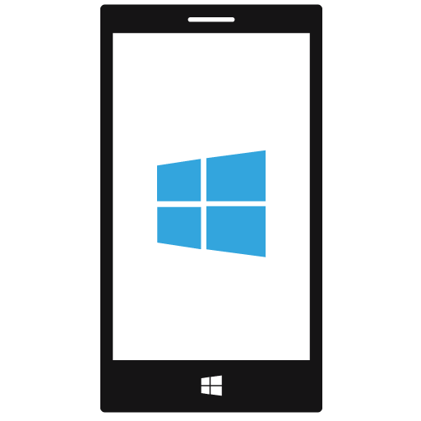
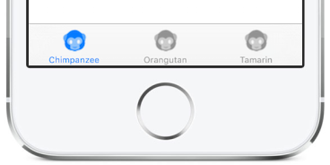
OS Rules
Notes:
Another problem was the graphical rules defined by each platform. We started with a mockup and we tried persistently to get the same product on all the different OS, but due to the fact that each of them has its specific rules we couldn’t create a uniform product. In the figure an example of a Tabbed Page and how it has displayed on the different platforms.

Slide 21
Outline
Requirements Analysis
Design Phase
Implementation
Demo

Slide 22
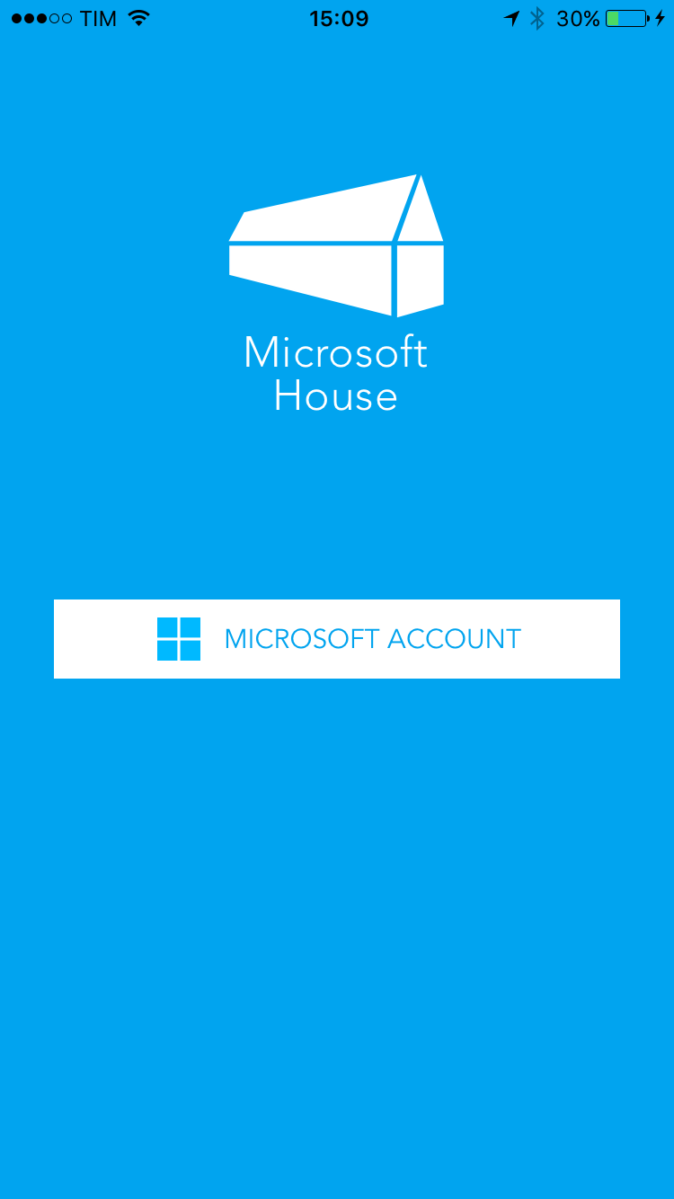
Demo
Notes:
Now it is time for the Demo.

Slide 23
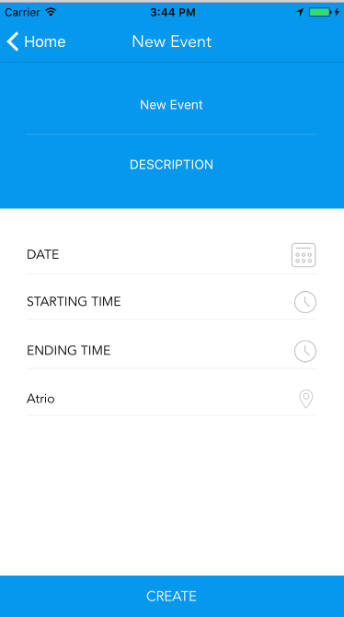
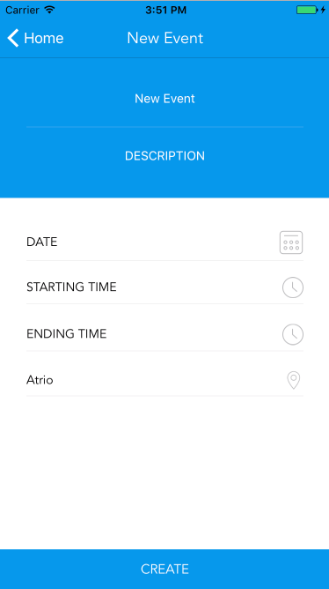
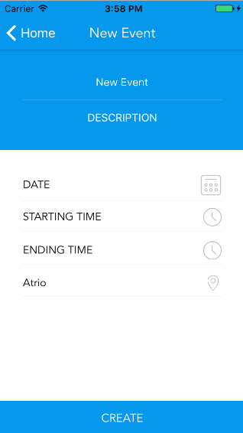
Testing
iPhone 7
iPhone 6
iPhone 5
Notes:
In the end, we decided to test our application on different devices, in order to understand if the product would work on all of them. We used many devices to see the different performances and we fixed the bugs where they were present. Here an example of a screen on different kind of iPhones.

Slide 24

Group project for the course
Design and Implementation of Mobile Applications
Thank you for your attention!
Filippo Pedrazzini, Emanuele Torelli
<name.surname>@mail.polimi.it
Final Presentation
July 27, 2017

