Slide 1
Voltage map algorithm
Input:
List of point exports recordings
Left atrial mesh
Algorithm:
For each point export
For each signal (EGM bipole)
Filter EGM [30 Hz, 300 Hz] (optional)
Exclude QRS
For each window
Compute peak to peak
Compute mean coordinates of electrode position
Exclude peak to peak values >3.5 mV and relative coordinates (optional)
Assign max voltage to vertices of mesh with cylinder and sphere method
Output:
Table of peak to peak voltages and relative mean coordinates

Slide 3
Unfiltered, unthresholded votlages

Slide 4
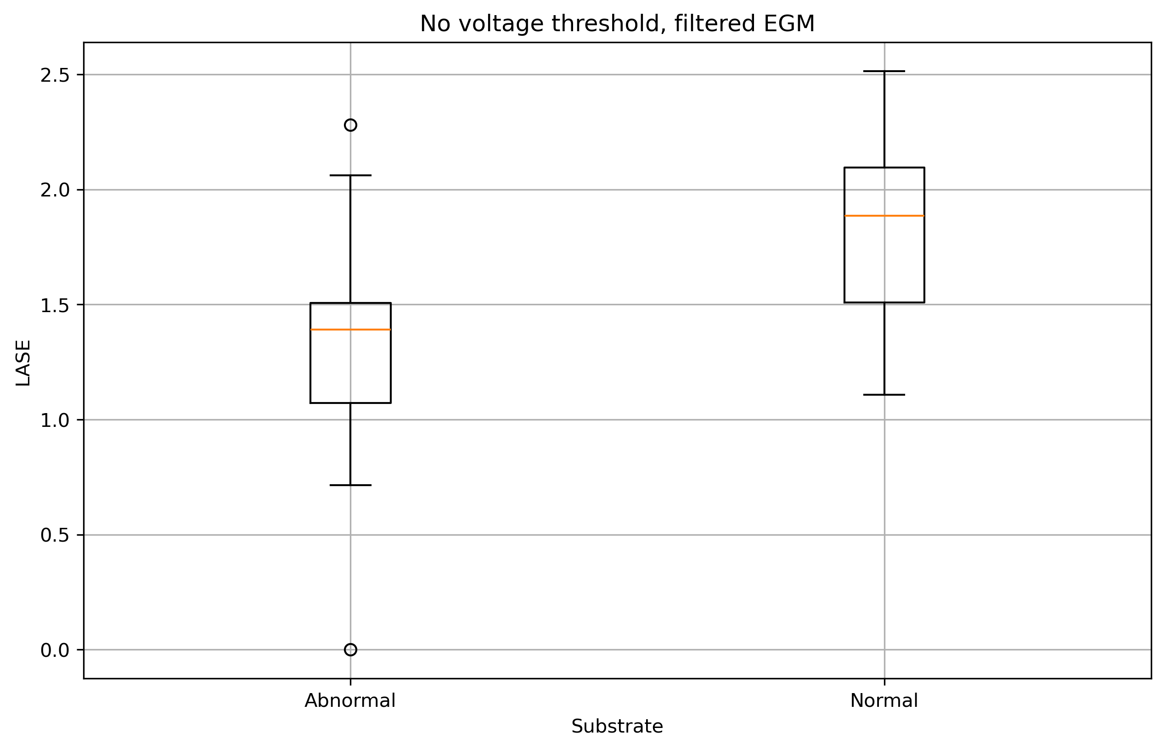
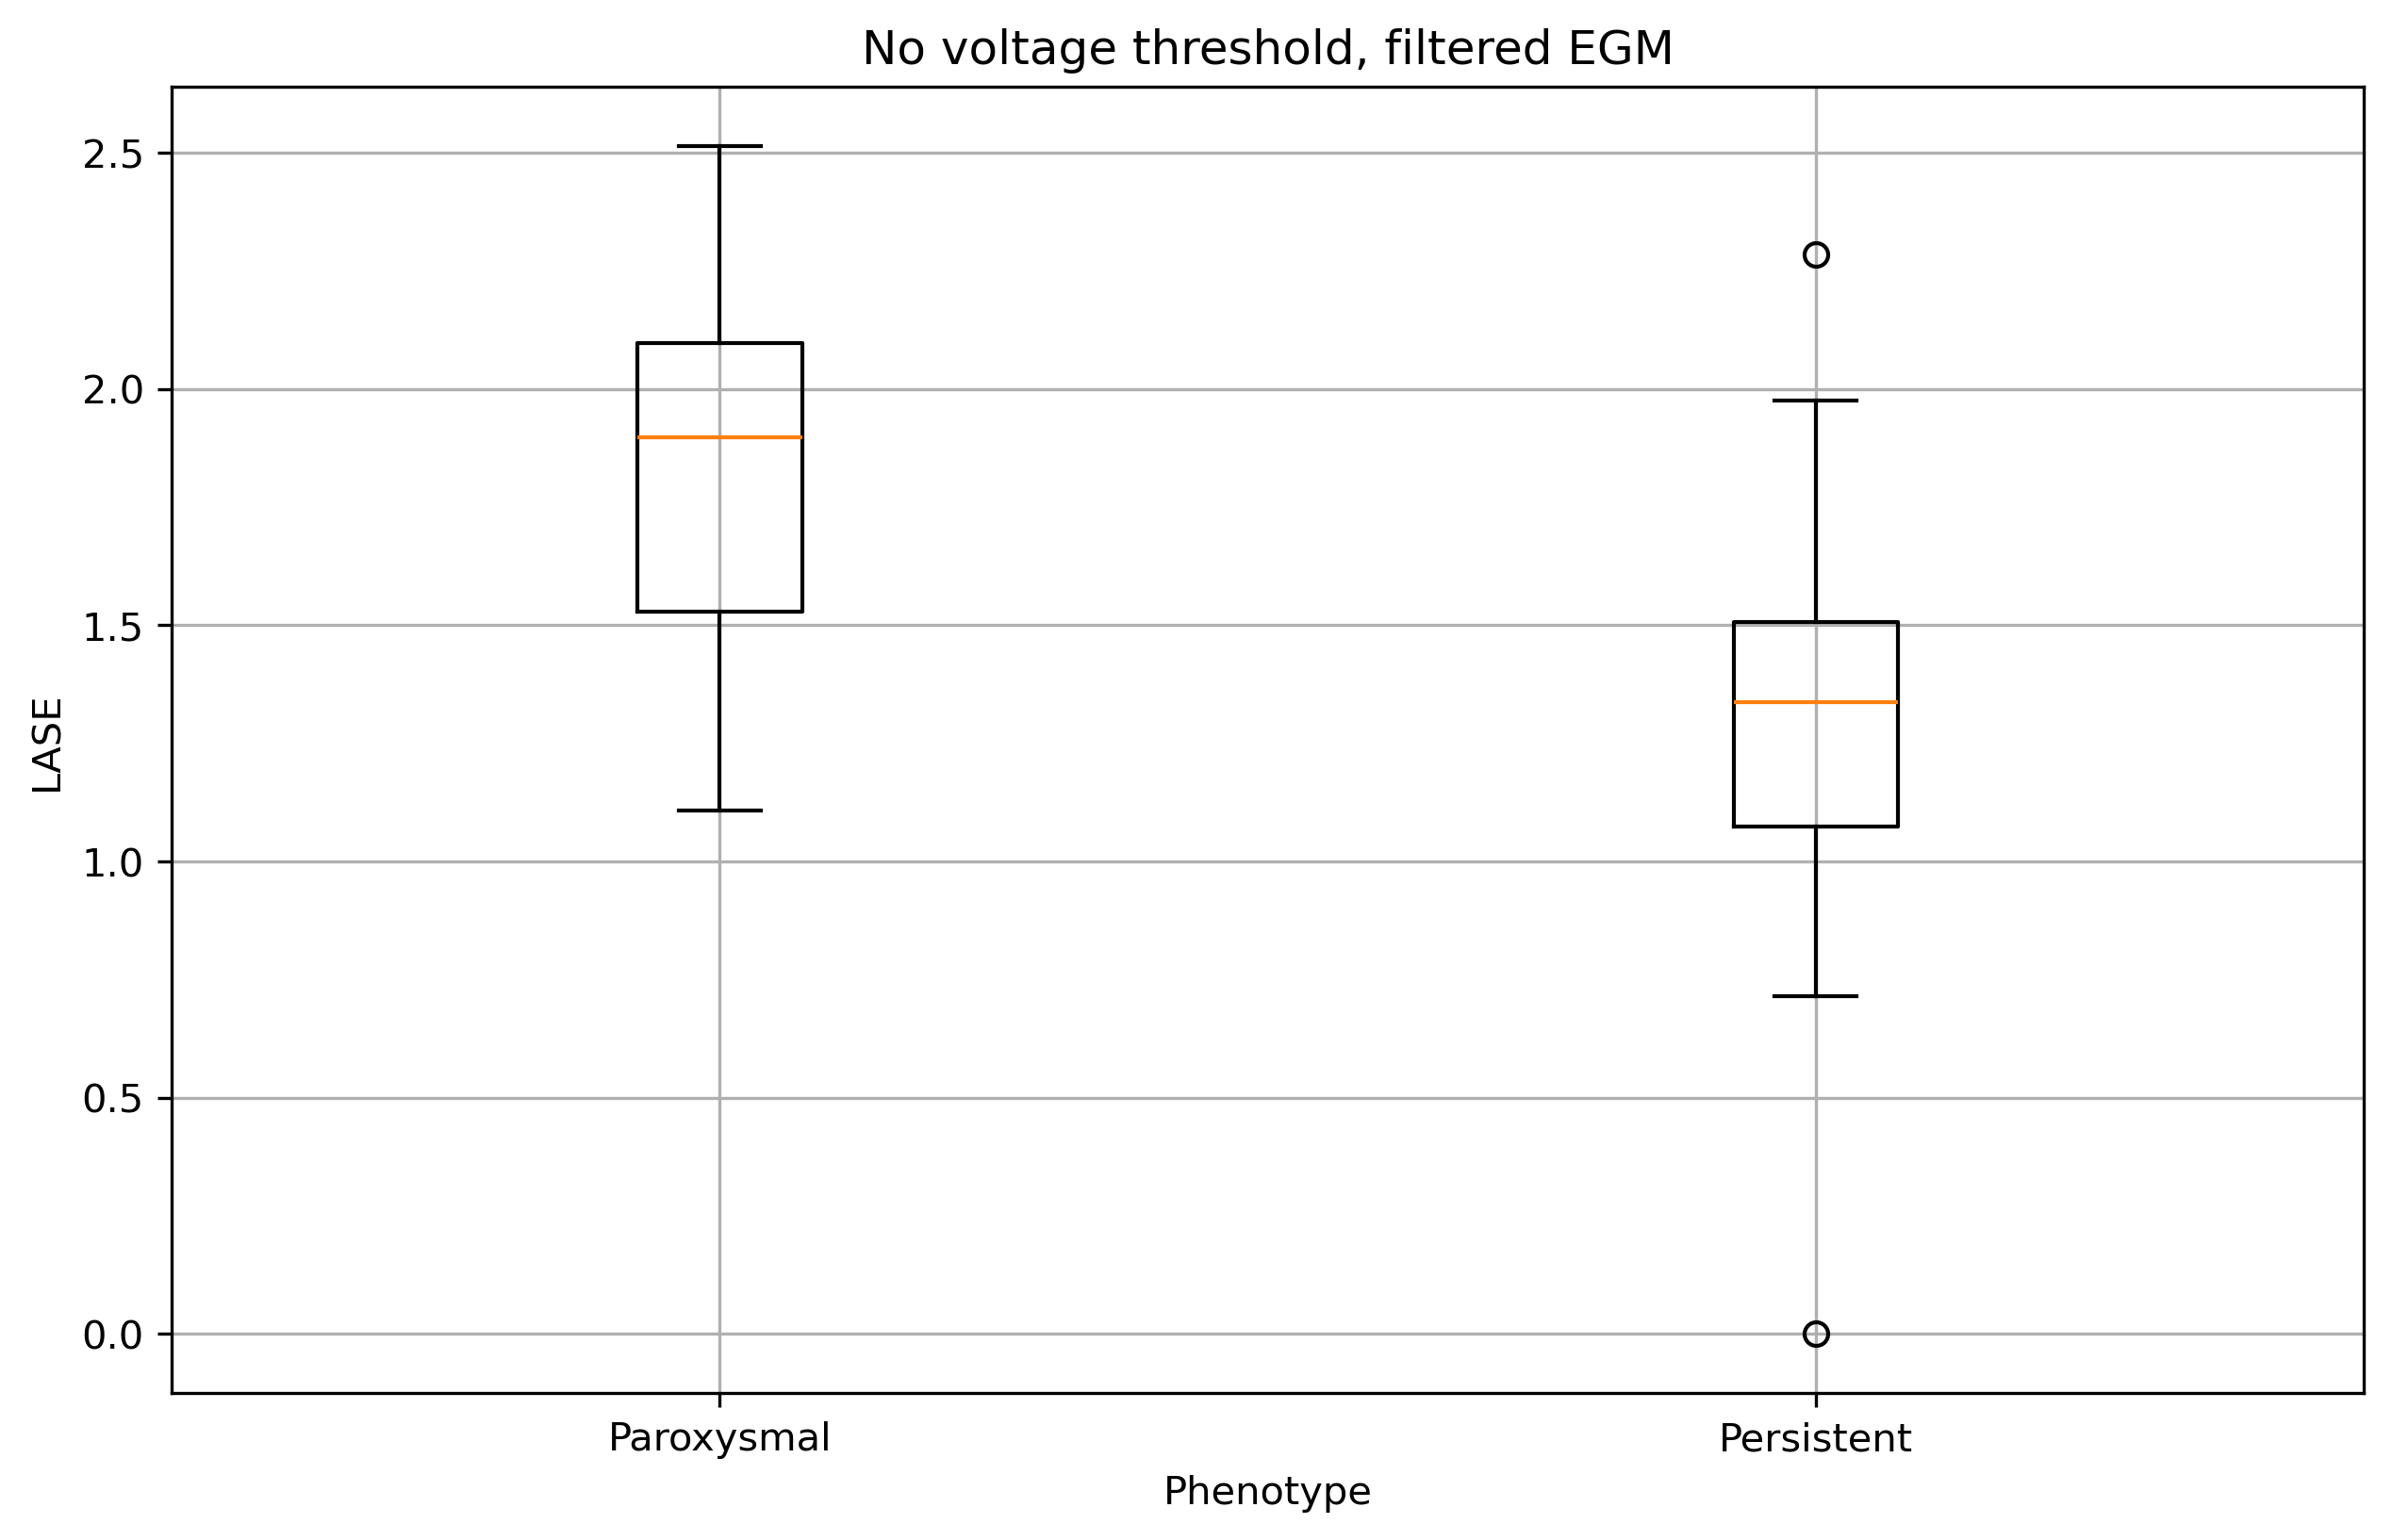
Results

Slide 5
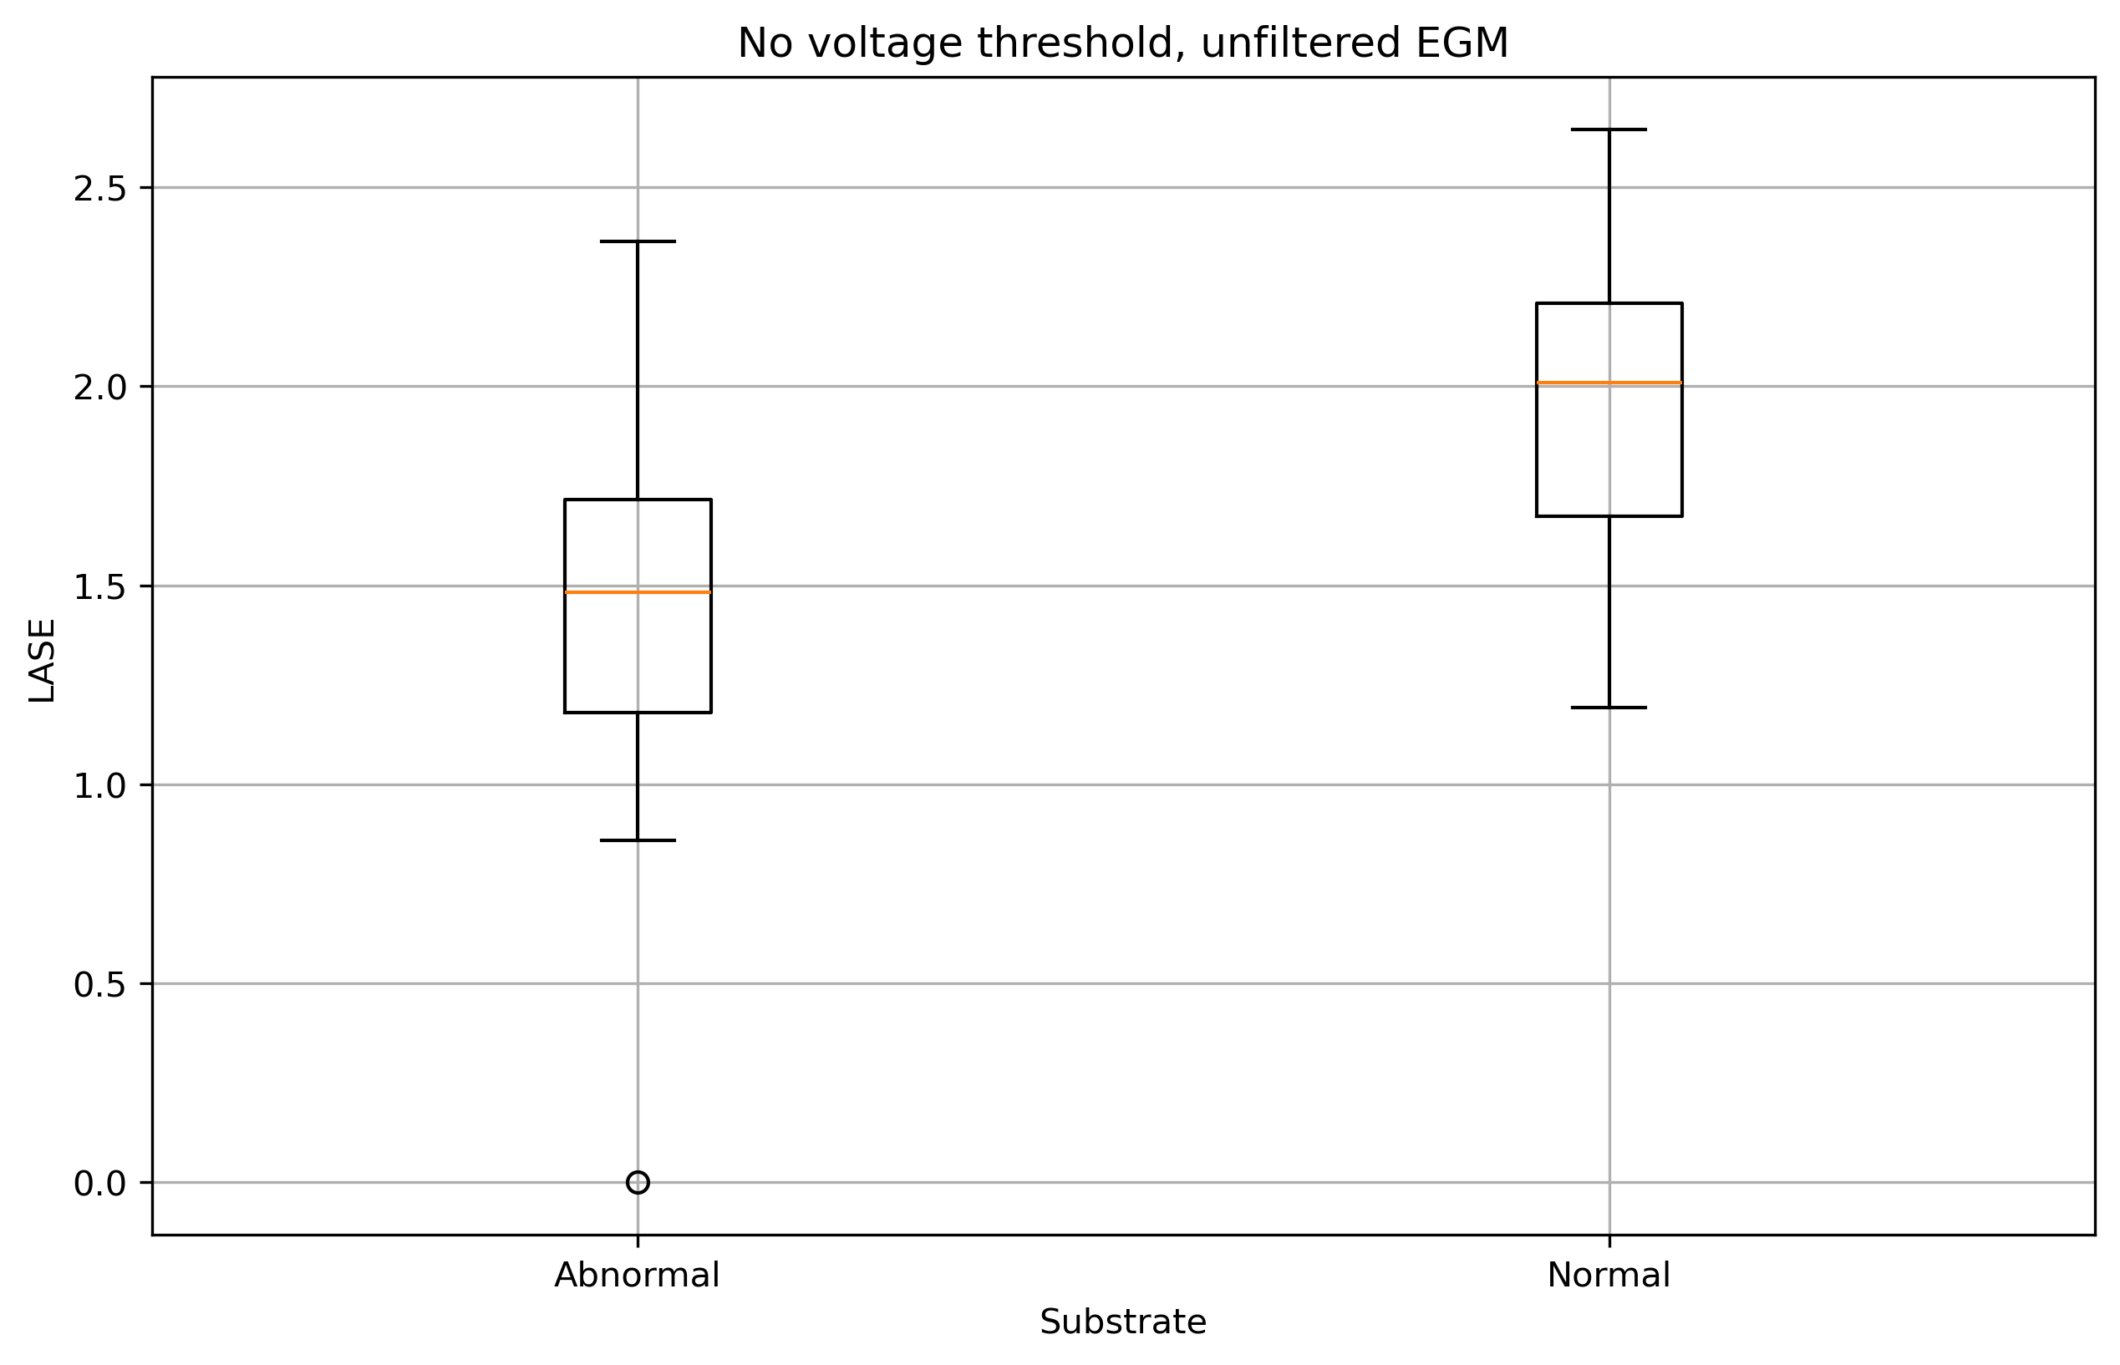
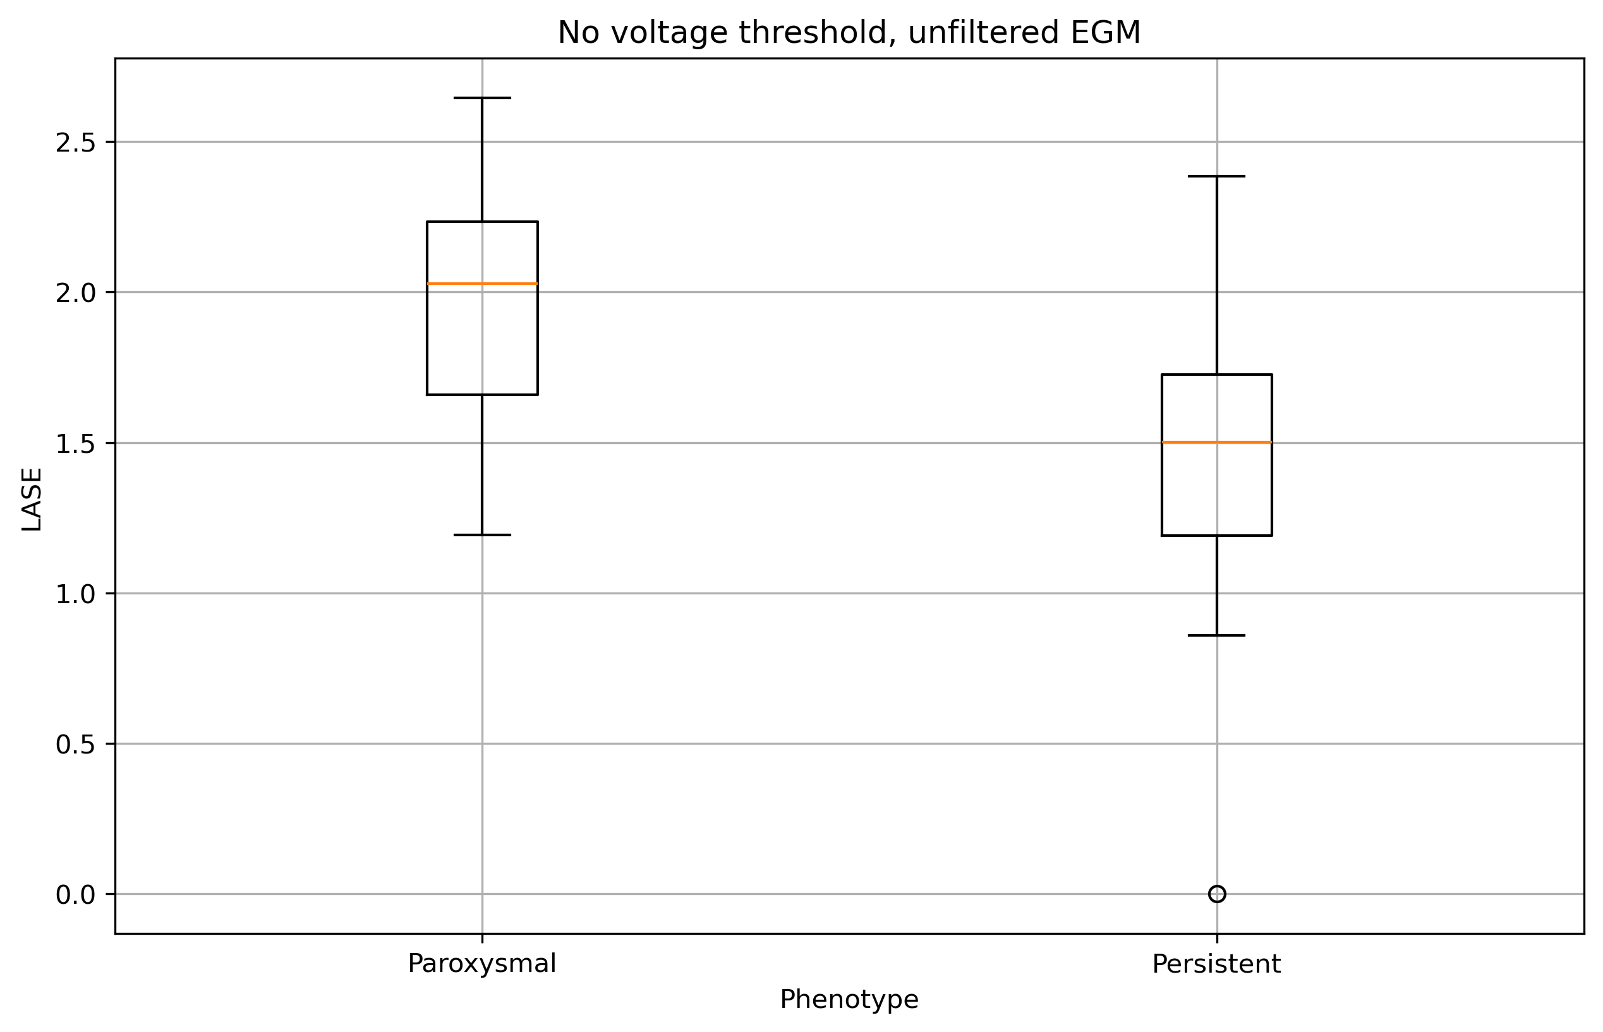
Results

Slide 6
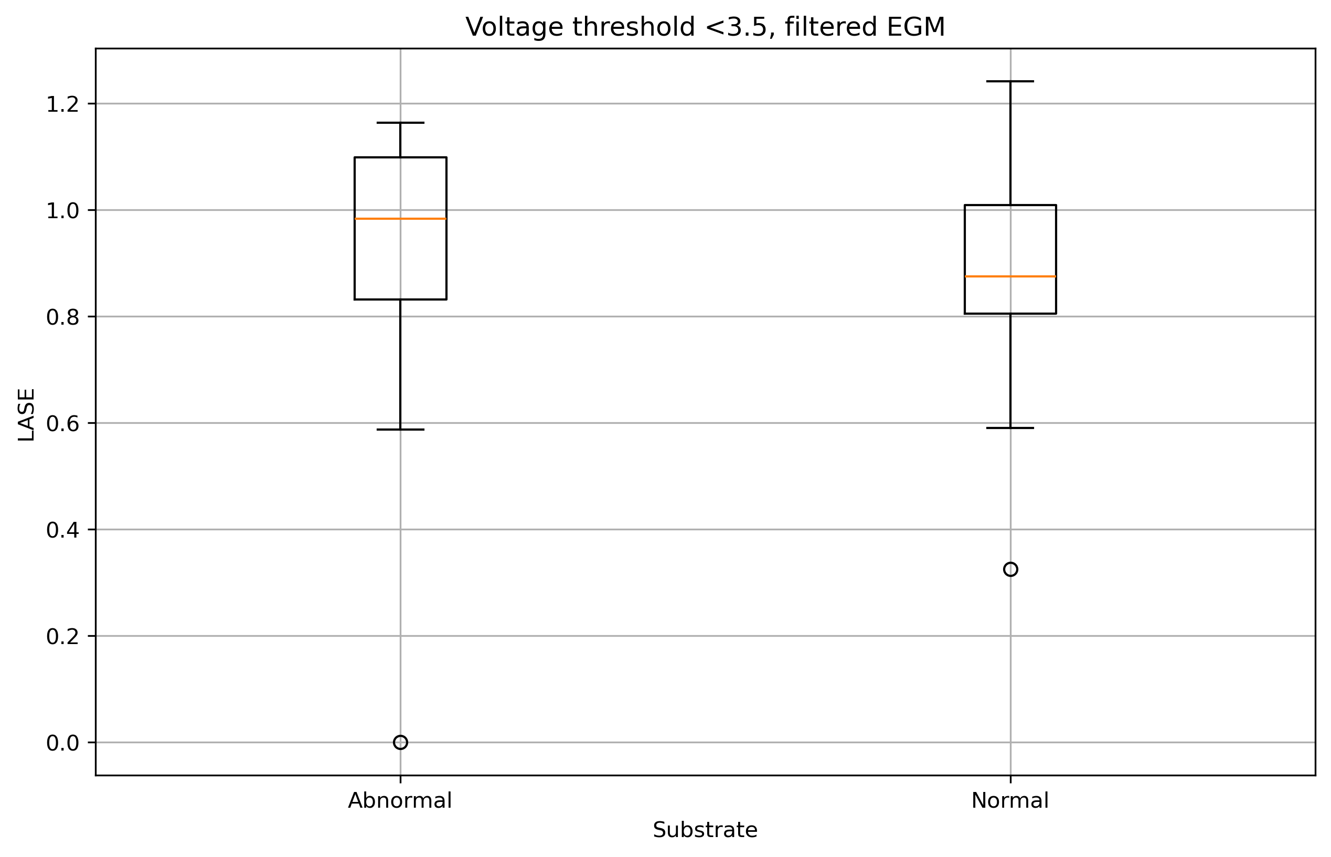
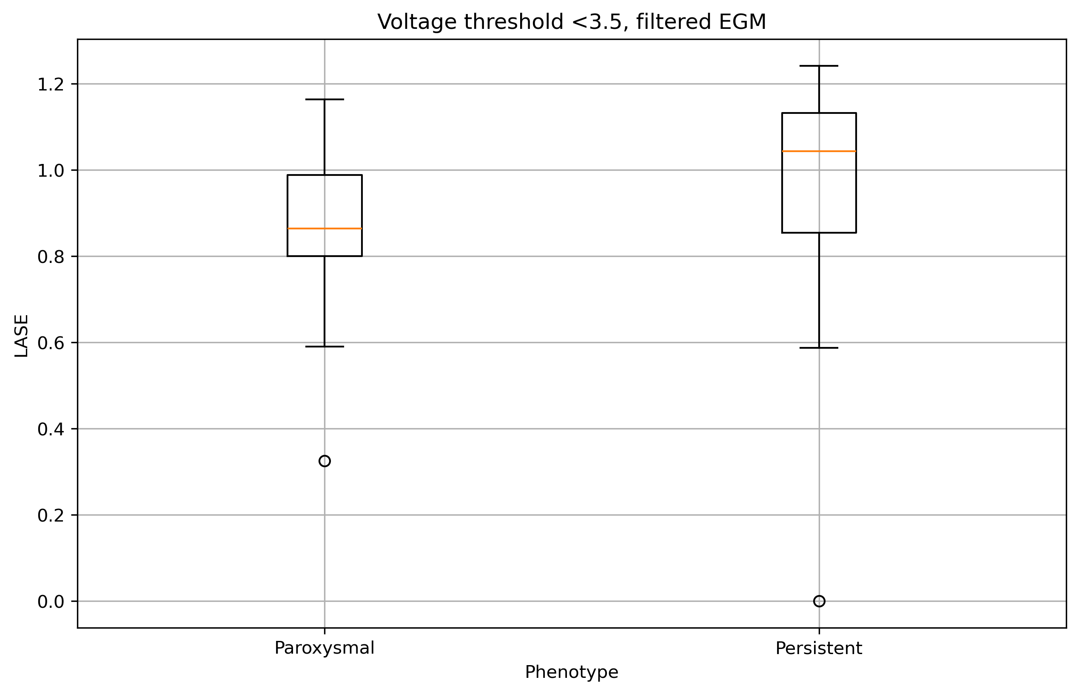
Results

Slide 7
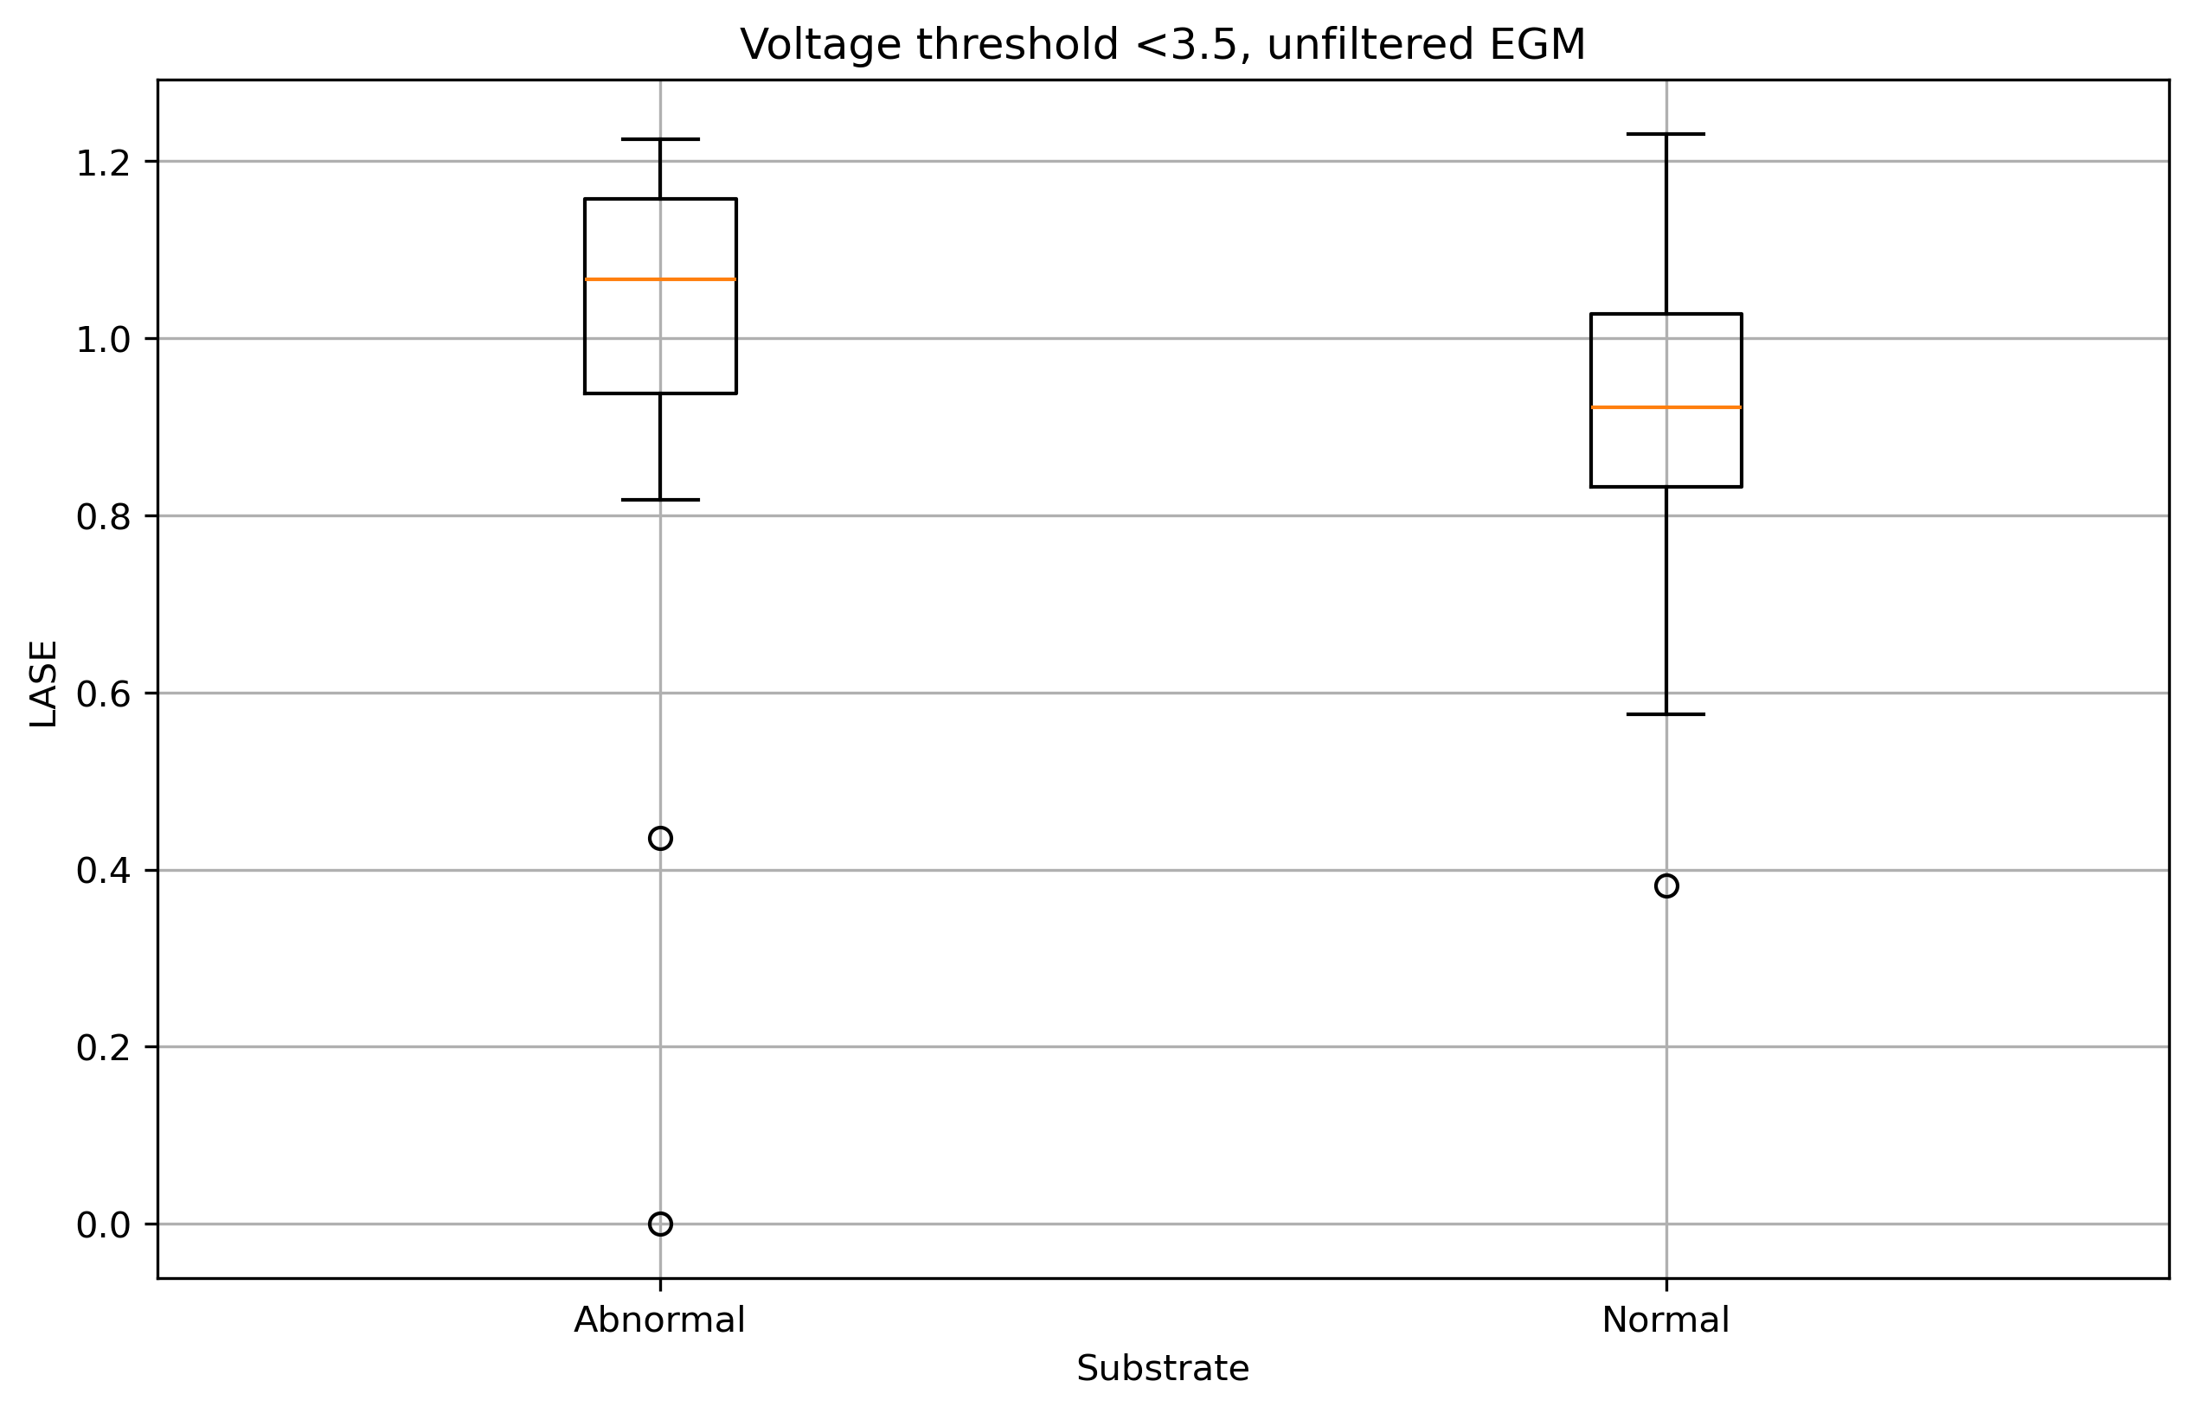
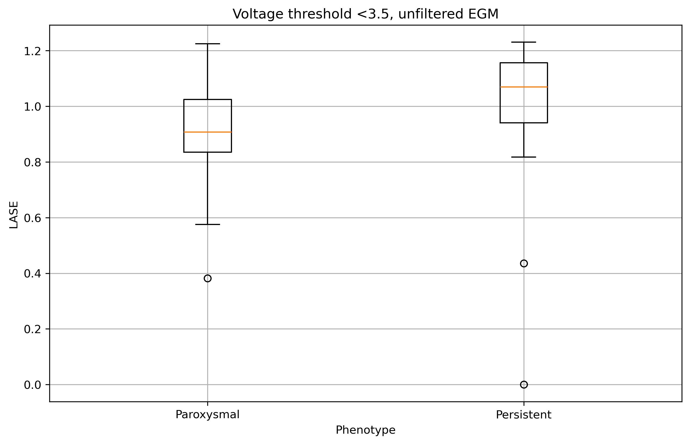
Results

