Slide 1

BIKE SHARING DEMAND
Forecast use of a city bikeshare system in Washington D.C.

Slide 2
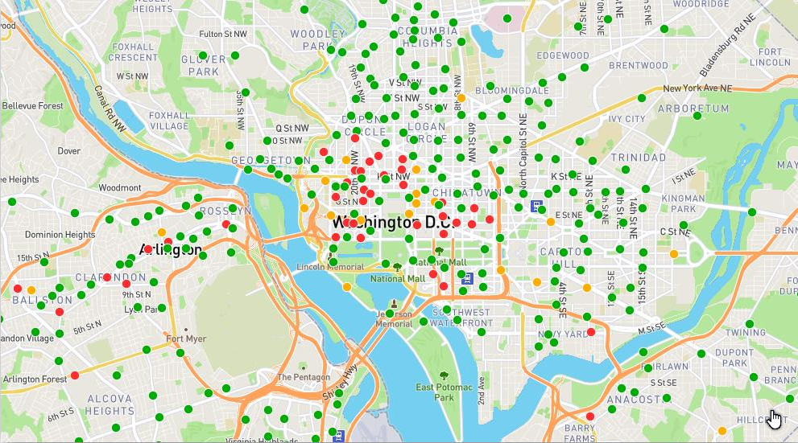
Project Goal:
Prediction of the total number of bikes in Washington D.C. that will be rented in each hour.
Hypothesis: The bike sharing are highly related with the time of the day, season and weather conditions.
Notes:
there is great interest in bike sharing systems as they play an important role in transport, the environment, and health.
In this study, it is predicted the total number of bikes that will be rented in each hour, using only the information that is available before the rental period.
The hypothesis in the research is that the bike sharing are highly related with the time of the day, season and weather conditions.
If bike-sharing demand is predicted in the best way, could be had good decisions to the determination of resources to redistribute bikes.
That is very important for increasing the market share in this rapidly developing market.

Slide 3
Data Description
Dependent Variable: Hourly count of rental bikes
Data Period: 2011-2012
Data Source: Capital bikeshare system in Washington D.C.
Datetime : hourly date + timestamp
Season : 1 = spring, 2 = summer, 3 = fall, 4 = winter
Holiday : Whether the day is considered a holiday
Workingday : Whether the day is neither a weekend nor holiday
Weather : 1: Clear, Few clouds, Partly cloudy, Partly cloudy
2: Mist + Cloudy, Mist + Broken clouds, Mist + Few clouds, Mist
3: Light Snow, Light Rain + Thunderstorm + Scattered clouds,
4: Heavy Rain + Ice Pallets + Thunderstorm + Mist, Snow + Fog
Temp : Temperature in Celsius
Atemp : "feels like" temperature in Celsius
Humidity : Relative humidity
Windspeed : Wind speed
Casual : Number of non-registered user rentals initiated
Registered : Number of registered user rentals initiated
Count : Number of total rentals
Notes:
This dataset contains the hourly count of rental bikes,
between years 2011 and 2012,
in Capital bikeshare system in Washington D.C. ,
with the corresponding weather and seasonal information...
Data set took from Kaggle…
There are 12 variables and 10586 rows…
There is no missing values…

Slide 4
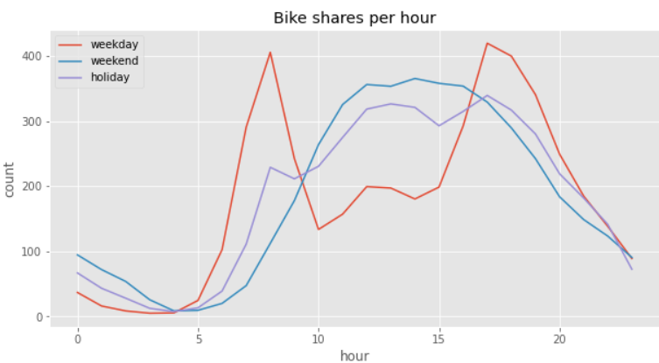
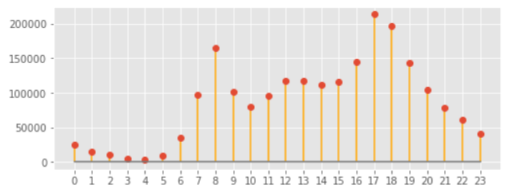
Data Description
Notes:
When we look at the number of rented bikes per hour for weekdays, weekends, and holidays between 6 am-8 pm in our dataset;
It is seen that
the demand is high during the hours of the commute to work on the weekdays..
At the weekends, the maximum demand is in the time between 12.00 – 4pm , a bit higher at 2pm
At the holidays demand shows a bit mobility….maximum value of the rented bike is at 5 pm…
we are seeing that the highest number of rented bikes per hour is happening respectively at 5 pm and afterwards at 6 pm…and 8 am..

Slide 5
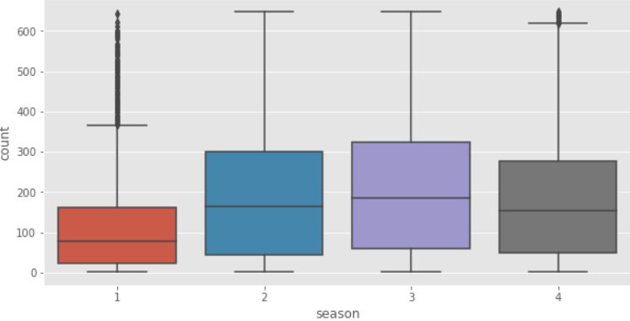
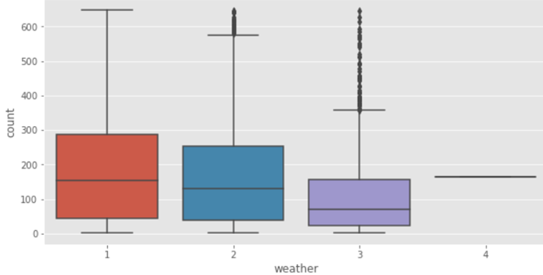
Data Description
‼ Spring has outliers, the reason could be changing weather conditions during spring.
Spring Summer Fall Winter
1: Clear, partly cloudy.
2: Mist + Cloudy
3: Light Snow, Light Rain
4: Heavy Rain + Thunderstorm + Snow
In the weather with cloud, mist, light snow, light rain have outliers...
‼ The reason for this could be that there could be most likely bad traffic in public transportation in the bad weather…That‘s why people could be prefer to use bikes.
Notes:
With boxplots, we can see the count of rented bikes (including up limit/down limit and mean) for each categorical variable.
First graph show us thatThe increase in the number of bike rentals is as Fall, Summer, Winter, Spring respectively.
to be honest, this information was a bit surprise for me...I was expecting that bikes are rented mostly in spring... in my opinion, the reason could be changing weather conditions during spring. That's why we are seeing outliers as well, that's mean if the weather is good in spring people highly tend to use bikes. But in general, the changeable spring season doesn't give permission to use bikes.
When we look at the weather’s boxplot, it seems a bit different…
we are seeing that bikes were rented mostly in the weather which is clear, few clouds or partly clouds...as we expected...
However, in foggy, rainy, and snowy weather, we see that in some cases more bikes are rented than expected. The reason for this could be that the traffic could be problematic in the bad weather…
That‘s why people may prefer to use bikes even though bad weather.
And ofcourse nobady uses bike in the weather with heavy rain, thunderstorm, ….

Slide 6
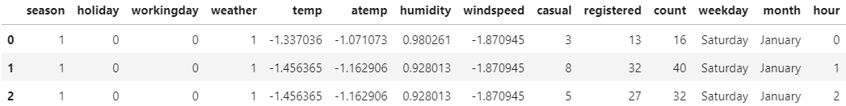
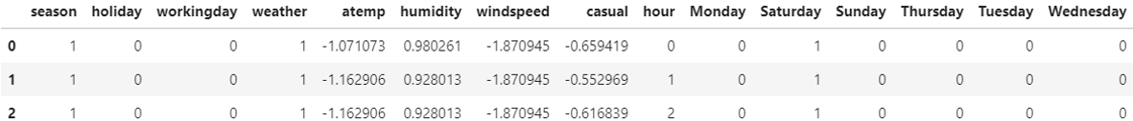
Feature Engineering
Datetime transformed to "weekday" , "month" and "hour".
Casual + registered = count, "registered" deleted from data set.
"month" deleted from data set, because it is not important variable for modelling.
" temp " deleted from data set, because "temp" and "atemp" almost same variable.
“Encoding” was applied to the 'weekday’ variable for using it in a model.
Notes:
What I want to explain here is that what I did with data ...
First of all, I transformed the variable DateTime to weekday, month, and hour.
I dropped 'registered' from a data frame because causal+registered is equal to count...
And… I dropped the 'temperature' variable from the data set because temp is very similar with atem (feel like temperature )
You can see the variables which are used in the model…

Slide 7
MODELLING
Independent Variables:
Season
Holiday
Workingday
Weather
Atemp
Humidity
Windspeed
Causal
Hour
Weekdays
Dependent Variable:
Count of rented bikes
Models | Scores | Model 1: without transfom | Model 2: with Power Transform and Standart Scale | Model 3: with Power Transform, Sdandart Scale and Logarithmic Transform
Linear Regression | R2 RMSE MAE | 0,57 117,73 82,48 | 0,63 92,35 67,42 | 0,54 0,90 0,69
K Nearest Neighbor Regressor | R2 RMSE MAE | 0,66 104,52 69,24 | 0,87 54,92 37,25 | 0,92 0,36 0,27
Decision Tree Regressor | R2 RMSE MAE | 0,89 58,28 37,86 | 0,89 50,21 33,54 | 0,92 0,37 0,27
Random Forest Regressor | R2 RMSE MAE | 0,91 53,59 34,19 | 0,90 47,46 30,67 | 0,94 0,31 0,23
√ Best Model
*RMSE: Root Mean Squared Error
*MAE: Mean Absolute Error
*R2: R2 Coefficient of Determination
*All scores were calculeted for the test set.
Notes:
The dataset consists of variables for hourly rental bikes for two years...(2011-2012).
Independent variables are……
Three different models were created to compare the methods applied in modeling which is without transforms, with power transform and standart scale… and with power transform an logarithmic transform…
The best model is random forest model in model 3.

Slide 8
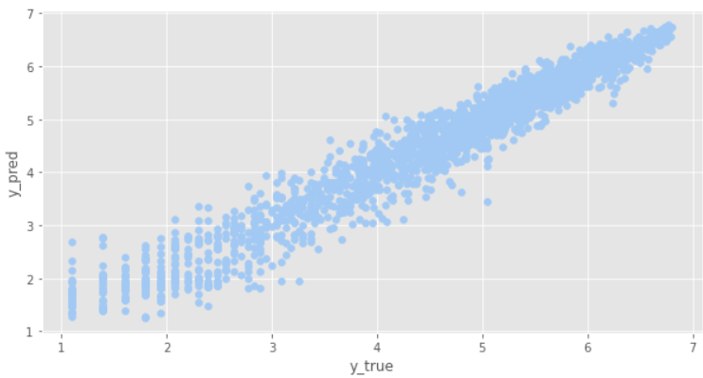
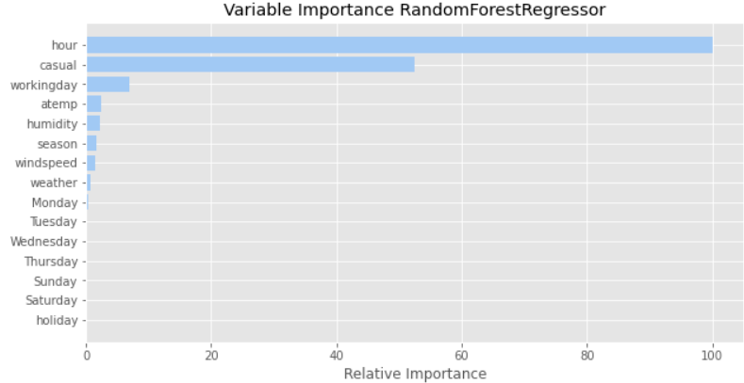
Random Forest Regressor Model‘s Performance
Project Goal:
Prediction of the total number of bikes in Washington D.C. that will be rented in each hour.
Scatter plot helps us with understanding that how well match the prediction values and true values.
We can see the reflection of the R2 score of the Random Forest model as high as 91% in this graph.
Hypothesis: The bike sharing are highly related with the time of the day, season and weather conditions.
Notes:
Here we can see the model‘s performance…
In the first graph…Scatter plot helps us with understanding that how well match the prediction values and true values.
Important variables are highly related with the hypotesis
…..most important variable is hour as expected…
It is not surprising that the "causal" variable explains very well the target variable because there is linearity between them...
We see that the third important variable is the" workingday"... In this case, we can say that the dateTime variables are more important than weather variables...

Slide 9

CONTACT DETAILS
drozkanf@gmail.com
filiz.oezkan@wzb.eu
Please connect to me on Linkedin…

Slide 10


