Slide 1
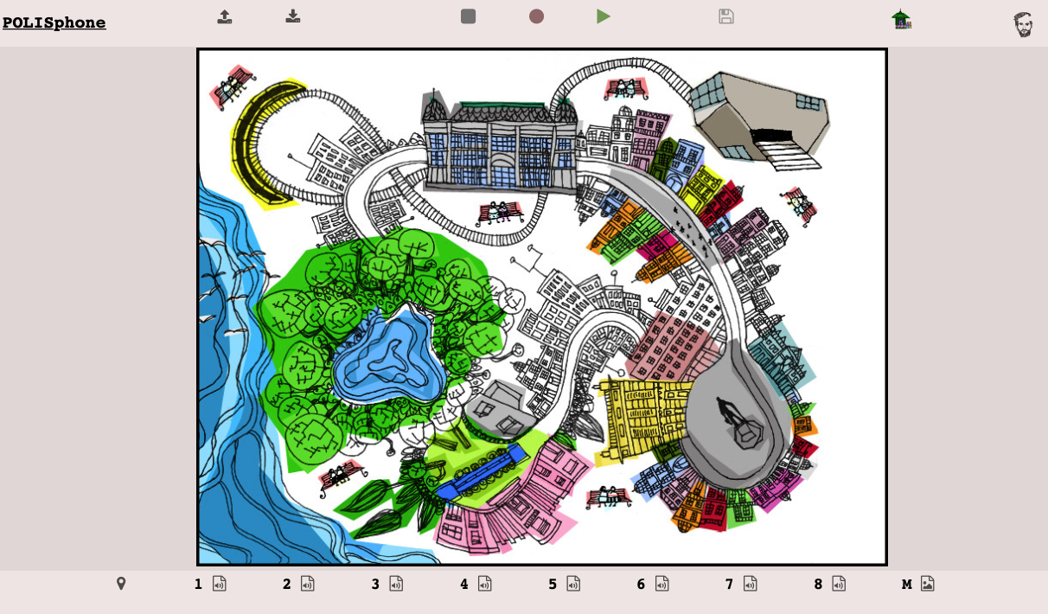
download
recorded performance
download polisphone
project
play
recorded performance
help
Reloads original polisphone
homepage
record performance
upload polisphone
project
stop music
or
stop recording
change location of each “sonic spot”
change sound assigned to “spot” nº3
change background image

