Slide 1

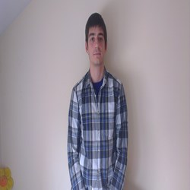
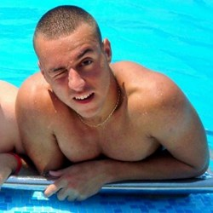
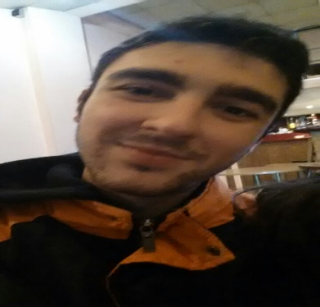
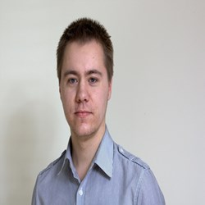
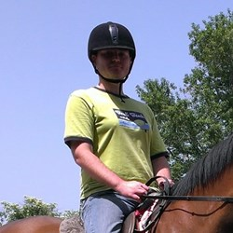
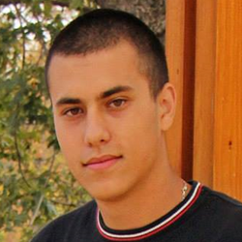
Copyright 2014
“BANANA YELLOW”
TEAM
PRESENTS
“BANANA YELLOW”
team

Slide 2
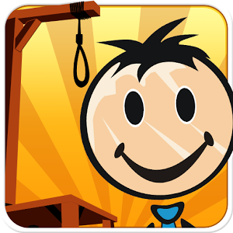
Copyright 2014
“BANANA YELLOW”
TEAM
HANGMAN
THE GAME

Slide 3
3 CATEGORIES
Copyright 2014
“BANANA YELLOW”
TEAM
Category “ANIMALS”
– more than 50 words.
2. Category “CAPITALS”
– more than 30 words.
3. Category “FRUITS AND VEGETABLES”
– more than 20 words.

Slide 4
STATISTICS
Copyright 2014
“BANANA YELLOW”
TEAM
Work Time ≈ 20 h / member.
Start Date – 12.09.2014
End Date – 16.09.2014
More than 500 lines of code.
80% of the time – DEBUGGING!

Slide 5

SOURCE CODE
Copyright 2014
“BANANA YELLOW”
TEAM
You can see full code with explanations in Bulgarian on:
http://webvisuality.com/hangman-by-banana-yellow
We are open for feedback and comments.
GitHub Repository
http://github.com/Filkolev/BANANA-YELLOW/Hangman

