Slide 1

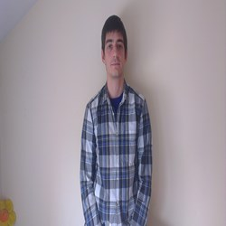


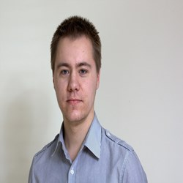
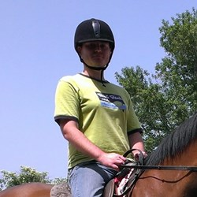
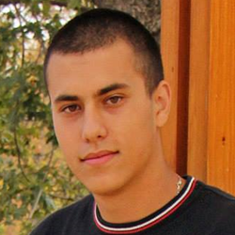
Copyright 2014
“BANANA YELLOW”
TEAM
PRESENTS
“BANANA YELLOW”
team

Slide 2

Copyright 2014
“BANANA YELLOW”
TEAM
HANGMAN
THE GAME

Slide 3

SOURCE CODE
Copyright 2014
“BANANA YELLOW”
TEAM

Slide 4
GitHub Repository
http://github.com/Filkolev/BANANA-YELLOW

