Slide 1

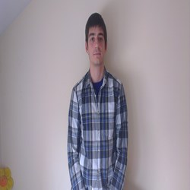


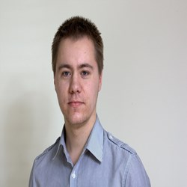
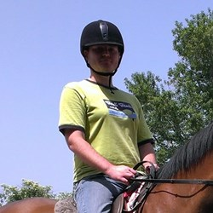
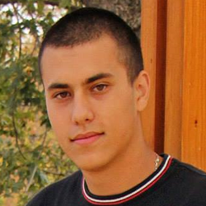
Copyright 2014
“BANANA YELLOW”
TEAM
PRESENTS
“BANANA YELLOW”
team

Slide 2

Copyright 2014
“BANANA YELLOW”
TEAM
HANGMAN
THE GAME

Slide 3

SOURCE CODE
Copyright 2014
“BANANA YELLOW”
TEAM
You can see full code with explanations in Bulgarian on:
http://webvisuality.com/hangman-by-banana-yellow/
GitHub Repository
http://github.com/Filkolev/BANANA-YELLOW/Hangman

