Slide 1
Linux Programming
Lecture 2
21.01.2016

Slide 2
Schedule
Lecture
Lab
Simple Computer Architecture
Processor and architecture
RAM and storage
Communication (UART, I2C, etc.)
Global Architecture
Software components of global architecture
Memory allocation
Memory speed
Select best memories for different occasions

Slide 3
Computer architecture
In order to live you must have a heart

Slide 4
Simple computer architecture
RAM
CPU
RAM
IO Controllers
Disc Drive
HID devices
GPIO devices

Slide 5
Simple computer architecture
CPU – The action making brain of the computer
RAM – Holds the information that is required to execute certain number of actions. After turning the power down this memory is reset to initial state (erased). It is extremely fast.
ROM – The long-lasting memory of the computer. It is volatile (on power down it is not erased). It is slow compared to RAM.
IO Controllers – All the peripheral devices of a computer systems such as mice, keyboard, displays, etc. They are connected to the CPU using different communication interfaces.

Slide 6
The processor

Slide 7
Processor purpose
Executes instructions that can process:
Basic arithmetic operations
Logical operations
Control operations
Input / Output operations

Slide 8
CPU Architecture
Program counter
Instruction register
Memory address register
Memory buffer register
I/O address register
I/O buffer register
Execution unit
Status register
Arithmetic- Logic Unit

Slide 9
Processor registers
User-visible registers
Enable programmer to minimize main memory references by optimizing register use
Control and status registers
Used by the processor to control operating of the processor
Used by privileged OS routines to control the execution of programs
Note:
Register is data-holding place in a computer processor

Slide 10
User-visible registers
May be referenced by machine language
Available to all programs – application programs and system programs

Slide 11
User-visible registers
Data
Address
Index register: Adding an index to the base value to get the effective address (used for modifying operand addresses during run of a program)
Segment pointer: When memory is divided into segments, memory is referenced by segment and an offset
Stack pointer: points to top of stack
Notes:
Index register: The contents of an index register is added to (in some cases subtracted from) an immediate address (one that is part of the instruction itself) to form the "effective" address of the actual data (operand)
Segment pointer
Segment pointer: Used to point to a new memory segment. For example if you have few different memories -> CPU internal RAM and external RAM.

Slide 12
Control and status registers
Program counter (PC)
Contains the address of an instruction to be fetched
Instruction register (IR)
Contains the instruction most frequently fetched
Program status word (PSW)
Contains information about the current state of the system.
Hold information about interrupts, address of next instrcution

Slide 13
Control and status registers
Condition codes or flags
Bits set by processor hardware as a result of operations
Example – positive, negative, zero, overflow, carry.

Slide 14
Instruction execution
What is instruction – simple action that the processor must execute (for example sum the data from register 0x32 and register 0x35, write number 0x4F to register 0x4A)
Instruction execution:
Processor fetches the instruction from memory
PC holds the address of the instruction to be fetched next
PC is incremented after each fetch

Slide 15
Instruction register
Fetched instruction loaded into instruction register
Categories
Processor – memory
Processor – I/O
Data processing
Control

Slide 16
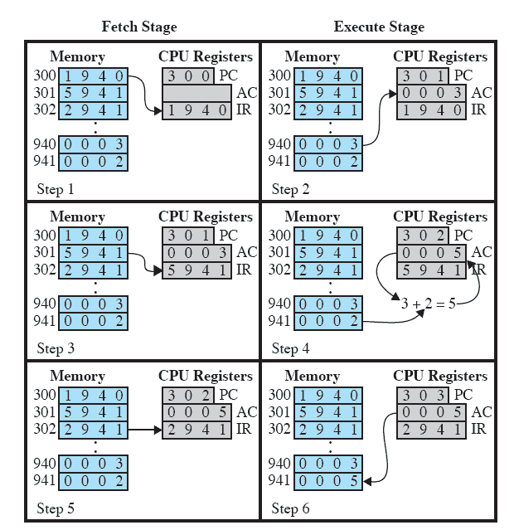
Example of program execution

Slide 17
Interrupts
Interrupt the normal sequencing of the processor
Most I/O devices are slower that the processor
Processor must pause to wait for device

Slide 18
Interrupt classes
Program – generated by some condition that occurs as a result of an instruction execution such as arithmetic overflow, division by zero, attempt to execute an illegal machine instruction and reference outsize a user’s allowed memory space
Time – Generated by timer within the processor. This allows operating system to perform certain function on a regular basis
I/O Generated by an I/O controller, to signal normal completion of an operation or to signal a variety of error conditions
Hardware failure – Generated by a failure, such as power failure or memory perity error

Slide 19
Transfer of control via interrupts
Normal operation
Interrupted operation
Program 1
Program 1
Point of interrupt
Interrupt handler
Program 2
Program 2
Program 3
Program 3

Slide 20
Program timing with and without interrupts
Interrupt task
Without interrupts
1
2
W8
3
4
W8
5
6
W8
T
With interrupts
Interrupt received
Interrupt task
1
2
3
4
5
6
I
T
7
8

Slide 21
Simple interrupt processing
Device controller or other system hardware issues an interrupt
Processor finishes execution of current instruction
Processor signals acknowledgement of interrupt
Processor pushes PSW and PC onto control stack
Processor pushes PSW and PC onto control stack
Processor loads new PC value based on interrupt
Save reminder of process state information
Process interrupt
Restore process state information
Restore old PSW and PC
hardware
software

Slide 22
Multiprogramming
Processor has more than one program to execute
The sequence in which programs are executed depend on their relative priority and whether they are waiting for I/O
After an interrupt handler completes control may not return to the program that was executing at the time of the interrupt

Slide 23
Processor architectures
X86 and X86-64 – used in PC platforms and some embedded systems
ARM – Most used and popular these days
PowerPC – RTOS, industrial applications
MIPS – network applications
SuperH – set top boxes and multimedia applications
Blackfin – DSP architecture
Microblaze – soft-core for Xilinx FPGA
Coldfile, Score, Tile, Xtensa, Cris, FRV, AVR, M32R

Slide 24
Software for playing with a simple processor
CPU-OS Simulator
Check video of the software- https://www.youtube.com/watch?v=NMvzN9Jv9WM

Slide 25
Questions ?

Slide 26
The memory

Slide 27
Memory rules
Faster access time, greater cost per bit
Greater capacity, smaller cost per bit
Greater capacity, slower access speed

Slide 28
The memory Hieararchy
Inboard memory
Registers
Cache
Outboard storage
SSD
HDD
Main memory
Optical drive
Off-line storage
Magnetic tape (Deprecated)
Data cards

Slide 29
Outboard (Secondary) memory
Auxiliary memory
External
Nonvolatile
Used to store program and data files

Slide 30
Cache memory
Processor speed is faster than the memory access speed
Exploit the principle of locality with a small fast memory

Slide 31
Cache and main memory
Main memory
CPU
Byte or word transfer
Cache
Block transfer

Slide 32
Cache principles
Contains copy of a portion of main memory
Processor first checks cache
If desired data item not found, relevant block of memory read into cache
Because of locality of reference, it is likely that future memory references are in that block

Slide 33
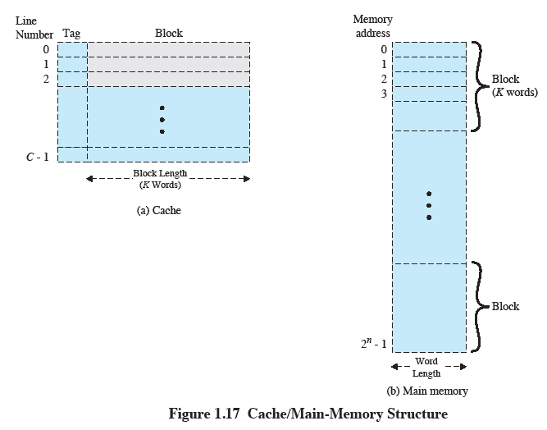
Cache/Main memory structure

Slide 34
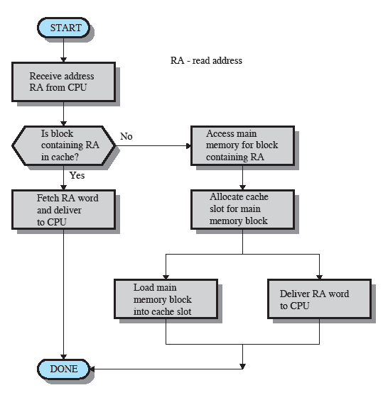
Cache read operation

Slide 35
Cache principles
Cache size
Even small caches have significant impact on performance
Block size
The unit of data exchanged between cache and main memory
Larger block size yields more hits until probability of using newly fetched data becomes less than the pribability of reusing data that have to be moved out of cache

Slide 36
Cache principles
Mapping function
Determines which cache location from the block will occupy
Replacement algorithm
Chooses which block to replace
Least-recently-used algorithm

Slide 37
Cache principles
Write policy
Dictates when the memory write operation takes place
Can occur every time the block is updated
Can occur when the block is replaced
Minimize write operations
Leave main memory in an obsolete state

Slide 38
Questions ?

Slide 39
Memory management

Slide 40
Memory management
Subdiving memory to accommodate multiple processes
Memory needs to be allocated to ensure a reasonable supply of ready processes to consume available processor time

Slide 41
Memory Management Requirements
Programmer does not know where the program will be placed in memory when it is executed
While the program is executing, it may be slapped to disk and returned to main memory at different location
Memory references must be translated in the code to actual physical memory address

Slide 42
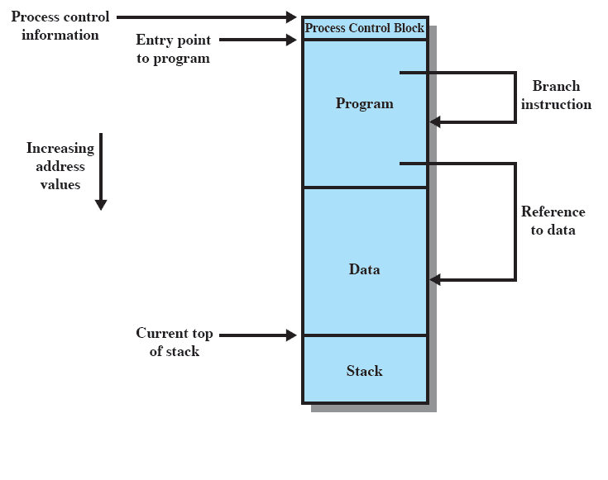
Addressing requirement

Slide 43
Memory management requirements
Protection
Processes should not be able to reference memory locations in another process without permission
Impossible to check absolute addresses at compile time
Must be checked at run time
Sharing
Allow several processes to access the same portion of memory
Better to allow each process access to the same copy of the program rather than have their own separate copy

Slide 44
Memory management requirements
Logical organization
Programs are written in modules
Modules can be written and compiled independently
Different degrees of protection given to modules (read-only, execute-only)
Share modules among processes

Slide 45
Memory management requirements
Physical organization
Memory available for a program plus its data may be insufficient
Overlaying allows various modules to be assigned to the same region of memory
Programmer doesn’t know how much space will be available at the compile time

Slide 46
Fixed partitioning
Equal-size partitions
Any process whose size is less than or equal to the partition size can be loaded into an available partition
If all partitions are full, the operating system can swap a process out of a partition
A program may not fit in a partition. The programmer must design the program with overlays
Main memory use is inefficient. Any program no matter how small, occupies an entire partition (This is called internal fragmentation)

Slide 47
Fixed partitioning
4MB
4MB
4MB
4MB
4MB
4MB
4MB
4MB
32 MB Block of memory with equal-size partitions

Slide 48
Fixed partitioning
2MB
2MB
4MB
8MB
16MB
32 MB Block of memory with non equal-size partitions

Slide 49
Placement algorithm
Equal-size
Placement is trivial
Unequal-size
Can assign each process to the smallest partition within which it will fit
Queue for each partition
Processes are signed in such a way as to minimize wasted memory within a partition

Slide 50
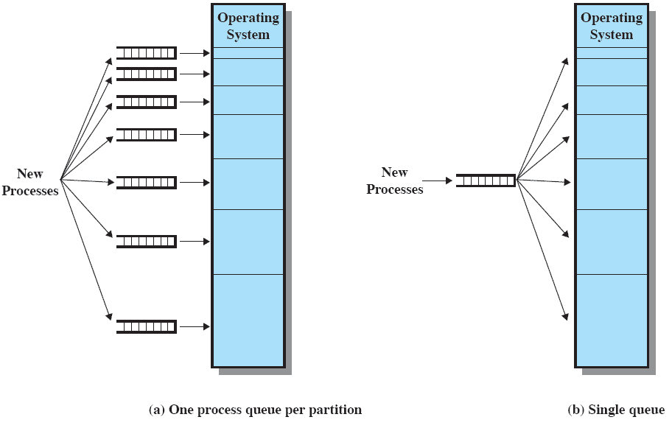
Fixed partitioning

Slide 51
Dynamic partitioning
Partitions are of variable length and number
Process is allocated exactly as much memory is required
Eventually get holes in the memory. This is called external fragmentation
Must use compaction to shift processes so they are contiguous and all free memory is in one block

Slide 52
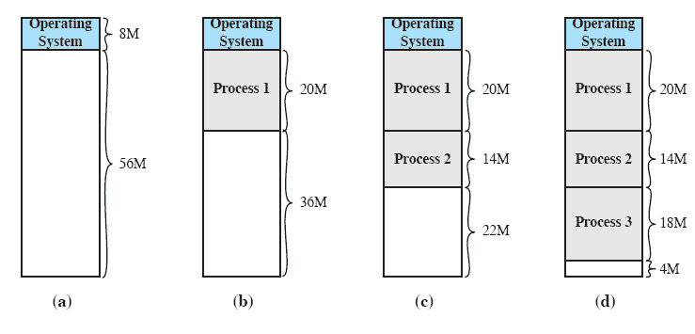
Dynamic partitioning

Slide 53
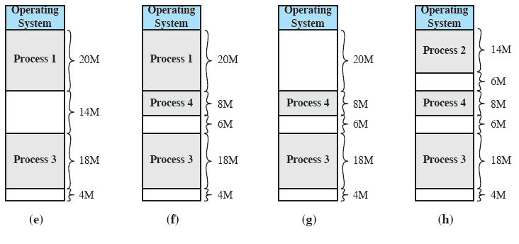
Dynamic partitioning

Slide 54
Dynamic partitioning
OS must decide which free block to allocate to a process
Best-fit algorithm
Chooses the block that is closest in size to the request
Worst performer overall
Since smallest block is found for the process, the smallest amount of fragmentation is left
Memory compaction must be done more often

Slide 55
Dynamic partitioning
First-fit algorithm
Scans memory from the beginning and chooses the first available clock that is large enough
Fastest
May have many process loaded in the front end of memory that must be searched over when trying to find a free block

Slide 56
Dynamic partitioning
Next-fit algorithm
Scans memory from the location of the last placement
More ofter allocates a block of memory at the end of memory where the largest block is found
The largest block of memory is broken up into smaller blocks
Compaction is required to obtain a large block at the end of memory

Slide 57
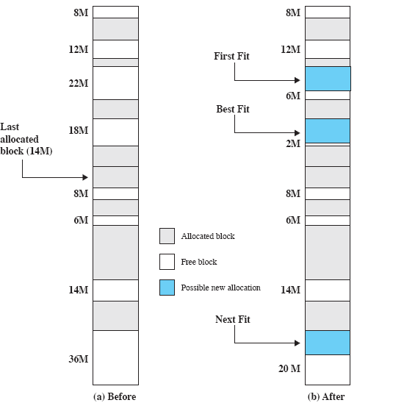
Allocation

Slide 58
Buddy system
Entire space available is treated as a single block of 2U
If a request of size such as 2U-1 < s <= 2U, entire block is allocated
Otherwise block is split into two equal buddies
Process continues until smallest block greater than or equal to the requested size is generated

Slide 59
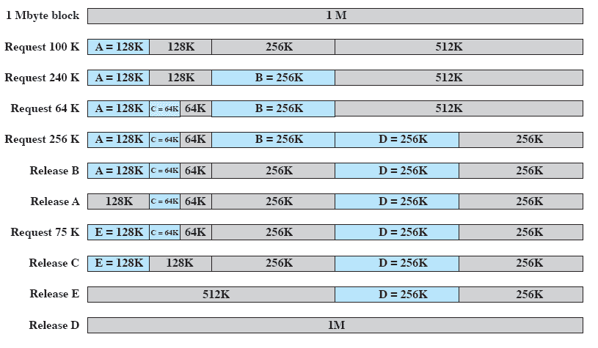
Example of Buddy

Slide 60
Relocation
When program is loaded into memory the absolute memory locations are determined
A process my occupy different partitions which means different absolute memory locations during execution (from swapping )
Compaction will also cause a program to occupy a different partition, which means different absolute memory locations

Slide 61
Addresses
Logical
Reference to a memory location independent of the current assignment of data to memory
Translation must be made to the physical address
Relative
Address expressed as a location relative to some known point
Physical
The absolute address or actual location in main memory

Slide 62
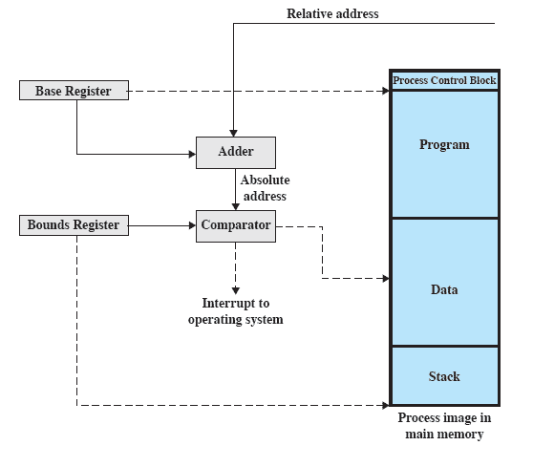
Relocation

Slide 63
Registers used during execution
Base register
Starting address for the process
Bounds register
Ending location of the process
This values are set when the process is loaded or when the process is swapped in

Slide 64
Registers used during execution
The value of the base register is added to a relative address to produce absolute address
The resulting address is compared with the value in the bounds register
If the address is not within bounds an interrupt is generated to the operating system

Slide 65
Paging
Partition memory into small equal fixed-size chunks and divide each process into the same size chunks
The chunks of a process are called pages and chunks of memory are called frames
OS maintains a page table for each process
Contains the frame location for each page in the process
Memory address consist of a page number and offset within the page

Slide 66
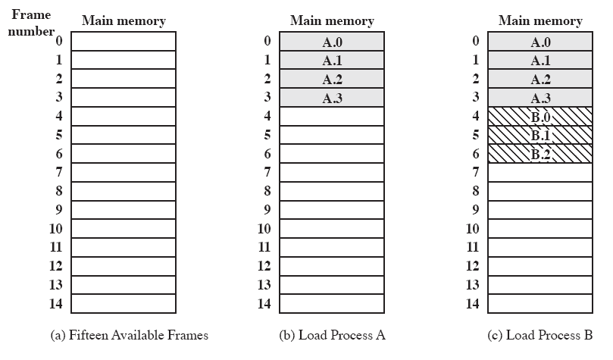
Paging and frames

Slide 67
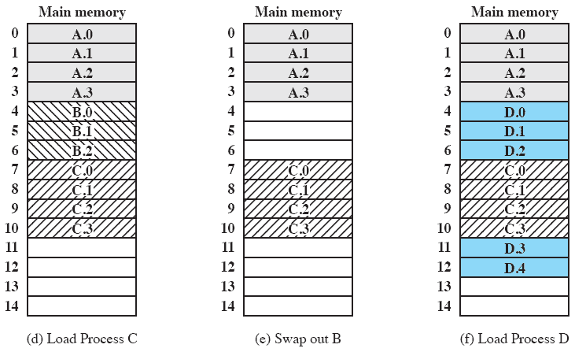
Paging and frames

Slide 68
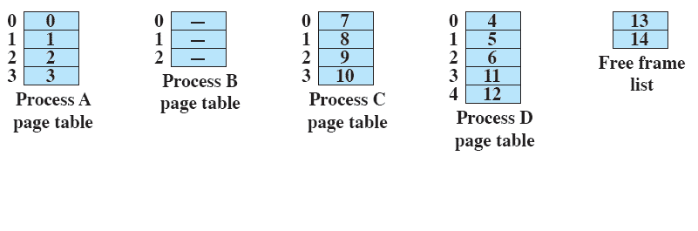
Page table

Slide 69
Segmentation
All segments of all programs do not have to be the same length
There is a maximum segment length
Addressing consist of two parts – a segment number and an offset
Since segments are not equal, segmentation is similar to dynamic partitioning

Slide 70
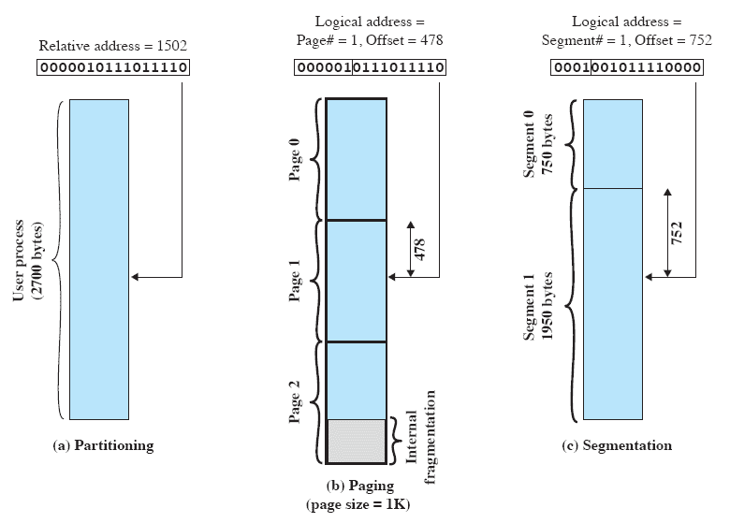
Addressing

Slide 71
Questions ?

Slide 72
Communication

Slide 73
Frequently used com interfaces
I²C – Inter-integrated circuit
SPI – Serial Peripheral Interface
UART – Universal Asynchronous Receiver Transmiter
CAN – Controller area network
1-wire – single wire communication interface
SDIO – Secure digital input Output
USB – Universal serial bus

Slide 74
I²C
Requires 2 wires for the communication
Uses simplex master-slave communication topology over one of the wires
The other is used as CLK (Clock) wire to match the communication speed
The interface is used mainly for communication between processor and sensor

Slide 75
SPI
Requires 4 wires for communication
Uses duplex master-slave communication topology over 2 of the wires (Master-In-Slave-Out, Master-Out-Slave-In)
CLK wire – to determine and match communication speed
CS wire – Chip select. In order not to mess the data from many devices, this wire is used by the processor to point the receiver of a message
RST (not necessary) – reset pin

Slide 76
UART
Requires 2 wires
Uses duplex communication topology between 2 devices (recommended)
RX wire – Receive X (data). Must be connected to other’s device TX
TX wire – Transmit X(data). Must be connected to other’s device RX.
Baudrate must be specified before starting the communication between devices.
Most used interface for communication between devices.

Slide 77
SPI Purpose
For higher speed communication between devices
Can be used for some displays, GPIO expanders, large LED matrixes, Ethernet connection, etc.
Can be used to upload firmware to a MCU and for manual modification of registers, as well as debug.

Slide 78
CAN
Requires 2 wires to communicate
Uses duplex multi-master communication topology over the two wires
High speed and no-data-loss communication
One-talks many-listens communication
Message priority
Used for sensors, actuators, board computers, diagnostics

Slide 79
1-wire
Single wire required
Uses simplex master-slave communication over the wire
Slow speed communication
All devices have 64-bit SN
Master send a command followed by the SN of the recipient.
In a case of mess with other devices, the failed package is resent.
Used in sensors in small packages

Slide 80
SDIO
Mainly used for communicating with SD cards
Very fast communication
Can be used with SPI port
Few devices different that Memory cards are available on the market in order to extend the capability of small devices

Slide 81
USB
3 wires required
3 wire tiered-star topology
Extremely high speed
Up to 127 devices on one host
Pipe communication
Stream and message data types

Slide 82
Questions ?

Slide 83
Linux system architecture

Slide 84
Types of hardware platforms
Evaluation platforms – expensive all-in board with a lot of peripherals. Unsuitable for a real project.
Component on Module – small board with CPU, RAM, flash and other core components. Can be used for prototypes or small quantities of a product
Community development platforms – Ready-to-use, low-cost platforms for developers. Can be used for real products
Custom platform – Used for the end product. Most optimized board with low-cost per module and selected components.

Slide 85
Criteria for choosing the hardware
Must be supported by Linux kernel and has an open-source bootloader
Having support in the official versions of the projects is better
See if the vendor contributes the changes between the official kernel and the kernel of their project
Having all the three points completed in the process of selection of a hardware will save you a lot of money and time.

Slide 86
Global architecture
Applications
Window manager
Libraries
Kernel interface
Process management
IPC
Virtual file system
Memory management
Network subsystem
SELinux/AppArmor
Drivers and dynamic modules
User-space
Bootloader
Linux kernel
Processor architecture
Hardware

Slide 87
Bootloader
Started by the hardware (BIOS/UEFI)
Responsible for loading the kernel an initial RAM disk before initiating the boot process
In SoC it is a place of the memory that is called by the processor on power-up

Slide 88
Kernel
Manages I/O requests from software and translates them into data processing instructions for the CPU and other electronic component of the hardware
It is just a program
It is separated and protected in order to be eliminated the chance of interfering between user data and kernel data

Slide 89
User space
All the code that runs outside the OS’s kernel
Each process has it’s own memory space
Contains C library to interface with the kernel
Contains top level libraries such as GNUstep, SDL, SFML, GTK+, etc.

Slide 90
Questions?

Slide 91
Lab

Slide 92
Task 1
Write a program that reads you name in format “<First name> <Family name>” from the keyboard, saves it into an array and prints it in format “<Family name>, <First name>”. The program must use stack memory.

Slide 93
Task 2
Write the same program but using the heap memory.

Slide 94
Task 3
Which allocation is better ?

Slide 95
Task 4
Calculate time of program execution that is finding the number prime numbers below 10000
Note : use <time.h>

Slide 96
Task 5
Determine time of execution of stack and heap programs

