Slide 1
AIpredict – project update 28th July 2025
„„Funded by the EU NextGenerationEU through the Recovery and Resilience Plan for Slovakia under the project No. 09I03-03-V03-00101“ ​

Slide 2
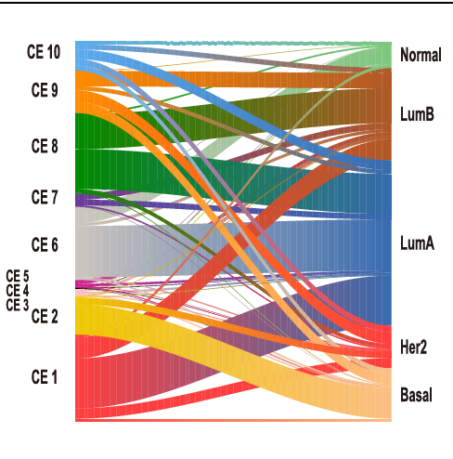


Integration of EcoTyper framework and CEs application
Cancer type classification challanges:
Standard techniques (PAM50,...) – unable to recognise tumor
microenvironment and intra‐tumoral heterogeneity
Machine learning frameworks (EcoTyper,...)
allows identification of interactions between various cell populations across tumor and stroma
Beside cell types, identifies also cellular states and carcinoma ecotypes
identifying novel prognostic biomarkers and biomarkers that predict immunotherapy response
Overlap between the 10 carcinoma ecotypes (CEs) and the 5 PAM50 subtypes, with labels from both classification schemes shown.
Carcinoma ecotypes (CEs) = A categorization of tumor microenvironments based on clustering of cellular states, demonstrating strong prognostic relevance and potential for use in personalized medicine.

