Slide 1
Analysis on Covid 19 Datasets New Cases vs Death Rate in 2021
Team 4

Slide 2


Background
Coronavirus Cases:
690,596,621
Deaths:
6,892,673

Slide 3
Agenda
Introduce datasets/How we clean and prepared the datasets
Hypothesis
Summary of our finding
Limitation of dataset

Slide 4
Introduce Datsets
worldometer_coronavirus_daily_d
continent
total_confirmed
total_recovered
active_cases
worldometer_coronavirus_daily_d
cumulative_total_cases
Daily_new_case
Active_case
Cumulative_total_deats

Slide 5
Cleaning the dataset
Read the daily dataset from csv files to Dataframes
For narrow down the dataset, we randomly chose one country from each continent
Separate the date from original data to year, month and date
Group the data by Country, Month
Keep the columns for Country, Month, Monthly new cases, Monthly new deaths
For further use we also added Continent and Country population columns in by merging.

Slide 6
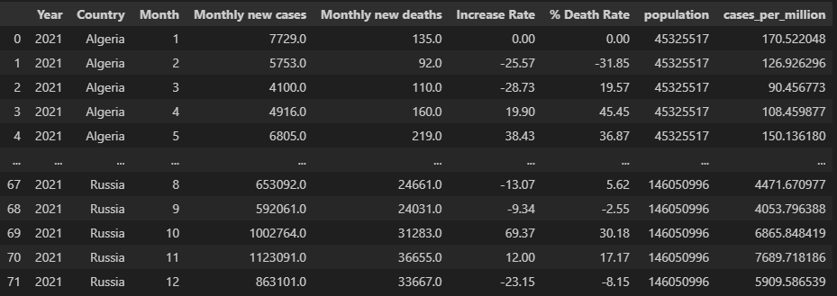
Last look to cleaned data

Slide 7
Hypothesis
Through an analysis of data from six randomly selected countries, each representing a different continent, our study aims to investigate the existence of a significant correlation between the monthly number of new COVID-19 cases and the corresponding death rate throughout the year 2021.
By examining aggregated data sets that include daily new COVID-19 cases and deaths, we have developed a Python-coded methodology to summarize the data on a monthly basis. This analysis will provide insights into the relationship between the incidence of new cases and the severity of COVID-19 outcomes, as measured by the death rate, contributing to a deeper understanding of the pandemic's impact on a global scale.

Slide 8
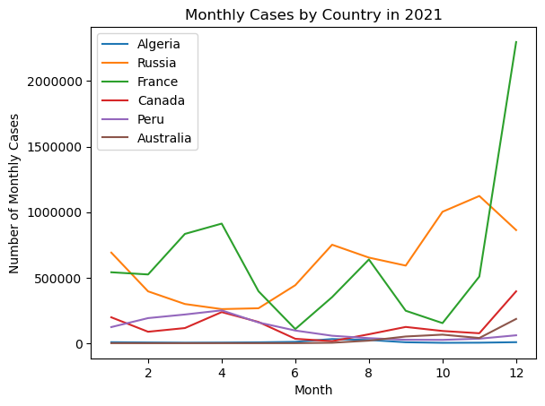
Monthly Covid-19 cases by country(2021)
This graph illustrates the monthly COVID-19 cases for the selected 6 countries throughout the year 2021.
COVID-19 cases varied among the selected countries with notable spikes observed in certain months.

Slide 9
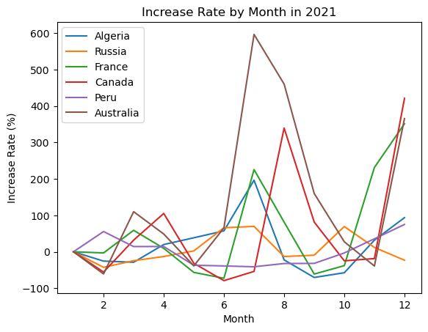
Monthly COVID-19 Cases by Country (2021)
The graph shows the monthly increase rate % for the 6 selected countries in 2021.
The increase rate % varies by month among the selected countries and show the fluctuation in the number of cases across the period of time for each country.

Slide 10
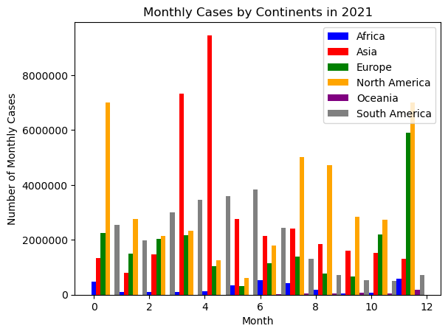
Monthly Cases by Continents in 2021
These bar graph illustrates the monthly cases distribution across continents in 2021.
Monitoring the distribution of cases by each continent can help identify the regions that experienced significant COVID-19 cases in specific months.

Slide 11
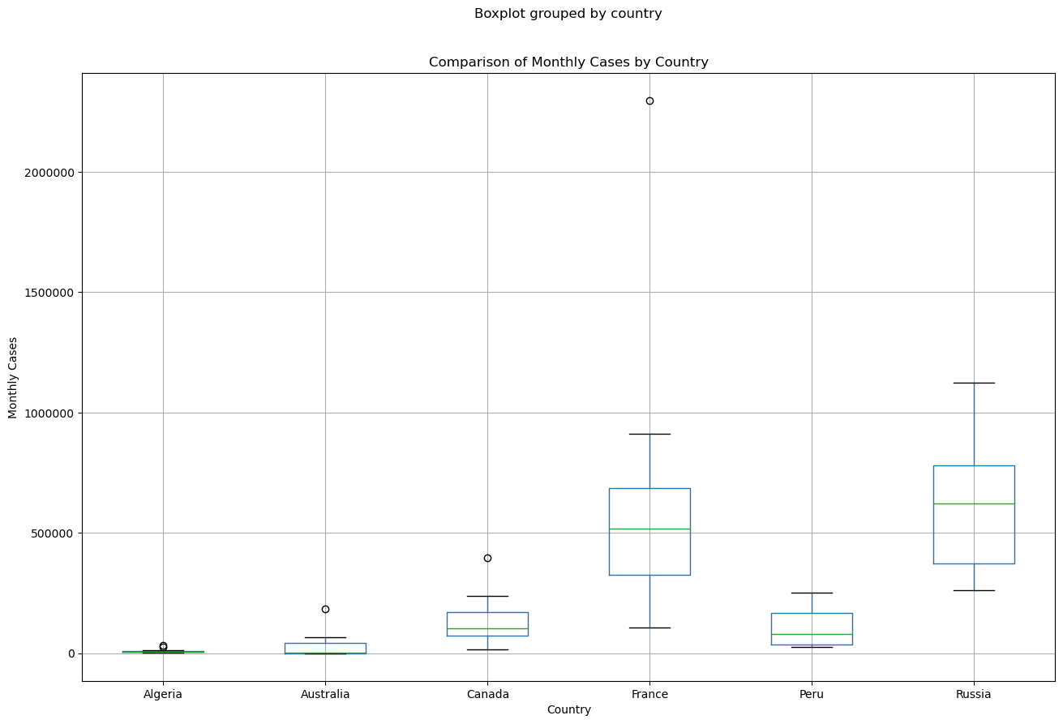
Monthly Cases by Country in 2021a
The box plot graph shows a comparison of monthly COVID-19 cases among 6 selected countries in 2021.
These graph provides more insights into the distribution of monthly cases, pointing out the range, median, and possible outliers for each country.

Slide 12
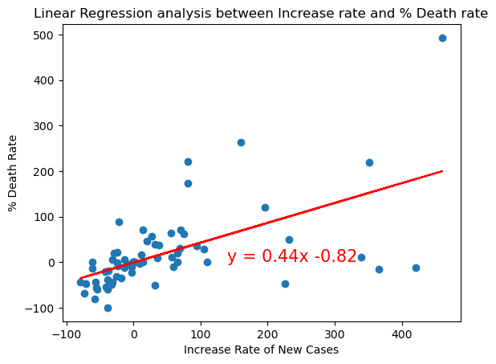
Relationship Between Increase Rate and % Death Rate
The graph shows a scatter plot of the data points and a regression line that represents the best-fit line for the data.
As the increase rate % of COVID-19 cases increases, there tends to be a corresponding increase in the % death rate.
The positive slope of the equation (0.44) suggests a moderate positive relationship between the increase rate % and the % death rate.
The r-value = 0.58 suggests a moderate positive correlation

Slide 13
Limitation of the dataset
Sample Size and Representativeness: The study uses a relatively small sample size of six randomly selected countries, one from each continent. This limited sample size may not be fully representative of the global population, potentially impacting the generalizability of the findings.
Selection Bias: The selection of countries from each continent may introduce bias, as certain countries might have different COVID-19 dynamics compared to others within the same continent. This bias can affect the accuracy of the correlation analysis.
Data Accuracy and Reliability: The study relies on data accuracy and reliability, as the analysis is based on COVID-19 data sets. Potential data inconsistencies, reporting errors, or variations in data collection methodologies across countries may impact the validity of the results.
Causality vs. Correlation: The hypothesis explores the correlation between new COVID-19 cases and the death rate. It is important to note that correlation does not imply causation. Other factors, such as healthcare infrastructure, testing capabilities, and government response, could influence both the number of cases and the death rate.
Temporal Limitation: The analysis is limited to the year 2021, which may not capture the complete impact of the COVID-19 pandemic. The dynamics of the virus and its effects may have evolved over time, potentially affecting the observed correlation.
Python Code Limitation: The hypothesis assumes that the Python code used for analysis is accurate and free from errors. However, if there are issues with the code implementation, it could affect the reliability of the results.
Data Availability and Completeness: The study relies on the availability and completeness of the data set used for analysis. Incomplete or missing data for certain countries or time periods could affect the accuracy and robustness of the findings.

Slide 14
Conclusion
The Null Hypothesis is rejected in favor of the alternate hypothesis.
Differences in the mean monthly cases among the countries are statistically significant.
With its insightful analysis of the COVID-19 pandemic’s global effects, this research advances knowledge of the corona virus.
The result can promote the creation of measures to reduce the spread of the virus and can help decision making process.
COVID-19 and population datasets were generously provided by the World Bank and Worldometer, respectively. Their efforts in gathering and storing this data have significantly advanced knowledge of the epidemic and study into it.

Slide 15
EXTRA (NY TIMES API REQUEST)
News related to Algeria and COVID:
Headline:Algeria Raises Oil Price
Snippet:
News related to Russia and COVID:
Headline:Why It Seems Everything We Knew About the Global Economy Is No Longer True
Snippet:While the world’s eyes were on the pandemic, China and the war in Ukraine, the paths to prosperity and shared interests have grown murkier.
News related to France and COVID:
Headline:Thousands Join Convoy to Paris to Protest France’s Covid Measures
Snippet:Inspired by trucker-led protests in Canada, French demonstrators set out from cities across the country in thousands of vehicles to oppose virus restrictions.
News related to Canada and COVID:
Headline:Alberta’s Vote Will Test American-Style Far-Right Politics
Snippet:An election in Alberta will be a test of a premier who has said that she models her politics after those of prominent right-wing U.S. politicians.
News related to Peru and COVID:
Headline:Two Former Peruvian Leaders Share the Same Jail. Another May Soon Join Them.
Snippet:Alejandro Toledo, who ruled Peru two decades ago, will be extradited from the United States. He has been charged in one of Latin America’s biggest corruption scandals.

Slide 16
Thank you
Questions?

