Slide 1
Delivergrid
A Motion Planning Puzzle Game by Brian Vacek

Slide 2
Goals
To Design a suite for creating and playing grid-based motion planning problems.
Allow multiple goals.
Allow player to solve ideal order for visiting goals or to set strict order.
Write an optional AI that can solve the minimum path and report the distance and show the route.
Create a suite of interesting special squares to complicate the puzzles.
Keep usability in mind so that players can design their own puzzles.
High scalability for adding new special pieces or ideas.

Slide 3
Implementation
Program written in VB.NET
Interface designed with simple two-button mouse in mind.
Types of squares: Regular, Wall, Solid, Goal, Fast, Jump, Teleport, Sink.
Squares distinguished by color and number.

Slide 4
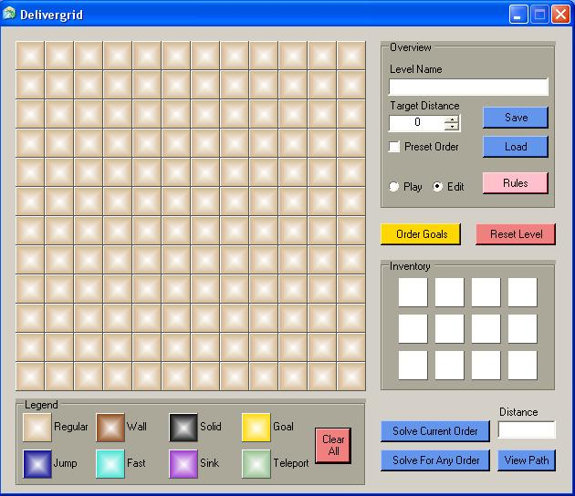
GUI
Target Distance
Save/Load level
Toggle whether goal order is preset.
Toggle Play/Edit Modes
Click to order goals
Inventory Squares
Current Distance
Main game grid
Legend
View latest best path
Solve current order of for any order

Slide 5
Instructions
(Basic)
The goal is to get a robot to visit all of the goals (yellow squares) in the least amount of distance. To win a level, you must find a route that is equal to or less than the number listed as “Target Distance.”
Moving to adjacent squares costs 1 while moving diagonally costs 1.5.

Slide 6
Instructions
(Finding the Best Route)
If “Preset Order” is not checked than the goals can be visited in any order. The player can number the goals in the desired order by clicking on the “Order Goals” button and then clicking on the goals in the order they wish the robot to visit them.
If “Preset Order” is checked than the goals must be visited in the preset order.
Pressing the “Solve Current Order” button will then find the minimum distance for visiting the goals in the selected order.
Pressing the “Solve For Any Order” button will find the minimum distance for visiting the goals in any order (only for eight goals or less).
Pressing the “View Path” button after solving for the minimum distance shows the robot (in red) traversing the minimal path.

Slide 7
Instructions
(Special Pieces 1)
Name: Regular Color: Light Brown
Rule: Open space where motion is free. Default terrain type.
Special: Regular squares can be given seven special characters (^ > v < | -- +). The four arrows force the robot to make their next move in the direction they point. The vertical and horizontal bars force the robot to make their next move only vertically or horizontally, respectively. The plus sign forces the robot to make its next move only to adjacent squares (no diagonals).
Name: Wall Color: Dark Brown
Rule: Can not be moved onto.
Special: If the wall square is numbered, the robot can move onto the square, but only by paying an immediate extra distance cost equal to that number.
Name: Solid Color: Black
Rule: Like a wall, but can not be erased even by inventory items.
Special: Same as wall.
Name: Goal Color: Gold
Rule: Each goal must be reached by the robot before the path is complete.
Special: The numbers given to the goals correspond to the order they will be visited.

Slide 8
Instructions
(Special Pieces 2)
Name: Jump Color: Dark Blue
Rule: The robot can leap from a jump square horizontally or vertically by a number of squares equal to the number on the jump square for the cost of 1. It can choose not to take the jump.
Special: None.
Name: Fast Color: Turquoise
Rule: Moving off of this square is free.
Special: If the fast square is numbered, the regular cost of moving off of the square is divided by that number.
Name: Sink Color: Purple
Rule: The robot can teleport to a sink at any time for the cost of 1.
Special: If the sink has a number on it, the cost to teleport to the sink is equal to that number.
Name: Teleport Color: Green
Rule: From on a teleport square the robot can go immediately to any other teleport square on the grid for the cost of 1. It can choose not to take the transporter.
Special: If the teleport has a number, the robot can only go immediately to other teleports with the same number. It can still choose not to take the transporter at all.

Slide 9
Instructions
(Inventory)
On the right side of the screen are twelve inventory squares that a player can place on the board to improve the minimum path of the robot. Each item can only be used once. To reset the level to way it started before any items were used, press the “Reset Level” button.
Non-regular inventory items can only be placed on unmarked regular squares. However, a regular square in the inventory can be used to clear away non-regular squares on the board (except for solid and goals, which can never be moved or destroyed).

Slide 10
Instructions
(Edit Mode)
Edit Mode allows the player to construct levels, try out test cases and experiment with the special pieces. To activate, select the “Edit” radio button. To deactivate, select the “Play” radio button.
While in Edit Mode, the user can click on the squares in the legend (bottom of screen) and then apply them to the game board or the inventory. To add or change numbers on a square simply left-click (increase) or right-click (decrease) on it. To remove an item from the inventory, right-click on it an extra time.
To clear the entire screen, press the “Clear All” button.
In Edit Mode you can also select whether the level will be have a preset order by checking or unchecking the “Preset Order” box. You can set the target distance with the “Target Distance” textbox or arrows.
To save a configuration press the “Save” button. To load a previous configuration press the “Load” button.

Slide 11
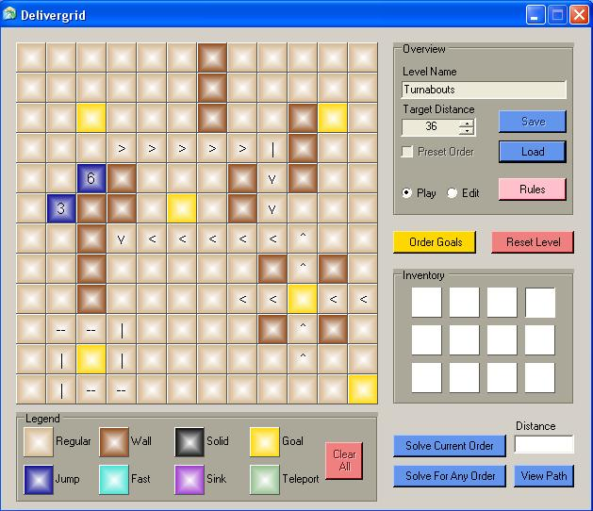
Example Level
In this example, the player receives no inventory items. They must solve for the fastest route simply by determining the best order to visit the goals.

Slide 12
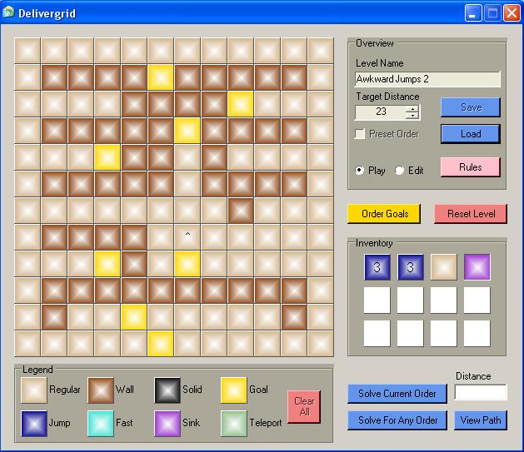
Example Level 2
(with inventory items)

Slide 13
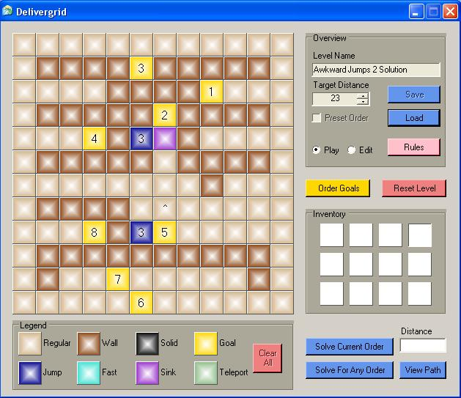
Example Level 2 Solved!

Slide 14
Solving for Fastest Path (1)
Ordered Path: When the goals have already been ordered, the algorithm uses a modified variation on the Navigation Field Technique that takes into account the special items and stores parents.
Unordered Path: When the goals are not ordered, the problem becomes a non-returning Traveling Salesperson Problem (which is NP complete). This is solved exhaustively by creating a lookup table of min distances between any two goals and then summing each permutation of visiting every route. The permutations are found using the HeapPermute recursive function designed by A. Levitin in “Introduction to The Design & Analysis of Algorithms” (pg 179). This is restricted to puzzles with 8 goals or less for computational time sake.

Slide 15
Solving for Fastest Path (2)
For the sake of computational time, the fastest route solvers do not take into account unused inventory items. This would require to re-run the algorithm on every combination of item uses, an enormously time-consuming process.

Slide 16
Further Research/Ideas
Optimize TSP solver to increase number of goals.
Increase resolution of puzzle grid.
Create new special items.
Create a series of increasingly difficult levels for a single-player version.
Implement a timed, multiplayer version.

