Slide 1
Loops and Arrays
Module 1: 04

Slide 2
Objectives
Arrays
Variable Scope
Loops
Debugging

Slide 3
Problem: We can hold a single value in a variable, for example: String name = “John”, but what if we want to hold multiple values for a similar purpose?
We could create a variable for each item:
String instructor1 = “John”;
String instructor2 = “Rachelle”;
String instructor3 = “Steve”;
String instructor4 = “Matt”;
String instructor5 = “Kevin”;
What problems would this cause?
We could reuse the same variable:
String instructor = “John”;
instructor = “Rachelle”;
instructor = “Steve”;
instructor = “Matt”;
instructor = “Kevin”;
What problems would this cause?

Slide 4
Arrays
An array is a series of values of the same data type that are held together in a wrapper that can be treated as a single thing.
Variables for Arrays are declared using the data type the array will contain and square brackets:[]
String[] instructors;
Arrays are created using the new keyword and Arrays are a fixed size. The number of items the array will contain must be set when the array is created and cannot be changed after it is set.
String[] instructors = new String[5];
In Java arrays can technically be defined as
int[] nums;
or
int nums[];
The second (int nums[]) syntax is a leftover from C, and while syntactically valid, is considered bad form due to decreased readability.

Slide 5
Array Default Values
Data Types have default values. When an array is created with the new keyword, each of the items is created with that data types default value.
int[] nums = new int[3];
boolean[] b = new boolean[5];
Data Type | Default
byte, short, long, int, char | 0
double, float | 0.0
boolean | false
String | null
Index | Value
0 | 0
1 | 0
2 | 0
Index | Value
0 | false
1 | false
2 | false
3 | false
4 | false

Slide 6
Array Elements and Indexes
Arrays are a set of values, like a variable, of the specified data type. These values are called Elements.
The elements in the array have an index. An index is a numeric value that starts at 0 and provides a way to identify a specific element in the array. The index is used to set or get an element.
Setting values for elements in an array:
instructors[0] = “John”; instructors[1] = “Rachelle”; instructors[2] = “Steve”; instructors[3] = “Matt”; instructors[4] = “Kevin”;
Index | Value
0 | John
1 | Rachelle
2 | Steve
3 | Matt
4 | Kevin

Slide 7
Getting values from an Array
instructors
Index | Value
0 | John
1 | Rachelle
2 | Steve
3 | Matt
4 | Kevin
Values from arrays can be retrieved using the index.
String name = instructors[2]; ← name will contain “Steve”
The array variable with the index, can be used like any other variable.
String greeting = “Hello, “ + instructors[1];
What will the variable greeting contain?

Slide 8
Updating Array Elements
instructors
Index | Value
0 | John
1 | Rachelle
2 | Steve
3 | Matt
4 | Kevin
The value of an element in an Array can be changed using its index.
instructors[0] = “The John Fulton”;
Index | Value
0 | The John Fulton
1 | Rachelle
2 | Steve
3 | Matt
4 | Kevin

Slide 9
How will the following code change the Array?
instructors[4] = “Doug”;
How will the following code change the Array?
instructors[1] = instructors[1] + “sh”;
How will the following code change the Array?
instructors[5] = “Kevin Again”;
instructors
Index | Value
0 | John
1 | Rachelle
2 | Steve
3 | Matt
4 | Kevin

Slide 10
What will the variable doubleNum contain?
int doubleNum = nums[1] * 2; 40
What will the variable third contain?
int third = num[0] / 3; 3
How will the following code change the Array?
nums[2] = nums[4];
How will the following code change the Array?
nums[1] = nums[1] * nums[0];
int[] nums
Index | Value
0 | 10
1 | 20 200
2 | 25 1
3 | 15
4 | 1

Slide 11
Arrays declared elsewhere...
Given the following Array: int[] nums that we know has been created and filled with values, how could we:
Access the first element in the Array?
nums[0]
Find out how many elements are in the array?
nums.length
Access the last element in the Array?
nums[ nums.length - 1 ]

Slide 12
Static Initialization
If the elements that will be in an array are known when the array is created, then those items can be used to create the array. The size will be populated from the number of elements in the list.
int[] nums = new int[] { 10, 20, 30 };
Is the same as:
int[] nums = new int[3]; int[0] = 10; int[1] = 20; int[2] = 30;
String[] instructors = new String[] { “John”, “Rachelle”, “Steve”, “Matt”, “Kevin”};
Is the same as:
String[] instructors = new String[5]; instructors [0] = “John”; instructors [1] = “Rachelle”; instructors [2] = “Steve”; instructors [3] = “Matt”; instructors [4] = “Kevin”;

Slide 13
Arrays Summary
Arrays are fixed-length - the size is set when created and cannot be changed
Arrays have a 0 based index
Items in an array are called Elements
Everything Element an array must be the same data type
Elements may be accessed to retrieved, changed, or set using their index
Arrays are created using the new keyword
The first element in an array is always at index 0
The number of elements in an array can be gotten using array.length
int[] numbers = new int[10]; ← creates an array that holds 10 integers
numbers[1] ← access the second element in the array numbers[2] = 10; ← sets the value of second element in the array to 10 numbers.length ← gets the number of elements in the array numbers[numbers.length - 1] ← access the last element in the array

Slide 14
Variable Scope
A variables scope defines where in a program that the variable is valid (can be referenced). When code execution reaches a point where the variable can no longer be referenced, then the variable is out of scope.
In Java, scope is determined by blocks.
Variables declared inside a block ( {...} ) are only available within that block.
Blocks can be nested within other blocks. Variables declared in a block are also available in any nested blocks. However, they are not available in a blocks parent block.
Java does not have the concept of Global scoped variables

Slide 15
{
int x = 10;
}
{
int y = 20;
}
{
int z = 5; y = y + z;
}
← what variables are available here? If y is available, what is its value?
← what variables are available here?

Slide 16
Implied Blocks
For some statements, if no curly braces are used, then an implied block is created. The implied block will be the next line of code.
if (x = 10) System.out.println(“x is 10);
While implied blocks are syntactically valid in Java, they produce harder to read code and are more prone to defects due to whitespace and scope. Implied blocks should only be used after mastery of statements, blocks, and scope. You may not use implied blocks for exercises.

Slide 17
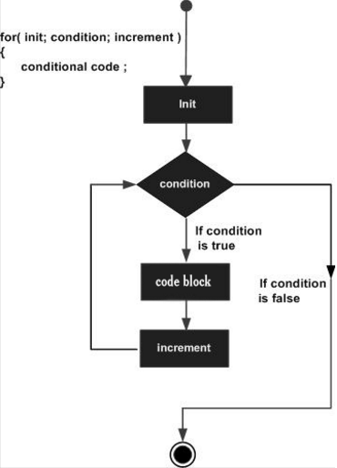
Loops
Loops allow code to repeated for a set number of times. Loops use a boolean condition, and execute the code while that condition is true and stop execution once the condition becomes false.
The boolean condition must start true, and something in the loop must change the loop so that it eventually becomes false, and ends the loop.

Slide 18
for loop
for (int i = 0; i < 10; i++) {
System.out.println(i);
}
Output:
0 1 2 3 4 5 6 7 8 9
Declare an incrementer variable.
Create a boolean condition that is true
Define an iterator expression that changes the incementer. This controls how many times the loop will execute the code block.
When the incrementer variable is declared in the for() it is in scope for the code block established by the loop, and out of scope once the loop ends.
for ( incrementer ; boolean condition ; iterator expression ) {
// Code that repeats while condition is true
}

Slide 19
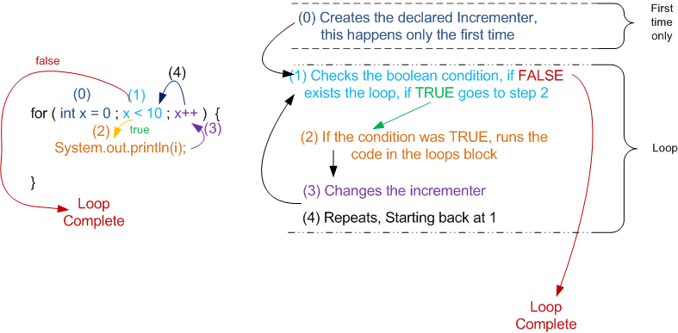

Slide 20
Increment / Decrement Shorthand
Assignment Shorthand
i++ → use the current value of i, and then i = i + 1;
++i → i = i + 1, then use the new value of i
i-- → use the current value of i, then i = i - 1;
--i → i = i - 1, then use the new value of i
For readability, the general standard is to only use these increment / decrement shorthand in the for() of a loop, or on lines by themselves.
for (; ; i++) ← OK i++; ← OK
x = 120 + --y - 5; ← Discouraged
x += y → x = x + y; x -= y → x = x - y; x *= y → x = x * y;
x /=y → x = x / y;

Slide 21
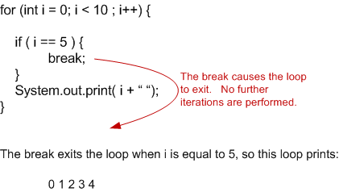
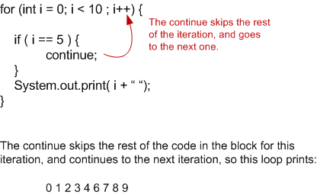
Break and Continue
Putting a break; statement in the code block of a loop, immediately ends the loop.
A continue; statement in the code block, ends the current iteration early, and continues the loop on the next iteration.
Visual Explanation
Visual Explanation

Slide 22
Loops with Arrays
instructors
Index | Value
0 | John
1 | Rachelle
2 | Steve
3 | Matt
4 | Kevin
The incrementor in a loop can start at 0, and be increased by 1, which matches the index of each element in an array. If we then create a boolean condition, that stops the loop when it reaches the last index of the array, it would effectively loop through each index in the array, allowing the code to access each element in the block.
for (int i = 0; i < instructors.length ; i++) {
System.out.println ( instructors[i] );
}
Output: John ( i == 0 → instructors[ 0 ] ) Rachelle ( i == 1 → instructors[ 1 ] ) Steve ( i == 2 → instructors[ 2 ] ) Matt ( i == 3 → instructors[ 3 ] ) Kevin ( i == 4 → instructors[ 4 ] )
Visual Explanation

Slide 23
Debugging
Use IntelliJ Debugger and Breakpoints!
Read Error messages
Runtime Errors: red text in IntelliJ console that says “An Exception has occurred…”
Test Case Assertion Errors
Compile Time Errors
Make small, simple incremental changes
Test in your head
Ask for another set of eyes from another programmer
Explain your code to someone or something that knows nothing about programming, or who will just listen and not give advice.
Rubber Ducking
Use timeboxing
Work on something else
Walk away for a while
Don’t be attached to your code or solution → throw it out and try fresh.

