Slide 1
Command Line Interfaces
Module 01 : 05

Slide 2
Objectives
System.in
Parsing Strings
System.out
Command Line Arguments
Project!!
Pair Programming

Slide 3
System.in
Java System.out and System.in refer to the standard input and output streams. The System.in captures characters a user types into the console, and System.out outputs characters to the console to be read by the user.
While System.out provides easy to use methods, like println(), System.in is more difficult to manage. The Scanner wrapper class can be used to make it easier.
import java.util.Scanner;
Scanner in = new Scanner(System.in); String userInput = in.nextLine();

Slide 4
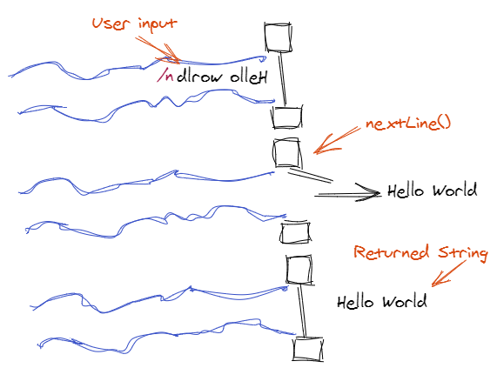
Scanner nextLine()
scanner.nextLine() gets text from input stream up until a newline (the user presses Enter). The text is returned as a String and the newline is digarded.
String userInput = scanner.nextLine();

Slide 5
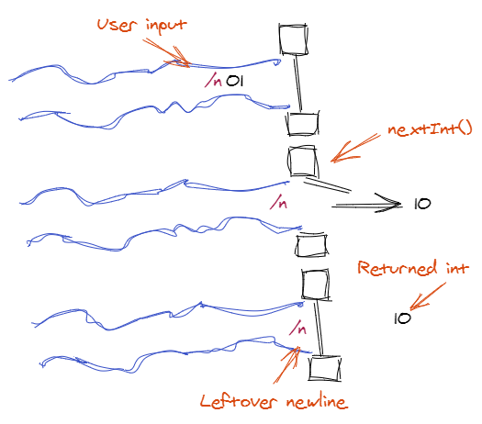
Scanner nextInt()
Scanner also provides methods to get the next numeric values from the stream. It gets the next characters that can be converted to the numeric data type and leaves the rest.
A newline character is not a numeric type, so it will be left on the stream. So after using methods like nextInt(), nextLine() must be called to “clean up” the newline.
int userNumber = scanner.nextInt();
scanner.nextLine();

Slide 6
Parsing Strings
When a data is converted between like data types, it is called casting. Parsing is the conversion of data between unlike data types. For example: String → int
Parse methods that can parse a string to that data type are available for each of the basic data types using their wrapper class. The String must contain characters that are valid for the data type it is being parsed into.
Data Type | Wrapper | Parse Method
int | Integer | Integer.parseInt(string)
long | Long | Long.parseLong(string)
double | Double | Double.parseDouble(string)
boolean | Boolean | Boolean.parseBoolean(string)

Slide 7
System.out
println(string) → prints the string to the console and adds a newline print(string) → prints the string to console and does not add a newline
println(format, data) → prints the data to the console using the provided format.
System.out.printf(“Your item is %-10s”, “book”); → adds book so that it always takes up 10 spaces
%-10s % - Starts a formatter -10 - 10 sets the size to 10, - adds any padding on the left.
s - defines the data type being formatted as a String
s – formats strings
d – formats decimal integers
f – formats the floating-point numbers
t– formats date/time values
System.out.printf(“Total Cost $%4.2f”, 4.2507); → formats 4.2507 to a total of 4 characters and 2 decimal places
%4.2f % - Starts a formatter
4.2 - sets the total size to 4 characters and .2 sets it to 2 decimal places
f - defines the data type being formatted as a floating point number
printf format cheat sheet
More info on printf in Java

Slide 8
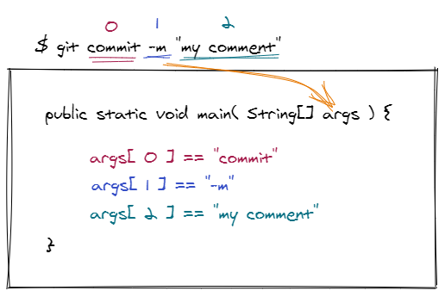
Command Line Arguments
Arguments passed on the command line to an application are populated into String[] args array of the main() method.

Slide 9


Slide 10
Pair Programming
Definition: a practice in which two programmers work side-by-side at one computer, continuously collaborating on the same design, algorithm, code, or test. This method has been demonstrated to improve productivity and the quality of software products.
Driver - writes code, but does not come up with ideas
Navigator - comes up with ideas, but does not write code

Slide 11
Rules of Pair Programming
Paraphrased from the article: Everything I Needed to Pair Program, I Learned in Kindergarten - 1999 Laurie Williams and Robert Kessler

Slide 12
Share
Both programmers own everything.
The Pair succeeds or fails together

Slide 13
Play Fair
Take turns driving (writing the code) and Navigating (continually reviewing)
Set a limit (time, lines of code, problems, etc) and Switch on time.

Slide 14
Clean Up
Defects and problems belong to the pair
Work together to solve issues
It is never your partner’s fault - if did it together, so you own the blame. You caused the defect together, so fix it together

Slide 15
Hold hands and Stay Together
ALL work must be done together, no exceptions
It is not a competition - it is 2 programmers working together to solve a singular task
If you partner needs a break, then you take a break

Slide 16
Say You’re Sorry
Practice Egoless programming
Don’t insist on it being your way, even if you think it is better
Don’t get defensive
Don’t be aggressive

Slide 17
Common Problems
Pairs at different skill levels
One partner taking control
One partner sitting back and not contributing
Scheduling and Reliability
Lack of communication about expectations

Slide 18
Violations of Pair Programming
Taking Turns doing the assignment
Splitting the assignment and each doing half
Working on the assignment without your pair
One partner rewriting code you worked together
Coming to ask an instructor for help without your pair

