Slide 1
Intro to Objects with Strings
Module 1: 06

Slide 2
Objectives
GIT Repositories
Objects and Classes
Reference and Value Types
Immutability
String and Object Equality
String Methods

Slide 3
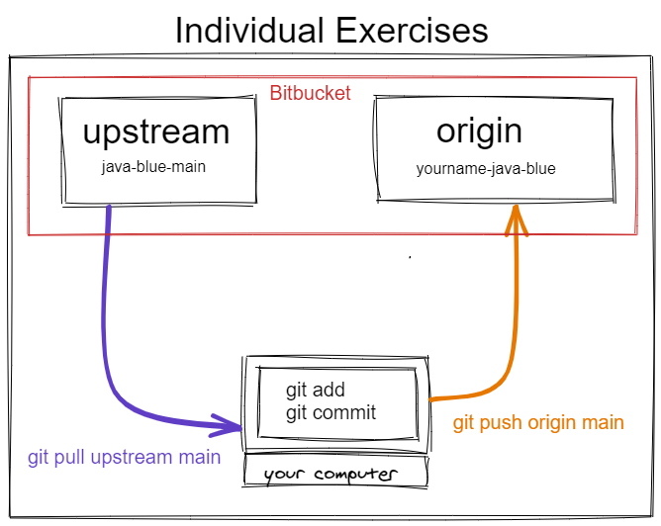
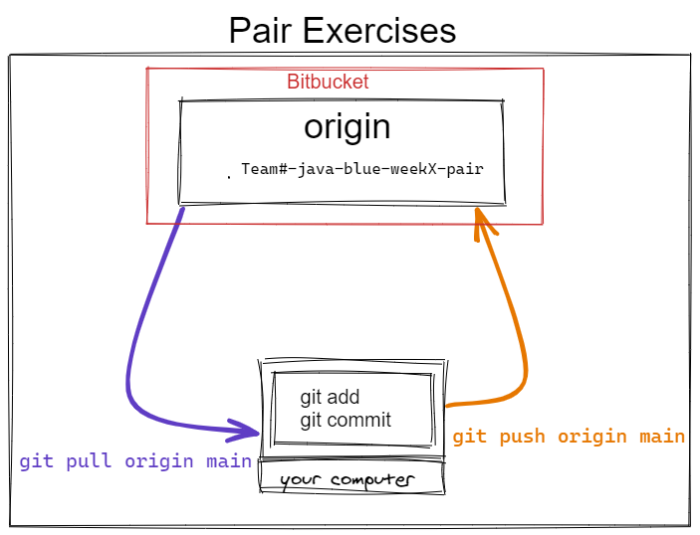

Slide 4
Individual Exercises
In folder: yourname-java-blue
Getting instructor changes
git add -A
git commit -m “your comment” git pull upstream main
Submitting your work
git add -A
git commit -m “your comment” git push origin main

Slide 5
Pair Exercises
In folder: teamX-java-blue-weekX-pair
Getting your pair’s changes
git add -A
git commit -m “your comment” git pull origin main
Submitting your changes
git add -A
git commit -m “your comment” git pull origin main
resolve merges
git add -A
git commit -m “your comment” git push origin main

Slide 6
GIT Tips
Always do an add and commit before doing a push or pull
Watch the messages.
If the message tells you it can’t pull changes due to not being able to merge files then do a git add and git commit and try again (even if you just did one)
If the message tells you there were merge conflicts and lists file names, then take note of those file names and check them in IntelliJ for merge markers.
Clean up merge markers in files immediately. After you clean them up, do an git add and commit to end the merge.
Merge conflicts are not errors, they are part of the development process!
How to resolve: Choose which code (yours, bitbuckets, or a combination) you want to keep and delete the rest, including the git markers. After you finish cleaning up save the file and do a git add/commit to finish the merge
<<<<<<< HEAD:file.txt
Hello world
Code from your computer
=======
Goodbye
>>>>>>> 77976da35a11db4580b80ae27e8d65caf5208086:file.txt
Code from bitbucket

Slide 7
Objects
An object is an in-memory data structure that combines state and behavior into a usable and useful abstraction.
Objects live in the computer’s memory and only exist while a program is executing
Each object is distinct and separate from every other object in our program
Objects are not written in source code, instead they are what is created when our program executes, based on the source code we write.
Everything in Java is an Object, except the primitive data types (byte, short, int, long, float, double, boolean, and char)

Slide 8
Class
Source code that defines how to create an object and what state and behavior that object will have.
A class is a blueprint for an object.
Classes don’t exist when the programming is running. Classes only exist in source code
Defines a Data Type, which makes everything in Java a Data Type.

Slide 9


A class is source code that defines how to create an object in memory. Multiple Objects can be created from the class, and each object created is distinct from others.
Class
Objects

Slide 10
Creating Objects
An Object is an instance of a class.
Steps to instantiate (create) an object from a class:
Declare a variable to hold the object. The class will be the data type.
Instantiate a new object from the class using the new keyword
Initialize variables inside the object with initial values using the constructor
LegoPerson legoSue = new LegoPerson(“carpenter”, blue, true);
Scanner in = new Scanner(System.in);
String name = new String();

Slide 11
Data Types Memory
2 types of Data Type in Java
Value Type (primitive) reference a single static space in memory to hold the value. This memory is allocated on the stack.
Only 8 value types: byte, char, short, int, long, float, double, and boolean
Reference Type (object) does not hold the value in static memory, the stack, but holds a reference to where the object is located in free-floating, dynamic memory, the heap
Everything except the 8 value types is a reference type.
Examples: Scanner, String, Array

Slide 12
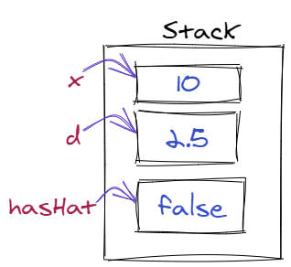
Value Types (Primitives) in Memory
The value assigned to the variable is stored directly on the stack
int x = 10;
double d = 2.5;
boolean hasHat = false;

Slide 13
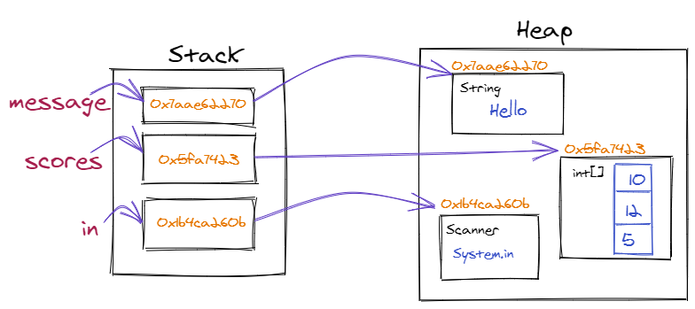
Reference Types (objects) in Memory
The value of an object is not stored directly on the stack. The variable points to a value on the stack that contains the memory address that points to the location of the Object in the Heap.
String message = “Hello”; int[] scores = new int[3]; Scanner in = new Scanner(System.in);

Slide 14
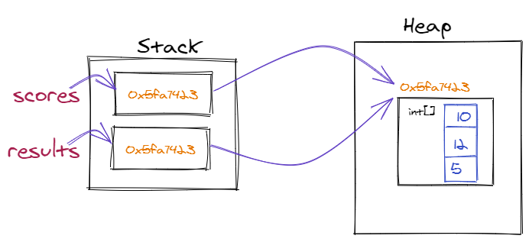
Since variables for Reference Types point to a value on the stack that contains a memory address that points to an object on the heap, it is possible for multiple variables to hold the same memory address, and thus point to the same object on the heap. This results in a change using either variable affecting the value for both.
int[] scores = new int[] {10, 12, 5};
int[] results = scores;
results[0] = 20;
results[0] == 20;
scores[0] == 20;

Slide 15
Pass by Reference or Value?
All programming languages are partially defined by whether they pass variables to methods by Value, meaning they pass the value of the variable, or by Reference, meaning they pass the memory location of the value.
Is Java Pass by Value or Pass by Reference?
Java is always Pass by Value. Java passes the value on the Stack when passing a variable to a method.
Common Interview Question

Slide 16
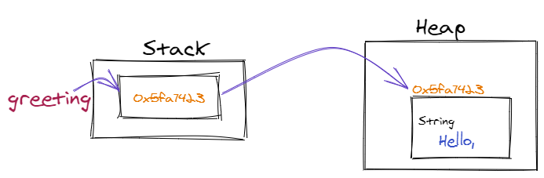
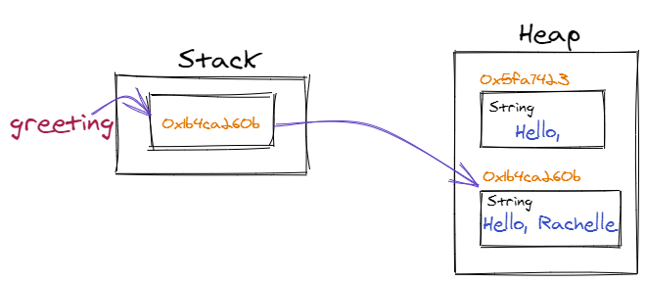
Immutability
An object whose state cannot be changed after it is created.
String is immutable, meaning after a string is created the value cannot be changed, but instead a new String must be created with the new value.
String greeting = “Hello , “;
greeting = greeting + “Rachelle”;

Slide 17
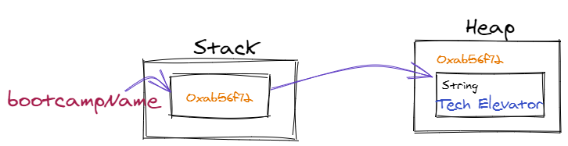
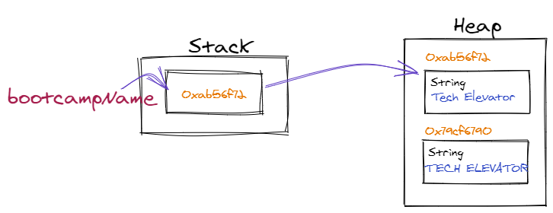
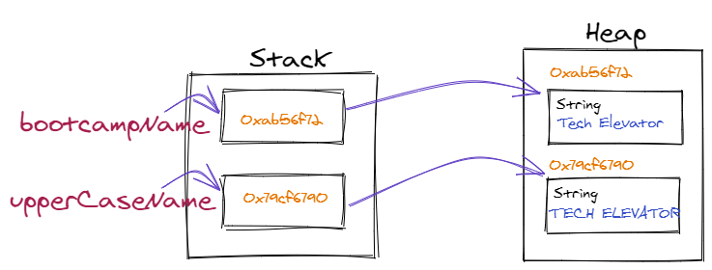
String bootcampName = “Tech Elevator”;
bootcampName.toUpperCase(); ← does not change the original String, instead creates a new one, but the value is in an unreferenced object, so is lost.
When the value of a String, is changed by concatenation,or a String method, the resulting new String must be assigned to a variable, either the original variable or a new one so the location of the new object that contains the changed value is not lost. String upperCaseName = bootcampName.toUpperCase();

Slide 18
Initializing and Object
All Objects must be instantiated (created using the new keyword) and initialized (starting state, or values, set).
String is the only object that can be both instantiated and initialized using a literal.
String name = “Steve”;

Slide 19
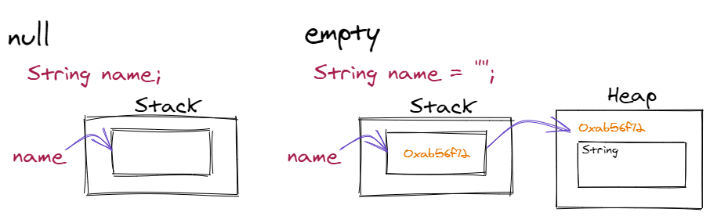
null
When variables for Reference Types are created they default to null, until they are assigned a reference to an instantiated object.
null is not the same thing as empty. null refers to no value on the Stack. empty refers to the value of an existing object on the Heap.

Slide 20
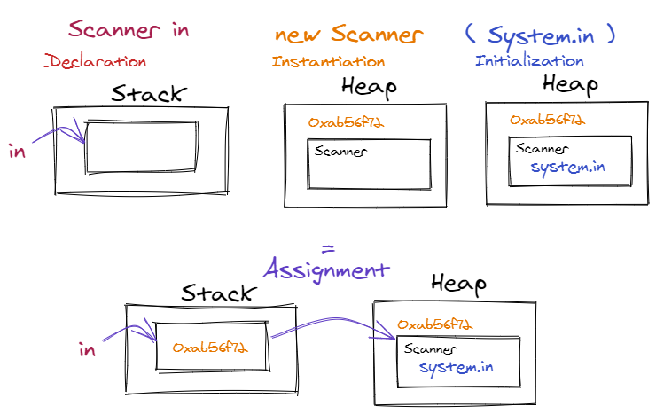
Creating Objects revisited
Declare a variable, instantiate a new Object using the new keyword, initialize the object with its starting state, and assign it to the variable
Scanner in = new Scanner ( System.in );

Slide 21
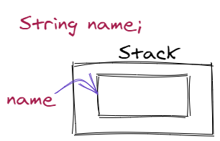
nullPointerException
A nullPointerException occurs when trying to use a method on an object when the variable does not contain a reference and is null.
String name;
name.toUpperCase(); ← nullPointerException
int[] numbers;
numbers.length; ← nullPointerException
There is no other cause of this exception.

Slide 22
Object Equality
String hello = new String( “Hello” ); String hello2 = new String( “Hello” );
hello == hello2 is FALSE
The value of Reference Types (objects) cannot use == to compare the value of objects, instead they use the .equals() method;
hello.equals(hello2) is TRUE
There are 2 Types of Equality for Objects in Java
Reference Equality ( == )
Value Equality ( .equals() )

Slide 23
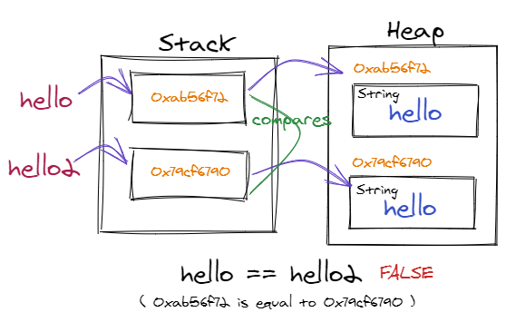
Reference Equality ( == )
The equality operator compares the value of 2 variables on the stack. For objects, this is the reference to the Object on the heap

Slide 24
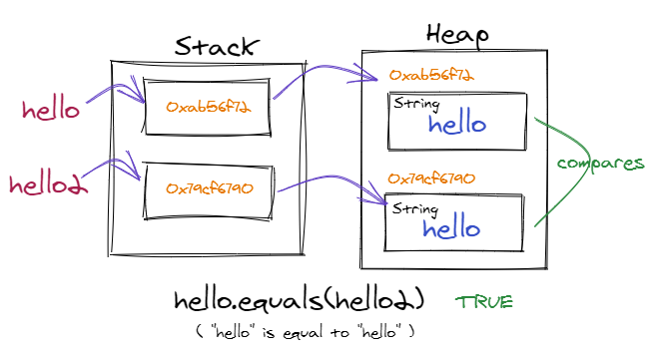
Value Equality ( .equals() )
The .equals() method compares the value of Objects on the Heap

Slide 25
String methods
Objects contain behaviors represented by methods. Methods can be invoked on an object by calling the method with the dot ( . ) operator and must be ended using parentheses ().
The String class contains many methods to manipulate strings. Since String is immutable, these methods do not change the original String, but create a new one that must be assigned to a variable.
String name = “Rachelle”;
String name = name.toUpperCase();
name → “RACHELLE”

Slide 26
Characters in a String are internally stored in a char array, so many of the methods use the index of the characters in the char array to select a position in the string.
String name = “Tech Elevator”;
name.length() ← returns 13
name.charAt(3) ← returns ‘h’
T | e | c | h |  | E | l | e | v | a | t | o | r | r
0 | 1 | 2 | 3 | 4 | 5 | 6 | 7 | 8 | 9 | 10 | 11 | 12 | 12
A for loop can be used to access each character in a string:
for ( int i = 0 ; i < name.length() ; i++ ) { System.out.println( name.charAt( i );
}

Slide 27
String.substring()
The String substring() method returns a portion of a string. It takes 2 arguments, the first is an inclusive starting index, and the second is the exclusive ending index. So substring() will return a new String with the character starting at the starting index and ending, but not including, the character at the ending index.
String name = “Tech Elevator”;
name.substring( 2, 6 ) → returns “ch E”
T | e | c | h |  | E | l | e | v | a | t | o | r | r
0 | 1 | 2 | 3 | 4 | 5 | 6 | 7 | 8 | 9 | 10 | 11 | 12 | 12
T | e | c | h |  | E | l | e | v | a | t | o | r | r
0 | 1 | 2 | 3 | 4 | 5 | 6 | 7 | 8 | 9 | 10 | 11 | 12 | 12
If only a starting index is provided, then a new String will be returned starting at that index through the end of the string.
name.substring( 5 ) → returns “Elevator”

Slide 28
String s1 = “The sun shone, having no alternative, on the nothing new.”;
char c = s1.charAt(5)
What will be the value of c? u
String s2 = s1.substring(16, 19);
What will be the value of s2? avi
String s3 = s1.substring( s1.length() - 2 );
What will be the value of s3? w.
String s4 = s1.substring( 0, 1 );
What will be the value of s4? T

Slide 29
Method | Return Type | Description
contains( string ) | boolean | True if the String contains the String passed as an argument.
startWith( string) endsWith( string ) | boolean | True if the String starts with or ends with the string passed as an argument
indexOf( string ) | int | Returns the starting index of the String passed in the argument
replace( string1, string2) | String | replaces string1 with string2
toLowerCase() toUpperCase() | String | Returns the String in all upper or lower case
split( str ) | String[] | Splits the str into an array using the str in the argument as a delimiter
equals( string ) equalsIgnoreCase( string ) | boolean | True if the value of the string is equal to the string passed in the argument. equalsIgnoreCase() compares the string without case.
trim() | String | removes whitespace from the beginning and ending of the String

Slide 30
String Static methods
Static methods are methods that are not available on the String objects, but only using the String data type.
For example: String intAsString = String.valueOf( 10 );
Method | Return Type | Description
valueOf( x) | String | Returns the String representation of x
join( delimiter, list of strings) | String | Returns a new String composed of the strings in the list separated by the delimiter.
There are many more String and String Static methods. Java Documentation (JavaDoc) contains a complete list of methods available for each version of the language.
String JavaDoc for Java 8

Slide 31
Creating a String with a char[]
Since String holds the characters internally as a char[], it can be instantiated and initialized with a char[] to create a new String.
char[] awesomeArray = new char[] { ‘A’, ‘w’, ‘e’, ‘s’, ‘o’, ‘m’, ‘e’ }; String awesomeString1 = new String( awesomeArray );
awesomeString1 has a value of “Awesome”

Slide 32
Given this code:
char[] awesomeArray = new char[] { ‘A’, ‘w’, ‘e’, ‘s’, ‘o’, ‘m’, ‘e’ }; String awesomeString1 = new String( awesomeArray ); String awesomeString2 = new String( awesomeArray ); String awesomeString3 = awesomeString1;
Will be the result of: awesomeString1 == awesomeString2 ? false Will be the result of: awesomeString1 == awesomeString3 ? true Will be the result of: awesomeString2 == awesomeString3 ? false
Will be the result of: awesomeString1.equals( awesomeString2 ) ? true Will be the result of: awesomeString3.equals( awesomeString1 ) ? true Will be the result of: awesomeString2.equals( awesomeString3 ) ? true

