Slide 1
Collections Part 1
Module 01 - 07

Slide 2
Objectives
Packages
Collections
List<T>
Boxing and Unboxing Objects
Java Wrapper Objects
Foreach Loops
Queue<T>
Stack<T>

Slide 3
Packages
Packages organize Java classes and creates scope to prevent two classes with the same name from having a name collision (i.e. overlapping in a way that makes them ambiguous)
Creates a namepsace
Groups related elements
Everything in the group must have a unique name within that group
Class names must be unique in the package, but not across packages
com.abank.accounts.deposit.CheckingAccount
com.techelevator.exercises.CheckingAccount

Slide 4
Fully Qualified Class Name
Classes can be referred to by the Class name when there is an import in the class.
import java.util.Scanner.
Scanner in = new Scanner(System.in);
Or can be referred to by the fully qualified class name, which is the package name along with the class name.
java.util.Scanner in = new java.util.Scanner(System.in);

Slide 5
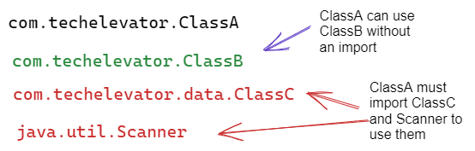
Importing Classes
Classes in the same package can see each other with an import.
The java.lang package is a special case, and can be used in any class without needing to explicitly import it. We must explicitly import all other classes, or use their fully qualified class name. java.lang contains core language features like String.
A * can be used to import all classes from a package. java.util.*; This is can lead to unexpected behaviors so it often discouraged outside of testing.

Slide 6
Arrays Recap
Arrays are simple data structures that allow us to work with a collection of like data.
Arrays are fixed sized
Arrays are indexed starting at 0
Arrays are accessed using [] brackets and the index
instructors[1]
String[] instructors
Index | Value
0 | John
1 | Rachelle
2 | Steve
3 | Matt
4 | Kevin

Slide 7
Collections
Collections are classes in the java.util package that define data structures that make working with a set of data easier.
Collections are written to be generic so that they are useful for all reference types.
CollectionType<T> ← <T> indicates a generic and that the Collection type can hold any reference type.
java.util.Collection JavaDoc

Slide 8
List<T>
An ordered set of elements that is 0-indexed like an array.
Maintains the Order of Insertion
Elements can be accessed by index
Allows duplicate elements
A List can hold 1 data type, like an Array, that is defined by <T>
Can grow and shrink as items are added and removed

Slide 9
Instantiating a List<T>
List<DataType> variableName = new ArrayList<DataType>();
List is an interface, which unlike a class contains no code and just creates a data type with guaranteed functionality.
<DataType> sets the Reference Data Type that the list will hold.
ArrayList is a class that implements the List data type, and will be instantiated by the new keyword. The ArrayList will hold the data type given, and the data type must match the one given for the variable created with the List interface.
List<String> instructors = new ArrayList<String>();

Slide 10
List methods
size() | Returns the number of elements in the list
add( x ) | Adds an element to the bottom of the List
add( index, x) | Adds an element to the List at the given index.
get( index ) | Returns the element at the given index
remove( index ) | Removes the element at the given index
A List can be converted to an Array:
String[] instructorsArray = instructors.toArray( new String[ instructors.size() ] );
An Array can be converted to a List:
List<String> instructorsList = Arrays.asList( instructorsArray );

Slide 11
Primitive Wrapper Objects
Collections can only hold Reference Types (objects), so to create a Collection, like List, to hold a primitive data type the primitives Wrapper Class must be used.
Primitive Type | Wrapper Class | Can be initialized with
byte | Byte | byte or String
short | Short | short or String
int | Integer | int or String
long | Long | long or String
float | Float | float or String
double | Double | double or String
char | Character | char
boolean | Boolean | boolean or String

Slide 12
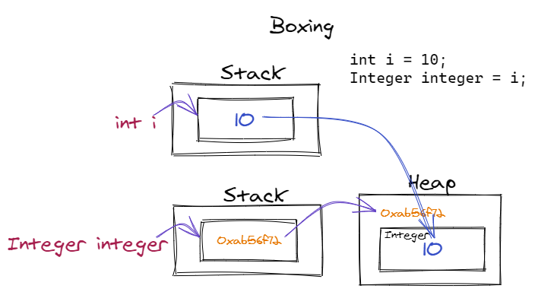
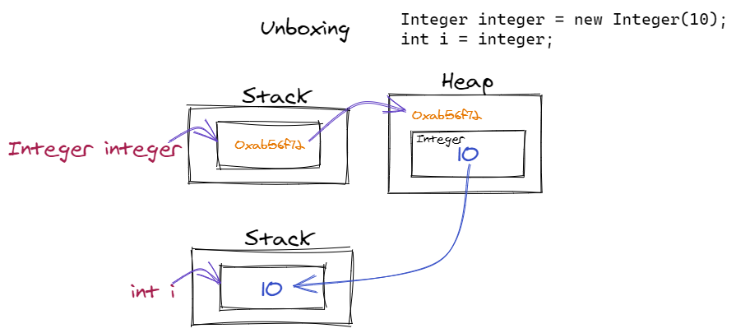
Autoboxing
Integer i = 10;
Integer x = 20; int y = x; x = x + 5;
An automatic process of converting between primitive and Wrapper Class data types.
Boxing is moving a primitive value from the Stack to a Wrapper Class object on the Heap. Primitive → Wrapper Class
Unboxing is moving the value from a Wrapper Class on the Heap to an appropriate primitive value on the Stack. Wrapper Class → primitive type

Slide 13
for each Loop
String[] instructors
Index | Value
0 | John
1 | Rachelle
2 | Steve
3 | Matt
4 | Kevin
Loops through each item in a collection or array in order
Cannot modify the collection or array in the loop
Does not know the iteration
for ( variable : collection_or_array ) {
variable ← variable with next value available in block
}
for (String name : instructors) {
System.out.println(name);
}
Visual Explanation

Slide 14
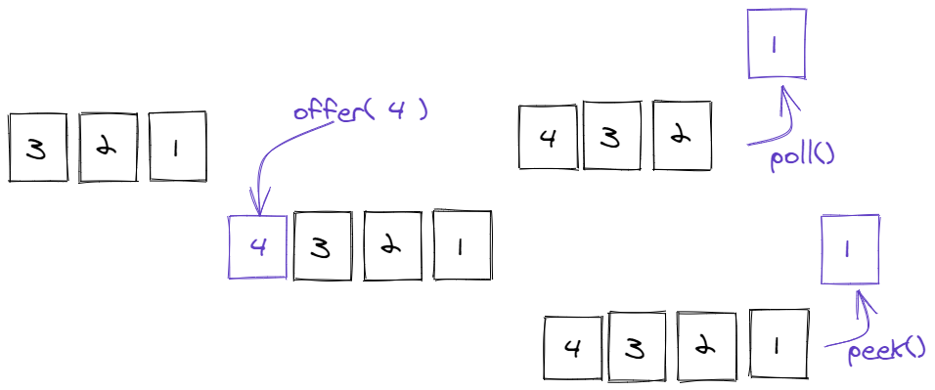
Queue<T>
A data structure that organizes data First in First Out (FIFO), like a checkout line at a store
Can only insert at the end of the Queue using offer( x )
Can only remove items from the beginning of the Queue using poll()
peek() can be used to look at the next item without removing it.
isEmpty() can be used to determine if the Queue has remaining items
Optimizes Insertion and Deletion, but not possible to search
Real World Uses
printing
email
call center processing

Slide 15
Creating a Queue<T>
Queue<T> variableName = new LinkedList<T>();
Queue is an interface.
<T> defines the data type the Queue will hold
LinkedList is one of many Queue implementation classes, but is the most commonly used.
Queue<String> messages = new LinkedList<String>();

Slide 16
while Loop
Data Structures without indexes, like Queue, rely on a method, like isEmpty(), instead of the number of elements to see if there are elements remaining in the structure.
A traditional for loop could be used by only supplying the boolean condition:
for ( ; !messages.isEmpty() ; )
A while loop allows for a loop when there is only a boolean condition for when to end the loop.
while( !messages.isEmpty() ) {
String msg = messages.poll();
}
Visual Explanation

Slide 17
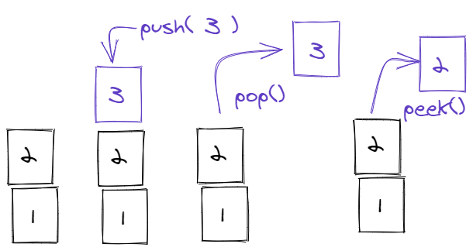
Stack<T>
A data structure that organizes data Last In First Out (LIFO), like a stack of books
Can only insert at the beginning of the Stack using push( x )
Can only remove items from the beginning of the Stack using pop()
peek() can be used to look at the next item without removing it.
isEmpty() can be used to determine if the Queue has remaining items
Optimizes Insertion and Deletion, but not possible to search
Real World Uses
Browser Back Button
Document Undo

Slide 18
Creating a Stack<T>
Stack<T> variable = new Stack<T>();
Stack is the class.
<T> defines the data type the Stack will hold
Stack is the only collection that does not use an interface.
Stack<String> history = new Stack<String>();

