Slide 1
Introduction to Classes
Module 1 - 09

Slide 2
Objectives
3 Fundamental Concepts of OOP
Encapsulation
Loose Coupling
Access Modifiers
Defining Classes & Packages
Creating a Class
Class Members and this
Member Variables
Properties (Getters and Setters)
Derived Properties
Static and final variables
Member Functions
Methods
Constructors
Overloading
Method Overloading
Constructor Overloading
Object Equality and Stringification
Method Overriding
Static Methods

Slide 3
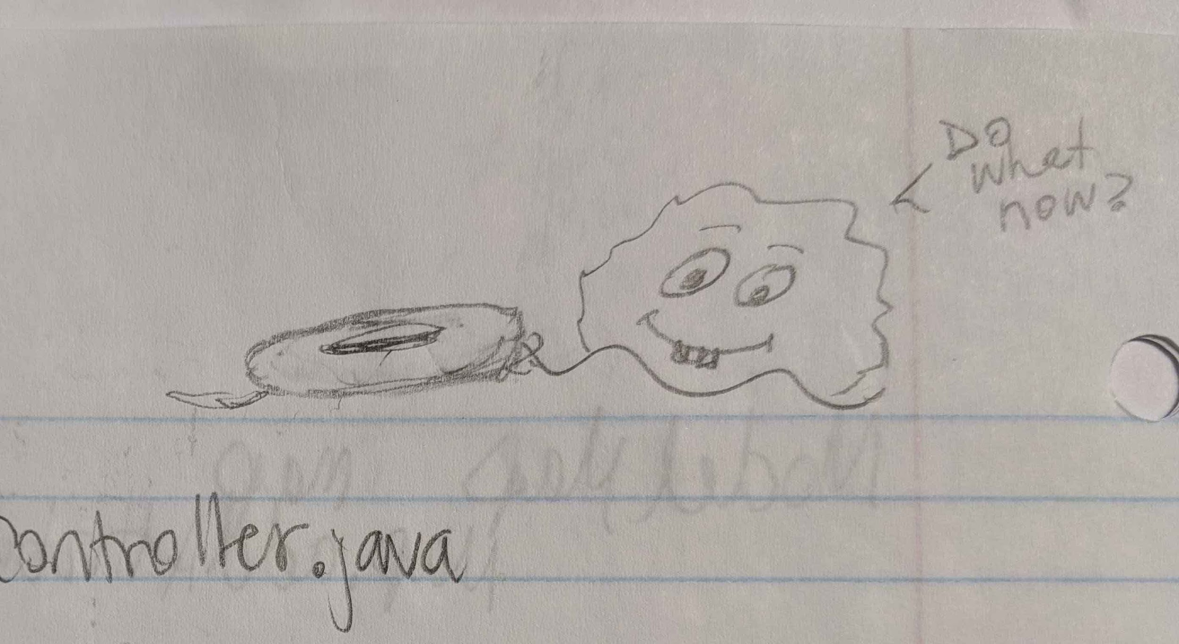

Slide 4



3 Fundamental Principles of Object Oriented Programming (OOP)
Encapsulation - the concept of hiding values or state of data within a class, limiting the points of access.
Inheritance - the practice of creating a hierarchy for classes in which descendants obtain the attributes and behaviors from other classes classes.
Polymorphism - the ability for our code to take on different forms. In other words, we have the ability to treat classes generically and get specific results.
The key starts the car. The Ignition system is hidden from the user turning the key to start the car.
Car
Has 4 wheels
Has Steering wheel
Honda
Toyota

Slide 5
Benefits of Object Oriented Programming (OOP)
Benefits of OOP are:
A natural way of expressing real-world objects in code
Modular and reliable, allowing changes to be made in one part of the code without affecting another
Discrete units of reusable code
Units of code can communicate with each other by sending and receiving messages and processing data
We will be talking about these more over the next week and a half

Slide 6
Encapsulation
the packaging of data and functions into a single component
hiding the implementation details of a class to prevent other parties from setting the data to an invalid or inconsistent state and also to reduce coupling.
Enables classes to be highly cohesive, meaning to have clear defined purpose
Highly cohesive classes have a clearly defined relationship with other classes
Implemented by using access modifiers that let the compiler know which data members and methods can be accessed and modified by others.

Slide 7
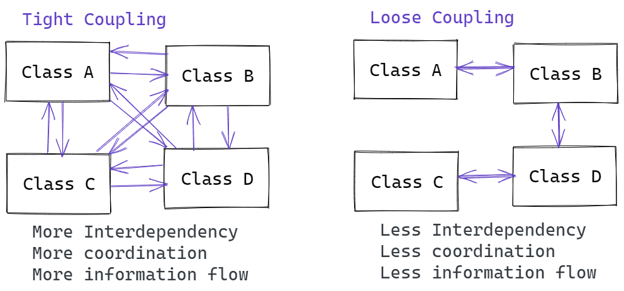
Loose vs Tight Coupling
Coupling
Coupling refers to the degree of direct knowledge each component of a system or application has of elements that it needs to use. Loose Coupling is an approach to connect components that depend on each other with the least knowledge possible. Encapsulation promotes Loose Coupling.

Slide 8


Tightly Coupled
Loosely Coupled

Slide 9
Access Modifiers
Visibility of classes, member methods, and variables
Defines who can use a class, method, or variable.
Access Modifier | Description
public | Accessible to anyone who can use our class
private | Accessible only to code within the same class
Why Limit access to parts of a class?
Makes code extendedable
Makes code maintainable
Promotes loose coupling
Variables in our class should always be private. If the others need access to them, then they should be given access via public getters and setters.
Methods should be public only if they are meant for use by the users of our class

Slide 10
Classes
Package com.mycarpackage
public class Car {
private int numberOfWheels;
private int numberOfDoors;
private String color;
public int mpg(){
return 0;
}
}
}
A class is a blueprint or model that defines state with fields (aka variables) and behavior with methods. We create new instances of a class that follow the blueprint but may have different property values.
All Reference Types are defined by a Class, and all Classes define a Data Type.
Member variables hold State of the object
Methods give the behavior or functionality of the object

Slide 11
Class Naming
Use nouns or noun phrases, not verbs
Short phrase that defines a thing
Try to use the singular form of a class name
Vehicle not Vehicles
Car not Cars
Class name must match the file name
Inside of Car.java file you have the class Car
Follow Pascal Casing
1st letter of every word is capitalized
Ex. userAccount is in camel case and UserAccount is in Pascal case.

Slide 12
Member Variables
package com.techelevator;
public class Rectangle {
private int length;
private int width;
public int getLength() {
return length;
}
public void setLength(int length) {
this.length = Math.abs(length);
}
public int getWidth() {
return width;
}
public void setWidth(int width) {
this.width = Math.abs(width);
}
}
}
Member Variables also known as Instance Variables hold the data. Member variables create object state.
Access Modifiers define class variables that represent its properties. They control visibility to methods and properties to the rest of your program.
public member variables are bad because they
allow direct access to object internals
they don't allow the object to verify or modify data before it gets into the object state.
Getters and Setters should be the only way to access member variables from outside the class
Getter and Setter methods should always begin with the "get" or "set" prefix, except for Getter methods that return a boolean, which should begin with the prefix "is".
Member Variables

Slide 13
Access Modifiers
Getters and Setters
Getters and Setters allow public access to a private member variable while still allowing the class to have full control of the variable.
Access modifiers control who can access a variable or method.
private String taskName; private boolean complete;
public String getTaskName() {
return this.taskName; }
public void setTaskName( String taskName ) { this.taskName = taskName ;
}
public boolean isComplete() {
return this.complete; }
public void setComplete( boolean complete ) {
this.complete = complete;
}
member variables
public | Can be accessed by anyone
private | Can only be accessed from inside the Class.
Getter
Setter
Getter
Setter

Slide 14
this
This this keyword refers to the member variable specific to the instance of an object where the code is run.
Car blueCar = new Car();
blueCar.setColor( “Blue“ );
public class Car {
private String color;
public String getColor {
return this.color;
}
public String setColor(String color) {
this.color = color; }
}
this instance
Car redCar = new Car();
redCar.setColor( “Red“ );
this instance

Slide 15
Derived Properties
package com.techelevator;
public class Rectangle {
private int length;
private int width;
public int getLength() {
return length;
}
public void setLength(int length) {
this.length = Math.abs(length);
}
public int getWidth() {
return width;
}
public void setWidth(int width) {
this.width = Math.abs(width);
}
public int getArea() {
return this.length * this.width;
}
}
}
A derived property is a getter that, instead of returning a member variable, returns a calculation taken from member variables. If we have firstName and lastName, we don't need to also store fullName, we can derive it from what we already have.

Slide 16
final
Sometimes we have constant values, or values that can not be changed, that we want to use in our code without duplicating the value all over the place. Many languages have the concept of constant and global constant variables, however, Java does not, but we can mimic one using the final keyword.
The final keyword allows the variable to be assigned once, but after set, it cannot be reassigned.
private final int x = 10;
x = 15; ← not allowed, since x is final and has a value
private final int y;
y = 20; ← allowed, y was declared as final, but not yet assigned
y = 30; ← not allowed, since y is final and has a value.

Slide 17
static variables
Static members belong to the class. Instance members belong to an instance of the class. Static methods can be invoked without creating an instance of the class. Static variables and methods cannot be accessed with the this keyword, since they are not part of the object.
private static int x = 10;
int y = x + 5;
int y = this.x + 5; ← the keyword this cannot be used with static
Since static variables are shared by all instances of a class and not the individual object. Changes to the value from one object can be seen from all objects of that type.

Slide 18
Methods
A function or method, is like a mathematical function (e.g. f(n) = n^2 ). Methods can have multiple parameters but can only return one value (for now).
Public methods define object behaviors.
Public and Private Methods help by
making the code base manageable with smaller chunks
reducing code into small units of work, making debugging simpler
and introducing reuse.

Slide 19
Method Signature
All methods have a name
usually a verb or verb phrase that describes the action
All methods have a return type
what the method will return
could be anything: Rectangle, boolean, void (returns nothing)
Methods can be parameterless or can include parameters (or inputs).
public <returnType> name (<List of Arguments>)
public boolean isLargerThan(int length, int width) {
return (this.length * this.width) > (length * width);
}

Slide 20
Function Overloads
Overloaded methods are methods with the same name and return type, and a different set of parameters. Java uses the correct overload based on the parameters sent to it.
ourRectangle.isLargerThan( otherRectangle );
ourRectangle.isLargerThan( 10, 12 );
public boolean isLargerThan( Rectangle other) {
return this.area > other.getArea();
}
public boolean isLargerThan( int width, int height ) {
return this.area > width * height;
}

Slide 21
Constructors
A constructor is a special method that runs every time a new object is instantiated. It allows for the object to be initialized with a starting state.
The name must exactly match the Class name
It has no return type
Can have arguments that set the value of member variables, like a Setter.
Can be Overridden to provide multiple ways to instantiate the object
If no constructor is present, then Java provides a default constructor, which has no arguments.
if any constructor is present then the default constructor is not provided, and if a no-argument overload of the constructor is needed, then it must be explicitly created.
Scanner input = new Scanner( System.in );
String myStr = new String();
← System.in is being passed to the constructor of Scanner.
← The () in an object instantiation calls the constructor. Here the no-argument constructor is being called to create a String object with no starting value;

Slide 22
public class Car { private String color; | Default Constructor: Car myCar = new Car();
public class Car { private String color; public Car( String color ){ this.color = color; } | Constructor with argument. The argument value must be passed to instantiate the Car object. Car myCar = new Car( “red” );
public class Car { private String color; public Car() { } public Car( String color ){ this.color = color; } | No-Argument Constructor with a constructor Overload that allows a value to set the starting state at instantiation. Car myCar = new Car(); Car myCar = new Car( “red” );

Slide 23
Function Overriding
Some methods will be “inherit” from other classes. For example, all class “inherit” the methods toString() and equals()
If we want to provide our own functionality for these methods we can create an “Override” which will hide the original methods functionality and provide our own.
To override a method, we must provide an identical method signature as the one being overriden. Though not required, It also a good practice to include the @Override annotation for readability.
@Override public String toString() { return “our string representation of our object”; }
@Override public boolean equals(Object obj) { return if the value of obj is equal to the value of this object
}

Slide 24
static methods
If we define a method static, our class does not need to be instantiated to use it. Instead it can be accessed from the Class itself, instead of the object. Static methods can only access other static methods or variables.
public class Rectangle() {
private static int length;
private static int width;
public static getArea() {
return length * width;
}
}
In the class using the static method:
Rectangle.getArea();
Rectangle rect = new Rectangle();
rect.getArea();
This seems easier, why not make everything static?
private static void main(String[] args)
Examples
Math.abs()
Math.random()
String.join()
String.valueOf()
Double.parseDouble()
Integer.parseInt()

