Slide 1
Inheritance
Module 1: 11

Slide 2
Objectives
Defining Inheritance
Specialization and is-a
Implementing inheritance
Polymorphism with inheritance
BigDecimal

Slide 3
Inheritance
Enables a class to take on the properties and methods defined in another class. A subclass will inherit visible properties and methods from the superclass while adding members of its own.
A subclass is the derived class acquiring the properties and behaviors from another class.
A superclass is the base class whose members are being passed down.
Except for Object which is the starting ancestor of all classes in Java, ALL classes in Java have ONE and ONLY ONE direct superclass, which is called Single Inheritance. If a class does not have an explicit superclass, then it is implicitly a subclass of Object

Slide 4
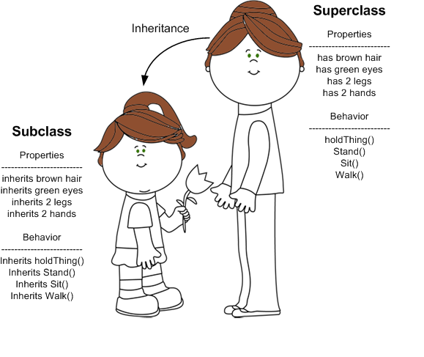
Inheritance
A subclass inherits all visible (non-private) properties and behaviors (methods) from the superclass.
A subclass DOES NOT inherit private properties or methods from the superclass.
Constructors are NOT inherited.
The subclass will then pass these traits through each subsequent generation, if it becomes a superclass to its own subclasses.
A Superclass can have multiple subclasses, however, a subclass may only have 1 superclass.

Slide 5
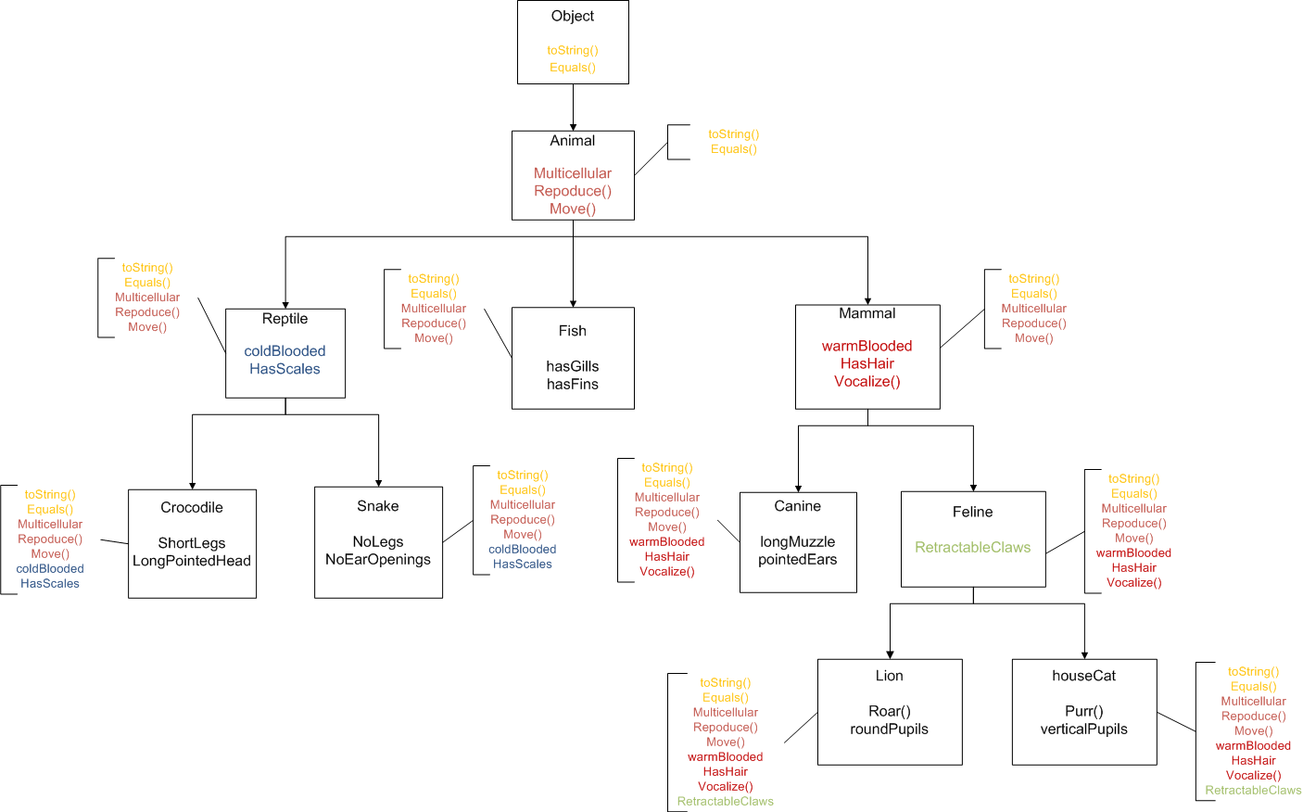

Slide 6
public class Calculator {
private double total;
public Calculator(double startingTotal) {
this.total = startingTotal;
}
public void add(double amount) {}
public void subtract(double amount) {}
public void multiple(double amount) {}
public void divide(double amount) {}
public double getTotal() {
return this.total;
}
}
public class ScientificCalculator extends Calculator {
public ScientificCalculator() {
super(0);
}
public void addExponent(int exponnent) {}
public void log(int base) {}
add() subtract() multiply() divide()
}
Inherited from Calculator
subclass of Calculator superclass of TrignometricCalculator
superclass of ScientificCalculator
public class TrigonometricCalculator extends ScientificCalculator {
public void sine() {}
public void cosine() {}
public void tangent() {}
addExponent()
log()
add() subtract() multiply() divide()
}
Inheritance is transitive. All public methods/properties, except the constructor, are passed from superclass to subclass, and to all further subclasses in the hierarchy.
Inherited from ScientificCalculator
Inherited from Calculator
subclass of ScientificCalculator
ancestor of Calculator

Slide 7
IS-A Relationship
Subclasses are specializations of their base(super) class
A Graphing Calculator IS-A more specific type of Calculator
A Honda Accord IS-A more specific type of Car
A Car is a more specific type of Land Vehicle
A Land Vehicle is a more specific type of Vehicle
We can say that a subclass IS-A of its superclass and all the superclasses above it.
Lion IS-A Feline
Lion IS-A Mammal
Lion IS-A Animal
Lion IS-A Object (in Java)

Slide 8
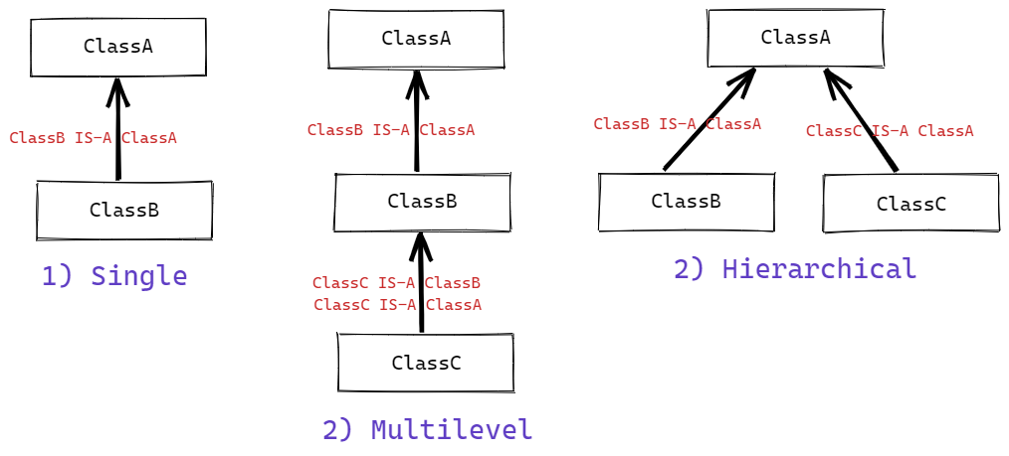
Types of Inheritance in Java

Slide 9
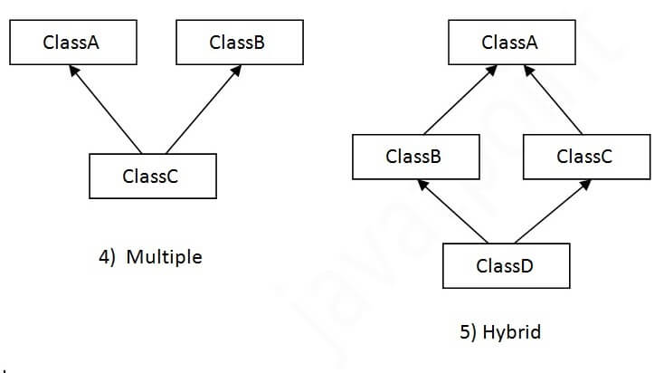
Java Does Not Support Multiple Inheritance

Slide 10
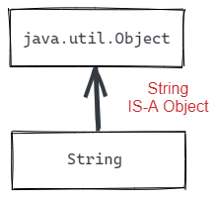
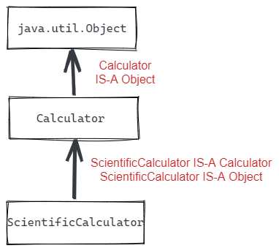
Object
In Java, all Objects (Reference Types) are subclasses of the class java.lang.Object. Object is the only class in Java that does not have a superclass.
The only things in the language that are not descendents of java.lang.Object are the primitives: long, int, double, boolean, etc.
Even if no superclass is specified, all classes still implicitly extend from java.lang.Object, and inherit a set of common methods, such as:
.toString()
.equals()
.hashCode()

Slide 11
Casting to a superclass (upclassing)
Objects can be cast to any superclass type in their hierarchy. Casting to a superclass is called Upclassing.
Upclassing is widening, so it is implicit.
ScientificCalculator sc = new ScientificCalculator(); Calculator c = sc;
Object obj = c;
Casting changes the way we view and use the object, but not the object itself. When an object is cast as another object in its hierarchy, then it can be treated as the object it is cast as, and will only have the methods and properties available to that type.

Slide 12
Casting to a subclass (downcasting)
Objects can be cast to any of their subclass types, called Downcasting, provided that internally the Object is already that subclass type. Downcasting is narrowing, so must be explicit.
ScientificCalculator sc = new ScientificCalculator(); Calculator c = sc;
ScientificCalculator backToSc = (ScientificCalculator) c;
If the Object is not internally the subclass type it is being cast as, then it will result in a ClassCastException runtime error
Calculator sc = new Calculator(); ScientificCalculator sc = (ScientificCalculator) c;
Object obj = new Scanner(); String s = (String) obj;
ClassCastException

Slide 13
Casting
When an object is downcast or upcast to another class in its hierarchy it will only have access to the properties or methods available on the type it is cast to, and will not have access to any of its own subclass specific methods or properties.
Casting an object to a different type in its hierarchy, only changes how the object is being treated, and does not change the object or what it internally is.
ScientificCalculator sc = new ScientificCalculator(); Calculator c = sc; Object obj = c;
In the code above, sc is instantiated as a ScientificCalculator and then upcast to a Calculator and then Object. However, in all cases the object is still internally a ScientificCalculator, even when it is cast and being treated as one of its superclasses.

Slide 14
instanceof
Since downcasting can only be done if the object is already internally the type it is being cast to, there is a boolean operator, instanceof, that can check if the object can be downcast to the subclass type.
object instanceof class
public void convert(Calculator calculator) { if (calculator instanceof ScientificCalculator) { ScientificCalculator = (Scientific) calculator; }
}
instanceof should be used when a class is being downcast to a subclass, and it is not known what type the object is internally.
instanceof never needs to be used when upcasting to a superclass, since all subclasses can always be upcast to their superclass.

Slide 15
Implementing Inheritance
A class extends a superclass
public class Feline extends Mammal {
}
Once extended, the subclass (Feline) will inherit all non-private properties and methods from the superclass (Mammal).
A common naming convention is name a subclass as SubClassNameSuperClassName
public class FelineMammal extends Mammal {
This is only convention so not required, and in recent years has become less common.

Slide 16
Constructors
Constructors are not inherited. If the superclass has a constructor with arguments, then the subclass must invoke the superclass’s constructor to provide the values.
The super keyword can be used to invoke the superclass’s constructor
public class Coin {
private int value;
public Coin(int value) {
this.value = value;
}
}
public class Quarter extends Coin {
public Quarter() {
super(25);
}
}

Slide 17
Method Overriding
Inherited methods can be Overridden to provide functionality that is specific to the subclass. The super keyword can be used in the subclass to invoke the super class’s version of an overridden method. To Override a superclass method, a method with an identical method signature is added to the subclass.
public class Account {
...
public void deposit(int amount) {
balance += amount;
}
}
public class CheckingAccount {
...
@Override
public void deposit(int amount) {
amount += depositFee;
super.deposit(amount);
}
}

Slide 18
Polymorphism with Inheritance
When a subclass is upcast to its superclass the subclass specific overrides will still be invoked. This allows for a subclasses to be treated as their more generic superclasses and still give responses specific to the subclass.
public class Vehicle {
public int getNumberOfWheels() {
return 0;
}
}
public class Car extends Vehicle {
@Override
public int getNumberOfWheels() {
return 4;
}
}
public class Bike() extends Vehicle {
@Override
public int getNumberOfWheels() {
return 2;
}
}
Vehicle vehicleOne = new Car();
Vehicle vehicleTwo = new Bike();
vehicleOne.getNumberOfWheels();
vehicleTwo.getNumberOfWheels();
List<Vehicle> vehicles = new ArrayList<Vehicle>();
vehicles.add( vehicleOne );
vehicles.add( vehicleTwo );
for (Vehicle v : vehicles) {
v.getNumberOfWheels();
}
returns 4
returns 2
uses subclass Override

Slide 19
BigDecimal
java.Math.BigDecimal
https://docs.oracle.com/javase/7/docs/api/java/math/BigDecimal.html
Does not have a floating point rounding problem like double and float. Does not truncate like integer. Is commonly used for currency and other calculations that require a high and precise significance of precision.
import java.math.BigDecimal;
BigDecimal amount = new BigDecimal(<value>); ← CANNOT use a No-Argument Constructor
Can’t use operators +, - , %, /, *, <, etc. instead use methods
example: amount.add()
BigDecimal is immutable.
BigDecimal amountOne = new BigDecimal(100.50);
BigDecimal amountTwo = new BigDecimal(200.25);
BigDecimal combinedAmount = amountOne.add(amountTwo);
In the above code, when add is called the value of amountOne is not changed, it remains 100.50. Instead a new BigDecimal is returned with the sum (300.75). This is due to BigDecimal being immutable, and is the same as when you use a String function like substring() or toUpperCase()

