Slide 1
Polymorphism
Module 1: 11

Slide 2
Objectives
Polymorphism
Polymorphism through inheritance
Object Context
Interfaces
Polymorphism through interfaces

Slide 3
Polymorphism
Polymorphism is the ability for a subclass to be treated as its superclass, while still providing subclass specific responses. The subclass can be treated generically while still providing non-generic, specific functionality.

Slide 4
Polymorphism through inheritance
Class can be treated as any superclass in their hierarchy. Every reference type in Java can be treated as Object, since it is the root superclass of all hierarchies.

Slide 5
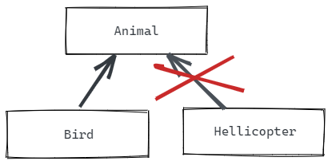
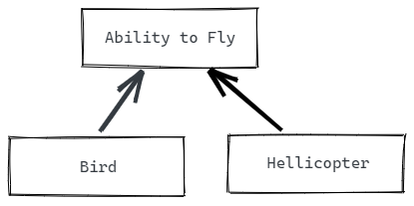
Object Context
An Object can have a relationship with another type in its hierarchy with an IS-A relationship.
A Bird IS-A Animal A Helicopter IS NOT A Animal
But we often want to group objects not by what they are, but what they can do, or by what abilities they have - a HAS-A relationship. This allows for grouping of unlike things with like abilities.
A Bird HAS-A ability to fly A Helicopter HAS-A ability to fly

Slide 6
Interfaces
Defines what something can do or how it can be used, but not how it does it.
A contact that defines what methods an object must have to be of that type, but does not define how those methods will work.
Provides method signatures, but not implementation.
Transitive like inherited methods
A single class may have multiple interfaces, allowing to be part of multiple groupings.
Can represent either an HAS-A or an IS-A relationship

Slide 7
Java Interfaces
Interfaces contain only method signatures.
The accessor is optional since methods in an interface can only be public
Interfaces cannot be instantiated
Interfaces cannot have member variables
public interface Drivable {
void turn(String direction);
boolean accelerate();
boolean decelerate();
}

Slide 8
Implementing Interfaces
A class implements an interface using the implements keyword.
public class Bicycle implements Drivable
When a class implements an interface it must provide Overrides for ALL methods signatures defined in the interface.
A class can implement an interface and extend a subclass.
public class Bicycle extends Vehicle implements Drivable
A class can only extend a single subclass, but can implement multiple interfaces.
public class Bicycle extends Vehicle implements Drivable, Explodable

Slide 9
Polymorphism using Interfaces
The interfaces create a data type to which the object can be cast. This allows objects with the same interfaces to be grouped generically, while still providing their specific response when a method is invoked.
List<Drivable> drivables = new ArrayList<Drivable>(); drivables.add( new Car() ); drivables.add( new Bicycle() ); drivables.add( new HotAirBalloon() );
for (Drivable d : drivables) {
d.turn( “Left” ); d.accelerate();
}

