Slide 1
Unit Testing
Module 1: 14

Slide 2
Objectives
Software Development Lifecycle (SDLC)
Testing Overview
Unit Testing
Unit Testing with JUnit
Code Coverage
Test Driven Development (TDD)

Slide 3
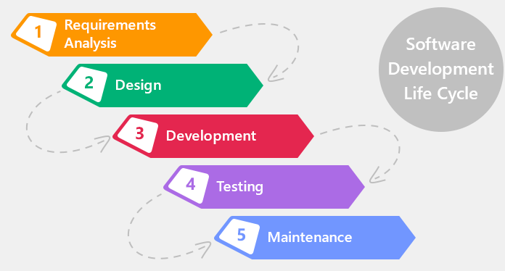
Software Development Life Cycle (SDLC)

Slide 4
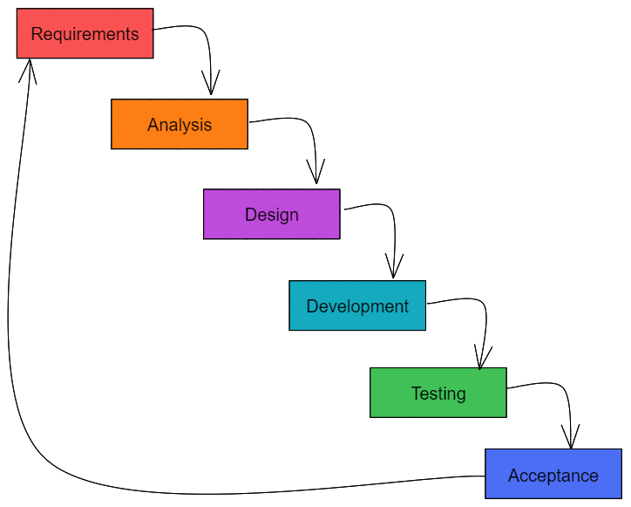
Waterfall Methodology
Advantages
Easy to Manage
Process well documented
Easily adaptable
Allows shifting teams
Disadvantages
Slow
Long time between start and first time final product seen
Rigid

Slide 5
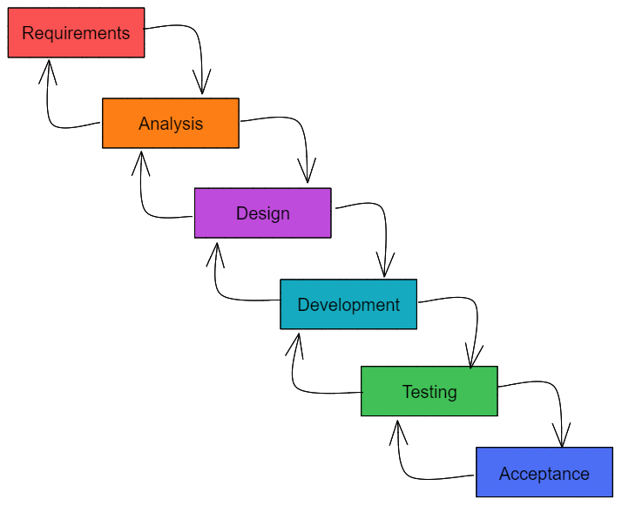
Agile Methodology
Advantages
Continuous Delivery
Flexible and fluid
Short time between parts of the final product seen
Specialized, stable teams
Disadvantages
Requires a set team of 4-12 specialists
Harder to manage
Not well suited to all projects

Slide 6
Agile Manifesto
Individuals and interactions MORE IMPORTANT THAN process and tools
Working software MORE IMPORTANT THAN comprehensive documentation
Customer collaboration MORE IMPORTANT THAN contract negotiation
Responding to change MORE IMPORTANT THAN following a plan
Original Agile Manifesto

Slide 7
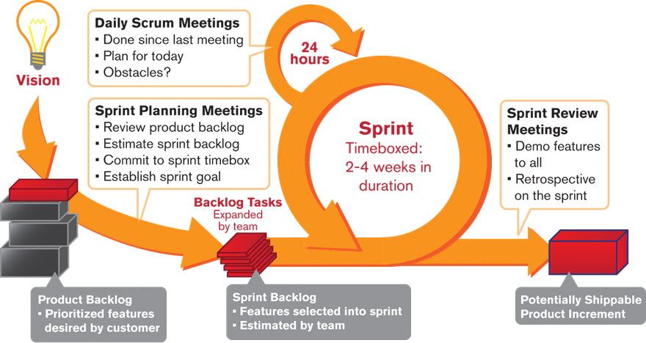
Concepts
Daily Standups
Spring Planning
Retrospectives
Sprint Review

Slide 8
Software Testing
Manual | Automated
Done by humans | Done by computer automation
Creativity | Speed / Efficiency
Subjectivity | Lower cost per execution
 | Repeatability / Dependability
 | Accuracy
Exploratory Testing - explores the functionality of the system looking for defects, missing features, usability, or other opportunities for improvement. Almost always manual.
Regression Testing - validates that existing functionality continues to operate as expected, as new new functionality is added and defects are resolved. Usually automated.

Slide 9
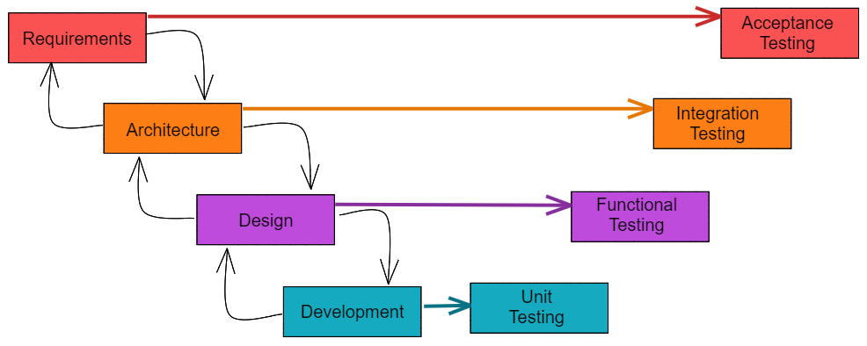
Acceptance Testing is performed from the perspective of a user of a system in order to verify the requirements have been satisfied.
Integration Testing is a broad category of tests that validate integration between units of code or code and outside dependencies such as a database, network resource, or file.
Functional Testing validates that the functional design has been satisfied
Unit Testing is low level testing performed by the programmer to validate that individual units of code function as expected by the programmer.

Slide 10
Some Other Types of Testing
Some Testing Roles
Performance
Scalability
Usability
Accessibility
Portability
Smoke / Sanity
Alpha
Beta
Stress
Security
Developer (Unit Test)
QA (Quality Assurance)
QC (Quality Control)
Automation Developer
Manual Tester

Slide 11
Unit Tests
Should be:
Fast
Repeatable
Independent
Obvious
Steps:
Arrange (Setup)
Act (Test)
Assert (Verify)
Rules:
No external dependencies
On logical assertion per test
Test code should be the same quality as product code
Test early, test often
Don’t save them for the end

Slide 12
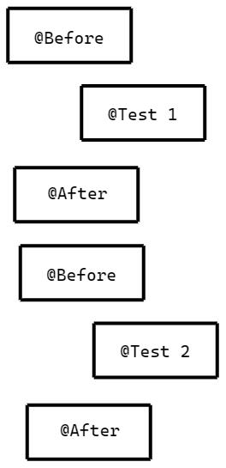
JUnit
JUnit is a Java Framework for writing and running Unit Tests.
Package: org.junit
The life cycle of JUnit tests are controlled by annotations on public methods in the class.
@Before - runs before each test, to do setup
@Test - runs as the test
@After - runs after each test to cleanup
@Before
public void setup() { }
@Test
public void test_something() { }
@After
public void cleanup() { }

Slide 13
org.junit.Assert
The Assert class allows verification of results. Some examples:
Assert.assertTrue( optionalMessage, booleanCondition )
Assert.assertFalse( optionalMessage, booleanCondition )
Assert.assertEquals( optionalMessage, expectedValue, actualValue )
Assert.assertEquals( optionalMessage, expectedDouble, actualDouble, precision )
Assert.fail()
Asserts can be in the test method or any private methods that it calls!

Slide 14
Code Coverage
Code Coverage is a tool that does an analysis of code when tests are run and outputs how much of the code was tested and what code was untested.
Code Coverage does not tell a developer when testing is complete. It is merely a guide to help visualize what tests may be missing. Even when code coverage is at 100% there are still many further unit tests that may be needed.
It is not always possible to reach 100% code coverage on all projects. The goal should be the highest level of coverage possible with a clear understanding of why code that could not be covered was excluded and the risks created.

Slide 15
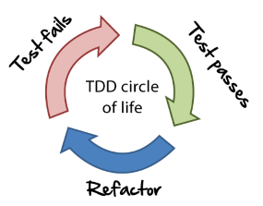
Test Driven Development (TDD)
TDD Circle of Life
Write failing test
Make test pass with minimum code
Refactor
Repeat

Slide 16
TDD Strategy
Create a list of tests needed.
Start by writing just enough test code
Always run the test to see it fail in the way you expect
Write enough code to make the test build
Write enough code to make that test pass
If you can’t solve it, fake it!
When the implementation is obvious then continue, if it is not then go back to #4
Refactor
TDD allows the problem to be worked on in 2 parts, the problem and the code. First you solve the problem without regard to code quality, then once the problem is solved you use the passing test cases to improve code quality with constant feedback regarding whether the problem is still being solved.

Slide 17
Refactoring
Refactoring introduces modifications to the code intended to improve the structure or design without changing functionality.
Simple Ways to refactor
Eliminate duplicate code
Extract a method by breaking down long difficult methods
Extract complex operations to variables
Introduce constants for magic numbers
Simplify conditional expressions
Article on Refactoring

Slide 18
Katas
A code kata is an exercise in programming which helps programmers hone their skills through practice and repetition.
TDD is a common method used to solve code katas to allow first focusing on the problem and then being able to focus on the quality of the code and experimentation with new ideas.
Why do Code Katas?
Practice
Improves Coding Skills
Improves Problem solving
Companies use them as part of the interview process
They can be fun!
A few places to find Katas
Awesome Katas
Code Wars
Code Kata
Code Abbey
Coding Dojo

Slide 19
TDD Steps for an interview Kata
Figure out what tests you need to meet the requirements
Pick a test and write it - fail it.
Git add/commit
Write just enough code to pass the test
Git add/commit
Refactor if needed
Add more tests if needed - fail the tests
Git add/commit
Pass the test
Git add/commit
Git add/commit after refactoring
Repeat steps 2-4 until all requirements are complete
If refactoring is needed for the entire project
Make a small change (can make like changes at once - like replacing magic numbers)
Verify all tests continue to pass
Git add/commit
Repeat until you are satisfied with the final refactored code
Add JavaDoc to public methods and classes
Git add/commit
Git push

