Slide 1
Server Side APIs
Part1
Module 2: 13

Slide 2
Objectives
Backend vs Frontend
MVC (Model View Controller) Pattern
Spring Boot MVC Framework
Creating an Web Service with Spring Boot

Slide 3
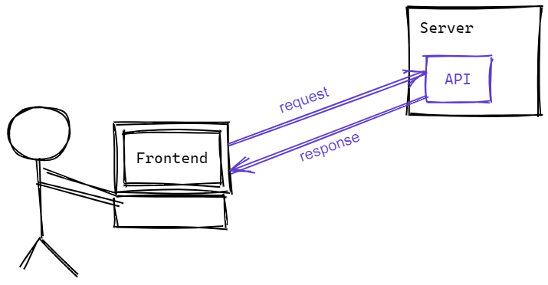
Backend vs Frontend
Frontend provides functionality for the user. It deals with the user input and showing output to the user.
Backend provides data, algorithms, and logic for the frontend to use.
It is common for the Frontend (client) to retrieve data and/or results based on user input from the Backend (server) using an API.

Slide 4
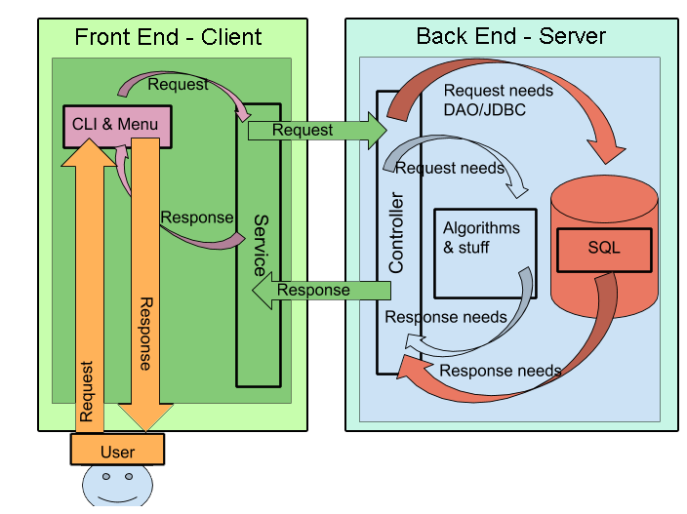

Slide 5
MVC (Model View Controller) Pattern
Model View Controller (MVC) is a pattern that divides the application based on responsibility.
Model
application state and business logic
only part of the application that talks to the database
Model could be classes
View
presents data to user
accept input from user
Views might be a desktop display, a mobile display, a file output based on a model
The View is not the output HTML/UI that displays in the browser or device, it is the code that generates the response.
Controller
Takes input from the view and passes it to the appropriate model objects
Grabs all necessary building blocks and organizes them for the output
Takes results from the model and passes it to the appropriate view
The end result is that the Model and View are unaware that the other exists. This decouples the Model and View.
The MVC Pattern is NOT only used for Web and Web Services. It is often used in other applications, and even exists in non-programming applications.

Slide 6
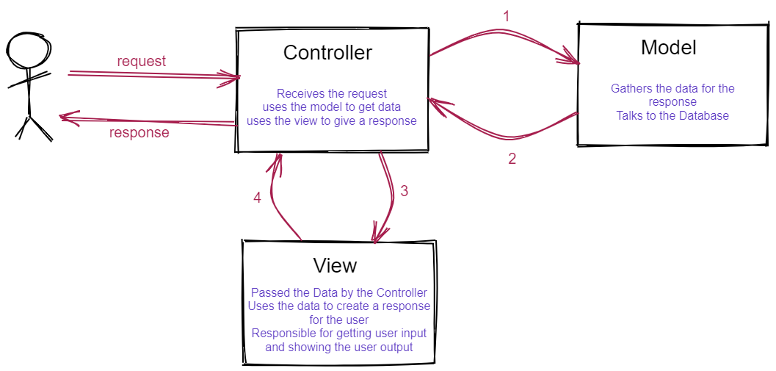

Slide 7
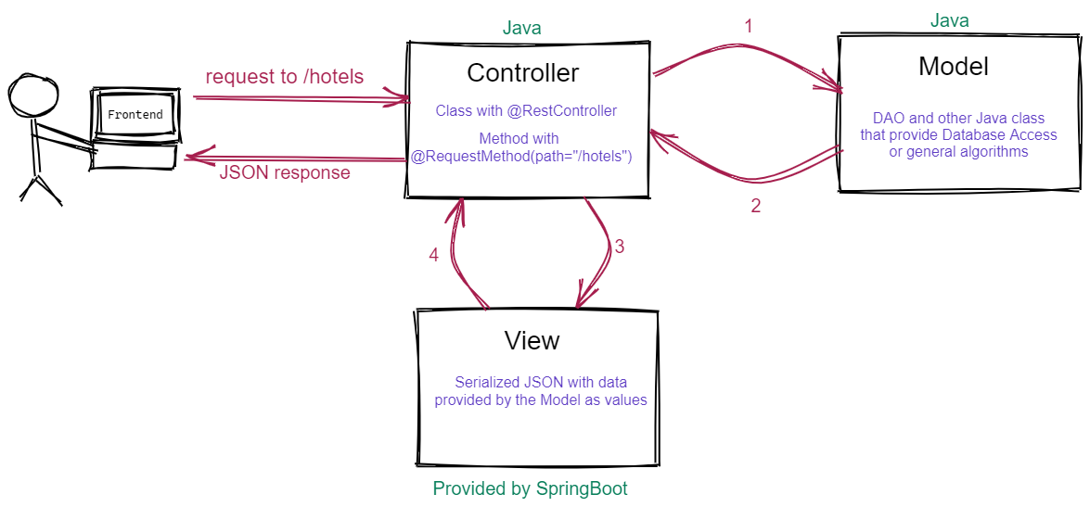
MVC in Spring Boot

Slide 8
End Points
list all hotels path: /hotels GET return: list of all hotels in the system
get a hotel by id path: /hotels/{id} GET return: hotel with the given id
list all reservations path: /reservations GET return: list of all reservations in the system
get reservation by id path: /reservations/{id} GET return: reservation info for given id using path variable
list all reservations by hotel path: /hotels/{id}/reservations GET return: list of all reservations in the system by hotel
add new reservation path: /hotels/{id}/reservations POST add a new reservation to the given hotel based on the request body
filter hotels path: /hotels?state={state}&city={city} GET find hotels by state and city (optional)

