Slide 1
Server Side APIs Part 2
Module 2: 14

Slide 2
Objectives
Dependency Injection
RESTful Service Design with CRUD
Bean Validation
HTTP Response Codes
Error Handling
400 errors from Validation
Other errors like 404
PUT
DELETE

Slide 3
Dependency Injection
Inversion of Control (IoC) is a object oriented principle that inverts the flow of normal flow of control of an application from a class to a higher layer. It is commonly used in Java Frameworks.
Dependency Injection is a design pattern that implements IoC. It inverts control of the instantiation of dependencies from the class using them to an dependency injection container. Rather than instantiating classes with “new” in our class, they will be injected into our class at runtime.
Dependency Injection Container is code that creates and injects the dependencies into our class. Spring has a Dependency Injection Container built into it.

Slide 4
Dependency Injection in Spring Boot
Create an Interface with an Implementation class (CityDao)
Add the @Component annotation to the implementation class (JdbcCityDao)
Declare an argument of a constructor using the Interface
public CityController( CityDao cityDao)
Or a variable can be created with the @Autowired annotation, but can make Integration/Unit testing more difficult.
@Autowired private CityDao cityDao;

Slide 5
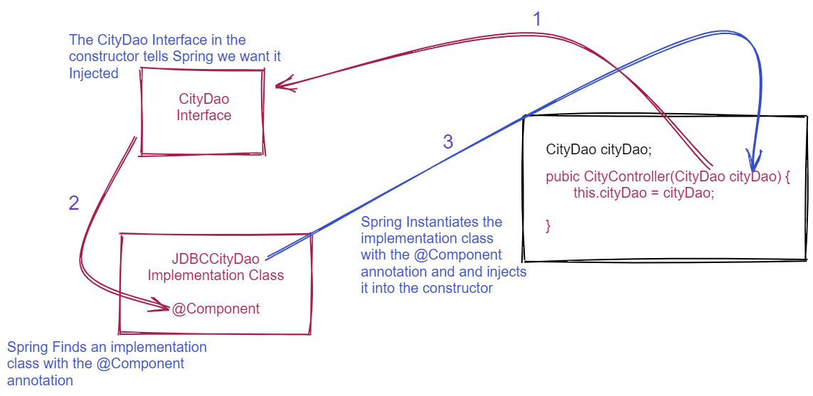

Slide 6
RESTful Service Design - End Points
Define the endpoints
Endpoints should be plural names that define what is being accessed (the entity)
Hotels, Reservations, Cities, etc.
IDs should be sent as Path Variables
Filters and Sorting should be sent as Query Parameters
Endpoints should reflect the hierarchy of the entities

Slide 7
RESTful Service Design - CRUD
Define the CRUD
What do you want your user to be able to Create? (POST)
What do you want your user to be able to Read? (GET)
What do you want your user to be able to Update? (PUT)
What do you want your user to be able to Delete? (DELETE)
Not all CRUD needs to be included, only what you want the user to be able to access. Some CRUD operations may have multiple routes that do different things:
/hotels /hotes/{id} /hotels?state=Ohio&city=Columbus

Slide 8
RESTful Service Design
Each endpoint should be defined for the CRUD (HTTP Methods) with the HTTP Status Codes it will return.
/api/reviews/:id (PUT)
Updates a specific review
Success: returns a 200 (OK) when successful
Error: returns a 404 if the id does not exist
/api/reviews/:id (DELETE)
Deletes a specific review
Success: returns a 200 (OK) when successful
Error: returns a 404 if the id does not exist
/api/reviews/:id/comments (GET)
Get comments for a specific review
Success: returns a list of comments
Error: returns a 404 if the id does not exist
/api/reviews (GET)
Gets a list of all reviews
Success: Returns a List of Reviews
/api/reviews/:id (GET)
Gets a single review by id
Success: Returns a single review if the id is valid
Error: returns a 404 if the id does not exist
/api/reviews (POST)
Creates a new Review
Success: returns a 201 (Created) when successful

Slide 9
Validation
Add Constraint Annotations to the Data Class member variables
@Min( value = 1, message = "The field 'hotelID' is required.")
private int hotelID;
@NotBlank( message = "The field 'fullName' is required.")
private String fullName;
@NotBlank( message = "The field 'checkinDate' is required.")
private String checkinDate;
@NotBlank( message = "The field 'checkoutDate' is required.")
private String checkoutDate;
@Min( value = 1, message = "The minimum number of guests is 1")
@Max( value = 5, message = "The maximum number of guests is 5")
private int guests;
Add @Valid Annotation to the Controller Method receiving the object.
public Reservation addReservation(@Valid @RequestBody Reservation reservation
List of Constraints

Slide 10
HTTP Response Status Codes
2xx Status Codes can be applied to a controller method using the @ResponseStatus annotation
@ResponseStatus(HttpStatus.CREATED)
4xx Status Codes can be returned by throwing an Exceptions from the the Controller Method
@ResponseStatus( code = HttpStatus.NOT_FOUND, reason = "Hotel not found.") public class HotelNotFoundException extends Exception
public Reservation addReservation(@Valid @RequestBody Reservation reservation, @PathVariable("id") int hotelID throws HotelNotFoundException

