Slide 1
Introduction to JavaScript
Module 3: 06

Slide 2
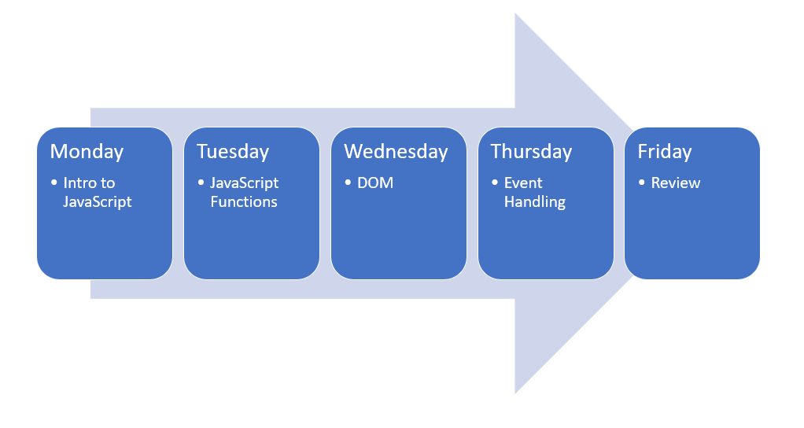
This week...

Slide 3

Objectives
Client Side Scripting
Intro to JavaScript
Including JavaScript
JavaScript Overview
Variables in JavaScript
Load Order and Hoisting
Data Types
Dynamic Typing
Named Functions
Equality Operators
Truthy
Scope
Arrays
Object Literals
Numbers, Math, Date, and String Libraries and Methods
Running Unit Tests and Debugging

Slide 4
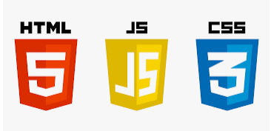
Client Side Scripting
Executes code in the user’s browser, allowing our code to interact with the rendered HTML and CSS
Creates less stress on the server, and a better experience for the user
Uses
Responding to an Event (mouse click, key press, resize, etc.)
Interact with APIs to dynamically update a page
Manipulate the loaded page without needing to refresh

Slide 5
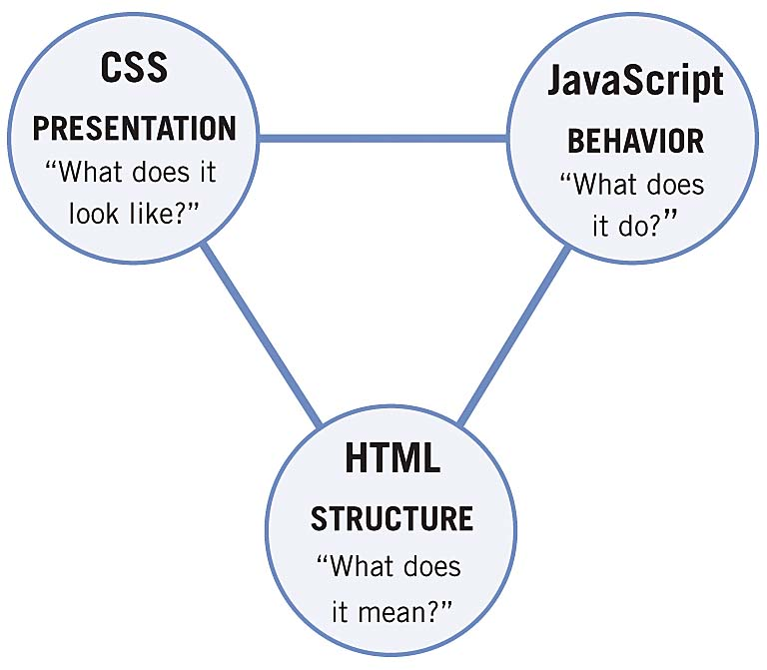
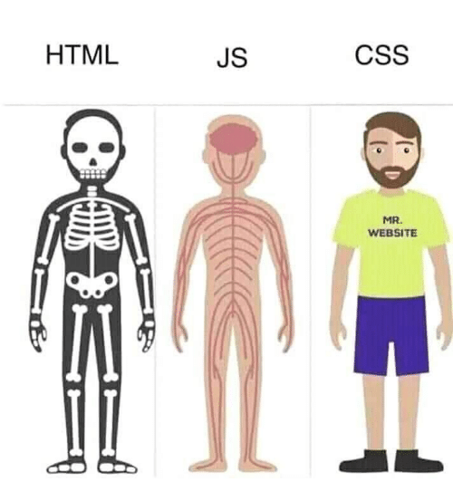
Client Side Scripting - Separation of Concerns
HTML - provides content and structure
CSS - provides presentation
JavaScript - provides behavior

Slide 6


Java vs JavaScript
Java | JavaScript
Syntax based on C | Syntax based on C
Object Oriented | Object Based (prototypes)
Compiled | Interpreted
Run by the JVM/JRE | Runs in a browser (engine)
Strict syntax | Loose Syntax
Statically Typed | Dynamically typed
Everything is a data type | 5 data types

Slide 7
Toolset for Vanilla JavaScript
VS Code - Integrated Development Environment (IDE)
LiveServer
ESLint
JavaScript Intellisense
Chrome
Runtime Engine
Debugging
Open the Project Directory in VS Code
4 Ways
Open Folder from Project View (when nothing is open)
From the project folder in terminal: code .
File > Open Folder (when no other projects are open)
File > Add Folder to Workspace (when other projects are open)
Right click on the html file (index.html) and select “Open with Live Server”

Slide 8
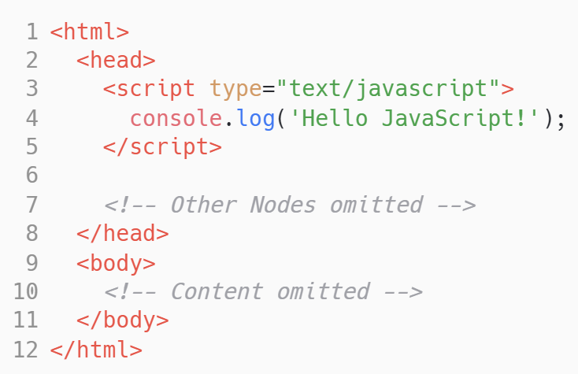

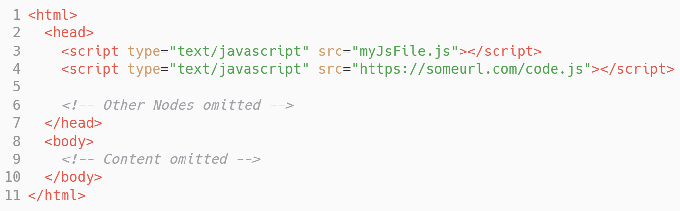
Including JavaScript
Embedded in a Script Tag.
The <script> tag can be included anywhere in the head or body of the html document.
<script> is not self-closing, so must always have an ending tag: <script></script>
JS File Reference

Slide 9
Variables in JavaScript
var - Old way of defining variables. DO NOT USE!!!
var name = ‘Rachelle’;
let - new way of declaring variables. The value can be reassigned. For values that can change.
let name = ‘Rachelle’; name = ‘John’; ← No Error
let name; name = ‘Matt’; ← No Error
const - new way of declaring variables. The value must be assigned at declaration and cannot be reassigned. For values that will not change - this should be your default.
const name = ‘Rachelle”; name = ‘John’; ← Error
const name;
name = ‘Matt’ ; ← Error

Slide 10
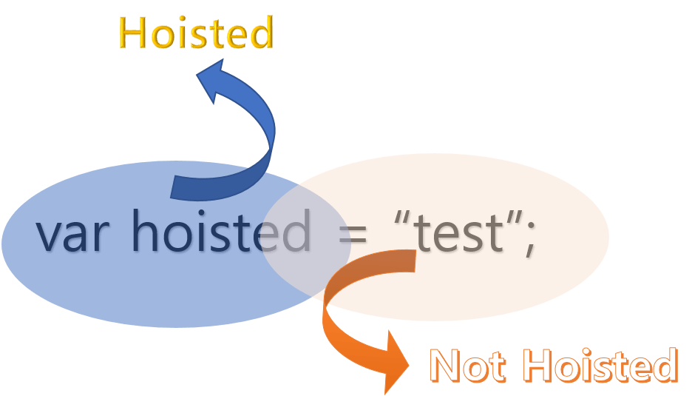
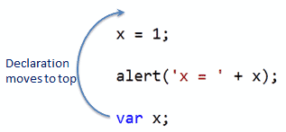
Load Order of JavaScript is important!
JavaScript runs sequentially (for now!) so the load order of scripts is important.
However, variable declarations, but not the assignment, and simple functions are hoisted - they are moved to the top of the script when it is preparing to run.
Hoisting on W3Schools
Scotch.io Hoisting Tutorial

Slide 11
Strict Mode
Strict Mode can be enabled for a JavaScript file, this:
Eliminates some silent JavaScript errors by changing them to explicit throw errors which will be spit out by the interpreter.
Fixes mistakes that make it difficult for JavaScript engines to perform optimisations.
Prohibits some syntax likely to be defined in future versions of JavaScript
Will not allow variables to be used before they are declared
Strict Mode is enabled by prefacing a file or function with:
‘use strict’; OR “use strict”;

Slide 12
JavaScript Semantics
Uses single quotes ( ‘ ) preferred, but can use double quotes
Can also use tick ( ` ) for template literals
Template Literal string that has a variable as a placeholder
name = ‘Joe’ → ‘Hello, ‘ + name + ‘ welcome!’ → ‘Hello, Joe welcome!’
name = ‘Joe’ → `Hello, ${name} welcome!` → ‘Hello, Joe welcome!’
Semicolons at the end of a statement are optional, but preferred for readability.
Blocks of code are defined with { }
Functions are called with ( )
variables and functions use camelCase

Slide 13
Data Types
JavaScript has 5 data types
string let name = ‘John’;
number let favoriteNumber = 42;
boolean let isDynamicallyTyped = true;
object let person = { name: ‘Rachelle’, numberGiantClocks = 1 };
function let logFunction = console.log;

Slide 14
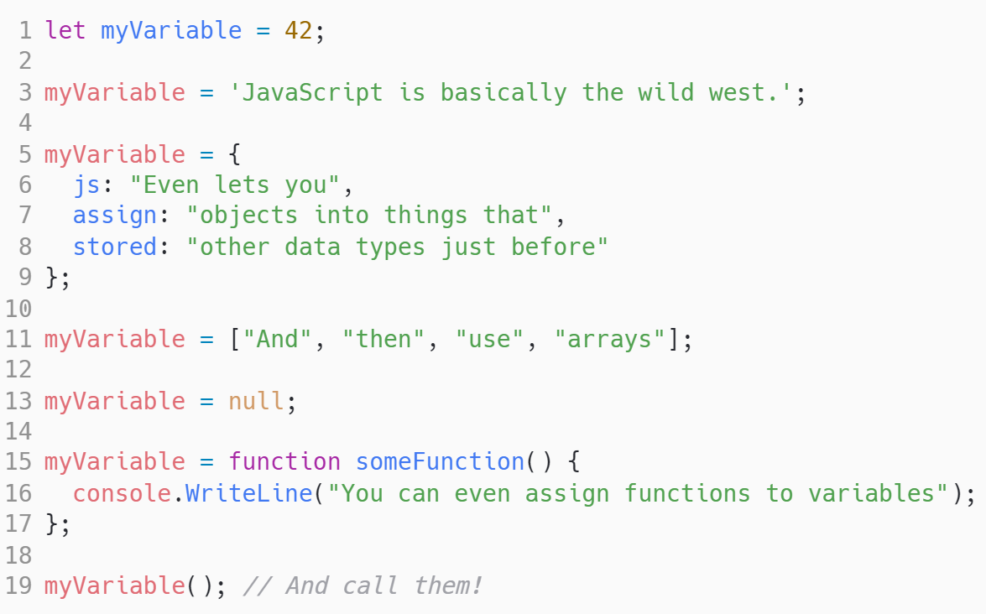
Dynamic Typing
The data type of a variable is not assigned by the developer, instead it is inferred by the data assigned to the variable.

Slide 15
Data Conversion
The typeof operator can be used to identify the data type.
typeof variable
Data Type conversion is often handled implicitly by JavaScript, but can be done explicitly using functions.
String(123) ← converts 123 into a string
Number(“123”) ←- converts “123” into a number
parseFloat(“3.14”) ← converts a string to a floating point number
parseInt(“10”) ← converts a string to an integer
JavaScript Data Types and Conversion Methods on W3Schools

Slide 16
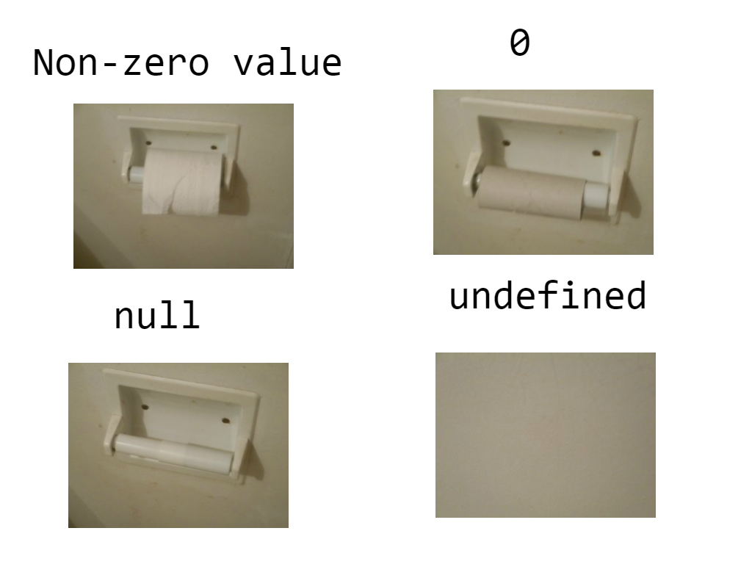
empty (0) vs null vs undefined
Other similar values a variable can have
NaN - Not a number
infinity - a mathematical operation returned an infinite result

Slide 17
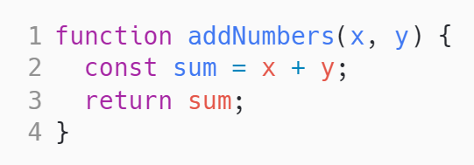
Defining Named Functions
defined with the word function
lack a return a return type
have no access modifier
parameters do not have defined data types

Slide 18
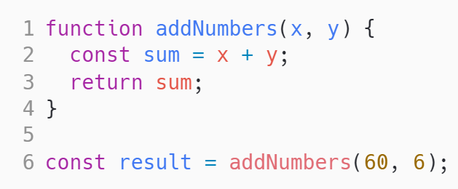
Calling Functions
parameters defined by order
not enough parameters = undefined for the extras parameters
Too many parameters = extra values are ignored.
addNumbers(10)
x = 10
y = undefined
addNumbers(10, 20, 30, 40, 50)
x = 10
y = 20
30, 40, 50 are ignored

Slide 19
Equality Operators ( == vs === )
== (Loose equality)
compares the value without taking the data type into consideration
1 == ‘1’ → true 1 == 1 → true 1 != 1 → false (not equal)
=== (Strict Equality)
compares the value and the data type
1 === ‘1’ → false 1 === 1 → true 1 !== 1 → false (not equal)

Slide 20
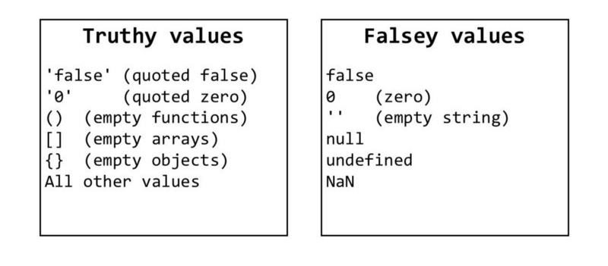
JavaScript is a Truthy Language
Everything in the language evaluates to either true or false
falsy (evaluate to false): false, 0, ‘’, null, undefined
truthy (evaluate to true): everything else

Slide 21
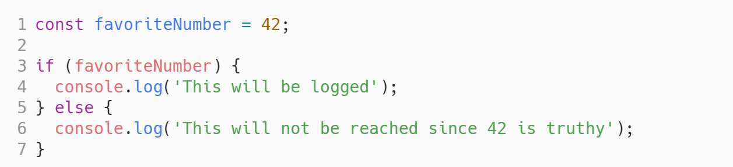
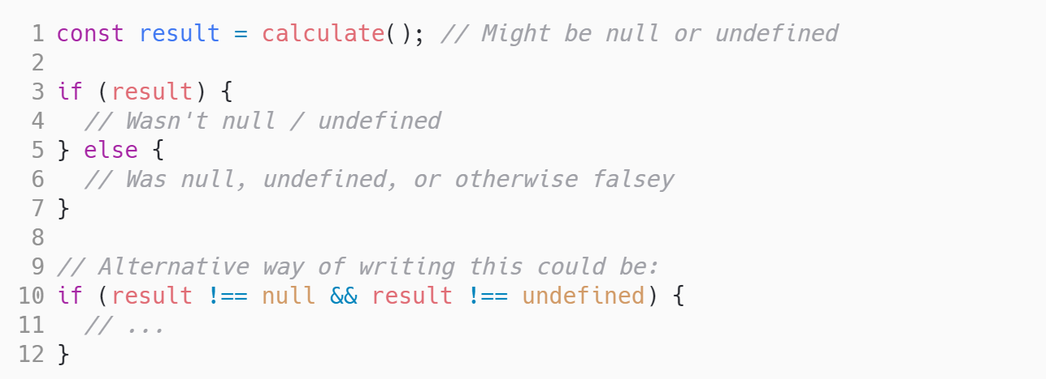
Truthy

Slide 22
Scope
Global Scope
variables defined outside of a function are available everywhere, even in other js files that are included in the html
Block Scope
works like block scope in Java
Function Scope
variable can be used anywhere in a function that it is declared in
let and const - obey block and function scope
Only allow 1 declaration of a variable per scope (like Java)
var - ignores block scope, and obeys function scope
A variable can be redeclared in the same scope
Function Scope function add(x, y) { // function scope } Obeyed by let, const, var
Block Scope if (x === 10) { // block scope } Obeyed by let, const Ignored by var

Slide 23
Arrays
defined by []
let x = []; ← declared an empty array
let x = [1, 2, 3, 4]
lex x = [‘a’,’b’,’b’]
Not confined to a single data type
let x = [ 1, ‘a’, 2 ]
Not a fixed size
x[3] = ‘b’; → [ 1, ‘a’, 2, ‘b’ ]
Methods (not a complete list)
length
concat() ← joins to arrays into 1,
push() → adds an element to the end of an array,
pop() → removes the last element from an array
unshift() → adds an element to the start of the array

Slide 24
Object Literals
defined with keys and literal values as being declared
Objects assigned to a variable
Defined as a comma delimited block of key : value pairs
let x = {} ← declares an empty object
const person = {
firstName: "Bill",
lastName: "Lumbergh",
age: 42,
employees: [
"Peter Gibbons",
"Milton Waddams",
"Samir Nagheenanajar",
"Michael Bolton"
]
};

Slide 25
Math and String Functions
isNaN() - returns true or false if a variable is not a number
Math
Built in Math object that has properties and methods for mathematical operations
Math.PI, Math.abs(), Math.floor(), Math.random()
Documentation on MDN
String
The String data type has properties and methods to manipulate the value of the String
.length
.endsWith(), .startsWith()
.indexOf()
.split()
toLowerCase(), .toUpperCase()
.substr(startIndex, numberOfCharactersToReturn)
.substring(startIndex, endingIndex)
.trim()
Documentation on MDN

