Slide 1
JavaScript Functions
Module 3 - 07

Slide 2
Objectives
Named Functions
Documenting Functions with JSDoc
Anonymous Functions
Array Functions
forEach()
reduce()
filter()
map()

Slide 3
Named Functions
Named Functions have a name and a list of parameters
function add( x, y ) { return x + y; }
Since not all parameters need to be sent to call the method, default values can be set to avoid unexpected behaviors from an undefined parameter
function add( x = 0, y = 0 ) { return x + y; }
add(1) → x (1) + y (undefined) = NaN
add(1) → x (1) + y (0) = 1

Slide 4
Dealing with an unknown number of Parameters
A default value can be set in the function parameters:
function addNumberAndString( x = 0, str = ‘’) { }
The arguments object is automatically passed to all JavaScript functions and can be used to determine the number and value of the arguments.
function unknownParams() { const numberOfArguments = arguments.length; }
The arguments object may look like an array, but it is not. It can be converted to an array using Array.from()
const argumentsAsArray = Array.from(arguments);

Slide 5
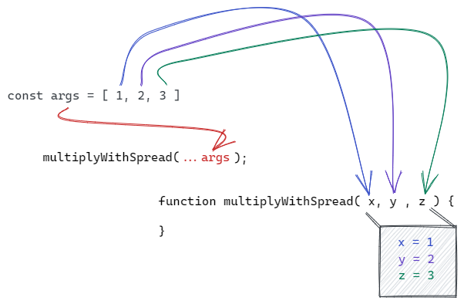
Spread Operator
Spread syntax allows iterables such as an array or string to be expanded in place to fill arguments.
function multipleWithSpread(x, y, z) { return x * y * z; }
const args = [1, 2, 3]; multipleWithSpread(...args);

Slide 6
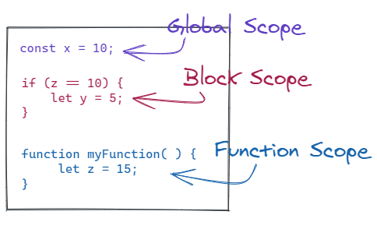
Scope
JavaScript has 3 Scopes
Global Scope
declared outside of a block or function
available everywhere
Block Scope
variables are available in the block in which they are created
like Java
if, for, etc.
let and const obey block scope
var ignores block scope
Function Scope
Variables created in a functions block are only available in that function
var, let, and const all obey function scope

Slide 7
JSDoc (Function Documentation)
/**
Should document what a function does, but not how it works
Each parameter should document
@param
data type
name
what it represents
@param {data type} name description
If there is a return, it should be document
@returns
data type
description
@returns {data type} description

Slide 8
Anonymous Functions
Anonymous functions have parameters and a code block, but do not have a name.
Can be assigned to variables
Can use the function keyword:
const doubleSum = function (x, y) {
let val = (x + y) * 2;
return val;
}
doubleSum(2, 4);
Or the the fat arrow operator ( => )
const trippleSum = (x, y) => {
let val = (x + y) * 3;
return val;
}
Equivalent except for the this keyword
this keyword
With function() { }
Has its own context
With () => { }
Inherits its context from where it is called

Slide 9
Array forEach() function
Loops through the values in the array 1 at a time, similar to a Java for each
https://developer.mozilla.org/en-US/docs/Web/JavaScript/Reference/Global_Objects/Array/forEach
Array.forEach()
Takes an anonymous function as an argument, that function will be passed 4 arguments:
Current value
index
array
Does not return a value

Slide 10
Array reduce() function
Aggregate the values in an array to a single value
https://developer.mozilla.org/en-US/docs/Web/JavaScript/Reference/Global_Objects/Array/reduce#Description
Array.reduce()
Takes an anonymous function as an argument, that function will be passed 4 arguments:
Aggregated value
Current value
index
array
returns the aggregated value

Slide 11
Array filter()
filter()
Creates a new array of values from the original array that match a condition
https://developer.mozilla.org/en-US/docs/Web/JavaScript/Reference/Global_Objects/Array/filter#Description
That condition is created by an anonymous function that is passed 3 values
Current value from the array
Current index
Array
Anonymous function should return true if the value should be included in the new array, and false if it should not be included

Slide 12
Array map()
map()
Creates a new array of all the values from the original array changed in a way defined by an anonymous function
https://developer.mozilla.org/en-US/docs/Web/JavaScript/Reference/Global_Objects/Array/map
That condition is created by an anonymous function that is passed 3 values
Current value from the array
Current index
Array
Anonymous function should the new value for the same index in the new array

