Slide 1
Document Object Model
Module 3 - 08

Slide 2
Objectives
Document Object Model (DOM)
DOM Transversal
DOM Manipulation
HTML Templates

Slide 3
Document Object Model (DOM)
Document Object Model (DOM) is a programming interface for the graphical representation of documents that are loaded into the browser. It provides a way to access and manipulate the structure, style, and content once loaded.
The HTML source is not the DOM
The HTML is parsed once when the page is loading and turned into the DOM.
A presentation of the DOM is what the browser is displaying to the user.
CSS and JavaScript select elements in the DOM, not the HTML
The representation of the DOM is the what is shown in the browser Development Tools

Slide 4
Nodes
The DOM represents the page in a Tree Structure
The top node is called the root (or root node)
Every node, except the root node, has 1 parent
Each node can have any number of children
Nodes with the same parent are called siblings
While the DOM representation often follows HTML, it may have extra nodes

Slide 5
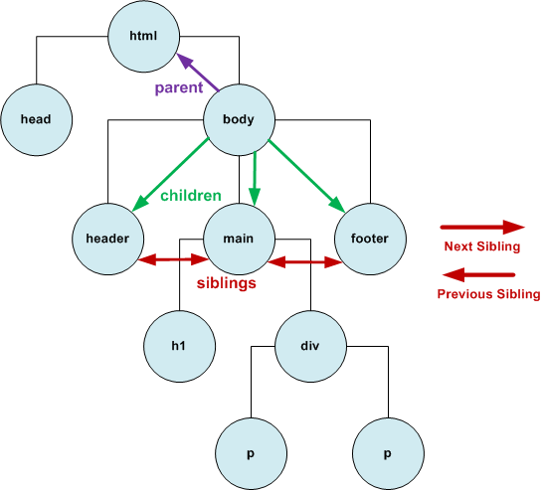
Nodes
HTML
<html> <head></head> <body> <header></header> <main> <h1></h1> <div> <p></p> <p></p> </div> </main> <footer></footer> </body> </html>

Slide 6
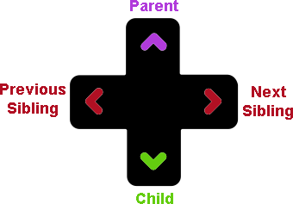
DOM Transversal
DOM Navigation on W3Schools
Moving around the DOM using the relationship of the nodes
Always start with the document node
Get Element
By ID: document.getElementById(‘id’)
By Selector: document.querySelector(‘css selector’)
a single item that matches the css selector
querySelectorAll()
return an array that matches the css selector
Select another element by Relationship
firstChild, lastChild
firstElementChild, lastElementChild
nextSibling, previousSibling
parent, child
childNodes[index]
Node: representations of the HTML document, but may not match the HTML exactly Element: representation of an HTML tag

Slide 7
DOM Manipulation
Writing code to change and select information on the DOM using JavaScript while the page is loaded in the browser
Select an element
Set HTML (innerHTML) - use carefully to avoid cross-site scripting
Set Text (innerText) - preferred way to set text, unless you need to insert HTML tags
Create Element
document.createElement(‘tag’)
Can manipulate the element
setAttribute()
classList()
add, remove, contains
Vanilla JavaScript
JavaScript that does not rely on outside libraries or frameworks.

Slide 8
insertAdjacentElement()
element.insertAdjacentElement(position, element);
position
A DOMString representing the position relative to the element; must be one of the following strings:
'beforebegin': Before the element itself.
'afterbegin': Just inside the element, before its first child.
'beforeend': Just inside the element, after its last child.
'afterend': After the element itself.
<!-- beforebegin -->
<p>
<!-- afterbegin -->
foo
<!-- beforeend -->
</p>
<!-- afterend -->
element The DOM element to be inserted into the tree

Slide 9
Adding/Removing Elements
insertAdjacentElement(), insertAdjacentText(), insertAdjacentHTML()
appendChild()
adds the new element as a new child to selected element - same position as beforeend
removeChild()
Removes a child element
insertRow(), insertCell()
used with tables
insertBefore()
inserts an element before the selected child of the current element

Slide 10
HTML Templates
Allows us to define HTML that is included in the DOM for manipulation, but not rendered on the page
Copy the template, manipulate it, and insert the updated copy into the DOM as regular elements that are rendered
document.getElementById('review-template').content.cloneNode(true);
content.cloneNode( true/false )
true - deep copy (includes children and ancestors)
false - shallow copy (just the node without its children)
Many older browsers do not support templates, so must always verify they are supported for using them in our JavaScript

