Slide 1
Event Handling
Module 3 - 09

Slide 2
Objectives
Introduction to Events
Event Handling
Event Handling in JavaScript
Event Propagation
Event Delegation

Slide 3
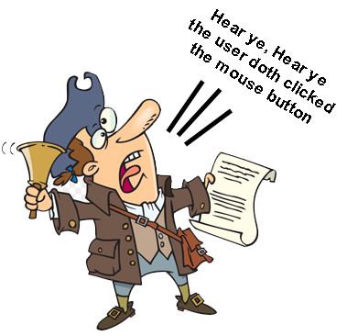
Events
Actions or Occurrences that happen in the system or your application, which the system tells you about so you can respond
When the user takes an action, like click a mouse button, the Operating System “screams” out to any application that is interested that the event occurred.
Applications that are interested in that event register an Event Listener that “hears” the event and allows the program to take action.

Slide 4
Web Events
When a user takes an action in the browser window, the browser raises an event letting application running it know that the event occurred
Everything the user does raises some sort of event, or sometimes multiple events, allowing the programmer to choose what events they care about and what actions they want to take in response.
Many of the actions the browser or HTML elements take are also raised as events that can be handled.
Example of user actions
User clicks a mouse button
User pressing a key on the keyboard
User moves the mouse
Example of browser/html actions
form submits
page has finished loading
textbox value has changed
browser has been resized

Slide 5
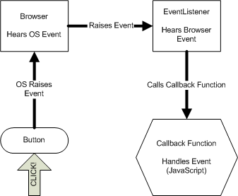
Event Handling
The receipt of an event at some event handler that was raised by an event producer
The event producer raises the event (the user clicked on a button), the event handler receives the event and forwards it to a callback function, which is a function in our code that will react to the event.
Event handling is managed in JavaScript not CSS or HTML

Slide 6
Event Handler
code in our JavaScript that reacts when an event occurs
Callback function that will be called by the Event Listener, which what “hears” the event, when the event occurs
usually an anonymous function
includes an optional parameter to receive the Event Object
The Event Object
An object that is passed to the event handler callback function that details the event
the Target: what was the focus of the event (example: what the user actually clicked on)
the events location
mouse events: includes which mouse was button was used
keyboard: which key was pressed
Each event type has an event object with information unique to that event

Slide 7
Event Listeners
To react to an event we must register an EventListener, this tells the browser that we are interested in the event and want to react to it.
When the EventListener a callback method is provided. When the EventListener is informed that the event has occurred it will call our callback method. In JavaScript we provide a callback method as an anonymous function that we pass to the eventListener when we create it.
document.addEventListener(eventType, eventHandler)
document - The element we want to listen for an event on
addEventListener - Adds an Event Listener Documentation
eventType- the event we want to add a listener for. Documentation
eventHandler - A callback function for the eventListener to call when the event occurs. This can be an anonymous function or a named function.
document.addEventListener('DOMContentLoaded', (event) => {
Code here to react to the event
});
document.querySelector(‘button’).addEventListener(‘click’, (event) => {
Code here to react to the event
});

Slide 8
DOMContentLoaded
Is raised on the document when the HTML has been fully loaded into the DOM and is ready for manipulation, does not include other resources such as images or stylesheets.
all functionality (not variable declarations) that is not in a Function should be only run once this event has been raised
functions should be declared outside of this event
Many example show to use the load event, but that is out of date, and in modern web applications is only used when other resources, such as images, need to exist before the JavaScript is run.
document.addEventListener('DOMContentLoaded', () => {
});

Slide 9
Common Web Document Events
DOMContentLoaded | Occurs once the HTML has been parsed and loaded into the DOM, but not the stylesheets, images, and subframes. This is the event most commonly used to verify the DOM is ready for manipulation by JavaScript.
load | Occurs once the page is fully loaded. Used if the JavaScript needs to wait until other resources, like images, are fully loaded into the DOM.
unload | Occurs when the page is being unloaded from the DOM. Used for annoying “Are you sure you want to leave this page” pop-ups.

Slide 10
Common Web Mouse Events
click | Occurs when a user clicks on an element
dblclick | Occurs when a user double clicks on an element
mouseenter | Occurs when the mouse pointer enters the border of an element.
mouseover | like mouseenter, but also occurs when the mouse pointer enters the border of the element or any of its children.
mouseleave | Occurs when the mouse pointer exists the box of the an element
mouseout | Like mouseleave, but also occurs when the mouse point exists the box of any of the elements children.

Slide 11
Common Web Keyboard Events
keydown | Occurs when a key is pressed down. Occurs for any key on the keyboard. The key pressed can be checked using either the key or keycode property of the event object.
keyup | Occurs when a key is released. Occurs for any key on the keyboard. The key pressed can be checked using either the key or keycode property of the event object.
keypress | Like keydown, but only occurs for keys that produce characters.
Keyboard Events: https://developer.mozilla.org/en-US/docs/Web/API/KeyboardEvent
Keyboard Event Codes: https://developer.mozilla.org/en-US/docs/Web/API/KeyboardEvent/key/Key_Values

Slide 12
Common Web Form Events
change | Occurs when the contents of a form element change. However, in some browsers it does not occur for input type text. For text fields the keyboard events can be used to capture the same behavior.
focus | Occurs when a user selects a form element to receive input, such as by clicking on it or navigating to it with the keyboard.
blur | Occurs when the user leaves a form element that previously had focus.
submit | Occurs when the form is being submitted. For form submissions the form submit event should be used and never the submit buttons click event.

Slide 13
Default Actions
Many elements like <a>, <button>, <form>, etc. have actions that occur “out of the box”
<a> redirects the browser to the URL in href
<form> submits
<button> cause a form to take action
Default actions occur anytime an element that has one is “used” - these are things that happen with just standard HTML
Can stop the default action by calling preventDefault() on the event object
event.preventDefault()

Slide 14
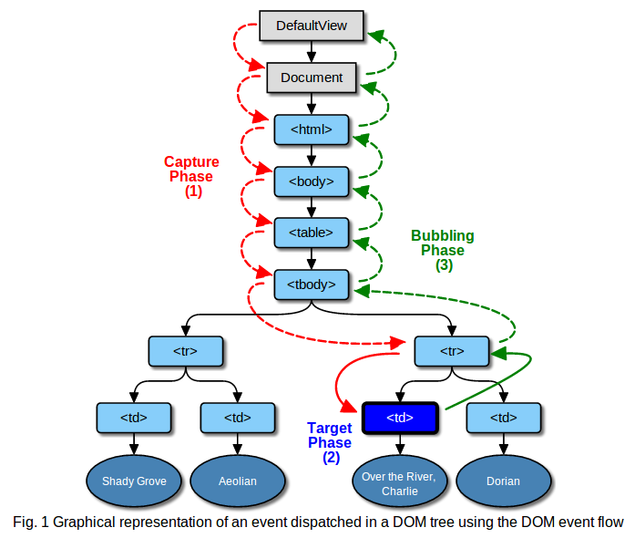
Event Propagation
When an event is raised on a DOM element every parent of that element is also notified
3 Phases
Capture phase - starts at the document and notifies every element in the hierarchy until it reaches the target element
Off by default but can be enabled
Target phase - the target element (example the button the user clicked on) is notified of the event
Always is included
Bubble phase - starts at the target and notifies all of the parents in the hierarchy of the target
This is the default for the browser event handler
Can stop propagation by calling: stopPropagation() on the event object

Slide 15
Event Delegation
Handling events for like elements on the common parent
handling events for a group of <li> on the common <ul> parent
Add the event handler to a common parent that will receive the event due to bubble propagation.
Use event.target on the event object to determine which element actually received the event
<ul>
<li>Item One</li>
<li>Item Two</li>
<li>Item Three</li>
</ul>
Event Handler
Event Propagated
Event Target

