Slide 1
Intro to Vue.js and Data Binding
Module 3 : 11

Slide 2
Week 11 Overview
Monday
Intro to Vue
Tuesday
Matchmaking (no class)
Wednesday
Vue Events
Thursday
Components
& VueX
Friday
Vue Router

Slide 3
Objectives
Introduction to Vue
Creating a Vue Project
Single Page Applications (SPA)
Parts of a Vue.JS project
Components
Vue Data Binding
1-Way Data Binding
Arrays with v-for
Binding DOM Element Attributes with v-bind
Computed Properties
Conditional Elements using v-if
2-Way Data Binding with v-model
Conditional Attributes with v-bind

Slide 4

Creating a new Vue.Js Project
In Terminal in today’s student-lecture folder
vue create vue-product-reviews
On the VueCLI Create Project Menu
Select Default ([Vue 2] babel, eslint) as project type
VUE.JS

Slide 5
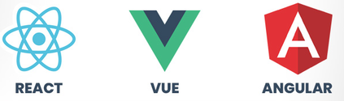
What is Vue.Js
Vue.Js is a JavaScript progressive framework for building user interfaces, that is designed to be incrementally adoptable. The core library focuses on the View Layer only and is easy to pick up and integrate with other libraries or existing projects. However, used in combination with a modern toolchain and supporting libraries it is also capable of creating sophisticated Single-Page Applications (SPA)..
progressive framework Implementing by extending HTML with new tags or attributes
Vue is an open source competitor to frameworks like Angular (Google) and React (Facebook). Unlike Angular and React, Vue is a non-opinionated interface and can be easily integrated into other libraries and frameworks.

Slide 6
VUE IS A JS FRAMEWORK
Event Management
Easy DOM Manipulation
Established Patterns
Integration Points
Reusable Components
Data Binding
URL Management

Slide 7

VUE IS JAVASCRIPT
===

Slide 8
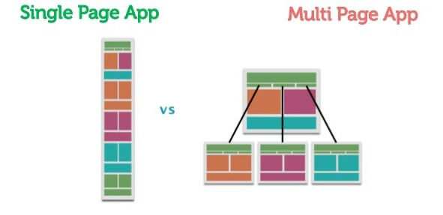
Single Page Application (SPA)
Serves a single HTML page and all other “pages” in the site are generated using DOM manipulation of the original HTML with new data retrieved from web API using JavaScript.

Slide 9
Single Page Application (SPA)
Pros
Better user experience due to instant responsive feedback
Servers require less resources
Allows more reusable Server Side Code, the server uses web services to provide data, so it is further decoupled from the view
Using caching can be transformed into an offline experience (e.g. Google Drive)
Allows separation of focus for developers: frontend developer can focus fully on the frontend and backend developers fully on the backend

Slide 10
Single Page Application (SPA)
Cons
Slower upfront load time
Work performed on the client and often kept open for hours rather than minutes like a traditional web page, developers must be aware of possible code issues that do not affect traditional web pages, like memory leaks.
Search engines cannot effectively index them, so sites that rely on content are not effective as a SPA (e.g. a Blog)
Requires more backend development
Limits users without JavaScript, slow machines, or Accessibility Needs. (e.g. Screen Readers).
browsers default navigation (Back button, etc) does not work, so SPA must handle these events.
The browser’s History API and Routers help deal with this

Slide 11
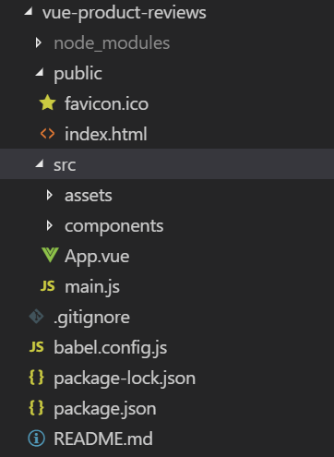
Parts of a Vue Project
node_modules
JavaScript libraries required run our project and the current Toolchain
Created when “npm install” is run for a project
public
Initial HTML file and other static files
src
Vue Source Code - where most vue application development is done
sub-folders
assets - images, css, reusable js scripts, etc.
components - vue components (.vue files)
App.vue - starting component. A place to add global components like a Header or Footer. The starting component does not need to be App.vue, but it is in the default project.
main.js - Single Vue instance that starts Vue running and loads the initially components (main method)

Slide 12
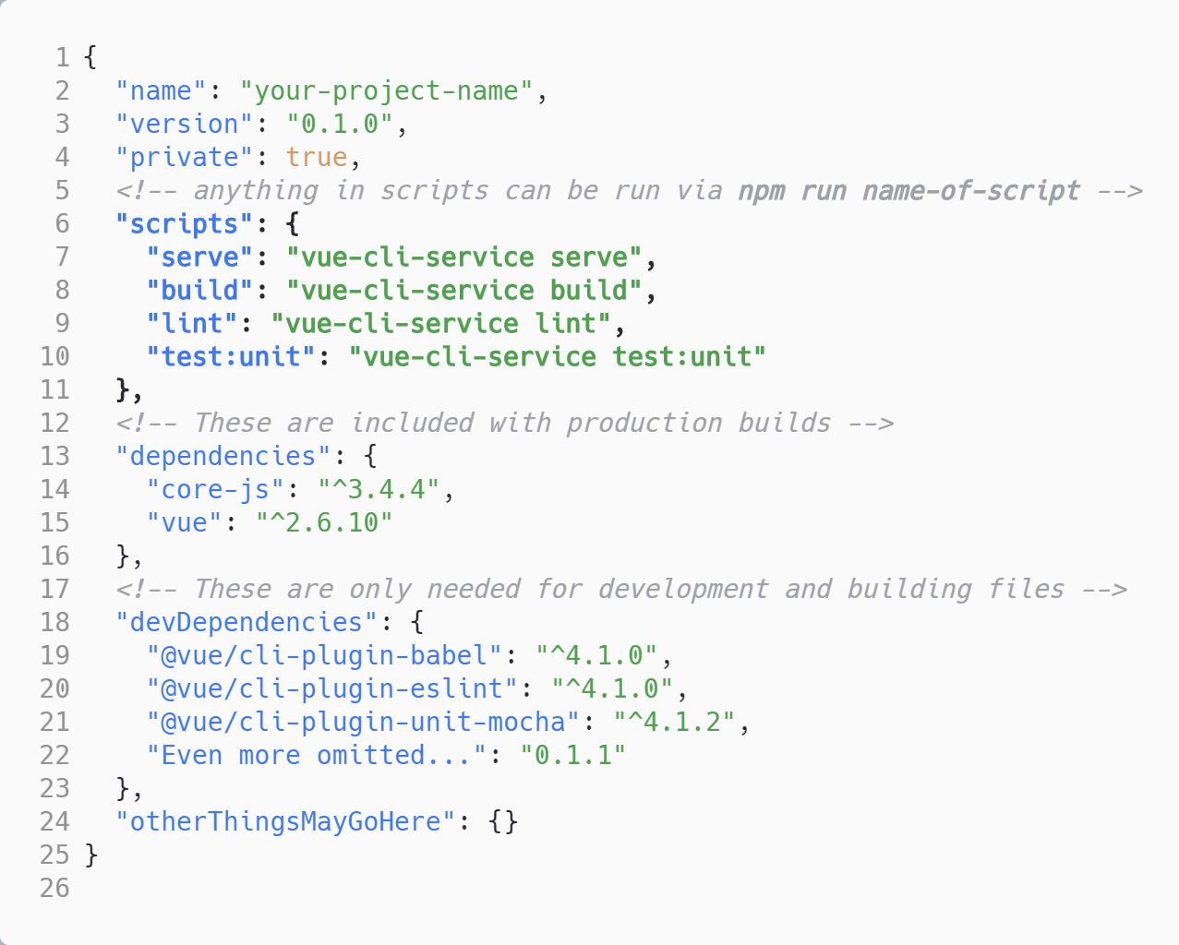
Parts of a Vue Project - Everything Else
.gitignore: sensible defaults for .gitignore
babel.config.js: babel configuration
package-lock.json: It describes the exact tree that was generated, such that subsequent installs are able to generate identical trees, regardless of intermediate dependency updates.
package.json: The NPM package meta file that contains all the build dependencies and build commands.
README.md: default readme file
package.json

Slide 13

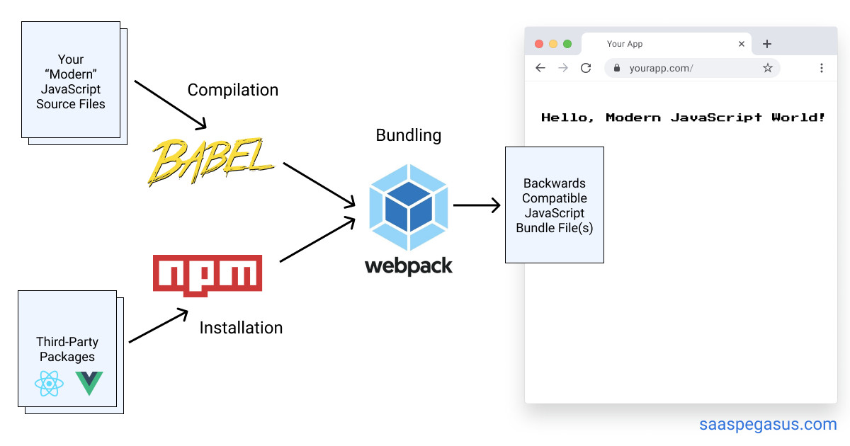
The Vue Toolchain
A set of programming tools that work together to perform a complex task or create a software product by linking together sequential to each provide part of the needed functionality.

Slide 14

Node Package Manager (NPM)
Manages Dependencies and builds
Similar to Maven in Java
https://docs.npmjs.com/about-npm/

Slide 15

JavaScript compiler and Transpiler that provides Polyfill
Compile - compiles other languages, like TypeScript, to JavaScript
Transpile - converts modern JavaScript syntax ( ECMAScript 6 ), which is not yet fully supported by browsers, into older style JavaScript that those browser can use.
Polyfill - fills gaps in support for newer web features, like HTML5, by providing functionality in a way that devices that do not support those newer features do support.
https://babeljs.io/docs/en/

Slide 16


Starting the Vue Application
WARNING
Vue applications do not use Live Server!
In the project directory which contains the package.json file:
npm run serve

Slide 17
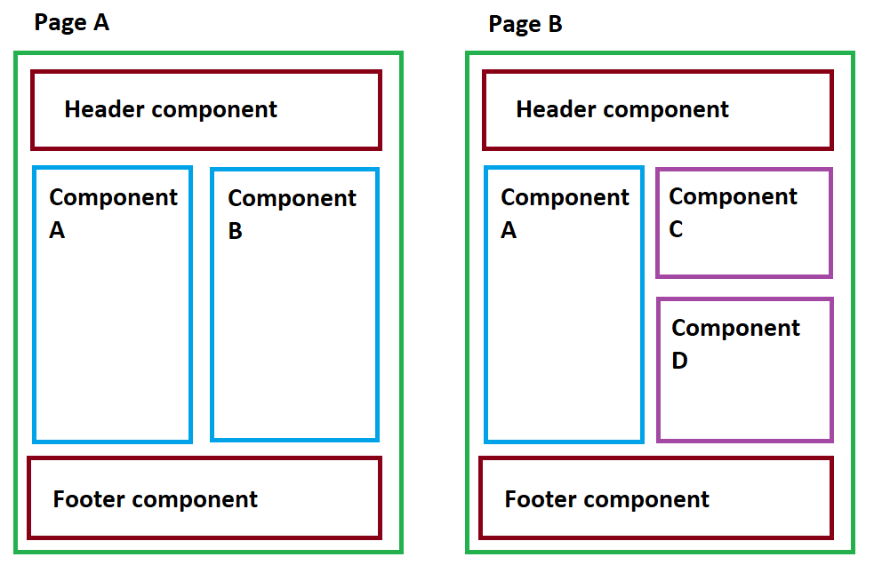
Vue Components

Slide 18

Parts of a Vue Component
Template - HTML (structure)
Script - JavaScript (behavior)
Style - CSS (presentation)

Slide 19
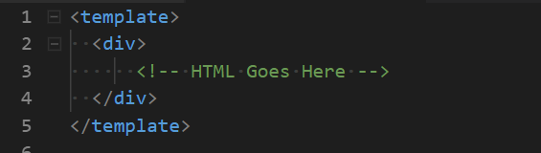
The Template
Provides the structure of the component
Contains HTML
must contain a single container (div, section, main, etc.) with all parts of the component children of that container

Slide 20
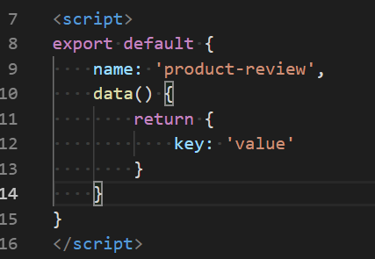
The Script
Provides the behavior and data of the component
Contains JavaScript
Mostly inside an export default {} block
define name for the component and data that component uses
data() must return an object of key/value pairs for the data the page uses

Slide 21
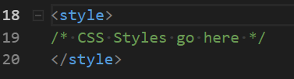
The Style
Provides the presentation of the component
CSS
scoped ( <style scoped>) : CSS in this component will only be applied to elements in this component and this CSS will not be available elsewhere. Does not work in regular CSS/HTML.

Slide 22
Adding a Component to the Page
In the views (App.vue) <script>:
import the component: import ProductReview from './components/ProductReview.vue'
Add the component to the components object in the export:
Add the component as a tag in the location where you want it displayed:
export default {
name: 'App',
components: {
ProductReview
}
}
In the views (App.vue) <template>:
<template>
<div id="app">
<product-review></product-review>
</div>
</template>

Slide 23
Basic Vue JS Terminology
To prepare a vue project you didn’t create: npm install
To start a Vue Project: npm run serve
Component: Encapsulated reusable code to be used in a Vue web application - can represent a “page” or a “widget”
App.vue - the main parent component of a view application
NPM commands like install and run serve must be run in the directory that contains the package.json file.

Slide 24
1-Way Data Binding
<template>
<div class="main">
<p class="description">{{ description }}</p>
</div>
</template>
<script>
export default {
...
data() {
return {
description: 'This is a description'
}
}
}
</script>
Uses the {{ variable }} syntax
Like a placeholder in HTML that “binds” to the variable in the data. Binding means that they stay in sync.
If the variable changes the value on the page is “automatically” updated - this is called reactivity.

Slide 25
Looping with v-for
Add v-for to any HTML element and that element will be created once for each loop.
Requires an identifier for each row called the key. If a unique identifier is present in the object, like an id, then that should be used for the key. If not then another value can be used.
v-for=”variable in arrayOrObject” v-bind:key=”id”
variable: a variable name to hold each item in the array arrayOrObject: The array or object to loop over id: the key to use

Slide 26
Arrays with v-for continued
Array
instructors = [ { id: 1, name: John }, { id: 2, name: Rachelle } ]
v-for
<div v-for=”instructor in instructors” v-bind:key=”instructor.id” > {{ instructor.name }} </div>
Generated HTML
<div> John </div> <div> Rachelle </div>

Slide 27
Binding to DOM element Attributes with v-bind
v-bind allows for data in the view model to be bound to attributes of elements in the DOM.
Any attribute (src, title, class, etc.) can be bound to data or a simple conditional statement using v-bind
<img src="../assets/star.png" v-bind:title="review.rating + ' Star Review'" />

Slide 28
<template>
<div class="main">
<p class="description">{{ averageRating }}</p>
</div>
</template>
<script>
export default {
...
data() { . . . },
computed: {
averageRating() {
let sum = this.reviews.reduce( (currentSum, review) => {
return currentSum + review.rating;
}, 0);
return sum / this.reviews.length;
}
}
</script>
Computed Properties
Allows one way data binding to a calculated value
Similar to a derived property in Java
If the value of the computed property changes then the bound text is updated on the page
The component’s data can be accessed by the this keyword

Slide 29
Conditional Elements using v-if
Added as an attribute to the HTML element you want to be conditional
v-if=”<boolean condition>”
if FALSE does not add or removes the element from the DOM
v-show=”<boolean condition>”
if FALSE adds the element to the DOM, but hides it
<p v-if="showDescription" class="description">{{ description }}</p>
<p v-show="showDescription" class="description">{{ description }}</p>

Slide 30
2-Way Model Binding with v-model
Form elements, which can be changed by a user (text fields, radio buttons, select boxes, etc.), can be bound using 2-way data binding using the v-model attribute.
2-way data binding keeps the data and the user input in sync. So that when the form element is changed by the user the data is reactively updated and if the data is changed the form element is reactively updated.
Some Vue attributes, like v-model can accept modifiers. For example, v-model.trim modifies the data by removing leading and trailing whitespace similar to trim() in Java.
HTML
<input
type="text"
id="name"
v-model.trim="contact.name"
/>
Data
contact: {
name: '',
email: '',
emailType: ''
}

Slide 31
Conditional Attributes with v-bind
Simple conditionals can be used with v-bind. For example, binding different CSS classes depending on a condition.
Conditionals in a v-bind are blocked by a single { } instead of {{ }} like is used in variable binding. The value can either be a string in single quotes or a variable. The value and the condition are separated by a colon ( : ). When the condition is TRUE the value is used, when it is false no value is used. It is possible to do more complex bindings with else like conditions.
Syntax: v-bind:attribute=”{ ‘value’ : boolean condition}”
<h4 v-bind:class="{'verifiedReviewer' : review.verifiedReview}">{{ review.reviewer }}</h4>
Output when review.verifiedReview is TRUE: <h4 class=”verifiedReviewer”>...</h4>
Output when review.verifiedReview is FALSE: <h4 class=””>...</h4>

