Slide 1
Vue Event Handling
Module 3: 12

Slide 2

Last time in
VUE.JS

Slide 3
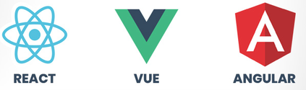

VUE IS A JS FRAMEWORK
Vue is a progressive framework Implement by extending HTML with new tags or attributes
Event Management
Easy DOM Manipulation
Established Patterns
Reusable Components
Data Binding
URL Management
VUE IS JAVASCRIPT
===

Slide 4
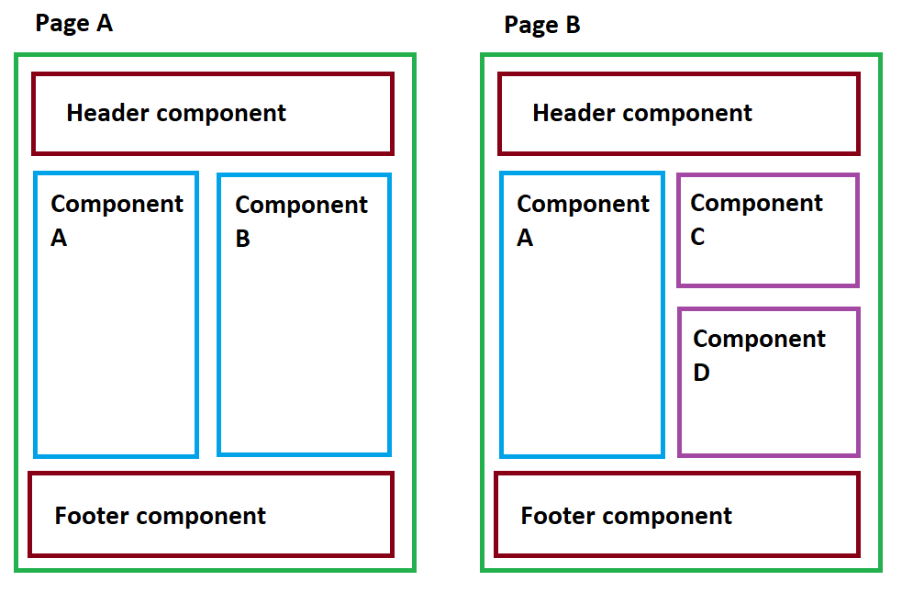

Components

Slide 5
1-Way Data Binding
<template>
<div class="main">
<h2>Product Reviews for {{ name }}</h2>
...
</template>
<script>
export default {
...
data() {
return {
name: "Cigar Parties for Dummies",
}
...
}
}
</script>
Binds data from the view model data() return to be displayed in the template.
If the data is changed Vue reacts by updating the display in the template.
Uses {{ variable }}

Slide 6
Loops ( v-for )
<template>
<div class="main">
...
<div
v-for="review in reviews"
v-bind:key="review.id"
>
<h4>{{ review.reviewer }}</h4>
...
</div>
</div>
</template>
<script>
export default {
data() {
return {
...
reviews: []
}
},
}
</script>
Repeats an HTML element by looping over an array in the data like a foreach loop.
If the array is changed Vue reacts by redrawing the looped elements.
A variable is created to hold each element of array, which can be used in the tag being repeated and its children.
Required a key attribute on the tag being repeated that is bound with v-bind to a unique property in the array items.
v-for=”variable in array”
v-bind:key=”variable.uniqueProperty”

Slide 7
Attribute Binding ( v-bind )
Setting a value: v-bind:attribute=”variable”
Allows for a single, simple line of JavaScript to be evaluated for the value of an attribute.
Can be bound to data in an v-for variable or in the data() to set the value of an attribute.
v-bind:attribute=”variable”
Can use a simple boolean expression to conditionally set the value of the attribute.
v-bind:class=”{ value: boolean }”
<img
...
v-bind:title="review.rating + ' Star Review'"
/>
Conditionally setting a value: v-bind:attribute=”{ value : booleanCondition }”
<div
...
v-bind:class="{ favorited: review.favorited }"
...
>

Slide 8
Computed Properties
<template>
...
<span class="amount">{{ averageRating }}</span>
...
</template>
<script>
export default {
data() {
return {
...
reviews: []
} },
computed: {
averageRating() {
let sum = this.reviews.reduce(...);
return sum / this.reviews.length;
},
}
Creates a calculated property that can be 1-way bound to the template.
Uses values from the data() to calculate the value. If the data value is updated Vue reacts by computing the property again and updating the template with the new value.
Must return a value and cannot take parameters
Added to the computed: section of the script.
Requires the this keyword to access data in other parts of the view model.

Slide 9
2-Way Data Binding
<template>
<div id="addemail">
...
<input type="text" id="name"
v-model="usersName">
...
</template>
<script>
export default {
data() {
return {
usersName: '',
...
}
}
}
</script>
Binds data from the view model data() return to a form element.
If the data is changed Vue reacts by updating the value of the form element.
If the value of the form element is changed Vue reacts by updating the value of the data.
Uses v-model=”variable”

Slide 10
Today in
Binding a Form to a new Object
Methods
Vue Event Handling
Event Listening with v-on
Event Modifiers
Keyboard and Mouse Event modifiers
Event Actions
Inline Events
Event Methods
The Event object
VUE.JS

Slide 11
Binding Forms to a new Object
Forms can be bound to an empty object that represents it. The object does not need to have the keys already defined. When the form is bound the keys used will be created in the object.
Object in Code
person: {},
Form
<input id=”firstName” type=”text” v-model.trim=”person.firstName”>
<input id=”lastName” type=”text” v-model.trim=”person.lastName”>
Resulting Object
person: { firstName: value, lastName: value }

Slide 12
Methods
We can also add functions to our component.
Added in the methods: {} section.
Unlike computed properties, methods can have arguments.
Methods are NOT REACTIVE - meaning they are not updated when values change, we must call them when there is an update or use them in a computed property and pass them the data to make them reactive - which will the reactive computed property to call the method again when the data is changed.
Methods can use the this keyword. this refers to this component and can be used to access the data or other methods in the view model.

Slide 13
Event Listening with v-on
Adds an event listener for an element
v-on Documentation
Syntax: v-on: <event>=” <action to take> “
v-on:click="showForm = true"
Can use @ to alias v-on:
@click="showForm = true"
The Action can either be a single line of JavaScript or a method call
v-on:click="showForm = true"
v-on:click="showForm()"

Slide 14
Event Modifiers
Syntax: v-on:<event>.<modifier (optional)>=” <action to take> “
Modifiers (documentation):
.stop → Stops Propagation
.prevent → Prevents default behavior
.once → Event is triggered only once
v-on:click.prevent="showForm = true"
Modifiers can be chained - and are applied in the order indicated
v-on:click.prevent.once="showForm = true"

Slide 15
Keyboard and Mouse Event Modifiers
Alias exist for Keyboard keys and Mouse Buttons for Keyboard and mouse events.
For Keyboard any regular JavaScript KeyboardEvent.key value can be used by converting them to all lower-kebab-case
Vanilla JavaScript PageDown : <input v-on:keyup.page-down="onPageDown">
ArrowDown: keyup.arrow-down
Mouse events have modifiers that can restrict the event to specific mouse buttons: v-on.click.right=”handleRightMouseButtonClick()”
.left v-on.click.right.prevent=”handleRightMouseButtonClick()”
.right
.middle

Slide 16
Event Actions
Event actions can be a single line of JavaScript
v-on:click="showForm = true"
Event actions can also be a method
v-on:click="showFormMethod()"
When the action is a method, if no arguments are passed then the parenthesis can be omitted
v-on:click="showFormMethod"
Arguments (0...n) can be passed to to an method from an event action
v-on:click="showFormMethod(2, true)"

Slide 17
The Event Object
The Event Object will be passed as an implicit variable to any method that does not take any arguments
v-on:click="showFormMethod"
If a method takes other arguments, then the event object can be passed to a method using $event
v-on:click="showFormMethod(2, $event)"
function showFormMethod(event) {
event.target;
}
function showFormMethod(num, event) {
event.target;
}

