Slide 1
Vue Component Communication
Module 3: 13

Slide 2
Objectives
Single Responsibility Principle
VueX
Component Design

Slide 3
Vue Components
Meant to reusable parts
Components that are meant to be reusable parts are called Components
Components that represent a full page are called Views
Views contain components

Slide 4
Single Responsibility Principle
The single-responsibility principle (SRP) is a computer-programming principle that states that every module or class should have responsibility over a single part of the functionality provided by the software, and that responsibility should be entirely encapsulated by the class, module or function.

Slide 5
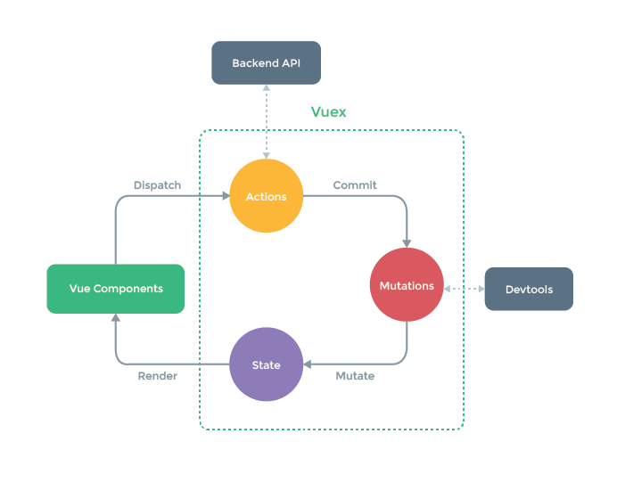
VueX
Vuex is a state management pattern + library for Vue.js applications. It serves as a centralized store for all the components in an application, with rules ensuring that the state can only be mutated in a predictable fashion.
VueX helps us deal with shared state between components with the cost of more concepts and boilerplate code. It’s a trade off between short-term development costs and long term increased productivity.
VueX Documentation

Slide 6
The VueX Store
VueX adds a shared state “store” that will be used by all components in our application. It is divided into 5 major parts.
State
Getters
Mutations
Actions
Modules
Not all parts of the VueX store are needed for an application. Today we will focus on State and Mutations.

Slide 7
VueX Store - State
The State is the data. It contains much of what we added to the data() property of our single component.
It can be accessed from any component using this.$state.key in the <script> or $state.key in the <template>
When used in a computed property, then then elements bound to the computed property will be reactively updated when the state changes.

Slide 8
VueX Store - Getters
Vuex allows us to define "getters" in the store. You can think of them as computed properties for stores. Like computed properties, a getter's result is cached based on its dependencies, and will only re-evaluate when some of its dependencies have changed.

Slide 9
VueX Store - Mutations
The value of properties in the state should never be changed directly. Instead they should be changed by committing mutations. A mutation is similar to a setter in a Java class, but adds additional functionality.
Mutations allow for the state to be changed in a way that will be reactive for other components sharing the same state.
Mutations have the added benefit of tracking when and how state was changed. The view Dev Tools can be used to view and manipulate this history, which is invaluable during debugging.

Slide 10
VueX Store - Actions
Actions work similar to methods that can be called ( dispatched ) to change state or perform other functionality.
An Action contains business logic and does not necessarily care about the state. However, it can change the state using a mutation.
For example, an Action may load data by calling an API before committing a mutation.

Slide 11
VueX Store - Modules
Modules allow for groups of state, mutations, actions, and getters to be encapsulated together similar to a class.
This allows for each module to have responsibility for one segment of the VueX state store.

Slide 12
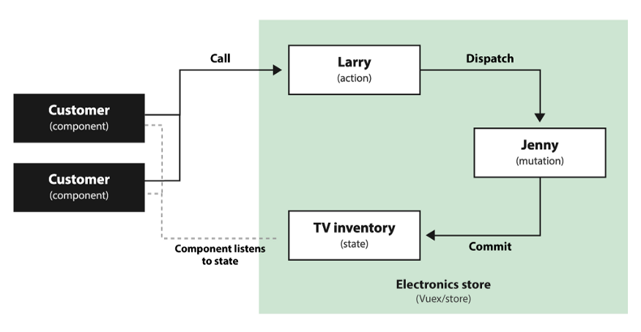

Slide 13
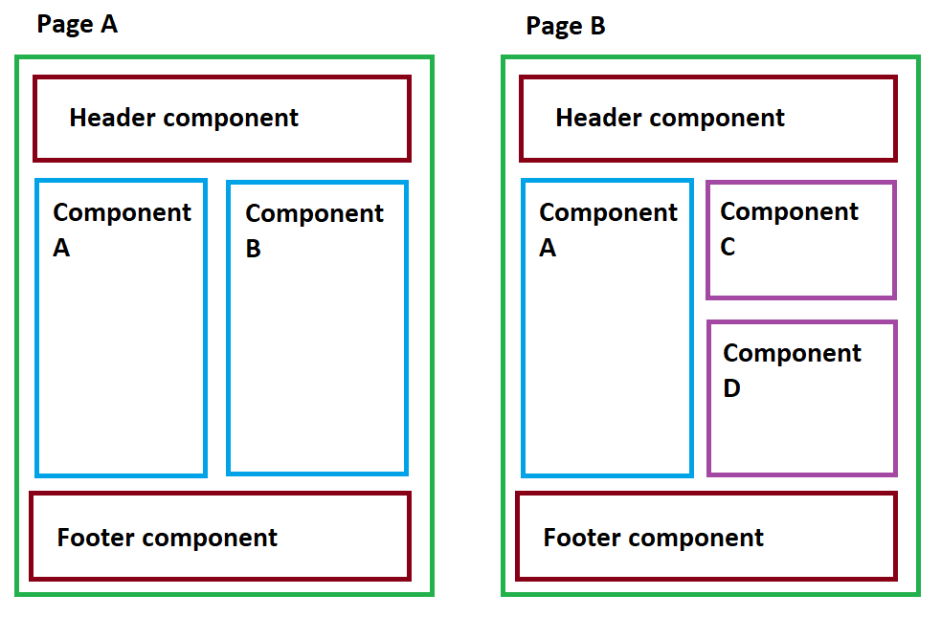

Slide 14
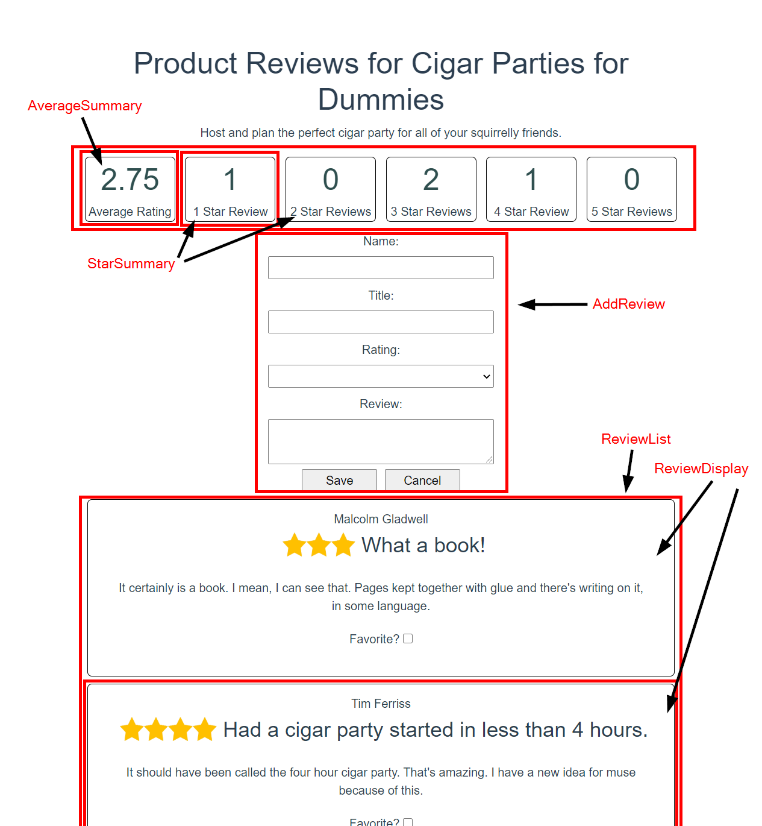
Components
AverageSummary
StarSummary
AddReview
ReviewList
ReviewDisplay

