Slide 1
Vue Routing
Module 3: 14

Slide 2
Objectives
The Problem with SPA
Vue Router
Views vs Components
Configuring Routes
<router-view>
Accessing Route Parameters
<router-link>
Redirects
Handling Not Found (404)
Navigation Guards
Vue LifeCycle and LifeCycle Hooks
Watchers

Slide 3

Single Page Application (SPA)
Serves a single HTML page and all other “pages” in the site are generated using DOM manipulation of the original HTML with new data retrieved from web API using JavaScript.

Slide 4


The Problem with Single Page Applications (SPA)
Browsers tracks individual pages by the HTTP Request/Responses and the resources they return. In a traditional web application each individual page is a separate resource (html/jsp) and has its URL.
In a SPA site only one resource is returned, the index.html, so there is only 1 URL for the browser to track. Since most websites have multiple pages, how can the browser track what page the user is a one, when they all use the same resource and different pages are created by API calls and DOM manipulation of that resource?
.

Slide 5
The Problem with SPA continued...
Answer: the browser can’t track what internal page the user is on since it sees all the pages as a single URL
The problems this creates:
The Back button doesn’t work for internal pages, instead they go “back” to the last resource, which is most likely a different site.
The Refresh button doesn’t refresh the internal page, instead it repeats the browsers last HTTP Request, which reloads the index.html, or the starting page.
Browser History doesn’t track internal pages, instead the entire visit to the site is represented in history as a single request for the initial index.html
Users can’t bookmark an internal page. If they do and come back the browser correctly sends the request, but the server does not know what the URL means so can’t load the bookmarked page, and can only respond with a 404.

Slide 6
SPA Solution - The Router
SPA Frameworks like Vue, Angular, and React solve this problem by providing a Router that allows fine-grained navigation, bookmarking of pages, and traditional use of a URL.
Vue provides the Vue Router for this purpose. Documentation
The router allows definition of URL routes for “internal” pages of a Single Page Application giving users a traditional web application experience. This works by not loading the routes on the server, but by the server still responding with the index.html when a bookmark, back button, or refresh button are used. The Vue Framework then uses the URL to load the correct View and load the data on the client side.

Slide 7
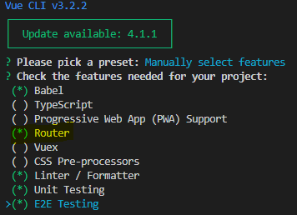
Adding the Vue Router to a project
To add to a new project: when you run vue create select “Router” as an option.
To add to a an existing project. Go to the project directory with the package.json file in terminal. Run npm install, if you have not already done so. Then run command: vue add router

Slide 8
Router History Mode
When you run vue add router you will be asked if you want to use history mode (Documentation)
The default mode for vue router is to use hash mode which simulates a full URL, but adds the client side portion of the URL after a #. This works because the # indicates a fragment in the URL that is ignored by the server and is for use by the client.
http://localhost:8080/app/#/Home
History mode allows cleaner looking URLs by taking advantage of the browser’s history.pushState API to achieve navigation.
http://localhost:8080/app/Home
However, without proper server side configuration this will result in the server returning a 404 for the page.
For projects here at Tech Elevator this will not be an issue since use the local npm server which already handles this, but it will need to configured to be used on a production server.

Slide 9
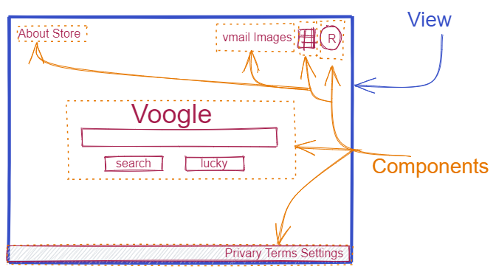
Views vs Components
From a code perspective Views and Components are the same. The difference is organizational and how they are used with routing.
Views: represent things we will route to (aka web pages) Components: reusable parts that will be used on Views

Slide 10
Router Configuration
Configured in router.js
The routes are defined in an array of JavaScript objects that define the path, name, and component to load.
routes: [
{
path: "/about",
name: "about",
component: About
} ]
path is how the route will appear in the URL
name is the routes name, like a variable name, that we use in the router-link
component identifies the component to load. The component name matches the name given to the component when importing it into the script.
import About from './views/About.vue'

Slide 11
Adding Routing for a View
In router.js
Import the View
import Books from "./views/Books.vue";
Add an object to the routes array
{
path: "/books",
name: "books",
component: Books
}
Why does the import path not use the @ alias?
Since router.js is a JS file and not a Vue component the @ alias is not available, so we must use a regular path.
/books is what will appear in the URL
books is the name we can use in a router-link to reference this route
Books is the name we gave the view in the import

Slide 12
Dynamic Routes
Dynamic routes are URLs that contain variable data, such as a product id or a user id. In SpringMVC we referred to these as PathVariables: /users/10
In route configuration a dynamic route can be used with a placeholder variable name identified by a colon ( : )
{
path: "/user/:id",
name: "user",
component: User
}

Slide 13
Accessing a parameter from the route
Route Parameters can be accessed using the $route.param object and the parameter name given in the configuration and router-link.
{
path: "/user/:id",
name: "user",
component: User
}
http://localhost:8080/user/2
this.$route.params.id will be equal to 2

Slide 14
Creating Navigation with <router-link>
To add a navigation to another page the <router-link> (Documentation) tag can be used. In Vue this replaces the <a href> tag and instead of sending the request to the server will redirect to the Vue Router to be handled.
The router-link can be used with traditional routes, like above, similar to how the routes in SpringMVC @RequestMapping worked:
<router-link to="/about">About</router-link>
However, we will generally want more control over the router-link and can bind it to an object in our router configuration. This will give us one place to change the route, the router configuration, if our routes change.

Slide 15
Router-Link
The Router-Link can be bound to a router configuration by providing a JavaScript object with a name key that matches the routes name key in the router configuration.
Syntax: <router-link :to=”{ name: ‘route_name’ }”
<router-link :to="{ name: 'about' }" >About</router-link>
Optionally, the router link can specify a HTML tag to be rendered as:
<router-link :to="{ name: 'about' }" tag=”li” >About</router-link>

Slide 16
Sending Parameters with router-link
The route object in a bound router-link can include a parameter that will be passed as part of the URL.
Route Configuration:
{
path: "/user/:id",
name: "user",
component: User
}
Router Link with Parameter
<router-link :to="{name: 'user', params: {id: user.id}}">
If user.id = 2 then the resulting URL will be: /user/2
In the router-link params object, the key (id) is the name given to the parameter in the route configuration. The value (user.id) is the value we want to send for the parameter.

Slide 17
Router-Link: exact
The default behavior for router-link is to match the route inclusively. For example, given the route: <router-link to="/a"> then both /a/ or /a will match.
So if we want to route to the root of the site: <router-link to="/"> then all routes ending in /, like /a/ will match and route to the root.
Exact mode forces the router link to only route to the location if the pattern matches exactly. To enable exact matching the keyword exact can be added to the <router-link> tag as an attribute.
<router-link :to="{ name: 'home' }" tag="li" exact>Home</router-link>

Slide 18
Redirects
Redirect routes can also be configured. A redirect route is one that when visited redirects to a different route to be used.
routes: [
{
path: "/",
redirect: { name: "users" }
},
{
path: "/users",
name: "users",
component: Users
}
When a user goes to the root route “/” in their browser, the redirect will automatically send them to the route named in the redirect, users.

Slide 19
Vue Lifecycle Hooks
As a Vue component is used it goes through a set lifecycle of activity including a time when it is setup, compiles the template, mounts the HTML to the DOM, updates the DOM, etc. During each of these stages it calls a method called a lifecycle hook. Code can be added to these methods to run custom code at each of these specific stages. Documentation
To add code for a lifecycle hook the method for it is added to the view model along with data(), methods:, computed:, etc.
data() {
return {
}
},
created() {
},
Common Lifecycle Hooks
created - when the page is created
mounted - when the DOM is loaded
beforeUpdate - before a DOM update is performed
updated - after a DOM update is completed
destroyed - after the page is destroyed

Slide 20
Watchers
While computed properties are more appropriate in most cases, there are times when a custom watcher is necessary. That’s why Vue provides a more generic way to react to data changes through the watch option. This is most useful when you want to perform asynchronous or expensive operations in response to changing data.
<input v-model="question">
data: {
question: '',
},
watch: {
// whenever question changes, this function will run
question: function (newQuestion, oldQuestion) {
}
Watchers Documentation

Slide 21
Next Week...
Monday
Matchmaking (no class)
Tuesday
Week 11 Review
Wednesday
Vue APIs
Thursday
Full Review
Friday
Agile Presentation Review Capstone kickoff

