Slide 1


Implementation of a Replica Exchange Monte Carlo algorithm using Python
ROUAUD Lucas
Master 2 bio-informatique
Thachuk, C., Shmygelska, A. & Hoos, H. H. A replica exchange Monte Carlo algorithm for protein folding in the HP model 8, 342. URL: https://bmcbioinformatics.bio
medcentral.com/articles/10.1186/1471-2105-8-342.

Slide 2
Introduction
HP model
Hydrophobic
<numéro>

Slide 3
Introduction
HP model
Hydrophobic
<numéro>

Slide 4
Introduction
HP model
Energy
Monte Carlo
Conformation
Hydrophibic
<numéro>

Slide 5
Introduction
HP model
Energy
Monte Carlo
Conformation
Hydrophibic
<numéro>

Slide 6
Introduction
REMC
37
38
39
<numéro>

Slide 7
Introduction
REMC
37
38
39
<numéro>

Slide 8
Pipline
FASTA sequence
ATWVER
<numéro>

Slide 9
Pipline
FASTA sequence
HP model
ATWVER
HPHHPP
<numéro>

Slide 10
Pipline
Random placement
(2D matrix)
FASTA sequence
HP model
HP
HH
HHPP
ATWVER
HPHHPP
<numéro>

Slide 11
Pipline
Movement
+
Monte Carlo
(replica
exchange)
Random placement
(2D matrix)
FASTA sequence
HP model
HP
HH
HHPP
PPHP
PPHH
ATWVER
HPHHPP
<numéro>

Slide 12
Implementation
<numéro>

Slide 13
Implementation
Coordinates:
(x, y)
<numéro>

Slide 14
Implementation
move
give id
give neighbors
manipulate
Coordinates:
(x, y)
<numéro>

Slide 15
Implementation
move
ask to move
validate
Monte Carlo
Replica Exchange
Monte Carlo
give id
give neighbors
manipulate
Coordinates:
(x, y)
<numéro>

Slide 16
Implementation
move
ask to move
validate
Monte Carlo
Replica Exchange
Monte Carlo
give id
give neighbors
manipulate
feed buffer
ask printing
Coordinates:
(x, y)
Output
<numéro>

Slide 17
Implementation
END MOVE
<numéro>

Slide 18
Implementation
END MOVE
<numéro>

Slide 19
Implementation
CORNER MOVE
<numéro>

Slide 20
Implementation
CORNER MOVE
<numéro>

Slide 21
Implementation
CRANKSHAFT MOVE
<numéro>

Slide 22
Implementation
CRANKSHAFT MOVE
<numéro>

Slide 23
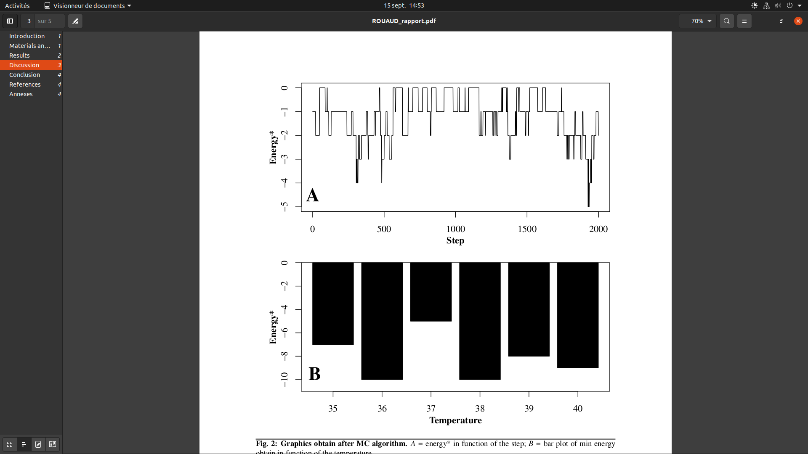
Results
Energy in function of the step, obtain with
the sequence in the original paper.
Energy in function of the temperature.
Only minimal energy are show here.
<numéro>

Slide 24
Results
Energy in function of the step, obtain with
the sequence in the original paper.
Energy in function of the temperature.
Only minimal energy are show here.
<numéro>

Slide 25
Conclusion
What have been done:
Program implementation in Oriented Object Programmation.
Accelerate the program by not using matrix.
Implemented Monte Carlo and Replica Exchange Monte Carlo.
Use all VHSD move.
Perspective:
Adding the pull move.
Parallelize the program.
Upgrade OOP implementation.
Use C++/C.
<numéro>

Slide 26
THANKS FOR
YOUR
ATTENTATION

