Slide 1
Operating Systems
Chapter 1 Computer System Overview

Slide 2
Agenda
1.1 Intro
1.2 Processor Registers
1.3 Instruction Execution
1.4 Interrupts
1.5 The Memory Hierarchy
1.6 Cache Memory
1.7 I/O Communication Techniques

Slide 3
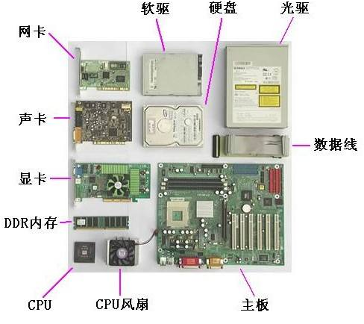
1.1 Intro
A Computer contains： Hardware+software
  Hardwares：One or more processors/Main memory/ I/O devices(secondary memory,Network card,keyboard…) System bus(系统总线)…

Slide 4
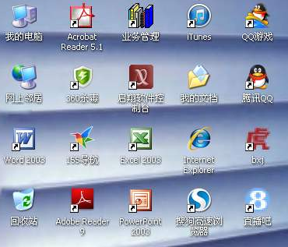
1.1 Intro
Software
  系统软件
    硬盘碎片整理…
  应用软件
    播放器
    浏览器
    阅读器
    杀毒软件
    …

Slide 5
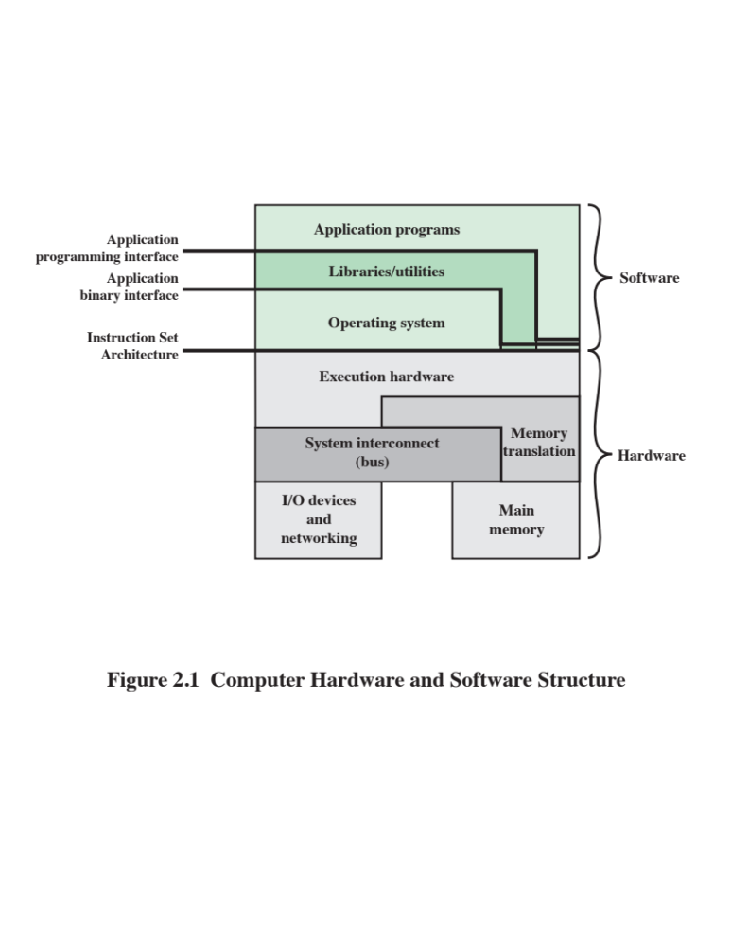
1.1 Intro
Operating System 概述
  承上：Provides a set of services to system users
  启下：Exploits the hardware resources of
应用程序
OS
硬件
图2.1

Slide 6
1.1 Intro
应用程序
OS
硬件
学生
教学管理部门/系统
教师/教室/设备 /食堂/宿舍

Slide 7
Agenda
1.1 Intro
1.2 Processor Registers
1.3 Instruction Execution
1.4 Interrupts
1.5 The Memory Hierarchy
1.6 Cache Memory
1.7 I/O Communication Techniques

Slide 8
1.2 Processor Registers(1/4)
Introduction
  What is Registers
    Memory inside CPU
  Why Registers
    Enable CPU to minimize main-memory references
  Can be classified into:
    User-visible registers(用户可见寄存器)
    Control and status registers(控制和状态寄存器)
Notes:
分类标准不同，可以分成不同类别；比如还有按功能分，通用寄存器，段寄存器等等

Slide 9
1.2 Processor Registers (2/4)
User-Visible Registers
  How to use：May be referenced（访问/存取） by machine/assemble language
  Who will use：Available to all programs
    application programs
    system programs
Control and Status Registers控制状态寄存器
  are used to control the operation of the processor
  Most are not visible to the user.
  Some may be accessibly by machine instruction in control or system mode
Notes:
比如通用寄存器

Slide 10
1.2 Processor Registers (3/4)
Control and Status Registers控制状态寄存器
  Program Counter (PC)
    Contains the address of an instruction to be fetched
  Instruction Register (IR)
    Contains the instruction most recently fetched
  Program Status Word (PSW)
    Condition codes [more detail next]
    Other state-related bits, such as:
      Interrupt enable/disable
      Supervisor/user mode
      … …
Notes:
程序状态寄存器PSW是计算机系统的核心部件——运算器的一部分，PSW用来存放两类信息：一类是体现当前指令执行结果的各种状态信息，称为状态标志，如有无借位进位（CY位）、有无溢出（OF位）、结果正负（SF位）、结果是否为零（ZF位）、奇偶标志位（PF位）等；另一类是存放控制信息，称为控制状态，如允许中断(IF位)，跟踪标志（TF位），方向标志(DF)等。有些机器中将PSW称为标志寄存器FR（Flag Register）。

Slide 11
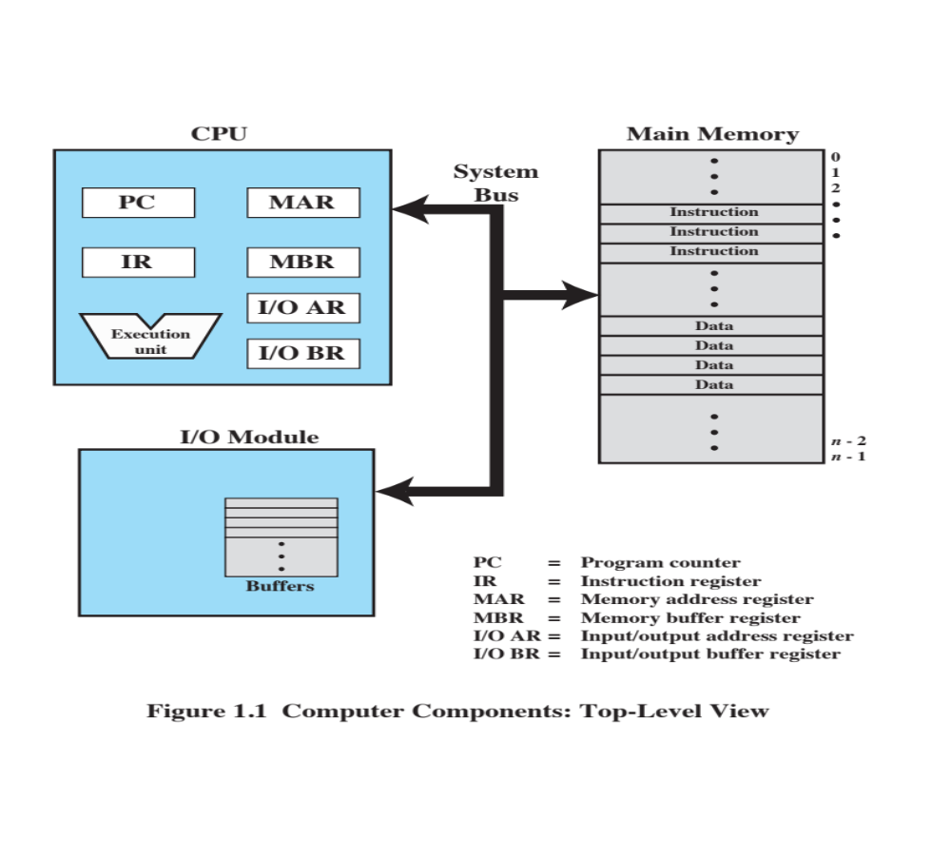
1.2 Processor Registers (4/4)

Slide 12
Agenda
1.1 Intro
1.2 Processor Registers
1.3 Instruction Execution
1.4 Interrupts
1.5 The Memory Hierarchy
1.6 Cache Memory
1.7 I/O Communication Techniques

Slide 13
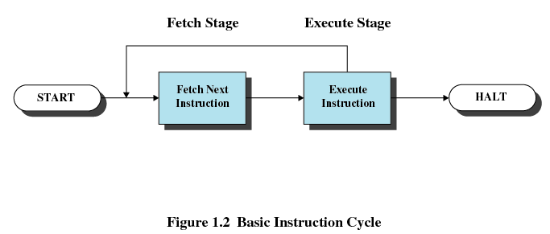
1.3 Instruction Execution (1/4)
Two stages of each Instruction Execution
  Processor reads/loads/Fetches instructions from memory
  Processor Executes each instruction
Instruction Cycle(指令周期): The processing required for a single instruction execution

Slide 14
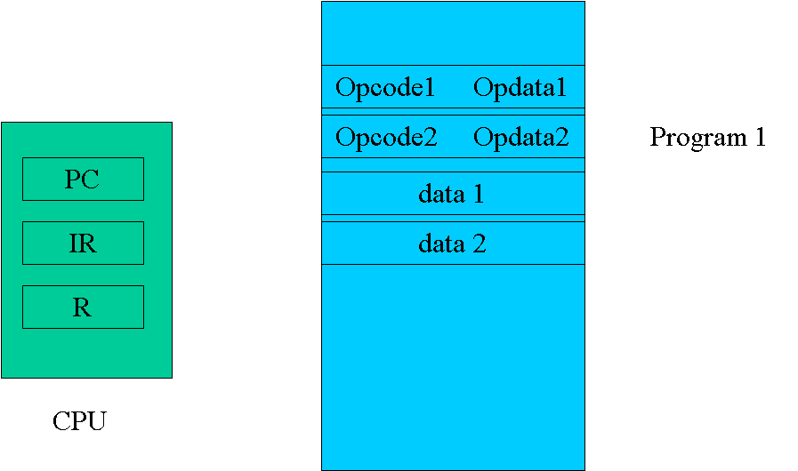
1.3 Instruction Execution (2/4)
Key point:
  Program counter (PC) of CPU holds address of the instruction to be fetched next
  Fetched instruction is placed in the instruction register (IR)
  Program counter (PC) of CPU is incremented after each fetch
int a,b,c;
a=2;b=3;
c=a+b;
R此处为通用寄存器，用户可见，比如累加器AC

Slide 15
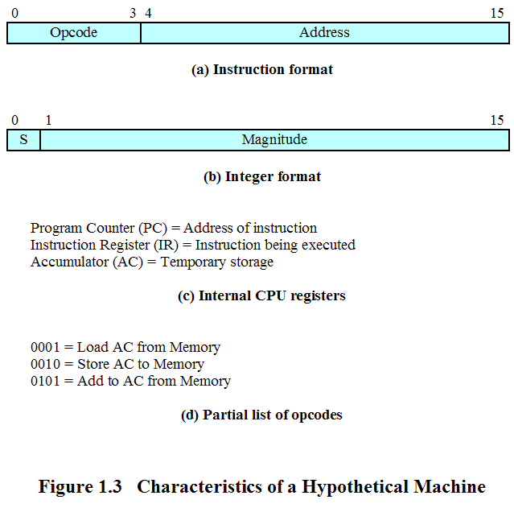
1.3 Instruction Execution (3/4)
An Example: the Instruction
一台理想机器的特征

Slide 16
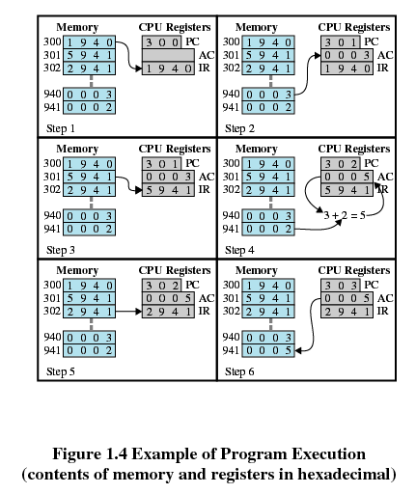
1.3 Instruction Execution (4/4)
An Example (cont.): the process of a program execution
指令1
指令2
指令3
Notes:
指令2和指令1对比，多一个+动作，所以要多一个CPU时钟周期

Slide 17
Agenda
1.1 Intro
1.2 Processor Registers
1.3 Instruction Execution
1.4 Interrupts
1.5 The Memory Hierarchy
1.6 Cache Memory
1.7 I/O Communication Techniques

Slide 18
1.4 Interrupts
1.4.0 Interrupt Introduction
1.4.1 Interrupts and the Instruction Cycle
1.4.2 Interrupt Processing
1.4.3 Multiple Interrupts
1.4.4 Multiprogramming

Slide 19
1.4.0 Interrupt Introduction (1/3)
Instruction 1
WRITE1
PC
Program 1
Instruction n
IR
data 1
R
data n
CPU
M
WRITE1子程序
  初始化I/O controler
  完成要打印数据的Output
  等待打印机完成打印
  其他收尾工作
I/O controler
printer

Slide 20
1.4.0 Interrupt Introduction (2/3)
Why Interrupt in computer system?
  Most I/O devices are slower than the processor，so interrupt can improve CPU’s utilization（提高CPU利用率）
    Processor must pause to wait for device
    E.g.: printer disk
  Count （计数）
  Avoid some program to monopolize CPU (避免CPU被独占)
Notes:
发生错误需要处理，程序进行调试等等硬中断，软中断，时钟计数

Slide 21
1.4.0 Interrupt Introduction (3/3)
Introduction Interrupt Definition
  A mechanism by which other modules (I/O, clock) may interrupt the normal sequencing of the processor.
    An I/O device can stop what the CPU is operating to provide some necessary service.
  Interrupt and Restore/Resume 中断和恢复
    Both software and hardware are used to support it

Slide 22
1.4 Interrupts
1.4.0 Interrupt Introduction
1.4.1 Interrupts and the Instruction Cycle
1.4.2 Interrupt Processing
1.4.3 Multiple Interrupts
1.4.4 Multiprogramming

Slide 23
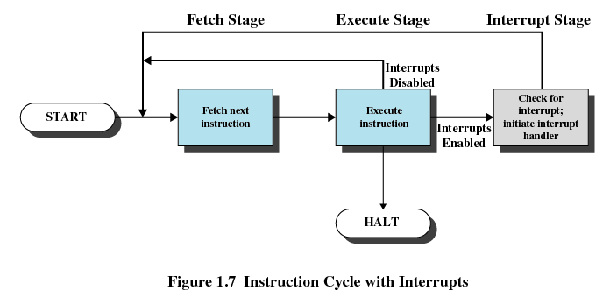
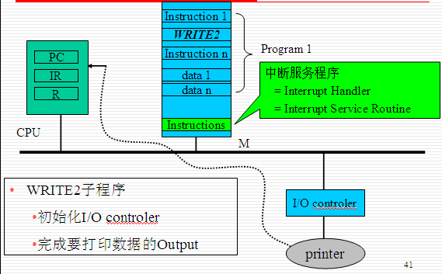
1.4.1 Interrupts and the Instruction Cycle(1/3)
修改PC的值成中断服务程序首指令的地址

Slide 24
1.4.1 Interrupts and the Instruction Cycle(2/3)
A0
I0
A1
I1
…
An
In
PC= An
Exception
Handler (ISR)
INTR
An+1
In+1
…
…
IR= In
Ax
Ix
NMI
ETR
Ax+1
…
iret
CPU
…
Exception Table
  Exception的编号
  对应编号的Exception的ISR的地址
…
…
…
Exception
Table
ISR Address
…
…
…
M
Notes:
中断产生时，附带提供一个中断的编号，类似身份证，然后根据这个编号可以查找exception table来得出对应服务程序ISR的地址，也就是中断的PC

Slide 25
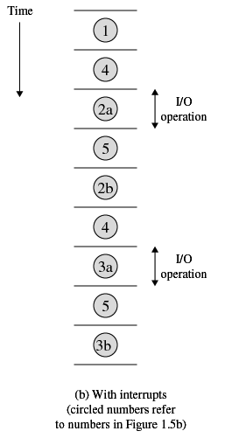
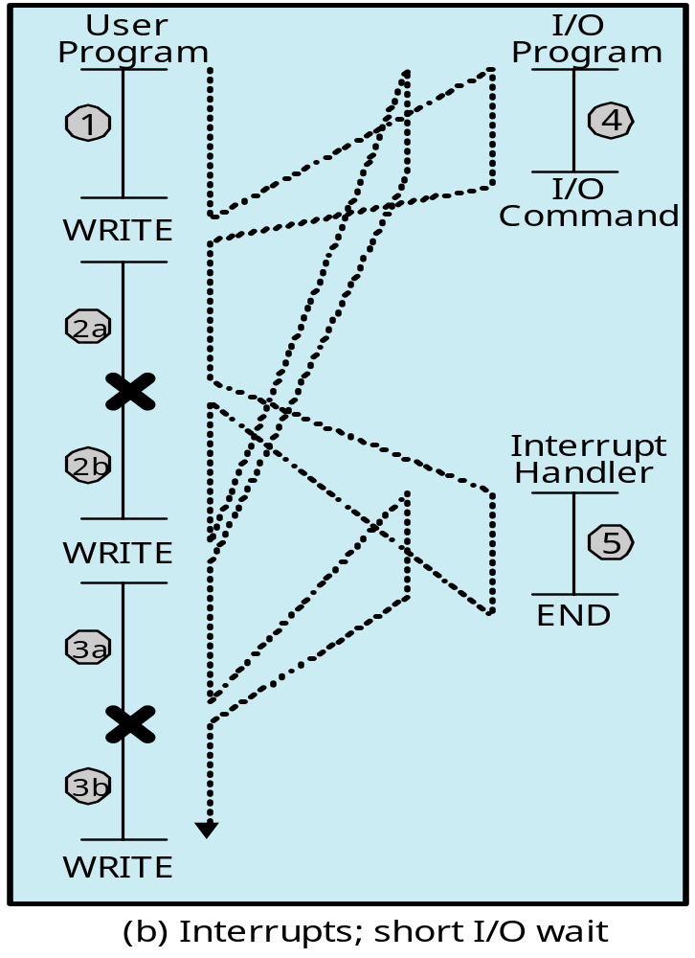
1.4.1 Interrupts and the Instruction Cycle(3/3)
中断点
中断点

Slide 26
1.4 Interrupts
1.4.0 Interrupt Introduction
1.4.1 Interrupts and the Instruction Cycle
1.4.2 Interrupt Processing
1.4.3 Multiple Interrupts
1.4.4 Multiprogramming

Slide 27
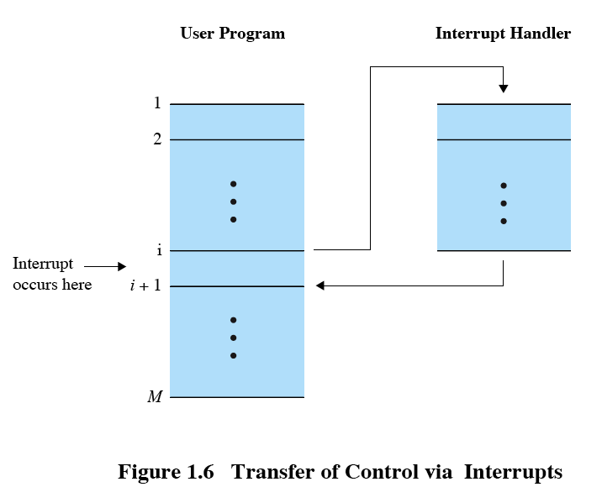
1.4.2 Interrupt Processing (1/3)
Suspends the normal sequence of execution
Notes:
一般可以由中断服务号来生成中断服务程序在内存的地址，从而查找到对应的ISR

Slide 28
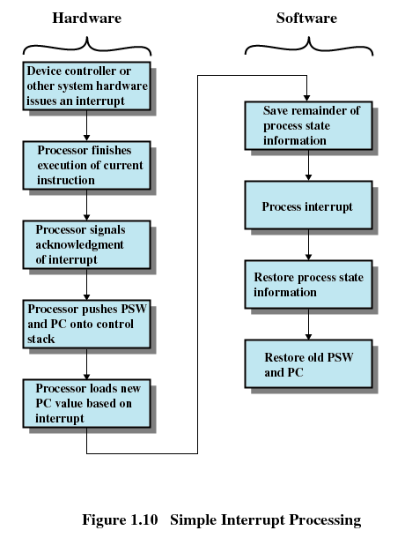
1.4.2 Interrupt Processing (2/3)
Notes:
中断的判断是在当前指令执行完毕
怎么知道中断的PC呢？见下下页

Slide 29
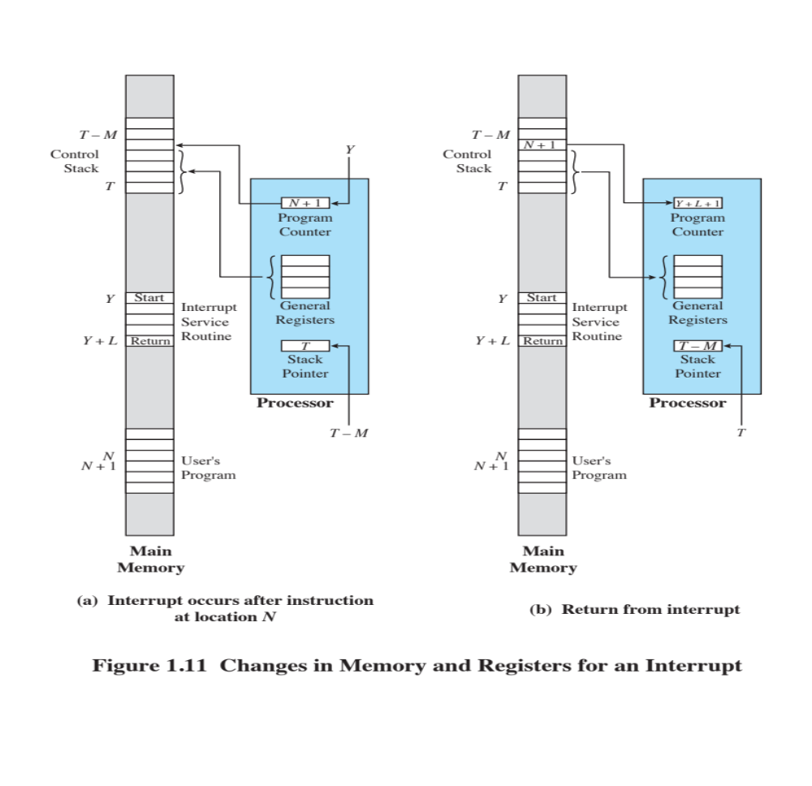
1.4.2 Interrupt Processing (3/3)
图1.11观察各个代码或数据在内存的分布

Slide 30
1.4 Interrupts
1.4.0 Interrupt Introduction
1.4.1 Interrupts and the Instruction Cycle
1.4.2 Interrupt Processing
1.4.3 Multiple Interrupts
1.4.4 Multiprogramming

Slide 31
1.4.3 Multiple Interrupts (1/3)
Q: What will happen if an I/O modules rouse a Interrupt, while the CPU is processing instruction of an ISR 中断服务时遇到新中断产生
  That is interrupt an ISR

Slide 32
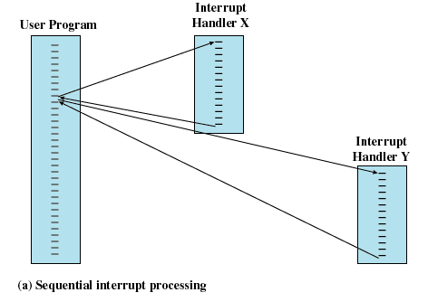
1.4.3 Multiple Interrupts (2/3)
Method 1：Disable interrupts while an interrupt is being processed

Slide 33
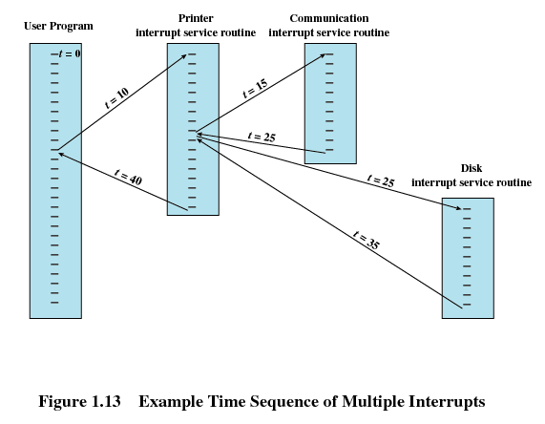
1.4.3 Multiple Interrupts (3/3)
An Example of Method 2: Define priorities for interrupts
  Nested interrupt processing
最高
最低
中等

Slide 34
1.4 Interrupts
1.4.0 Interrupt Introduction
1.4.1 Interrupts and the Instruction Cycle
1.4.3 Interrupt Processing
1.4.3 Multiple Interrupts
1.4.4 Multiprogramming

Slide 35
Agenda
1.1 Intro
1.2 Processor Registers
1.3 Instruction Execution
1.4 Interrupts
1.5 The Memory Hierarchy存储层次结构
1.6 Cache Memory
1.7 I/O Communication Techniques

Slide 36
1.5 The Memory Hierarchy (1/6)
The design constraints of a computer’s memory
  How much : Capacity : larger
  How fast : Speed : faster/ as fast as CPU
  How expensive : Price : cheaper
CPU
M
Disk

Slide 37
1.5 The Memory Hierarchy (2/6)
(Speed , Price, Capacity)的不可兼得性/矛盾:
  Faster access time, greater cost per bit
  Greater capacity, smaller cost per bit
  Greater capacity, slower access speed
What can we do?
  中庸？
    To use them all in the right way: Memory Hierarchy

Slide 38
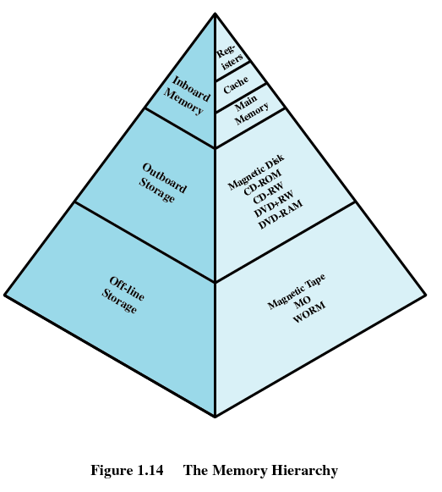
1.5 The Memory Hierarchy (3/6)
Memory Hierarchy： Three Levels
  Level 1：板上存储器
  Level 2：板外存储器
  Level 3：离线存储器

Slide 39
1.5 The Memory Hierarchy (4/6)
Going Down the Hierarchy
  Increasing capacity
  Increasing access time ( that is slow speed )
  Decreasing cost per bit
  Decreasing frequency of access of the memory by the processor

Slide 40
1.5 The Memory Hierarchy (5/6)
Obtaining larger and faster memory
  Get larger capacity
    Smaller, more expensive, faster memories are supplemented (后备) by larger, cheaper, slower memories
  Get faster speed
    larger, cheaper, slower memories cached（缓存） by Smaller, more expensive, faster memories
Locality of reference(访问局部性/局部性原理/principle of locality)
  Spatial locality (空间局部性)
  Temporal locality (时间局部性)
  Why it exists

Slide 41
1.5 The Memory Hierarchy (6/6)
…
指令 i
指令 i+1
指令 i+2
…
a[0][0]
a[0][1]
…
b[0][0]
b[0][1]
…
c[0][0]
for(i=0;i<m;i++)
for(j=0;j<n;j++)
a[i][j]=b[i][j]+c[i][j];
代码角度 and 数据角度
Notes:
局部性原理具体工作示例由下一节的CACHE介绍来理解

Slide 42
Agenda
1.1 Intro
1.2 Processor Registers
1.3 Instruction Execution
1.4 Interrupts
1.5 The Memory Hierarchy
1.6 Cache Memory
1.7 I/O Communication Techniques

Slide 43
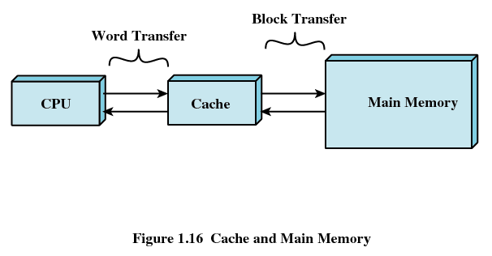
1.6 Cache Memory (1/5)
Exploit the principle of locality
  Add some cache between fast and slow memory

Slide 44
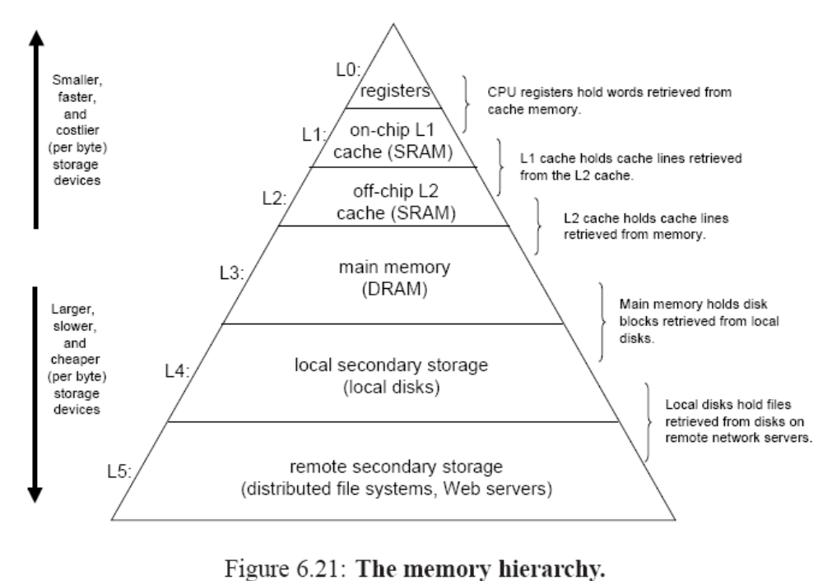
1.6 Cache Memory (2/5)

Slide 45
1.6 Cache Memory (3/5)
Cache Principles
  Contains a copy of a portion of main memory
  Processor first checks cache
    (Hit命中) If found, just use it. And do not need access to the memory
    (Miss不命中) If not found in cache, the block of memory containing the needed information is moved to the cache and delivered to the processor

Slide 46
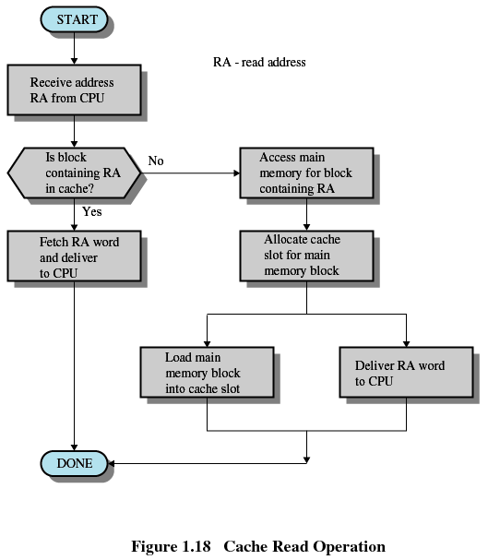
1.6 Cache Memory (4/5)

Slide 47
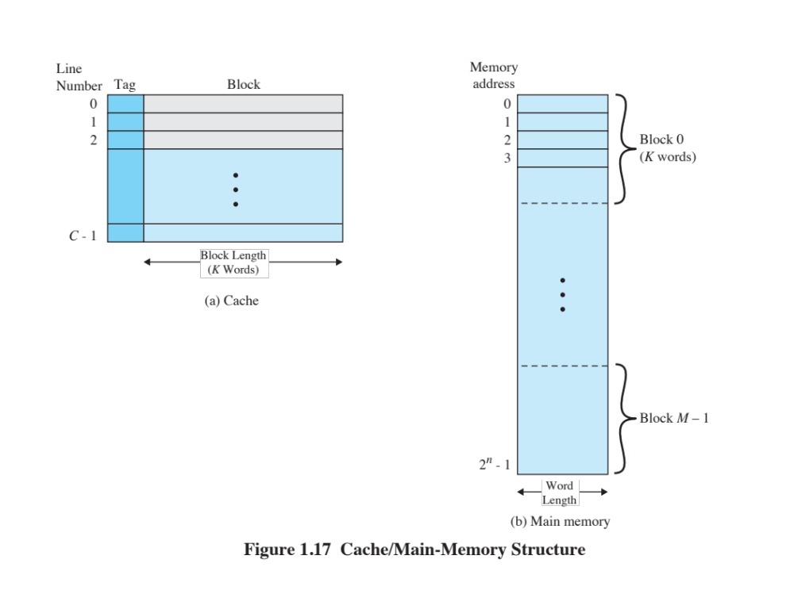
1.6 Cache Memory (5/5)
More: Cache design
  Cache size
  Block size
  Mapping function 映射策略
  Replacement algorithm替换算法
  Write policy写算法
  Number of cache levels 级数
Notes:
一行Block可以包含K个字，而不是像内存的一个byte一个地址

Slide 48
Agenda
1.1 Intro
1.2 Processor Registers
1.3 Instruction Execution
1.4 Interrupts
1.5 The Memory Hierarchy
1.6 Cache Memory
1.7 I/O Communication Techniques

Slide 49
1.7 I/O Communication Techniques (1/4)
Three methods
  Programmed I/O 可编程
  Interrupt-Driven I/O 中断驱动
  Direct Memory Access / DMA 直接内存访问
CPU
M
I/O
I/O

Slide 50
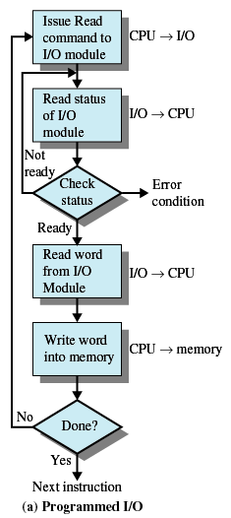
1.7 I/O Communication Techniques (2/4)
发出读指令
Method1: Programmed I/O (可编程I/O)
  I/O module performs the action, not the processor
  I/O module sets appropriate bits in the I/O status register
  Processor checks status until operation is complete
  Disadvantage: It is a time-consuming process that keeps the processor busy needlessly.
cpu
code
I/O

Slide 51
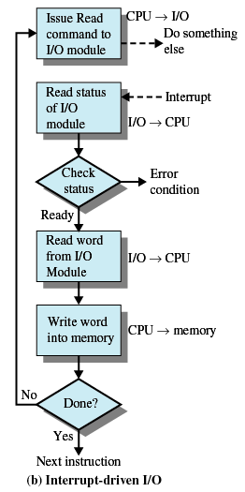
1.7 I/O Communication Techniques (3/4)
Method2: Interrupt-Driven I/O
  Processor is interrupted when I/O module ready to exchange data
  Processor saves context of program executing and begins executing interrupt-handler
  Advantage：No needless waiting, so more efficient than programmed I/O
  Disadvantage ：Still consumes a lot of processor time because every word read or written passes through the processor
cpu
code
I/O

Slide 52
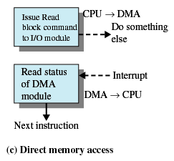
1.7 I/O Communication Techniques (4/4)
Method3: Direct Memory Access
  Transfers a block of data directly to or from memory，I/O exchanges occur directly with memory
    Processor grants I/O module authority to read from or write to memory
    Processor continues with other work
    An interrupt is sent when the transfer is complete
  Advantage：Relieves the processor responsibility for the exchange
I/O

