Slide 1
Operating Systems
Chapter 2 Operating System Overview

Slide 2
Agenda
2.1 Operating System Objectives and Functions
2.2 The Evolution of Operating Systems
2.3 Major Achievements
2.4 Developments Leading to Modern Operating Systems
2.5 Load of APP & OS
2.6 Other topic

Slide 3
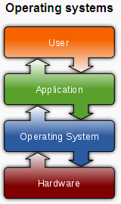
2.1Operating System Objectives and Functions (1/6)
Operating System definition: A program that
  controls the execution of application programs
  Acts as an interface between applications and hardware

Slide 4
2.1Operating System Objectives and Functions (2/6)
The Operating System as Resource Manager
  Responsible for managing resources/Hardware
  Work in the same way as ordinary computer software
    It is program that is executed
  Operating system frequently relinquishes(放弃) and regains control of the processor

Slide 5
2.1Operating System Objectives and Functions (3/6)
Operating System Objectives
  As User/Computer Interface --Convenience/方便
  As Resource Manager--Efficiency /有效
  As System Software--Ability to evolve /扩展
    Hardware upgrades plus new types of hardware
    New services：Windows Subsystem for Linux
    Fixes Bug
    How： Modularization / OS Architecture
Notes:
Windows Subsystem for Linux（简称WSL）是一个在Windows 10\11上能够运行原生Linux二进制可执行文件（ELF格式）的兼容层。它是由微软与Canonical公司合作开发，其目标是使纯正的Ubuntu、Debian等映像能下载和解压到用户的本地计算机，并且映像内的工具和实用工具能在此子系统上原生运行。

Slide 6
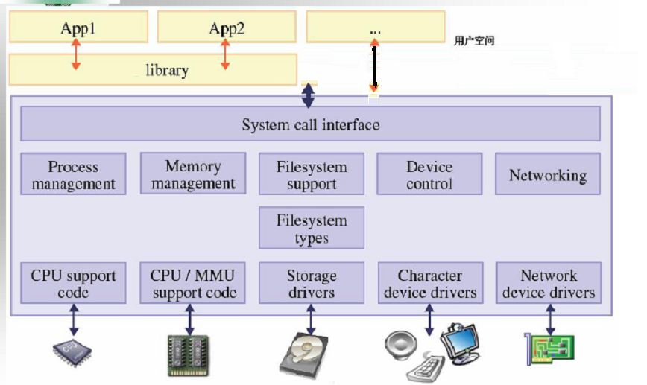
2.1Operating System Objectives and Functions (4/6)
Compare with Fig2.2 on textbook
Notes:
MMU memory management unit
vc目录下,有CRT源代码,搜索fwrite.c,一路找下去会发现一个write.c文件,最终调用API的WriteFile()
System call interface 到各类管理系统是隶属于kernal部分的

Slide 7
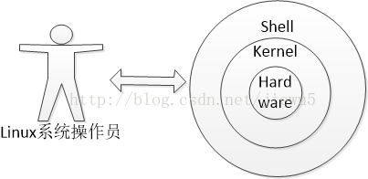
2.1Operating System Objectives and Functions (5/6)

Slide 8
2.1Operating System Objectives and Functions (7/6)
Shell(外壳)
  CLI :command line interface
  GUI:graphical user interface
Kernel(内核)
  Portion of operating system that is in main memory
  Contains most frequently used functions
  Also called the nucleus（核子）
    Linux ubuntu 4.15.0-142-generic #uname -a
      第一个组数字：4, 主版本号
      第二个组数字：15, 次版本号，当前为稳定版本
      第三个组数字：0, 修订版本号
      第四个组数字：142，当前内核版本（4.15.0）的第142次微调patch

Slide 9
Agenda
2.1 Operating System Objectives and Functions
2.2 The Evolution of Operating Systems
2.3 Major Achievements
2.4 Developments Leading to Modern Operating Systems
2.5 Load of APP & OS
2.6 Other topic

Slide 10
2.2 The Evolution of Operating Systems(1/17)
Why learn it?
    This history is itself interesting and also serves the purpose of providing an overview of OS principles.
    In attempting to understand the key requirements for an OS and the significance of the major features of a contemporary OS, it is useful to consider how operating systems have evolved over the years

Slide 11
2.2 The Evolution of Operating Systems(2/17)
阶段1：提高昂贵计算机的使用率
  1 Serial Processing: No Operating Systems 串行处理
  2 Simple Batch Systems 简单批处理
  3 Multiprogrammed Batch Systems 多道批处理
  4 Time-Sharing Systems时分系统
阶段2：PC普及
  易用性GUI/安全性
阶段3：网络普及
  分布式系统
Future
  服务云计算，大数据
Notes:
单道批处理系统：为了实现对作业的连续处理，需要先把一批作业以脱机方式输入到磁盘上，并在系统中配上监督程序（Monitor），在它的控制下，使得这批作业能一个接着一个的连续工作。
具体的工作过程是首先由监督程序将磁带上的第一个作业装入内存，并把运行控制权交给作业；该作业处理完时，又把控制权交给监督程序，再有监督程序把磁带的第二个作业调入内存等等。可以看成是串行的。
优点：解决人机矛盾和CPU与IO设备速度不匹配问题，提高系统资源的利用率和系统吞吐量。
缺点：不能充分的利用系统资源，现很少使用。
多道批处理系统：用户所提交的作业先放在外存上，并排成一个对列（后备对列），由作业调度程序按照一定的算法，从后备对列中选择若干个作业调入内存，使其共享CPU和系统中的各种资源。同时在内存中装入若干程序，这样可以在A程序运行时，利用其IO操作而暂停的CPU空挡时间，再调度另一道程序B运行，同样可以利用B程序在IO操作时调用CPU空档调用程序C运行，使用多道程序交替运行，始终保持CPU忙碌的状态。
优势：资源利用率高，使CPU始终处于忙碌的状态，提高内存的利用率，提高IO利用率；系统吞吐量大（CPU和其资源始终保持忙碌的状态，仅在作业完成时或者运行不下去的时候才切换，系统开销小）。
缺点：平均周转时间长，无交互能力。
需要解决的问题：
1）处理机争用的问题
2）内存分配和保护的问题：系统应为每道程序分配必要的内存空间，使其各得其所，并不相互干扰；
3）IO设备分配的问题
4）文件组织和管理的问题
5）作业管理的问题
6）用户与系统接口的问题

Slide 12
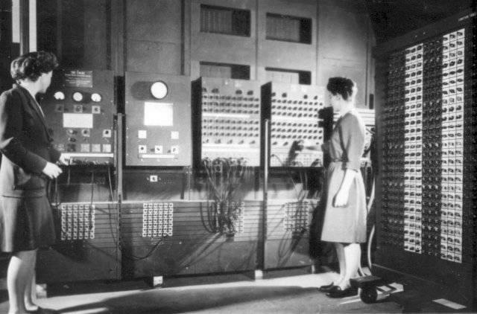
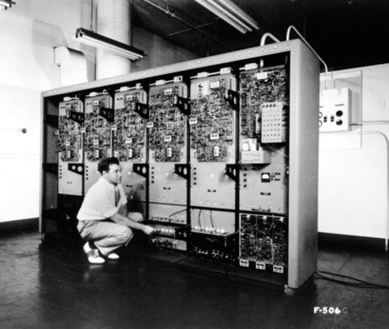
2.2 The Evolution of Operating Systems(3/17)
1 Serial Processing: No Operating Systems
When 1940s-1950s
How it work
Features
Problems
操作ENIAC
Notes:
Time 最早的ENIAC （Electronic Numerical Integrator and Computer）没有键盘显示器等等的，所有的输入操作都是通过对开关的通断来实现的，输出是通过灯泡的亮灭显示的，改变计算公式甚至需要对线路进行重新的布置，那个年代是没有操作系统的
ENIAC里面并没有内存，只有寄存器，而且控制系统是通过硬接线实现的，想改变公式就需要对线路重新布置。这样操作其实非常的不方便。
所以，著名的“计算机之父”冯·诺依曼加入这个计划之后，提出了改进意见EDVAC （Electronic Discrete Variable AutomaticComputer）计划。EDVAC实际上就是最早的冯诺依曼结构的雏形，现在我们使用的通用计算机结构仍旧属于冯诺依曼结构。
From: <什么是操作系统？兼谈WebOS >: http://tech.163.com/06/0520/14/2HIT72KQ00091JUR.html

Slide 13
2.2 The Evolution of Operating Systems(4/17)
1 Serial Processing: No Operating Systems
命名：the user have access to the system in series
特点：the programmer interacted directly with the computer hardware
如何操作：Machines run from a console with display lights, toggle switches转换开关, input device, and printer
问题
  Scheduling: Most installations used a hardcopy sign-up sheet to reserve computer time
  Setup time: included loading the compiler, source program, saving compiled program, and loading and linking

Slide 14
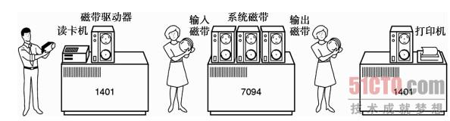
2.2 The Evolution of Operating Systems(5/17)
2 Simple Batch Systems
  Feature: without interactive from users
  When 1950s-1960s
IBM 7094 简单/单任务批处理系统
Monitor
Notes:
需计算的内容放到最昂贵的7094设备上串行，前一个执行完，后一个执行。

Slide 15
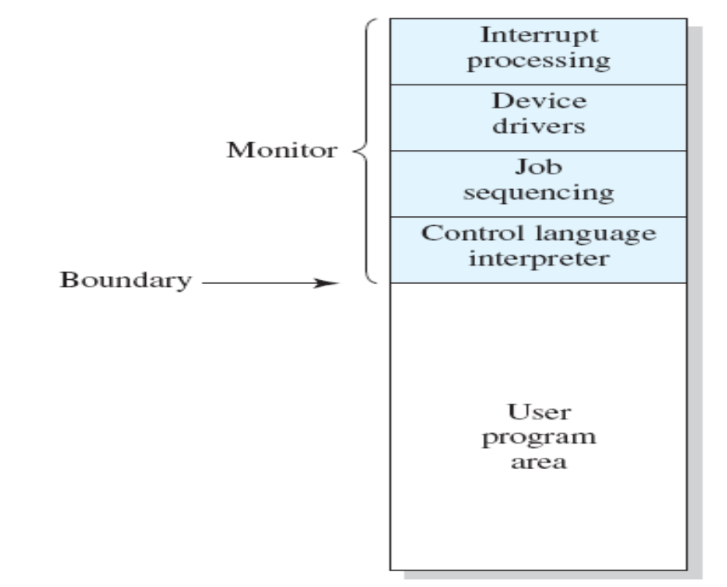
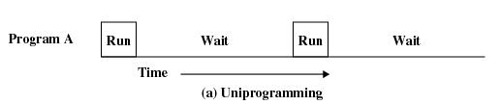
2.2 The Evolution of Operating Systems(6/17)
Simple Batch Systems
  Only one job in memory at a time
  Processor must wait for I/O instruction to complete before preceding

Slide 16
2.2 The Evolution of Operating Systems(7/17)
The central idea is
  Batch: made up by many jobs from users
    A job may use several program
  the use of a piece of software known as the monitor that controls the sequence of events.
The Process
  The monitor reads a job from the batch
  Then control is passed to this job
  When the job is completed, it returns control to the monitor
  The monitor reads in the next job

Slide 17
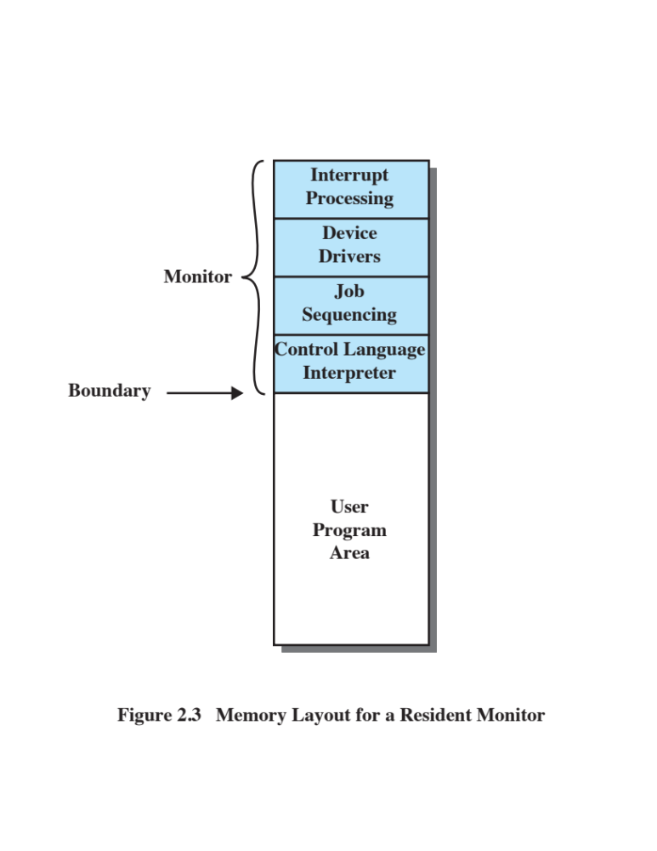
2.2 The Evolution of Operating Systems(8/17)
Job Control Language (JCL)
  Special type of programming language
  Provides instruction to the monitor
    What compiler to use
    What data to use
    …….

Slide 18
2.2 The Evolution of Operating Systems(9/17)
New: CPU mode
  User program executes in user mode(用户模式)
    Certain instructions may not be executed
    Some memory can not be accessed
  Monitor executes in system mode(系统模式)
    Kernel mode(内核模式)
    Privileged instructions are executed
    Protected areas of memory may be accessed
Disadvantage?

Slide 19
2.2 The Evolution of Operating Systems(10/17)
Hardware Features
  Memory protection
    Do not allow the memory area containing the monitor to be altered
  Timer
    Prevents a job from monopolizing独占the system
  Privileged instructions
    Certain machine level instructions can only be executed by the monitor
  Interrupts
    This feature gives the OS more flexibility in relinquishing放弃 control to and regaining control from user programs

Slide 20
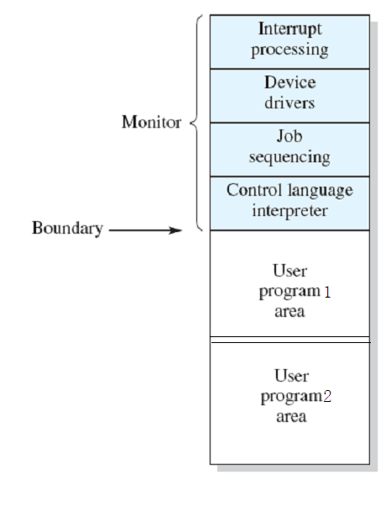
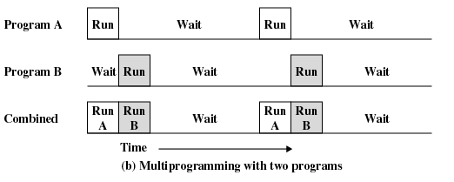
2.2 The Evolution of Operating Systems(11/17)
3 Multiprogrammed Batch Systems
  Multiple jobs in memory at a time
Why ?
  I/O Devices Slow
    CPU not Busy
Notes:
多个程序驻扎在内存，当前一个任务尚未执行完，但在等待IO时，下一个任务可以先使用CPU，相当于程序1虽然整体任务没有完成，但等待IO使得它主动让出CPU给程序2，和简单批处理不同，简单批处理需要前一个任务执行完毕。等IO中断返回，则第一个任务继续执行。
问题：如何管理多个程序的切换
When one job needs to wait for I/O, the processor can switch to the other job

Slide 21
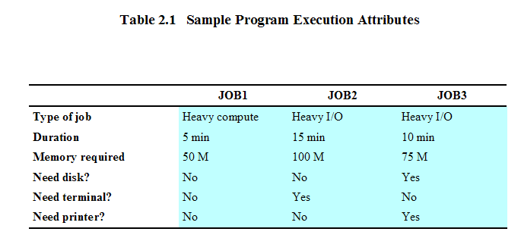
2.2 The Evolution of Operating Systems(12/17)
Example: 3个作业/程序
  各自情况描述: MM 250MB

Slide 22
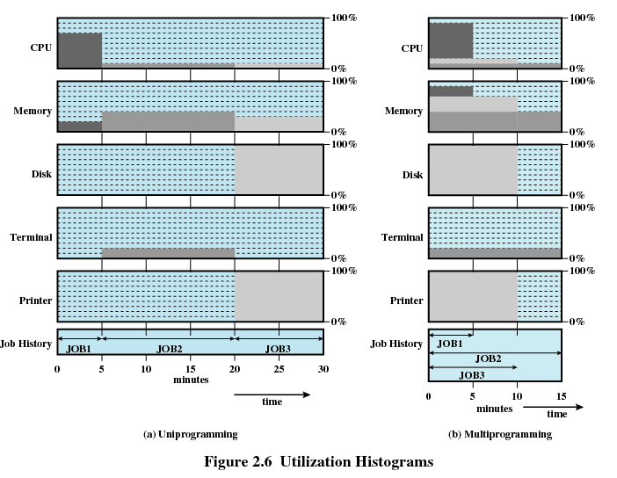
2.2 The Evolution of Operating Systems(13/17)
Example: 3个作业/程序 (cont.)
  Utilization Histograms(利用率直方图)
Notes:
利用率计算方法，如CPU
单道程序： (0.7*5+0.1*25)/30 = 0.2
多道程序：(0.9 *5 + 0.2 *5 + 0.1*5)/15 = 0.4
响应时间计算方法：
从提交到计算完毕所需要的时间，本例中，假设3个JOB在开始时同时提交。

Slide 23
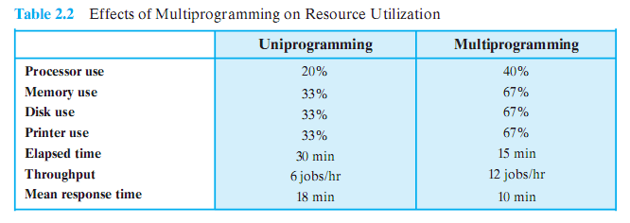
2.2 The Evolution of Operating Systems(14/17)
Example: 3个作业/程序(cont.)
  Effects of Multiprogramming on Resource Utilization

Slide 24
2.2 The Evolution of Operating Systems(15/17)
4. Time-Sharing Systems
When: 1960s~
Why?
  Multiple users simultaneously access the system(mainframe computer 大型主机)through terminals
  Requirement: handle multiple interactive users/jobs
Idea
  Processor’s time is shared among multiple users/jobs
    Time slicing 时间片 (技术)
Products:CTSS 兼容分时系统
Notes:
和多道程序不同，即便第一个程序正在使用CPU，而非等待IO，后续程序也可以以时间片来轮换使用CPU，相当于程序1被动出让CPU
mainframe computer 大型主机Mainframe Computer System:

Slide 25
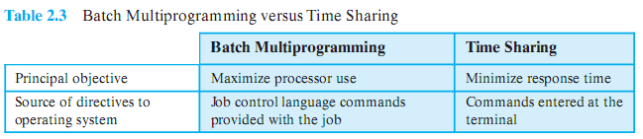
2.2 The Evolution of Operating Systems(16/17)
Batch Multiprogramming VS Time Sharing

Slide 26
2.2 The Evolution of Operating Systems(17/17)
当代操作系统实例
  封闭微软：DOS, Windows系列
    95,NT,98,me,2000,xp,vista…window 10, window 11
  开放Unix:
    主要分支Unix BSD(Berkeley Software Distribution版，开源，可商用)
    进一步演变solaris,mac OS
  开源Linux(仿unix，但是完全独立)、鸿蒙操作系统
    redhat, 红旗，ubuntu, openeuler, 麒麟
    继续扩展变化Android

Slide 27
Agenda
2.1 Operating System Objectives and Functions
2.2 The Evolution of Operating Systems
2.3 Major Achievements
2.4 Developments Leading to Modern Operating Systems
2.5 Load of APP & OS
2.6 Other topic

Slide 28
2.3 Major Achievements(1/12)
1 The Process
2 Memory Management
3 Information Protection and Security
4 Scheduling and Resource Management
5 System Structure
Notes:
这里面的几个部分是相辅相成的

Slide 29
2.3 Major Achievements(2/12)
1. Processes
Processes consists of three components
  An executable program /code
  Associated data needed by the program
  Execution context of the program (the core)
    All information the operating system needs to manage the process
The process is realized/implemented as a data structure
  All information the operating system needs to manage the process is stored in the data structure
Notes:
多道批处理，分时，和实时事物系统， 时间安排，同步等问题推动进程概念的出现

Slide 30
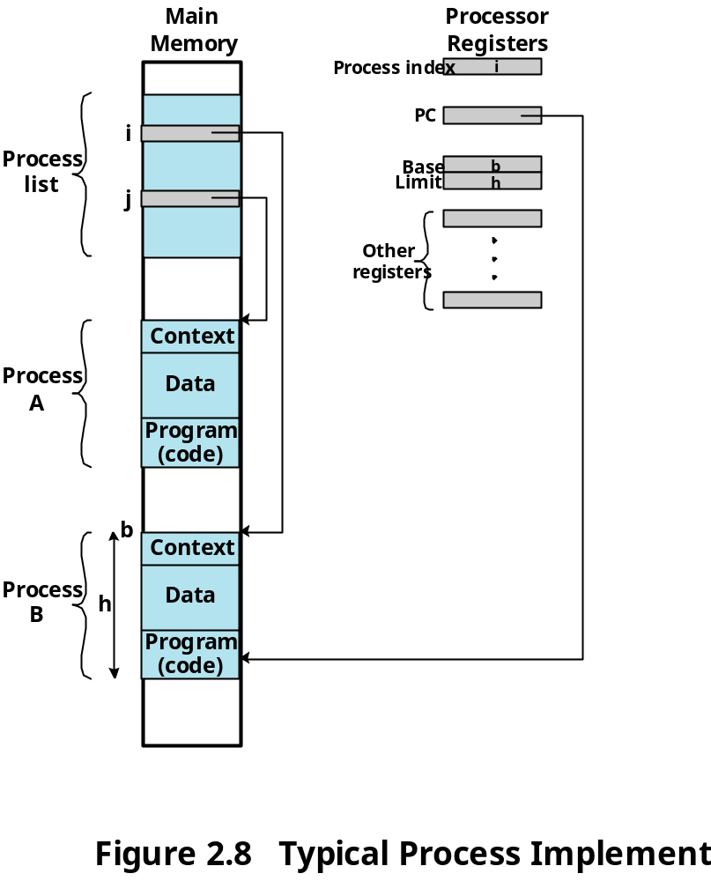
2.3 Major Achievements(3/12)
An example
CPU
Notes:
问题：进程是不是真的全部加载入内存了

Slide 31
2.3 Major Achievements(4/12)
2. Memory Management
OS has five storage management responsibilities:
  Process isolation(进程隔离)
  Automatic allocation and management(自动分配和管理)
  Support of modular programming(模块化程序设计)
  Protection and access control (保护与存取控制)
  Long-term storage(长期存储)

Slide 32
2.3 Major Achievements(5/12)
Virtual Memory / VM
  Allows programmers to address memory from a logical point of view
  No hiatus(脱节) between the execution of successive processes while one process was written out to secondary store and the successor process was read in
Page
  Allows process to be comprised of a number of fixed-size blocks, called pages
  Each page may be located any where in main memory

Slide 33
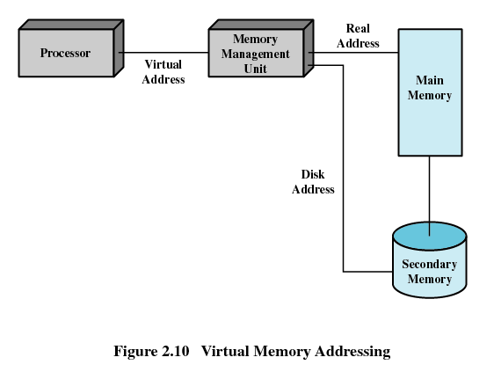
2.3 Major Achievements(6/12)
Virtual Memory Addressing
  Storage system consists of main memory and auxiliary辅助 memory

Slide 34
2.3 Major Achievements(7/12)
3. Information Protection and Security
Availability 不被中断
Confidentiality保密性，授权
Data integrity 不被未授权篡改
Authenticity认证

Slide 35
2.3 Major Achievements(8/12)
4. Scheduling and Resource Management
Manage the resources (such as CPU, Main Memory, I/O devices)
Schedule/调度 these resources to various active processes/进程

Slide 36
2.3 Major Achievements(9/12)
The factors that should be considered
  Fairness(公平性)
    Give equal and fair access to resources
  Differential responsiveness(有差别的响应性)
    Discriminate区别 among different classes of processes
  Efficiency(高效性)
    Maximize throughput(吞吐量), minimize response time(响应时间), and accommodate as many users as possible

Slide 37
2.3 Major Achievements(10/12)
5. System Structure
The size and complexity of operating systems has grown.
  MIT CTSS: 32,000 36-bit words Compatible Time-Sharing System
  Windows
    Windows NT 4.0: 16 million lines of code
    Windows 2000: more than 32 million lines of code
    Windows XP: 35 million lines of code
    Windows Vista: 50 million lines of code
  Linux 2.6.27: 10 million lines of code
Notes:
CTSS Compatible Time-Sharing System，兼容分时系统
IBM OS/360
multics是一个分时操作系统，该系统开始作为一个合资项目，是1964年由贝尔实验室、麻省理工学院及美国通用电气公司所共同参与研发的，其目的是为了开发出一套安装在大型主机上多人多工的操作系统。

Slide 38
2.3 Major Achievements(11/12)
Led to four unfortunate but all-too-common problems
  late delivery
  performance unexpected
  latent潜在的bugs
  vulnerable易受攻击的to a variety of security attacks
Solution：
  The software must be modular and modules must have well-defined interfaces
  Levels

Slide 39
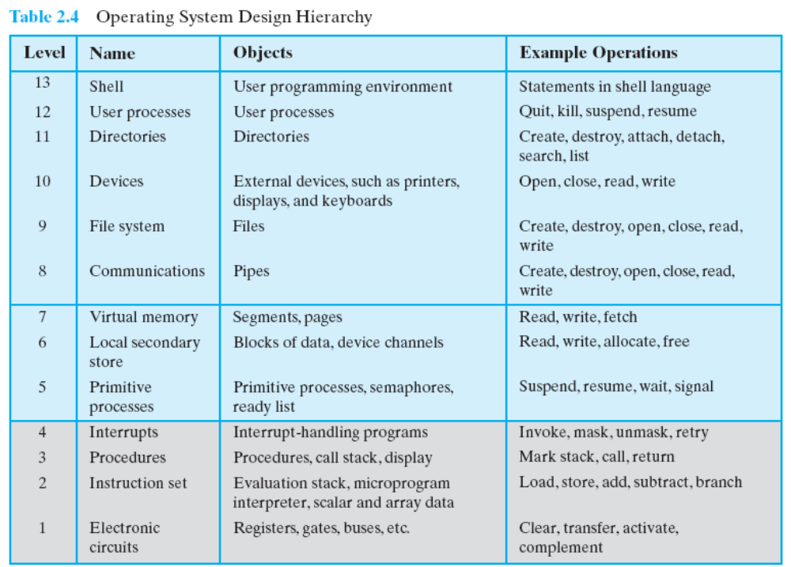
2.3 Major Achievements(12/12)
Notes:
View the system as a series of levels
Each level performs a related subset of functions
Each level relies on the next lower level to perform more primitive functions
效果：This decomposes a problem into a number of more manageable subproblems

Slide 40
Agenda
2.1 Operating System Objectives and Functions
2.2 The Evolution of Operating Systems
2.3 Major Achievements
2.4 Developments Leading to Modern Operating Systems
2.5 Load of APP & OS
2.6 Other topic

Slide 41
2.4 Modern Operating Systems (1/3)
Background
  new developments in hardware
  new applications
  new security threats
Notes:
Microkernel(微内核) architecture
VS monolithic kernel(单体内核) architecture
Assigns only a few essential functions to the kernel
Address spaces
Interprocess communication (IPC)
Basic scheduling

Slide 42
2.4 Modern Operating Systems (1/3)
Five features are mentioned in this chapter
  Microkernel architecture
    对比OS的单内核完成所有管理工作，它含基本功能
  Multithreading
    进程含多线程，资源占用少，调度单位
  Symmetric multiprocessing (SMP)对称多处理
    一般具有multiple processors，且完全相同对等
    性能提升，对抗处理器失效，配置灵活
  Distributed operating systems : chapter 14~15: 不讲
    网络一组独立计算机虚拟为用户的一台完整计算机
  Object-oriented design
Notes:
Microkernel(微内核) architecture
VS monolithic kernel(单体内核) architecture
Assigns only a few essential functions to the kernel
Address spaces
Interprocess communication (IPC)
Symmetric对称multiprocessing (SMP)
There are multiple processors
These processors share same main memory and I/O facilities
All processors can perform the same functions
Basic scheduling
The OS of an SMP schedules processes or threads across all of the processors.
SMP has a number of potential advantages over uniprocessor architecture, including the following:
Performance
Availability：对抗处理器失效
Incremental growth: 增量增长，增加处理器
分布式系统：配置灵活在一个分布式系统中，一组独立的计算机展现给用户的是一个统一的整体，就好像是一个系统似的。系统拥
有多种通用的物理和逻辑资源，可以动态的分配任务，分散的物理和逻辑资源通过计算机网络实现信息交换。

Slide 43
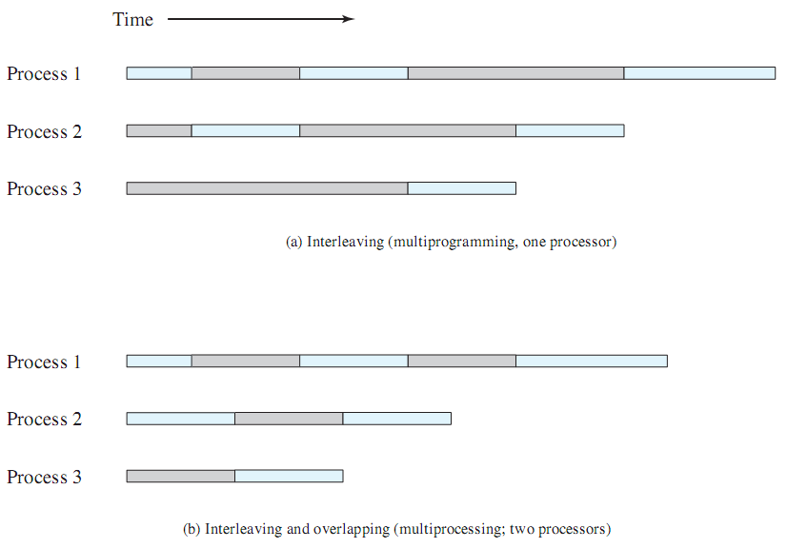
2.4 Modern Operating Systems (1/3)

Slide 44
Agenda
2.1 Operating System Objectives and Functions
2.2 The Evolution of Operating Systems
2.3 Major Achievements
2.4 Developments Leading to Modern Operating Systems
2.5 Load of APP & OS
2.6 Other topic

Slide 45
2.5 Load of hello.exe
Process
Virtual Memory
File
shell
process
hello
process
Time
Application code
Context
switch
OS code
Application code
OS code
Context
switch
Application code
201001V1.1
Notes:
A process is the operating system’s abstraction for a running program. With the help of process , the operating system provides the illusion that the program is the only one running on the system.
The program appears to have exclusive use of both the processor, main memory, and I/O devices. The processor appears to execute the instructions in the program,one after the other, without interruption. And the code and data of the program appear to be the only objects in the system’s memory.
In fact Multiple processes can run concurrently on the same system, and each process appears to have exclusive use of the hardware. This is what we call concurrency. instructions of different process are interleaved executed. In order to keep each processes run correctly, the system will keep the state of each process. The state is called the context. It contains current values of the PC, the register file, and the contents of main memory. When the operating system decides to transfer control from the current process to a some new process, it
performs a context switch by saving the context of the current process, restoring the context of the new process, and then passing control to the new process.
There are two concurrent processes in our example scenario: the shell process and the hello process. Initially, the shell process is running alone, waiting for input on the command line. When we ask it to run the hello program, the shell invokes a special function called system call that pass control to the operating system. The operating system saves the shell’s context, creates a new hello process and its context, and then passes control to the new hello process. This is where the context switch happens. After hello terminates,
the operating system restores the context of the shell process and passes control back to it.
The concurrency brings us convenient and at the same time makes it difficult to obtain the accurate measurement of the running time. We’ll continue this topic in chapter 9.

Slide 46
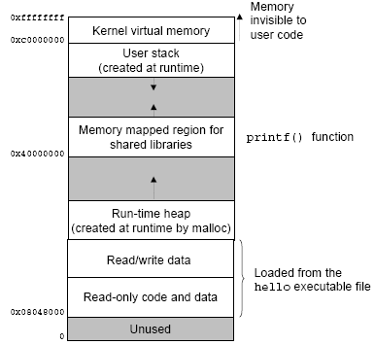
2.5 Load of hello.exe
Process
Virtual Memory
File
201001V1.1
Notes:
A process is the operating system’s abstraction for a running program. With the help of process , the operating system provides the illusion that the program is the only one running on the system. Virtual memory play an important role in providing the illusion. Each process has the same uniform view of memory, which is known as its virtual address space. The virtual address space for Linux processes is shown in Figure. Windows systems use a similar layout. Note that addresses in the figure increase from bottom to the top.
The address space in the red rectangle is reserved for code and data in the operating system. The address space in the green rectangle holds the code and data defined by the user’s process. You can the stack and heap we often talk about on the figure. Note that the stack and heap grow in opposite direction. That’s why in question 1, the order of define variable i and array will lead to different performance.
We can see the blue rectangle in the figure, this is where we use function to access file abstraction the of IO device.
Detailed content will be discussed in chapter 3, 7 and 10. These topics will be very important in Avoiding security bugs.

Slide 47
2.5 Load of hello.exe
CPU
Register file
ALU
PC
System bus
Memory bus
Main
memory
Bus interface
I/O
bridge
I/O bus
Expansion slots for
other devices such
as network adapters
USB
controller
Graphics
adapter
Disk
controller
Mouse
Keyboard
Display
hello executable
stored on disk
Disk
201001V1.1
Notes:
Initially the hello file is stored on the disk. And the shell program is executing its instructions, waiting for us to type a command.

Slide 48
2.5 Load of hello.exe
CPU
Reading the hello command from the keyboard
Register file
ALU
PC
System bus
Memory bus
Main
memory
"hello"
Bus interface
I/O
bridge
I/O bus
USB
controller
Graphics
adapter
Disk
controller
Mouse
Keyboard
Display
Disk
User types
"hello"
201001V1.1
Notes:
As we type the characters hello at the keyboard, the shell program reads each one into a register, and then stores it in memory.

Slide 49
2.5 Load of hello.exe
Loading the executable from disk into main memory
CPU chip
Register file
ALU
Main
memory
Bus interface
I/O bus
USB
controller
Graphics
adapter
Disk
controller
Mouse
Keyboard
Monitor
Disk
hello executable
stored on disk
201001V1.1
Notes:
When we hit the enter key on the keyboard, the shell knows that we have finished typing the command.
The shell then loads the executable hello file and copies the code and data in the hello object file from disk to main memory. The copy process will use the direct memory access (DMA) technique, and the data travels directly from disk to main memory, without passing through the processor.

Slide 50
2.5 Load of hello.exe
Writing the output string from memory to the display
CPU
Register file
ALU
PC
System bus
Memory bus
Main
memory
"hello,world\n"
Bus interface
I/O
bridge
hello code
I/O bus
Expansion slots for
other devices such
as network adapters
USB
controller
Graphics
adapter
Disk
controller
Mouse
Keyboard
Display
Disk
hello executable
stored on disk
"hello,world\n"
201001V1.1
Notes:
Once the load work is done, the CPU begins execute the machine-language instructions in the hello program’s main function. These instruction copy the ”hello, world\n” string from memory to the register file in bytes and then via the printf function output the string on screen.

Slide 51
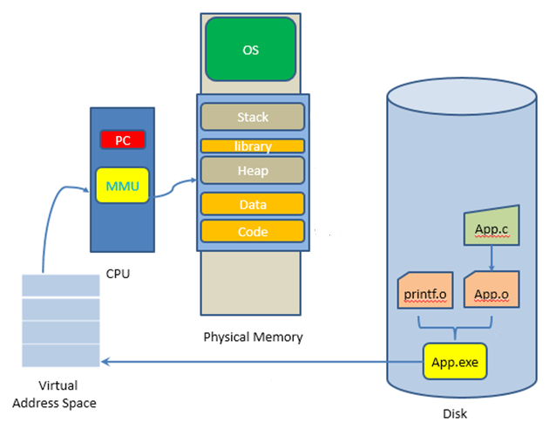
2.5 Load of OS
The load of
OS
Application

Slide 52
2.5 Load of OS
加电->读BIOS->读加载程序->读OS内核映像文件
加电后第一条指令从MEM的ROM部分读出（MEM=ROM+RAM),即BIOS(Basic Input Output System)
实模式：CS:IP=0XF000:FFF0
实模式地址CS*16+IP,最大访问1M
物理内存 | 地址
空闲 | 4G
BIOS启动固件 | 1M
 | 64KB
空闲 | 0
Notes:
1.为啥不能从硬盘读？没有OS正常工作就不能读硬盘

Slide 53
2.5 Load of OS
引导的最终目的是从磁盘加载OS，因此BIOS需要建立以下功能
  基本输入输出：磁盘和键盘，显示
  系统设置：系统从哪个盘启动，usb，硬盘，光盘？
  开机自检程序
  系统启动程序
Notes:
1.为啥不能从硬盘读？没有OS正常工作就不能读硬盘

Slide 54
2.5 Load of OS
BIOS将加载程序从磁盘的引导扇区512个字节读到内存指定的0x7c00,跳转到CS:IP=0000:7C00执行
加载程序将操作系统代码和数据从硬盘加载到内存，然后跳转到操作系统起始地址（即内核执行地址）
物理内存 | 地址
空闲 | 4G
BIOS启动固件 | ~1M
加载程序 | 0x7c00~
BIOS数据 | 0
Notes:
1.为啥不能从硬盘读？没有OS正常工作就不能读硬盘
2.为啥不又BIOS直接从磁盘读OS的进程映像文件，要经过加载程序？因为每个电脑装载的操作系统和文件系统不一样，出厂设置时不能预知
因此约定从固定的磁盘引导扇区读加载程序，由该程序负责识别和判断
如有多个OS系统，那么BIOS要读主引导代码，主引导扇区代码读活动分区的引导扇区代码，由它最终加载文件(系统的)加载程序

Slide 55
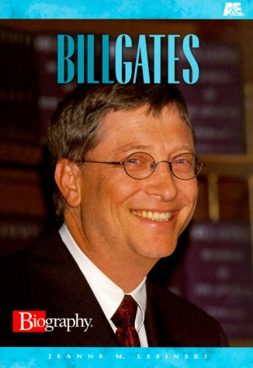
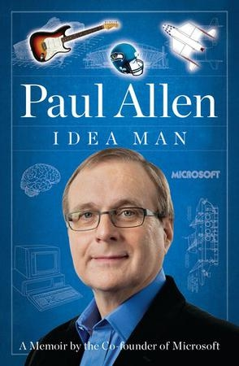
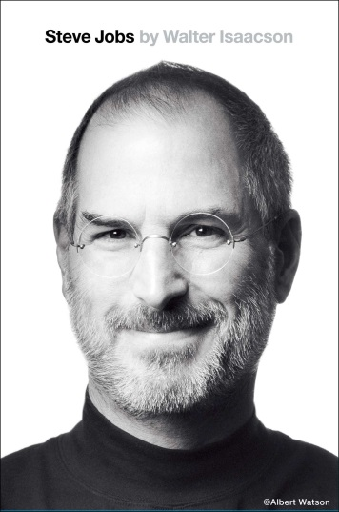





How is Operating System (OS) developed?
2.6 Other topic
操作系统的发展：相关书籍：人物传记
Microsoft Apple Linux
Notes:
【to be done】：
Ellon Mask的传记

Slide 56

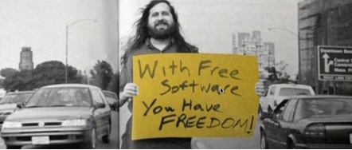
How is Operating System (OS) developed?
2.6 Other topic
操作系统的发展：纪录片
Notes:
http://www.phpstudy.net/b.php/29467.html
《The code - Linux》和《Revolution OS》 这两很有名的关于 Linux 的纪录片。
https://movie.douban.com/subject/1418357/
代码 The Code (2001)
https://movie.douban.com/subject/3124124/?from=subject-page
代码奔腾 Code Rush (2000)

Slide 57

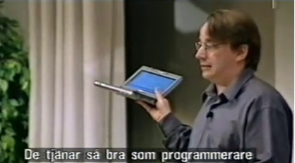
How is Operating System (OS) developed?
2.6 Other topic
操作系统的发展：纪录片

Slide 58
Q:
假设有一台多道程序的计算机，每个作业都有相同的特征，即在一个计算周期T里，I/O占用第一和第四个1/4周期，处理器占有第二和第三个1/4周期。而各个作业占用的I/O设备各不相同。如果计算机被任何一个作业单独占用的话，完成作业总共需要1个计算周期。假设使用时间片轮转进程调度策略，而且I/O操作能与处理器操作重叠，不同的I/O设备可以同时运行。定义以下变量：
周转时间=完成一个作业的实际时间
吞吐量=每周期T完成的作业的数量的平均值
处理器使用率=处理器处于活动状态(非等待)的时间在总时间中占的百分比

Slide 59
Q:
若有两个作业同时要求运行，作业l的优先级较高，作业都只运行一次。进程状态转换时的操作系统开销忽略不计，且时间片的大小远小于T。
计算：
(1) 作业1和作业2各自的周转时间。
(2) 从作业开始运行，到两个作业都已完成的瞬间，计算机系统的吞吐量和处理器使用率。
（3）如果是前T/2是I/O,后T/2是处理器时间呢？
多道批处理和时分系统的任务调度策略是否一致？

