Slide 1
重要通知
本周起作业除非电脑坏了或者病了，作业一律不补。
换班或等待选课的同学请在学习通平台按时提交作业。你收到哪个班的作业通知就在哪个班交。
不要以我记错了时间为由晚交。请不要安排到周日再做作业，我们的作业耗时一般情况下比你估计的长很多。
线上QQ答疑时间：周五下午2:30~4:30
群里可以匿名发言，同学之间可以讨论
答疑问题请先百度几次再来

Slide 2
Chapter 3 Process Description and Control
Operating Systems
Notes:
课堂听课，手机

Slide 3
A big picture:
How to abstract program instances?
Process
Linux:
pstree –a 查看进程树/windows 任务管理器
$ sudo apt-get install adacontrol
ps -aux ppt28
大家一起干活 会出现啥状况
场面情况：Process States
如何描述各自的状况
各自劳动情况：Process Description
OS怎么管理(创建切换)进程
管理劳动：Process Control
Notes:
学生老师就像进程

Slide 4
Process Creation
by user:
New app
By OS
Like process interrupt
By existing process
Codeblocks runs hello.exe
Chrome open a new tab

Slide 5
Process Termination
Processes may terminate because
Errors
Data/protection/mem failure/illegal behavior
Kill by parents process
Normal completion (job is done)

Slide 6
A big picture:
How to management and share (Concurrency)
Information and context (PCB)
communication
Mutual Exclusion and Synchronization/Deadlock(死锁) and Starvation
The SW & HW used to solve the problem (OS’s perspective)
The classic problem and solutions (Programmer’s perspective)
MEM CPU I/O：MMU, Sheduling, file system
Notes:
比如粘贴版，在excel, word间共享数据，一个只能写，一个只能读，反之亦然。

Slide 7
Agenda
3.1 What is a Process
3.2 Process States
3.3 Process Description
3.4 Process Control
3.5 Execution of the Operating System
3.6 process API introduction

Slide 8
3.1 What is a Process
Definition:
A program in execution
An instance of a program running on a computer
The entity that can be assigned to and executed on a processor
A unit of activity characterized by：
the execution of a sequence of instructions
a current state
an associated set of system resources

Slide 9
3.1 What is a Process
Process Elements
Identifier
State
Priority
Program counter
Memory pointers
Context data
I/O status information
Accounting information
Notes:
Linux 下 task_struct
https://blog.csdn.net/yulong__li/article/details/88073213
记录进程在每个CPU上所消耗的用户态时间和核心态时间，在哪个用户组，中断，外设，文件

Slide 10
Agenda
3.1 What is a Process
3.2 Process States
3.3 Process Description
3.4 Process Control
3.5 Execution of the Operating System
3.6 process API introduction
Notes:
Why?: concurrency, limit resources and easy management

Slide 11
3.2 Process States
3.2.1 Trace of the Process
3.2.2 A Two-State Process Model
3.2.3 A Five-State Model
3.2.4 Suspended Process

Slide 12
3.2 Process States
How to Inspect Multiple processes
By users:
Trace of Process(进程轨迹)
By OS:
Linked lists according to different States of Processes

Slide 13
Trace of Process(进程轨迹)
3.2 Process States
Sequence of instruction that execute for a process
Dispatcher(调度器) switches the processor from one process to another

Slide 14
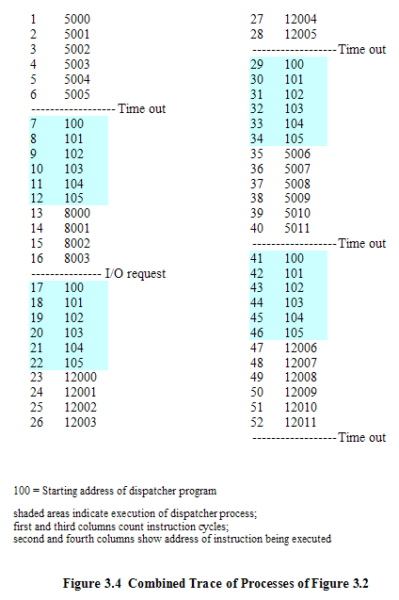
3.2 Process States
Notes:
对进程而言，当前处于何种状态

Slide 15
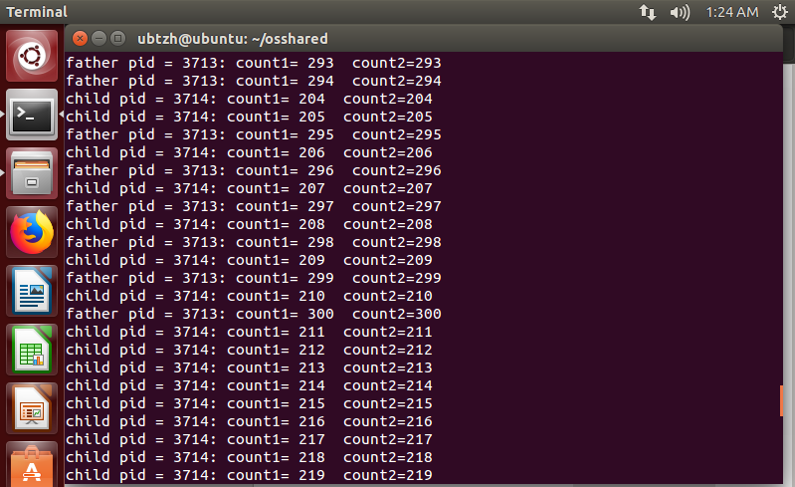
3.2 Process States
Notes:
对系统而言，各个进程当前的状态决定下一次的调度策略
基本状态，在运行，和非运行

Slide 16
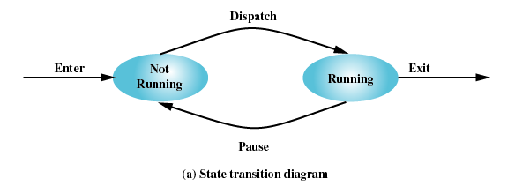
3.2 Process States
Two-State Process Model
Process may be in one of two states
Running
Not-running

Slide 17
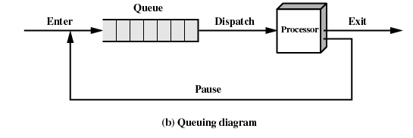
3.2 Process States
Two-State Process Model
Two states，one queue, any disadvantage？
Notes:
提问：
1.选择下一个running线程是等当前线程加入ready队列还是没加入之前呢？优先级影响
2.可以用链表管理，只有一个队列带来的问题：主要是调度策略和搜索时间性能不够优秀，如阻塞、优先级（按优先级分ready队列）

Slide 18
3.2 Process States
Limit of Two-State Process Model
Dispatcher分派器 cannot just select the process that has been in the queue the longest because it may be blocked
Not-running
ready to execute 就绪
waiting for I/O (blocked阻塞)

Slide 19
3.2 Process States
A Five-State Model
Running(运行态)
Ready (就绪态)
Blocked(阻塞态)
New (新建态)
Exit (退出态)

Slide 20
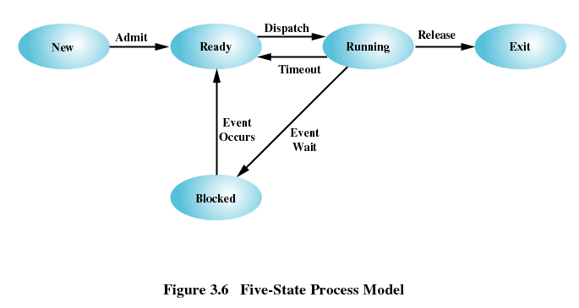
3.2 Process States
A Five-State Model
Notes:
其实是不运行状态进一步细分了
请列出各种状态转换发生的情况
New 一定ready 吗？伏笔 7状态
Ready 不可能转blocked，I/O调用只可能发生在程序执行过程中（注意比如word每隔几分钟存盘一次，word可能不是桌面热点应用，但依然是在获得CPU运行时发生存盘动作）
Running 要么完成任务退出，要么时间片用完，要么I/O挂起
Blocked 为啥转ready 不直接到running， 因为搜索队列不同，running只搜索ready队列
其它，父进程结束，导致blocked,ready的子进程退出

Slide 21
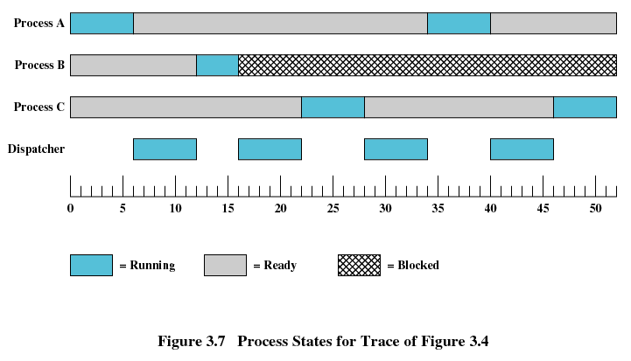
3.2 Process States
A Five-State Model

Slide 22
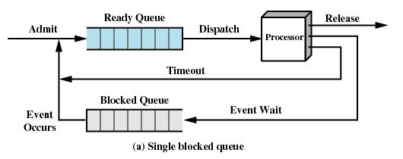
Using Two Queues：Efficiency？
3.2 Process States
A Five-State Model

Slide 23
Multiple Blocked Queues
3.2 Process States
Notes:
饭堂的排队策略，不同类型需求不同窗口（性能不佳，受窗口效率影响），队列过长，在计算机中导致搜索效率下降
分布式系统

Slide 24
3.2 Process States
A Five-State Model
Is it perfect?
So far, we only focus on all the possible states of processes, together with the resources they may waiting for.
Now consider the memory spaces allocated for all the processes
Any upper limitation of the number of process?
Less impact on capability of the computer system
Notes:
基于这些考虑，进程并非完全进驻在内存中，所以就绪和挂起又要继续进一步细分

Slide 25
3.2 Process States
Suspended Processes(被挂起的进程)
Processor is faster than I/O so all processes could be waiting for I/O
Swap these processes to disk to free up more memory
Blocked state becomes suspend state when swapped to disk
Two new states
Blocked/Suspend
Ready/Suspend

Slide 26
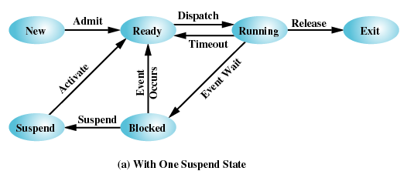
3.2 Process States
A Five-State Model+One Suspend State
Notes:
Suspend的都是阻塞态吗？极端情况时阻塞态全部挂起内存也不够用，这时候挂起谁？举个例子，我早上就打开了ppt,但翻了3页就读不下去了，这个进程就一直就绪，是否可以被挂起？是否比目前正在频繁修改和保存的代码的VS2022(更多I/O挂起的操作）更值被挂起

Slide 27
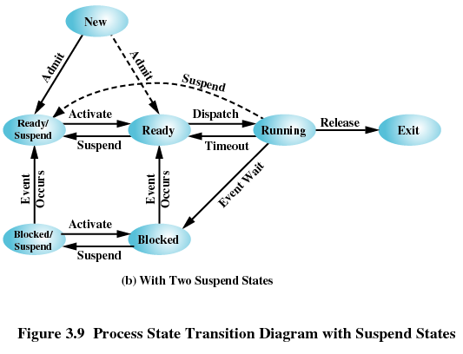
3.2 Process States
A Seven-State Model(Two Suspend States)

Slide 28
Linux 进程状态
R (TASK_RUNNING)，可执行状态（对应就绪和执行）
S (TASK_INTERRUPTIBLE)，可中断的睡眠状态，如等待信号量
D (TASK_UNINTERRUPTIBLE)，不可中断的睡眠状态，不受异步信号唤醒（少见）进程必须等待直到有中断发生
T (TASK_STOPPED or TASK_TRACED)，暂停状态或跟踪状态，gdb断点调试
Z (TASK_DEAD - EXIT_ZOMBIE)，退出状态，进程成为僵尸进程，仅保留task_struct(PCB)，其它的都释放了,等待父进程wait 来释放
< 高优先级 N 低优先级 L 有些页被锁进内存 s 包含子进程 + 位于后台的进程组； l 多线程，克隆线程
Notes:
TASK_UNINTERRUPTIBLE状态存在的意义就在于，内核的某些处理流程是不能被打断的。如果响应异步信号，程序的执行流程中就会被插入一段用于处理异步信号的流程（这个插入的流程可能只存在于内核态，也可能延伸到用户态），于是原有的流程就被中断了。（参见《linux内核异步中断浅析》）在进程对某些硬件进行操作时（比如进程调用read系统调用对某个设备文件进行读操作，而read系统调用最终执行到对应设备驱动的代码，并与对应的物理设备进行交互），可能需要使用TASK_UNINTERRUPTIBLE状态对进程进行保护，以避免进程与设备交互的过程被打断，造成设备陷入不可控的状态。这种情况下的TASK_UNINTERRUPTIBLE状态总是非常短暂的，通过ps命令基本上不可能捕捉到。
当进程正在被跟踪时，它处于TASK_TRACED这个特殊的状态。“正在被跟踪”指的是进程暂停下来，等待跟踪它的进程对它进行操作。比如在gdb中对被跟踪的进程下一个断点，进程在断点处停下来的时候就处于TASK_TRACED状态。而在其他时候，被跟踪的进程还是处于前面提到的那些状态。
TASK_DEAD状态。在这个退出过程中，进程占有的所有资源将被回收，除了task_struct结构（以及少数资源）以外。于是进程就只剩下task_struct这么个空壳，故称为僵尸。之所以保留task_struct，是因为task_struct里面保存了进程的退出码、以及一些统计信息。而其父进程很可能会关心这些信息。比如在shell中，$?变量就保存了最后一个退出的前台进程的退出码，而这个退出码往往被作为if语句的判断条件。

Slide 29
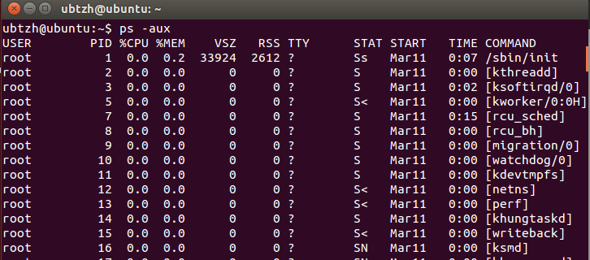
Linux 进程状态
ps –aux ps -ef
Notes:
ps a 显示现行终端机下的所有程序，包括其他用户的程序。
ps u 以用户为主的格式来显示程序状况。
ps x 显示所有程序，不以终端机来区分。
# ps -lA |more 小写L
USER 进程的属主；
PID 进程的ID；
PPID 父进程；
%CPU 进程占用的CPU百分比；
%MEM 占用内存的百分比；
NI 进程的NICE值，数值大，表示较少占用CPU时间；
VSZ 进程使用的虚拟內存量（KB）；
RSS 该进程占用的固定內存量（KB）（驻留中页的数量）；
TTY 该进程在那個終端上運行（登陸者的終端位置），若與終端無關，則顯示（？）。 “？” 表示这些进程不属于任何TTY，因为它们是由系统启动的，tty1-tty6 是本机上面的登入者程序，若为pts/0等，则表示由网络连接主机进程
WCHAN 当前进程是否正在進行，若为-表示正在進行；
START 該進程被觸發启动时间；
TIME 該进程實際使用CPU運行的时间；
COMMAND 命令的名称和参数；
STAT狀態位常見的狀態字符
D 无法中断的休眠状态（通常 IO 的进程）；
R 正在运行可中在队列中可过行的；
S 处于休眠状态；
T 停止或被追踪；
W 进入内存交换 （从内核2.6开始无效）；
X 死掉的进程 （基本很少見）；
Z 僵尸进程；
< 优先级高的进程
N 优先级较低的进程
L 有些页被锁进内存；
s 进程的领导者（在它之下有子进程）；
l 多进程的（使用 CLONE_THREAD, 类似 NPTL pthreads）；
+ 位于后台的进程组；
，若为 pts/0 等等的，则表示为由网络连接进主机的程序。STAT：该进程的状态，有下一个板块的几个状态，D，R，S，T，Z是ps指令标识进程的5种状态码TIME：进程已消耗的CPU时间CMD：启动进程的命令

Slide 30
Agenda
3.1 What is a Process
3.2 Process States
3.3 Process Description
3.4 Process Control
3.5 Execution of the Operating System
3.6 process API introduction

Slide 31
3.3 Process Description
To answer a fundamental question: What information does the OS need to control processes and manage resources for them?
3.3.1 Operating System Control Structures
即：OS掌握进程哪些信息，怎么存储这些信息
3.3.2 Process Control Structures
即：进程记录哪些信息便于运行和管理

Slide 32
3.3.1 Operating System Control Structures
Information about the current status of each process and resource (每个进程和资源的当前状态)
Tables are constructed for manage 4 kinds of resources (操作系统构造并维护他所管理的四类资源实体的信息表)
MEM,I/O,FILE,PROCESS
Tables are linked or cross-referenced这些表交叉引用

Slide 33
3.3.1 Operating System Control Structures
OS控制表通用结构
Notes:
所有这些表将以某种方式交叉引用，比如mem里面也有关于分配给进程的内的相关信息，IO分配信息在进程里面也有

Slide 34
3.3.1 Operating System Control Structures
Memory Tables
Allocation of main memory to processes (分配给进程的主存)
Allocation of secondary memory to processes (分配给进程的辅存)
Protection attributes for access to shared memory regions(共享内存区域的保护属性)
Information needed to manage virtual memory(虚拟内存的管理信息)

Slide 35
3.3.1 Operating System Control Structures
I/O Tables
I/O device is available or assigned(分配状态)
Status of I/O operation
Location in main memory being used as the source or destination of the I/O transfer (数据传送的源和目的地址)

Slide 36
3.3.1 Operating System Control Structures
File Tables
Existence of files
Location on secondary memory
Current Status
Attributes
Notes:
比如读写问题，需要知道文件当前的状态

Slide 37
3.3 Process Description
3.3.1 Operating System Control Structures
3.3.2 Process Control Structures

Slide 38
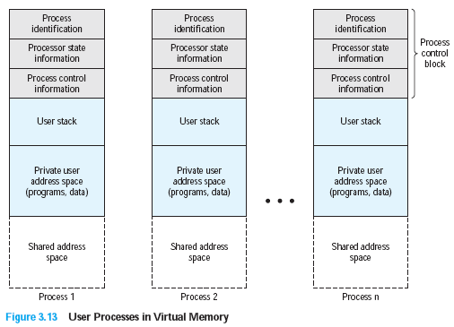
3.3.2 Process Control Structures
Process image 进程映像
The collection of program, data, stack, and attributes(PCB): not contiguous in addresses
PCB
进程代码数据

Slide 39
3.3.2 Process Control Structures
in memory tables by OS VS
in PCB by Process
Ppt34页内容
show the location of each page of each process image.(页表)
Process Attributes
the location
on disk
and in main memory
Textbook Table 3.5
process identifier
Processor state information
切换进程需要
Process control information
Notes:
There must be some reference to memory, I/O, and files, directly or indirectly
The tables themselves must be accessible by the OS and therefore are subject to memory management
Before we can deal with the questions of where a process is
located or what its attributes are, we need to address an even more fundamental
question: What is the physical manifestation of a process? At a minimum, a process
must include a program or set of programs to be executed. Associated with these
programs is a set of data locations for local and global variables and any defined
constants. Thus, a process will consist of at least sufficient memory to hold the
programs and data of that process. In addition, the execution of a program typically
involves a stack (see Appendix P) that is used to keep track of procedure calls and
parameter passing between procedures. Finally, each process has associated with it
a number of attributes that are used by the OS for process control.
The location of a process image will depend on the memory management
scheme being used. In the simplest case, the process image is maintained as a
contiguous, or continuous, block of memory. This block is maintained in secondary
memory, usually disk. So that the OS can manage the process, at least a small portion
of its image must be maintained in main memory. To execute the process, the entire
process image must be loaded into main memory or at least virtual memory. Thus,
the OS needs to know the location of each process on disk and, for each such process
that is in main memory, the location of that process in main memory. We saw
a slightly more complex variation on this scheme with the CTSS OS, in Chapter 2 .
With CTSS, when a process is swapped out, part of the process image may remain in
main memory. Thus, the OS must keep track of which portions of the image of each
process are still in main memory.
Modern operating systems presume paging hardware that allows noncontiguous
physical memory to support partially resident processes. 8 At any given time, a
portion of a process image may be in main memory, with the remainder in secondary
memory. 9 Therefore, process tables maintained by the OS must show the location
of each page of each process image.

Slide 40
3.3.2 Process Control Structures
Process Control Block
Process Identification
Processor State Information
User-Visible Registers
Control and Status Registers
Stack Pointers
Process Control information
Scheduling and State Information
Data Structuring (link information)
Interprocess Communication
Process Privileges
Memory Management
Resource Ownership and Utilization
Notes:
所有操作系统中的管理等功能模块，如调度，资源分配，中断，性能监控，等都可以访问修改PCB，重点是一旦PCB出现错误和变动，如何保护和控制这些变动对操作系统模块的影响

Slide 41
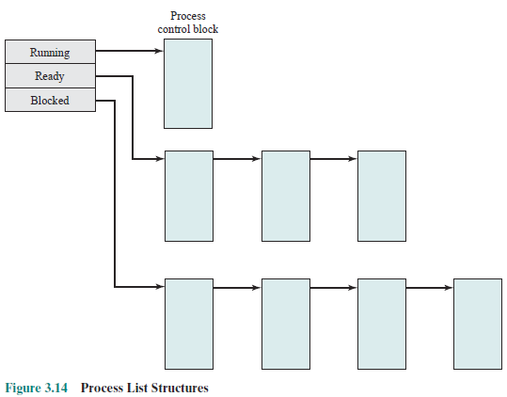
3.3.2 Process Control Structures
PCB contains: Structuring information: pointers to linked list of queues
Any potential risk?
Notes:
一个错误导致列表出错：所以由唯一一个授权程序来进行PCB读写

Slide 42
Agenda
3.1 What is a Process
3.2 Process States
3.3 Process Description
3.4 Process Control
3.5 Execution of the Operating System
3.6 process API introduction

Slide 43
3.4 Process Control
3.4.1 Modes of Execution
3.4.2 Process Creation
3.4.3 Process Switching

Slide 44
3.4.1 Modes of Execution(CPU)
To protect OS
User mode
Typically when User programs executes
System mode, control mode, or kernel mode
More-privileged mode
Kernel of the operating system
Table 3.7
Notes:
3.5.2第三段，区别进程状态切换和模式切换
Certain instructions can only be executed in the more-privileged mode. These would include reading or altering a control register, such as the program status word; primitive I/O instructions; and instructions that relate to memory management. In addition, certain regions of memory can only be accessed in the more-privileged mode.

Slide 45
3.4.1 Modes of Execution(CPU)
Translation between the two model
Interrupt/Trap/Syscall
Modifiy Processor status register (psr) and current privileged level (cpl)
Figure 3.4
Notes:
3.5.2第三段，区别进程状态切换和模式切换
Certain instructions can only be executed in the more-privileged mode. These would include reading or altering a control register, such as the program status word; primitive I/O instructions; and instructions that relate to memory management. In addition, certain regions of memory can only be accessed in the more-privileged mode.

Slide 46
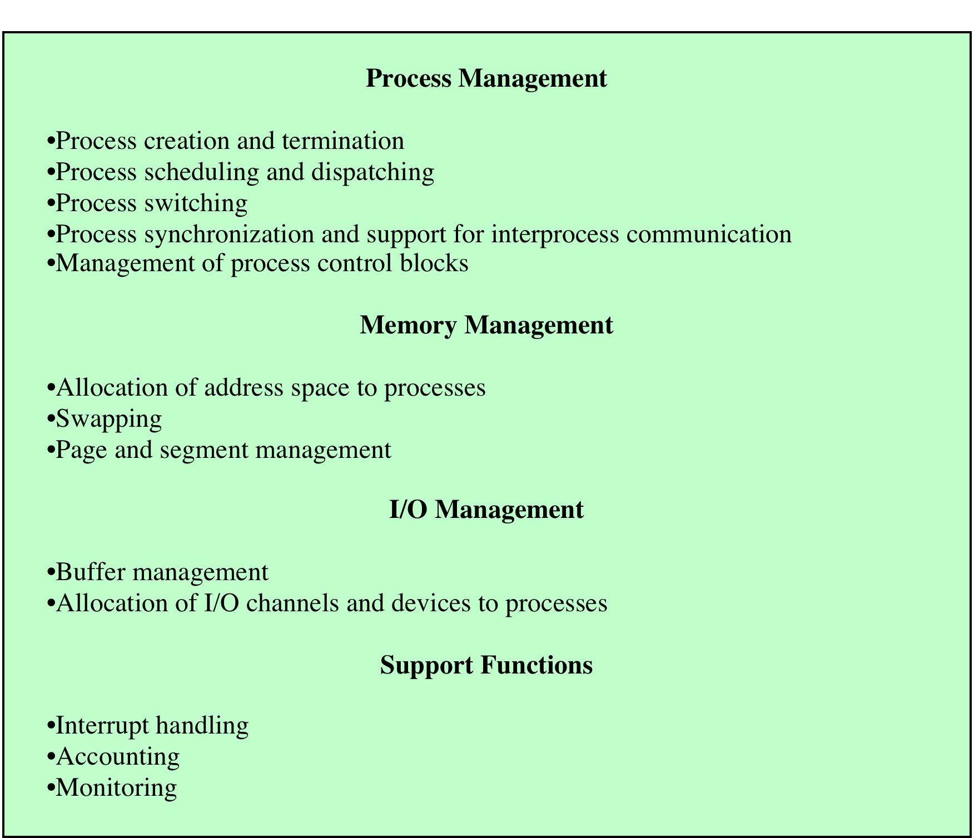
System mode
3.4.1 Modes of Execution(CPU)
Table 3.7
Typical Functions
of an OS Kernel

Slide 47
Process Creation
3.4.2 Process Creation
Assign a unique process identifier
Allocate space for the process
Initialize process control block
Set up appropriate linkages
Ex: add new process to linked list used for scheduling queue
Create of expand other data structures
Ex: maintain an accounting file

Slide 48
3.4.3 Process Switching
Process Switching：When
A process switch may occur any time that the OS has gained control from the currently running process. The possible events that may give control to the OS include:
Interrupt
Clock interrupt
process has executed for the maximum allowable time slice
I/O interrupt
Memory fault
Referenced virtual address is not in main memory, so it must be brought in.

Slide 49
3.4.3 Process Switching
Trap
error or exception occurred
may cause process to be moved to Exit state
Supervisor call (System Call)
such as file open
Notes:
Trap 比如捕获文件不存在的指令，try catch指令捕获exception 异常

Slide 50
3.4.3 Process Switching
Process Switching：How
Save context of processor including program counter and other registers
Update the process control block of the process and change the process’s state that is currently in the Running state
Move process control block to appropriate queue – ready; blocked; ready/suspend
Select another process for execution

Slide 51
3.4.3 Process Switching
Process Switching：How
Update the process control block of the process selected and change it state
Update memory-management data structures
Restore context of the selected process
Notes:
6.页表等信息，如果是倒查页表就不需要更新

Slide 52
Agenda
3.1 What is a Process
3.2 Process States
3.3 Process Description
3.4 Process Control
3.5 Execution of the Operating System
3.6 process API introduction

Slide 53
3.5 Execution of the Operating System
1.Non-process Kernel（无进程内核）
2.Execution Within User Processes(在用户进程中执行)
3.Process-Based Operating System（基于进程的OS）

Slide 54
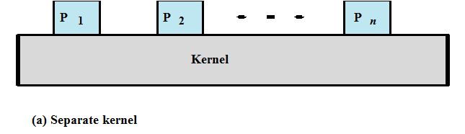
3.5 Execution of the Operating System
Non-process Kernel（无进程内核）
Execute kernel outside of any process
Operating system code is executed as a separate entity that operates in privileged mode

Slide 55
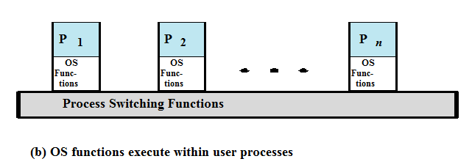
3.5 Execution of the Operating System
Execution Within User Processes(在用户进程中执行)
Operating system software within context of a user process
Process executes in privileged mode when executing operating system code
Unix
Notes:
状态切换 和模式切换的区别

Slide 56
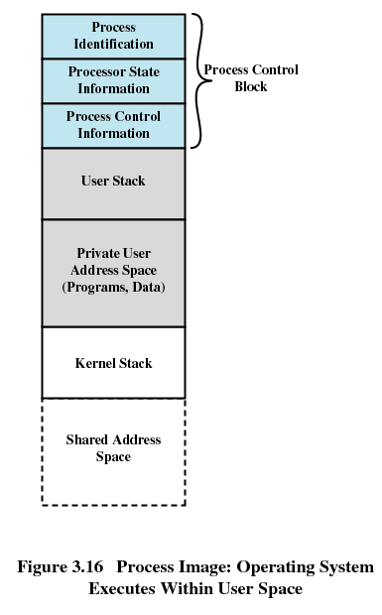

Slide 57
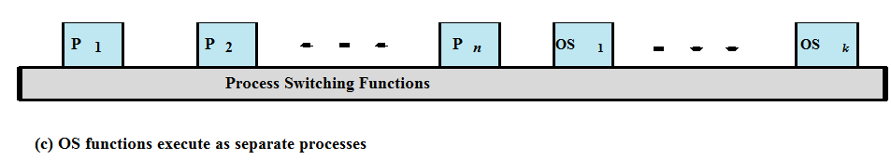
3.5 Execution of the Operating System
Process-Based Operating System（基于进程的OS）
Implement operating system as a collection of system processes
Useful in multi-processor or multi-computer environment

Slide 58
3.6 process API introduction
3.1 What is a Process
3.2 Process States
3.3 Process Description
3.4 Process Control
3.5 Execution of the Operating System
3.6 process API introduction

Slide 59
3.6 process API introduction(1/15)
创建 create
fork
在父进程中，fork返回新创建子进程的进程ID；
在子进程中，fork返回0；
如果出现错误，fork返回一个负值；
销毁 destroy
等待 wait

Slide 60
3.6 process API introduction(2/15)
fork
Process image
//main.c
int main()
{
printf("first command:(pid:%d)\n",(int)getpid());
int rc=fork();
if(rc)
printf("%d father of %d\n",(int)getpid(),rc);
else
printf("%d child\n",(int)getpid());
return 0;
}
PCB ：parent
User stack: rc非零,为子进程pid
Code & data: main
…
Process image
PCB： child
User stack：rc 为0
Code & data 代码内容同上
…
Notes:
父进程返回pid，子进程返回0

Slide 61
3.6 process API introduction(3/15)
fork
parent
int main()
{
printf("first command:(pid:%d)\n",(int)getpid());
int rc=fork();
if(rc)
printf("%d father of %d\n",(int)getpid(),rc);
else
printf("%d child\n",(int)getpid());
return 0;
}
Why clone the same code?
Notes:
父进程返回pid，子进程返回0

Slide 62
3.6 process API introduction(4/15)
fork
child
int main()
{
printf(“first command:(pid:%d)\n”,(int)getpid());//机器指令存在，但不执行
int rc=fork(); //返回值保存执行，但fork的功能不执行
if(rc)
printf("%d father of %d\n",(int)getpid(),rc);
else
printf("%d child\n",(int)getpid());
return 0;
}
Notes:
父进程返回pid，子进程返回0

Slide 63
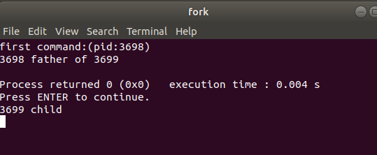
3.6 process API introduction(5/15)

Slide 64
3.6 process API introduction(6/15)
wait: 父进程等待子进程终止并返回
why：进程只能释放自己的空间，不能销毁自己的PCB，父进程销毁子进程的PCB
孤儿进程：父进程已经结束，子进程尚未结束

Slide 65
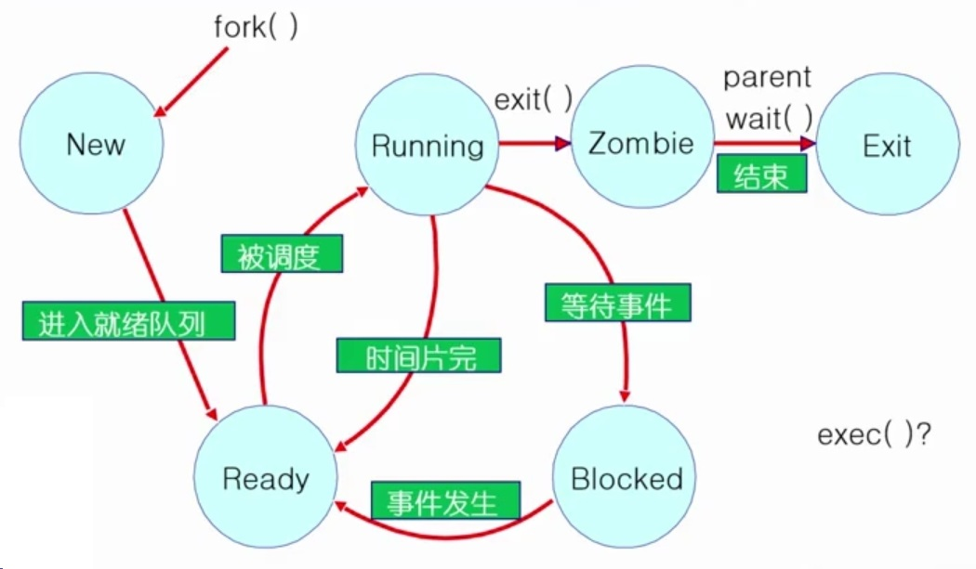
3.6 process API introduction(7/15)
Notes:
Zombie僵尸 指空间已经释放，但PCB尚在

Slide 66
3.6 process API introduction(8/15)
int main()
{
int wc；
printf("first command:(pid:%d)\n",(int)getpid());
int rc=fork();
if(rc) {
wait(& wc);
printf("%d father of %d\n",(int)getpid(),rc);
}
else
printf("%d child\n",(int)getpid());
return 0;
}

Slide 67
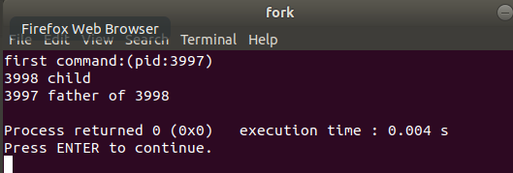
3.6 process API introduction(9/15)

Slide 68
3.6 process API introduction(10/15)
执行完fork()时，各个进程映像
exec(lab04:3.4.3)
Process image
//execDemo.c
int main()
{
fpid=fork() ;
char *args[]={"./EXEC",NULL};
if(fpid==0)
execvp(args[0],args);
printf("Ending-----");
return 0;
}
PCB ：parent
User stack: args
Code & data：execDemo
…
Process image
PCB ：child
User stack: args
Code & data：execDemo
…

Slide 69
3.6 process API introduction(11/15)
//execDemo.c
int main()
{
fpid=fork();
char *args[]={"./EXEC",NULL};
if(fpid==0)
execvp(args[0],args);
printf("Ending-----");
return 0;
}
执行完execvp()时，各个进程映像
PCB ：parent
User stack: args
Code & data : exeDemo
…
PCB：child
User stack：i
Code & data : EXEC
…
//EXEC.c
int main() {
int i;
printf("I am EXEC.c called by execvp() ");
return 0;
}

Slide 70
3.6 process API introduction(12/15)
int main()
{
printf("first command:(pid:%d)\n",(int)getpid());
int rc=fork();
char *args[]={"./exec",NULL};
if(rc) {
printf("%d father of %d\n",(int)getpid(),rc);
int wc=wait();
}
else{
execvp(args[0],args);
printf(“%d child\n”,(int)getpid());//不会执行
}
return 0;
}

Slide 71
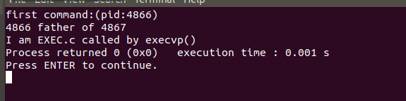
3.6 process API introduction(13/15)
//EXEC.c
int main() {
int i;
printf("I am EXEC.c called by execvp() ");
return 0;
}

Slide 72
3.6 process API introduction(14/15)
//execDemo.c
int main()
{
char *args[]={"./EXEC",NULL};
execvp(args[0],args);
printf("Ending-----");
return 0;
}
PCB ：
User stack: args
Code & data : exeDemo.c
…
PCB：
User stack：i
Code & data : EXEC
…
//EXEC.c
int main() {
int i;
printf("I am EXEC.c called by execvp() ");
return 0;
}

Slide 73
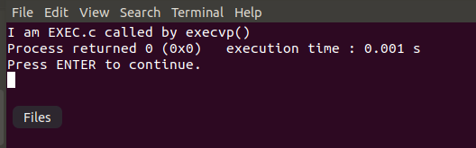
3.6 process API introduction(15/15)

