Slide 1
Operating Systems
Chapter 4 Threads, SMP, and Microkernels

Slide 2
Agenda
4.1 Processes and Threads
4.2 Types of Threads

Slide 3
4.1 Processes and Threads
4.1.1 Introduction
4.1.2 Multithreading
4.1.3 Thread Functionality

Slide 4
4.1.1 Introduction(1/2)
These two characteristics are treated independently by the operating system OS区别对待以下问题
  Resource ownership(资源所有权) - process includes a virtual address space to hold the process image
  Scheduling/execution(调度/执行)- follows an execution path that may be interleaved with other processes

Slide 5
4.1.1 Introduction(2/2)
Scheduling/execution
  Dispatching is referred to as a thread or lightweight process(调度的单位称为线程或轻量进程)
Resource
  Resource of ownership is referred to as a process or task(资源所有权的单位称为进程或者任务)

Slide 6
4.1 Processes and Threads
4.1.1 Introduction
4.1.2 Multithreading
4.1.3 Thread Functionality

Slide 7
4.1.2 Multithreading(1/9)
Single-Thread(单线程)
  Single-threaded approach refers to the traditional approach of a single thread of execution per process, in which the concept of a thread is not recognized（单线程指一个进程中只有一个线程在执行的传统方法，线程的概念并不明确）
    MS-DOS supports a single thread(单进程、单线程)
    Some UNIX supports multiple user processes but only supports one thread per process（多进程，每个进程单线程）

Slide 8
4.1.2 Multithreading(2/9)
Multithreading(多线程)
  Multithreading refers to the ability of an OS to support multiple threads of execution within a single process(指操作系统支持在一个进程中执行多个线程的能力)
    Windows, OpenEuler,Solaris, Linux, Mach, and OS/2 support multiple threads

Slide 9
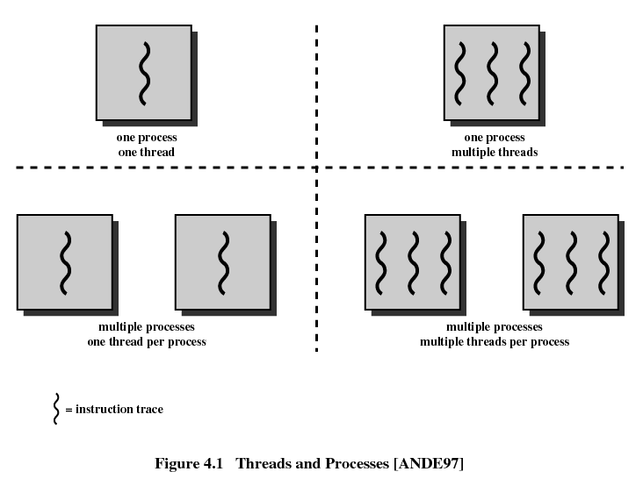
4.1.2 Multithreading(3/9)

Slide 10
4.1.2 Multithreading(4/9)
Process : Unit of Resource allocation and Unit of Protection(资源分配和保护的单位)
  Have a virtual address space(虚拟地址空间) which holds the process image( code, data, stack and PCB)
  Protected access to processors, memory, other processes(与其他进程通信), files, and I/O resources
  Contains one or more threads
Notes:
ULT KLT 线程调度策略不同

Slide 11
4.1.2 Multithreading(5/9)
Thread : Unit of Scheduling/Execution(调度执行的单位)
  Each thread has:
    An execution state (running, ready, etc.)
    Saved thread context when not running (pc)
    Has an execution stack
    Some per-thread static storage for local variables 局部变量
    Access to the memory and resources of its process 比如全局变量

Slide 12
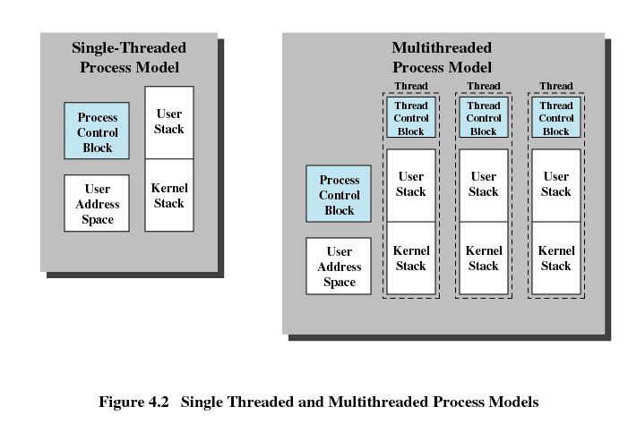
4.1.2 Multithreading(6/9)
Distinction Between Threads and Processes From the Point of View of Process Management (从进程管理的角度看线程和进程)
线程=进程-共享资源
Notes:
Heap 所有线程共享

Slide 13
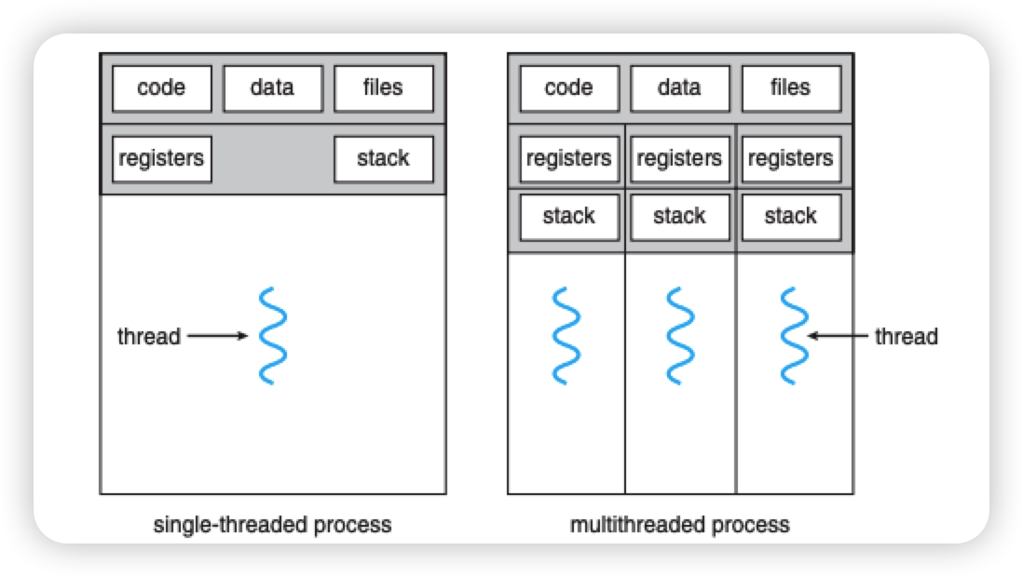
4.1.2 Multithreading(7/9)
多线程共享进程的代码段和数据段(全局变量)，每个线程有自己的程序计数值和局部变量stack
Notes:
Heap 所有线程共享

Slide 14
4.1.2 Multithreading(8/9)
Benefits(优点) of Threads
  Takes less time to create a new thread than a process (创建快)不重头分配内存等资源
  Less time to terminate a thread than a process (结束快)
  Less time to switch between two threads within the same process (切换快)相同镜像，不需要切换页表
  Since threads within the same process share memory and files, they can communicate with each other without invoking the kernel (通信快)不经过内核通信

Slide 15
4.1.2 Multithreading(9/9)
Threads are Affected by Many Process Action
  Suspending a process involves suspending all threads of the process since all threads share the same address space (挂起进程会挂起该进程的所有线程)
  Termination of a process, terminates all threads within the process (终止进程会终止该进程的所有线程)
Notes:
注意挂起和阻塞不同，挂起时进程内存被移出内存，那么线程就全部移出
Google chrome

Slide 16
4.1 Processes and Threads
4.1.1 Introduction
4.1.2 Multithreading
4.1.3 Thread Functionality (线程功能特性)
Notes:
线程具有执行状态，且可以与另外一个线程同步。线程的同步与进程同步相同，在以后的章节中讲解

Slide 17
4.1.3 Thread Functionality(1/5)
key states for a thread
  Running, Ready,Blocked.
Operations associated with a change in thread state
  Spawn(派生)
    Spawn another thread
  Block(阻塞)
  Unblock(解除阻塞)
  Finish
    Deallocate register context and stacks
Notes:
Running ， ready 是调度决定的，派生，阻塞等是操作决定的

Slide 18
4.1.3 Thread Functionality(2/5)
Suspending a process involves suspending all threads of the process
  swap address space to disk
Blocking a thread involves blocking the process，right？
  Better not

Slide 19
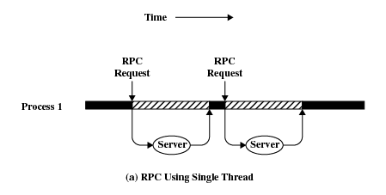
4.1.3 Thread Functionality(3/5)
Remote Procedure Call Using Single Thread
Notes:
Figure 4.3 (based on one in [KLEI96]) shows a program that performs two remote procedure calls (RPCs)2 to two different hosts to obtain a combined result. In a single-threaded program, the results are obtained in sequence, so the program has to wait for a response from each server in turn. Rewriting the program to use a separate thread for each RPC results in a substantial speedup. Note that if this program operates on a uniprocessor, the requests must be generated sequentially and the results processed in sequence; however, the program waits concurrently for the two replies
假设process1是形成天气预报的进程，现在它需要向两台计算机分别获取风速预测和降雨预测情况，如果是单线程单进程，那么就需要串行；如果多线程，即便process1跑在单cpu的计算机上，也可以用线程分别发出访问请求，从而节约等待时间。这里要说明的就是一个进程多个线程情况下，最好的状态是一个线程block，不影响第二个线程，否则第二个线程无法发出获取降雨的请求，就无法部分同时等待对方返回结果，从而节约等待信息的时间。
此话题和4.2部分的内容相关，如果是ULT模式，其实一个线程阻塞，进程就阻塞了，那么上图的预期就无法实现。
A significant issue is whether the blocking of a thread results in the blocking of the entire process. In other words, if one thread in a process is blocked, does this prevent the running of any other thread in the same process even if that other thread is in a ready state? Clearly, some of the flexibility and power of threads is lost if the one blocked thread blocks an entire process. We return to this issue subsequently in our discussion of user-level versus kernel-level threads, but for now let us consider the performance benefits of threads that do not block an entire process.

Slide 20
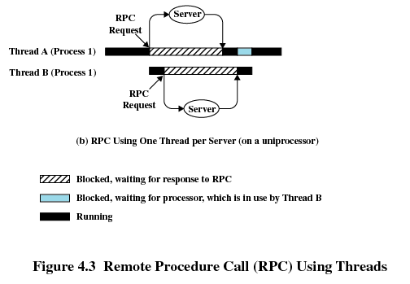
Remote Procedure Call Using Two Threads
4.1.3 Thread Functionality(4/5)

Slide 21
4.1.3 Thread Functionality(5/5)
THREAD Synchronization 线程同步
Why?
In a process:
  All threads share the same address space and other resources(open files).
  Any alteration of a resource by one thread affects the others.

Slide 22
Agenda
4.1 Processes and Threads
4.2 Types of Threads
  4.2.1 User-LeveIntroduction
  4.2.2 Kernel-Level Thread
  4.2.3 Combined Approaches
  4.2.4 Other Arrangements

Slide 23
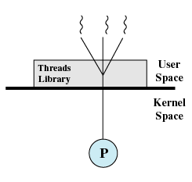
4.2 Types of Threads(1/10)
1. User-Level Threads (ULT，用户级线程)
Multithread implemented by a threads library线程库
All thread management is done by the application
The kernel is not aware of the existence of threads & scheduling is done on a process basis

Slide 24
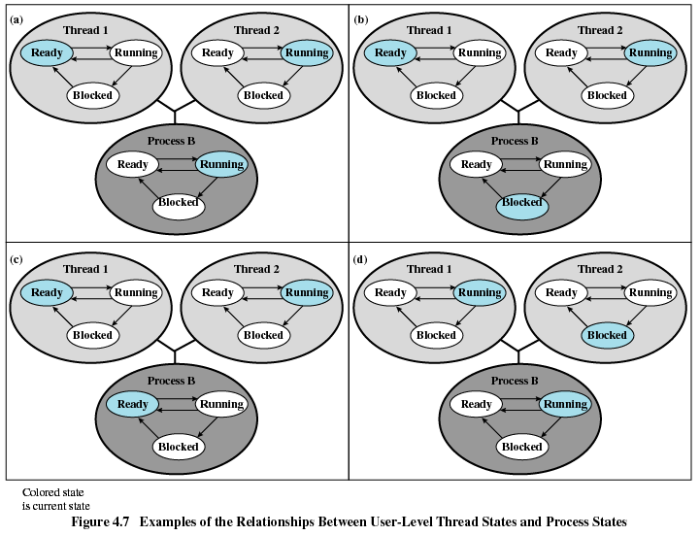
4.2 Types of Threads(2/10)
Notes:
A的阻塞是系统调用，切换内核态，进程阻塞，d的阻塞是阻塞在线程1的某个点，比如等待信号量，所以不影响进程状态
The figure shows the relationship between thread scheduling and process scheduling.
1、Thread 2 makes a system call that blocks Process B. According to the data structure maintained by the threads library, thread 2 is still in the Running state. Figure (a) and (b).
2、Process B exhausts its time slice and the kernel places Process B in the Ready state. Meanwhile, according to the data structure maintained by the threads library, thread 2 is sting in the Running state. Figure(c)
3、Thread 2 has reached a point where it needs some action performed by thread 1. Thread 2 enters a Blocked state and thread 1 transitions from Ready to Running. Process B remains in the Running state. Figure (d)
A process that implements multithread using thread library may be in the midst of a thread switch from one thread to another when interrupted.

Slide 25
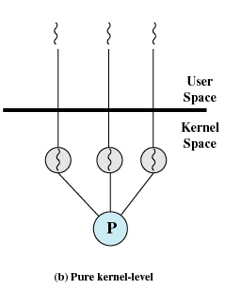
4.2 Types of Threads(3/10)
2.Kernel-Level Threads(内核级线程)
Kernel maintains context information for the process and the threads
Scheduling is done on a thread basis

Slide 26
4.2 Types of Threads(4/10)
Advantages of ULT to KLT
  Less overhead of thread switches(mode switches do not required) 切换开销小
  Scheduling can be application specific 调度策略根据应用可以不同
  ULTs can run on any operating system without modify the underlying kernel 无需底层内核修改

Slide 27
4.2 Types of Threads(5/10)
Disadvantages of ULT to KLT
  One thread is blocked, all other threads of the process are blocked(ULT按进程调度)
  A multithreaded application cannot take advantage of multiprocessing (线程不能分配到多核)
  Ways to work around these drawbacks:
    Multiple processes 用多进程代替多线程
    Jacketing套管 针对阻塞问题
Notes:
对OS而言调度单位是进程，一旦系统调用，进入内核态

Slide 28
4.2 Types of Threads(6/10)
KLT
  Kernel manage the threads
    Windows provides API
  Kernel routines themselves can be multithreaded
Advantages of KLT to ULT
  Overcomes the two principal drawbacks of the ULT
    Multiple threads in one process can simultaneously run on multiple processors 多CPU执行
    One threads blocked cannot make the other threads within the same process blocked 仅阻塞单个线程

Slide 29
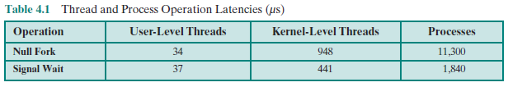
4.2 Types of Threads(7/10)
Disadvantages of KLT to ULT
  The principal disadvantage is that thread switch requires mode switches(模式切换) to the kernel
Notes:
Klt创建进程通过api，需要切换到内核模式

Slide 30
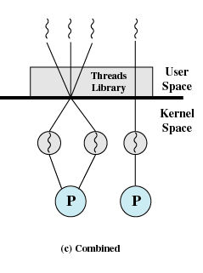
4.2 Types of Threads(8/10)
3. Combined Approaches 混合方式
  thread creation/scheduling/synchronization is done completely in user space 分配调度同步可以在用户空间
  The multiple ULTs from a single application are mapped onto some (smaller or equal) number (adjustable) of KLTs. 允许映射到内核

Slide 31
4.2 Types of Threads(9/10)
Advantages of Combined Approaches
  multiple threads within the same application run
  in parallel on multiple processors 多cpu运行
  A blocking system call only blocks the thread.仅阻塞单个线程
Notes:
一半像ULT,一半像KLT

Slide 32
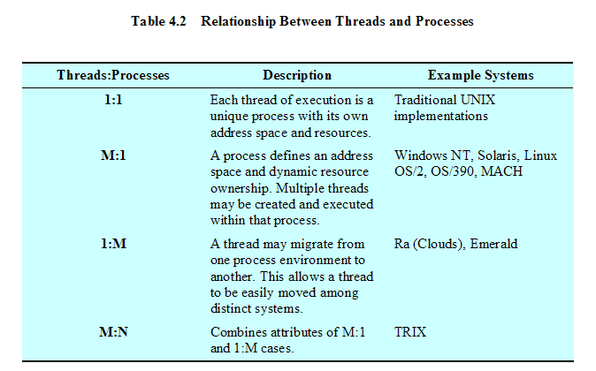
4.2 Types of Threads(10/10)
Relationship Between Threads and Processes

