Slide 1
Operating Systems
Chapter 5 Mutual Exclusion(互斥) and Synchronization(同步)

Slide 2
Agenda
5.1 Principles of Concurrency
5.2 Mutual Exclusion: Hardware Support
5.3 Semaphores
5.4 Monitors
5.5 Message Passing
5.6 Readers/Writers Problem
5.7 Summary

Slide 3
Review section1&2
Concurrency and Problems
  Race condition/deadlock/livelock/starvation
Solutions : Mutual Exclusion
  概念：
    Critical section临界区, Atomic Operation原子操作
    thdcas_demo
  实现
    1、Hardware approaches
      Interrupt Disabling、Special Machine Instructions
    2、Software approaches
      Dekker，Peterson
Notes:
重点考察学生对概念的掌握，比如临界区是否出现线程切换；原子操作是指原子指令还是原子操作包裹的临界区
用lab06里面的thdcas_demo演示
Lab05
Basic threads application: create, join, deadlock…
Merge Sort : thread shared variables/ cost of context switch
评讲实验

Slide 4
Review section1&2
Lab06 Part I:
  阅读实验指导：4.1 Linux线程-互斥锁pthread_mutex_t
线程互斥锁pthread_mutex_t的实现原理：
pthread_mutex_lock: atomic_dec(pthread_mutex_t.value); if(pthread_mutex_t.value!=0) futex(WAIT) else success pthread_mutex_unlock: atomic_inc(pthread_mutex_t.value); if(pthread_mutex_t.value!=1) futex(WAKEUP) else success
Notes:
前面介绍原子操作xchg等，其实就是锁这个概念，我们说锁可以忙等，也可以加入队列，linux实现mutex就是用了队列
在Linux下，信号量和线程互斥锁的实现都是通过futex系统调用。
futex（fast userspace mutex快速用户区互斥的简称）是一个在Linux上实现锁定和构建高级抽象锁如信号量和POSIX互斥的基本工具。它们第一次出现在内核开发的2.5.7版；其语义在2.5.40固定下来，然后在2.6.x系列稳定版内核中出现。
Futex 由一块能够被多个进程共享的内存空间（一个对齐后的整型变量）组成；这个整型变量的值能够通过汇编语言调用CPU提供的原子操作指令来增加或减少，并且一个进程可以等待直到那个值变成正数。

Slide 5
Review section1&2
Lab06 Part I:
  先完成实验指导：4.1 Linux线程-互斥锁pthread_mutex_t
  体会生产数据和使用数据间的配合：
    互斥满足
    但数据同步，不满足
问题：如何既互斥又同步
Notes:
CDC项目中，无法限制3个进程哪一个先进入执行，因此会出现3先执行，却没有数据的问题，即同步问题
简化问题：一个生产者，一个消费者问题，如何实现先生产，再消费
扩展到：多个生产者，多个消费者
读写问题，某段程序允许多个进程执行等
，为此引入信号量

Slide 6
Agenda
5.1 Principles of Concurrency
5.2 Mutual Exclusion: Hardware Support
5.3 Semaphores
5.4 Monitors
5.5 Message Passing
5.6 Readers/Writers Problem
5.7 Summary

Slide 7
Agenda
5.3 Semaphores
5.4 Monitors

Slide 8
5.3 Semaphores
信号量的定义和实现
5.3.1 Overview
5.3.4 Implement of Semaphores
5.3.2 Mutual Exclusion互斥
5.3.3 The Producer/Consumer problem同步
信号量的应用

Slide 9
5.3.1 Semaphores(信号量) Overview(1/3)
Fundamental principle(基本原理):
  Two or more processes can cooperate by means of simple signals, such that a process can be forced to stop at a specified place until it has received a specific signal.(两个或者多个进程可以通过简单的信号进行合作，一个进程可以被迫在一个位置停止，直到它收到一个信号)

Slide 10
5.3.1 Semaphores(信号量) Overview(2/3)
For signaling, special variables called semaphores are used(一种称为信号量的特殊变量用来传递信号)
If a process is waiting for a signal, it is blocked until that signal is sent (如果一个进程在等待一个信号，它会被阻塞，直到它等待的信号被发出）

Slide 11
5.3.1 Semaphores(信号量) Overview(3/3)
Semaphore : sem变量 + 2 atomic operations原子操作
  Sem(integer value整数值)
    initialize to a nonnegative number (非负数)?
    初始值问题：0,1,…n ？
  semWait (P)：
    --sem
    If sem < 0, the process executing the semWait is blocked.
    else , process continue execute
  semSignal (V)：
    ++sem
    If sem<=0, then a process blocked by a semWait operation is unblocked.
    else , process continue execute
Notes:
P,V 来自荷兰语增加减少：Dijkstra

Slide 12
5.3 Semaphores
信号量的定义和实现
5.3.1 Overview
5.3.4 Implement of Semaphores
5.3.2 Mutual Exclusion互斥
5.3.3 The Producer/Consumer problem同步
信号量的应用

Slide 13
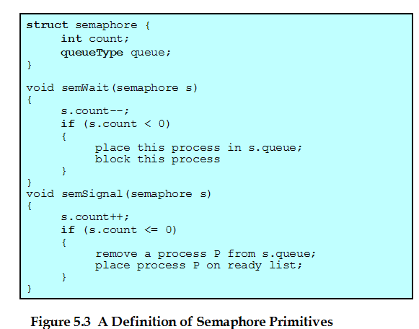
5.3.4 Implement of Semaphores(1/6)
Semaphore Primitives(原语被假定为原子操作)

Slide 14
5.3.4 Implement of Semaphores(2/6)
Semaphore operations are atomic operations.
  时间非常短
  Implement in hardware or firmware(固件)
  Implement in software, e.g. Dekker or Peterson
  Implement by inhibit interrupts(中断禁止) for a single-processor system

Slide 15
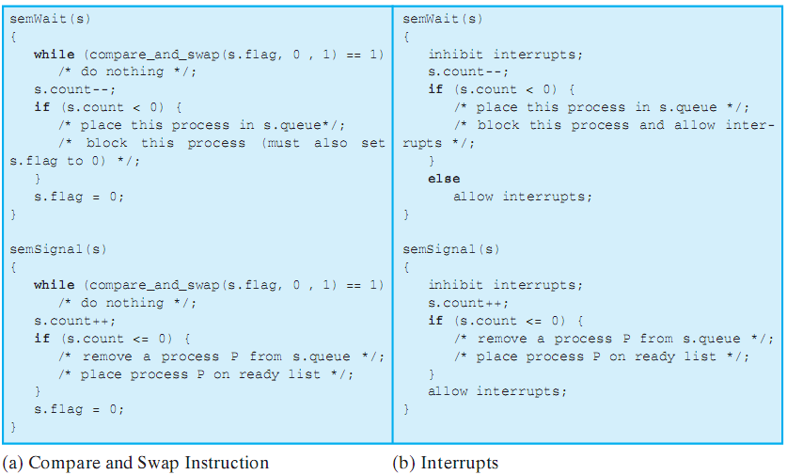
5.3.4 Implement of Semaphores(3/6)
Notes:
对比图5.3原语，其实只增加了cas或者interrupt保证原子操作

Slide 16

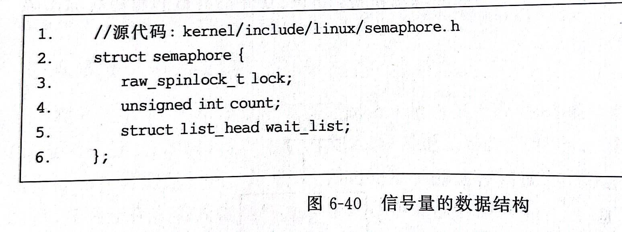
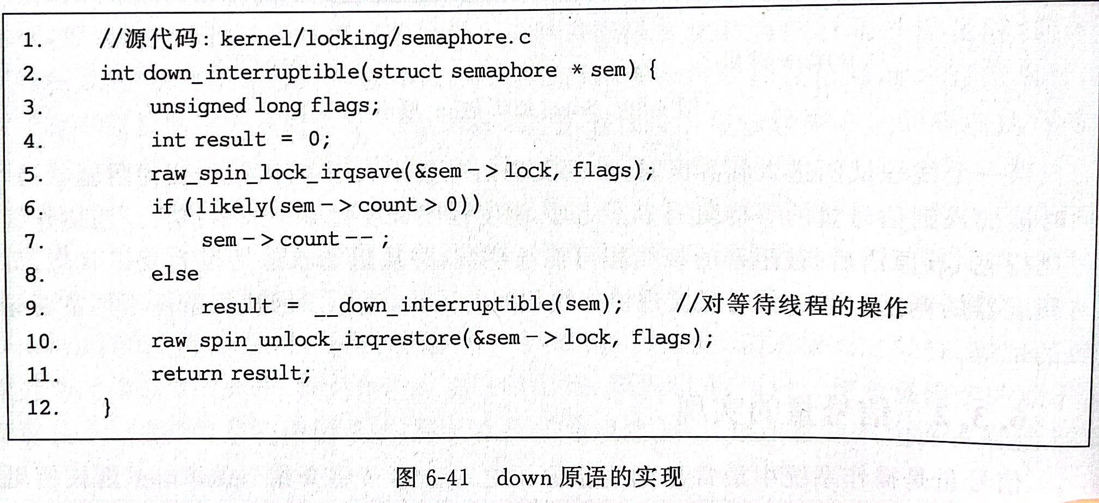
5.3.4 Implement of Semaphores(4/6)
OpenEuler 信号量的实现

Slide 17
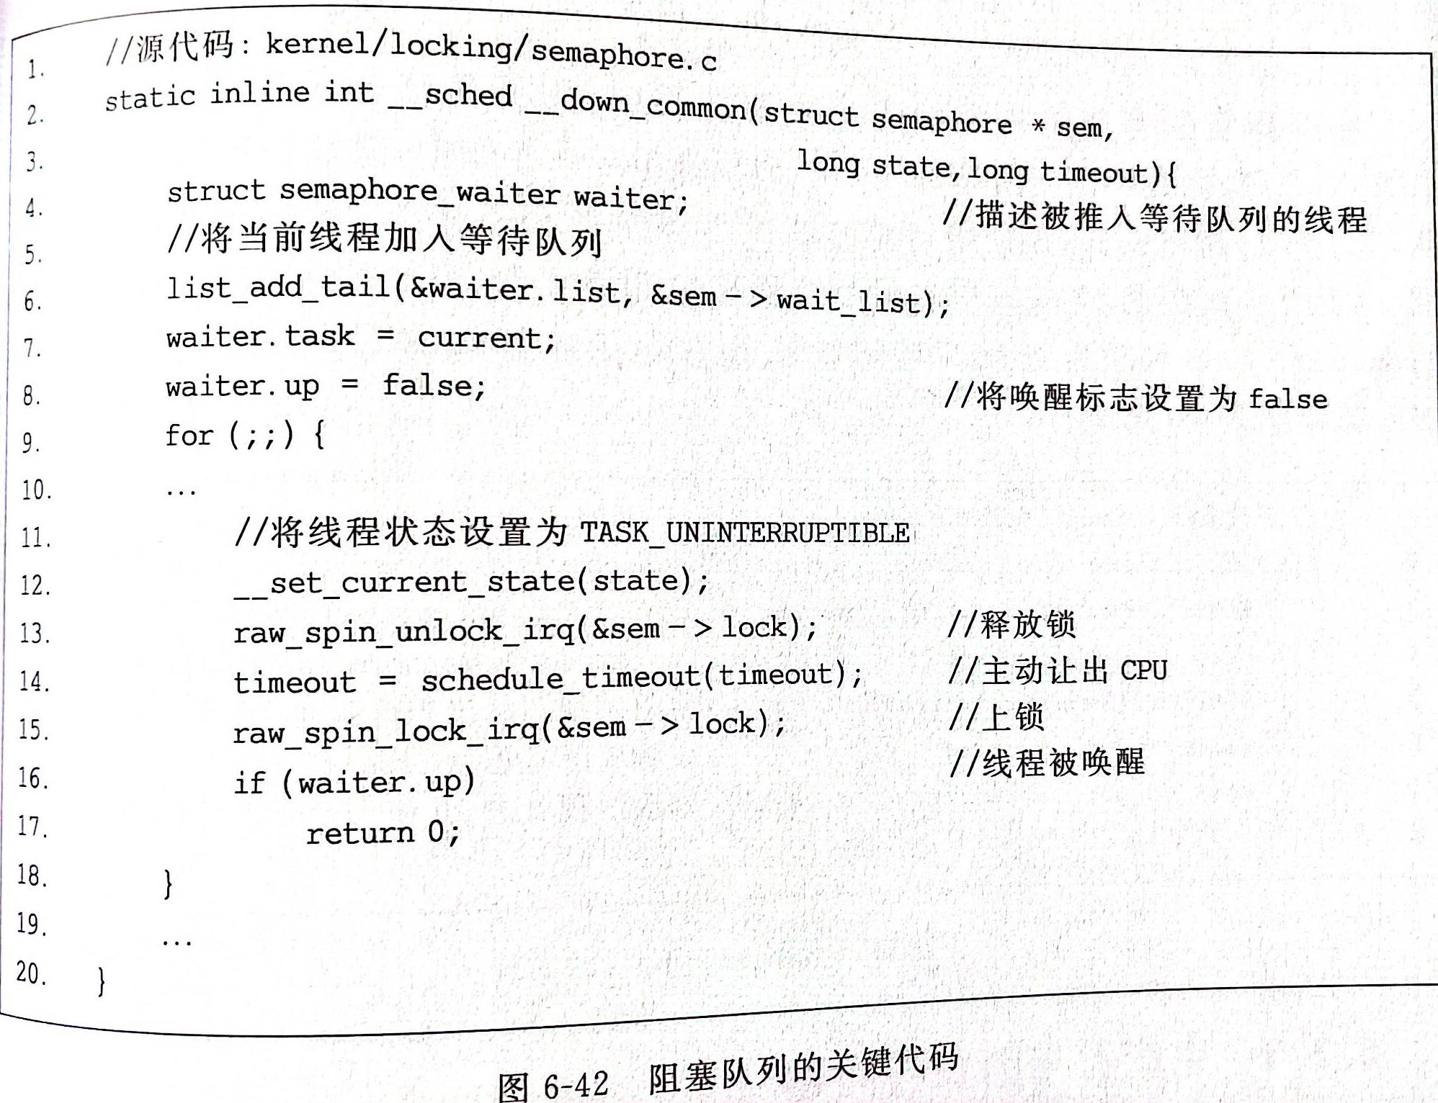
5.3.4 Implement of Semaphores(5/6)
OpenEuler 信号量的实现
Notes:
是6-41 _down_interruptible的主要处理函数

Slide 18
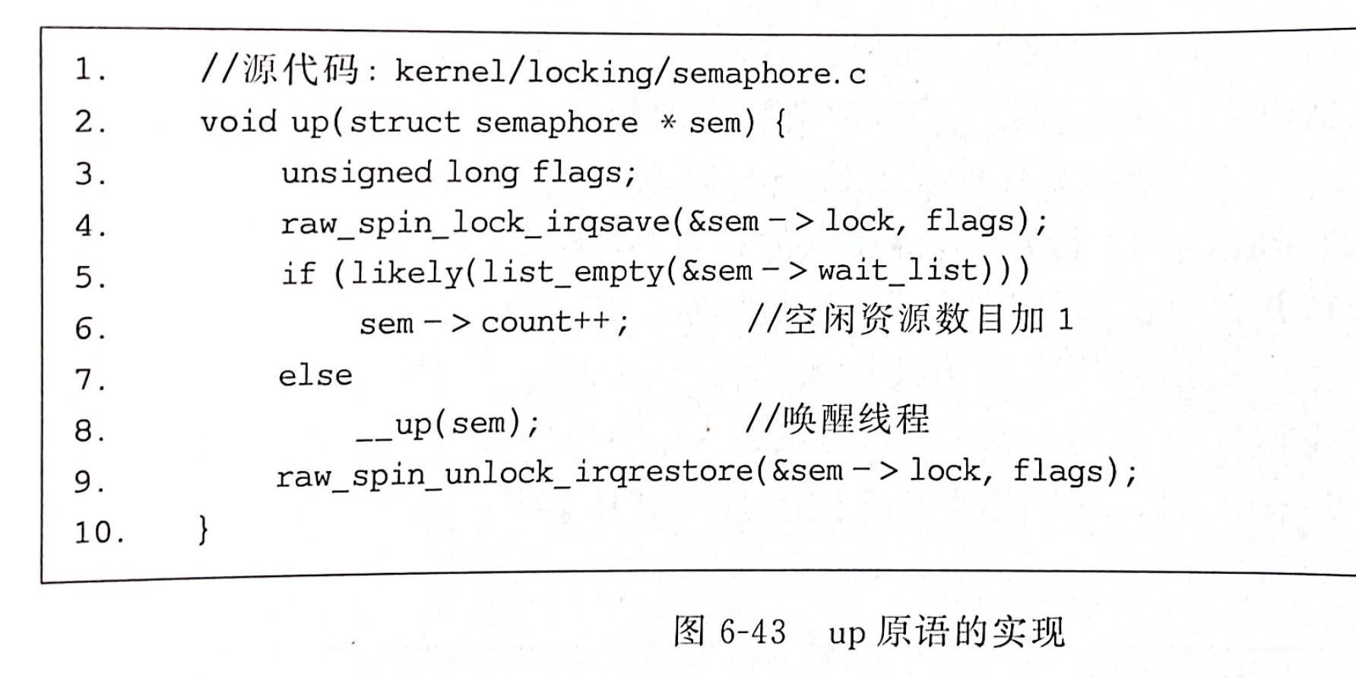
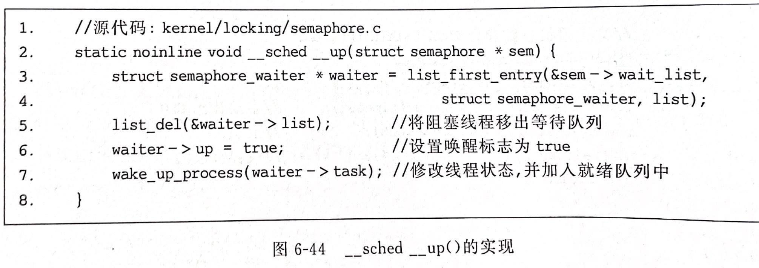
5.3.4 Implement of Semaphores(6/6)
OpenEuler 信号量的实现

Slide 19
5.3 Semaphores
信号量的定义和实现
5.3.1 Overview
5.3.4 Implement of Semaphores
5.3.2 Mutual Exclusion互斥
5.3.3 The Producer/Consumer problem同步
信号量的应用

Slide 20
5.3.2 Mutual Exclusion(1/9)
用Semaphore完成上一节练习的互斥
int a=1,b=1;
void* P1(void *arg)
{
int i=0;
while(i<1e2){
i++;
a=a+1;
b=b+1;
}
}
void* P2(void *arg)
{
int i=0;
while(i<1e2){
i++;
b=2*b;
a=2*a;
}
}

Slide 21
5.3.2 Mutual Exclusion(2/9)
Semaphore application
  Solution: Semaphore for Mutual Exclusion
int a=1,b=1;
semaphore sem =?
void* P1(void *arg)
{
int i=0;
while(i<1e2){
i++;
semWait(sem);
a=a+1;
b=b+1;
semSignal(sem);
}}
void* P2(void *arg)
{
int i=0;
while(i<1e2){
i++;
semWait(sem);
b=2*b;
a=2*a;
semSignal(sem);
}}
Notes:
从0开始尝试，发现1就够了，2就错了

Slide 22
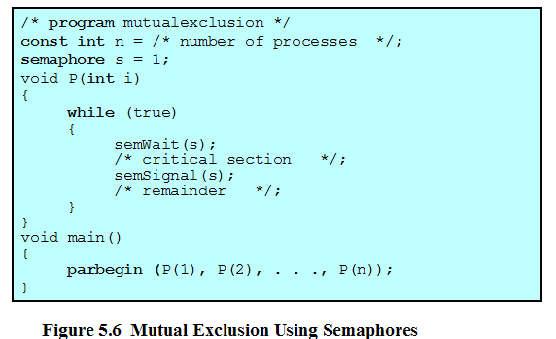
5.3.2 Mutual Exclusion(3/9)

Slide 23
5.3.2 Mutual Exclusion(4/9)
小结1
信号量互斥框架如上图
当两个线程竞争同一资源（互斥区）时，信号量初始值为1
  Race condition: Winner enters and continues to execute
  信号量值只能为 0 或 1，用Binary Semaphore(二元信号量)即可
Notes:
从0开始尝试，发现1就够了，2就错了

Slide 24
5.3.2 Mutual Exclusion(5/9)
Binary Semaphore & Mutexlock
In common:
  Mutual Exclusion
Difference:
  MutexLock: lock and unlock operations can only be called by the same thread or process
  Semaphore: semWait and semSignal operations can be called by different process, like producer_thread and consumer_thread
Notes:
优先级翻转
比较好理解，简单来说，就是低优先级任务持锁，导致高优先级任务反而后与低优先级任务运行的情况。 优先级继承
优先级继承是用于优化优先级翻转的，：当一个线程请求一个锁时，如果发现该锁当前的owner thread的优先级低于当前线程，则将owner thread的优先级临时提升到和当前thread一样，从而尽量缩短当前线程等待的时间。临时提升的优先级，在owner thread释放锁时恢复。
互斥量和信号量的区别：信号量类似交通指令灯，对动作负责：互斥量是锁，调是权限，只能在线程中操作，不能在中断中释放（优先级继承）。信号量可以中断中释放，可能会导致优先级翻转优先级翻转：中优先级抢占低优先级，而导致高优先级的线程（高优先级线程和低优先级公用资源，而低优先级线程没有释放）被中优先级抢占，而互斥量会提高与高优先级共用资源的低优先级的线程的优先级到与高优先级相同

Slide 25
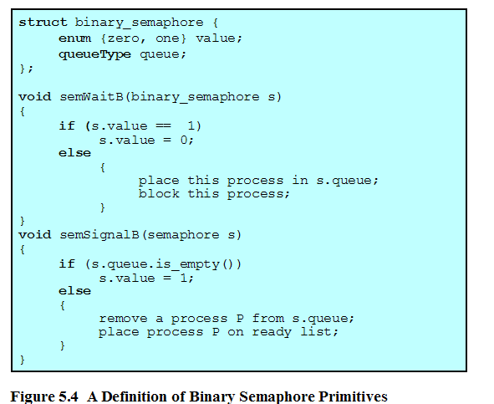
5.3.2 Mutual Exclusion(6/9)
Binary Semaphore(二元信号量) Primitives(原语)

Slide 26
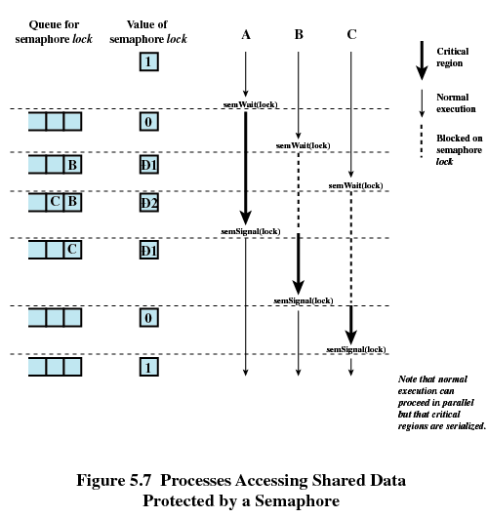
  5.3.2 Mutual Exclusion(7/9)
  Counting Semaphore计数信号量: sem= 1 ； 3 threads
-1
-2
-1
Notes:
初始值为1，表明竞争进入
初始值为-n，表示有n个线程在等待

Slide 27
5.3.2 Mutual Exclusion(8/9)
小结 2：
  当有k(k >2)个线程竞争同一资源（临界区）时：
  使用Counting Semaphore计算信号量
  信号量初始值为1
When sem is –m, m indicates the number of threads waiting to enter为-m表示已经有m个线程在等待进入临界区(m<k)

Slide 28
5.3.2 Mutual Exclusion(9/9)
Semaphore terms (信号量术语)
  Mutex [lock] (互斥信号量，锁)
  Binary Semaphore (二元信号量): sem(0,1)
  Counting Semaphore (计数信号量)/General Semaphore(一般信号量): sem >=0
  Strong Semaphore(强信号量): 等待线程的调度遵循FIFO
  Weak Semaphore(弱信号量): policy undefied

Slide 29
5.3 Semaphores
信号量的定义和实现
5.3.1 Overview
5.3.4 Implement of Semaphores
5.3.2 Mutual Exclusion互斥
5.3.3 The Producer/Consumer problem同步
信号量的应用

Slide 30
5.3.3 Producer/Consumer Problem(1/14)
Policy:
  When buffer is empty, can not consume同步
  When buffer is full, can not produce (finite, not infinite)同步
  Only one producer or consumer may access the buffer at any one time ( mutual exclusion互斥)
Analyze
  Two messages 即2个信号量: full, empty
    如何初始化？
  One mutex lock
Notes:
一开始，不能消费，所以消费信号量=0；一开始可以生产，所以生产信号量为1，为啥不能为大于1的k?(K代表k个进程可以同时计入互斥区）

Slide 31
5.3.3 Producer/Consumer Problem(2/14)
One producer, one consumer，buffer size = 1
Semaphore ?
void* producer(void *arg)
{
while(1){
produce();
}}
Semaphore empty=1,full=0
void* consumer(void *arg)
{
while(1){
remove();
} }
semWait(empty)
semWait(full)
semSignal(full)
semSignal(empty)
Threads switch?
Fine. mutual exclusion and synchronization
Notes:
需要几个sem，取决于有几个不同类型的消息？如何放置？
思考：
1.注意在produce和remove时任然有可能会出现线程的切换
2. 不需要互斥的原因，buffersize为1，需要两个线程交替执行，由信号量控制
3. 对同一个信号量+1和-1操作出现在不同的线程里
4. 如果有2个生产者线程，是否本模型依然成立？ 成立

Slide 32
5.3.3 Producer/Consumer Problem(3/14)
One producer, one consumer，buffer size = 1
Semaphore ?
void* producer(void *arg)
{
while(1){
produce();
}}
pthread_mutex_t mutex;
void* consumer(void *arg)
{
while(1){
remove();
} }
pthread_mutex_lock(&mutex);
pthread_mutex_lock(&mutex);
pthread_mutex_unlock(&mutex);
pthread_mutex_unlock(&mutex);
Unable to work effectively
Notes:
需要几个sem，取决于有几个不同类型的消息？如何放置？
思考：
1.注意在produce和remove时任然有可能会出现线程的切换
2. 不需要互斥的原因，buffersize为1，需要两个线程交替执行，由信号量控制
3.如果有2个生产者线程，是否本模型依然成立？ 成立
4. 如果换成mutex lock 是否可以？不行，不能同步，只能互斥

Slide 33
5.3.3 Producer/Consumer Problem(4/14)
可否去除互斥锁？
Finite buffer
生产者数目对代码是否有影响？
int buffer[bufsize]={0};
sem empty=bufsize,full=0,mutex=1;
void* producer(void *arg)
{
while(1){
produce();
}}
void* consumer(void *arg)
{
while(1){
remove();
} }
semWait(empty)
semWait(full)
semWait(mutex)
semWait(mutex)
semSignal(mutex)
semSignal(mutex)
semSignal(full)
semSignal(empty)
Notes:
思考问题：
1. 模拟前一页buffer=1是否可以？假设P执行一次后，如果P、S均想执行，那么会产生问题。
2. 生产者数目对代码是否有影响？没有影响，因为不同生产者生产和同一个生产者多次生产是一样的。
3. 不能去除互斥锁，比如bufsize >1，那么可能2个生产者同时修改buffer[]，这个时候需要互斥
4. 讨论bufsize 和 几个producer之间是否有关系。没有直接对应关系，不论是一个线程多次进入还是若干线程竞争进入，都受到bufsize和互斥区控制
如果写入buffer的是一个参数，那么通过arg传入producer，再传给produce

Slide 34
5.3.3 Producer/Consumer Problem(5/14)
Exchange the position of 2 semWaits or 2 semSignals?
  semSignals won’t block any threads, it’s OK to exchange
  But semWaits may block threads(dead lock). Don’t exchange.
  可以交换signal的位置，不能交换wait(死锁)
void* producer(void *arg)
{
while(1){
produce();
}}
void* consumer(void *arg)
{
while(1){
remove();
} }
semWait(empty)
semWait(mutex)
semWait(mutex)
semWait(full)
semSignal(mutex)
semSignal(mutex)
semSignal(full)
semSignal(empty)
Notes:
交换wait，考虑buffer满和buffer空两种情况，可能导致producer或者consumer死锁

Slide 35
5.3.3 Producer/Consumer Problem(6/14)
inFinite buffer
//int buffer[inf]={0};
sem full=0,mutex=1;
void* producer(void *arg)
{
while(1){
produce();
}}
void* consumer(void *arg)
{
while(1){
remove();
} }
//semWait(empty)
semWait(full)
semWait(mutex)
semWait(mutex)
semSignal(mutex)
semSignal(mutex)
semSignal(mutex)
semSignal(full)
//semSignal(empty)
Notes:
因为buffer无穷大，因此不需要等待empty信号才可以写入

Slide 36
5.3.3 Producer/Consumer Problem(7/14)
  Mutual Exclusion and synchronize同步与互斥
    Produce before consume： 同步
  The buffer may be finite or infinite
  Producer & consumer：empty sem>1互斥
    One producer, one consumer (已生产1个，生产第二个和消费需要互斥)
    One or more producers are generating data and placing these in a buffer；A single consumer is taking items out of the buffer, one at time.

Slide 37
5.3.3 Producer/Consumer Problem(8/14)
总结
One sem releases one information
Semaphore initialized to n:sem = n
  n is the number of processes permit to enter; in another words: n processes is allowerd in its critical section at a time(多个进程同时在临界区内)
    n=0, 同步问题(消费者等待生产者)
    n=1，互斥问题(-m表示m个线程在等待)
      二元信号量，2个线程互斥
      计数信号量，-K个线程在等待
    n>1, 互斥(资源数为n，多个生产者、哲学家就餐, 多个读者问题等)
Notes:
哲学家就餐里面房间允许进入人数为4,4是一个大于1的资源数
或者读文件问题

Slide 38
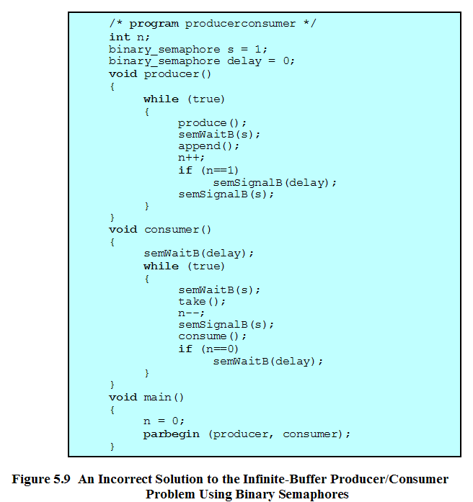
5.3.3 Producer/Consumer Problem(9/14)
缓冲区中的项数
控制进入临界区
避免“超前”消费
Notes:
其实错误的原因可以简单认为是N这个变量可能在线程切换过程中被另外一个线程p修改，因此c中的if(n==0)已经不满足。
因此对于n的访问应当是连续的，即应当位于互斥区内

Slide 39
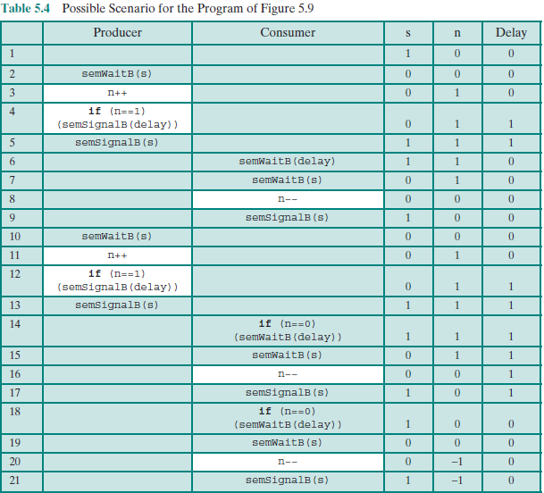
5.3.3 Producer/Consumer Problem(10/14)

Slide 40
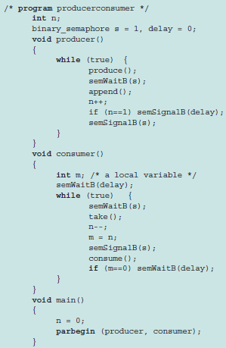
5.3.3 Producer/Consumer Problem(11/14)

Slide 41
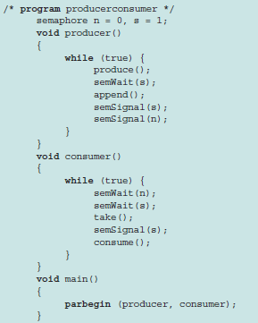
5.3.3 Producer/Consumer Problem(12/14)
同34页A better solution: using counting semaphore
    读信号可以累积

Slide 42
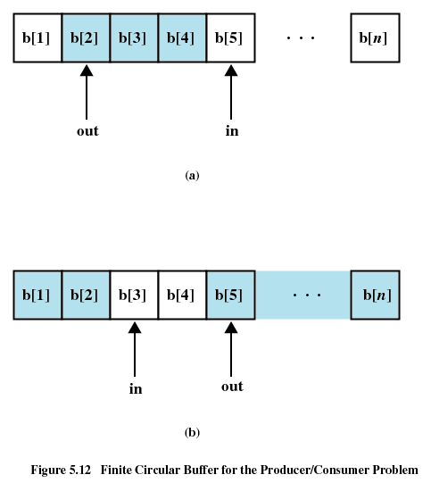
5.3.3 Producer/Consumer Problem(13/14)
Finite Circular Buffer
In即将写入的位置
Out即将读出的位置

Slide 43
5.3.3 Producer/Consumer Problem(14/14)
with Circular Buffer
producer:
while (true) {
/* produce item v */
while ((in + 1) % n == out)
/* do nothing */;
b[in] = v;
in = (in + 1) % n
}
consumer:
while (true) {
while (in == out)
/* do nothing */;
w = b[out];
out = (out + 1) % n;
/* consume item w */
}
灰色部分置换为信号量 Fig 5.13 sem empty = n;

Slide 44
Agenda
5.1 Principles of Concurrency
5.2 Mutual Exclusion: Hardware Support
5.3 Semaphores
5.4 Monitors
5.5 Message Passing
5.6 Readers/Writers Problem
5.7 Summary

Slide 45
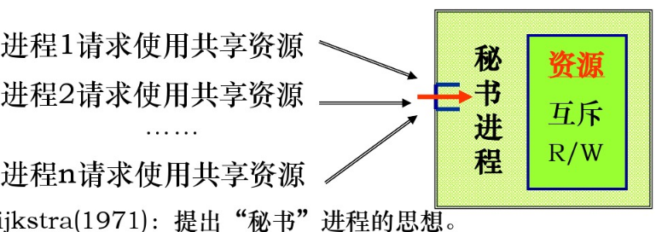

5.4 Monitors(1/10)
Why Monitor?
  Semaphore should be deployed with cautious.
    E.g. semWait() in correct order
  semWait, semSignal be scattered throughout the program.
Notes:
封装，一次只允许一个进程线程访问

Slide 46
5.4 Monitors(2/10)
Definition:
  Monitor is a software module consisting of one or more procedures, an initialization sequence, and local data(管程由一个或者多个例程、一段初始化代码和局部数据组成).
the chief characteristics :
  Local data variables are accessible only by the monitor
  Process enters monitor by invoking one of its procedures 进程调用管程函数即进入管程
  Only one process may be executing in the monitor at a time

Slide 47
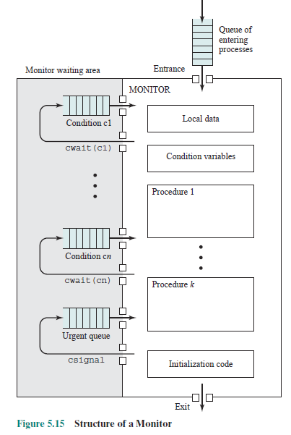
5.4 Monitors(3/10)
1. Local data
2. Condition variables
3. Procedures
4. Initialization code

Slide 48
5.4 Monitors(4/10)
A monitor supports synchronization by the use of condition variables (管程通过条件变量实现同步)
  cwait(c): Block execution of the calling process on condition c. The monitor is now available for use by another process.
  csignal(c): Resume execution of some process blocked after a cwait on the same condition. If there are several such processes, choose one of them; if there is no such process, do nothing.

Slide 49
5.4 Monitors(5/10)
管程和信号量的Differences：
monitor wait and signal vs semaphore wait and signal
If a process in a monitor signals and no task is waiting on the condition variable, the signal is lost.

Slide 50
5.4 Monitors(6/10)
One monitor object
  One lock：一次只能有一个进程
  Several conditional objects
    Object: Counting variable and queue
    Operation: cwait/csingal
  Several functions

Slide 51
5.4 Monitors(7/10)
boundedbuffer bf;//管程对象
int data;
void main(){
parbegin (producer,comsumer);
}
管程下的生产者消费者问题
void producer(void *arg){
while(1){
data = rand()%100;
bf.deposit(data);}
}
void consumer(void *arg){
while(1){
bf.remove(&data);}
}

Slide 52
5.4 Monitors(8/10)
class boundedbuffer{…//管程类
Lock lock;
int count=0;
condition notfull, notempty;
deposit(void data);
remove(void *data);}
boundedbuffer::deposit(void data){
lock.lock();
while(count==n)
notfull.wait(&lock)
add data to buffer
count++;
notempty.signal();
lock.release();
}
boundedbuffer::remove(void *data){
lock.lock();
while(count==0)
notempty.wait(&lock)
remove data from buffer
count--;
notfull.signal();
lock.release();
}
Notes:
Hanson 方法，当notfull.signal唤醒deposit时，依然是remove执行完毕后才切换回来，

Slide 53
5.4 Monitors(9/10)
class condition{
int numWaiting = 0;//阻塞线程计数
waitqueue q;//阻塞等待队列
wait(Lock *plock);
signal( ); }
condition::wait(Lock *plock){
numWaiting++;
add this thread to q;
release(plock);
schedule();
require(plock);
}
condition::signal( ) {
if(numWaiting>0){
remove a thread t from q;
wakeup(t);
numWaiting--;
}}
Reentry point
Notes:
Hanson 方法，需要等调用signal的函数运行完毕才会切换回来这个位置,因此signal 里没有lock操作

Slide 54
5.4 Monitors(10/10)
实例：
实现管程类 monitor_class
需要Linux support：
  pthread_mutex_t lock 互斥锁
  +
  pthread_cond_t consume_cond, produce_cond; 条件变量

Slide 55
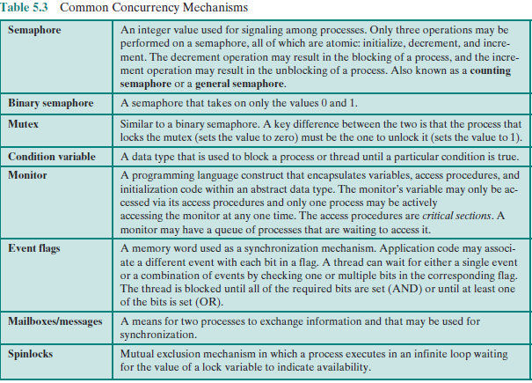
summary

Slide 56
summary
Concurrency programming
Critical Section
Monitor
High level
abstract
semaphore
Mutex lock
Condition variable
Hardware
support
Interrupt disable
atomic operation

