Slide 1
Operating Systems
Chapter 5 Mutual Exclusion(互斥) and Synchronization(同步)

Slide 2
Agenda
5.1 Principles of Concurrency
5.2 Mutual Exclusion: Hardware Support
5.3 Semaphores
5.4 Monitors
5.5 Message Passing
5.6 Readers/Writers Problem
5.7 Summary

Slide 3
5.5Message Passing(1/9)
Enforce mutual exclusion
Exchange information
send (destination, message)
receive (source, message)

Slide 4
5.5Message Passing(2/9)
Synchronization
  Sender and receiver may or may not be blocking
  Blocking send, blocking receive
    Both sender and receiver are blocked until message is delivered

Slide 5
5.5Message Passing(3/9)
Nonblocking send, blocking receive
  Sender continues on
  Receiver is blocked until the requested message arrives
Nonblocking send, nonblocking receive
  Neither part is required to wait

Slide 6
5.5Message Passing(4/9)
Direct addressing
  Send primitive includes a specific identifier of the destination process
  Receive primitive could know ahead of time which process a message is expected or receive primitive could use source parameter to return a value when the receive operation has been performed

Slide 7
5.5Message Passing(5/9)
Indirect addressing
  Messages are sent to a shared data structure consisting of queues
  Queues are called mailboxes
  One process sends a message to the mailbox and the other process picks up the message from the mailbox

Slide 8
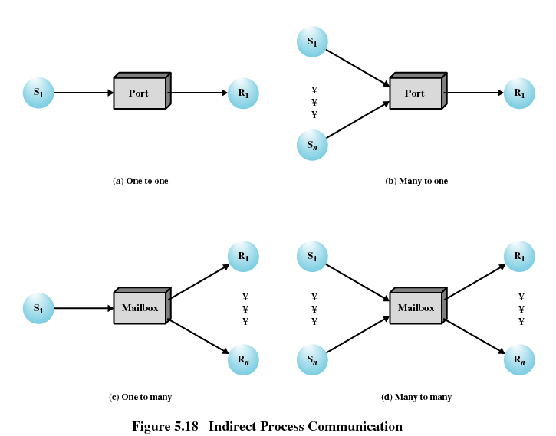
5.5Message Passing(6/9)

Slide 9
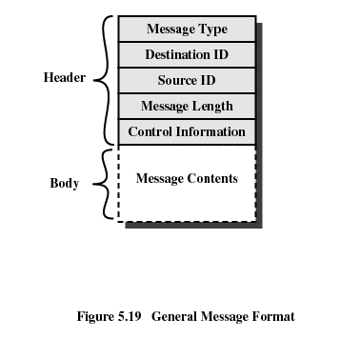
5.5Message Passing(7/9)
Message Format

Slide 10
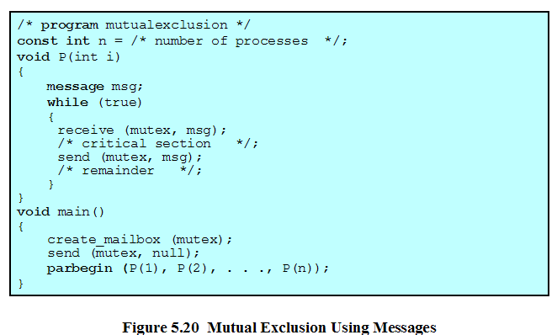
5.5Message Passing(8/9)

Slide 11
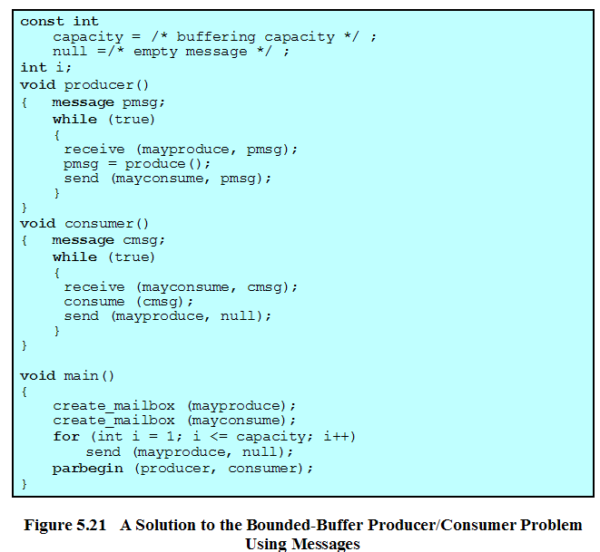
5.5Message Passing(9/9)
Linux message queue demo
Lab07 4.1
Linux-message案例.pptx

Slide 12
Agenda
5.1 Principles of Concurrency
5.2 Mutual Exclusion: Hardware Support
5.3 Semaphores
5.4 Monitors
5.5 Message Passing
5.6 Readers/Writers Problem
5.7 Summary

Slide 13
5.6 Readers/Writers Problem(1/9)
Any number of readers may simultaneously read the file(no writer)
  如何知道有其它读者存在？
Only one writer at a time may write to the file(no other writers)
  如何知道有写者存在？
If a writer is writing to the file, no reader may read it
Summary
  Read&write, write&write need mutual exclusion
  Read&read doesn’t need mutual exclusion
  the number of reader: need mutual exclusion

Slide 14
5.6 Readers/Writers Problem(2/9)
readers & writers
Data
writemutex
readers
rcount
countmutex
sem writemutex=？, countmutex=？;
Semaphore → mutual exclusion Set to 1

Slide 15
5.6 Readers/Writers Problem(3/9)
Reader First
  Once a single reader has begun to access the data area, it is possible for readers to retain control of the data area as long as there is at least one reader in the act of reading. Therefore, writers are subject to starvation.目前正在读，新的读会持续进入，写会饥饿
Writer First
  no new readers are allowed access to the data area once at least one writer has declared a desire to write. 当有新的写存在，新的读不能进行读

Slide 16
5.6 Readers/Writers Problem(4/9)
Reader First
  Reader:
    当前在写：等待写结束(不能进入) semWait(writemutex)
    当前正在读：新的读进入，if(rcount>0) , rcount++
  Writer
    当前在写：等待写结束(不能进入) semWait(writemutex)
    当前正在读：等待读结束(不能进入) semWait(writemutex)

Slide 17
5.6 Readers/Writers Problem (5/9)
Reader & Writer race to enter
sem writemutex=1, countmutex=1;
void* reader(void *arg){
while(1){
void* writer(void *arg){
while(1){
semWait(writemutex)
semWait(writemutex)
writedata();
readdata();
semSignal(writemutex)
semSignal(writemutex)
}}
}}
Notes:
最基本的读写互斥，竞争进入; 当只有多个读者进入的时候，不合适，需要在wrtitemutex上排队等待

Slide 18
5.6 Readers/Writers Problem (6/9)
Reader First
void* reader(void *arg){
while(1){
sem writemutex=1, countmutex=1;
semWait(countmutex)
rcount++
void* writer(void *arg){
while(1){
if(rcount==1)
semWait(writemutex)
semSignal(countmutex)
semWait(writemutex)
readdata();
writedata();
semWait(countmutex)
semSignal(writemutex)
rcount--
if(rcount == 0)
}}
semSignal(writemutex)
semSignal(countmutex)
}}
Notes:
优先体现在不需要在writemutex上排队等待

Slide 19
sem writemutex=1, mutex1=1,mutex2=1;
Writer First
void* writer(void *arg){
while(1){
void* reader(void *arg){
while(1){
semWait(mutex2)
semWait(mutex1)
wcount++
rcount++
semSignal(mutex2)
if(rcount==1)
semWait(writemutex)
semWait(writemutex)
writedata();
semSignal(mutex1)
readdata();
semSignal(writemutex)
semWait(mutex1)
semWait(mutex2)
rcount--
wcount--
if(rcount == 0)
semSignal(mutex2)
semSignal(writemutex)
semSignal(mutex1)
}}
}}
Notes:
问题分析：
1.当目前正在写：新的 读和写同时到达：读写都会在semWait(writemutex)上等待，因此需要竞争进入(or fifo)，不能保证写优先
2.当前正在读：新的读和写同时到达，写会在semWait(writemutex)上等待，而读会直接执行readdata();
因此需要让写在semWait(mutex1)前排队才行，故尝试新增readmutex来保证写优先。因此需要一旦有写，阻塞读.

Slide 20
sem writemutex=1,readmutex=1, mutex1=1,mutex2=1;
void* reader(void *arg){
while(1){
void* writer(void *arg){
while(1){
Writer First
semWait(readmutex)
semWait(mutex2)
wcount++
semWait(mutex1)
if(wcount==1)
rcount++
semWait(readmutex)
if(rcount==1)
semSignal(mutex2)
semWait(writemutex)
semSignal(mutex1)
semWait(writemutex)
semSignal(readmutex)
writedata();
readdata();
semSignal(writemutex)
semWait(mutex1)
semWait(mutex2)
rcount--
wcount--
if(rcount == 0)
if(wcount==0)
semSignal(writemutex)
semSignal(readmutex)
semSignal(mutex1)
semSignal(mutex2)
}}
}}
Notes:
（1）思路：仿照读优先，增加一个用于排队的信号量readmutex，首先解决已经在写的情况下，新来的读写中，写可以跳过readmutex。而读不可以跳过。
假设目前正在写，那么同时来一个写和读，写会在semwait(writemutex)上等待，而读会在semwait(readmutex)上等待，因此写会先进入。
（2）假设目前正在读，那么同时来一个写和读，第一个写和所有新的读都会在semwait（readmutex）上等待，需要竞争或者FIFO；
另外后续读很多的话，新来的写无法越过在semwait（readmutex）上排队的所有的读，在排队时处于不利地位，不符合写优先，同时后续其它写会阻塞在mutex2无法进入临界区。
解决方案：将后续读写的排队分为在不同队上排。避免读在readmutex在排队中挡住后续的读，所以新增z，用于读排队，z的signal信号应当在在第一个写排队的readmutex之后释放以确保写优先获得信号。
Reader的semsignal(readmutex)在前，而非函数尾，有利于下一个来的读尽快进入

Slide 21
sem writemutex=1,readmutex=1, z=1,mutex1=1,mutex2=1;
void* reader(void *arg){
while(1){
void* writer(void *arg){
while(1){
Writer First
semWait(mutex2)
semWait(z)
wcount++
semWait(readmutex)
if(wcount==1)
semWait(mutex1)
semWait(readmutex)
rcount++
semSignal(mutex2)
if(rcount==1)
semWait(writemutex)
semWait(writemutex)
semSignal(mutex1)
writedata();
semSignal(readmutex)
semSignal(writemutex)
semSignal(z)
readdata();
semWait(mutex2)
wcount--
semWait(mutex1)
rcount--
if(wcount==0)
if(rcount == 0)
semSignal(readmutex)
semSignal(writemutex)
semSignal(mutex2)
semSignal(mutex1)
}}
}}
Notes:
解决了刚才提到的目前正在读情况下，新写和新读中新写无法优先的问题。因为读需要先在z上排队，而写在readmutex排队
在极端情况下，当前正在读，大量读源源不断的进入，那么就可能阻塞在semwait（readmutex）上，因为太多读，无法及时从该临界区退出。
这是突然来第一个写，写将阻塞在semwait(readmutex)上，那么就无法保证写优先，因此增加一个z，让读在z上排队，由于z的释放晚于readmutex，那么可以保证写优先。
读阻塞在z，而z后于readmutex释放，利于写先进入

Slide 22
sem writemutex=1,readmutex=1, z=1,mutex1=1,mutex2=1;
void* reader(void *arg){
while(1){
void* writer(void *arg){
while(1){
Writer First
semWait(mutex2)
semWait(mutex1)
wcount++
semWait(readmutex)
if(wcount==1)
semWait(readmutex)
rcount++
semSignal(mutex2)
if(rcount==1)
semWait(writemutex)
semWait(writemutex)
semSignal(readmutex)
writedata();
semSignal(mutex1)
semSignal(writemutex)
readdata();
semWait(mutex2)
wcount--
semWait(mutex1)
rcount--
if(wcount==0)
if(rcount == 0)
semSignal(readmutex)
semSignal(writemutex)
semSignal(mutex2)
semSignal(mutex1)
}}
}}
Notes:
不正确，想法，让读者在mutex1上排队，替代z
假设第一个线程是读线程，目前在readdata(),
第二个线程是写线程，那么会在得到readmutex，并在semWait(writemutex)排队
第三个线程是读线程，进入semWait(mutex1)后，在semWait(readmutex)排队
这时发生死锁，因为线程3占据mutex1不释放,导致线程1在readdata()完成后，不能执行后面的操作，因此writemutex一直不释放，而线程2得不到writemutex不执行,则readmutex不释放，那么线程3就阻塞不释放mutex1.
归根结底是读者中两个semwait不能交换

Slide 23
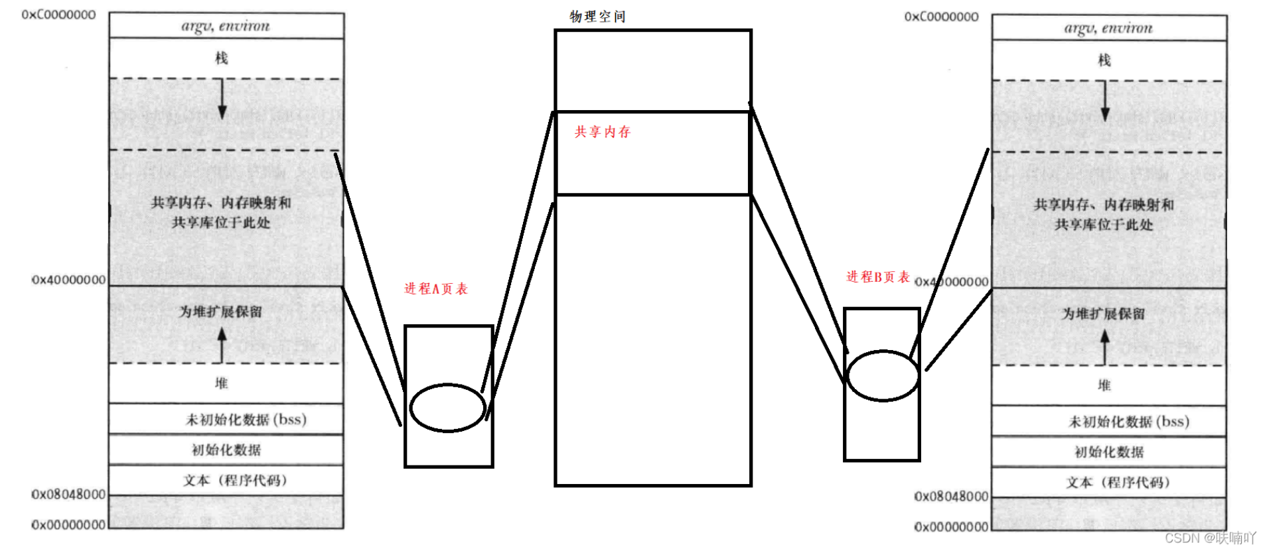
扩展1：共享内存(1/3)
进程通信
  消息
  共享内存

Slide 24

扩展1：共享内存(2/3)
OpenEuler 支持POSIX 和 System V 共享内存
  4个API:
    shmget()创建
    shmat()映射入进程地址
    shmdt()解除映射
    shmctl()销毁
  与消息机制不同，需要注意同步与互斥

Slide 25
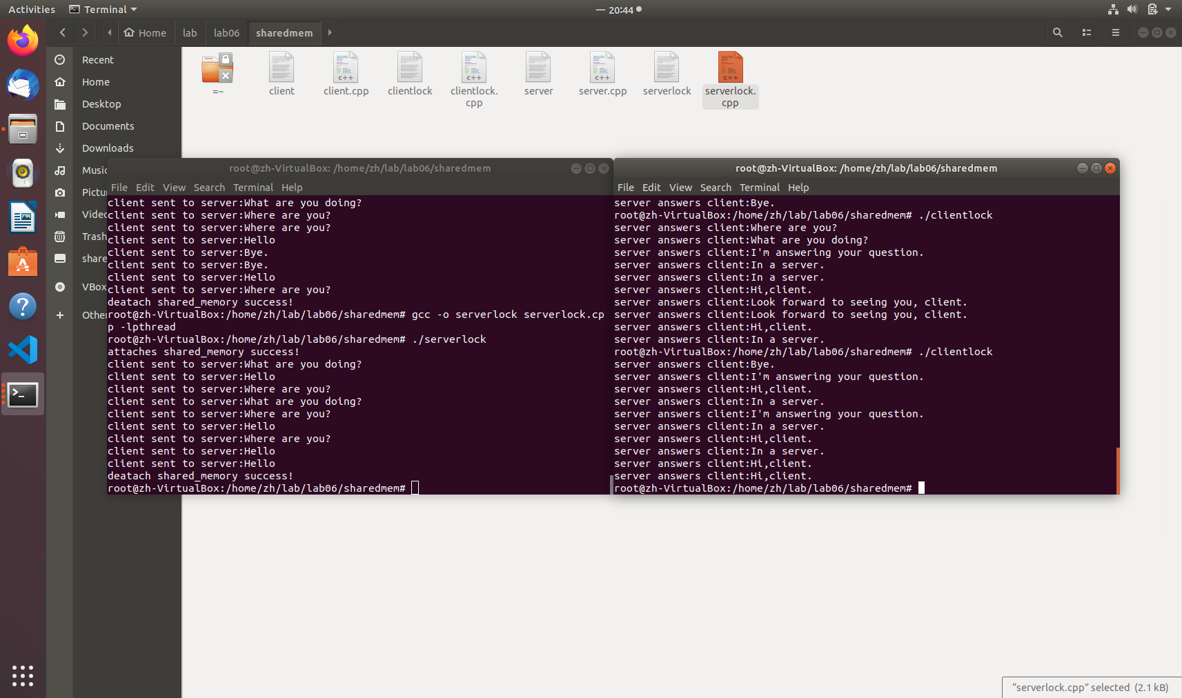
扩展1：共享内存(3/3)
OpenEuler 支持POSIX 和 System V 共享内存
  示范代码：clientlock.cpp serverlock.cpp
    仅互斥，未同步
    互斥锁需要写入共享内存

Slide 26
扩展2：内存屏障(1/4)
鲲鹏CPU，OpenEuler 中的内存屏障实现
  问题提出：现代CPU支持乱序执行，且具有多核
a=1;
b=2;
c=3;
flag=true;
while(flag){
do_something(a,b,c);
return;
}

Slide 27
扩展2：内存屏障(2/4)
鲲鹏CPU，OpenEuler 中的内存屏障实现
CPU0
a=1;
b=2;
c=3;
flag=true;
CPU1
while(flag){
do_something(a,b,c);
return;
}
CPU0
a=1;
b=2;
flag=true;
c=3;
CPU1
while(flag){
do_something(a,b,c);
return;
}

Slide 28
扩展2：内存屏障(3/4)
鲲鹏CPU，OpenEuler 中的内存屏障实现
CPU0
a=1;
b=2;
c=3;
memory_barrier()
flag=true;
CPU1
ready=flag
memory_barrier()
while(ready){
do_something(a,b,c);
return;
}
Notes:
确认flag赋值后才执行while

Slide 29
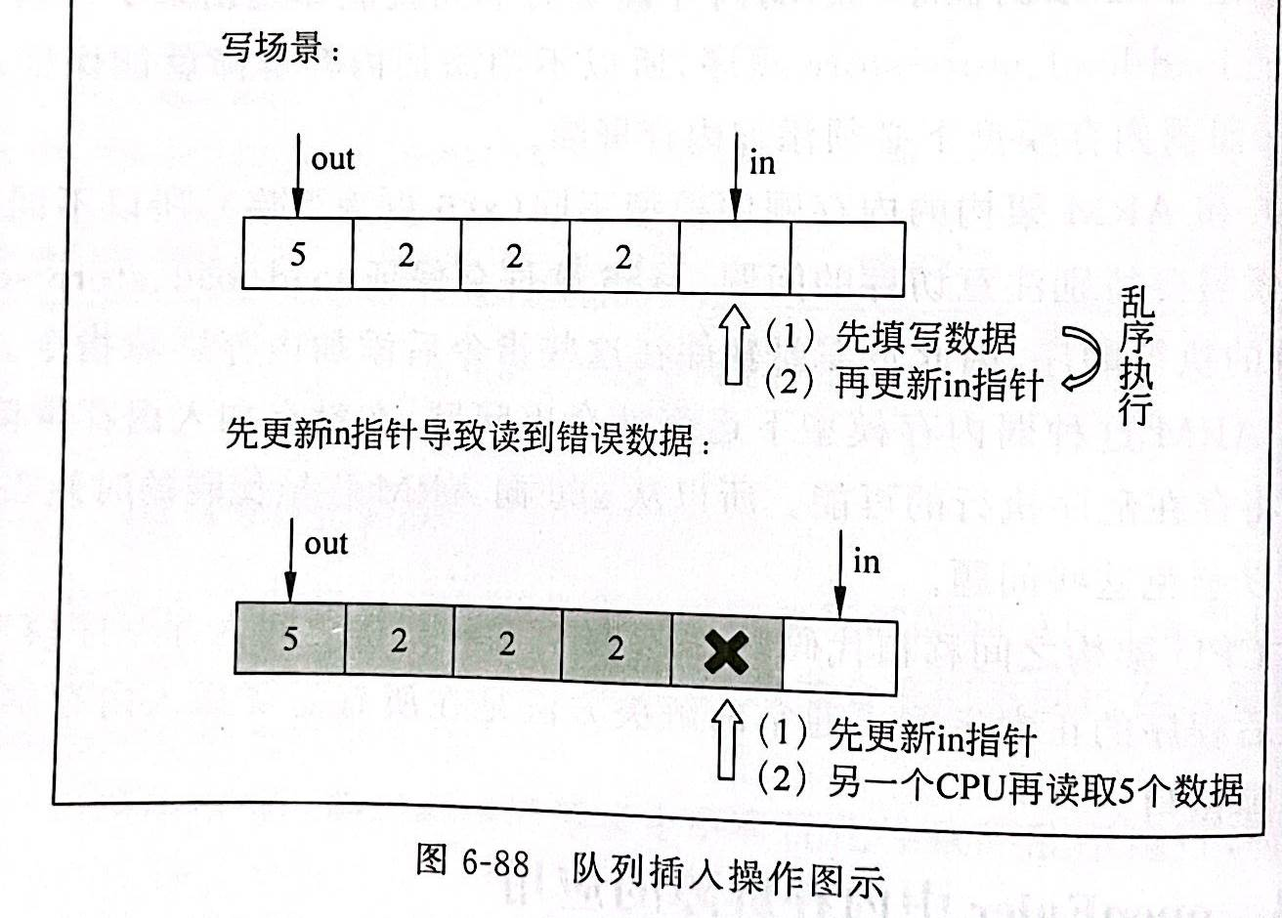
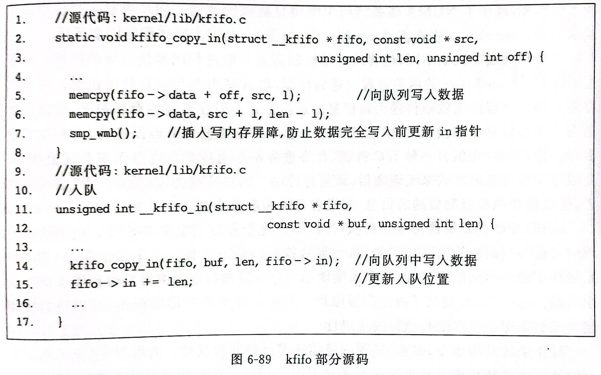
扩展2：内存屏障(4/4)
鲲鹏CPU，OpenEuler 中的内存屏障实现
Notes:
line7确保先插入，15行才更新in指针

