Slide 1
Operating Systems
Chapter 6 Concurrency: Deadlock(死锁) and Starvation(饥饿)

Slide 2
6.1 Principles of Deadlock
6.1 Principles of Deadlock
6.2 Deadlock Prevention
6.3 Deadlock Avoidance
6.4 Deadlock Detection
6.5 An Integrated Deadlock Strategy
6.6 Dining Philosophers Problem
6.7 Summary

Slide 3
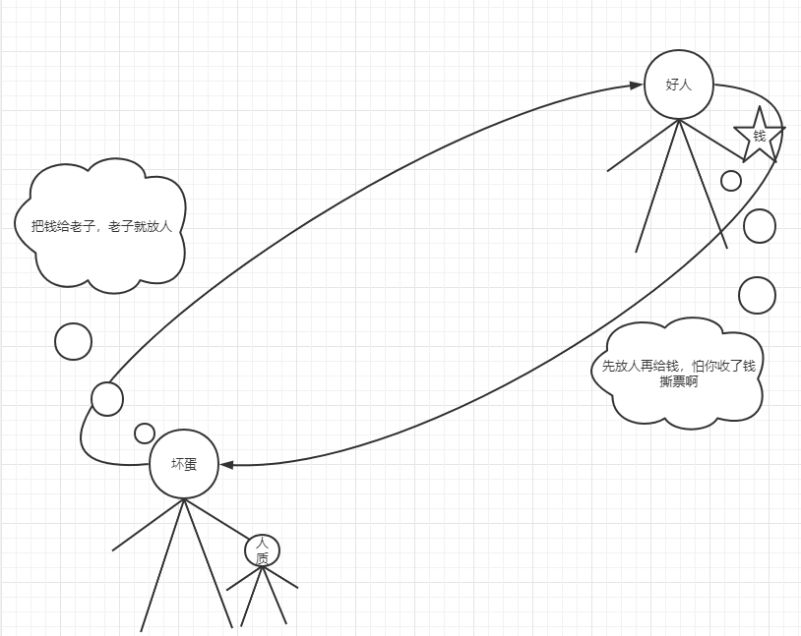
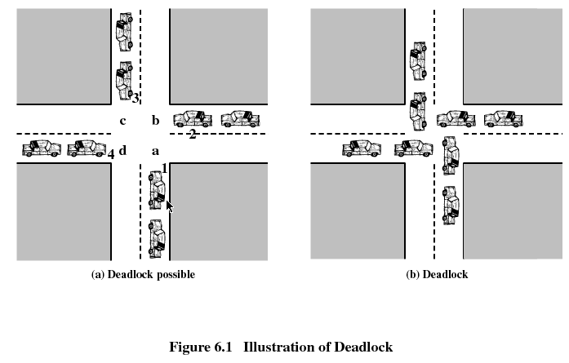
6.1 Principles of Deadlock(1/9)
Why: compete for finite resources

Slide 4
6.1 Principles of Deadlock(2/9)
Reusable Resources可重用
  processors, I/O channels, main and secondary memory, devices, and data structures such as files, databases
  Used by only one process at a time
  Obtainable after release
Consumable Resources消费型
  interrupts, signals, messages, and information in I/O buffers
  created (produced) and destroyed (consumed) by processes

Slide 5
6.1 Principles of Deadlock(3/9)
Permanent blocking of a set of processes that either compete for system resources or communicate with each other
All deadlock involve conflicting needs for resources by two or more processes (死锁源于两个或者多个进程的资源需求冲突).
  Reusable Resources(可重用资源)
  Consumable Resources(可消费资源)
No efficient solution in the general case

Slide 6
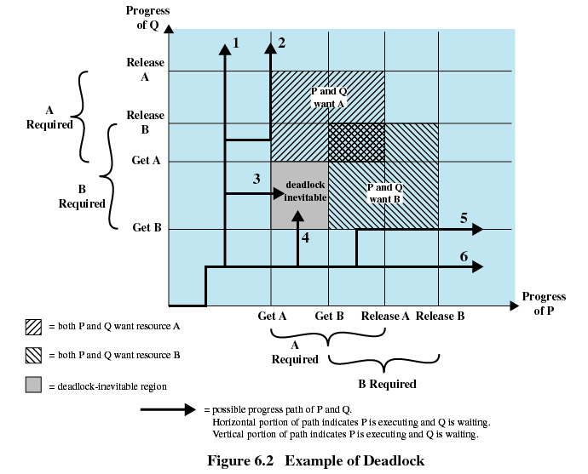
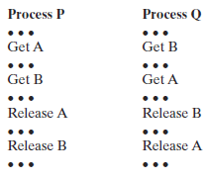
6.1 Principles of Deadlock(4/9)
Uncertainty
Notes:
2代表Q已经获得AB

Slide 7
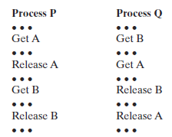
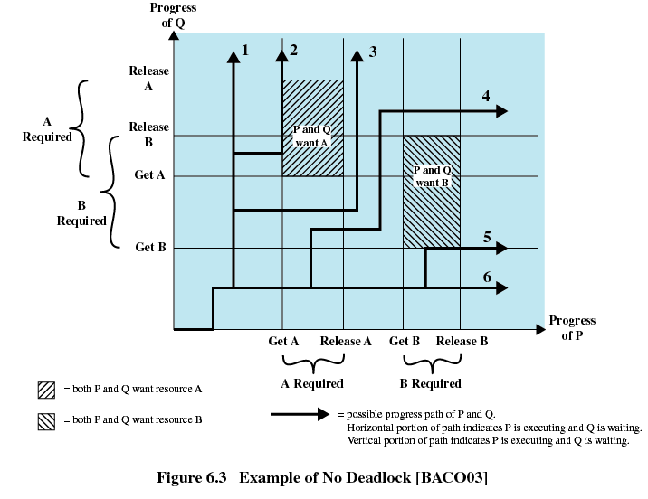
6.1 Principles of Deadlock(5/9)
Notes:
针对以上问题，是否可以找到一种计算机的方法来描述和发现问题呢？

Slide 8
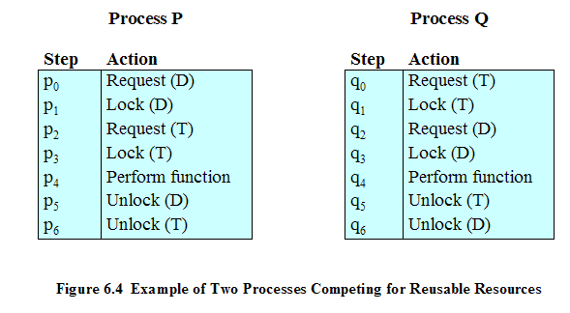
6.1 Principles of Deadlock(6/9)
Interleaves the execution: p0 p1 q0 q1 p2 q2
One strategy : require resources in order
(wait信号的位置不要随意变换)
Notes:
当拥有一个资源，请求其它资源，并无法获取可能死锁

Slide 9
6.1 Principles of Deadlock(7/9)
Space is available for allocation of 200Kbytes, and the following sequence of events occur
P1
P2
. . .
. . .
Request 80 Kbytes;
Request 70 Kbytes;
. . .
. . .
Request 60 Kbytes;
Request 80 Kbytes;
One strategy : virtual memory 缓解发生概率

Slide 10
6.1 Principles of Deadlock(8/9)
communicate designed incorrect (using blocking receive)
P1
P2
. . .
. . .
Receive(P2);
Receive(P1);
. . .
. . .
Send(P2, M1);
Send(P1, M2);
Design the program with caution
Notes:
Another example in previous lab project
消息阻塞
信号量设计不恰当，都看造成死锁

Slide 11
6.1 Principles of Deadlock(9/9)
By now, we got that…
  Processes may or may not cause deadlock
  deadlock may be solved by different ways according to resources and situation
  How to generate a model to describe all conditions
  How to solve the problem

Slide 12
6.1 Principles of Deadlock
6.1.3 Resource Allocation Graphs
6.1.4 The Conditions for Deadlock

Slide 13
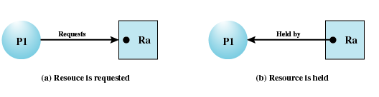
6.1.3 Resource Allocation Graphs(资源分配图)(1/5)
Directed graph(有向图) that depicts(表述) a state of the system of resources and processes

Slide 14
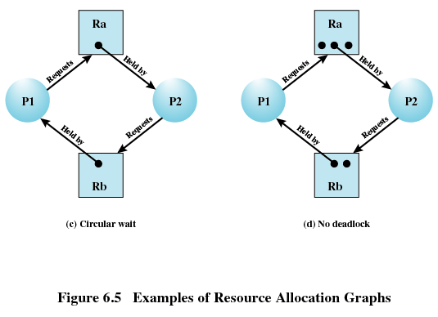
6.1.3 Resource Allocation Graphs(2/5)

Slide 15
6.1.3 Resource Allocation Graphs(3/5)
R₁
R₂
P₁
P₂
P₃
R₃

Slide 16
6.1.3 Resource Allocation Graphs(4/5)
R₁
R₂
P₁
P₂
P₃
R₃
Notes:
此处循环等待是书上的定义：闭合的进程链，每个进程至少占用下一个进程所需要的资源

Slide 17
6.1.3 Resource Allocation Graphs(5/5)
R₁
R₂
P₁
P₂
P₃
R₃
P₄
Notes:
此处循环等待是书上的定义：闭合的进程链，每个进程至少占用下一个进程所需要的资源

Slide 18
6.1 Principles of Deadlock
6.1.3 Resource Allocation Graphs
6.1.4 The Conditions for Deadlock

Slide 19
6.1.4 The Conditions for Deadlock
(死锁的条件)(1/3)
Mutual exclusion(互斥)
  A resource may used only by one process at a time
Hold-and-wait(占有且等待)
  A process may hold allocated resources while awaiting assignment of others
No preemption(非抢占)
  No resource can be forcibly removed from a process holding it

Slide 20
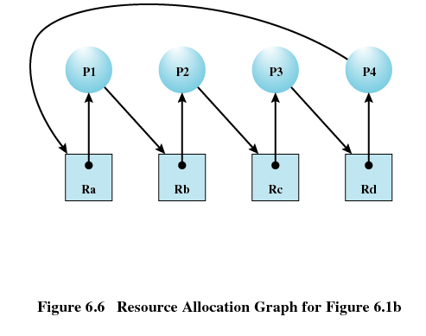
6.1.4 The Conditions for Deadlock(2/3)
Circular wait(循环等待)
  A closed chain of processes exists, such that each process holds at least one resource needed by the next process in the chain

Slide 21
Possibility of Deadlock
(死锁的可能性)
6.1.4 The Conditions for Deadlock(3/3)
Mutual Exclusion
Hold and wait
No preemption
Existence of Deadlock
(死锁的存在性)
Circular wait

Slide 22
Agenda
6.1 Principles of Deadlock
6.2 Deadlock Prevention
6.3 Deadlock Avoidance
6.4 Deadlock Detection
6.5 An Integrated Deadlock Strategy
6.6 Dining Philosophers Problem
6.7 Summary
约束强度依次减弱
Notes:
放置系统进入死锁;进入死锁然后恢复，忽略死锁;用于大多数操作系统，如UNIX(希望程序员设计正确的程序）

Slide 23
6.2 Deadlock Prevention(死锁预防)(1/2)
Mutual Exclusion
  Must be supported by the operating system
    不太可能去掉互斥
Hold and Wait
  Require a process request all of its required resources at one time拿到全部资源
    其它进程时效性、新需求的出现(交互)
Notes:
打破死锁成立的4个条件

Slide 24
6.2 Deadlock Prevention(死锁预防)(2/2)
No Preemption无抢占
  if a further request is denied , Process must release resource and request again
  Operating system may preempt a process to require it releases its resources(kill the process, higher priority)
Circular Wait
  Define a linear ordering of resource types线性排序
    时效性

Slide 25
Agenda
6.1 Principles of Deadlock
6.2 Deadlock Prevention
6.3 Deadlock Avoidance
6.4 Deadlock Detection
6.5 An Integrated Deadlock Strategy
6.6 Dining Philosophers Problem
6.7 Summary

Slide 26
6.3 Deadlock Detection(1/13)
在资源申请前进行判断
A decision is made dynamically whether the current resource allocation request will, if granted, potentially lead to a deadlock
Requires knowledge of future resource requests

Slide 27
6.3 Deadlock Detection(2/13)
Two Approaches to Deadlock Avoidance
  1. Process Initiation Denial
    Do not start a process if its demands might lead to deadlock(如果一个进程的请求会导致死锁，则不启动此进程，进程启动拒绝)
  2.Resource Allocation Denial
    Do not grant an incremental resource request to a process if this allocation might lead to deadlock(如果一个进程增加资源的请求会导致死锁，则不容许此分配，资源分配拒绝)

Slide 28
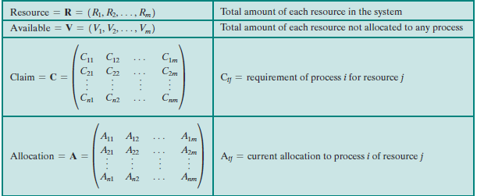
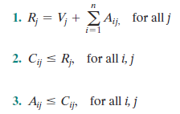

6.3 Deadlock Detection(3/13)
1. Process Initiation Denial进程启动拒绝
i process ID; j resource ID
Notes:
这是一种避免策略，进程在此种情况启动不一定会死锁（比如在进行过程中有其它进程释放资源），但是有可能会死锁（其它进程没有释放资源）。为了避免可以在新建态等待，等有其它进程释放资源后在就绪

Slide 29
6.3 Deadlock Detection(4/13)
2.Resource Allocation Denial分配资源拒绝--Referred to as the banker’s algorithm银行家算法
  State of the system(系统状态) is the current allocation of resources to process
  Safe state(安全状态) is where there is at least one sequence序列 that does not result in deadlock
  Unsafe state(不安全状态) is a state that is not safe

Slide 30
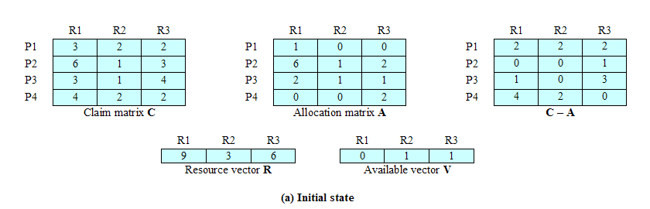
6.3 Deadlock Detection(5/13)
安全状态示范
a. Initial State
Determination of a Safe State

Slide 31
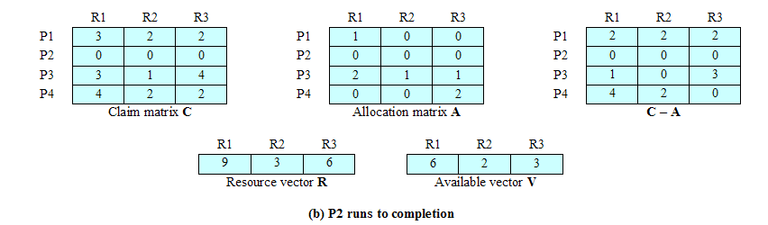
6.3 Deadlock Detection(6/13)
b.P2 Runs to Completion
need
Determination of a Safe State

Slide 32
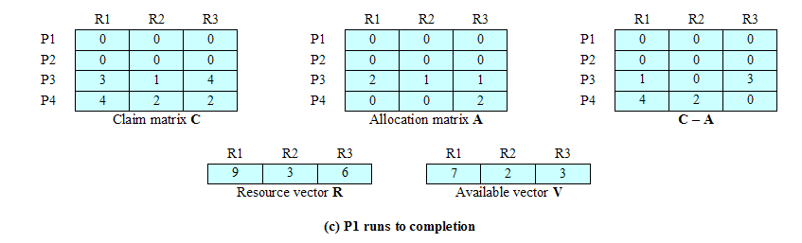
6.3 Deadlock Detection(7/13)
c. P1 Runs to Completion
Determination of a Safe State

Slide 33
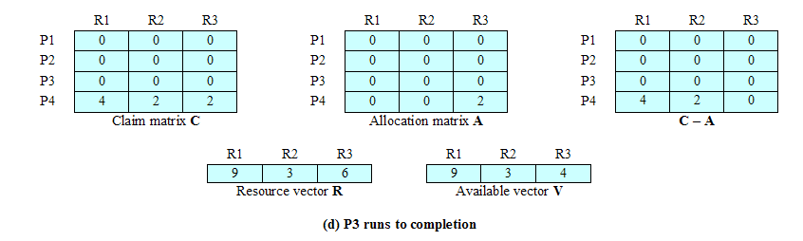
6.3 Deadlock Detection(8/13)
d. P3 Runs to Completion
safe sequence：P2,P1,P3,P4
Determination of a Safe State

Slide 34
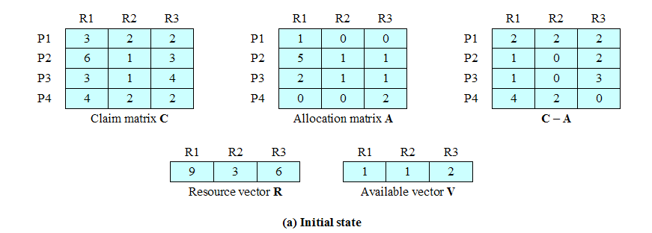
6.3 Deadlock Detection(9/13)
不安全状态示范
Initial state is safe, if p2 completes first.
But before p2 requests the remaining resources and completes, P1 requests for one additional unit of R1 and R3 each
Determination of a Unsafe State
Notes:
系统目前处于安全状态，因为存在序列P2,P1,P3,P4, 此时P1要求分配资源R1,R3各一个，如果获准会导致系统处于不安全状态，不存在安全序列。

Slide 35
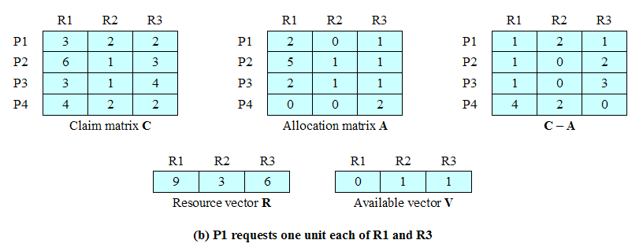
6.3 Deadlock Detection(10/13)
If P1’s request is granted, the state is unsafe.满足p1请求，会进入不安全状态
Determination of a Unsafe State

Slide 36
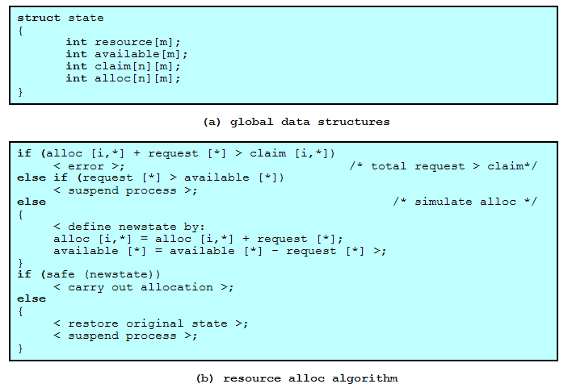
Deadlock Avoidance Logic(死锁避免逻辑)
6.3 Deadlock Detection(11/13)

Slide 37
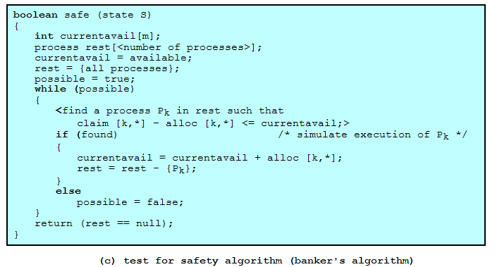
6.3 Deadlock Detection(12/13)
Deadlock Avoidance Logic

Slide 38
6.3 Deadlock Detection(13/13)
Restrictions 限制of Deadlock Avoidance
  Maximum resource requirement must be stated in advance最大资源需求量需要提前申明
  Processes under consideration must be independent; no synchronization requirements（进程间相互独立，否则影响序列的搜索）
      比如等待某个进程的消息
  There must be a fixed number of resources to allocate
  No process may exit while holding resources

Slide 39
Agenda
6.1 Principles of Deadlock
6.2 Deadlock Prevention
6.3 Deadlock Avoidance
6.4 Deadlock Detection
6.5 An Integrated Deadlock Strategy
6.6 Dining Philosophers Problem
6.7 Summary

Slide 40
6.4 Deadlock Detection(1/6)
1. Mark each process that has a row in the Allocation matrix of all zeros. A process that has no allocated resources cannot participate in a deadlock.
2. Initialize a temporary vector W to equal the Available vector.
3. Find an index i such that process i is currently unmarked and the ith row of Q(request) is less than or equal to W. That is, Qik <= Wk, for k: 1 … m. If no such row is found, terminate the algorithm.
4. If such a row is found, mark process i and add the corresponding row of the allocation matrix to W. That is, set Wk = Wk + Aik, for 1 … k … m. Return to step 3.
Notes:
不需要知道一个线程所需要的全部资源，只需要知道某一刻已经分配的资源和申请新分配的资源请求

Slide 41
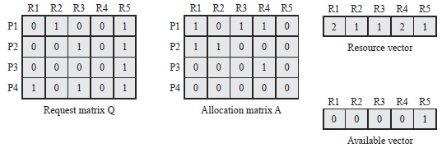
6.4 Deadlock Detection(2/6)
Reference P.265 of the textbook for deadlock detection algorithm
T
T
0 | 0 | 0 | 1 | 1
P1 & P2 cause deadlock

Slide 42
6.4 Deadlock Detection(3/6)
Deadlock Avoidance ≠Deadlock Detection
  Deadlock Avoidance：在分配新资源时，进行是否安全，是否导致死锁的检查
  Deadlock Detection：所有新资源分配的请求都允许，周期性的检测当前的资源状况是否已经死锁

Slide 43
6.4 Deadlock Detection(4/6)
Recovery Strategies Once Deadlock Detected (死锁检测后的解锁策略)
复杂度递增
  Abort all deadlocked processes (most common)
  Back up (回滚) each deadlocked process to some previously defined checkpoint, and restart all process
    Original deadlock may occur, however nondeterminancy of concurrent processing may ensure this doesn’t happen.
  Successively abort (连续取消) deadlocked processes until deadlock no longer exists
  Successively preempt (连续剥夺) resources until deadlock no longer exists

Slide 44
6.4 Deadlock Detection(5/6)
Selection Criteria Deadlocked Processes （被剥夺或者取消进程的选择标准）
  Least amount of processor time consumed so far
  Least number of lines of output produced so far
  Most estimated time remaining (not easy to measure)
  Least total resources allocated so far
  Lowest priority

Slide 45
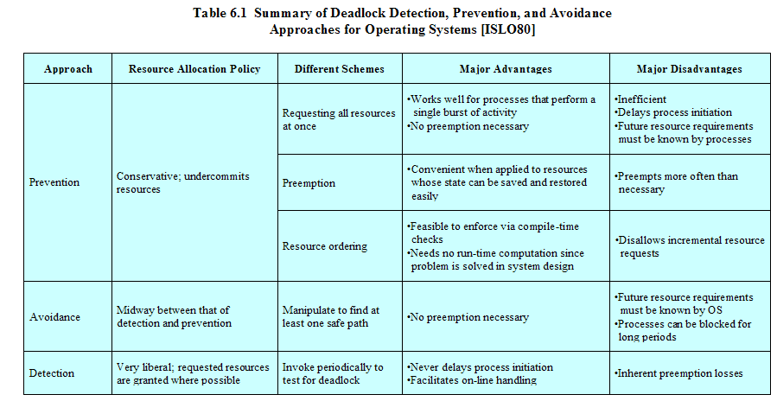
Strengths and Weaknesses of the Strategies
6.4 Deadlock Detection(6/6)

Slide 46
Agenda
6.1 Principles of Deadlock
6.2 Deadlock Prevention
6.3 Deadlock Avoidance
6.4 Deadlock Detection
6.5 An Integrated Deadlock Strategy
6.6 Dining Philosophers Problem
6.7 Summary

Slide 47
6.5 An Integrated Deadlock Strategy(一种综合死锁策略)(1/2)
Group resources into a number of different resource classes(资源分类)
Use the linear ordering strategy(线性排序策略) defined previously for the prevention of circular wait to prevent deadlocks between resource classes(类与类之间用线性排序策略避免死锁)
  e.g. steps process may follow during lifetime
    可交换空间
    进程资源
    内存
    外部资源（I/O）

Slide 48
6.5 An Integrated Deadlock Strategy(一种综合死锁策略)(2/2)
Within a resource class, use the algorithm that is most appropriate for that class(每个类中使用适合于该类的策略)
  Swappable space可交换空间： 外存一次性分配
  Process resources : 死锁避免或排序
  Mem: page/segment, 置换到辅存
  内部资源： 排序

Slide 49
Agenda
6.1 Principles of Deadlock
6.2 Deadlock Prevention
6.3 Deadlock Avoidance
6.4 Deadlock Detection
6.5 An Integrated Deadlock Strategy
6.6 Dining Philosophers Problem
6.7 Summary

Slide 50
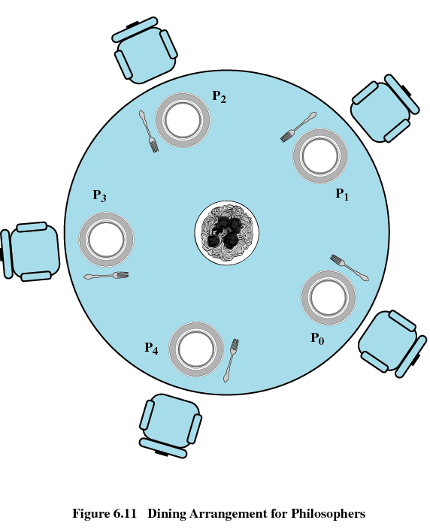
6.6 Dining Philosophers Problem(1/7)
哲学家就餐问题

Slide 51
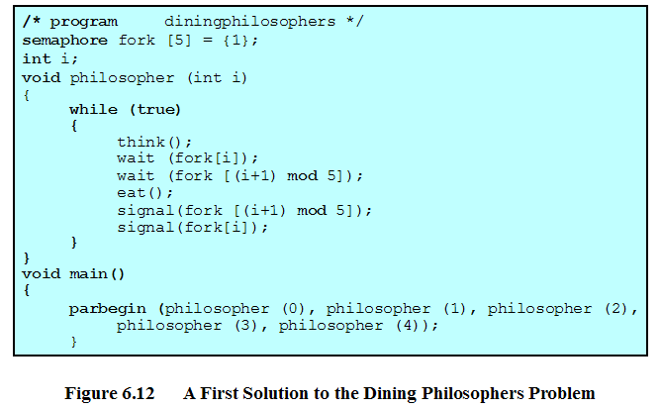
6.6 Dining Philosophers Problem (2/7)
incorrect
Notes:
此时加入简单的对fork的互斥依然不能解决问题，因为关键是需要协调工作，也就是某种同步和默契

Slide 52
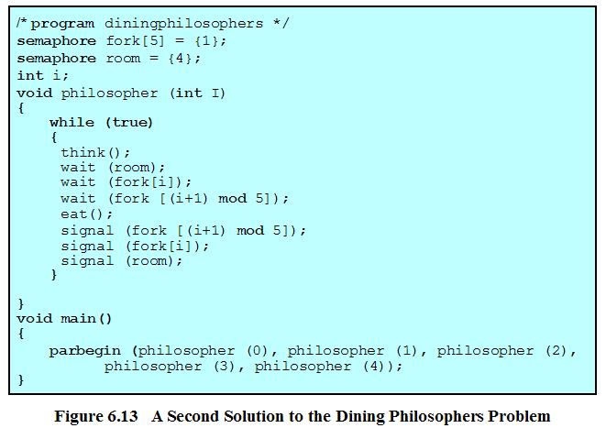
6.6 Dining Philosophers Problem(3/7)
method 1
Notes:
不会死锁和饥饿

Slide 53
Dining Philosophers Problem(4/7)-method 2
先测试,只有左右都有叉子才吃饭
1：thinking
2. feel hungry
3. test: if right OR left neighbor is eating, wait; if not, continue
4. take two forks
5. eating
6. put left fork, test left neighbor, if its left neighbor is not eating , invoke it
7. put right fork, test right neighbor, if its right neighbor is not eating , invoke it
8. jump to 1
Example Code
Notes:
测试过程和拿起2个叉子的步骤是在临界区完成的，参考dining-philosophy-problem里面的6,7解法

Slide 54
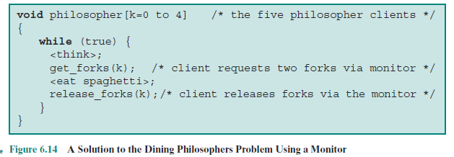
Dining Philosophers Problem(5/7)-method 3 Monitor

Slide 55
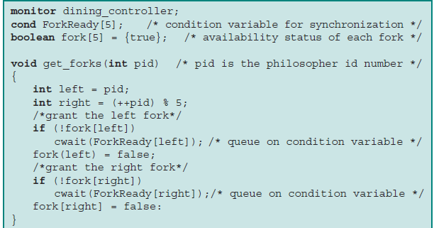
Dining Philosophers Problem(6/7)-method 3 Monitor

Slide 56
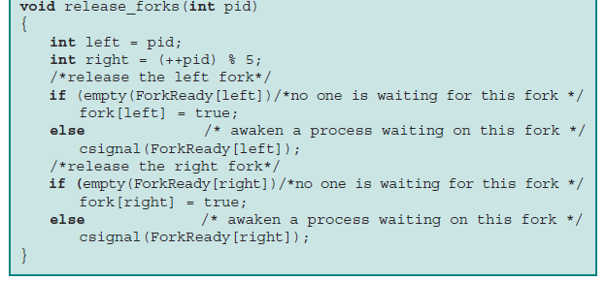
Dining Philosophers Problem(7/7)-method 3 Monitor

Slide 57
Agenda
6.1 Principles of Deadlock
6.2 Deadlock Prevention
6.3 Deadlock Avoidance
6.4 Deadlock Detection
6.5 An Integrated Deadlock Strategy
6.6 Dining Philosophers Problem
6.7 Summary

