Slide 1
Operating Systems
Chapter 7 Memory Management(内存管理)

Slide 2
A few words
本章介绍了内存管理的要求，思想
重定位，分页和分段三个基本概念
但实用内存管理办法是第八章的虚拟内存

Slide 3
Agenda
7.1 Memory Management Requirements
7.2 Memory Partitioning
7.3 Paging
7.4 Segmentation
7.5 Summary

Slide 4
7.1 Memory Management Requirements(1/12)
Memory Hierarchies
Smaller,
faster,
and
costlier
(per byte)
storage
devices
L0:
registers
CPU registers hold words retrieved from L1 cache.
L1:
on-chip L1
cache (SRAM)
L1 cache holds cache lines retrieved from the L2 cache memory.
L2:
off-chip L2
cache (SRAM)
L2 cache holds cache lines retrieved from main memory.
L3:
main memory
(DRAM)
Larger,
slower,
and
cheaper
(per byte)
storage
devices
L4:
local secondary storage
(local disks)
L5:
remote secondary storage
(distributed file systems, Web servers)

Slide 5
7.1 Memory Management Requirements(2/12)
CPU
访问速度
L1 cache
最快
ns/3.6GHZ
L2 cache
高速缓存不命中
硬件
MMU内存管理单元
Memory内存
快
1.3GHZ
缺页
软件
OS操作系统
慢
5ms
Disk硬盘(虚拟内存)
201001V1.1
Notes:
Cache的命中率可以通过代码局部性原理得以提升
但在编译得到的机器代码中，我们感觉不到cache的影响，因此对于程序员是透明的
而memory地址和代码中的逻辑地址有一定关系
MMU是内存管理单元，位于CPU中，负责虚拟内存和物理内存的映射，和修改内存的访问级别(一般有0,1,2三个级别)。

Slide 6
7.1 Memory Management Requirements(3/12)
Subdividing memory to accommodate multiple processes(为支持多道程序将内存进行划分)
Memory needs to be allocated to ensure a reasonable supply of ready processes to consume available processor time(内存管理应确保有适当数目的就绪进程使用处理器时间)

Slide 7
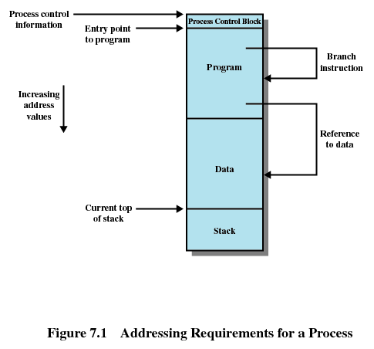
7.1 Memory Management Requirements(4/12)
Notes:
MMU是内存管理单元，位于CPU中，负责虚拟内存和物理内存的映射，和修改内存的访问级别(一般有0,1,2三个级别)。
进程映像中0~3g为用户空间，3g~4g为内核虚拟空间，2部分访问级别不同。

Slide 8

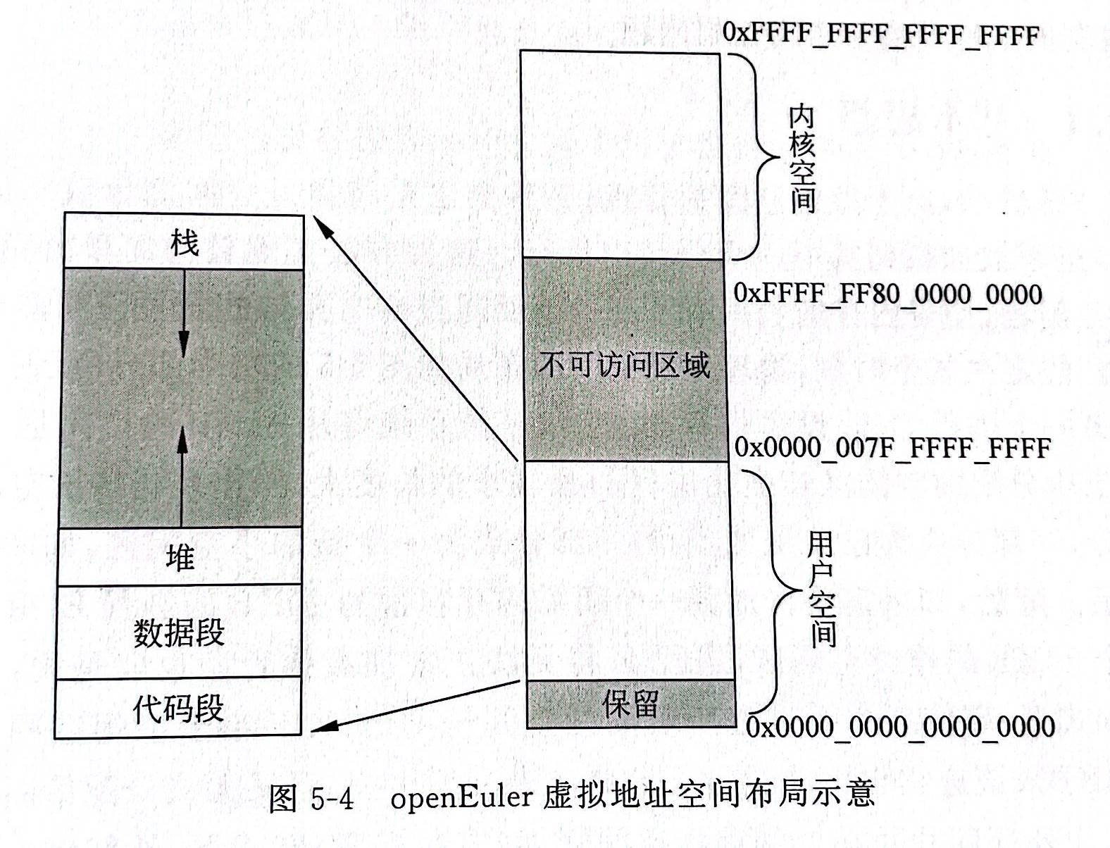
7.1 Memory Management Requirements(5/12)
OpenEuler虚拟地址空间布局
Notes:
64G

Slide 9
7.1 Memory Management Requirements(6/12)
P1进程1
P2进程2
P3进程3
relocation重定位
Protection保护
Sharing 共享
OS kernel
逻辑地址空间
MMU
物理地址空间
内存
外存硬盘
201001V1.1

Slide 10
7.1 Memory Management Requirements(7/12)
Relocation(重定位)
  Programmer does not know where the program will be placed in memory when it is executed程序员无关
  While the program is executing, it may be swapped(交换) to disk and returned to main memory at a different location (relocated) 每次载入位置允许不同
  Memory references must be translated in the code to actual physical memory address(逻辑地址到物理内存地址)
  Q：whose job？ OS or hardware
Notes:
OS 负责表的生成，页的分配
HARDWARE负责地址的转换

Slide 11
7.1 Memory Management Requirements(8/12)
Protection(保护)
  Processes should not be able to reference memory locations in another process without permission or jump to instructions area of another process (进程不能在未授权的情况下访问其他进程的数据，不能跳转到其他进程的代码区域执行指令)
  Normally, processes cannot access any portion of the OS, neither program nor data
  Impossible to check absolute addresses at compile time, instead, absolute addresses must be checked at rum time.运行时检测绝对地址
  Whose Job？ Memory protection requirement must be satisfied by the processor (hardware) rather than the operating system
    MMU on chip
Notes:
Mmu提供: 每个核可以有自己的MMU ,TLB

Slide 12
7.1 Memory Management Requirements(9/12)
Sharing(共享)
  Allow several processes to access the same portion of memory
    Share same copy of the program
    Share data structure to cooperate on some task
Notes:
(405条消息) 04进程学习之详解虚拟内存通过MMU映射到物理内存和MMU对物理内存分级(或者叫虚拟内存和物理内存的映射关系)_Mango酱的博客-CSDN博客_mmu内存映射

Slide 13
7.1 Memory Management Requirements(10/12)
Logical Organization(逻辑组织)
  Conflicts
    Main memory is organized in a linear address space, consisting of a sequence of bytes or words
    Programs are written in modules
      Modules can be written and compiled independently
      Different degrees of protection given to modules (read-only, execute-only)
      Share modules among processes
  Segmentation分段 satisfies these requirements

Slide 14
7.1 Memory Management Requirements(11/12)
Physical Organization(物理组织)
  Memory is organized into at least two levels, referred to as main memory and secondary memory(disk)
  Memory available for a program plus its data may be insufficient(内存对程序和其数据来说可能不足)
    Overlaying(覆盖) allows various modules to be assigned the same region of memory
  Programmer does not know how much space will be available and where his/her program will be loaded in memory

Slide 15
7.1 Memory Management Requirements(12/12)
Keys of memory management
  Relocation
  Segmentation
  Paging
  Virtual memory

Slide 16
Agenda
7.1 Memory Management Requirements
7.2 Memory Partitioning
7.3 Paging
7.4 Segmentation
7.5 Summary

Slide 17
7.2 Memory Partitioning
固定分区 | 过时
动态分区
简单分页 | 未投入实用
简单分段
虚存分页 | 页大小一致
虚存分段 | 段大小不一致

Slide 18
7.2 Memory Partitioning(内存分区)
7.2.1 Fixed Partitioning
7.2.2 Dynamic Partitioning
7.2.3 Buddy System
7.2.4 Relocation

Slide 19
7.2.1 Fixed Partitioning(1/9)(固定分区)
Alternatives for Fixed Partitioning
  Equal-size partitions(大小相等的分区)
  Unequal-size partitions(大小不等的分区)

Slide 20
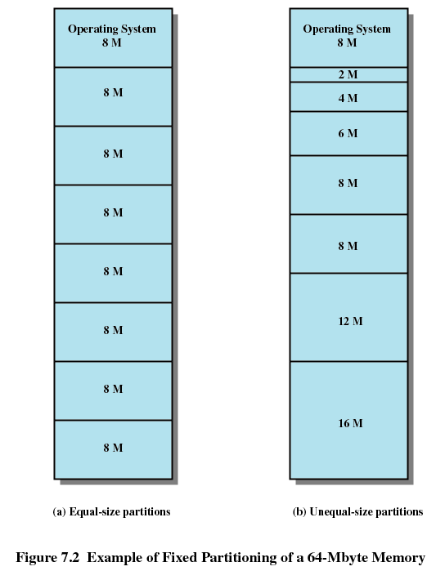
7.2.1 Fixed Partitioning(2/9)

Slide 21
7.2.1 Fixed Partitioning(3/9)
Equal-size partitions: features
  Any process whose size is less than or equal to the partition size can be loaded into an available partition
  If all partitions are full, the operating system can swap a process out of a partition
Notes:
一个进程占用一个分区，不论进程大小

Slide 22
7.2.1 Fixed Partitioning(4/9)
Equal-size partitions: difficulties
  A program may not fit in a partition. The programmer must design the program with overlays 覆盖
  Main memory use is inefficient. Any program, no matter how small, occupies an entire partition.
    internal fragmentation(内部碎片/内零头).
Equal-size partitions: benefits
  Because all partitions are of equal size, it does not matter which partition is used or replaced

Slide 23
7.2.1 Fixed Partitioning(5/9)
overlays 覆盖 by programmer
MEM BLOCK
Main
1k
管理程序
1K MAIN
Fun A
5k
Fun B
2k
5k(A or B)
5k(A1,A2,B1,B2)
3k(B11)
Fun A1
5k
Fun A2
4k
Fun B1
4k
Fun B2
3k
2k Spare
Fun B11
3k
Notes:
Main和管理程序常驻，调用者和被调用者同时存在
占用了一个16k的分区，然后程序的总共大小27K，用overlap的方式

Slide 24
7.2.1 Fixed Partitioning(6/9)
Unequal-size partitions(大小不等的分区)
  Both of these problems of equal-size partitions can be lessened, though not solved, by using unequal-size partitions.

Slide 25
7.2.1 Fixed Partitioning(7/9)
Unequal-size partitions
  Policy: Can assign each process to the smallest partition within which it will fit
  Queue for each partition
  Processes are assigned in such a way as to minimize wasted memory within a partition

Slide 26
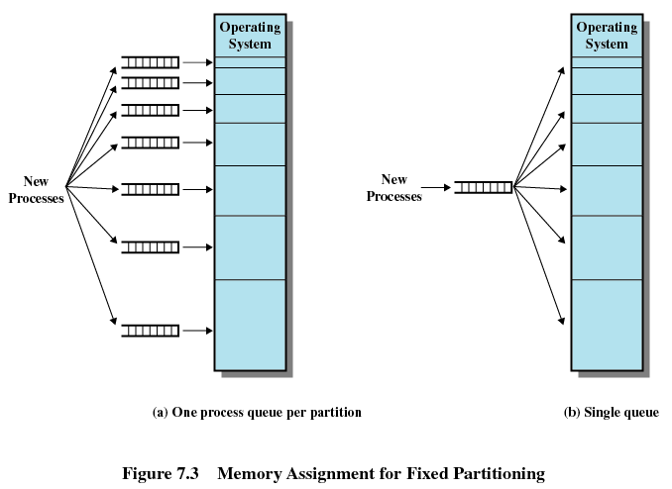
7.2.1 Fixed Partitioning(8/9)
Placement Algorithm(放置算法) with Fixed Partitions？

Slide 27
7.2.1 Fixed Partitioning(9/9)
Disadvantages of Fixed Partitions
  The number of active processes in the system is limited by the number of partitions
  Small jobs will not utilize partition efficiently

Slide 28
7.2 Memory Partitioning
7.2.1 Fixed Partitioning
7.2.2 Dynamic Partitioning
7.2.3 Buddy System
7.2.4 Relocation

Slide 29
7.2.2 Dynamic Partitioning(1/6)(动态分区)
Partitions are of variable length and number
Process is allocated exactly as much memory as required
Eventually get holes in the memory. This is called external fragmentation(外部碎片/外零头)
Must use compaction(压缩) to shift(移动) processes so they are contiguous and all free memory is in one block

Slide 30
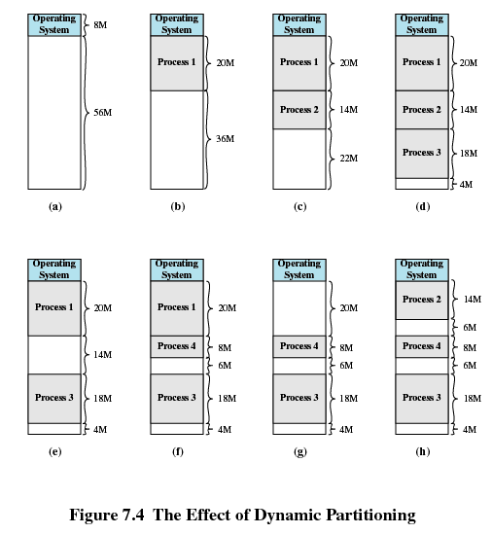
7.2.2 Dynamic Partitioning(2/6)

Slide 31
7.2.2 Dynamic Partitioning(3/6)
Dynamic Partitioning Placement Algorithm
Three placement algorithms：
Best-fit algorithm(最佳适配) 性能最差
  Chooses the block that is closest in size to the request
  Worst performer overall
  Since smallest block is found for process, the smallest amount of fragmentation is left
  Memory compaction must be done more often

Slide 32
7.2.2 Dynamic Partitioning(4/6)
First-fit algorithm(首次适配) 性能最佳
  Scans memory form the beginning and chooses the first available block that is large enough
  Simplest and usually fastest and best
  May have many process loaded in the front end of memory that must be searched over when trying to find a free block

Slide 33
7.2.2 Dynamic Partitioning(5/6)
Next-fit(邻近适配) 性能次佳
  Scans memory from the location of the last placement and chooses the next available block that is large enough
  More often allocate a block of memory at the end of memory where the largest block is found
  The largest block of memory is broken up into smaller blocks
  Compaction is required to obtain a large block at the end of memory

Slide 34
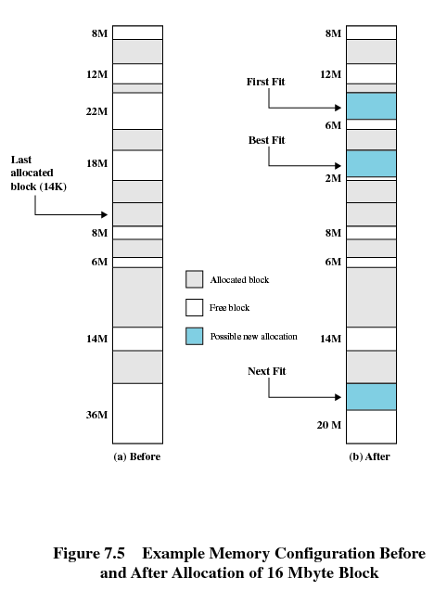
7.2.2 Dynamic Partitioning(6/6)

Slide 35
7.2 Memory Partitioning
7.2.1 Fixed Partitioning
7.2.2 Dynamic Partitioning
7.2.3 Buddy(伙伴) System
7.2.4 Relocation

Slide 36
7.2.3 Buddy伙伴 System(1/3)
Entire space available is treated as a single block of 2^{U} (e.g. 1M = 2²⁰ )
If a request of size s such that 2^{U-1} < s <= 2^{U}, entire block is allocated
Otherwise block is split into two equal buddies
Process continues until smallest block greater than or equal to s is generated

Slide 37
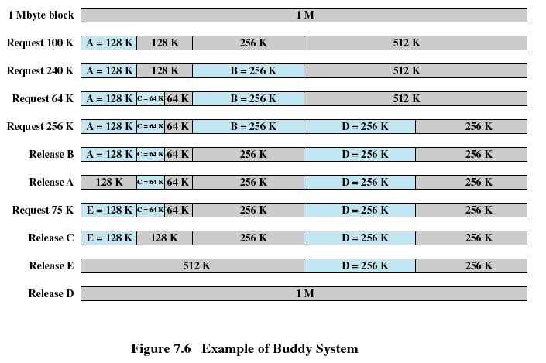
7.2.3 Buddy伙伴 System(2/3)

Slide 38
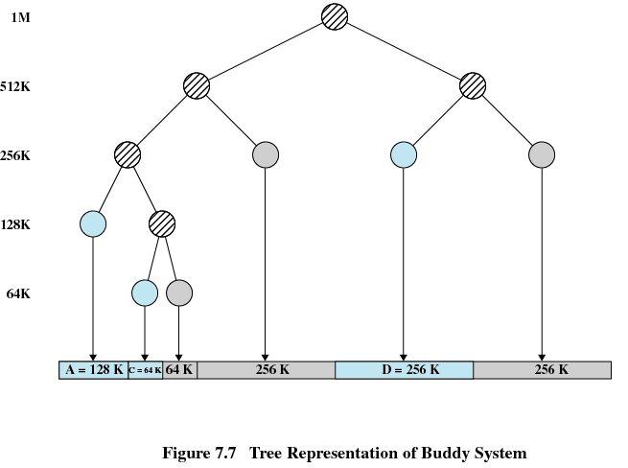
7.2.3 Buddy伙伴 System(3/3)

Slide 39
7.2 Memory Partitioning
7.2.1 Fixed Partitioning
7.2.2 Dynamic Partitioning
7.2.3 Buddy System
7.2.4 Relocation

Slide 40
7.2.4Relocation(1/6)(重定位)
When program loaded into(载入) memory the actual (absolute) memory locations are determined
A process may occupy different partitions which means different absolute memory locations during execution (from swapping 交换)
Compaction(压缩) will also cause a program to occupy a different partition which means different absolute memory locations

Slide 41
7.2.4Relocation(2/6)
Addresses
  Logical Address(逻辑地址)
    Reference to a memory location independent of the current assignment of data to memory(与当前数据在物理内存中分配无关的访问地址)
    Textbook 8.1 进程中的所有内存访问都是逻辑地址
    Translation must be made to the physical address
  Relative Address(相对地址)
    Address expressed as a location relative to some known point
  Physical Address(物理地址)
    The absolute address(绝对地址) or actual location in main memory
Notes:
比如进程映像是逻辑地址，其中数据段中，可以说某个地址距离数据段起始位置的距离是多少，这个就是相对地址

Slide 42
7.2.4Relocation(3/6)
逻辑地址的生成
  与OS无关
  由相关软件完成
程序在内存中 进程映像
PCB……
常规库
… push Jmp 653 …
.exe
0
0
常规库
… push Jmp 153 …
500
.c
.s
.o
0
100
main{
…
func(a)
…
}
{
…
push
jmp _func
…
}
{
…
push
jmp 53
…
}
加载
重定位
编译
汇编
链接

Slide 43
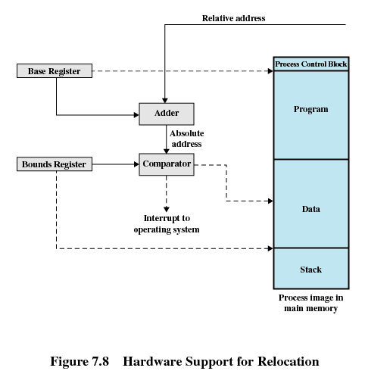
7.2.4Relocation(4/6)
653 相对地址
加法器
Main memory
PCB
Program … Jmp 653 …
data
stack
基址寄存器
0
进程映像
500
对进程进行了内存保护
界限寄存器
比较器
绝对地址
1.图中，基址和界限寄存器的值有OS负责生成
2.但具体的逻辑地址生成方法见第8章，OS的主要工作是完成逻辑到物理地址的映射表(段表页表)
3.CPU内的硬件MMU完成地址转换
给操作系统的中断
Hardware support for relocation
Notes:
注意在真实的操作系统里面进程映像不是连续和完全存在于物理内存上的,也可能部分在硬盘上

Slide 44
7.2.4Relocation(5/6)
Registers Used during Execution
  Base register(基址寄存器)
    Starting address for the process
  Bounds register(界限寄存器)
    Ending location of the process
  Whose job? OS: These values are set when the process is loaded(加载) or when the process is swapped in(换入)
Notes:
思考：每个进程都需要这两个寄存器吗？如何实现

Slide 45
7.2.4Relocation(6/6)
1. The value of the base register is added to a relative address to produce an absolute address
2. The resulting address is compared with the value in the bounds register
3. If the address is not within bounds, an interrupt is generated to the operating system

Slide 46
Agenda
7.1 Memory Management Requirements
7.2 Memory Partitioning
7.3 Paging
7.4 Segmentation
7.5 Summary

Slide 47
7.3 Paging(1/6) (分页)
Partition memory into small equal fixed-size chunks(块) which are called frames(帧)
Divide each process into small equal fixed-size chunks which are called pages(页).
The size of pages == the size of frames
  Memory address consist of a page number(页号) and offset(偏移量) within the page
Operating system maintains a page table(页表) for each process：帧页对应关系表
    Contains the frame location(帧位置) for each page in the process

Slide 48
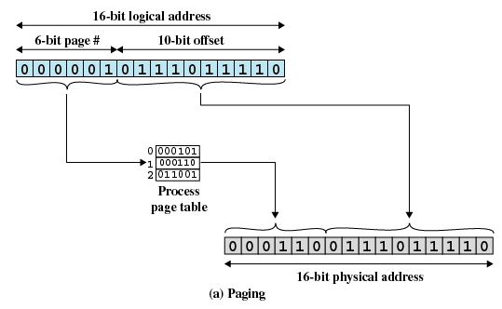
7.3 Paging(2/6)
  Memory address ： page number(页号) + offset(偏移量)
  Operating system maintains a page table(页表) for each process
  Contains the frame location(帧位置) for each page in the process
进程A
A.0page
A.1page address：0x05DE
A.2page
A.3page
Notes:
Offset 的bit数对应一页的大小

Slide 49
7.3 Paging(3/6)
地 Frame no | 址 frame | 内存
000000
000001
000010
000011
000100
000101 | 0000000000 - 1111111111
000110 | 0000000000 -0111011110 1111111111
 |  | …
地 Frame no | 址 frame | 进程 映像
000000 | 0000000000 - 1111111111
000001 | 0000000000 -0111011110 1111111111
000010 | 0000000000 - 1111111111
000011 | 0000000000 - 1111111111

Slide 50
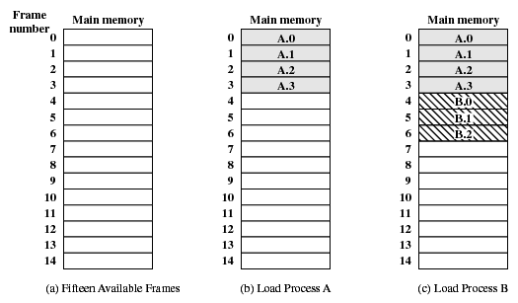
7.3 Paging(4/6)
Assignment of Process Pages to Free Frames

Slide 51
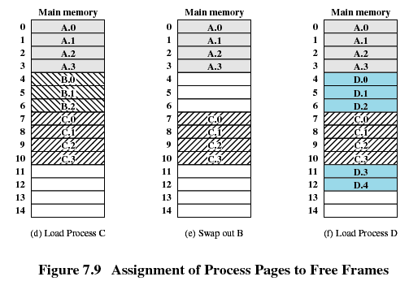
7.3 Paging(5/6)

Slide 52
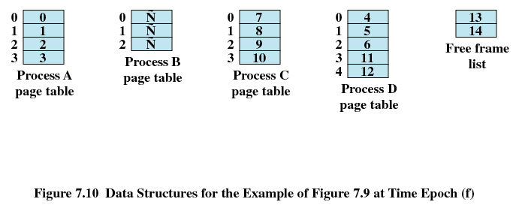
7.3 Paging(6/6)
页号
帧
号
Lab09 paging.c
Page Tables for Example

Slide 53
Agenda
7.1 Memory Management Requirements
7.2 Memory Partitioning
7.3 Paging
7.4 Segmentation
7.5 Summary

Slide 54
7.4 Segmentation(1/3)(分段)
Program and its data can be divided into a number of segmentation, all segments of all programs do not have to be of the same length
There is a maximum segment length
Addressing consist of two parts
  segment number(段号)
  offset(偏移量)
Since segments are not equal, segmentation is similar to dynamic partitioning(动态分区)
Notes:
由于段长度不同， 所以才需要和段最长地址比较

Slide 55
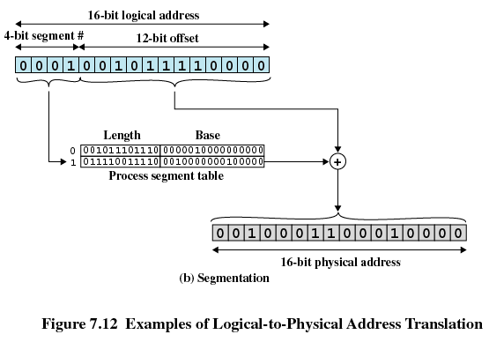
7.4 Segmentation(2/3)(分段)
Offset 和 length 比较判断是否是有效地址

Slide 56
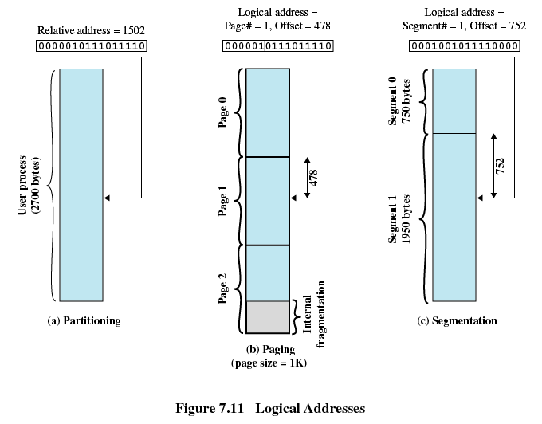
7.4 Segmentation(3/3)(分段)

Slide 57
Agenda
7.1 Memory Management Requirements
7.2 Memory Partitioning
7.3 Paging
7.4 Segmentation
7.5 Summary

Slide 58
Summary
解决的问题
  进程可以分割为模块装载
  程序员无关
尚未解决的问题
  页表，段表大小，检索速度问题

Slide 59
拓展：bitmap(1/9)
Q：如何表示空间是否可用？
位图（bitmap)为 n 个二进制位的串，用于表示 n 项的状态。
  如有n个资源，第 i 个bit表示资源i的可用性,0 表示可用，而 1 表示不可用（或相反）。
    例如，现有如下位图：00101110
    第 1、2、3、5 资源是不可用的，第 0、4、6 和 7 资源是可用的。
7 | 6 | 5 | 4 | 3 | 2 | 1 | 0
0 | 0 | 1 | 0 | 1 | 1 | 1 | 0

Slide 60
拓展：bitmap(2/9)
当考虑空间效率时，位图优势明显。如果所用的布尔值是 8 位的而不是 1 位的，那么最终的数据结构将会是原来的 8 倍。因此，当需要表示大量资源的可用性时，通常采用位图。
磁盘驱动器就是这么工作的。一个中等大小的磁盘可以分成数千个单元，称为磁盘块（disk block）。每个磁盘块的可用性就可通过位图来表示。

Slide 61
拓展：bitmap(3/9)
某文件管理系统在磁盘上建立了位示图（Bitmap），记录磁盘的使用情况。若磁盘上的物理块依次编号为0、1、2、…，系统中字长为32位，每一位对应文件存储器上的一个物理块，取值0和1分别表示空闲和占用，如下所示。假设将4195号物理块分配给某文件，那么该物理块的使用情况在位示图中的第（ ）个字（从0编号）中描述；选择（）
A . 128
B . 129
C . 130
D . 131
Notes:
4195实际是第4196块，4196/32=131.1 故0~130,为前131块对应字，4195在131中
D

Slide 62
拓展：bitmap(4/9)
因为物理块编号是从0开始的，所以4195号物理块其实就是第4196块。因为字长为32位，也就是说，每个字可以记录32个物理块的使用情况。4196/32=131.125，所以，4195号物理块应该在第131个字中（字的编号也是从0开始计数）。那么，具体在第131个字的哪一位呢。到第130个字为止，共保存了131×32=4192个物理块（0～4191），所以，第4195块应该在第131个字的第3位记录（要注意：0是最开始的位）。因为系统已经将4195号物理块分配给某文件，所以其对应的位要置1。
如何判断某个物理块是否占用？

Slide 63
拓展：bitmap(5/9)
假设用 char bitmap[8]；来描述64个块的分配情况
如修改n=14为占用
1.先找到n在bitmap数组中的下标index，显然index = 1
  index = n / 8 = n >> 3，即1110>>3得到1
2.找到n在bitmap[index](bitmap[1])中的位置position，这里position = 6。
  position = n % 8 ,即 n & 0x07。
bitmap[0]
1 | 0 | 1 | 0 | 1 | 0 | 1 | 0
7 | 6 | 5 | 4 | 3 | 2 | 1 | 0
0 | 0 | 0 | 0 | 0 | 1 | 0 | 1
15 | 14 | 13 | 12 | 11 | 10 | 9 | 8
bitmap[1]
假设左高位右位低
Notes:
对8取余数，相当于/8后剩下的余数，而/8是右移3位，那么余数自然就是右边移出去的3位，也就是&7取出来的3位

Slide 64
拓展：bitmap(6/9)
3.对对应bit做或操作
  bitmap[1] |= 1<<position
位移
0 | 1 | 0 | 0 | 0 | 0 | 0 | 0
| 或
0 | 0 | 0 | 0 | 0 | 1 | 0 | 1
15 | 14 | 13 | 12 | 11 | 10 | 9 | 8
结果
0 | 1 | 0 | 0 | 0 | 1 | 0 | 1
15 | 14 | 13 | 12 | 11 | 10 | 9 | 8

Slide 65
拓展：bitmap(7/9)
//用>>的操作是，运算会比较快
int index = n >> 3;
int position = n & 0x07;
bitmap[index] |= 1 << position;//set to 1
bitmap[index] &= ~(1 << position);// set to 0
(bitmap[index] & (1 << position)) != 0;// 判断是否存在
Notes:
！0即存在

Slide 66
拓展：bitmap(8/9)
void bit_set(bits bit, unsigned int pos, unsigned char value)
{
unsigned char mask = 0x1 << (pos & 0x7);
if (value)
bit-> bitmap[pos>>3] |= mask;
else
bit-> bitmap[pos>>3] &= ~mask;
}

Slide 67
拓展：bitmap(9/9)
char bit_get(bits bit, unsigned int pos)
{
unsigned char mask = 0x1 << (pos & 0x7);
return (mask & bit-> bitmap[pos>>3]) == mask ? 1 : 0;
}

