Slide 1
Operating Systems
Chapter 8 Virtual Memory (虚拟内存)

Slide 2
A simple review(1/3)
In chapter 7:
Relocation
Memory references are dynamically translated into physical addresses at run time(运行时访问地址动态转换)
Fixed partition/dynamic partition
Paging/Segmentation
A process may be broken up into pieces that do not need to located contiguously in main memory(进程分块)
The whole process is resident in memory进程整体驻留于内存

Slide 3
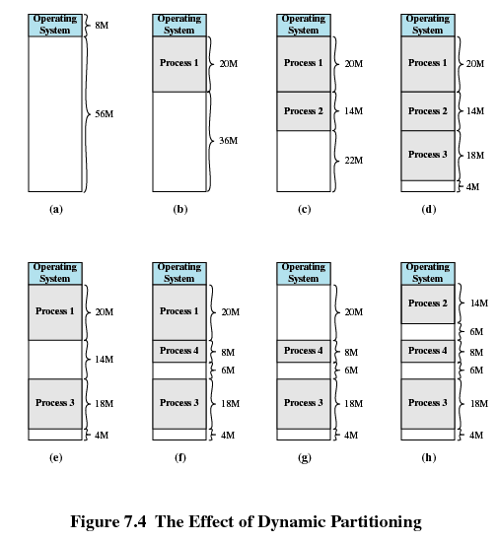
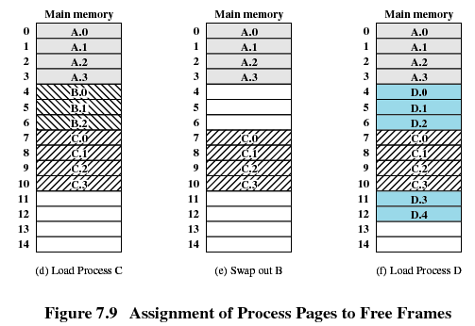
A simple review (2/3)

Slide 4
A simple review (3/3)
Problem unsolved:
Paging: Page table need to be stored somewhere and accessed efficiently
TLB, multi-level paging table, Inverted Page Table
Limited memory: logic mem <,=,> physical mem
Virtual memory, Replacement Policy, Resident Set Management, Clearing Policy
Notes:
进程所需要逻辑内存与物理内存的关系，在大于时如何解决？覆盖，交换不能完全满足要求： 解决方法：进程部分代码数据加载入内存，剩下的在硬盘的中，加载的内容分散于内存中并不连续，虚拟内存;
分页中尚未解决的问题，在本次分页中继续讨论效率和空间优化问题，提出快表，多级页表，反向页表

Slide 5
Agenda
8.1 Hardware and Control Structure
8.2 Operating System Software
8.3 Summary

Slide 6
8.1 Hardware and Control Structure
8.1.0 Overview
8.1.1 Locality and Virtual Memory
8.1.2 Paging
8.1.3 Segmentation
8.1.4 Combined Paging and Segmentation
8.1.5 Protection and Sharing

Slide 7
8.1.0 Overview(1/6)
Virtual memory definition: The memory to programmer’s view
内存+部分辅存构成A storage allocation scheme in which secondary memory can be addressed as though it were part of main memory.
逻辑和物理地址自动转换The addresses a program may use to reference memory are distinguished from the addresses the memory system uses to identify physical storage sites, and program-generated addresses are translated automatically to the corresponding machine addresses.
尺寸不受内存限制，受计算机寻址和可用辅存限制The size of virtual storage is limited by the addressing scheme of the computer system and by the amount of secondary memory available and not by the actual number of main storage locations.

Slide 8
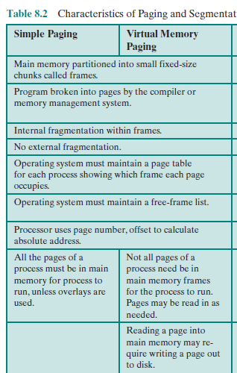
8.1.0 Overview(2/6)
Operating system brings into main memory a few pieces of the program
Resident set(常驻集) - portion of process that is in main memory

Slide 9
8.1.0 Overview(3/6)
When an address is needed that is not in main memory:
1. An interrupt is generated, which is known as page fault interrupt(缺页中断)
2. Operating system places the process in a blocking state

Slide 10
8.1.0 Overview(4/6)
3. Piece of process that contains the logical address is brought into main memory
Operating system issues a disk I/O Read request
Another process is dispatched to run while the disk I/O takes place
An interrupt is issued when disk I/O complete
4. operating system place the affected process in the Ready state

Slide 11
8.1.0 Overview(5/6)
Advantages
More processes may be maintained in main memory(主存中保留多个进程)
With so many processes in main memory, it is very likely a process will be in the Ready state at any particular time
effective multiprogramming
Relieves the user of tight constraints of main memory (解除了用户与主存之间的紧密约束)
A process may be larger than all of main memory(支持大于主存的进程)
Notes:
Only load in some of the pieces of each process

Slide 12
8.1.0 Overview(6/6)
Thrashing系统抖动/系统颠簸
Swapping out a piece of a process just before that piece is needed
Too much of this operations may leads the processor spends most of its time swapping pieces rather than executing user instructions

Slide 13
8.1 Hardware and Control Structure
8.1.0 Overview
8.1.1 Locality and Virtual Memory局部性原理
8.1.2 Paging
8.1.3 Segmentation
8.1.4 Combined Paging and Segmentation
8.1.5 Protection and Sharing

Slide 14
8.1.1 Locality and Virtual Memory(1/3)
void main()
{
int arr[50][50];
for(int i=0;i<50;i++)
for(int j=0;j<50;j++)
arr[i][j]=0;
}
void main()
{
int arr[50][50];
for(int j=0;j<50;j++)
for(int i=0;i<50;i++)
arr[i][j]=0;
}
Locality：code and data

Slide 15
8.1.1 Locality and Virtual Memory (2/3)
Locality suggests that virtual memory may work efficiently
Program and data references within a process tend to cluster(程序和数据访问的集簇倾向)
Only a few pieces of a process will be needed over a short period of time
Possible to make intelligent guesses about which pieces will be needed in the future

Slide 16
8.1.1 Locality and Virtual Memory (3/3) ---Support Needed for Virtual Memory
Hardware：
support paging and segmentation (硬件要支持分页和分段)
Software：
Operating system must be able to management the movement of pages and/or segments between secondary memory and main memory (操作系统要实现内存管理，使得段/页可以在内存与辅存之间移动)

Slide 17
8.1 Hardware and Control Structure
8.1.0 Overview
8.1.1 Locality and Virtual Memory
8.1.2 Paging分页
8.1.3 Segmentation
8.1.4 Combined Paging and Segmentation
8.1.5 Protection and Sharing

Slide 18
8.1 Hardware and Control Structure
8.1.2 Paging分页
8.1.2.0 Introduction to Paging
8.1.2.1 Multi-level Paging System多级页表
8.1.2.2 Inverted Page Table(反向/倒排页表)
8.1.2.3 Translation Lookaside Buffer(快表)
8.1.2.4 Page Size

Slide 19
8.1.2.0 Introduction to Paging(1/7)
Each process has its own page table(页表)
Each page table entry(页表项) contains the frame number of the corresponding page in main memory
Present Bit(存在位):
A bit is needed to indicate whether the page is in main memory or not
If try to access an address that is not in memory, a page fault 缺页interrupt will be generated

Slide 20
8.1.2.0 Introduction to Paging(2/7)
Modified Bit(修改位):
A bit may be needed to indicate whether the page has been modified or not since it was loaded in main memory
If no change has been made, the page does not have to be written to the disk when it needs to be swapped out(换出)
Notes:
修改位在现代操作系统中还会参与替换策略

Slide 21
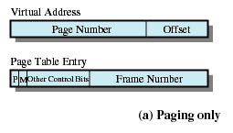
Page Table Structure
8.1.2.0 Introduction to Paging (3/7)
Notes:
the valid bit says whether or not the PTE can be used
says whether or not a virtual address is valid
it is checked each time a virtual address is used
the referenced bit says whether the page has been accessed
it is set when a page has been read or written to
the modified bit says whether or not the page is dirty
it is set when a write to the page has occurred
the protection bits control which operations are allowed
read, write, execute
the page frame number determines the physical page
physical page start address = PFN

Slide 22
8.1.2.0 Introduction to Paging (4/7)
页号
offset
0x 0000 0000 0000 0000 0000 0000 0000 0000 | 每页4K
………………………………………………. 0x 0000 0000 0000 0000 0000 1111 1111 1111
0x0000 0000 0000 0000 0001 0000 0000 0000 | 4K
… 0x 0011 0001 0000 0000 0001 1111 1111 1111
 | 4K
0x0000 0000 0000 0000 0010 0000 0000 0000
0x 0011 0001 0010 0001 0000 **** **** **** …
0x 0011 0001 0010 0001 1111 1111 1111 1111
0x 0011 0001 0010 0010 0000 0000 0000 0000 0x 0011 0001 0010 0010 **** **** **** **** … 0x 1111 1111 1111 1111 1111 1111 1111 1111
4G进程映像
16G内存
2^20页
yy | yyyy | yyyy | yyyy | yyyy | yyyy | xxxx | xxxx | xxxx
帧号
offset

Slide 23
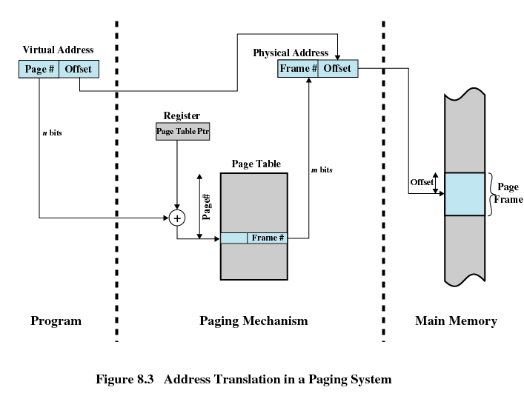
8.1.2.0 Introduction to Paging (5/7)
Address Translation in a Paging System(地址转换系统)

Slide 24
8.1.2.0 Introduction to Paging (6/7)
考虑：访问效率和存储空间
分页机制中页表的存放问题：内存?
那么一次对内存的访问需要访问两次内存
读内存中的页表项
读物理地址中需要的数据
页表存放需要多大的内存空间？
假设物理内存大小为1G, 共有32个进程，每个进程为4G，每页大小为4k， 每个页表项为4字节，那么存储所有页表需要多少空间？
每个进程需要1M个页，对应的页表大小为1M*4B=4MB
32个进程共需要 128MB
128MB/1GB=12.5%内存占有率
Notes:
缓存 TLB

Slide 25
8.1.2.0 Introduction to Paging (7/7)
The entire page table size is proportional to that of the virtual address space, and may take up too much main memory(页表大小与虚拟地址空间成比例增加，可能会很大)
Page tables are also stored in virtual memory(页表自身在虚存)
When a process is running, part of its page table is in main memory(部分页表在主存)

Slide 26
8.1 Hardware and Control Structure
8.1.2 Paging分页
8.1.2.0 Introduction to Paging
8.1.2.1 Multi-level Paging System多级页表
8.1.2.2 Inverted Page Table(反向/倒排页表)
8.1.2.3 Translation Lookaside Buffer(快表)
8.1.2.4 Page Size

Slide 27
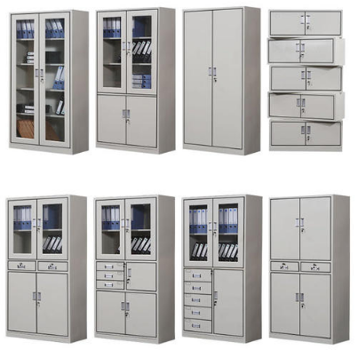

8.1.2.1 Multi-level Paging System(1/8)
年级 | 专业 | 第几人
2020 | 314 | 1356
2019 | 314 | 0096
20203141356
学号

Slide 28
8.1.2.1 Multi-level Paging System(2/8)
zzzz | zzzz | zz yy | yyyy | yyyy | xxxx | xxxx | xxxx
2^10个
2^10个
2^12个
年级 | 专业 | 第几人
2020 | 314 | 1356
2019 | 314 | 0096
学号
20203141356

Slide 29
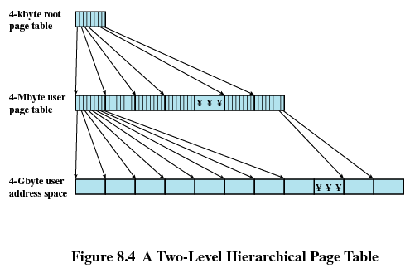
8.1.2.1 Multi-level Paging System(3/8)
2级页表
1
年级 | 专业 | 第几人
2020 | 314 | 1356
2019 | 314 | 0096
1kbyte*1kbyte=1Mbyte user
Page table
用户地址空间
1Mbyte*4kbyte=4Gbyte user
address space
Two-Level Scheme for 32-bit Address(32位地址的两级页表)

Slide 30
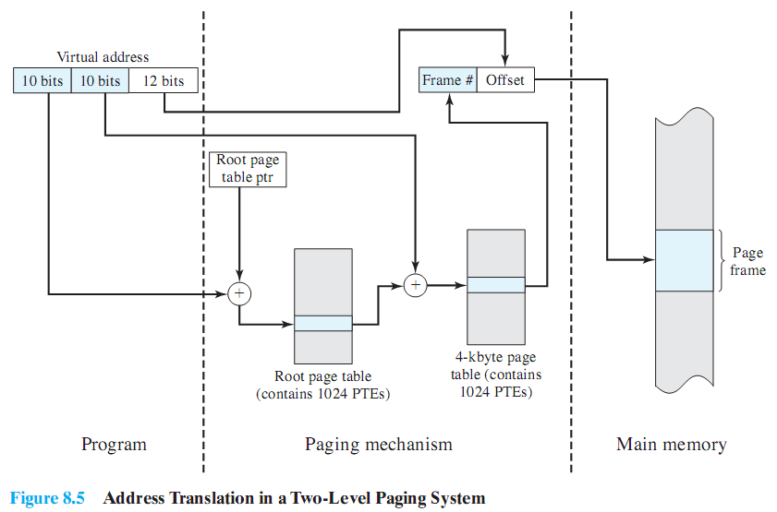
8.1.2.1 Multi-level Paging System(4/8)
多级页表示意图.xlsx

Slide 31
8.1.2.1 Multi-level Paging System(5/8)
Multi-level paging system
部分解决了存储空间的问题
多级页表为什么省内存？二级页表可以不存在
但访问机制的复杂性导致时间开销进一步增大，需要硬件的支持
考虑：
存储空间过大是因为为每个进程维护一个页表，而且进程所需逻辑空间的大小影响页表的大小
物理内存是一定的
Notes:
没有加载的页表在一级中由无效位标识，那么就不存在于二级页表
https://www.zhihu.com/question/63375062

Slide 32

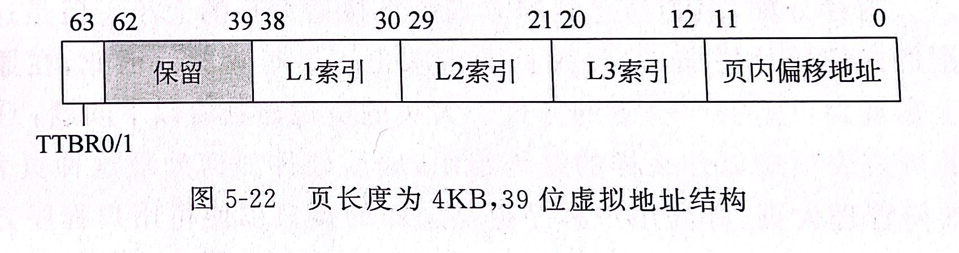
8.1.2.1 Multi-level Paging System(6/8)
OpenEuler下的多级页表
39位虚地址下，支持3级页表和2级页表
页表项8B，分页粒度4KB，每个页框保存512项记录: 8B*512 -> 4K
Notes:
Armv8最大支持48位虚地址

Slide 33
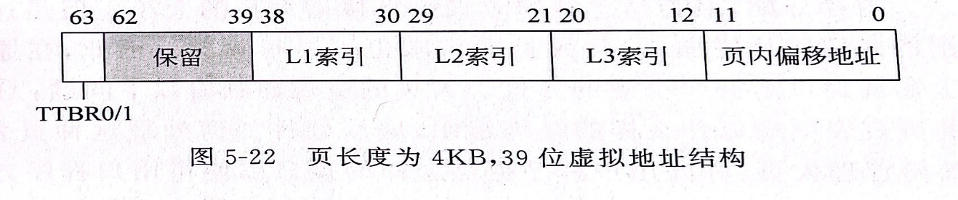
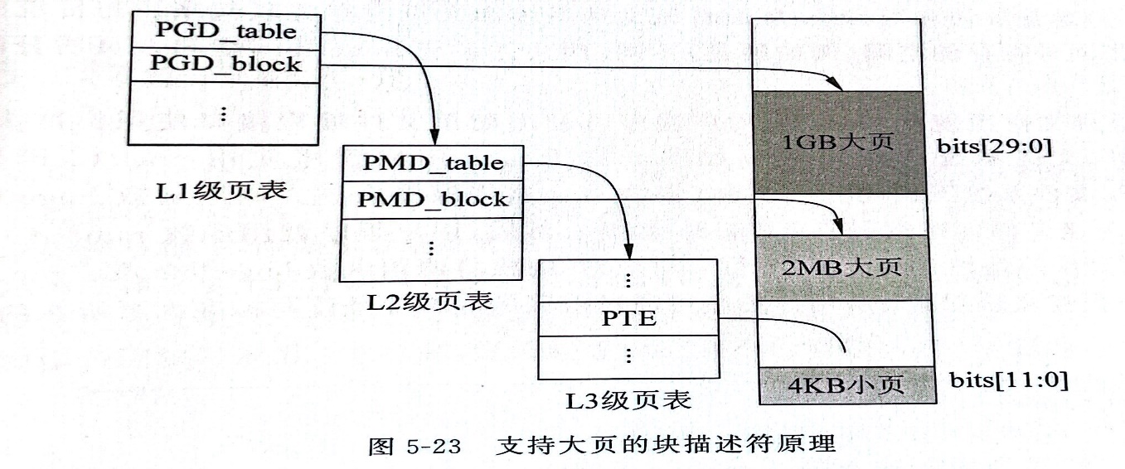
8.1.2.1 Multi-level Paging System(7/8)
OpenEuler支持下的标准大页
问题提出：分配4MB空间需要1024个4KB页的页表项，在查询过程中有1024次TLB不命中和页表查询
解决：大页：二级和一级索引部分用作块描述符：如L3为块描述符，则2^(12+9)对应页尺寸为2MB
Notes:
Armv8最大支持48位虚地址

Slide 34
8.1.2.1 Multi-level Paging System(8/8)
OpenEuler支持下的标准大页
MMU 支持大页机制下的块描述符
openEuler用hstate记录大页信息
openEuler采用标准大页池，用户申请空间时，操作系统在大页池寻找空闲大页
Notes:
Armv8最大支持48位虚地址

Slide 35
8.1 Hardware and Control Structure
8.1.2 Paging分页
8.1.2.0 Introduction to Paging
8.1.2.1 Multi-level Paging System多级页表
8.1.2.2 Inverted Page Table(反向/倒排页表)
8.1.2.3 Translation Lookaside Buffer(快表)
8.1.2.4 Page Size

Slide 36
8.1.2.2 Inverted Page Table(1/8)(反向/倒排页表)
The page table’s structure is called inverted because it indexes page table entries by frame number rather than by virtual page number.
Notes:
反向页表：表项的数目由物理内存数目关联
查找依然是page号+pid作为输入，输出时frame 号 i，然后查找反向页表，避免碰撞，得到正确的帧号（j），再寻址

Slide 37
8.1.2.2 Inverted Page Table(2/8)
线性反向页表
线性倒排页表是倒排页表的基本形式，由于它是全局唯一的，并且每个进程有自己独立的地址空间，表项中必须包含进程ID。表项由三部分组成，进程ID（PID，16位），虚拟页号（VPN，52位），信息位（INFO，12位，包含该页的一些保护信息），共80位（10Bytes）。物理页框号由表项索引隐含表示。
设虚拟地址空间为64位，页面大小为4KB，页表项大小为4Bytes，物理内存大小为512MB，
所有表项占用的内存大小为2^(64-12) 个*4B
用反向页表的表项数目为：2^(29-12) = 128K个
Notes:
https://www.jianshu.com/p/8a86033dfcb0

Slide 38
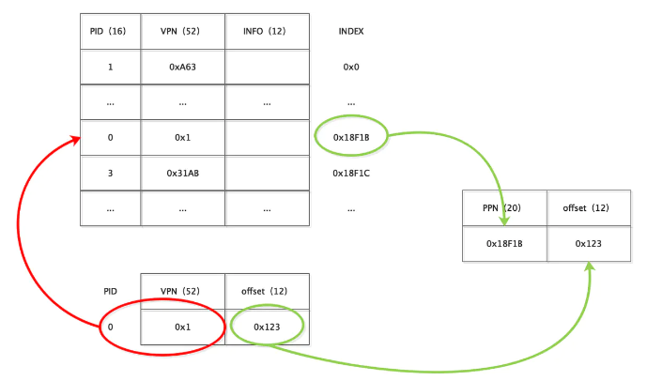
8.1.2.2 Inverted Page Table(3/8)
线性反向页表
Mov ax,[0x000..1123]
Notes:
为了找到PID和VPN的匹配对，每次转换需要128K次的内存访问操作。这个PID和VPN的搜索过程导致地址转换十分低效，可以用散列表降低内存访问次数

Slide 39
8.1.2.2 Inverted Page Table(4/8)
线性反向页表
为了加快地址转换速度，可以在线性转换表前增加一层散列表。散列表的输入是PID??和VPN，输出是倒排页表的索引。利用散列表进行散列时可能发生冲突，可以利用链地址法解决冲突，我们通过在倒排页表项中增加next域使其能够构成链表（表头的索引位于散列表中）。
Vpn 页号
PID 线程号

Slide 40
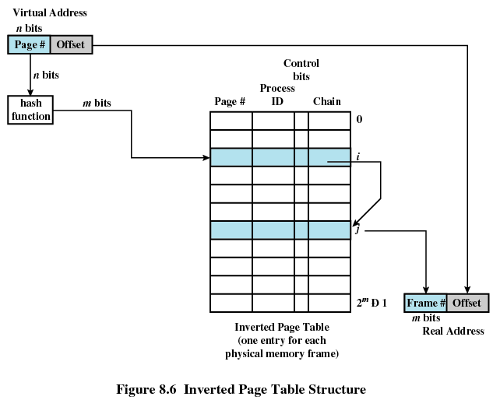
8.1.2.2 Inverted Page Table(5/8)
Notes:
哈希的反向页表依然需要用到TLB来对表进行缓存，从而加速访问

Slide 41
8.1.2.2 Inverted Page Table(6/8)
Page table entry
Page number(页号)
Process identifier(进程标志符)
Control bits(控制位)
Chain pointer(链指针)
Only one table for all processes

Slide 42
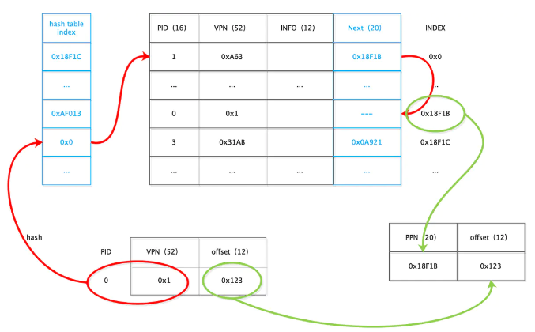
8.1.2.2 Inverted Page Table(7/8)
Mov ax,[0x000..1123]
Notes:
散列倒排页表的大小为 hash表大小 + 倒排页表大小 = 4 X 128KB + 14 X 128KB = 2.3MB，理想情况下（找到一个足够好的散列函数），平均一次地址转换需要2.5次内存访问操作。

Slide 43
8.1.2.2 Inverted Page Table(8/8)
Used on PowerPC, UltraSPARC, and IA-64 architecture
Page number portion of a virtual address is mapped into a hash value
Hash value points to inverted page table
Fixed proportion of real memory is required for the tables regardless of the number of processes or virtual pages supported

Slide 44
8.1 Hardware and Control Structure
8.1.2 Paging分页
8.1.2.0 Introduction to Paging
8.1.2.1 Multi-level Paging System多级页表
8.1.2.2 Inverted Page Table(反向/倒排页表)
8.1.2.3 Translation Lookaside Buffer(快表)
8.1.2.4 Page Size

Slide 45
8.1.2.3 Translation Lookaside Buffer(1/7)(快表)
Each virtual memory reference can cause two physical memory accesses
One to fetch the page table/One to fetch the data
To overcome this problem a high-speed cache is set up for page table entries借鉴高速缓存设计
Called a Translation Lookaside Buffer (TLB)
Contains page table entries that have been most recently used

Slide 46
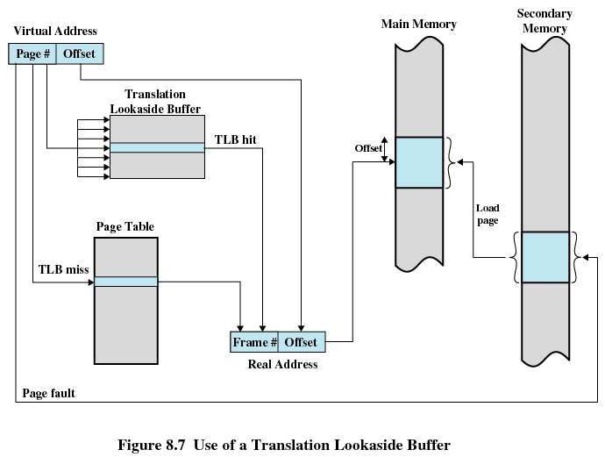
8.1.2.3 Translation Lookaside Buffer(2/7)
Notes:
TLB位于CPU内部，特殊的硬件实现，可以支持并行查找。TLB缺失对X86系统而言由硬件完成，而对于MIPS cpu而言，由OS完成

Slide 47
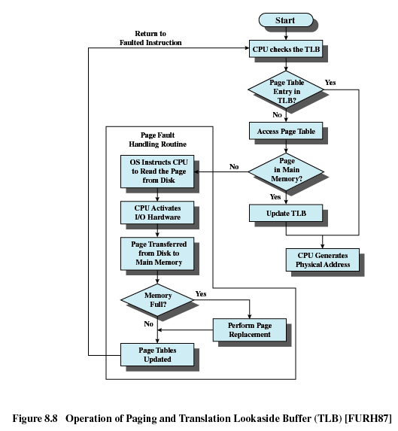
8.1.2.3 Translation Lookaside Buffer(3/7)

Slide 48
8.1.2.3 Translation Lookaside Buffer(4/7)
Work Flow of Translation Lookaside Buffer
Given a virtual address, processor examines the TLB
If page table entry is present (TLB hit), the frame number is retrieved and the real address is formed
If page table entry is not found in the TLB (TLB miss), the page number is used to index the process page table

Slide 49
8.1.2.3 Translation Lookaside Buffer(5/7)
First checks if page is already in main memory
If not in main memory a page fault is issued
The TLB is updated to include the new page entry

Slide 50
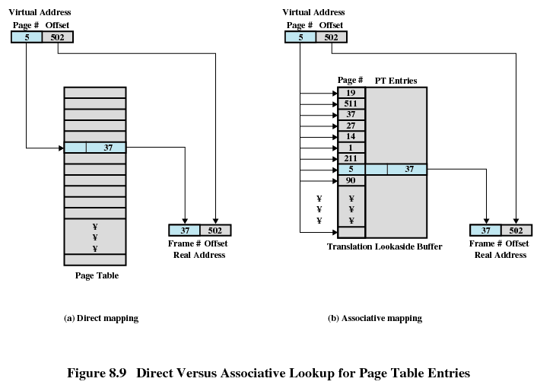
8.1.2.3 Translation Lookaside Buffer(6/7)
直接映射
关联映射

Slide 51
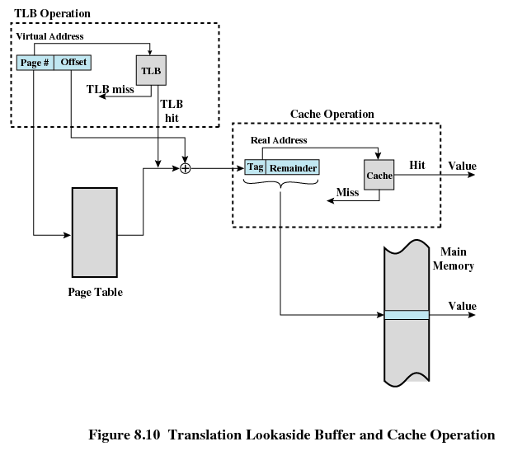
8.1.2.3 Translation Lookaside Buffer(7/7)

Slide 52
8.1.2.4 Page Size(1/4)(页尺寸/页大小)
Smaller page size, less amount of internal fragmentation(页越小，内部碎片越少)
Smaller page size, more pages required per process，larger page tables(页越小，每个进程需要的页越多，进程的页表就越大)
Larger page tables means large portion of page tables in virtual memory (页表越大，占有用虚存越多)
Secondary memory is designed to efficiently transfer large blocks of data so a large page size is better(DMA传递大块效率高)

Slide 53
8.1.2.4 Page Size(2/4)
Small page size, large number of pages will be found in main memory(页越小，进程在内存中的页越多)
As time goes on during execution, the pages in memory will all contain portions of the process near recent references. Page faults low.
Increased page size causes pages to contain locations further from any recent reference. Page faults rise.
However the page fault rate will begin to fall as the size of page approaches a point.
Huge Page 大页模式 ppt page 32

Slide 54
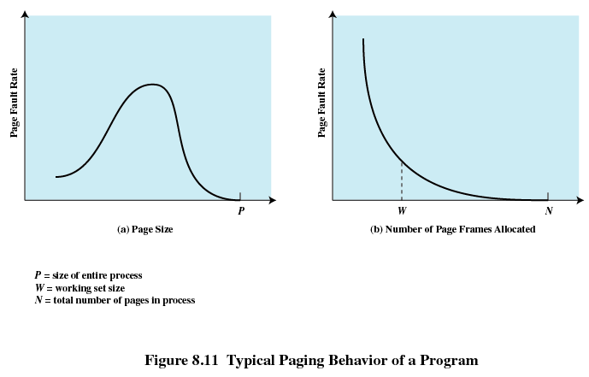
8.1.2.4 Page Size(3/4)

Slide 55
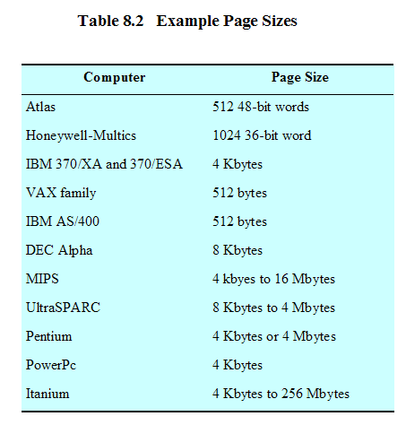
8.1.2.4 Page Size(4/4)

Slide 56
8.1 Hardware and Control Structure
8.1.0 Overview
8.1.1 Locality and Virtual Memory
8.1.2 Paging
8.1.3 Segmentation (分段)
8.1.4 Combined Paging and Segmentation
8.1.5 Protection and Sharing
Notes:
程序有代码段，数据段，堆，栈，每个的权限是不一样的，所以以段方式进行管理有这个优点
段对应可执行文件的模块，比如全局常量区，全局变量，堆，代码，每一个模块的长度不同，权限也不同，如果用分页，那么可能全局变量需要1.5个页，常量需要0.5个页会造成浪费，然后不同的页分配不同权限。如果是段就可以各成一段，权限不同，这样内部碎片少，管理的段表也小了，权限也好控制。

Slide 57
8.1.3 Segmentation(1/4)
May be unequal, dynamic size (大小不等), advantages:
Simplifies handling of growing data structures(简化不断增长的数据结构的处理)
Allows programs to be altered and recompiled independently (允许程序独立的修改和编译)
Lends itself to sharing data among processes (有助于进程间共享)
Lends itself to protection (有利于保护)
Disadvantage?
书上没有讨论从硬盘到内存加载时的单位问题
Notes:
程序有代码段，数据段，堆，栈，每个的权限是不一样的，所以以段方式进行管理有这个优点
段对应可执行文件的模块，比如全局常量区，全局变量，堆，代码，每一个模块的长度不同，权限也不同，如果用分页，那么可能全局变量需要1.5个页，常量需要0.5个页会造成浪费，然后不同的页分配不同权限。如果是段就可以各成一段，权限不同，这样内部碎片少，管理的段表也小了，权限也好控制。

Slide 58
8.1.3 Segmentation(2/4)
Segment Tables(段表)
Corresponding segment in main memory(对应一个内存段)
Each entry contains the length of the segment(段长) and segment base(段基址)
A bit is needed to determine if segment is already in main memory(存在位)
Another bit is needed to determine if the segment has been modified since it was loaded in main memory(修改位)

Slide 59
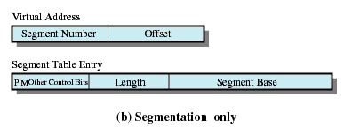
8.1.3 Segmentation(3/4)
Segment Table Entries
段长
段基址

Slide 60
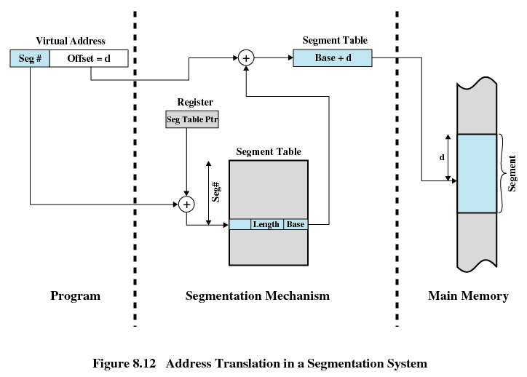
8.1.3 Segmentation(4/4)

Slide 61
8.1 Hardware and Control Structure
8.1.0 Overview
8.1.1 Locality and Virtual Memory
8.1.2 Paging
8.1.3 Segmentation
8.1.4 Combined Paging and Segmentation
8.1.5 Protection and Sharing

Slide 62
8.1.4 Combined Paging and Segmentation(1/3)
Paging is transparent to the programmer
Segmentation is visible to the programmer
Each segment is broken into fixed-size pages
Each Process has a segment table and several segments
Each segment has a page table

Slide 63
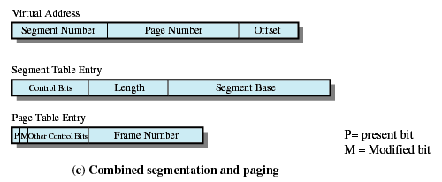
8.1.4 Combined Paging and Segmentation(2/3)
Notes:
段号寻找在段表寄存器指向的段表的第几项段表项是需要访问的。
段表项包含段长度和Segment base 是指向页表的起始位置。控制位表示段的权限。
页表包含存在位和修改位，因为内存的交换单位是页和帧，而非段。

Slide 64
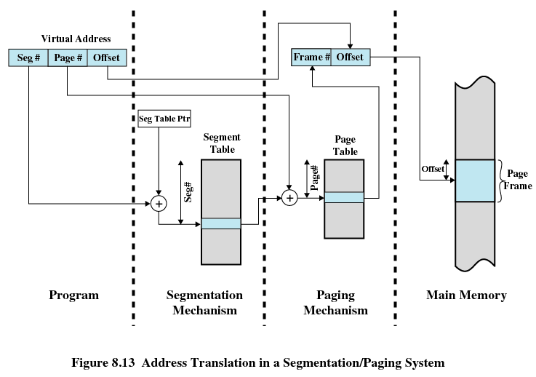
8.1.4 Combined Paging and Segmentation(3/3)

Slide 65
8.1 Hardware and Control Structure
8.1.0 Overview
8.1.1 Locality and Virtual Memory
8.1.2 Paging
8.1.3 Segmentation
8.1.4 Combined Paging and Segmentation
8.1.5 Protection and Sharing

Slide 66
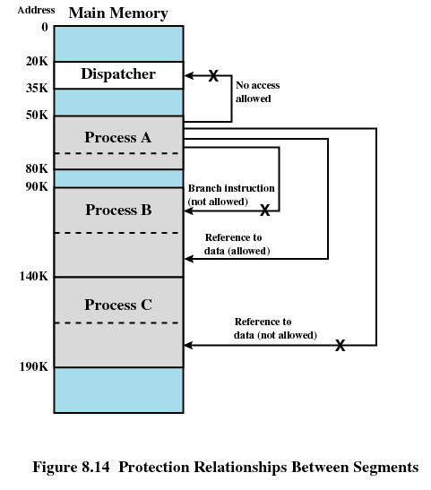
8.1.5 Protection and Sharing(1/2)

Slide 67
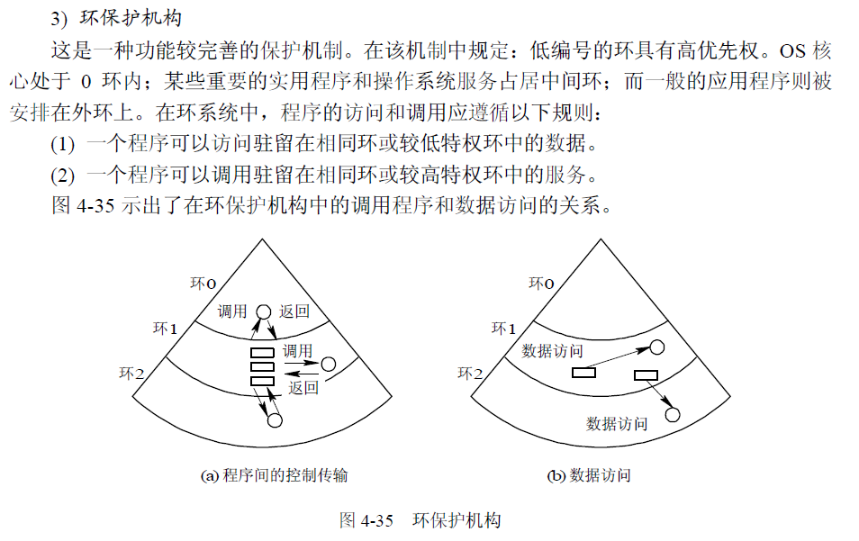
8.1.5 Protection and Sharing (2/2)

Slide 68
Agenda
8.1 Hardware and Control Structure
8.2 Operating System Software
8.3 Summary

Slide 69
8.2 Operating System Software
8.2.1 Fetch Policy： 何时放
8.2.2 Placement Policy：放物理内存哪(NUMA)
8.2.3 Replacement Policy：满了怎么替换
8.2.4 Resident Set Management：推广至全局性
8.2.5 Clearing Policy
8.2.6 Load Control

Slide 70
8.2.1 Fetch Policy(1/1)(读取策略)
Fetch Policy: Determines when a page should be brought into memory
Demand paging(请求分页式) only brings pages into main memory when a reference is made to a location on the page
Many page faults when process first started
Prepaging(预约分页式) brings in more pages than needed
More efficient to bring in pages that reside contiguously on the disk

Slide 71
8.2.2 Placement Policy(1/1)(放置策略)
Placement Policy: Determines where in real memory a process piece is to reside
Important in a nonuniform memory access(NUMA, 非一致存储器访问) system (放置策略对NUMA 处理器影响大)
Not that important in segmentation system
Can use first fit, best fit, etc.
Paging or combined paging with segmentation hardware performs address translation and placement is usually irrelevant(放置策略对分页和段页式系统影响不大)
Notes:
多核

Slide 72
8.2 Operating System Software
8.2.1 Fetch Policy
8.2.2 Placement Policy
8.2.3 Replacement Policy
针对单个进程：重点讨论各种置换方法
8.2.4 Resident Set Management
针对所有进程: 全局置换
如何评估系统性能和各个进程分配的页帧数？
8.2.5 Clearing Policy
8.2.6 Load Control

Slide 73
8.2.3 Replacement Policy(1/16)(置换策略)
Basic Rules of Placement Policy
Frame Locking帧锁定
If frame is locked, it may not be replaced, some examples:
Kernel of the OS
Important Control structures of OS
I/O buffers
Associate a lock bit with each frame

Slide 74
8.2.3 Replacement Policy(2/16)
Basic Rules of Placement Policy
Easy to implement and Efficient 简单高效
Page removed should be the page least likely to be referenced in the near future（最近访问可能性最小的页）
Most policies predict the future behavior on the basis of past behavior（基于过去的行为预测未来的行为）

Slide 75
8.2.3 Replacement Policy(3/16)
1. Optimal policy( OPT, 最佳 )
Selects for replacement that page for which the time to the next reference is the longest(下次访问距当前时间最长的页)
Impossible to have perfect knowledge of future events
主要用于对比评估其它算法
先跑一次得出数据，然后再运行第二次，以此数据和其它算法对比

Slide 76
8.2.3 Replacement Policy(4/16)
2. Least Recently Used (LRU, 最近最少使用)
Replaces the page that has not been referenced for the longest time(上次访问距当前时间最长的页)
By the principle of locality, this should be the page least likely to be referenced in the near future
Each page could be tagged with the time of last reference. This would require a great deal of overhead.
为什么这样说？请分组讨论从如何实现LRU的角度说明
Notes:
基于历史数据

Slide 77
8.2.3 Replacement Policy(5/16)
openEuler
采用LRU策略
5个链表记录不同的页类型
非活跃匿名页LRU链表
活跃匿名页LRU链表
非活跃文件页LRU链表
活跃文件页LRU链表
不可回收LRU链表
OS从非活跃链表尾部开始回收记录
Notes:
没有文件背景的页面，即匿名页（anonymous page），如堆，栈，数据段等，不是以文件形式存在，因此无法和磁盘文件交换，匿名页-swap 可以通过硬盘上划分额外的swap交换分区或使用交换文件进行交换。Swap分区可以将不活跃的页交换到硬盘中，缓解内存紧张。
文件页，即与磁盘文件存在映射关系的内存页(有文件背景的页面)，例如进程代码段、文件的映射页等 ,他们有对应的硬盘文件，因此如果要交换，可以直接和硬盘对应的文件进行交换。内存紧张时，非dirty的文件页可以直接drop掉，需要时从硬盘直接读取
非活跃匿名页LRU链表：最近没有访问的并且可以存放到交换空间的匿名页的记录
活跃匿名页LRU链表：最近访问的匿名页的记录
非活跃文件页LRU链表：最近没有访问的文件页记录：活跃文件页LRU链表：最近访问的文件页记录
不可回收LRU链表：禁止换出的页的记录

Slide 78
8.2.3 Replacement Policy(6/16)
3. First-in, first-out (FIFO, 先进先出)
Treats page frames allocated to a process as a circular buffer(把分配给进程的页帧看做是一个循环缓冲区)
Pages are removed in round-robin(循环) style
Simplest replacement policy to implement
Page that has been in memory the longest is replaced
These pages may be needed again very soon
实现：链表
Belady现象：物理页帧越多，缺页可能增加
Notes:
链表，每访问一次，将节点移至队首或尾，那么以后队尾或首即为最老的节点
如果程序的N+1页呈现局部性，但常驻集只有N，最不利的情况每次LRU换掉的就是即将下一次访问的页。
链表，时间最长的在链表首，每次被替换；

Slide 79
8.2.3 Replacement Policy(7/16)
3. 实现：链表/队列/堆栈？
访问序列：1 3 4 5 2 4？
3
1 | 3 | 4
0
1
1
4
1 | 3 | 4 | 5
2
1 | 3
5
2 | 3 | 4 | 5
Notes:
链表，时间最长的在链表首，每次被替换；
这个循环缓冲方式，如果4被再次访问 指针就不移动

Slide 80
8.2.3 Replacement Policy(8/16)
3. 实现：链表/堆栈
队列
1 3 4 5 2 4
3
 | 1 | 3 | 4
0
1
 |  |  | 1
4
1 | 3 | 4 | 5
2
 |  | 1 | 3
5
3 | 4 | 5 | 2
6
3 | 4 | 5 | 2
Notes:
链表，时间最长的在链表首，每次被替换；

Slide 81
8.2.3 Replacement Policy(9/16)
4. Clock Policy(时钟策略)
Additional bit called a use bit(使用位)is association with every page
When a page is first loaded in memory, the use bit is set to 1
When the page is referenced, the use bit is set to 1
When it is time to replace a page, the first frame encountered with the use bit set to 0 is replaced
During the search for replacement, each use bit set to 1 is changed to 0
Once set use bit to 1 or 0, the pointer move to next position

Slide 82
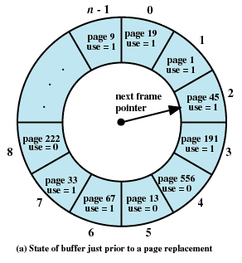
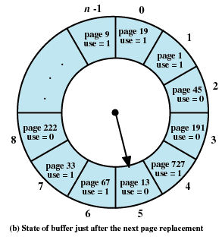
8.2.3 Replacement Policy(10/16)

Slide 83
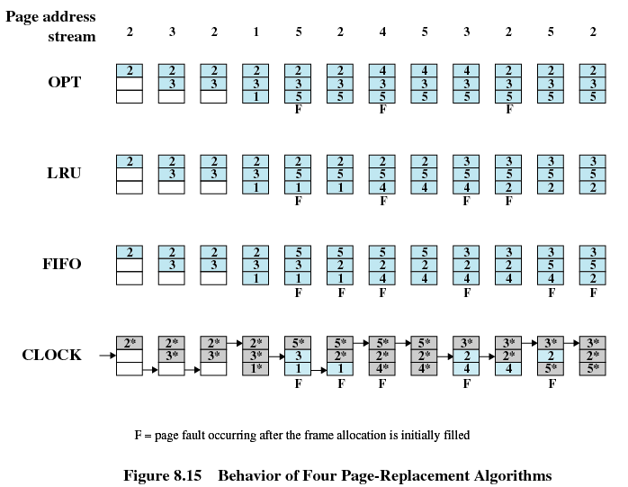
8.2.3 Replacement Policy(11/16)
Notes:
注意：在clock算法中，深灰色表示“访问位”为“1”，浅蓝色表示“访问位”为”0“,只有缺页才会移动指针，命中只修改use位，不动指针
讨论实现各种机制的开销LRU时间戳,FIFO

Slide 84
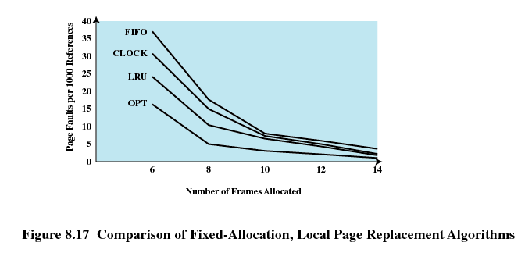
8.2.3 Replacement Policy(12/16)
Notes:
适合的帧数在曲线的拐角处，既保证较少的页帧分配，也保证较少的缺页率

Slide 85
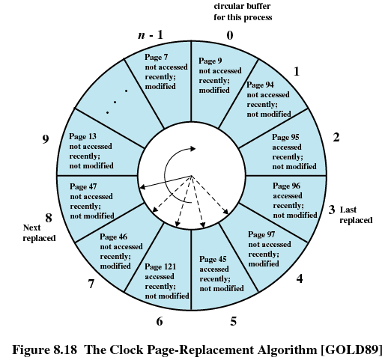
8.2.3 Replacement Policy(13/16)
Clock Policy Using Use Bit and Modified Bit增强二次机会法
Not accessed recently, not modified (u=0;m=0)
(u=1;m=1)
(u=0;m=1)
(u=1;m=0)

Slide 86
8.2.3 Replacement Policy(14/16)
Clock Policy Using Use Bit and Modified Bit增强二次机会法
Scan, if (0,0), replace; if not found jump to 2
Rescan, meet first (0,1), replace; during scan, set all used bit to 0; if not found, jump to 3
Rescan, set all used bit to 0 and repeat 1 and 2
used | modified
0 | 0
0 | 1
1 | 0
1 | 1
used | modified
replaced | replaced
0 | 1
1 | 0
1 | 1
Notes:
Beginning at the current position of the pointer, scan the frame buffer. During this scan, make no changes to the use bit. The first frame encountered with ( u = 0; m = 0) is selected for replacement.
If step 1 fails, scan again, looking for the frame with (u = 0; m = 1).The first such frame encountered is selected for replacement. During this scan, set the use bit to 0 on each frame that is bypassed.
If step 2 fails, the pointer should have returned to its original position and all of the frames in the set will have a use bit of 0. Repeat step 1 and, if necessary, step 2. This time, a frame will be found for the replacement.

Slide 87
Clock Policy Using Use Bit and Modified Bit增强二次机会法
8.2.3 Replacement Policy(15/16)
prev | c | aw | d | bw | e | b | aw | b | c
a | a | a | a | a | a | a | a | a | a
b | b | b | b | b | b | b | b | b | b
c | c | c | c | c | e | e | e | e | e
d | d | d | d | d | d | d | d | d | c
 |  |  |  |  | F |  |  |  | F
a | 01
b | 01
c | 00
d | 00
a | 01
b | 11
e | 10
d | 00
a | 11
b | 11
e | 10
d | 00
a | 11
b | 11
e | 10
c | 10
a | 11
b | 11
c | 10
d | 10
a | 01
b | 01
c | 00
d | 00
a | 01
b | 01
e | 10
d | 00
Notes:
Beginning at the current position of the pointer, scan the frame buffer. During this scan, make no changes to the use bit. The first frame encountered with ( u = 0; m = 0) is selected for replacement.
If step 1 fails, scan again, looking for the frame with (u = 0; m = 1).The first such frame encountered is selected for replacement. During this scan, set the use bit to 0 on each frame that is bypassed.
If step 2 fails, the pointer should have returned to its original position and all of the frames in the set will have a use bit of 0. Repeat step 1 and, if necessary, step 2. This time, a frame will be found for the replacement.

Slide 88
8.2.3 Replacement Policy(16/16)
Page Buffering(页缓冲)
1. 维护有一个空闲帧缓冲池：先回空闲帧缓冲，再选中牺牲者，减少时间开销
2.Replaced page is added to one of two lists
Free page list if page has not been modified (空闲页表) and Modified page list (修改页表)
Modified pages are written out in clusters rather than one at a time
Notes:
见操作系统概念 第七版

Slide 89
8.2 Operating System Software
8.2.1 Fetch Policy
8.2.2 Placement Policy
8.2.3 Replacement Policy
8.2.4 Resident Set Management驻留集管理
8.2.5 Clearing Policy
8.2.6 Load Control

Slide 90
8.2.4 Resident Set Management(1/10)
两者有关系吗？
Working Set工作集
进程P正在访问的页面集合称为它的工作集w(k,t): 在任意时刻t，前k次访问内存的页面的集合。例如 w(5,7)即页面1,2,4,5
Resident Set驻留集
目前进程P驻留在OS分配的N个页帧物理内存中的页,如下时刻7，驻留集2,4,5。
time | 0 | 1 | 2 | 3 | 4 | 5 | 6 | 7 | 8 | 9 | 10 | 11
Page tracks | 2 | 3 | 2 | 1 | 5 | 2 | 4 | 5 | 3 | 2 | 5 | 2
Stack LRU | 2 | 3 | 2 | 1 | 5 | 2 | 4 | 5 | 3 | 2 | 5 | 2
 |  | 2 | 3 | 2 | 1 | 5 | 2 | 4 | 5 | 3 | 2 | 5
 |  |  |  | 3 | 2 | 1 | 5 | 2 | 4 | 5 | 3 | 3
PF |  |  |  |  | F |  | F |  | F | F
Notes:
某个时间片段内，如果工作集和驻留集的大小比较合适，即工作集都包含在驻留集里面，那么缺页率就低，系统效率就高
但随着进程的执行，两者之间的关系不是固定的，而是可变的。
后面的小节讨论的策略就是这对这两者关系衍生的

Slide 91
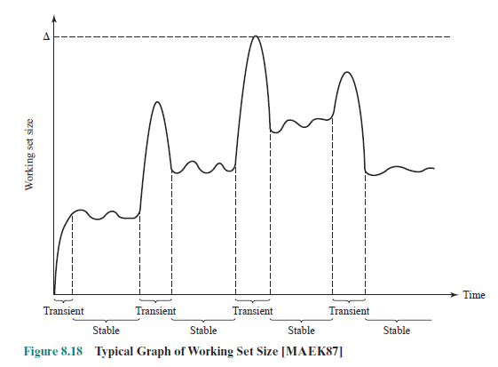
8.2.4 Resident Set Management(2/10)

Slide 92
8.2.4 Resident Set Management(3/10)
Resident Set Size(驻留集大小)
这对单个进程意味着什么？对系统意味着什么？
Fixed-allocation(固定分配)
Gives a process a fixed number of pages within which to execute
When a page fault occurs, one of the pages of that process must be replaced
Variable-allocation(可变分配)
Number of pages allocated to a process varies over the lifetime of the process

Slide 93
8.2.4 Resident Set Management(4/10)
Replace Scope(替换范围)
Local Replace Policy(局部置换)
Chooses only among the resident pages of the process that generated the page fault in selecting a page to replace
Global Replace Policy(全局置换)
Considers all unlocked pages in main memory as candidates for replacement, regardless of which process owns a particular page
One process gets one more page indicates the other may lose one page if no more spare pages in system

Slide 94
8.2.4 Resident Set Management(5/10)
Fixed Allocation, Local Scope(固定分配，局部置换)
Decide ahead of time the amount of allocation to give a process (事先确定给进程分配多少页)
too small, high page fault rate (如果太少，导致高缺页率)
too large，too few programs in main memory (如果分配太多，内存中驻留的程序会过少)

Slide 95
8.2.4 Resident Set Management(6/10)
Variable Allocation, Global Scope(可变分配，全局置换)
Easiest to implement/Adopted by many operating systems
OS keeps list of free frames
Free frame is added to resident set of process when a page fault occurs
If no free frame, replaces one from any of the resident processes
No better policy for selecting a victim process, so page buffering is prefered

Slide 96
8.2.4 Resident Set Management(7/10)
基于工作集的全局置换算法 k=4(前k次)
只要前K次不访问就换出，在K次内访问过的页驻留
time | -3 | -2 | -1 | 0 | 1 | 2 | 3 | 4 | 5 | 6 | 7 | 8 | 9 | 10 | 11
Page tracks | 5 | 1 | 3 | 2 | 3 | 2 | 1 | 5 | 2 | 4 | 5 | 3 | 2 | 3 | 2
page1 |  | ☺ | ☺ | ☺ | ☺ | x | ☺ | ☺ | ☺ | ☺ | ×
page2 |  |  |  | ☺ | ☺ | ☺ | ☺ | ☺ | ☺ | ☺ | ☺ | ☺ | ☺ | ☺ | ☺
page3 |  |  | ☺ | ☺ | ☺ | ☺ | ☺ | ☺ | × |  |  | ☺ | ☺ | ☺ | ☺
page4 |  |  |  |  |  |  |  |  |  | ☺ | ☺ | ☺ | ☺ | ×
page5 | ☺ | ☺ | ☺ | ☺ | × |  |  | ☺ | ☺ | ☺ | ☺ | ☺ | ☺ | ☺ | ×
PF | F | F | F | F |  |  | F | F |  | F |  | F
k变化？动态驻留集
Notes:
本例子中，随着时间t的变化，可见需要的驻留集页数也会发生变化，如何动态评估这种变化呢？ Page fault frequency PFF缺页频率
只有蓝色F对应的PAGEFAULT与驻留集大小相关，如果驻留页是4，那么1和2时刻，page5和page1不会被换出

Slide 97
8.2.4 Resident Set Management(8/10)
Variable Allocation, Local Scope(可变分配，局部置换)
When new process added, allocate number of page frames based on application type, program request, or other criteria
When page fault occurs, select page from among the resident set of the process that suffers the fault
Reevaluate(重新评估) allocation of processes from time to time and increase or decrease allocation to improve overall performance

Slide 98
8.2.4 Resident Set Management(9/10)
Reevaluate: How?
Clue：Page Fault is very low/high that indicates ?
Page fault frequency PFF缺页频率
PFF受以下因素影响：
置换算法
程序局部性
Page size
分配给进程的Frame数量
缺页率的高低如何定义？
缺页发生的间隔等于一个缺页中断服务的时间时，系统响应效率较好，否则会明显感觉程序运行缓慢
避免频繁变化(程序有过渡期和稳定期图8.18)
Notes:
缺页发生的间隔等于一个缺页中断服务的时间时，系统响应效率较好，否则会明显感觉程序运行缓慢

Slide 99
8.2.4 Resident Set Management(10/10)
1. window size = 2
1. 发生PF则添加该页到工作集
2. 评估：如果当前PF距上次PF的两次PF间隔>时间窗口2,则在第二次PF发生时，将两次PF间隔内没有访问的页移出工作集；如果间隔<=2，仅增加当前缺失页到工作集，不移除
2. VSWS on textbook
time | 0 | 1 | 2 | 3 | 4 | 5 | 6 | 7 | 8 | 9 |  | 10 | 11
Page tracks | 2 | 4 | 2 | 1 | 5 | 1 | 2 | 3 | 5 | 3 | 2 | 3 | 2
page1 |  |  |  | ☺ | ☺ | ☺ | ☺ | ☺ | ☺ | ☺ | ☺ | ☺ | ☺
page2 | ☺ | ☺ | ☺ | ☺ | ☺ | ☺ | ☺ | ☺ | ☺ | ☺ | ☺ | ☺ | ☺
page3 |  |  |  |  |  |  |  | ☺ | ☺ | ☺ | ☺ | ☺ | ☺
page4 |  | ☺ | ☺ | ☺ | ☺ | ☺ | ☺ | ×
page5 | ☺ | ☺ | ☺ | ☺ | ☺ | ☺ | ☺ | ☺ | ☺ | ☺ | ☺ | ☺ | ☺
PF | F | F |  | F |  |  |  | F
Notes:
LRU替换
注意扫描或统计频度，否则一样发生不断增加和减少
当前算法中，如果不再出现PF则一直没有缩减驻留集，这个需要进一步考虑
因此VSWS的策略更加完善，书上有详细的流程描述。
0时刻是冷不命中，不在讨论范围内
注意扫描或统计频度，否则一样发生不断增加和减少
当前算法中，如果不再出现PF则一直没有缩减驻留集，这个需要进一步考虑
因此VSWS的策略更加完善，书上有详细的流程描述。

Slide 100
8.2 Operating System Software
8.2.1 Fetch Policy
8.2.2 Placement Policy
8.2.3 Replacement Policy
8.2.4 Resident Set Management
8.2.5 Clearing Policy
8.2.6 Load Control

Slide 101
8.2.5 Cleaning Policy(1/2)(清除策略)
Write back the modified pages
Demand cleaning(请求式清除)
A page is written out only when it has been selected for replacement
Precleaning(预约式清除)
Pages are written out in batches before they are needed

Slide 102
8.2.5 Cleaning Policy(2/2)
Combined two policy with page buffering
Best approach uses page buffering页缓冲
Replaced pages are placed in two lists
Modified and unmodified
Pages in the modified list are periodically written out in batches
Pages in the unmodified list are either
reclaimed if referenced again
or lost when its frame is assigned to another page

Slide 103
8.2 Operating System Software
8.2.1 Fetch Policy
8.2.2 Placement Policy
8.2.3 Replacement Policy
8.2.4 Resident Set Management
8.2.5 Clearing Policy
8.2.6 Load Control

Slide 104
8.2.6 Load Control(1/4)(加载控制)
Determines the number of processes that will be resident in main memory
Too few processes, many occasions when all processes will be blocked and much time will be spent in idle or swapping
Too many processes will lead to thrashing抖动
有什么指标可以用于观察并发度是否过高或过低

Slide 105
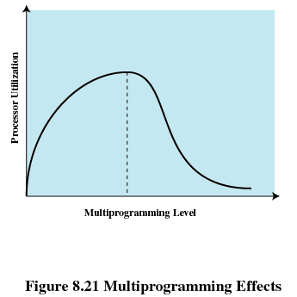
8.2.6 Load Control(2/4)
抖动发生概率高
Notes:
并发度的衡量

Slide 106
8.2.6 Load Control(3/4)
Process Suspension(进程挂起)
Lowest priority process(最低优先级进程)
Faulting process(页错误进程)
This process does not have its working set in main memory so it will be blocked anyway
Last process activated(最后被激活的进程)
This process is least likely to have its working set resident工作集没有全部驻留

Slide 107
8.2.6 Load Control(4/4)
Process with smallest resident set(驻留集最小的进程)
This process requires the least future effort to reload
Largest process(占用空间最大的进程)
Obtains the most free frames
Process with the largest remaining execution window(具有最大剩余执行窗口的进程，进程被放入就绪队列尾前运行时间很短)

Slide 108
Agenda
8.1 Hardware and Control Structure
8.2 Operating System Software
8.3 Summary

