Slide 1
Operating Systems
Chapter 9 Uniprocessor Scheduling

Slide 2
Agenda
9.1 Type of Processor Scheduling
9.2 Scheduling Algorithms
9.3 Summary

Slide 3
9.1 Type of Processor Scheduling
9.1.0 Overview
9.1.1 Long-term Scheduling
9.1.2 Medium-term Scheduling
9.1.3 Short-term Scheduling

Slide 4
9.1 Type of Processor Scheduling(1/10)
Why：Aim of Scheduling(调度目标)
  Assign processes to be executed by the processor(s)(处理器分配)
    Response time (响应时间)
    Throughput (吞吐率)
    Processor efficiency (处理器效率)

Slide 5
9.1 Type of Processor Scheduling(2/10)
When to Scheduling
  Nonpreemptive主动放弃CPU
    The running thread terminates.
    The running thread is blocked.
  Preemptive
    The running thread is running out of time slice.
    Interrupt service is completed.（blocked to ready）
    New thread arrives

Slide 6
9.1 Type of Processor Scheduling(3/10)
How to Scheduling
  Save context in PCB
  Select a ready process
    Criteria/evaluate
  and load ready process’s context (switch)

Slide 7
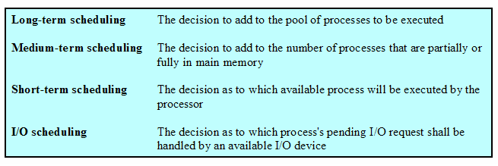
9.1 Type of Processor Scheduling(4/10)
Types of Scheduling

Slide 8
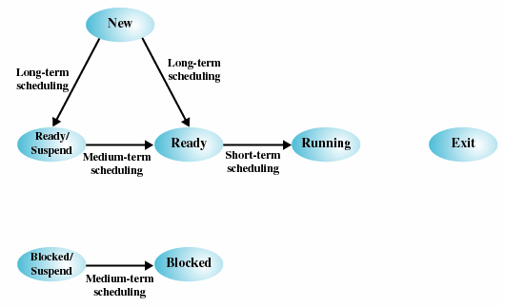
9.1 Type of Processor Scheduling(5/10)
Scheduling and Process State Transitions(调度与进程状态转换)

Slide 9
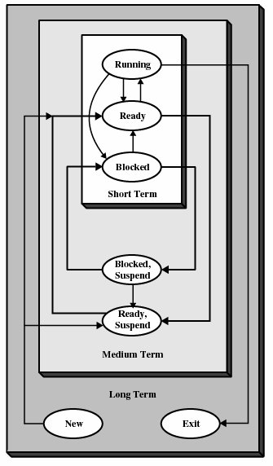
9.1 Type of Processor Scheduling(6/10)
Levels of Scheduling
(调度层次)

Slide 10
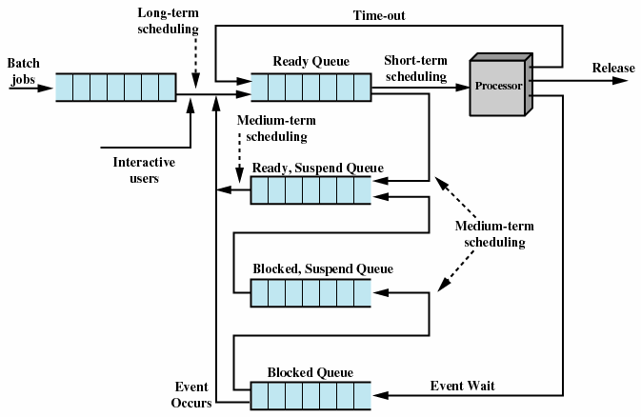
9.1 Type of Processor Scheduling(7/10)
Queuing Diagram for Scheduling调度队列图

Slide 11
9.1 Type of Processor Scheduling(8/10)
Long-Term Scheduling (长程调度)
  Determines which programs are admitted to the system for processing
  Controls the degree of multiprogramming
  More processes, smaller percentage of time each process is executed
  增加新进程
    当一个进程终止
    当CPU空闲率超过某个阈值

Slide 12
9.1 Type of Processor Scheduling(9/10)
Medium-Term Scheduling (中程调度)
  Part of the swapping function交换功能的一部分
  Based on the need to manage the degree of multiprogramming (thrashing 抖动)

Slide 13
9.1 Type of Processor Scheduling(10/10)
Short-Term Scheduling (短程调度)
  Known as the dispatcher(分派器)
  Executes most frequently
  Invoked when an event occurs
    Clock interrupts(时钟中断)
    I/O interrupts(I/O中断)
    Operating system calls(操作系统调用)
    Signals(信号)

Slide 14
Agenda
9.1 Type of Processor Scheduling
9.2 Scheduling Algorithms
9.3 Summary

Slide 15
9.2 Scheduling Algorithms
9.2.1 Short-term Criteria
9.2.2 The Use of Priorities
9.2.3 Alternative of Scheduling Policies
9.2.4 Fair-Share Scheduling

Slide 16
9.2.1 Short-term Criteria(1/4)
Short-Tem Scheduling Criteria(短程调度准则)
  User-oriented(面向用户) &&Performance-related(性能相关)
    Behavior of OS as perceived by the user (用户感知到的系统行为)
      Turnaround time周转时间 This is the interval of time between the submission of a process and its completion.
      Response Time(响应时间):Elapsed time between the submission of a request until there is output.
      Deadlines(终止时间)：maximizing the percentage of deadlines met
Notes:
比如缓冲游戏，预装软件的时间：终止时间

Slide 17
9.2.1 Short-term Criteria(2/4)
Short-Tem Scheduling Criteria(短程调度准则)
  User-oriented(面向用户)&& other
    Qualitative 定性的 and Unmeasurable
      predictability(可预测性)
Notes:
可预测周转时间变化不大

Slide 18
9.2.1 Short-term Criteria(3/4)
Short-Tem Scheduling Criteria(短程调度准则)
  System-oriented(面向系统) &&Performance-related(性能相关)
    Processor utilization：Effective and efficient utilization of the processor(处理器的使用效率)
    Throughput(吞吐量)：单位时间完成进程数
Notes:
对单用户不太重要

Slide 19
9.2.1 Short-term Criteria(4/4)
Short-Tem Scheduling Criteria(短程调度准则)
  System-oriented(面向系统) &&other
    Fairness ：no process starvation
    Enforcing priorities： scheduling policy favor higher-priority processes.
    Balancing resources(also for medium-term and long-term
    )： keep the resources busy. Processes requests underutilize stressed resources should be favored.

Slide 20
9.2 Scheduling Algorithms
9.2.1 Short-term Criteria
9.2.2 The Use of Priorities
9.2.3 Alternative of Scheduling Policies
9.2.4 Fair-Share Scheduling

Slide 21
9.2.2 The Use of Priorities(1/2)
Scheduler will always choose a process of higher priority over one of lower priority
Have multiple ready queues to represent each level of priority
Lower-priority may suffer starvation
  Allow a process to change its priority based on its age or execution history
Notes:
类似垃圾回收中 的年代策略

Slide 22
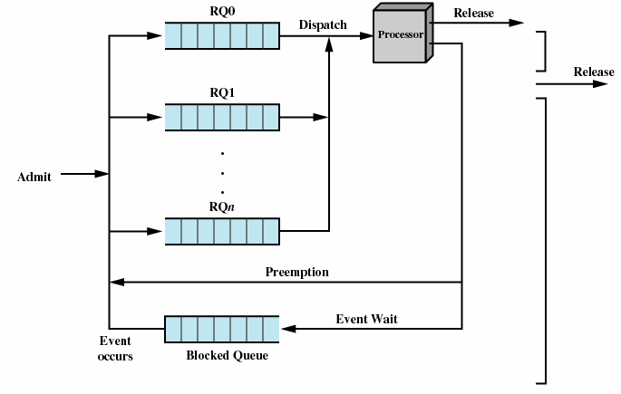
9.2.2 The Use of Priorities(2/2)
Priorities Queuing

Slide 23
9.2 Scheduling Algorithms
9.2.1 Short-term Criteria
9.2.2 The Use of Priorities
9.2.3 Alternative of Scheduling Policies
9.2.4 Fair-Share Scheduling

Slide 24
9.2.3 Alternative of Scheduling Policies
9.2.3.1 Terms 相关术语
9.2.3.2 FCFS先来先服务
9.2.3.3 Round-Robin (RR轮转)
9.2.3.4 Shortest Process Next (SPN最短进程优先)
9.2.3.5 Shortest Remaining Time (SRT最短剩余时间)
9.2.3.6 Highest Response Ratio Next (HRRN最高响应比优先)
9.2.3.7 Feedback (反馈)

Slide 25
9.2.3.1 Terms (1/2)相关术语
Response time(响应时间)
服务时间Ts：进程单独执行需要的时间
Throughput (吞吐量)
Turnaround time(周转时间) Tr或驻留时间
  Tr=完成时间-到达时间
  受并发的其它进程执行时间的影响
Normalized turnaround time(归一化周转时间）=Tr/Ts

Slide 26
9.2.3.1 Terms (2/2)相关术语
Predictability(可预测性)
Selection function(选择函数，确定在就绪进程中选择哪一个进程在下一次执行)
Decision mode(决策模式，选择函数被执行瞬间的处理方式)
    Preemptive (抢占，当前正在执行的进程可能被操作系统中断，并转移到就绪态)
    Nonpreemptive(非抢占，一旦处于运行态就不断执行直到终止或者被阻塞)
      通常在上一个时间片结束时/也可在新进程到达时

Slide 27
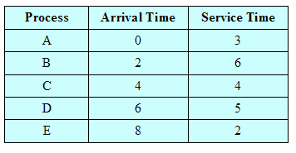
Process Scheduling Example

Slide 28
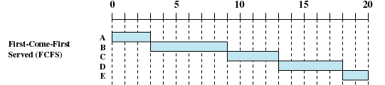
9.2.3.2First-Come-First-Served(1/3) (FCFS先来先服务)
Decision mode: Nonpreemptive非抢占
Dispatch time: the current process ceases to execute结束切换
Method: The oldest process in the Ready queue is selected

Slide 29
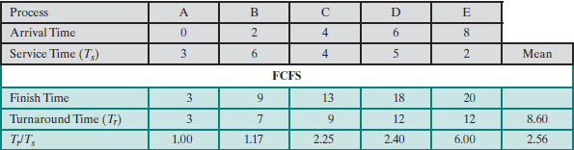
9.2.3.2First-Come-First-Served(2/3) (FCFS先来先服务)
Tr= Finish time – arrival time
前5项的平均值

Slide 30
9.2.3.2First-Come-First-Served(3/3) (FCFS先来先服务)
Disadvantageous to short process
  A short process may have to wait a very long time before it can execute
Favors CPU-bound processes(适合处理器密集型进程)
  I/O processes have to wait until CPU-bound process completes
  combined with a priority scheme to provide an effective scheduler.

Slide 31


9.2.3.3 Round-Robin (1/6)(RR轮转)
RR，q＝1
Decision mode: preemption
Dispatch time: period q based on a clock
Method：select next process based on FCFS
Notes:
0. 队列 A
队列 A
队列： BA
a b
B c
cb
bdc
dcb
cbed //新的加在上一刻执行的任务前
bedc
edcb
dcbe

Slide 32
9.2.3.3 Round-Robin (2/6)(RR轮转)
时刻 | 运行 |  | (头)就绪队列(尾)
0 | A
1 | A
2 | B |  | A
3 | A |  | B
4 | B |  | C
5 | C |  | B
6 | B |  | D | C
7 | D |  | C | B
8 | C |  | B | E | D
9 | B |  | E | D | C
时刻 | 运行 |  | (头)就绪队列(尾)
10 | E |  | D | C | B
11 | D |  | C | B | E
12 | C |  | B | E | D
13 | B |  | E | D | C
14 | E |  | D | C | B
15 | D |  | C | B
16 | C |  | B | D
17 | B |  | D
18 | D
19 | D

Slide 33


9.2.3.3 Round-Robin (3/6)(RR轮转)

Slide 34
9.2.3.3 Round-Robin (4/6)(RR轮转)
Clock interrupt is generated at periodic intervals
When an interrupt occurs, the currently running process is placed in the ready queue
  Next ready job is selected based on FCFS
Known as time slicing (时间片)
  Size?
Disadvantageous to I/O-bound processes .Thus, processor-bound processes receive major portion of CPU time.(better than FCFS)
Notes:
只有2个进程，比如A是I/O型，B是CPU密集型。那么当A被IO阻塞，B会用完一个时间片，随后进入第二个时间片，如果在第二个时间片中途A返回了，那么也需要等B执行完毕。B使用大部分cpu时间。
如果AB均为IO型，那么A在阻塞结束后可能不需要等到第二个时间片结束就会获得CPU，因为b可能在前一次执行中阻塞。故ab的响应都比较好。

Slide 35
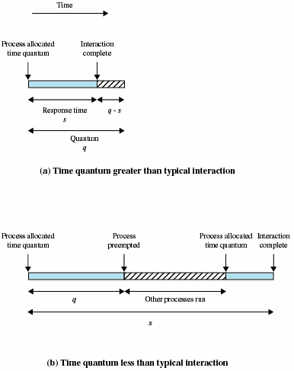
9.2.3.3 Round-Robin (5/6)(RR轮转)
Effect of Size of Preemption Time Quantum (时间片大小的影响)：
略大于一次典型交互时间为好
Notes:
比如点开ppt的替换或者插入图标，如果点击后，没有弹出对话框即线程切换，那么要至少多等一个（最理想情况，2个进程）时间片线程才会切换回来，那么用户响应就比较差。如果对话框弹出后，人在准备操作阶段，CPU执行起来进程，可能用户感觉不到。

Slide 36
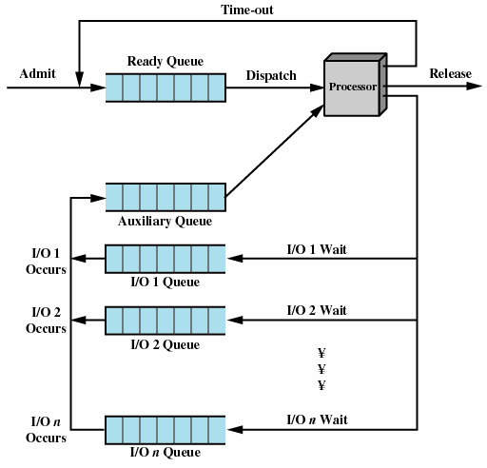
9.2.3.3 Round-Robin (6/6)(RR轮转)
Queuing Diagram for virtual Round-Robin Scheduler (VRR，虚拟轮转法)
优先
Notes:
辅助队列优先于就绪队列被调度执行，但执行时间片长度于就绪队列选中的进程不同

Slide 37

9.2.3.4Shortest Process Next(1/2) (SPN最短进程优先)
Decision mode: Nonpreemptive
Dispatch time: the current process ceases to execute
Method: Process with shortest expected processing time is selected next

Slide 38
9.2.3.4Shortest Process Next(2/2) (SPN最短进程优先)
Predictability of longer processes is reduced(长进程的可预测性降低了)
Possibility of starvation(饥饿) for longer processes

Slide 39

9.2.3.5Shortest Remaining Time(1/1) (SRT最短剩余时间)
Decision mode: Preemptive version of shortest process next
Dispatch time: decision is made when a new process arrives
Method: Process with shortest remaining time is selected next

Slide 40

9.2.3.6Highest Response Ratio Next (1/2)(HRRN最高响应比优先)
Decision mode: Nonpreemptive
Dispatch time: the current process ceases to execute
Method: Choose next process with the greatest response ratio
time spent waiting + expected service time
expected service time
R =

Slide 41
9.2.3.6Highest Response Ratio Next (2/2)(HRRN最高响应比优先)
时刻 | A | B | C | D | E
3 | N | (1+4)/4 | N | N | N
9 | N | N | (9-4+4)/4 | (9-6+5)/5 | (9-8+2)/2
13 | N | N | N | (13-6+5)/5 | (13-8+2)/2

Slide 42
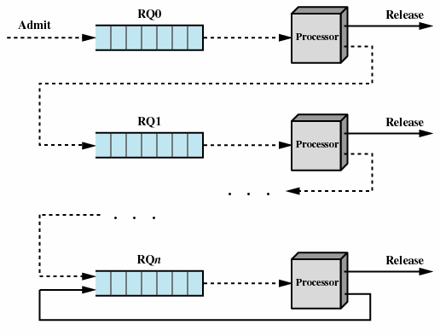
9.2.3.7Feedback(1/4) (反馈)
Feedback doesn’t know process service time while SPN/SRT/HRRN need
Preemptive
Penalize(惩罚) jobs that have been running longer

Slide 43
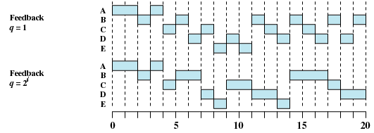
9.2.3.7Feedback(2/4) (反馈)

Slide 44


9.2.3.7Feedback(3/4) (反馈)
0
0
1
0
1
2
3
0
1
2
3
0
1
2
3
0
1
q=1
分配时间片 | 时刻 | 2
1 | RQ0 | B run
1 | RQ1 | A
1 | RQ2
分配时间片 | 时刻 | 3
1 | RQ0
1 | RQ1 | A run | B
1 | RQ2
分配时间片 | 时刻 | 4
1 | RQ0 | Crun
1 | RQ1 | B
1 | RQ2
分配时间片 | 时刻 | 5
1 | RQ0
1 | RQ1 | B run | C
1 | RQ2
分配时间片 | 时刻 | 6
1 | RQ0 | D run
1 | RQ1 | C
1 | RQ2 | B
分配时间片 | 时刻 | 7
1 | RQ0
1 | RQ1 | C run | D
1 | RQ2 | B
分配时间片 | 时刻 | 8
1 | RQ0 | E run
1 | RQ1 | D
1 | RQ2 | B | C
分配时间片 | 时刻 | 10
1 | RQ0
1 | RQ1 | E run
1 | RQ2 | B | C | D
分配时间片 | 时刻 | 9
1 | RQ0
1 | RQ1 | D run | E
1 | RQ2 | B | C
分配时间片 | 时刻 | 11
1 | RQ0
1 | RQ1
1 | RQ2 | Brun | C | D

Slide 45

9.2.3.7Feedback(4/4) (反馈)
q=2^{i}
0
0
1
0
1
2
0
1
2
0
1
2
抢占
0
1
q=2⁰
q=2¹
2
q=2²

Slide 46
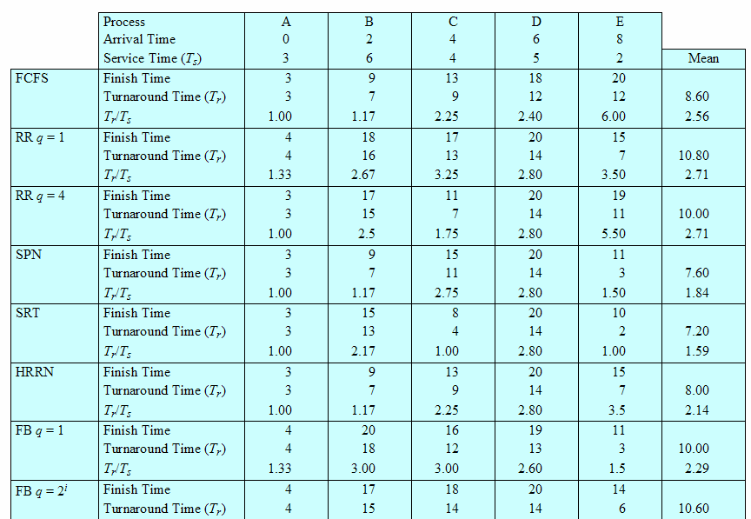
9.2.3.8 comparision (1/2)
A Comparison of Scheduling policies
Notes:
FCFS更适合长进程
3种性能好的方法都需要知道程序服务时间

Slide 47
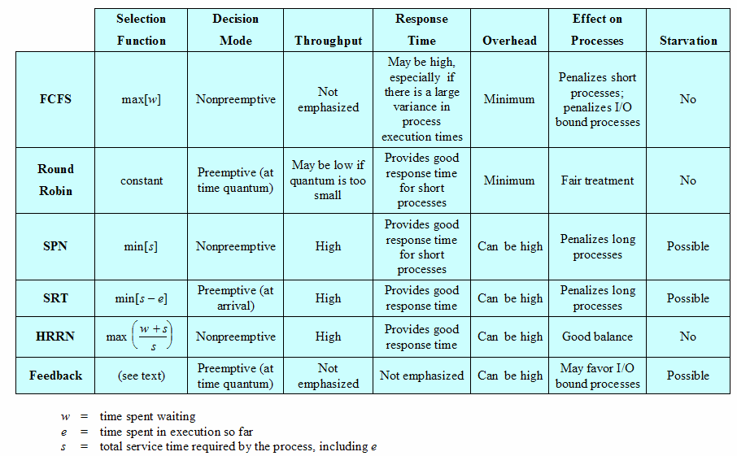
9.2.3.8 comparision (2/2)
Characteristics of Various Scheduling Policies

Slide 48

拓展：OpenEuler 多处理器调度(1/3)
openEuler调度策略
  基于优先级0~99
    为每个优先级维护一个进程链表，从最高优先级选择一个进程占用CPU
    用位图表示某个优先级是否有进程排队
  要求每个进程都有一个调度策略
    若选中的进程使用FIFO，则该进程一直占用CPU，直到结束/被高优先级抢占/自己阻塞
    若选中的进程使用RR，则该进程直到时间片用完/提前结束/自己阻塞

Slide 49
拓展：OpenEuler 多处理器调度(2/3)
openEuler调度策略
  核心基础调度策略：标准轮流分时调度策略，其采用的是CFS(Completely Fair Scheduler，完全公平调度)
  为满足不同应用场景，对多种类别基础调度（限期，实时和普通）实现多种调度策略。每种进程对应不同策略。
    限期：限期调度策略，选截至实践距当前时间点最近的进程
    实时：FIFO和RR
    普通：标准轮流分时，CFS(根据优先级分配不同时间片，一个调度时延内所有进程都有机会被调度一次）
    其它：停机(0号线程)，空闲进程
Notes:
调度时延：某线程第一次获得CPU时间到下一次获得CPU时间的时间间隔

Slide 50
拓展：OpenEuler 多处理器调度(3/3)
openEuler调度策略
  每个处理器都有一个调度队列
//源代码：kernal/sched/sched.h
struct rq{
unsigned int nr_running;//进程总数
struct cfs_rq cfs;//CFS
struct rt_rq rt;//real time
struct dl_rq dl;//dead line
struct task_struct *idle;
struct task_struct *stop;
int cpu;
};

Slide 51
9.2 Scheduling Algorithms
9.2.1 Short-term Criteria
9.2.2 The Use of Priorities
9.2.3 Alternative of Scheduling Policies
9.2.4 Fair-Share Scheduling

Slide 52
9.2.4 Fair-Share Scheduling(1/3)(公平共享调度)
User’s application runs as a collection of processes (threads)
User is concerned about the performance of the application
Need to make scheduling decisions based on process sets

Slide 53
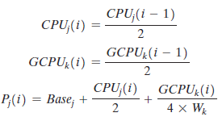
9.2.4 Fair-Share Scheduling(2/3)(公平共享调度)
Scheduling is done on the basis of
  under-lying priority of the process进程基本优先级
  recent processor usage of the process进程使用cpu
  recent processor usage of the group用户组使用cpu
The higher the numerical value of the priority, the lower the priority. The following formulas apply for process j in group k:

Slide 54
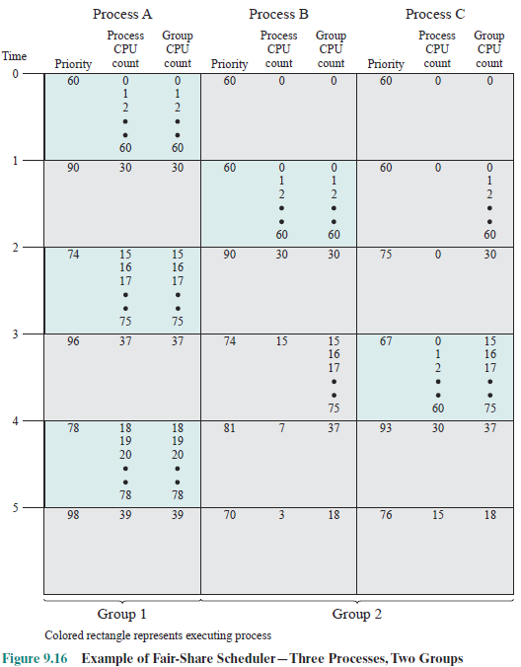
Example of Fair share Scheduler
90←60+30/2+30/2
90←60+30/2+30/2
90←60+0+30/2
96←60+37/2+37/2

Slide 55
Agenda
9.1 Type of Processor Scheduling
9.2 Scheduling Algorithms
9.3 Summary

Slide 56
An interesting problem
到目前为止我们讨论了各种调度方案，但有一个小问题我们没有分析，如果低优先级的进程占用了某个高优先级需要的资源，会怎么样？优先级A>B>C,
time
A |  |  |  |  | Blocked: Waiting for resource R |  |  | R
 |  |  |  |  |  |  |  | L
B
C |  |  | R |  | R |  | R
 |  |  | L |  | L |  | L | UL
preempted
preempted
如何设计一个调度策略解决这个问题？
Notes:
UL: unlock
L: lock
A何时运行取决于C释放资源，而C何时释放取决于高优先级的B何时结束，因此可以说优先级最高的A何时运行完成取决于低优先级的B
解决方案：1. 优先级继承：由于C需要的资源和A同，则让C优先级提升至A的优先级:
2. 优先级天花板：对所有资源进行统计，让资源的优先级等于会LOCK该资源的所有任务中最高的优先级
除非优先级高于系统中所有被锁定的资源的优先级的上限，否则任务尝试执行临界区的时候会被阻塞
持有最高优先级上限的信号量锁的任务，会继承被改锁所阻塞的任务的优先级 （上图例子中c会优先于b执行，尽快释放R）
这里还有一个八卦，1997年的美国的火星探测器（使用的就是vxworks)就遇到一个优先级反转问题引起的故障。简单说下，火星探测器有一个信息总线，有一个高优先级的总线任务负责总线数据的存取，访问总线都需要通过一个互斥锁（共享资源出现了）；还有一个低优先级的，运行不是很频繁的气象搜集任务，它需要对总线写数据，也就同样需要访问互斥锁；最后还有一个中优先级的通信任务，它的运行时间比较长。平常这个系统运行毫无问题，但是有一天，在气象任务获得互斥锁往总线写数据的时候，一个中断发生导致通信任务被调度就绪，通信任务抢占了低优先级的气象任务，而无巧不成书的是，此时高优先级的总线任务正在等待气象任务写完数据归还互斥锁，但是由于通信任务抢占了CPU并且运行时间比较长，导致气象任务得不到CPU时间也无法释放互斥锁，本来是高优先级的总线任务也无法执行，总线任务无法及时执行的后果被探路者认为是一个严重错误，最后就是整个系统被重启。Vxworks允许优先级继承，然而遗憾的工程师们将这个选项关闭了。

