Slide 1
Operating Systems
Chapter 11 I/O Management and Disk Scheduling

Slide 2
Agenda
11.1 I/O Devices
11.2 Organization of the I/O Function
11.3 Operating System Design Issues
11.4 I/O Buffering
11.5 Disk Scheduling
11.6 RAID
11.7 Disk Cache
11.8 Summary

Slide 3
11.1 I/O Devices(1/4)
Roughly grouped into three categories:I/O设备分类
  1. Human readable(人可读):字符流
    Used to communicate with the user
    Printers、Display、Keyboard、Mouse
  2. Machine readable(机器可读)：字符流和块数据
    Used to communicate with electronic equipment
    Disk and tape drives、Sensors、Controllers
  3. Communication(通信)：报文
    Used to communicate with remote devices
    Digital line drivers、Modems、Network device
将导致哪些差异

Slide 4
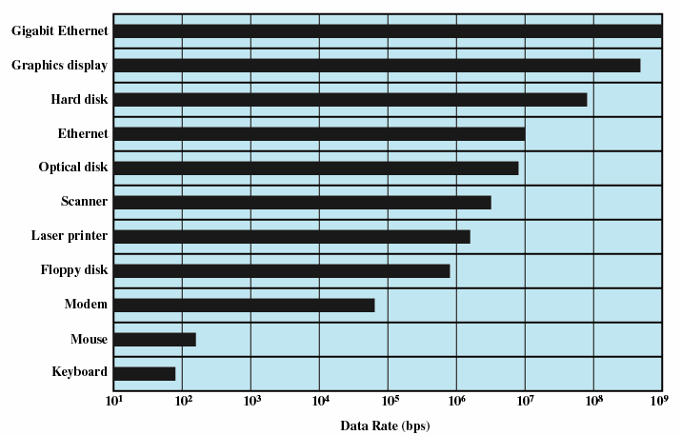
11.1 I/O Devices(2/4)
Differences in I/O Devices
1. Data rate 传输速率
  May be differences of several orders of magnitude(数量级) between the data transfer rates
  如何减少对系统整体性能的影响？
  北桥：快速
  南桥：慢速
Notes:
1.南桥芯片负责I/O总线之间的通信，如PCI总线、USB、LAN、ATA、SATA、音频控制器、键盘控制器、实时时钟控制器、高级电源管理等。
所2、北桥芯片的作用
北桥芯片负责与CPU与内存，并控制AGP数据、PCI数据在北桥内部传输
北桥在电脑中起着主导的作用，所以人们习惯的称为主桥。主板芯片组中北桥芯片的数量要远远多于南桥芯片

Slide 5
11.1 I/O Devices(3/4)
Differences in I/O Devices cont
2. Application：
  Disk used to store files requires file management software
  Disk used to store virtual memory pages needs special hardware and software to support it
  Terminal used by system administrator may have a higher priority
  不同需求，管理的差异性

Slide 6
11.1 I/O Devices(4/4)
Differences in I/O Devices cont
3. Complexity of control
4. Unit of transfer
  Data may be transferred as stream of bytes/blocks/network message
5. Data representation
  Encoding schemes
6. Error conditions
  Devices respond to errors differently
无法以统一标准解决所有I/O控制访问
Notes:
网络数据包错误，电源错误

Slide 7
Agenda
11.1 I/O Devices
11.2 Organization of the I/O Function
11.3 Operating System Design Issues
11.4 I/O Buffering
11.5 Disk Scheduling
11.6 RAID
11.7 Disk Cache
11.8 Summary

Slide 8
11.2 Organization of the I/O Function(1/8)
synchronous/asynchronous communication同步/异步通信
  同步：
    Wait：发出读写请求，然后阻塞，等待服务完成中断后，继续执行
    Not Wait：直接读或者写
  异步：
    利用缓冲区
    发出读写请求，及设置缓冲区地址
    进程返回继续执行不阻塞
    等待服务完成中断通知CPU

Slide 9
11.2 Organization of the I/O Function(2/8)
用户态
I/O请求处理过程
设备驱动
中断处理
硬件控制数据传输
内核态

Slide 10
three techniques for performing I/O:
  Programmed I/O: The processor issues an I/O command, on behalf of a process, to an I/O module; that process then busy waits for the operation to be completed before proceeding.
  Interrupt-driven I/O: the process is nonblocking or blocking
  Direct memory access (DMA):

Slide 11
11.2 Organization of the I/O Function(3/8)
Evolution of the I/O Function (I/O功能的发展)
Processor directly controls a peripheral device
  Processor has to handle details of external devices
Controller or I/O module is added
  Processor uses programmed I/O without interrupts
  Processor does not need to handle details of external devices

Slide 12
11.2 Organization of the I/O Function(4/8)
Controller or I/O module with interrupts
  Processor does not spend time waiting for an I/O operation to be performed
Direct Memory Access
  Blocks of data are moved into memory without involving the processor
  Processor involved at beginning and end only

Slide 13
11.2 Organization of the I/O Function(5/8)
I/O module (I/O channel) is enhanced to a separate processor
  The central processing unit (CPU) directs the I/O processor to execute an I/O program in main memory.
  The I/O processor fetches and executes these instructions without processor intervention.
I/O processor(module+memory->’computer’)
  I/O module has its own local memory
  It’s a computer in its own right
Notes:
GPU

Slide 14
11.2 Organization of the I/O Function(6/8)
Direct Memory Access(直接存储器访问)
  Processor delegates(委派) I/O operation to the DMA module
  DMA module transfers data directly to or from memory
  When complete DMA module sends an interrupt signal to the processor

Slide 15
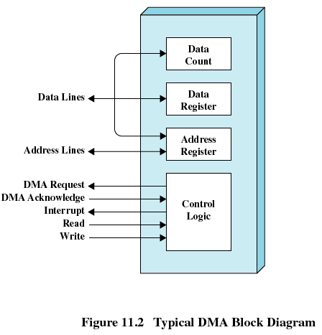
11.2 Organization of the I/O Function(7/8)
Direct Memory Access(直接存储器访问)

Slide 16
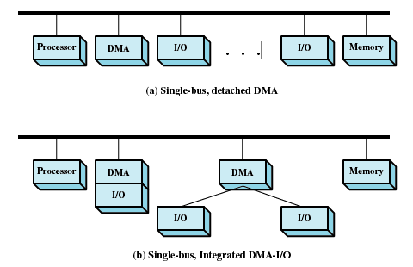
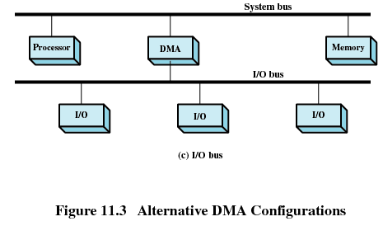
DMA Configurations：不断改进对访问效率的提升，总线剥离-→独立总线
11.2 Organization of the I/O Function(8/8)
Notes:
目前有DMA芯片支持I/O到I/O
南桥芯片链接IO总线（袁春风 计算机体系结构chapter8 原书page313）
北桥本质上是一个DMA

Slide 17
Agenda
11.1 I/O Devices
11.2 Organization of the I/O Function
11.3 Operating System Design Issues操作系统设计问题
11.4 I/O Buffering
11.5 Disk Scheduling
11.6 RAID
11.7 Disk Cache
11.8 Summary

Slide 18
11.3 Operating System Design Issues(1/4)
Two most important objectives
  1. Efficiency (效率)
    Most I/O devices extremely slow compared to main memory，I/O cannot keep up with processor speed
    Use of multiprogramming(多道程序) allows for some processes to be waiting on I/O while another process executes
    Swapping(交换) is used to bring in additional Ready processes which is an I/O operation更多就绪队列换入意味着更多disk读写
Notes:
速率不同的解决

Slide 19
11.3 Operating System Design Issues(2/4)
2. Generality (通用性)
  Desirable to handle all I/O devices in a uniform manner(统一模式)
  Hide most of the details of device I/O in lower-level routines so that processes and upper levels see devices in general terms such as read, write, open, close, lock, unlock

Slide 20
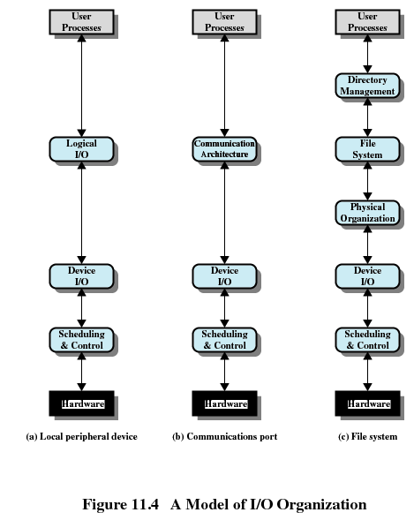
11.3 Operating System Design Issues(3/4)

Slide 21
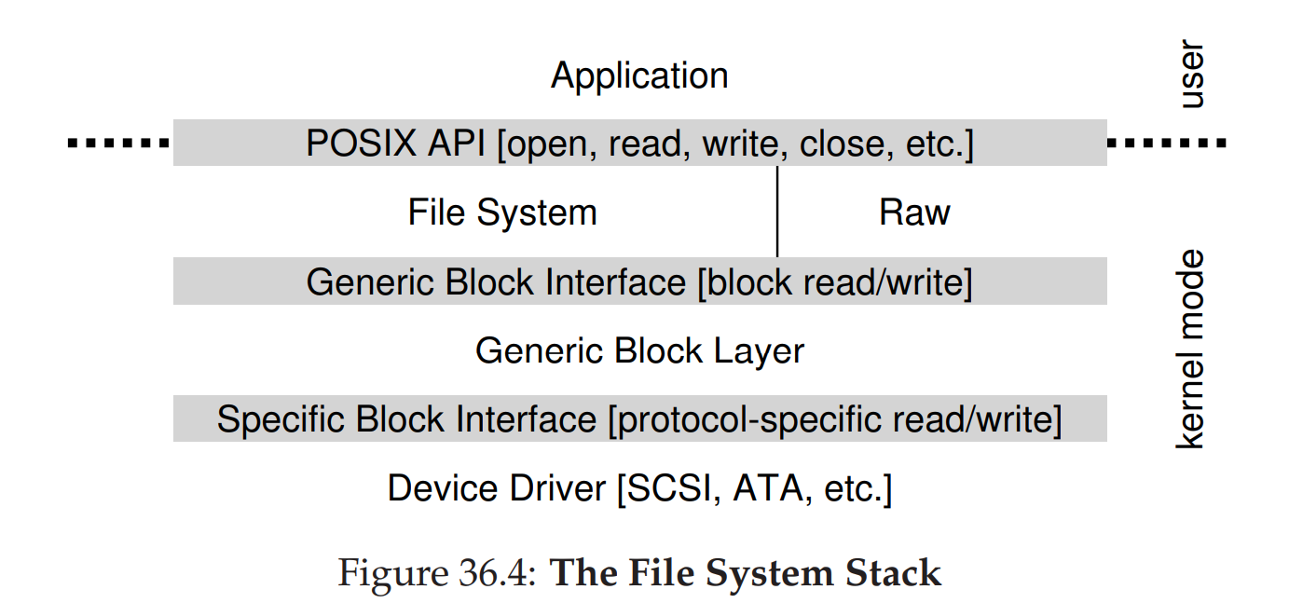
11.3 Operating System Design Issues(4/4)
Notes:
3 easy pieces chapter36 page308

Slide 22
Agenda
11.1 I/O Devices
11.2 Organization of the I/O Function
11.3 Operating System Design Issues
11.4 I/O Buffering I/O缓冲
11.5 Disk Scheduling
11.6 RAID
11.7 Disk Cache
11.8 Summary
Notes:
解决不同传输速率的效率问题

Slide 23
11.4 I/O Buffering(1/8)
Reasons for buffering(缓存原因)
  Processes进程 must wait for I/O to complete before proceeding
  Certain pages must remain in main memory during I/O
    block<-->suspend / deadlock
Define of I/O buffering
  Performs input transfers in advance of requests being made and performs output transfers some time after the request is made(预输入，缓输出) ： like cache
  In memory
Notes:
播放视频，向打印机输出

Slide 24
11.4 I/O Buffering(2/8)
Block-oriented(面向块)
  Information is stored in fixed sized blocks
  Transfers are made a block at a time
    Used for disks and tapes
Stream-oriented(面向流)
  Transfers information as a stream of bytes
    Used for terminals, printers, communication ports, mouse and other pointing devices, and most other devices that are not secondary storage

Slide 25
11.4 I/O Buffering(3/8)
Single Buffer(单缓冲)
  Operating system assigns one buffer in the system space for an I/O request
    Block-oriented single buffering
      Input transfers are made to buffer
      Block is moved to user space when needed
      Another block is requested immediately
        Read ahead(预读), or anticipated input(预输入)

Slide 26
11.4 I/O Buffering(4/8)
Single Buffer(单缓冲)
  Advantages of block-oriented single buffer
    User process can process one block of data while next block is read in
    Swapping can occur since input is taking place in system memory, not user memory缓冲期间允许把进程换出
  Disadvantages of block-oriented single buffer
    Operating system keeps track of assignment of system buffers to user processes 追踪进程对应缓冲区
    The swapping logic is affected 如果在同一磁盘

Slide 27
11.4 I/O Buffering(5/8)
Stream-oriented single buffer
  Line-at-a-time fashion行缓冲
    Input from or output to a terminal is one line at a time with carriage return signaling the end of the line
  Byte-at-a-time fashion 字节缓冲
    Input and Output follow the producer/consumer model

Slide 28
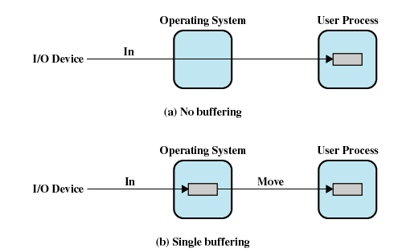
11.4 I/O Buffering(6/8)
Single Buffer(单缓冲)
处理时间：T+C
T：传输时间：外设传入
C：计算时间
M：移动时间
处理时间：max[T, C]+M
Notes:
MOVE时间无法节约，MOVE时，buffer无法缓冲

Slide 29
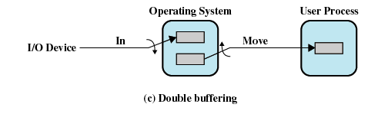
11.4 I/O Buffering(7/8)
Double Buffer(双缓冲)
  Use two system buffers instead of one
  A process can transfer data to or from one buffer while the operating system empties or fills the other buffer
  not typical producer consumer problem,as single buffer
处理时间：max[T, C] 如果C<T,则效果更明显。
Notes:
max[T, C+M] ???

Slide 30
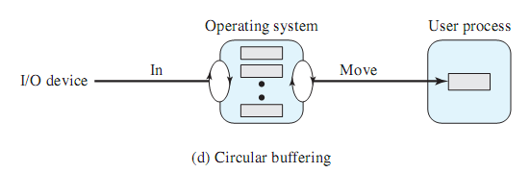
11.4 I/O Buffering(8/8)
Circular Buffer(循环缓冲)
  More than two buffers are used
  Each individual buffer is one unit in a circular buffer
  Used when I/O operation must keep up with process
  Bounded producer consumer problem

Slide 31
Agenda
11.1 I/O Devices
11.2 Organization of the I/O Function
11.3 Operating System Design Issues
11.4 I/O Buffering
11.5 Disk Scheduling
  11.5.1Disk Performance Parameters
  11.5.2Disk Scheduling Policies
11.6 RAID
11.7 Disk Cache
11.8 Summary

Slide 32
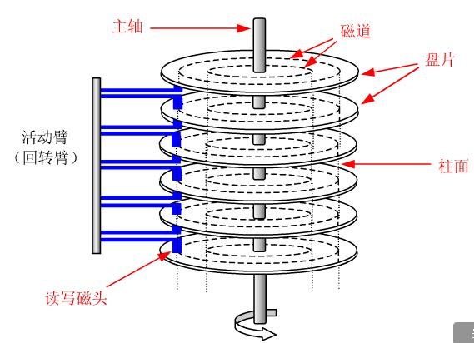
11.5.1Disk Performance Parameters(1/6)
To read or write, the disk head must be positioned at the desired track(磁道) and at the beginning of the desired sector(扇区)
spindle
track
platter
cylinder k
surface 0
surface 1

Slide 33
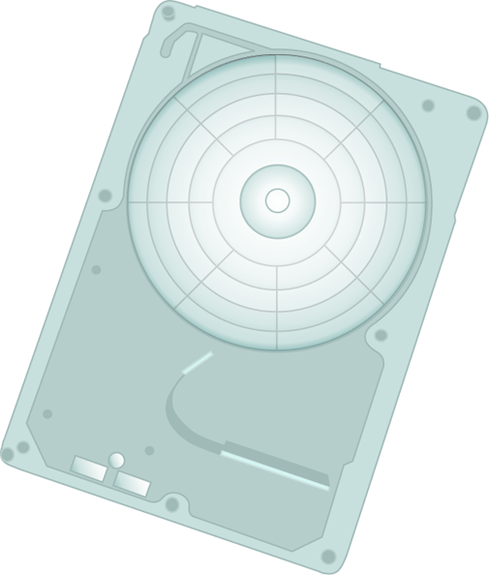


11.5.1Disk Performance Parameters(2/6)
Seek time (寻道时间)
  Time it takes to position the head(磁头) at the desired track
Notes:
Seek times describes the time it takes to position the read/write heads radially across the platter. The following specifications are often published:
Full Stroke - the time it takes to move across the entire width of the disk, from the innermost track to the outermost.
Average – the average time it takes to move from one random track to another (normally listed as the time for one-third of a full stroke).
Track-to-Track – the time it takes to move between adjacent tracks.
Each of these specifications is measured in milliseconds (ms).

Slide 34
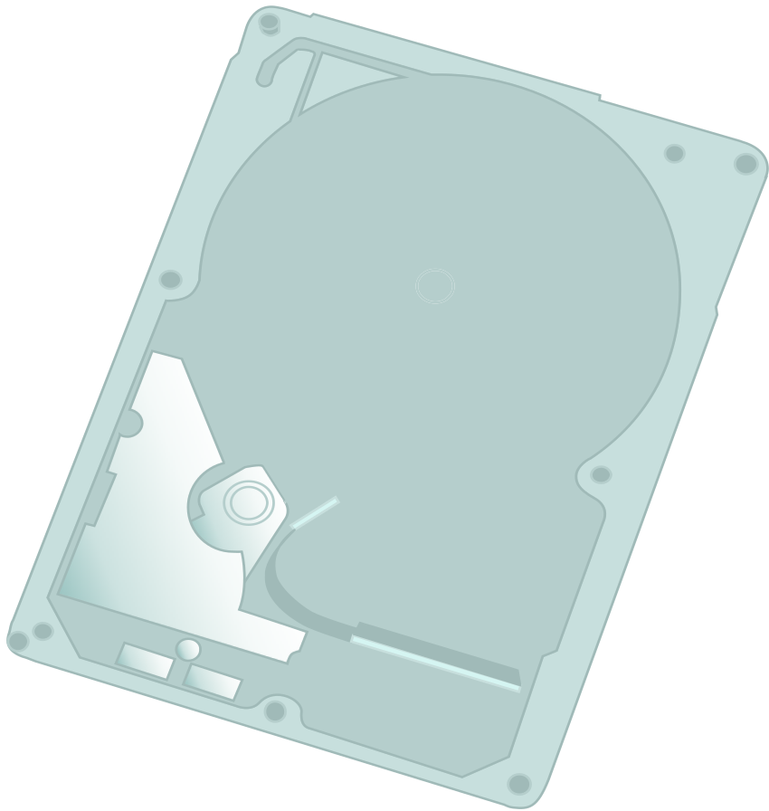
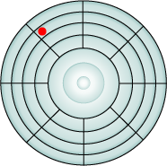

11.5.1Disk Performance Parameters(3/6)
Rotational delay (旋转延迟)
  Time its takes for the beginning of the sector to reach the head
Notes:
The actuator moves the read/write head over the platter to a particular track, while the platter spins to position the a particular sector under the read write head.
Rotational latency is the time that it takes the platter to rotate and position the data under the read/write head.
Rotational latency is dependent upon the rotation speed of the spindle and is measured in milliseconds (ms)
The average rotational latency is one-half of the time taken for a full rotation.
Like seek times, rotational latency has more of an impact on reads or writes of random sectors on the disk than on the same operations on adjacent sectors.
Instructor note: rotational latency is around 5.5 ms for a 5,400 rpm drive, and around 2.0 ms for a 15,000 rpm drive.

Slide 35
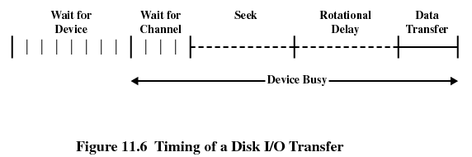
11.5.1Disk Performance Parameters(4/6)

Slide 36

11.5.1Disk Performance Parameters(5/6)
Access time(存取时间)
  The time it takes to get in position to read or write
  Sum of seek time (T_{s}) and rotational delay (1/2r)
Transfer time(传输时间, b/(rN) )
  Data transfer occurs as the sector moves under the head
  1/r: 一转的时间 b/N 多少转
Thus the total average access time can be expressed as:
Ta：总平均存取时间
Ts：平均寻道时间
r：旋转速度，转/秒
b：要传送字节数
N：一个磁道的字节数

Slide 37
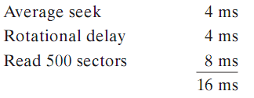
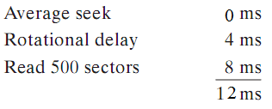
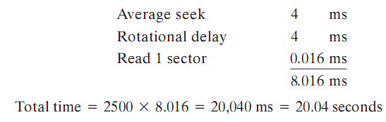
11.5.1Disk Performance Parameters(6/6)
Sequential access: 5 adjacent tracks, 500 sectors/track, total 2500 sectors，Ts 4ms， 1/r ：8ms
First track: Next 4 tracks:
Random access: 2500 sectors
存放方式
影响速度
Notes:
8ms/500=0.016ms
尽可能紧凑的存放在相邻扇区，但不一定连续扇区和磁道，所以有旋转延迟

Slide 38
Agenda
11.1 I/O Devices
11.2 Organization of the I/O Function
11.3 Operating System Design Issues
11.4 I/O Buffering
11.5 Disk Scheduling
  11.5.1Disk Performance Parameters
  11.5.2Disk Scheduling Policies
11.6 RAID
11.7 Disk Cache
11.8 Summary

Slide 39
11.5.2Disk Scheduling Policies(1/9)(磁盘调度策略)
Seek time and rotational delay are the reasons for differences in performance
  The key to increase performance of disk is to minimize seek time减少寻道时间
Random scheduling
  For a single disk there will be a number of I/O requests
  random scheduling 随机调度 yields poor performance
    used to evaluate other techniques

Slide 40
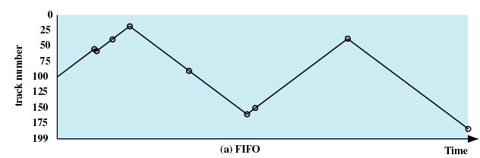
11.5.2Disk Scheduling Policies(2/9)
First-in, first-out (FIFO)
  Process request sequentially
  Fair to all processes
  Approaches random scheduling in performance if there are many processes
Intial position 100
55、58、39、18、90、160、150、38、184
Notes:
请求多的情况下和随机调度性能差不多

Slide 41
11.5.2Disk Scheduling Policies(3/9)
Priority(优先级)
  Goal is not to optimize disk use but to meet other objectives
  Short batch jobs may have higher priority
  Provide good interactive response time

Slide 42
11.5.2Disk Scheduling Policies(4/9)
Last-in, first-out (LIFO)
  Good for transaction事物处理 processing systems
    The device is given to the most recent user so there should be little arm movement
  Possibility of starvation since a job may never regain the head of the line
Notes:
事务处理，访问文件的顺序导致可能新任务就在上一个任务附近（假设存储连续，比如移动一个文件夹）

Slide 43
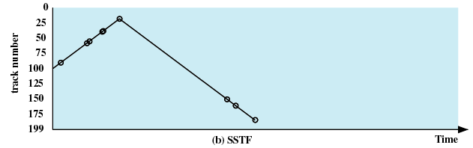
11.5.2Disk Scheduling Policies(5/9)
Shortest Service Time First (SSTF)
  Select the disk I/O request that requires the least movement of the disk arm from its current position
  Always choose the minimum Seek time
55、58、39、18、90、160、150、38、184
Notes:
不断有近任务会导致饥饿和黏性

Slide 44
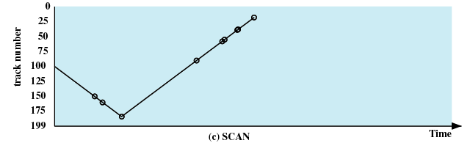
11.5.2Disk Scheduling Policies(6/9)
SCAN 又名电梯算法
  Arm moves in one direction only, satisfying all outstanding requests until it reaches the last track in that direction
  Direction is reversed单调增/减直至到头原路折返
55、58、39、18、90、160、150、38、184
Notes:
两端的服务间隔时间较长

Slide 45
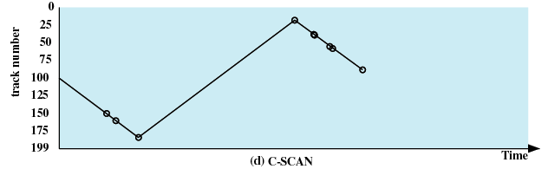
11.5.2Disk Scheduling Policies(7/9)
C-SCAN (circular SCAN)
  Restricts scanning to one direction only仅单增
  When the last track has been visited in one direction, the arm is returned to the opposite end of the disk and the scan begins again
55、58、39、18、90、160、150、38、184
Notes:
如果新任务不断出现在附近，没有时间限制

Slide 46
11.5.2Disk Scheduling Policies(8/9)
N-step-SCAN
  Segments the disk request queue into subqueues of length N 按时间分段
  Subqueues are processed one at a time, using SCAN
  New requests added to other queue when queue is processed
FSCAN
  Two queues
  One queue is empty for new requests

Slide 47
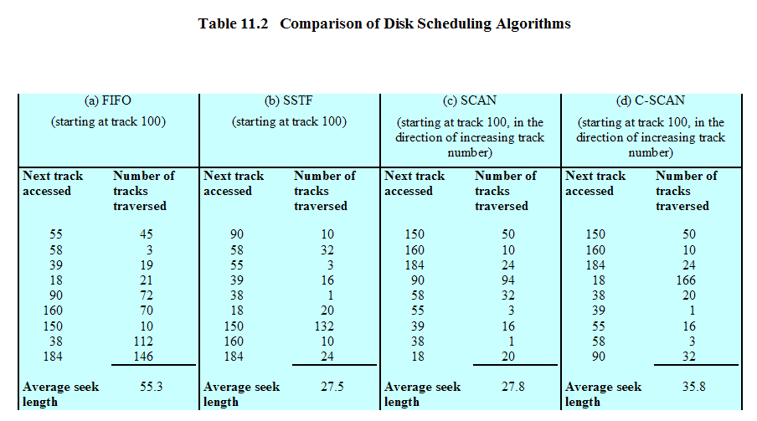
11.5 Disk Scheduling Algorithms(9/9)

Slide 48
Agenda
11.1 I/O Devices
11.2 Organization of the I/O Function
11.3 Operating System Design Issues
11.4 I/O Buffering
11.5 Disk Scheduling
11.6 RAID
11.7 Disk Cache
11.8 Summary

Slide 49
11.6 RAID(1/6)
Redundant Array of Independent Disks (独立冗余磁盘阵列) or Redundant Array of Inexpensive Disks (廉价冗余磁盘整列)
  Set of physical disk drives viewed by the operating system as a single logical drive
  Data are distributed across the physical drives of an array
  Redundant disk capacity is used to store parity information奇偶校验
  RAID 0,1,5,6
Notes:
RAID 0,1,5,6
常用

Slide 50
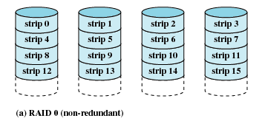
11.6 RAID 0 (non-redundant)(2/6)
条带分布数据→并行访问、高响应率
无纠错→非高稳定性

Slide 51
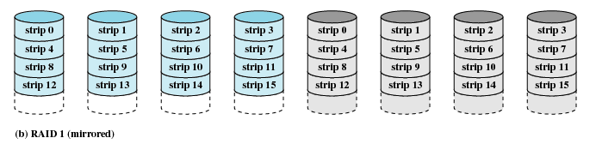
11.6 RAID 1 (mirrored)(3/6)
条带分布数据→并行访问、高响应率
镜像纠错
写速度降低，读相应好（可以并行任意读取一个）

Slide 52
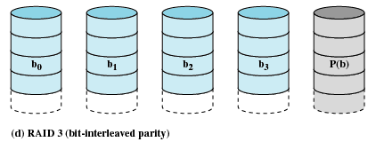
11.6 RAID 3 (bit-interleaved parity)(4/6)
条带分布数据（size 小 BYTE/WORD）
同一位置 位 交错奇偶校验位纠错→一次只能一个I/O请求因为要访问所有磁盘

Slide 53
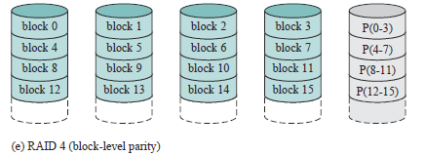
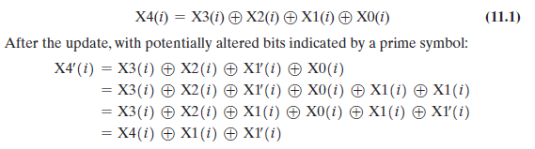
11.6 RAID 4 (block-level parity)(5/6)
条带分布数据
块奇偶校验位纠错→每次写需要操作2次读和2次写，X4成为性能瓶颈（必访问）

Slide 54
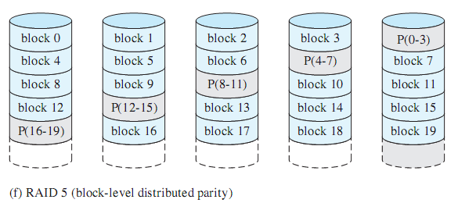
11.6 RAID 5 (block-level distributed parity)(6/6)
条带分布数据
分散块奇偶校验位纠错→解决X4性能瓶颈

Slide 55
Agenda
11.1 I/O Devices
11.2 Organization of the I/O Function
11.3 Operating System Design Issues
11.4 I/O Buffering
11.5 Disk Scheduling
11.6 RAID
11.7 Disk Cache
11.8 Summary

Slide 56
11.7 Disk Cache(1/4)
Buffer in main memory for disk sectors
Contains a copy of some of the sectors on the disk
Two design issues:
  Method to transfer the block of data from the disk cache to memory assigned to the user process(缓存数据与用户空间交换)
    Data move
    Pointer passing: reader writer problem
  The replacement strategy(置换策略) when the disk cache is full for store new data
Notes:
是前面缓冲技术在磁盘上的一个具体应用

Slide 57
11.7 Disk Cache(2/4)
Replacement Strategy 1: Least Recently Used (最近最少使用)
The block that has been in the cache the longest with no reference to it is replaced
The cache consists of a stack of blocks
Most recently referenced block is on the top of the stack
When a block is referenced or brought into the cache, it is placed on the top of the stack
The block on the bottom of the stack is removed when a new block is brought in
Blocks don’t actually move around in main memory，A stack of pointers is used

Slide 58
11.7 Disk Cache(3/4)
Replacement Strategy 2: Least Frequently Used (最不常用)
The block that has experienced the fewest references is replaced
A counter is associated with each block
Counter is incremented each time block accessed
Block with smallest count is selected for replacement
Some blocks may be referenced many times in a short period of time and the reference count is misleading

Slide 59
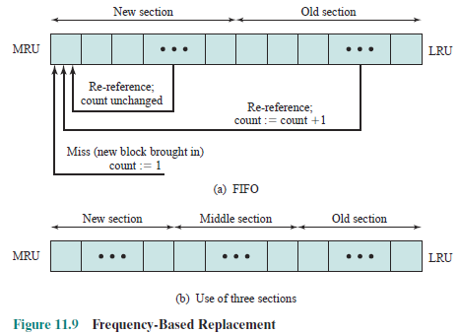
11.7 Disk Cache(4/4)
Different generations
Notes:
垃圾回收里面也有，不断添加新的到栈顶，那么相应老的块后移就到了中间段和后端

Slide 60
Agenda
11.1 I/O Devices
11.2 Organization of the I/O Function
11.3 Operating System Design Issues
11.4 I/O Buffering
11.5 Disk Scheduling
11.6 RAID
11.7 Disk Cache
11.8 Summary

