Slide 1
Operating Systems
Chapter 12 File Management

Slide 2
Agenda
12.1 Overview
12.2 File Organization and Access
12.4 File Directories
12.5 File Sharing
12.6 Record Blocking
12.7 Secondary Storage Management
12.8 Summary

Slide 3
12.1 Overview(3/6)
File System Properties(文件系统的特性)
  Long-term existence (长期存在)
  Sharable between processes (进程共享)
  Structure (结构化存储)
    Have specific structure according to application

Slide 4
12.1 Overview(5/6)
File Management Systems (文件管理系统)
  The way a user or application may access files(用户和程序使用文件的唯一方式)
  Programmer does not need to develop file management software
  objectives for a file management system:12.1.3
  a minimal set of requirements in a general-purpose system :12.1.3

Slide 5
12.1 Overview(6/6)
  File Management Functions
  Identify (标识) and locate (定位) a selected file
    Use file name to identify files
    Use a directory (目录) to describe the location of all files plus their attributes (属性)
  On a shared system describe user access control (存取控制)
  Blocking (块化) for access to files
  Manage free blocks
    Allocate free blocks to files (空闲块分配)
    Reclaim free blocks (空闲块回收)

Slide 6
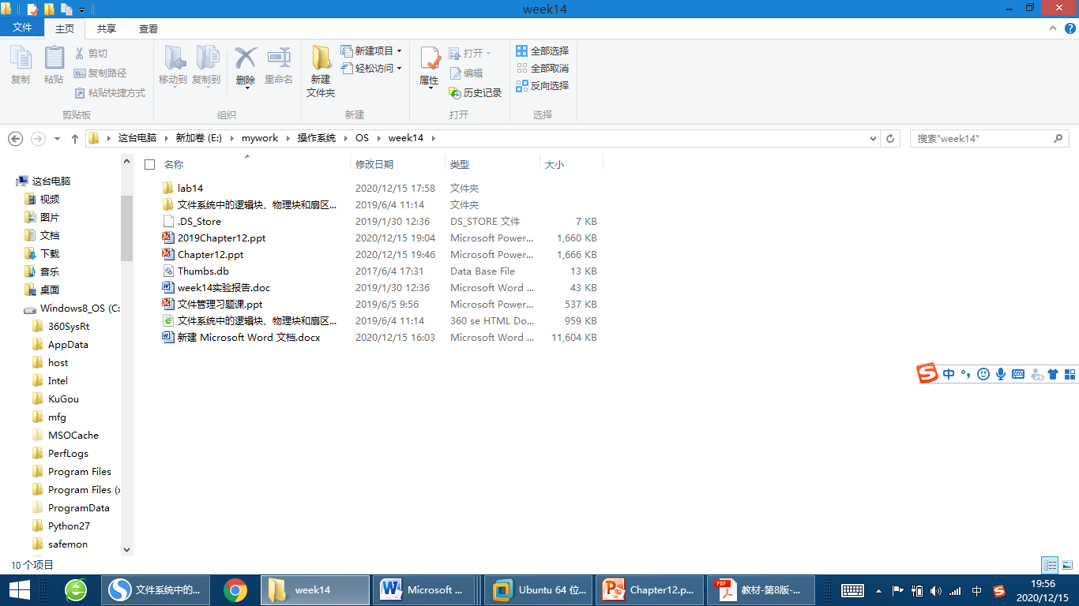
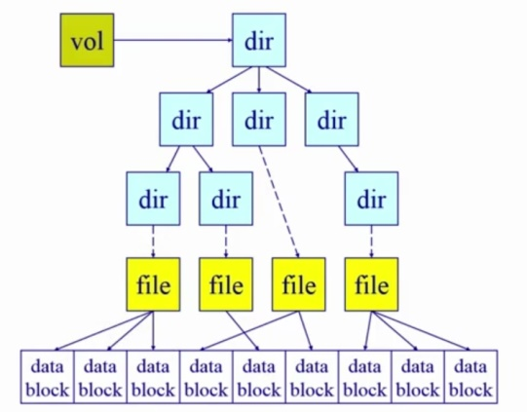
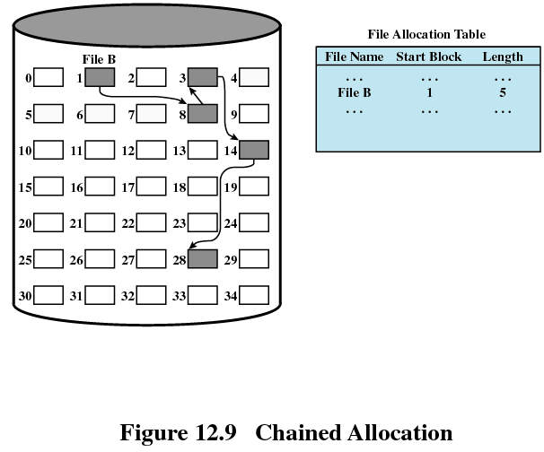
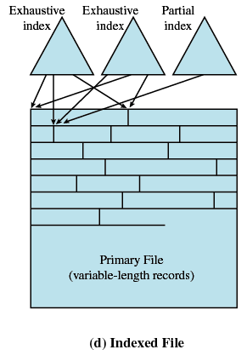
12.1 Overview(1/6)
Record.xls
一个文件m块，每块(n个扇区)
学号 | 姓名 | 籍贯
1001 | A | SC
1002 | B | BJ
Notes:
簇：fat,fat32,ntfs
块：linux：
块簇一般包含连续的扇区
现在的硬盘基本都是连续的，老式硬盘可以不连续，可以是1357......的间隔，此时交错因子是2；如果是159......的间隔，此时交错因子是4，老式硬盘在低级格式化时可以选择这个参数的。因为硬盘读取速度和转速当时是不匹配的，当硬盘处理完一个扇区上的磁道数据时，要么下一个扇区上的磁道还没有到，或者已经错过了，因此低级格式化时需要指定这个参数，使得硬盘使用时速度提高。

Slide 7
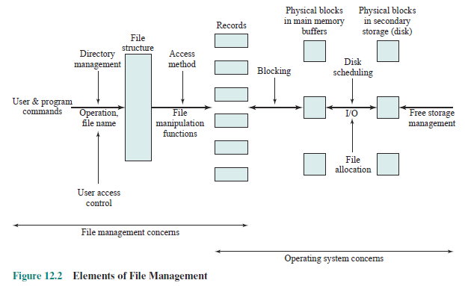
12.1 Overview(2/6)
第11章 I/O
4. 2.
6.
7.
7.
5.
Notes:
类似于windows的“文件资源管理器”

Slide 8
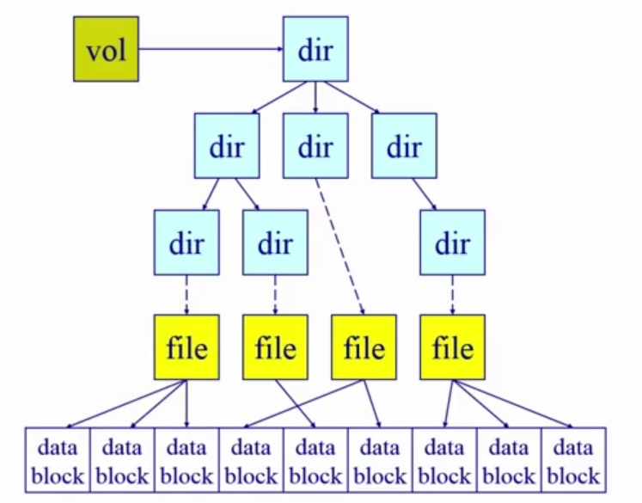
12.1 Overview(4/6)
Unix

Slide 9
Agenda
12.1 Overview
12.2 File Organization and Access
12.4 File Directories
12.5 File Sharing
12.6 Record Blocking
12.7 Secondary Storage Management
12.8 Summary

Slide 10
12.2 File Organization and Access
12.2.1 Criteria for File Organization
12.2.2 5 Different File Organizations

Slide 11
12.2.1 Criteria for File Organization(1/1)
Criteria for File Organization (文件组织评价标准)
Short access time (短的存取时间)
Ease of update (易于修改)
Economy of storage (存储经济性)
Simple maintenance (维护简单)
Reliability (可靠性)

Slide 12
12.2 File Organization and Access
12.2.1 Criteria for File Organization
12.2.2 5 Different File Organizations

Slide 13
12.2.2 5 Different File Organizations(1/11)
File Operations(文件操作)
  Create/Delete/Open/Close/Read/Write
Terms Used with Files (文件术语)
  Field (域)<Record (记录)<File (文件) < Database (数据库)
File Organizations
  文件的存储结构是指文件在外存上的组织方式

Slide 14
12.2.2 5 Different File Organizations (2/11)
2、The Sequential File (顺序文件)
  All fields the same (order and length)
    Field names and lengths are attributes of the file
  The First (only one) field is the key filed (关键域/关键字)
    Uniquely identifies the record
    Records are stored in key sequence
  New records are placed in a log file(日志文件) or transaction file(事务文件) (the pile堆 )
  Batch update (成批更新) is performed to merge(合并) the log file with the master file.

Slide 15
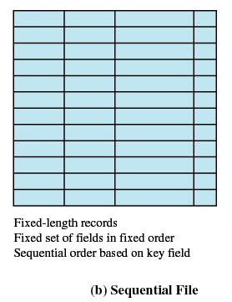
12.2.2 5 Different File Organizations (3/11)
顺序文件多用于磁带。
  一切存储在顺序存储器(磁带)上的文件都只能顺序文件 。只能按顺序查找法存取。
  存储在 直接存取存储器(磁盘) 上的顺序文件可以顺序查找法存取，也可以用分块查找法或二分查找法存取。

Slide 16
12.2.2 5 Different File Organizations(4/11)
1、The Pile堆
  Data are collected in the order they arrive
  Purpose is to accumulate a mass of data and save it
  Records may have different fields
  Disadvantages:
    No structure
    Record access is by exhaustive search (穷举搜索)
Notes:
这种格式是许多网络工具所使用的一种标准，这些工具包括WinDump，Etheral和Snort。

Slide 17
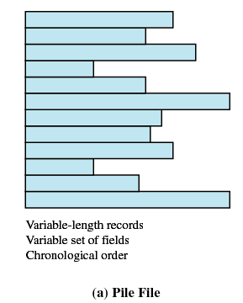
12.2.2 5 Different File Organizations(5/11)

Slide 18
12.2.2 5 Different File Organizations (6/11)
3、The Indexed Sequential File (索引顺序文件)
  Sequential file + index + overflow file
  Index: quickly reach the vicinity邻近 of the desired record (索引提供了快速接近目标记录的查询能力)
    Index contains a key field and a pointer to the main file
    Indexed is searched to find highest key value that is equal to or precedes the desired key value (索引查找关键字小于或者等于目标关键字的最大记录)
  Multiple level indexes (多级索引) for the same key field can be set up to increase efficiency
    1级索引：100万条记录，查找某记录平均时间50万条
    2级索引：1级1000条，2级1000条，则时间为500+500
Notes:
索引查找关键字小于或者等于目标关键字的最大记录 此处最大指，如索引有0 1000 2000 3000， 关键字为2666，那么2000是小于2666的最大记录
索引非顺序文件中的索引表为 稠密索引 。索引顺序文件中的索引表为 稀疏索引 。
若记录很大使得索引表也很大时，可对索引表再建立索引，称为 查找表 。通常可达四级索引。

Slide 19
12.2.2 5 Different File Organizations(7/11)
Overflow File of The Indexed Sequential File
  New records are added to an overflow file(溢出文件)
  Record in main file that precedes it is updated to contain a pointer to the new record
  The overflow is merged (合并) with the main file during a batch update

Slide 20
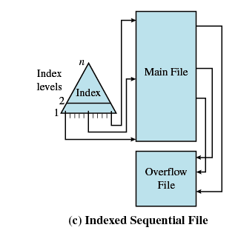
12.2.2 5 Different File Organizations (8/11)
Disadvantage:
Based on a single field

Slide 21
12.2.2 5 Different File Organizations(9/11)
4、The Indexed File (索引文件)
  Uses multiple indexes for different key fields
  May contain an exhaustive index(完全索引) that contains one entry for every record in the main file
  May contain a partial index(部分索引)
  Index itself are sequential file 索引是顺序的
      When a new record is added to the main file, all of the index files must beupdated.
  Records no longer no restrict to be sequential 记录非顺序
  Pointer in one index refers to that record 用索引查找记录

Slide 22
12.2.2 5 Different File Organizations(10/11)

Slide 23
12.2.2 5 Different File Organizations (11/11)
5、The Direct or Hashed File(直接文件或者散列文件)
  Key field required for each record
  Hash based on the key field
    根据文件中关键字的特点，设计一个散列函数和处理冲突的方法，将记录散列到存储设备上。
  优点：文件随机存放，记录不需要排序；插入删除方便；存取速度快；不需要索引区，节省存储空间。
  缺点是：不能进行顺序存取，只能按关键字随机存取
Notes:
对于文件来说，记录通常是成组存放的，若干个记录组成一个存储单位，称为桶。

Slide 24
Agenda
12.1 Overview
12.2 File Organization and Access
12.4 File Directories
12.5 File Sharing
12.6 Record Blocking
12.7 Secondary Storage Management
12.8 Summary

Slide 25
12.4 File Directories(1/9)
Contents：
Directory itself is a file owned by OS(一个目录本身是一个文件)
Provides mapping between file names and the files themselves(提供文件名和文件之间的映射)
Information Elements of a File Directory Table12.1
  Basic Information
  Address Information
  Access Control Information
  Usage Information
Notes:
某些信息可以保存在文件头，而非目录项里面。Nachos保存在文件头里，比如访问时间等信息

Slide 26
12.4 File Directories(2/9)
Structure：
File Directories
  Contain ：Directory entry 目录表项
  Operations ：
    Search
    Create file
    Delete file
    List directory
    Update directory

Slide 27
12.4 File Directories(3/9)
Structure 1：Simple Structure for a Directory (简单目录结构)：目录项列表
    Represented by a simple sequential file with the name of the file serving as the key (用顺序文件代表目录，该目录下的文件名做该顺序文件的关键字)
    Forces user to be careful not to use the same name for two different files (文件不能重名)

Slide 28
12.4 File Directories(4/9)
Structure 2：Two-level Scheme for a Directory(两级目录方案)
    A master directory (主目录)+One directory for each user (用户目录)
    Master directory contains entry for each user
      Provides address and access control information
    Each user directory is a simple list of files for that user
    Still provides no help in structuring collections of files （不能建子目录）

Slide 29
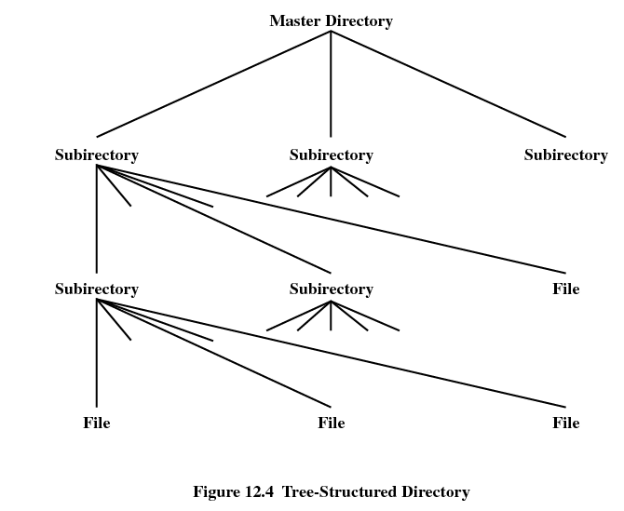
12.4 File Directories(5/9)
Structure 3：Hierarchical, or Tree-Structured Directory (层次/树状结构目录)
    Master directory with user directories underneath it
    Each user directory may have subdirectories and files as entries

Slide 30
12.4 File Directories(6/9)
In Hierarchical, or Tree-Structured Directory
  Files can be located (文件定位) by following a path from the root, or master, directory down various branches
    This is the pathname for the file
  Can have several files with the same file name (文件同名) as long as they have unique path names

Slide 31
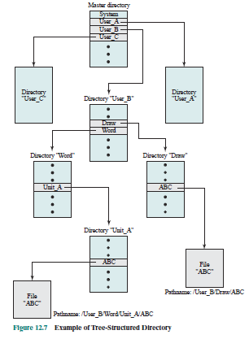
12.4 File Directories(7/9)
userB
  Word/Unit_A/ABC
  Draw/Unit_A/ABC
每个磁盘根目录位置固定

Slide 32
12.4 File Directories(8/9)
Effectively locate the file
  Current directory is the working directory (当前工作目录)
    Files are referenced relative to the working directory (相对路径)
    每个进程都会指向一个文件目录，用于解析文件名
Notes:
Q:
循环引用文件、减少存储共享（多个路径最终指向同一个文件名）
打开文件表（系统，进程）

Slide 33
12.4 File Directories(9/9)
文件系统挂载：启动时挂入根节点
users
User a
User b
bin
drv
Notes:
实际就是启动是只有根节点，然后读硬盘得到未挂载文件系统，把它挂入挂载点，此处为users

Slide 34
Agenda
12.1 Overview
12.2 File Organization and Access
12.4 File Directories
12.5 File Sharing
12.6 Record Blocking
12.7 Secondary Storage Management
12.8 Summary

Slide 35
12.5 File Sharing
In multiuser system, allow files to be shared among users
Two issues
  Access rights (存取权限)
  Management of simultaneous access (同时存取控制)

Slide 36
12.5 File Sharing
  Access Rights
None(无)
  User may not know of the existence of the file
  User is not allowed to read the user directory that includes the file
Knowledge(知道)
  User can only determine that the file exists and who its owner is

Slide 37
12.5 File Sharing
  Access Rights
Execution(执行)
  The user can load and execute a program but cannot copy it
Reading(读)
  The user can read the file for any purpose, including copying and execution
Appending(追加)
  The user can add data to the file but cannot modify or delete any of the file’s contents

Slide 38
12.5 File Sharing
  Access Rights
Updating(更新)
  The user can modify, deleted, and add to the file’s data. This includes creating the file, rewriting it, and removing all or part of the data
Changing protection(更改保护)
  User can change access rights granted to other users
Deletion(删除)
  User can delete the file

Slide 39
12.5 File Sharing
  Access Rights
Owners （所有者）
  Has all rights previously listed
  May grant rights to others using the following classes of users
    Specific user(指定用户)
    User groups(用户组)
    All for public files(所有用户)

Slide 40
12.5 File Sharing
Simultaneous Access(同时访问)
  User may lock entire file when it is to be updated
  User may lock the individual records during the update
  Mutual exclusion and deadlock are issues for shared access

Slide 41
Agenda
12.1 Overview
12.2 File Organization and Access
12.4 File Directories
12.5 File Sharing
12.6 Record Blocking
12.7 Secondary Storage Management
12.8 Summary

Slide 42
12.6 Record Blocking(1/3)记录组块
扇区(sector):
    硬件(磁盘)上的最小的操作单位,是操作系统和块设备(硬件、磁盘)之间传递单位
逻辑块Block：
    OS的虚拟文件系统从硬件设备上读取一个block，实际为从硬件设备读取一个或多个sector。
对于文件管理来说，每个文件对应的多个block可能是不连续的;block最终要映射到sector上，所以block的大小一般是sector的整数倍。不同的文件系统block可使用不同的大小，操作系统会在内存中开辟内存，存放block到所谓的block buffer中。

Slide 43
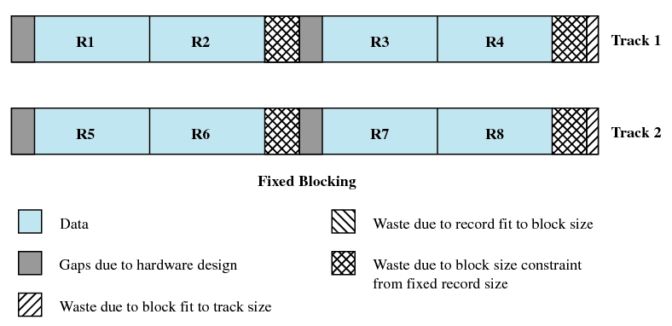
12.6 Record Blocking(2/3)
定长组块

Slide 44
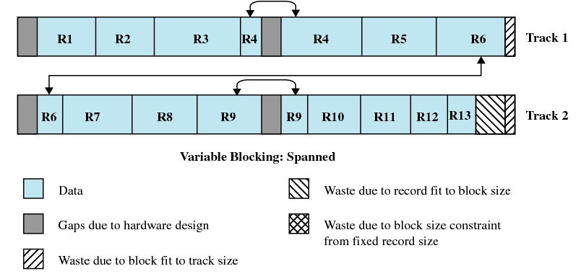
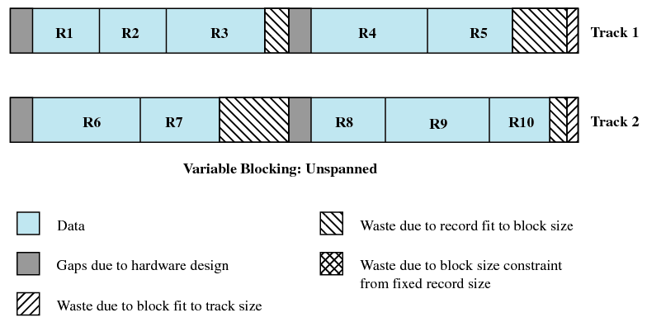
12.6 Record Blocking(3/3)
变长跨越式组块
变长非跨越式组块
Notes:
以块为传递单位，那么跨块导致两次IO访问

Slide 45
Agenda
12.1 Overview
12.2 File Organization and Access
12.4 File Directories
12.5 File Sharing
12.6 Record Blocking
12.7 Secondary Storage Management
12.8 Summary

Slide 46
12.7 Secondary Storage Management
(辅助存储管理)
12.7.1 File Allocation
拓展：File System in OpenEuler
12.7.2 Free Space Management
12.7.3 Reliability

Slide 47
12.7.1 File Allocation(1/13)
portions (文件)分区：
  Space is allocated to a file as one or more contiguous units, which we shall refer to as portions. That is, a portion is a contiguous set of allocated blocks.
  Size of portion：variable size or fixed size (block)
to keep track of the portions assigned to a file
  Using FAT (File Allocation Table)

Slide 48
12.7.1 File Allocation(2/13)
Preallocation VS Dynamic
  Preallocation(预分配)
    Need the maximum size for the file at the time of creation
    Difficult to reliably estimate the maximum potential size of the file
  Dynamic allocationallocation (动态分配)
    Allocates space to a file in portions as needed.

Slide 49
12.7.1 File Allocation(3/13)
Different allocation strategies (分配策略)
  Contiguous allocation (连续分配)
  Chained allocation (链式分配)
  Indexed allocation (索引分配)

Slide 50
12.7.1 File Allocation(4/13)
Contiguous allocation (连续分配)
  Single set of blocks is allocated to a file at the time of creation (文件创建时分配一组连续的块)
  Only a single entry in the file allocation table
    Starting block and length of the file
  External fragmentation will occur
    Need to perform compaction

Slide 51

12.7.1 File Allocation(5/13)
Contiguous allocation
外部碎片

Slide 52
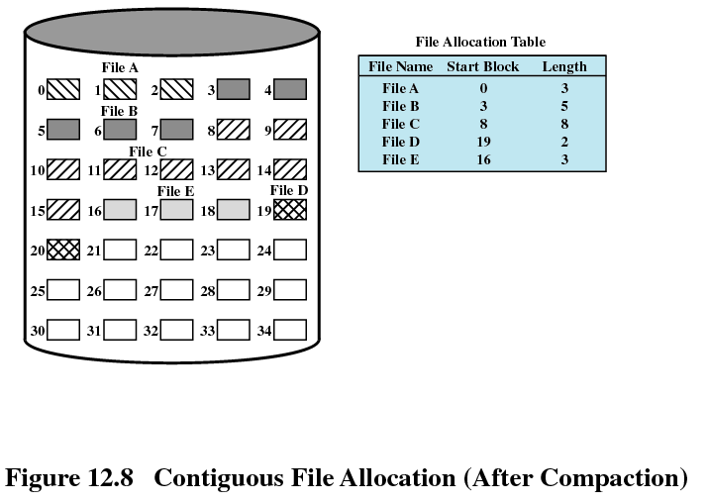
12.7.1 File Allocation(6/13)
Contiguous allocation

Slide 53
12.7.1 File Allocation(7/13)
Chained allocation (链式分配)
  Allocation on basis of individual block(基于单个块进行分配)
  Each block contains a pointer to the next block in the chain
  Only single entry in the file allocation table
    Starting block and length of file
  No external fragmentation
  Best for sequential files (适合顺序文件)
  No accommodation of the principle of locality (局部性原理不再适用)，so consolidation(迁移、集结) is need to move blocks adjacent each other

Slide 54
12.7.1 File Allocation(8/13)
Chained allocation

Slide 55
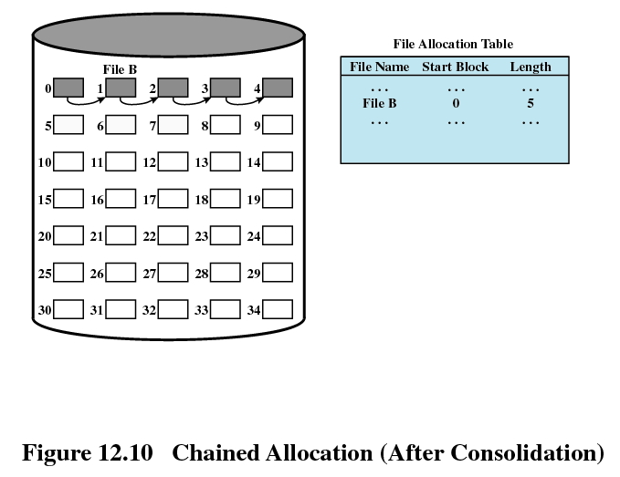
12.7.1 File Allocation(9/13)
Chained allocation
合并后

Slide 56
12.7.1 File Allocation(10/13)
Indexed allocation (索引分配)
  File allocation table contains a separate one-level index for each file (每个文件在文件分配表中有一个一级索引)
  The file allocation table contains block number for the index (文件分配表指向该文件在磁盘上的索引块)
  The index has one entry for each portion allocated to the file (分配给文件的每个分区都在索引中都有一个表项)
  Indexed allocation supports both sequential and direct access to the file and thus is the most popular form of file allocation.

Slide 57
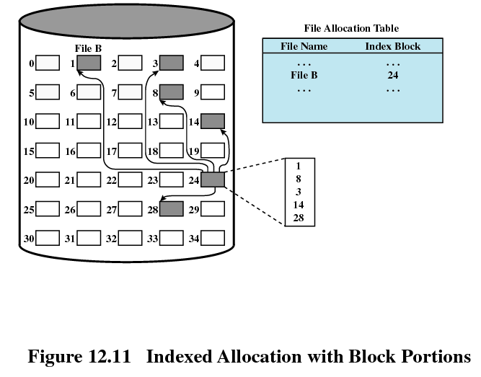
12.7.1 File Allocation(11/13)
Indexed allocation
24是磁盘索引块
和数据块一样大

Slide 58
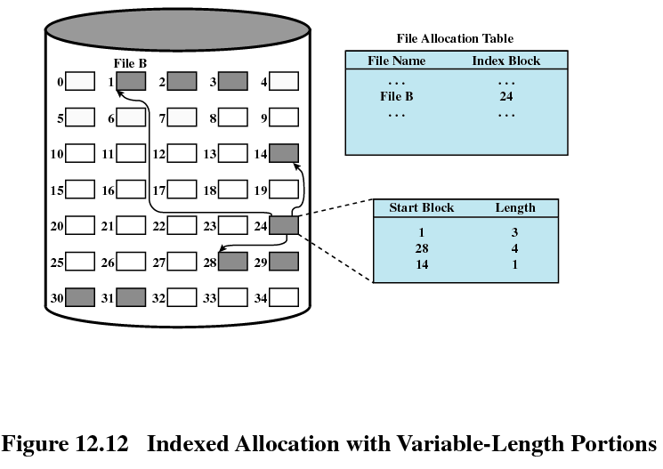
12.7.1 File Allocation(12/13)
变长 索引分配

Slide 59
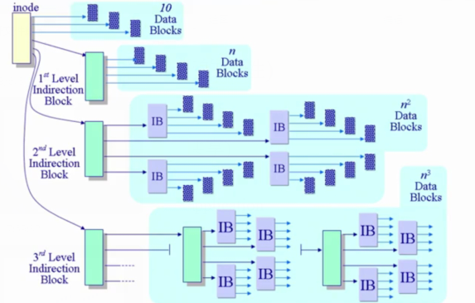
12.7.1 File Allocation(13/13)
Linux：一个索引节点对应一个文件
Unix见书图12.15
文件索引节点
数据块
文件间接索引节块
Notes:
根据需要，可以直接存放数据，也可以使用一级间接存储，二级间接存储，三级间接存储

Slide 60
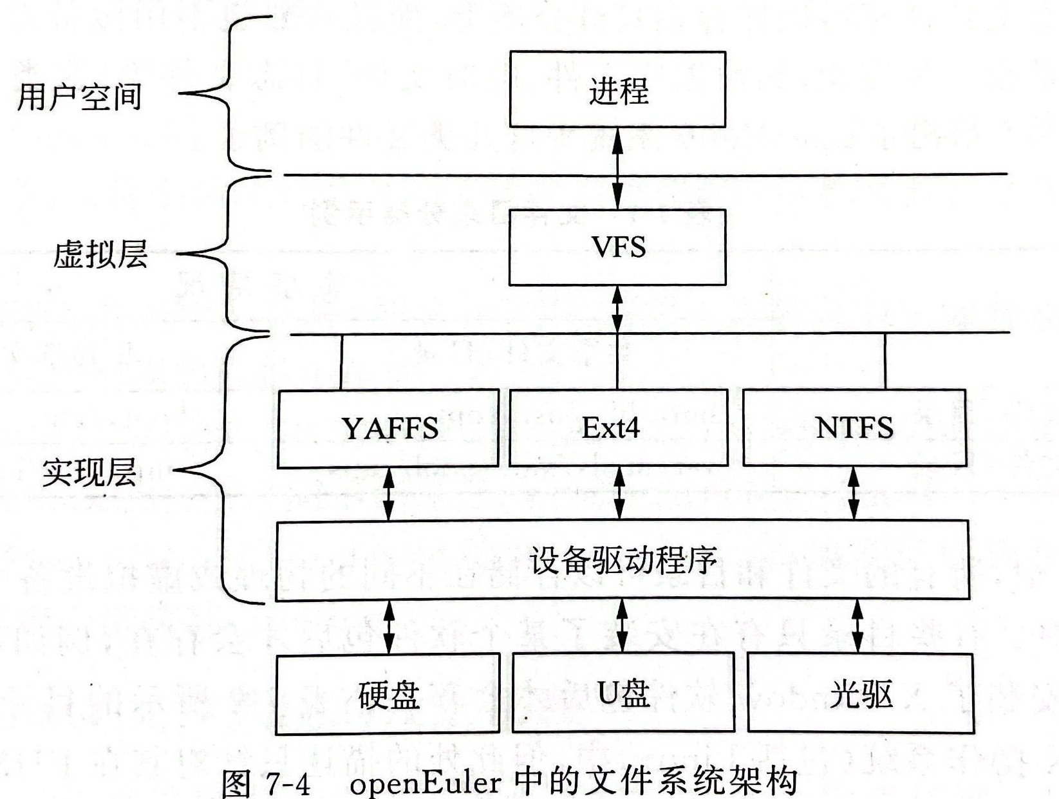
拓展：File System in OpenEuler(1/4)
OpenEuler文件系统架构
    进程位于架构上方，仅与VFS(Virtual File System)交互
    VFS抽象不同文件系统的行为，提供统一通用API，进行打开读取，写入等操作。是用户可见的目录树。
    现实层默认选用Ext4文件系统Fourth Extended File System

Slide 61
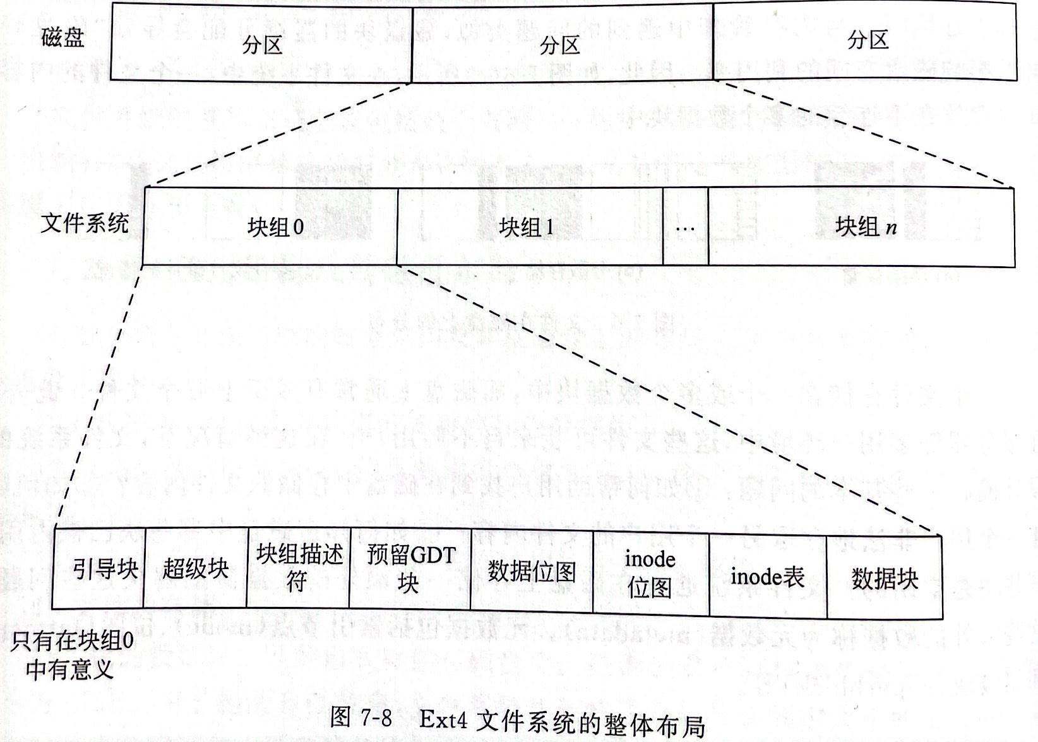
拓展：File System in OpenEuler (2/4)
Ext4文件系统布局
    每个分区可以安装不同文件系统
    安装操作系统的分区中的组块0中含有引导块，其它组块不含。

Slide 62
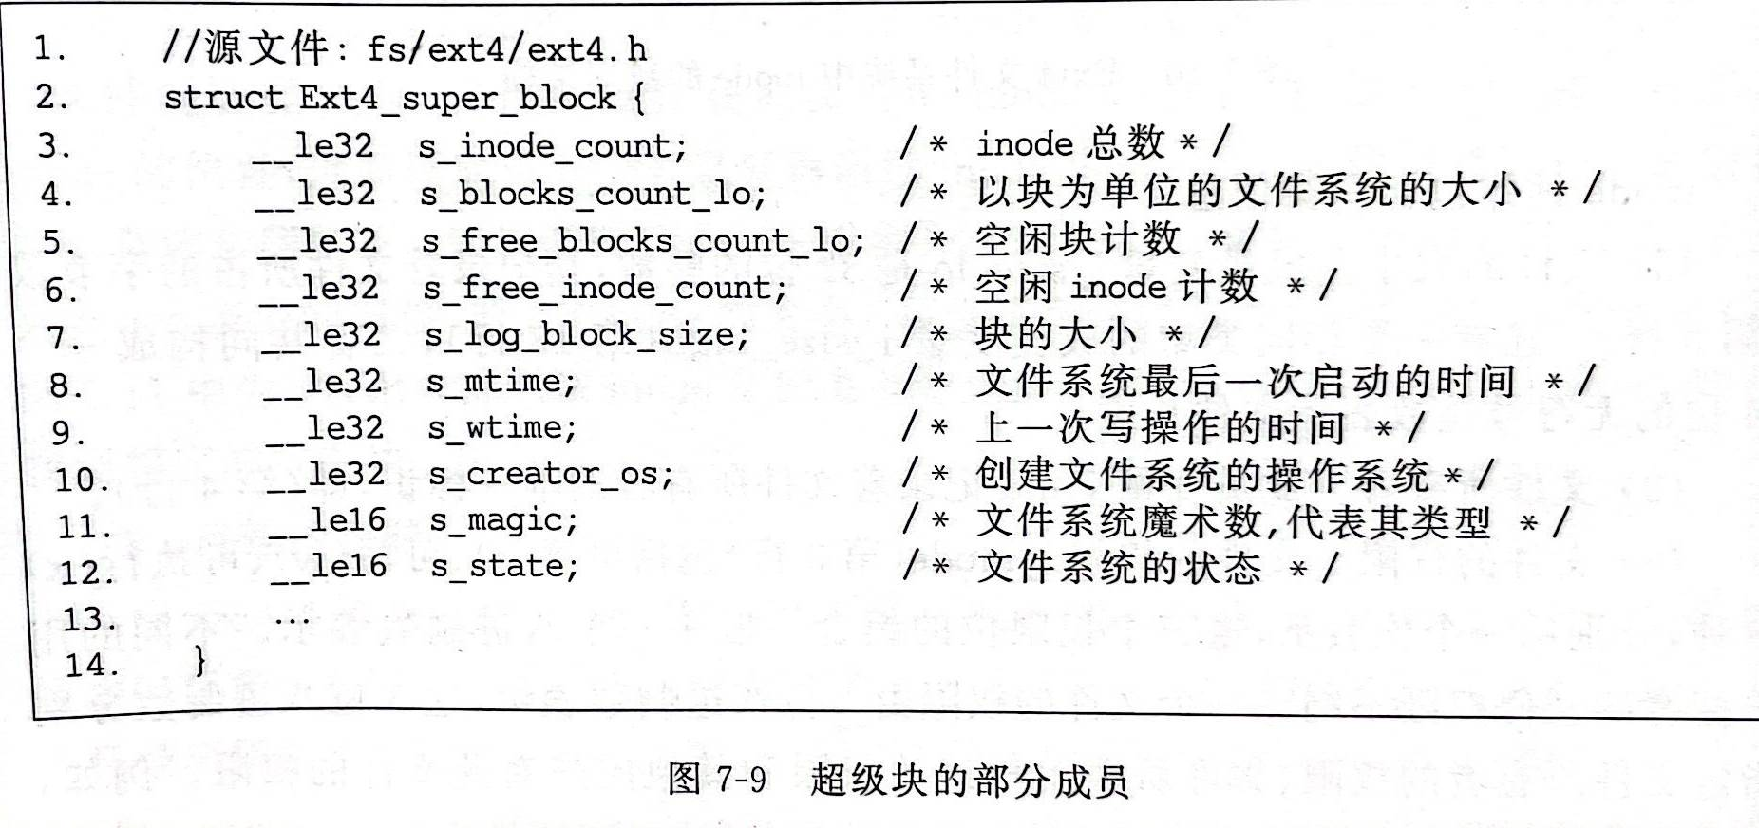
拓展：File System in OpenEuler (3/4)
Ext4文件系统布局
    超级块大小1KB,含记录文件系统整体层面的数据结构

Slide 63
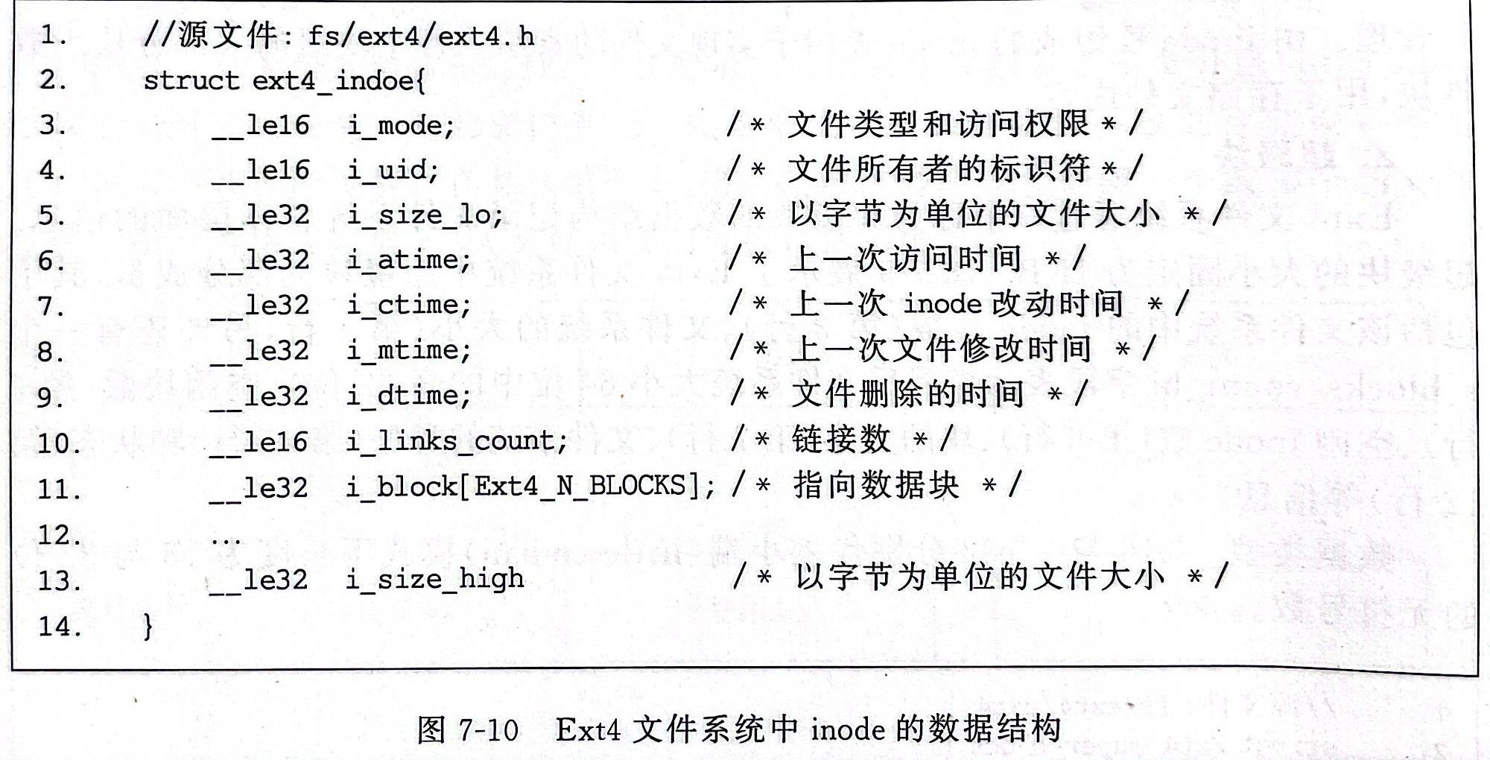
拓展：File System in OpenEuler (4/4)
Ext4文件系统布局
    Inode索引节点的数据结构记录文件的信息

Slide 64
12.7 Secondary Storage Management
12.7.1 File Allocation
拓展：File System in OpenEuler
12.7.2 Free Space Management
12.7.3 Reliability

Slide 65

12.7.2 Free Space Management(1/3)
1、Bit tables (位表)
  Use a vector containing one bit for each block on the disk. Each entry of a 0 corresponds to a free block, and each 1 corresponds to a block in use.
    Thus, for a 16-Gbyte disk with 512-byte blocks, the bit table occupies about 4 Mbytes.
Improve Efficiency :Auxiliary data structures that summarize the contents of subranges of the bit table

Slide 66
12.7.2 Free Space Management(2/3)
2、Chained free portions (链式空闲区)
  The free portions may be chained together by using a pointer and length value in each free portion
  negligible space overhead: a pointer to the beginning of the chain and the length of the first portion
3、Indexing (空闲索引表)
  The indexing approach treats free space as a file and uses an index table as described under file allocation.
4、Free block list (空闲列表)
  Assign a number to each blocks
  Maintain the list of the numbers of all free blocks
  Cache part of the list in memory

Slide 67
12.7.2 Free Space Management(3/3)
Allocate strategies:
  First fit: Choose the first unused contiguous group of blocks of sufficient size from a free block list.
  Best fit: Choose the smallest unused group that is of sufficient size.
  Nearest fit: Choose the unused group of sufficient size that is closest to the previous allocation for the file to increase locality.

Slide 68
12.7 Secondary Storage Management
12.7.1 File Allocation
拓展：File System in OpenEuler
12.7.2 Free Space Management
12.7.3 Reliability

Slide 69
12.7.3 Reliability(1/1)
Use a lock to prevent interfere among processes and make sure of consistent of space allocation

