Slide 1
FinAgent
Microservices-Based AI Financial Expense Tracking Platform
Microservices Architecture · CI/CD Automation · GitOps
Lijaz Salim

Slide 2
Problem Statement
Deploying an AI powered finance tracking microservice application demands more than running containers. This project addresses the real-world gap between a working prototype and a production-grade platform.
Reliability
Consistent, repeatable Kubernetes deployments across environments
Automation
CI/CD pipelines that validate, build, and release without manual steps
Security
Controlled access, encrypted secrets, and hardened container images
Governance
Controlled releases with audit trails and policy enforcement

Slide 3
Application Stack
Frontend: React/Next.js served via HAProxy
Backend Services: Python FastAPI, RESTful APIs, Langchain.
Internal Communication: HTTP REST API calls over ClusterIP with NetworkPolicy
Data Layer: MySQL DB per service, isolated via PVCs
AI Layer: Ollama serving the Llama:3.2b model for local LLM inference
Backend Microservices
Auth Service: login, registration, token validation, user/profile checks
Chat Service: chat requests, conversation handling, context assembly
Expense Service: create, update, list, delete expenses
Insights Service: summaries, analytics, trends, recommendations
Llama Service: model inference and response generation

Slide 4
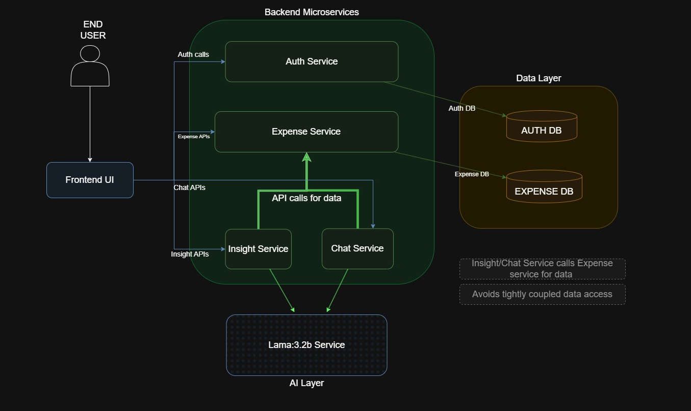
Application Architecture

Slide 5
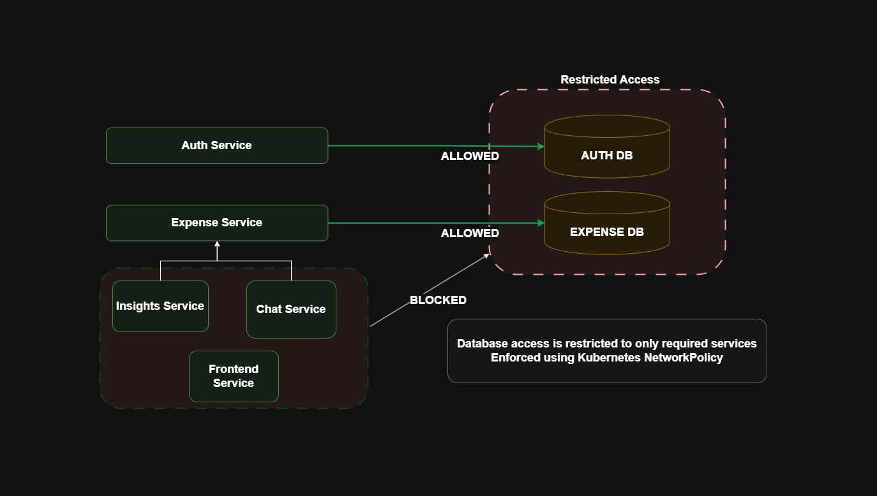
DB Architecture

Slide 6
DevOps Platform Architecture
VPC & Subnets
Worker Nodes
Control Plane
This Kubernetes platform was built around my project’s real needs. It provides:
Namespace-based separation
Internal ClusterIP communication
Isolated gateway access
Persistent, dynamic storage for databases
Sealed secrets
And more
Isolated network with public/private subnet separation
2 general-purpose + 1 GPU node for AI workloads
Single master node
HAProxy Gateway
KGateway
Single entry point, Acts as the external load balancer, all the services are ClusterIP-only internally
Acts as the Gateway API to handle all routes in the cluster. External or internal.

Slide 7
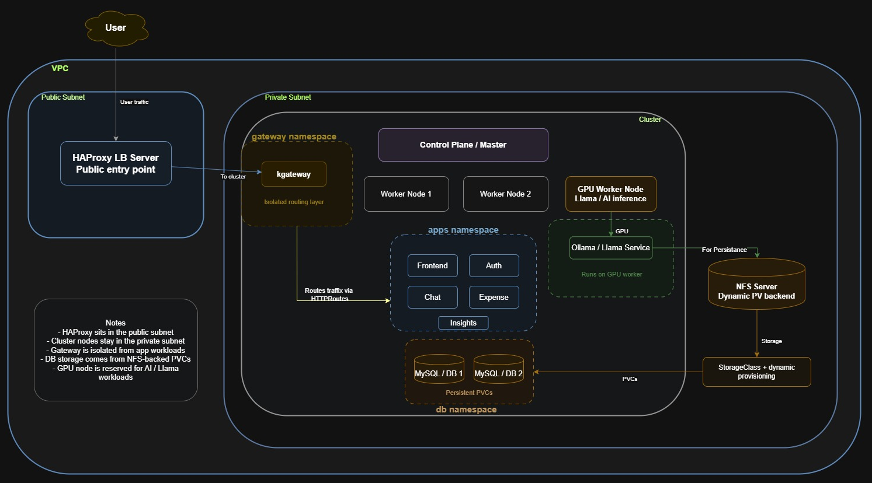
DevOps Platform Architecture

Slide 8
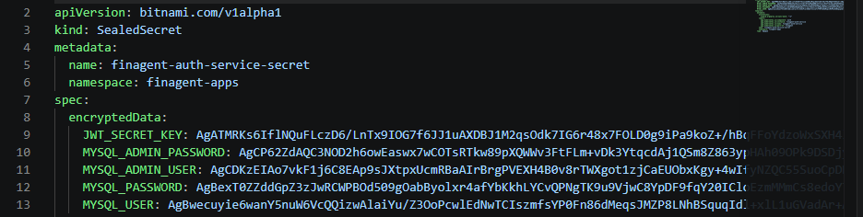
SECURITY & GOVERNANCE
Sealed Secrets Integration
Adopted Bitnami Sealed Secrets CRD to manage Kubernetes secrets securely in GitOps workflows
Used the kubeseal CLI to encrypt secrets locally with the cluster’s public key
The encrypted output is stored as a SealedSecret, not as a plaintext Secret
Only the Sealed Secrets controller inside this specific cluster can decrypt and unseal those secrets
This means even if the sealed manifest is copied elsewhere, it cannot be unsealed outside the target cluster

Slide 9
SECURITY & GOVERNANCE
Access Control and Team Governance
Identity and access management is enforced through OIDC integration with Keycloak, providing centralized authentication across all platform tools. Headlamp leverages this integration to enforce RBAC policies at the Kubernetes cluster level, ensuring every team member operates strictly within their authorized scope.
OIDC + Keycloak
Namespace-Level RBAC
Least Privilege by Design
Centralized identity provider for all platform services. Users authenticate once and receive scoped tokens for Headlamp, Argo CD, and Grafana.
DB Team is restricted to database namespaces only. Dev Team access is limited to application namespaces. Cross-team access is explicitly denied by default.
No broad cluster-admin grants. Every role is scoped to the minimum verbs and resources required. Audit logs capture all privileged actions.

Slide 10
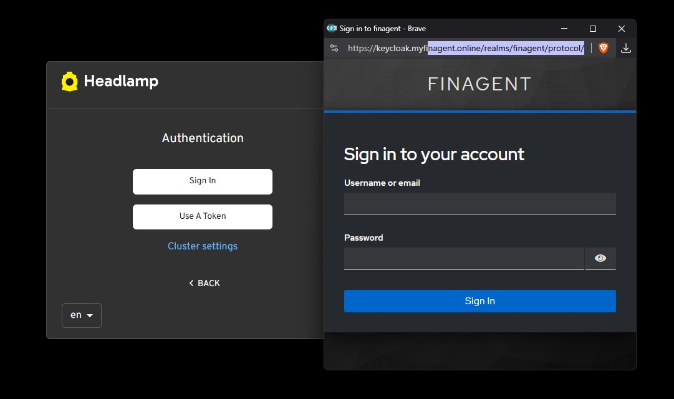
SECURITY & GOVERNANCE
Access Control and Team Governance

Slide 11
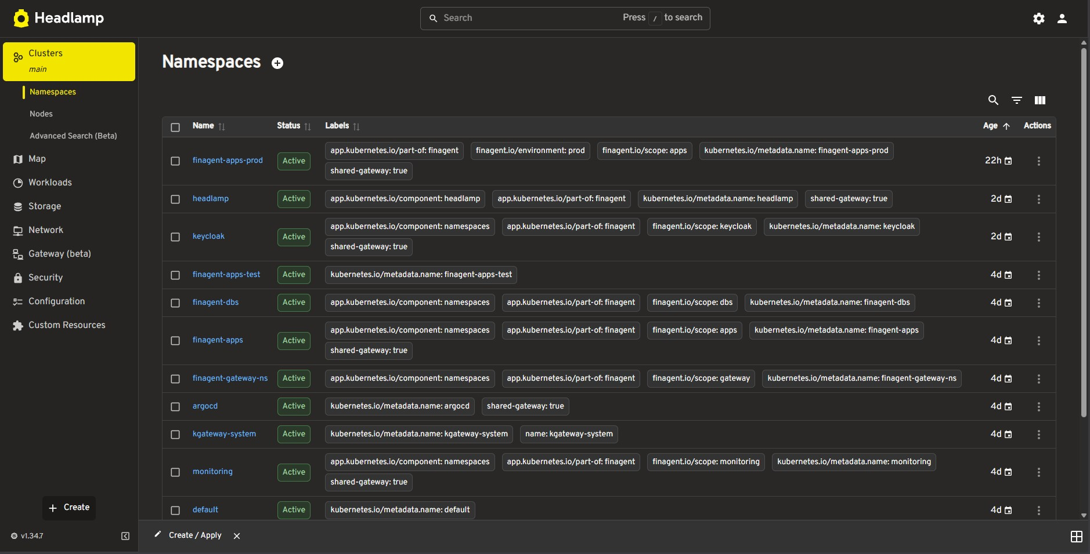
SECURITY & GOVERNANCE
Access Control and Team Governance

Slide 12
SECURITY & GOVERNANCE
CIS k8s benchmark scan – Kube-bench
Area | Summary
Tool Used | kube-bench
Benchmark | CIS Kubernetes Benchmark
Coverage | Master, etcd, control plane, worker nodes, policies
PASS | 69
FAIL | 12
WARN | 41
Main Strengths | Permissions, etcd TLS, kubelet baseline security
Main Gaps | Audit logs, API server flags, encryption config, policy hardening

Slide 13
SECURITY & GOVERNANCE
Network and Workload Security
Database Network Policy
Hardened Container Images
A strict Kubernetes NetworkPolicy ensures only two authorized services can communicate with the database pod. All other ingress traffic is dropped at the network layer — defense in depth, not just application-level checks.
Base images are selected and maintained with security as a first-class concern. Each image undergoes vulnerability assessment before adoption and is pinned to specific digests to prevent drift.
Trivy scans integrated into CI pipeline
Images with known CVEs above threshold block promotion
Backend API service — allowed
Migration job pod — allowed
All other sources — denied

Slide 14
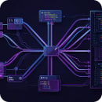
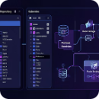
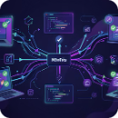
PLATFORM & CONFIGURATION
Repository Strategy and Branching
The project follows a multi-repository structure that separates concerns, reduces blast radius, and enables independent service lifecycles. Each microservice owns its code and CI pipeline, while Helm charts are managed in a dedicated infrastructure repository.
Per-Service Repositories
Dedicated Helm Charts Repo
Trunk-Based Workflow
Each microservice (e.g., auth-service, insights-service) has its own repository containing application code, Dockerfile, and service-specific CI workflow. Teams own their pipelines independently.
All Helm charts live in a separate helm-charts repository. This centralizes environment configuration (values-test.yaml, values-prod.yaml) and enables consistent chart versioning across services.
Short-lived feature branches merge to main frequently. Branch protections enforce: no direct pushes to main, PR required, at least one reviewer approval, and status checks must pass before merge.

Slide 15
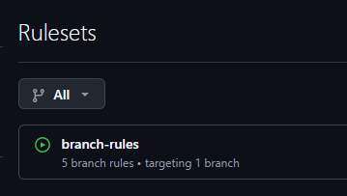
PLATFORM & CONFIGURATION
Repository Strategy and Branching
Branching Rules – main is the protected branch
No direct pushes to main
Pull request required before merge
At least one approval required
Status checks must pass before merge
Teams
Dev – Devolpoers working on the repo and rasies PRs
Reviewers – approve or reject changes

Slide 16
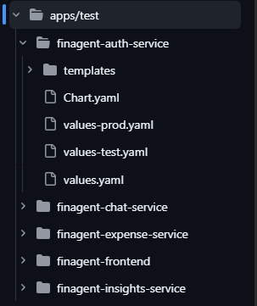
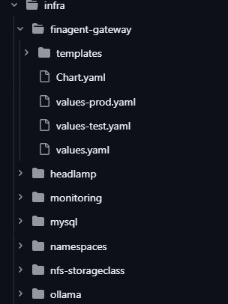
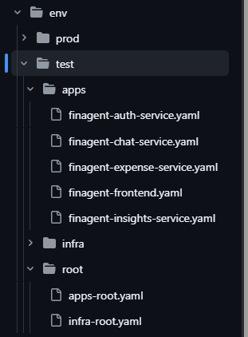
PLATFORM & CONFIGURATION
Helm Charts/gitops repo structure
/apps directory:
Contains all microsrvice Charts
Every chart has values,values-test,values-prod
/infra directory:
Contains all infrastructure Charts
Every chart has values,values-test,values-prod
/env directory:
Contains argocd application yamls for test env and prod env
./test contains ./apps and ./infra and ./root

Slide 17




AUTOMATION & CI/CD
CI/CD Architecture Overview
The end-to-end pipeline is designed as a controlled, stage-gated automation flow — from pull request validation through build, scan, test deployment, and manual production promotion. Each stage has clear entry criteria and failure handling, ensuring nothing reaches production without explicit approval.
PR Validation
Build & Scan
SonarQube + Snyk sequential scan on every PR
Docker build, Trivy scan, Update in test cluster
GitOps Sync
Manual Promotion
Argo CD auto-applies changes to test cluster
Release publish triggers SHA retag and prod update is manual

Slide 18
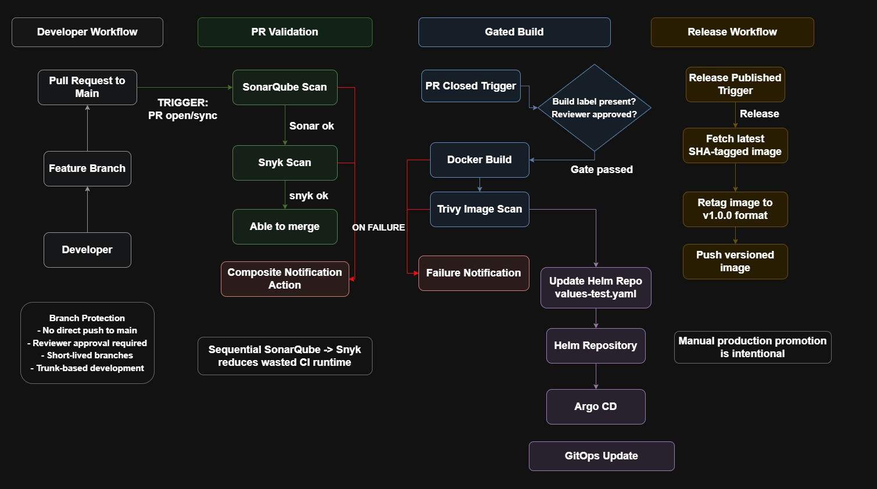
AUTOMATION & CI/CD
CI Pipeline

Slide 19
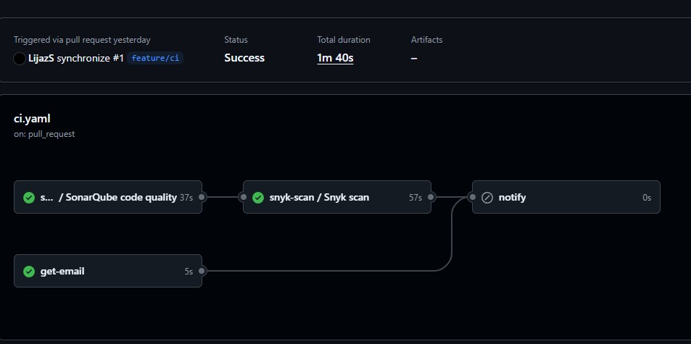
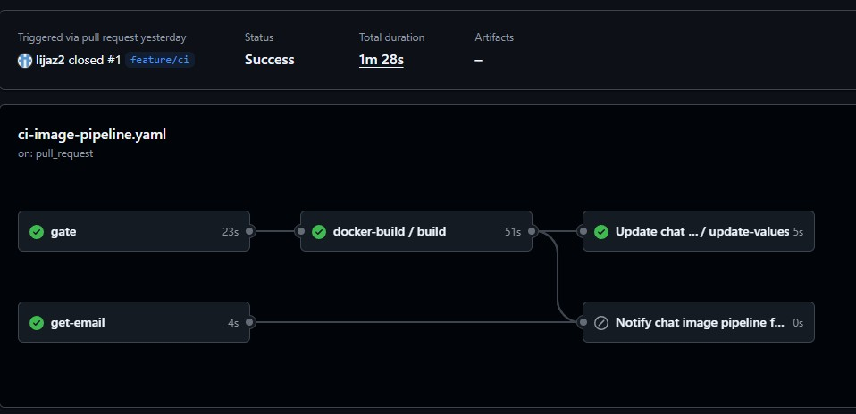
AUTOMATION & CI/CD
PR Validation
Gated Build

Slide 20
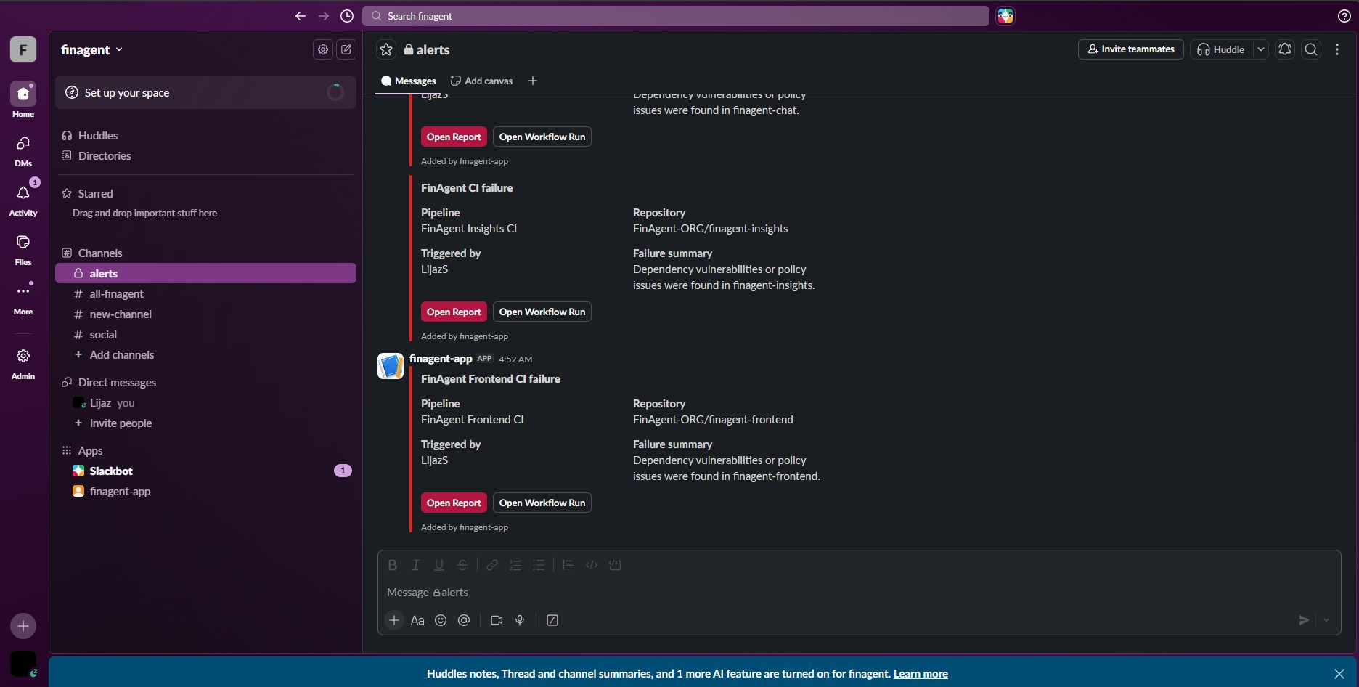
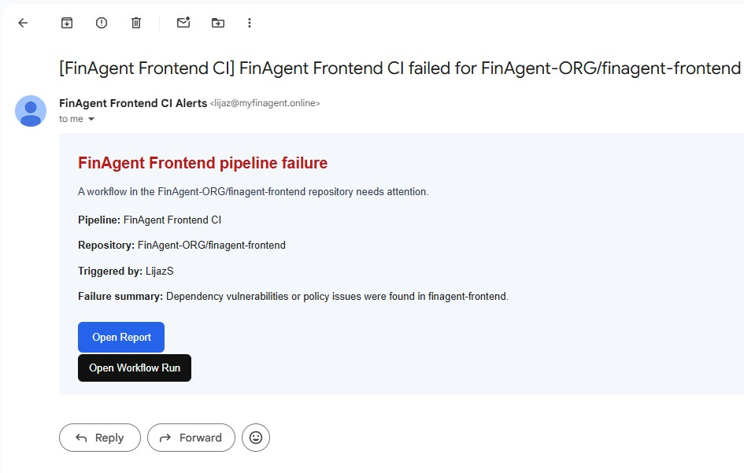
AUTOMATION & CI/CD
Failure Notifications
Slack notifications
Mail notifications

Slide 21
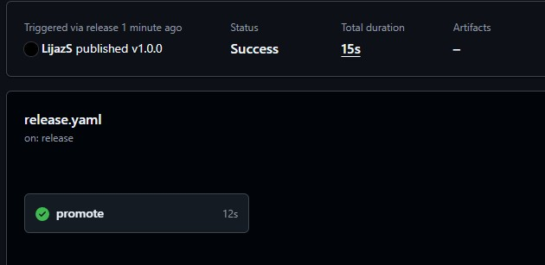
AUTOMATION & CI/CD
Release Workflow and Manual Promotion
Why Manual Promotion is Intentional
Release Trigger Flow
Production deployments are never automated in this architecture. When a release is published (Git tag created), the workflow retags the immutable SHA to a semantic version (e.g., v1.0.0), then updates values-prod.yaml in the Helm repo. Argo CD detects the change but requires manual approval in the Argo CD UI before syncing to production.
Git tag published (e.g., v1.0.0)
Workflow captures commit SHA
Image retagged with semantic version
values-prod.yaml updated in Helm repo
Argo CD detects change, waits for approval
Engineer approves → production sync
SHA → SemVer Retag
Manual Gate
Immutable build artifact receives a human-readable version tag at release time.
Engineer reviews test results, confirms readiness, and approves Argo CD sync explicitly.

Slide 22
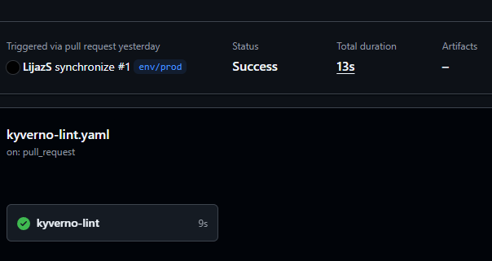
AUTOMATION & CI/CD
Helm/gitops repo CI
The Helm repo uses a dedicated CI pipeline for configuration validation
On PRs, rendered manifests are checked using Kyverno CLI
Policy checks help catch invalid or non-compliant Kubernetes configuration early
This is especially important when promoting env/prod changes into main
It strengthens GitOps governance by validating infrastructure and application manifests before merge
This reduces the risk of pushing unsafe configuration to production

Slide 23
PLATFORM & OBSERVABILITY
Observability and Additional Controls
The platform provides full-stack observability and policy enforcement across all layers — from application metrics to cluster-level compliance checks.
Grafana + Loki + Promtail
Kyverno Policy Enforcement
Domain & Subdomain Setup
Grafana provides unified dashboards. Loki aggregates logs via Promtail agents. Prometheus scrapes metrics from all workloads. Engineers have full operational visibility without SSH access.
Kyverno validates Helm repo PRs against cluster policies — rejecting manifests that violate security standards (e.g., missing resource limits, privileged containers, missing network policies).
All platform tools are exposed via dedicated subdomains with TLS: sonarqube., headlamp., grafana., argocd., and keycloak. — accessible securely from a single domain.

Slide 24
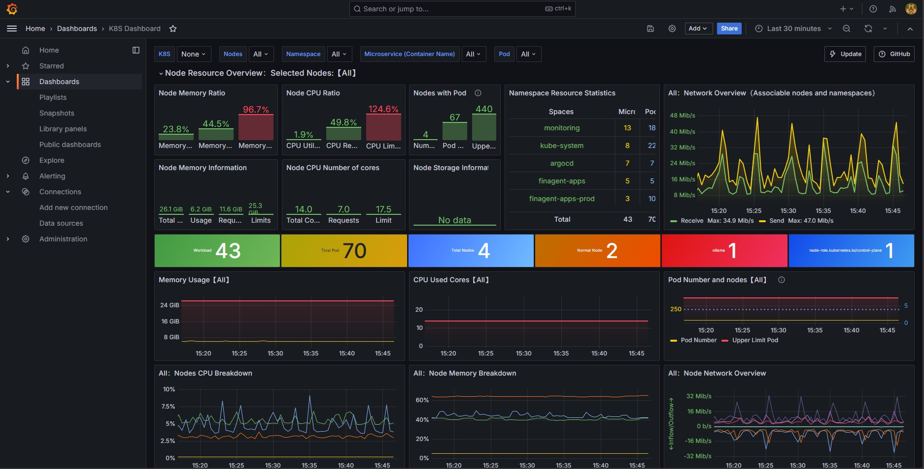
PLATFORM & OBSERVABILITY
Grafana – k8s dashboard

Slide 25
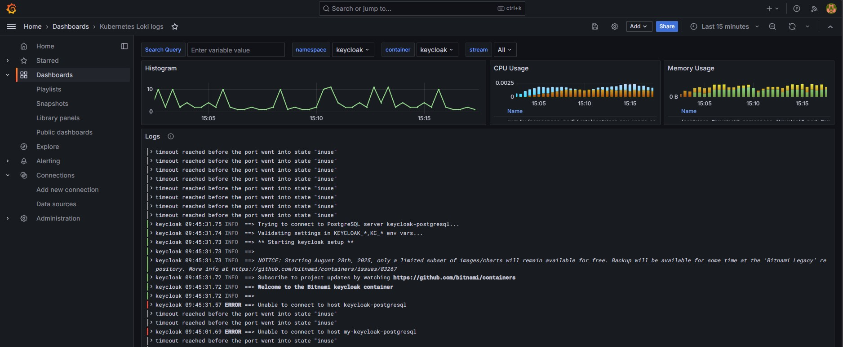
PLATFORM & OBSERVABILITY
Grafana – Loki Logs dashboard

Slide 26
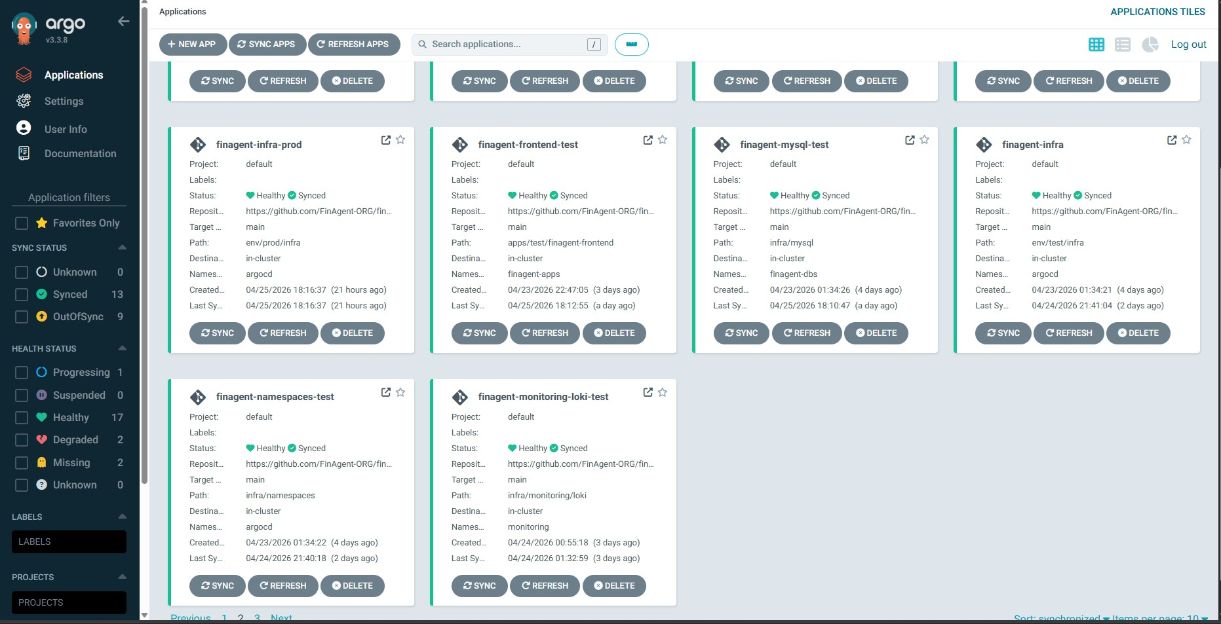
PLATFORM & OBSERVABILITY
ArgoCD Dashboard

Slide 27
Domain and Endpoint Structure
Category | Domain | Purpose
User Access | myfinagent.online | Main frontend application
Platform & Ops | grafana.myfinagent.online | Monitoring and observability dashboards
Platform & Ops | sonarqube.myfinagent.online | Code quality and static analysis
Platform & Ops | k8s.myfinagent.online | Kubernetes dashboard / Headlamp
Identity & Access | keycloak.myfinagent.online | Authentication and identity management

Slide 28
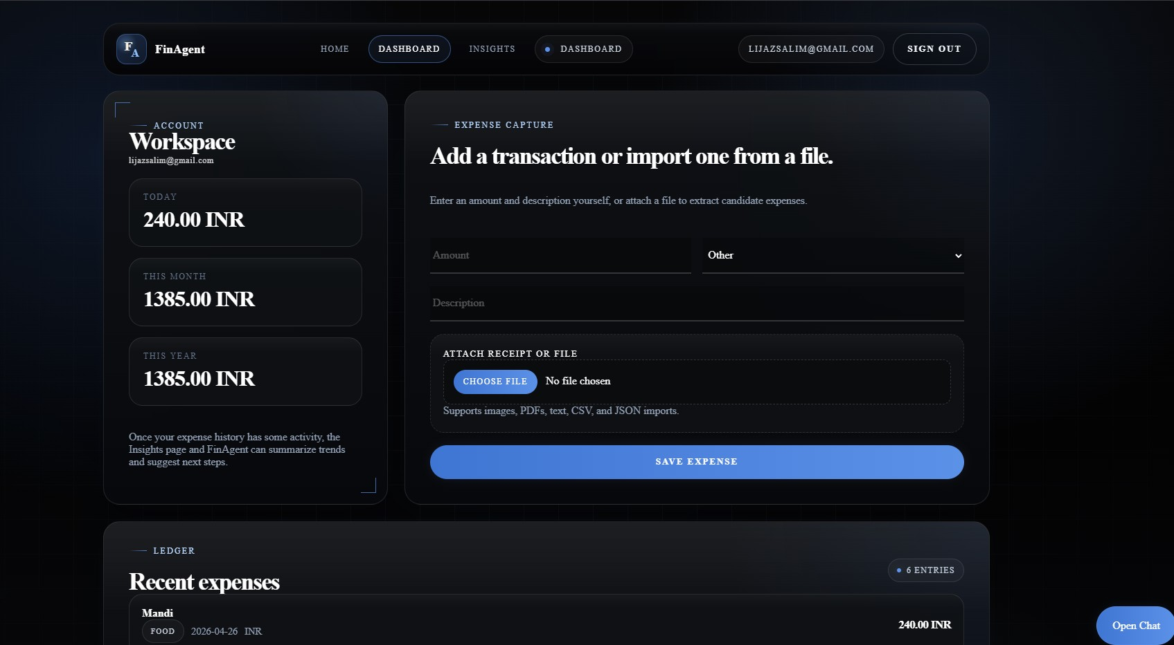
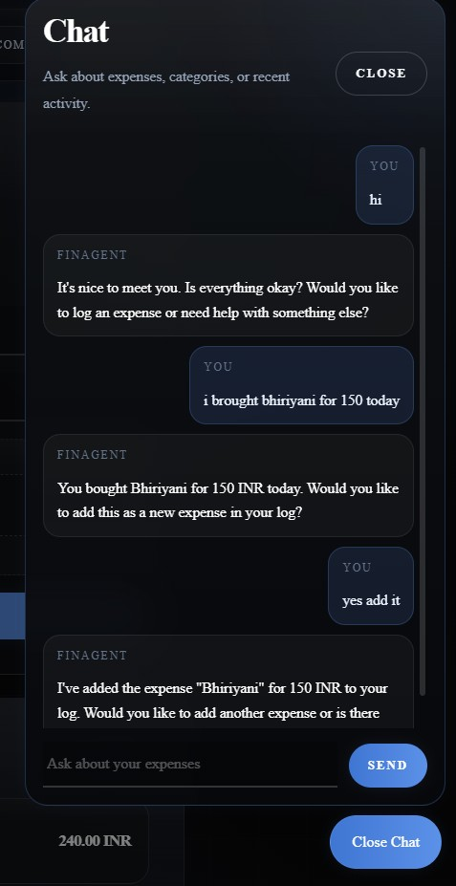
Application User Experience

Slide 29
CAPSTONE SUMMARY
Outcomes and Key Takeaways
Conclusion
This project demonstrates a complete, enterprise-ready DevOps platform — from identity management and network segmentation to automated CI/CD pipelines and GitOps-driven deployments. The architecture is secure by default, observable by design, and scalable through pattern-driven configuration. It represents a production-grade implementation of modern cloud-native DevOps principles.
Future Improvements
Implement progressive delivery with Argo Rollouts (canary/blue-green)
Extend Kyverno policies
Add alerts in Grafana
Add helm lint as well for helm repo

