Slide 1

xLSTNet:
Predicting Futures Price with Feature Interaction and Time Series Model
SIGIR 2020: FinIR REPORT
USTC_火锅真好吃
University of Science and Technology of China

Slide 2

1. Task
2. Methods
Contents
3. Experiments
4. Results & Conclusion
Notes:
First we will introduce the tasks of the competition, then the methods we use, then our experiments, and finally our results and conclusions.

Slide 3
Task: Predict the change of metal prices
3 sub-tasks
Evaluation metric: accuracy
Predict the rise and fall of 6 metals over 1-day, 20-day and 60-day period
Notes:
The task is to predict the rise and fall of six different metals over 1-day, 20-day and 60-day period, and uses accuracy as evaluation metric.

Slide 4
Our Method: Data Collection
Collect Dow Jones Industrial Index dataset
Collect English and Chinese news text data
Only use DOW dataset
Notes:
We collect DOW dataset, English news and Chinese news text data, but we only use DOW dataset.

Slide 5
Our Method: Data Preprocessing
Only use LME dataset after 2005
Validation set: the last 10% of the above data
Missing value preprocessing: replace it with the previous day's value
Min-Max Normalization: scale the data into the range [-1, 1], where the maximum and minimum values are taken from the training set
Notes:
We find that the length of train set will influence prediction accuracy, so we only use LME dataset after 2005 and use the last 10% of the data as the validation set.
There are some missing values in original dataset, so we replace it with the previous day's value. We use the Min-Max Normalization method to scale the data into the range minus one to one where the maximum and minimum values are taken from the training set.

Slide 6
Our Method: xLSTNet
Idea: incorporate feature interactions[1] into LSTNet[2]
Use the feature interaction inspired by the xDeepFM[1]
Use the LSTNet model[2], a deep Learning Network specially designed for time series prediction
[1] Lian, Jianxun , et al. "xDeepFM: Combining Explicit and Implicit Feature Interactions for Recommender Systems." (2018).
[2] Lai, Guokun , et al. "Modeling Long- and Short-Term Temporal Patterns with Deep Neural Networks." The 41st International ACM SIGIR Conference ACM, 2018.
Notes:
Next, the idea of our method xLSTNet incorporates feature interactions into time series prediction network LSTNet, which is inspired by the idea of the following 2 papers.

Slide 7
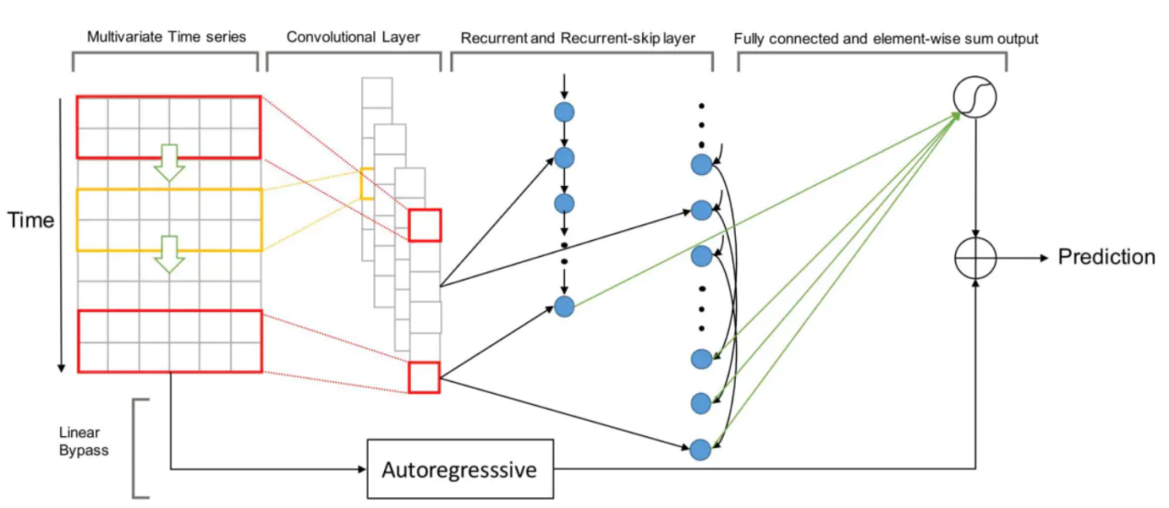
Main idea: LSTNet
Use LSTNet to predict the Close Price, then to compute the label
Loss function: use Minimum Mean Square Error instead of Absolute Error
Notes:
LSTNet is a deep learning framework for the task of multivariate time series forecasting. It combines the strengths of convolutional and recurrent neural networks and an autoregressive component.
The first layer of LSTNet is a convolutional network without pooling.
The output of the convolutional layer is simultaneously fed into the Recurrent component and Recurrent-skip component. The Recurrent component is a recurrent layer with the GRU.
The Recurrent-skip component uses temporal skip connections to capture periodic patterns.
The outputs of the Recurrent and Recurrent-skip components are combined by a dense layer.
We decompose the final prediction of LSTNet into a linear part, which primarily focuses on the local scaling issue, plus a non-linear part containing recurring patterns. In the LSTNet architecture, we adopt the classical Autoregressive (AR) model as the linear component.
The final prediction of LSTNet is then obtained by integrating the outputs of the neural network part and the AR component.
We use LSTNet to predict the close price, and then to compute the label, so we add RELU function as the activation function.

Slide 8
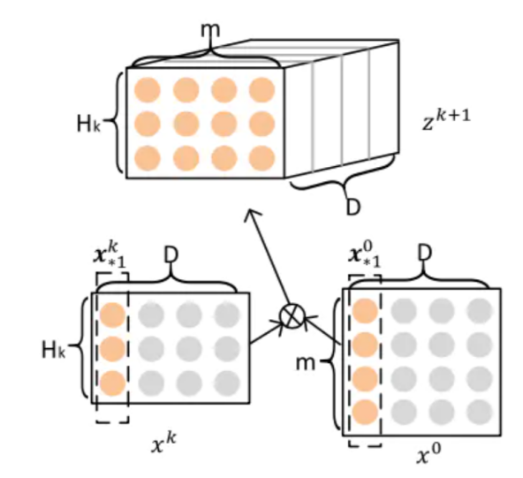
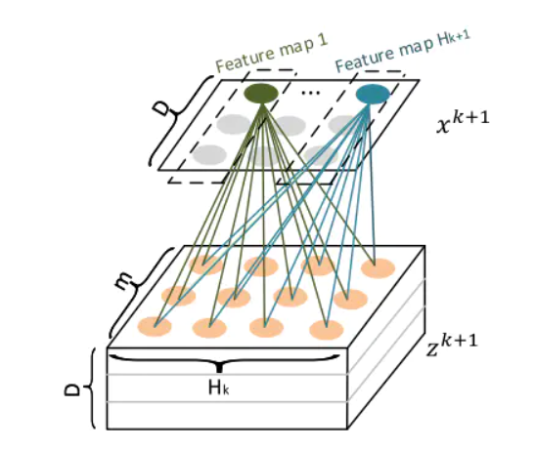
Main idea: Feature Interactions
Simplify the Compressed Interaction Network module in [1] to interact features
Notes:
Feature interaction is mainly used in recommendation systems, such as DeepFM and xDeepFM models. xLSTNet mainly uses the feature interaction module in xDeepFM and simplifies it so that high-level interaction between features can be explicitly performed.
Specifically, first we do an outer product of the feature matrix and itself as shown in the left figure, and then for the obtained tensor, use the method shown in the right figure to do an operation similar to convolution. Due to time constraints, the specific process can refer to the references given above or our code. We did not continue to do pooling and compression as in the original paper, and finally only did one feature interaction, that is, using second-order features as the input of the time series model.

Slide 9
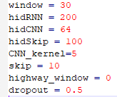
Experiments: Settings
Baseline
1.Guess all 0
2.Lightgbm
3.LSTNet-Label
4.LSTNet-Close
Notes:
We did not adjust the parameters of xLSTNet in the first round, and our model parameters in the second round are shown on the left.
We used the following baselines. The first one is that we guess all labels are 0. The second baseline is Lightgbm, which is an efficient implementation of gbdt. The last two are LSTNet models, the third of which directly predicts the rise and fall, and the fourth directly predicts the price.

Slide 10
Experiments: Settings
 | All 0 | Lightgbm | LSTNet-Label | LSTNet-Close | xLSTNet
Task1 | 53.16206 | 52.10803689 | - | 49.34123847 | 53.68906456
Task2 | 63.57049 | 55.59947299 | 62.31884058 | 64.49275362 | 65.87615283
Task3 | 63.96574 | 57.90513834 | 35.83662714 | 67.45718050 | 72.26613966
Overall | 60.23276 | 55.20421607 | - | 60.43039087 | 63.94378568
Notes:
In the first round, the results of xLSTNet and baseline are as follows. It should be noted that the task1 data of the LSTNet-Label method is lost, and the actual data should be below 50, which does not affect the final result. xLSTNet achieved the best results. In the second round, because the number of submissions is relatively precious, we did not take the evaluation baselines.

Slide 11
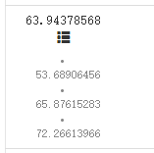

Results & Conclusion
(a) The First Round
(b) The Second Round
Notes:
This is the result of our two rounds of competition. In the second round, we fine-tuned the parameters, making the results significantly improved.

Slide 12
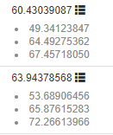
Results & Conclusion
Time series models such as LSTNet perform better than other models such as GBDT
Compared with LSTNet, xLSTNet has a significant improvement in the 3 tasks, which means that the feature interaction module can well capture the impact between metals
xLSTNet is sensitive to parameters
Notes:
Compared with LSTNet, xLSTNet has a significant improvement in the three tasks, which means that the feature interaction module can well capture the impact between metals.
xLSTNet is sensitive to parameters. We did not adjust the parameters in the preliminary rounds, which resulted in average results. During the finals, we adjusted the parameters to significantly improve the model's ability.

Slide 13
THANK YOU

