Slide 1
Stock Price Prediction Using Machine Learning
A Case Study on Exxon Mobil Corp (XOM)
Nijat Hasanli Daryush Ray

Slide 2
In this presentation, we will explore the methodologies and techniques used in stock price prediction, using Exxon Mobil Corporation as a case study. Exxon Mobil, a leading multinational oil and gas corporation, provides an ideal subject due to its significant market presence and the complexity of factors influencing its stock prices.
Company
Global Presence: Exxon Mobil operates in over 70 countries
Diversified Operations: The company is involved in all aspects of the oil and gas industry, including upstream, downstream, and chemical manufacturing.
Financial Strength: Exxon Mobil is known for its strong financial performance, with significant revenues, profits, and a solid balance sheet.

Slide 3
Data
Collection and Preprocessing
Time Period: January 1990 - Present
Train: January 1990 - December 2022
Test: January 2023 - Present
Data Sources: Yahoo Finance, FRED
Data Types:
Stock Prices (Open, Close, High, Low)
Moving Averages (50-day, 200-day)
Financial Statements (Income, Expenses, etc.)
Macroeconomic Indicators (CPI, Unemployment Rate, etc.)
Handling missing values
Merging datasets
Technical indicators (RSI, MACD, Bollinger Bands)
Scaling features

Slide 4
Technical Indicators:
50-Day Moving Average
200-Day Moving Average
Relative Strength Index
Moving Average Convergence Divergence
Upper Bollinger Band
Lower Bollinger Band
Financial Data:
Open:
Low:
Tax Effect Of Unusual Items
Normalized EBITDA
Reconciled Depreciation
EBITDA
Net Interest Income
Normalized Income
Total Expenses
Basic Average Shares
Basic EPS: Basic Earnings Per Share
Net Income Common Stockholders
Minority Interests
Net Income Continuous Operations
Pretax Income
Other Non Operating Income Expenses
Net Non Operating Interest Income Expense
Operating Income
Other Operating Expenses
Selling General And Administration
Other Grand A
Gross Profit
Total Revenue
Macroeconomic Variables:
Consumer Price Index for All Urban Consumers
Effective Federal Funds Rate
10-Year Treasury Constant Maturity Rate
M2 Money Stock
Consumer Price Index for All Urban Consumers: All Items Less Food & Energy
Personal Savings Rate
Durable Goods Orders
Company

Slide 5
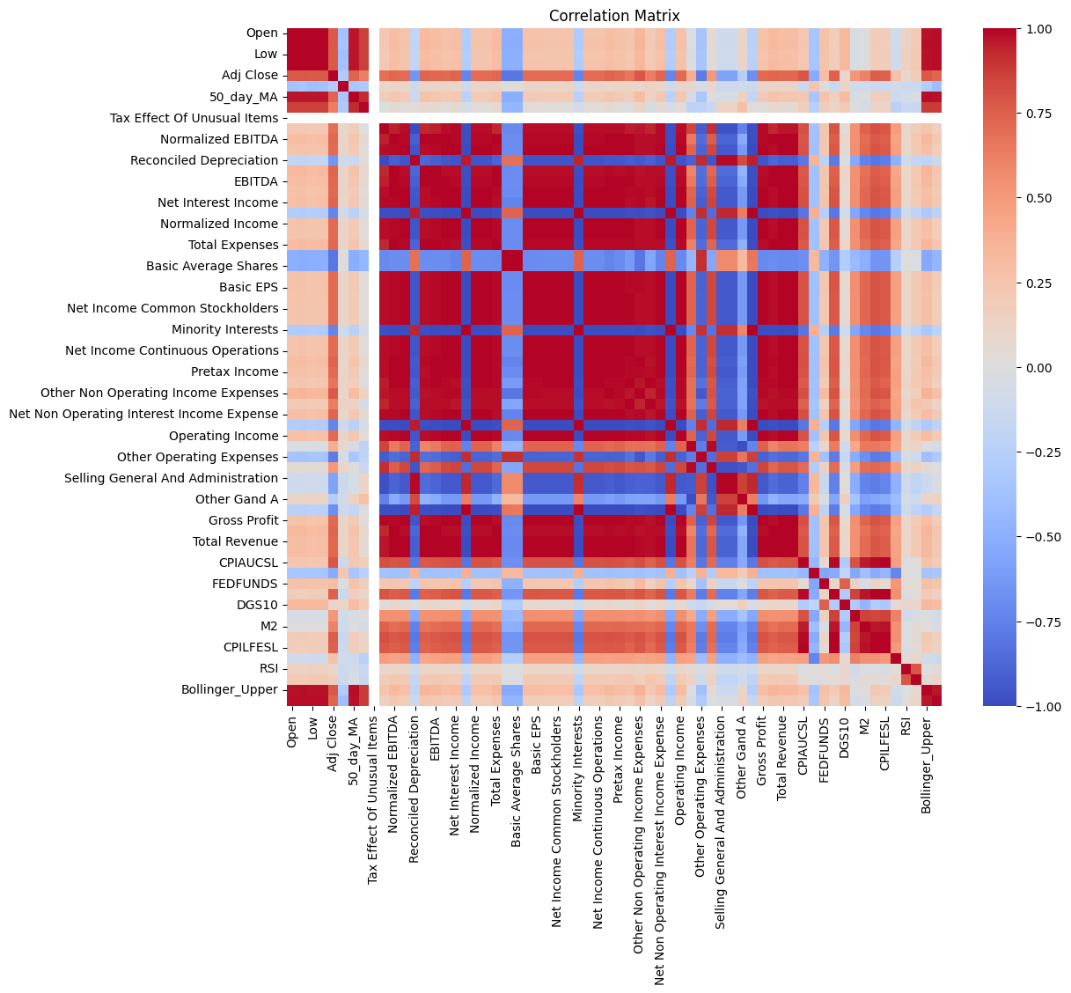
Highly Positive Correlations:
Open, Low, Adj Close: These price features are highly correlated with each other.
Total Revenue and Gross Profit: High correlation indicates that total revenue directly impacts gross profit.
Basic EPS and Net Income Common Stockholders: Suggests that earnings per share are highly influenced by net income attributed to common stockholders.
Highly Negative Correlations:
CPIAUCSL (Consumer Price Index) and Stock Prices: High CPI could be negatively correlated with stock prices, indicating inflation impacts.
FEDFUNDS (Federal Funds Rate) and Stock Prices: Higher interest rates might negatively impact stock prices, as borrowing costs increase.
Feature Importance:
Total Revenue, Gross Profit, Basic EPS, Net Income: Strong correlations with target variables suggest these are important predictors for the stock price.

Slide 6
Machine
Learning Models
AdaBoost: Combines multiple weak learners to create a strong predictive model by focusing on errors of previous models.
Gradient Boosting: Sequentially builds models by correcting errors of previous models using gradient descent optimization.
XGBoost: An optimized version of Gradient Boosting designed for speed and performance, especially with large datasets.
LightGBM: A highly efficient Gradient Boosting framework that uses a leaf-wise tree growth algorithm for faster training.
CatBoost: Handles categorical features automatically and reduces overfitting through ordered boosting.
Hyperparameter Tuning: Grid Search with Cross-Validation

Slide 7
Model Performance and
Predictions

Slide 8
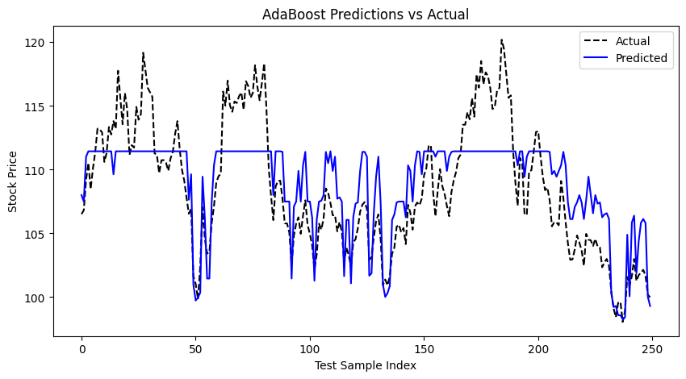
The model captures some of the general trends in the stock price movements but appears to miss many of the smaller fluctuations and rapid changes.
The smoother prediction line suggests that the AdaBoost model might be over-smoothing or not fully capturing the complexity of the stock price variations.

Slide 9
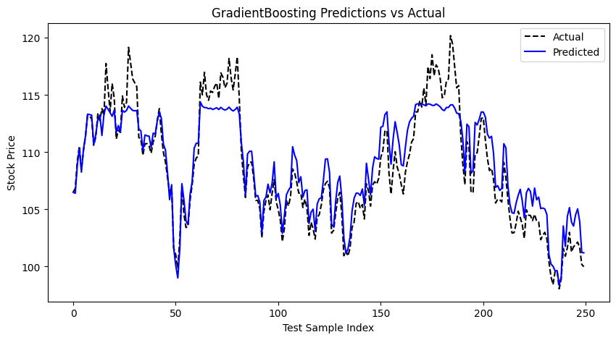
The Gradient Boosting model provides a more accurate and detailed prediction of stock prices compared to the AdaBoost model.
The closer fit to actual prices suggests that Gradient Boosting is more effective in capturing the complexities of stock price movements.

Slide 10
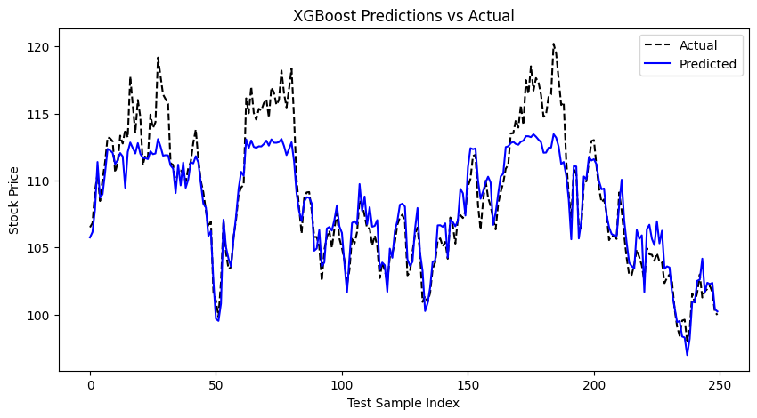
The XGBoost model provides highly accurate and detailed predictions of stock prices, closely aligning with actual observed prices.
The model's ability to capture the complexity of stock price movements suggests it is well-suited for applications requiring precise short-term predictions.

Slide 11
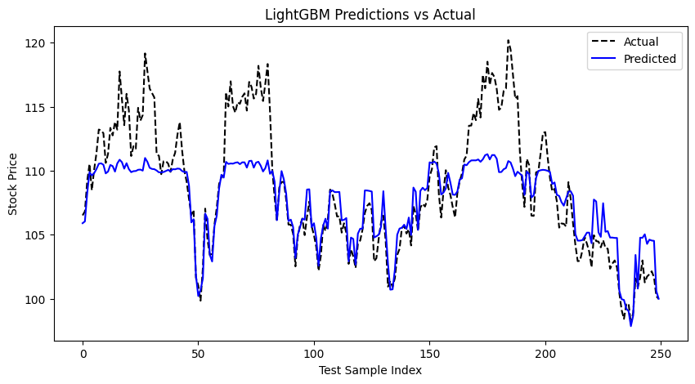
The LightGBM model provides a reasonably accurate prediction of stock prices, capturing the general trends and some of the variability.
The smoother predictions suggest that the model might be averaging out some of the noise, potentially sacrificing some accuracy in capturing the rapid fluctuations.

Slide 12
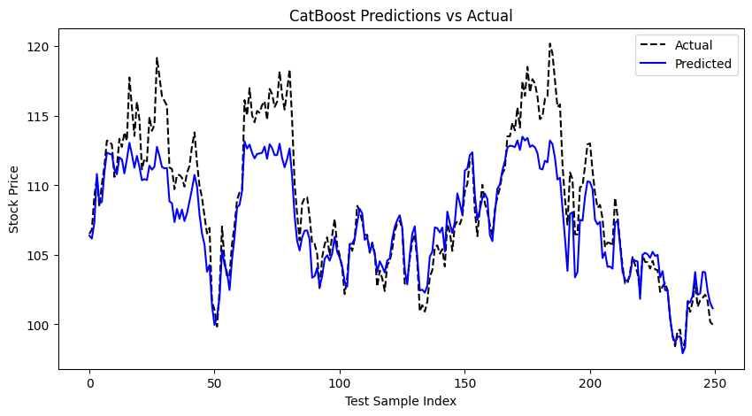
The CatBoost model provides highly accurate and detailed predictions of stock prices, closely aligning with actual observed prices.
The model's ability to capture both overall trends and finer details suggests it is well-suited for applications requiring precise short-term predictions.

Slide 13
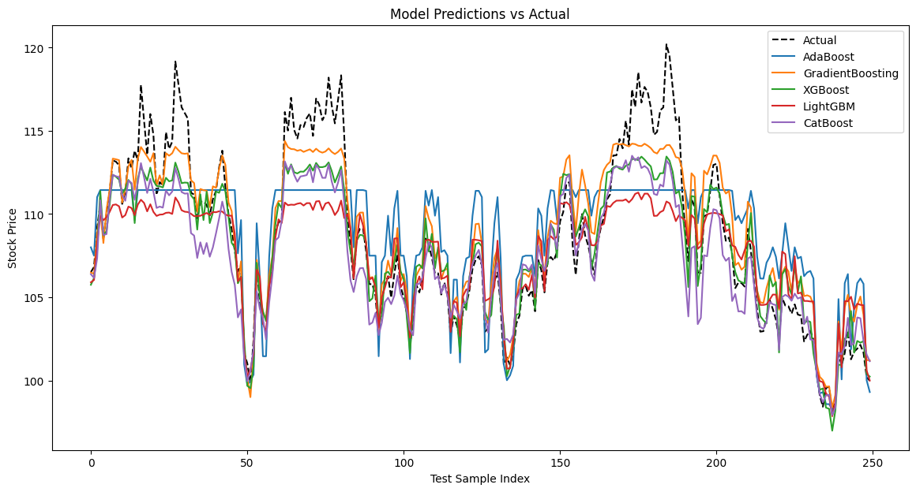

Slide 14
Conclusion
Model Variety: AdaBoost, Gradient Boosting, XGBoost, LightGBM, and CatBoost.
Hyperparameter Tuning: Optimized model performance through extensive hyperparameter tuning using Grid Search with Cross-Validation.
Best Performing Model: Gradient Boosting achieved the lowest mean squared error, indicating superior predictive accuracy.
Model Comparison: Each model's performance was evaluated, revealing strengths and weaknesses in different market conditions.
Practical Implications: Accurate predictions can aid investors in making informed decisions and enhance trading strategies.
Future Enhancements:
Potential for improving models by incorporating more granular data and exploring alternative algorithms.
Introducing baseline models.
Complex grid search to avoid overfitting
Multicollinearity

