Slide 1




Hibiscus – ALM
finance
Client
Achat
Tool Deliverable
Prestataire

Slide 2
ANNEXE Presentation agenda
1
Executive Summary
2
Hibiscus ALM Generator DEMO
3
Hibiscus ALM Generator Integration Process : Technical & Functional
4
Hibiscus ALM Generator User Guide

Slide 3
1. Executive Summary
Final Objective
1. A simple-to-use tool capable of generating reports 2. Analyze entities based on several indicators 3. Produce reliable reports
Data Importation
Data Filtering
Data Processing
Next Executive steps
Industrialize Hibiscus to generate reports: Proof of Concept in Python for automatic generation with a batch ctrl m that deposits all possible views with the most granular filtering possible at a predefined frequency, with a formalized graphical interface in the form button processes: Import Export or Update.
Data
Integration
Reports Ready to use

Slide 4
2. HIBISCUS ALM GENERATOR DEMO
Report Generation
Creation of a folder hierarchy, one folder per entity. Each folder contains reports of selected analysis indicators with data and calculated ratios related to the entity and the specific indicator.
View
Data Processing &
Integration
Entity 1
Entity n
Entity …
DATABASES
Indicator LCR
Indicator n
Indicator NSFR
Indicator n
Indicator NSFR
Indicator LCR
Indicator LCR
Indicator n
Indicator NSFR
* ETL : Extract – Transforme - Load

Slide 5

3. HIBISCUS ALM GENERATOR : FUNCTION & TECHNICAL
Data import with VBA
Data filtering with Power Query
Creation of data tables for indicators with Power Query
Ratio calculation with Power Query
Report generation with VBA based on indicator templates (Generates the report of an entity only if it is available)
Proof Of Concept
Excel + VBA + Power Query
Drawbacks
Functional but not smooth (Even with small datasets)
Performance-intensive

Slide 6

3. HIBISCUS ALM GENERATOR : FUNCTION & TECHNICAL
New Tool
Python
Same features as the tactical tool
Better performances !
Much simple to use
Interactive interface

Slide 7
4. HIBISCUS ALM GENERATOR USER GUIDE
New Tool
Python
Follow the link
Import : All data (with all entities, views and currencies)
Choose the indicators
Export reports

Slide 8
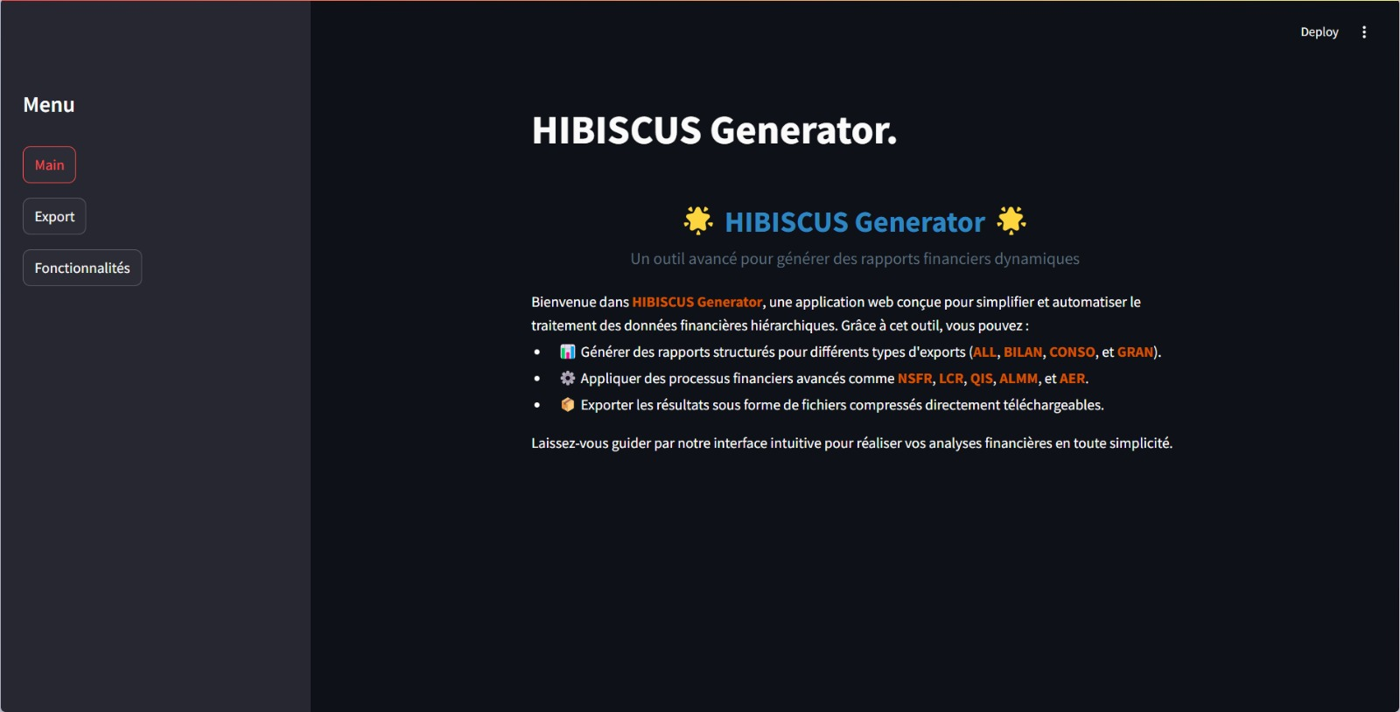
4. HIBISCUS ALM GENERATOR USER GUIDE
Main Interface
Main Interface
Export Interface
Features Interface

Slide 9
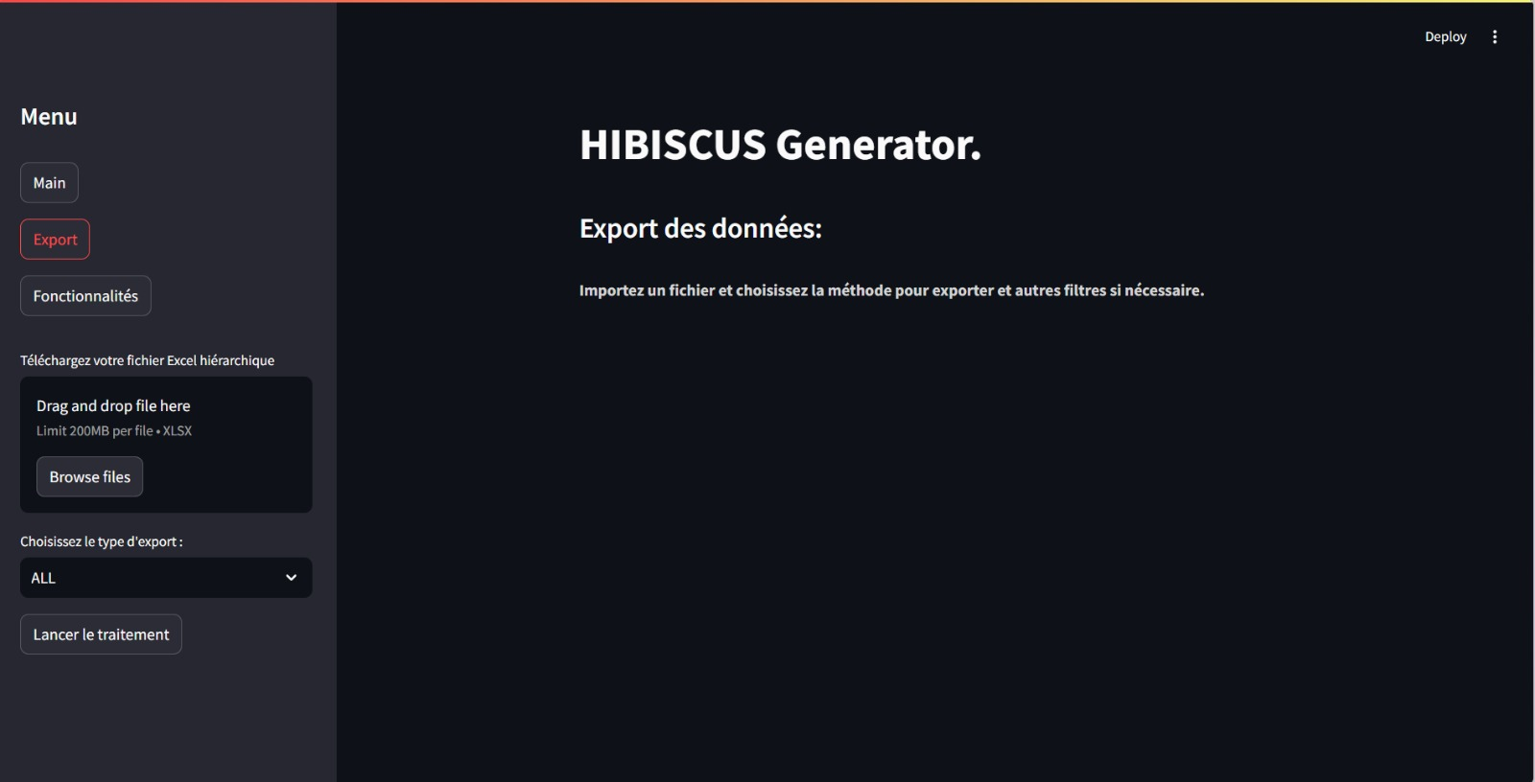
4. HIBISCUS ALM GENERATOR USER GUIDE
Export Interface
Browse File to Import Data
Choose Generation Mode
Start Generation

Slide 10
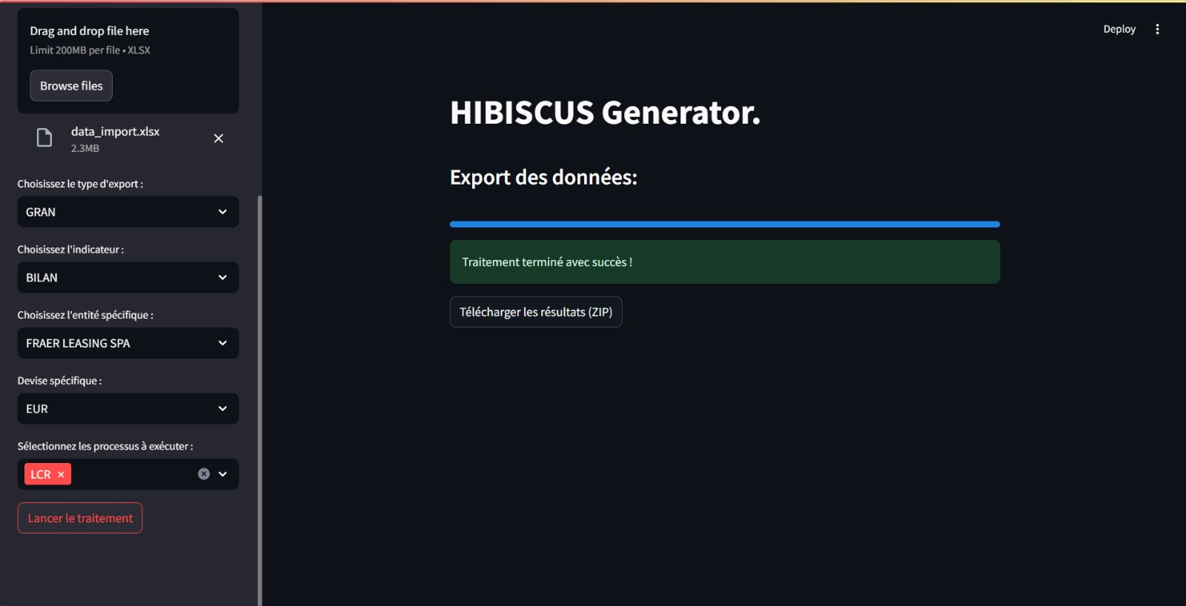
4. HIBISCUS ALM GENERATOR USER GUIDE
Grannular Export Interface
Choose View
Download Output
Choose Entity
Choose Indicator

Slide 11
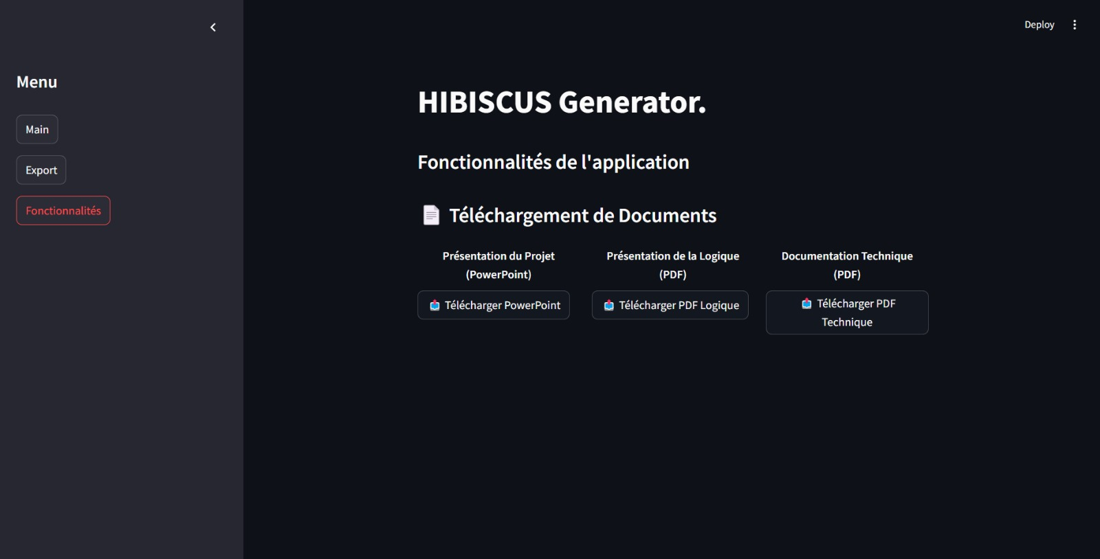
4. HIBISCUS ALM GENERATOR USER GUIDE
Feature Interface
Download User Guide
Download
Tool Presentation
Download Documentation

Slide 12

4. HIBISCUS ALM GENERATOR USER GUIDE
Results are stored in this format with the date and the generation mode (generator take system date)

Slide 13
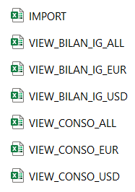
4. HIBISCUS ALM GENERATOR USER GUIDE
KPI Generation
After the report generation is completed, the directory tree report, and the KPI report (number of reports per entity and indicator) will be generated with the output folder.
Inputs Storage
The imported data is automatically stored in the folder “Import Views” sorted by view. (Import contains the global Data)

Slide 14
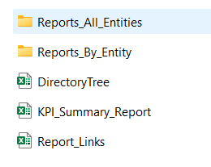
4. HIBISCUS ALM GENERATOR USER GUIDE
Output
Upon successful completion, the tool will generate the following outputs:
Entity Reports: Detailed reports generated for each selected entity and indicator, stored in the specified folder.
Directory Tree Report: An organized view of the folder structure, showing all files and subfolders.
KPI Report: A summary report showing the count of generated reports per entity and per indicator, providing a quick overview of the reporting activity.
All reports are saved in the main output directory for easy access and organization.
Folders and reports generated by the tool

Slide 15
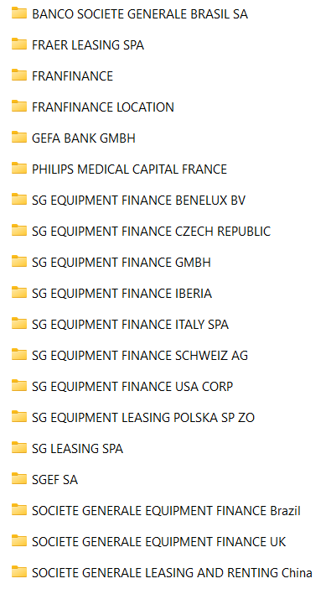
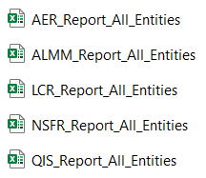
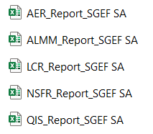
4. HIBISCUS ALM GENERATOR USER GUIDE
Output : A quick overview of the file contents
All entities reports
All Indicator for specific report
Report per entity

Slide 16
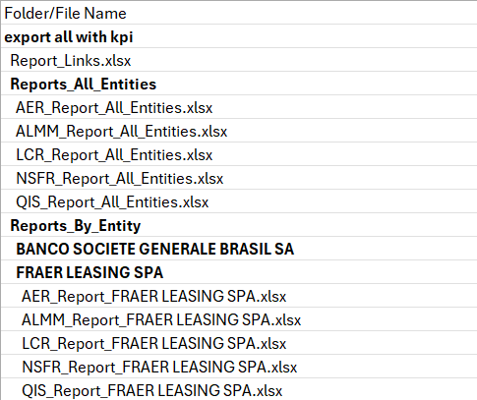
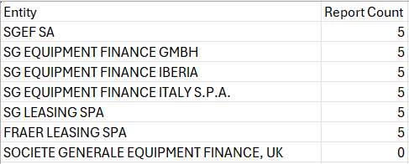
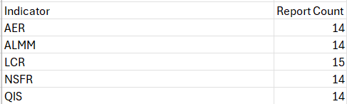
4. HIBISCUS ALM GENERATOR USER GUIDE
Output : A quick overview of the file contents
Quick overview of the directory tree
Quick overview of the KPI Report

