Slide 1


FinTech @ IU Python Session #3 – Data Structures and Looping
Prepared by
Gabriel Shores
Director of Technology – FinTech @ IU
https://www.linkedin.com/in/gabriel-shores-379b81291/
10/18/2024

Slide 2
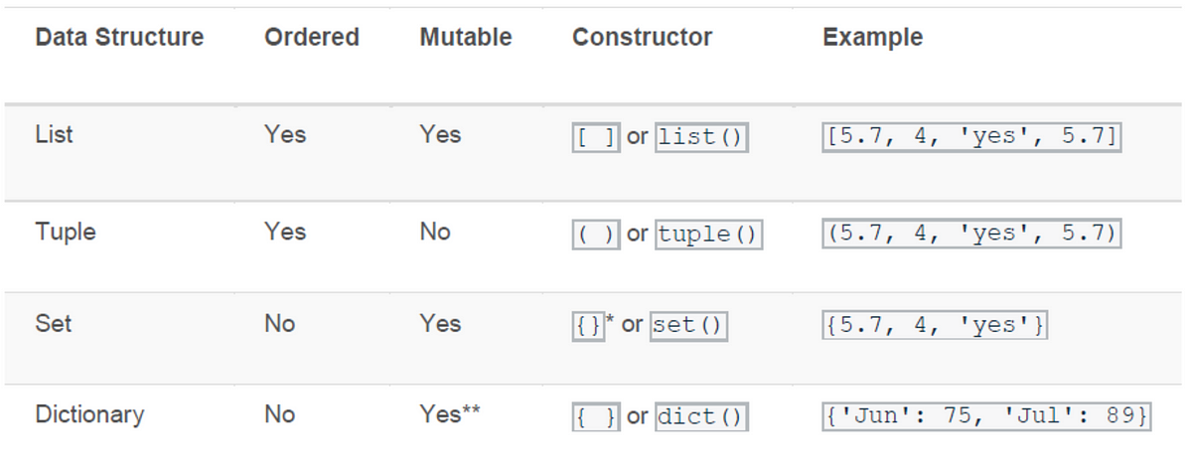
Why Are Data Structures Important
Allows us to store, access, and change data efficiently
Makes programs more scalable
Essential for Computer Science and Data Science
algorithmic design is it so Important How You Store Data

Slide 3
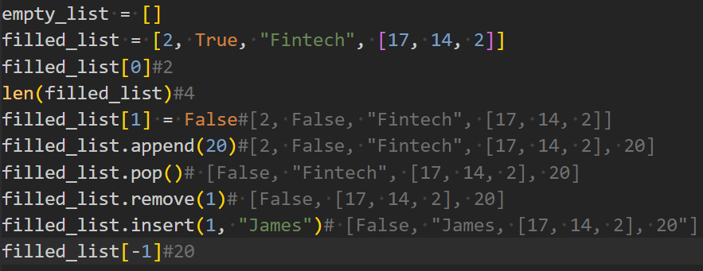
Lists
Allows us to store data sequentially
Each element of the list has an associated position, (0-based)
To access the first element, of a list use list_name[0], second list_name[1], and so on
Lists are defined with [ ], and can have elements listed out in them such as [2, 3, “D”, False, 17.6]I
Can insert, remove, and change items
Can contain duplicate values
Accessing out of bounds will throw an error!

Slide 4
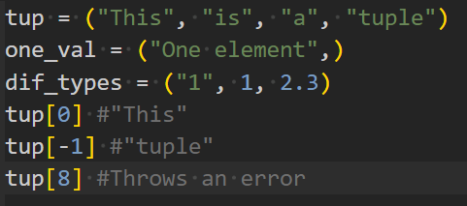
Tuples
Tuples are like lists, but unchangeable (immutable)
Values can only be accessed and not modified
There can be duplicates
Declared with ( ), such as (1, False, “k”)

Slide 5
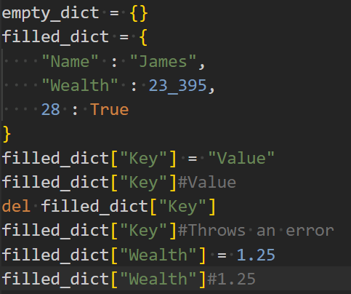
Dicts
Declared with {}
Stores elements in Key : Value pairs, separated by commas
Access a value with its key,
dict[“Key”] == “Value”
There cannot be duplicate Keys
Values can be updated, and Keys removed

Slide 6
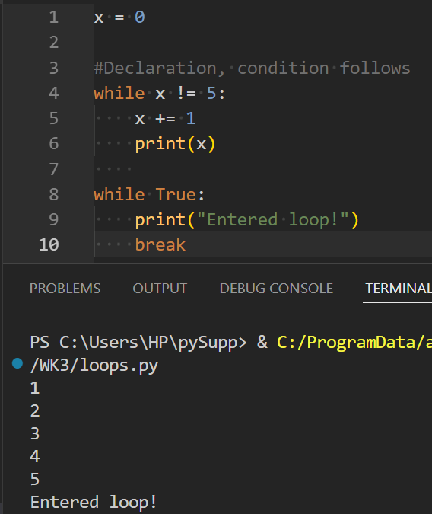
Loops - while
What if we want to run some code more than once? Instead of typing the same command out multiple times, a loop allows us to run it until a condition is meant
while loops run as long as a condition in ()
evaluates to True
The break statement prematurely breaks a loop
The continue statement prematurely goes to the next iteration of a loop (more useful with for)

Slide 7
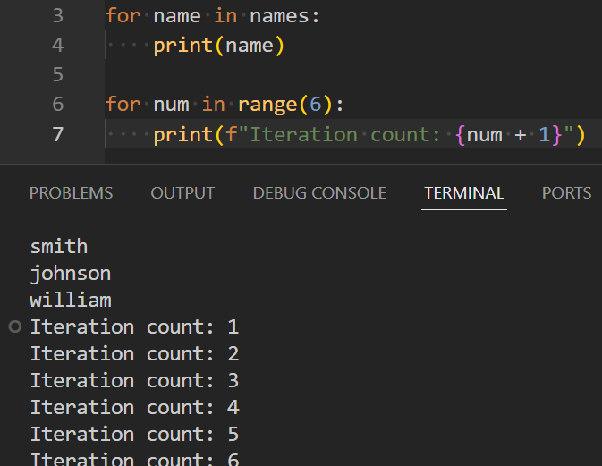
Loops - for
Increments for a bounded period of iterations
Easily allows data structures to be looped through
With range() function, allows for code to be
run a specified amount of times
Declares a variable to access during each
iteration

Slide 8
The End!
Next session we will be starting to use external libraries!
Thank you!

