Slide 1


FinTech @ IU Python Session #5 – Plotting & Intro to ML
Prepared by
Gabriel Shores
Director of Technology – FinTech @ IU
https://www.linkedin.com/in/gabriel-shores-379b81291/
Cameron Nelson
Fund Equities Lead– FinTech @ IU
https://www.linkedin.com/in/cameron-j-nelson/
11/08/2024

Slide 2
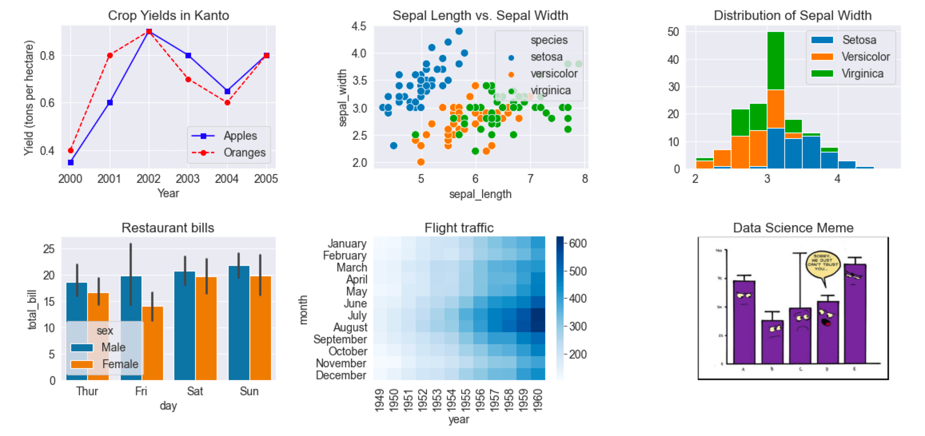
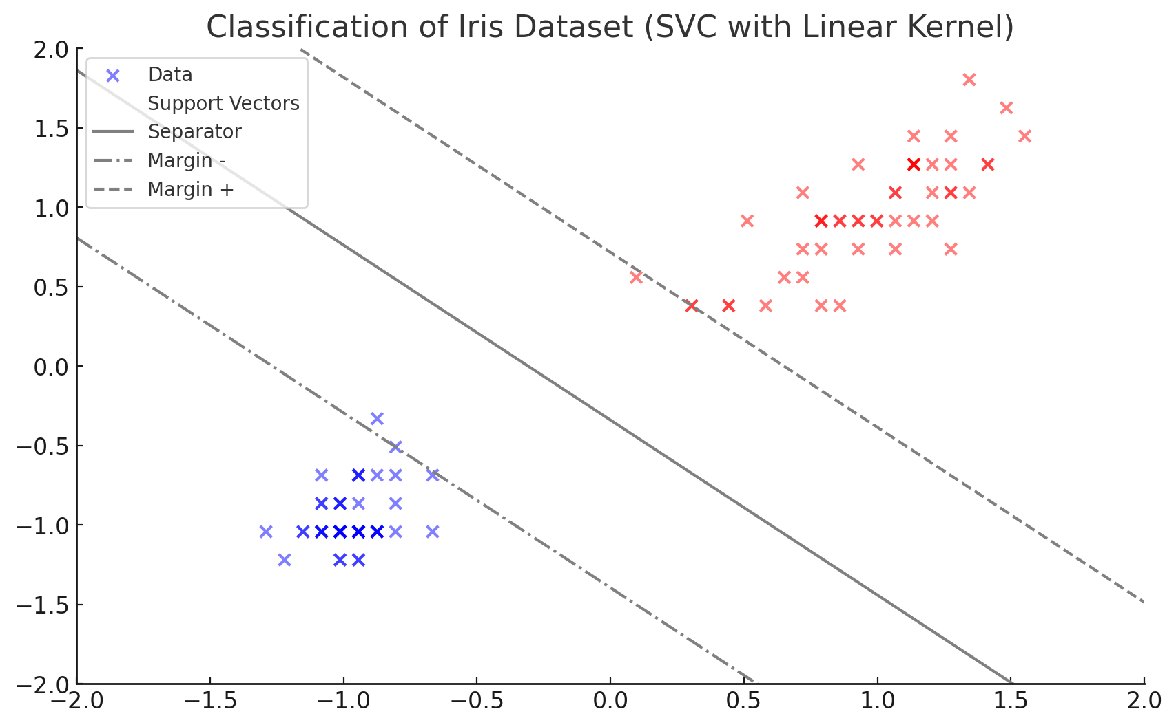
Graphs
Analyzing data is often easier through visualizations
The matplotlib library allows users to make different types of graphs
3 parts to a graph
Figures are the backgrounds which everything lies upon
Axes contain the different axes, labels, titles, and gridlines
Plots/subplots are the visual representations of data and includes line charts, bar charts, and scatter plots

Slide 3
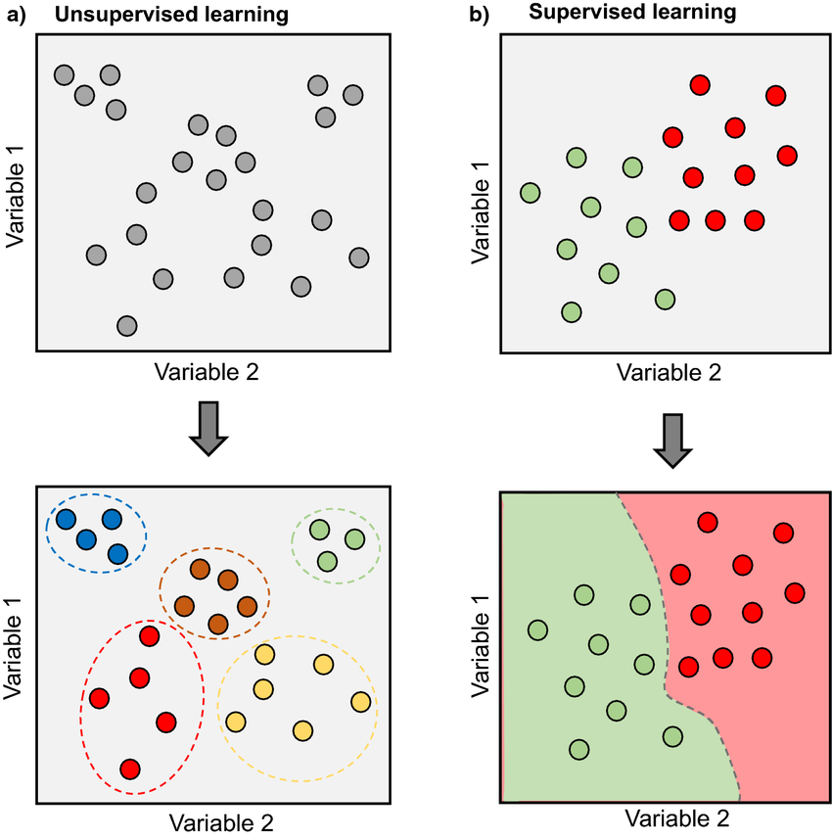
Machine Learning
Machine learning involves learning from data and making predictions or decisions without explicitly programming it
Supervised learning – Model is trained on labeled data (Predicting prices, image classification, spam detection)
Unsupervised learning – Determine labels / group data (Customer segmentation, detecting unusual transactions)
Reinforcement learning – Force models to learn through positive or negative feedback (Game AI, recommendation models)

Slide 4
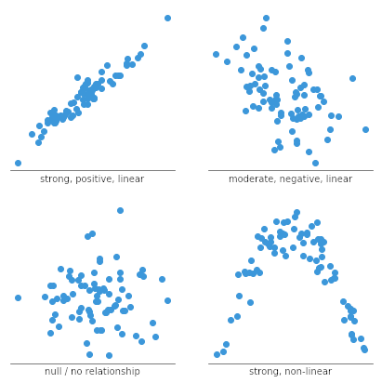
Classifying House Prices
Features – The measurable characteristics or variables provided in the dataset used to predict an outcome
Explanatory Variables – The variables that classify and categorize data
Let’s say we want to predict the price of a house given some number of rooms, location, and other such factors along with the associated prices
Let’s try to select one of these features and make predictions with it

Slide 5
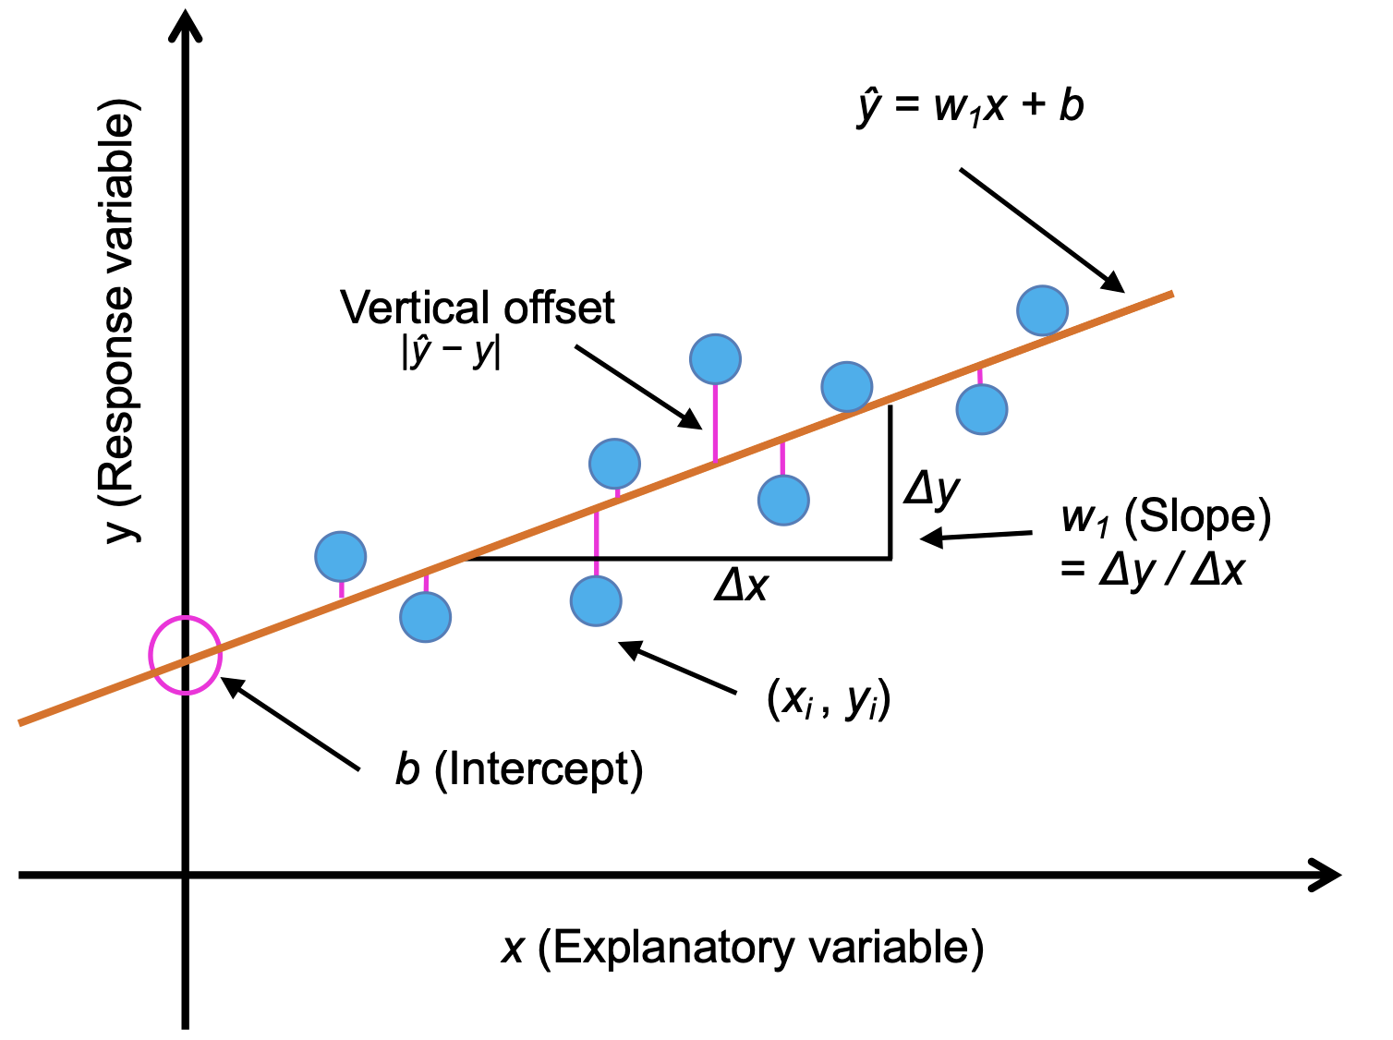
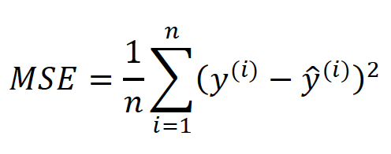
Classifying House Prices
Looking at our scatterplots, one way to predict data is with a line in the form
ŷ = w₁x + b
For more features we can use ŷ = w₁x₁ + w₂x₂ + … + w_{n}x_{n} + b
To measure how close our model, the line of best fit, is, we need to calculate how far away each point is from it
We use what is called the cost function, in this case the Mean Squared Error

Slide 6
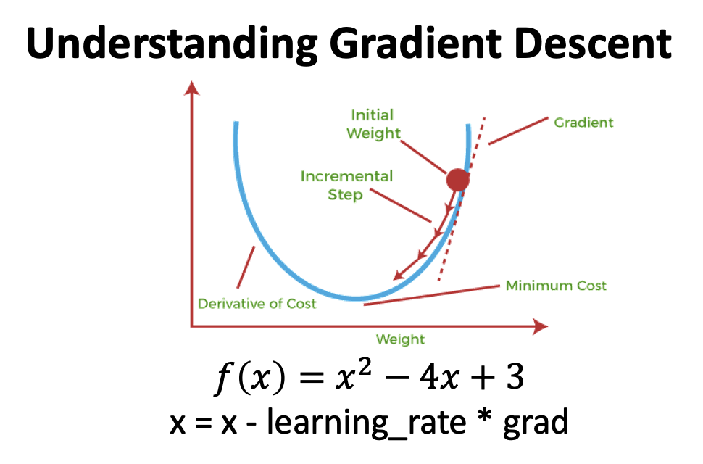
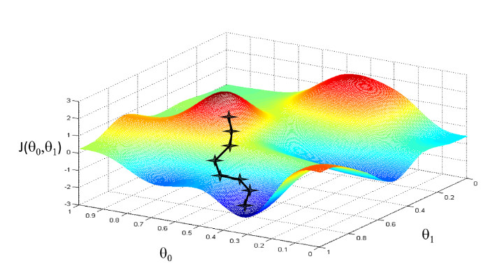
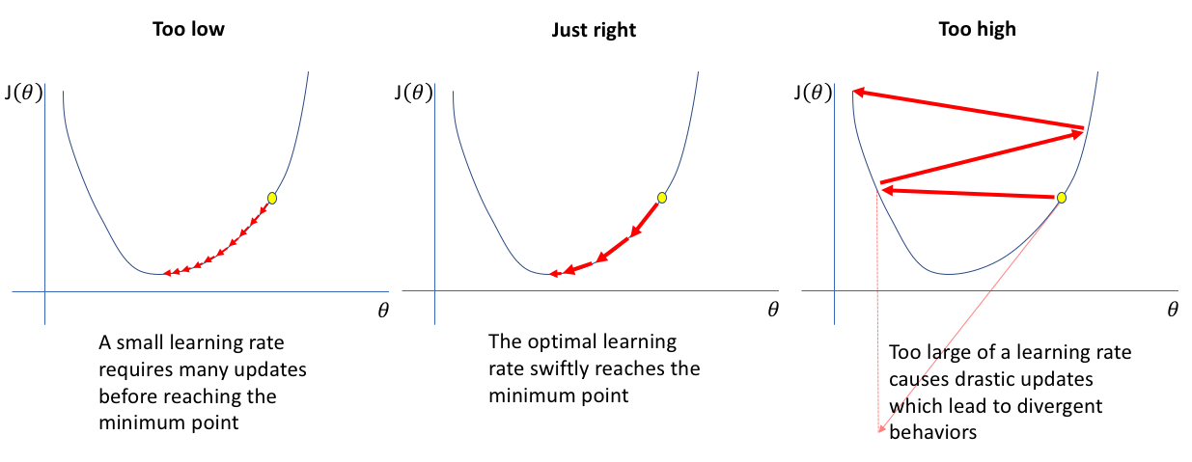
Gradient Descent
Let’s try to get the cost function to its minimum value
For each model, lets calculate the cost function and which direction we can go to decrease the cost function, opposite of the direction it increases the most
Adjust the weights and do it again until we hit the point which produces the least cost
The gradient is the derivative in calculus
Learning rate adjusts how much we want to move at each increment

Slide 7
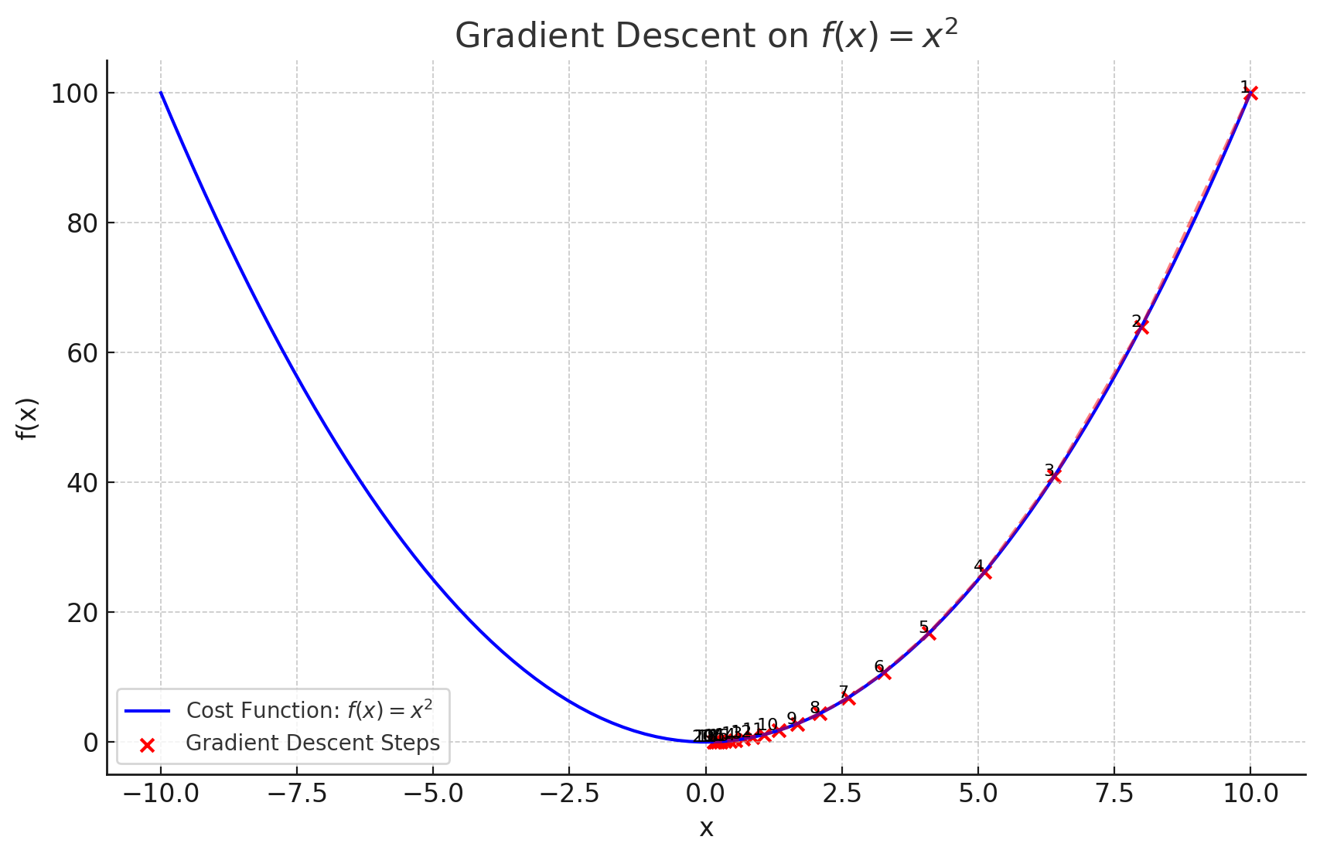
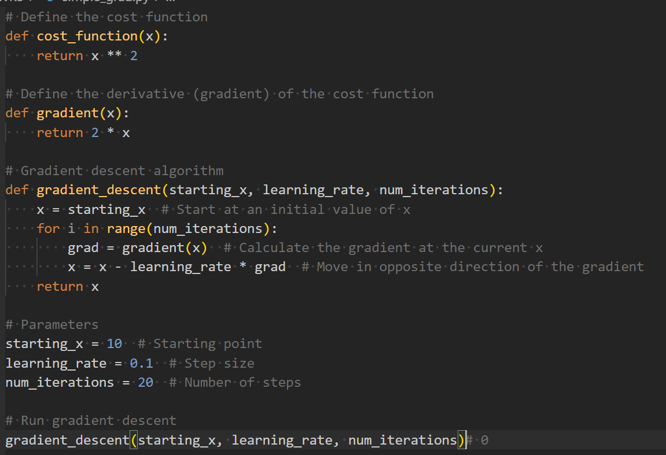
Gradient Descent

Slide 8
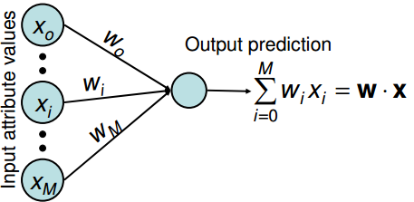
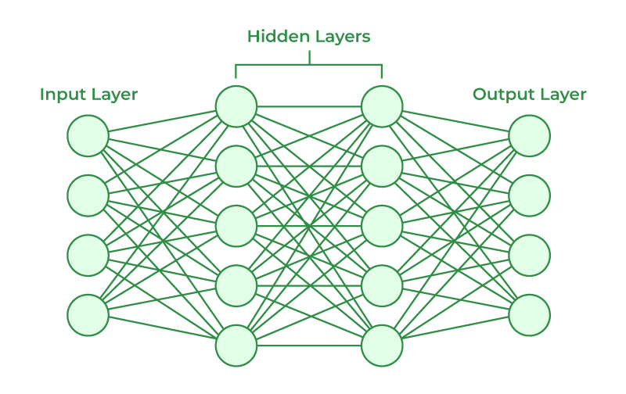
Applications
While linear regression is useful, it doesn’t classify data and can’t fit more complex data
However, the ideas used in linear regression are present in almost all ML algorithms, with neural networks being especially similar

Slide 9
The End!
Thank you!

